Slide 1
Python IDE setup
To those just starting with Python installing Python is just the beginning but from my experience a lot of people will face a lot of problem mid way installing libraries etc… only to realize they didn’t properly install Python.
This guide I made will show you what I discovered work for most system. Follow this guide and thy shall not get lost!

Slide 2
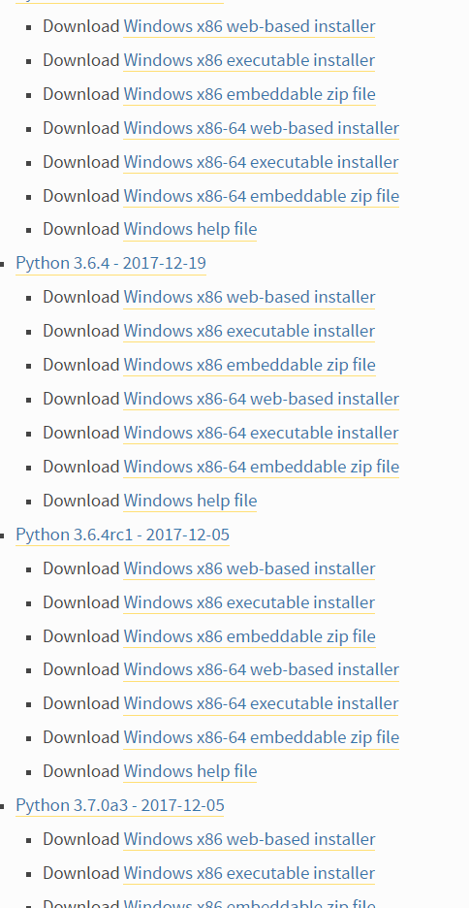
Python IDE setup
[ ] Download and Python 3.x in your laptop
[Go to https://www.python.org/downloads/windows/ ]
For windows 32-bit architecture
For windows 64-bit architecture
Make sure you install the correct installer for your system.
Some people will mistakenly install 32-bit on a 64-bit system and everything will seem fine until you face a problem installing libraries later on.

Slide 3
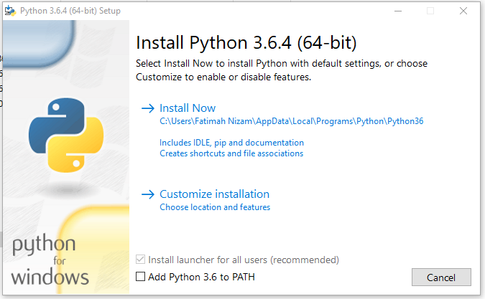
Choose this

Slide 4
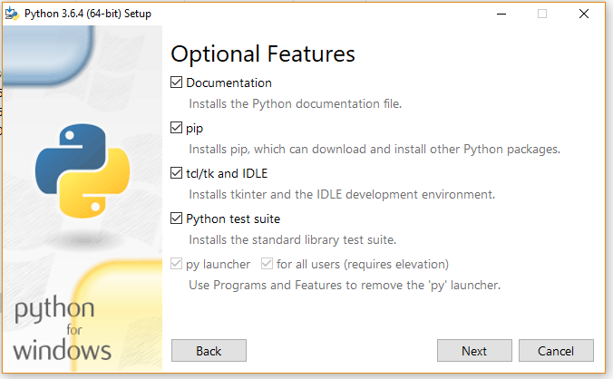
Click ‘Next’

Slide 5
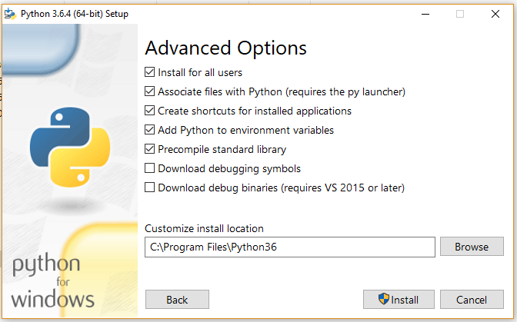
I would prefer adding it to “C:\Python36” to avoid having to run ‘pip’ install as administrator later on.

Slide 6
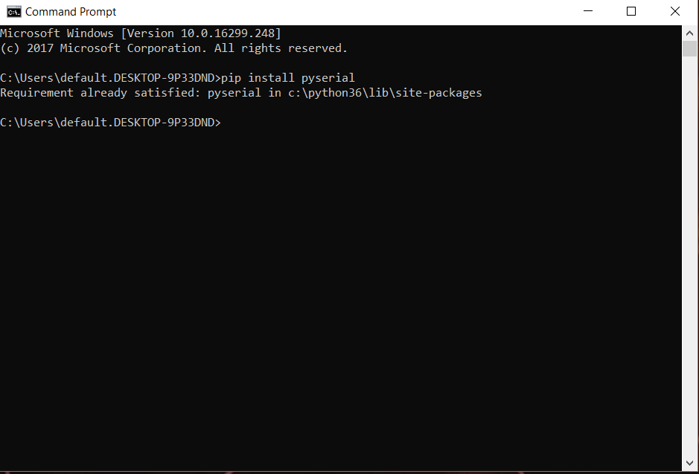
PIP (Preferred Installer Program)
pip is a command tool for installing and managing Python packages (libraries) a very handy tool to have properly installed.
To check if you have properly installed pip, open ‘Command Prompt’ and install one of the packages that we’ll use a lot in this course.
Open CMD and type ‘pip install pyserial’.
If everything goes well you, congrats you have a properly installed Python for this course ☺

