Slide 1
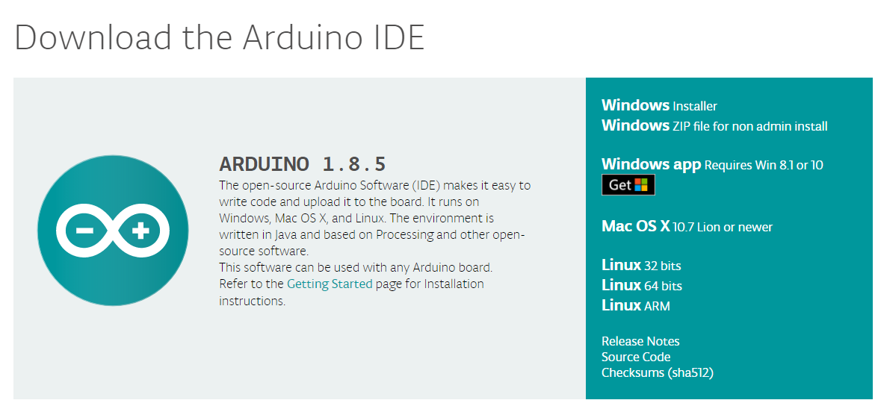
Arduino IDE setup
[ ] Download and Install Arduino IDE to code and upload codes to your Arduino Board
[Go to https://www.arduino.cc/en/Main/Software ]
Download installer

Slide 2
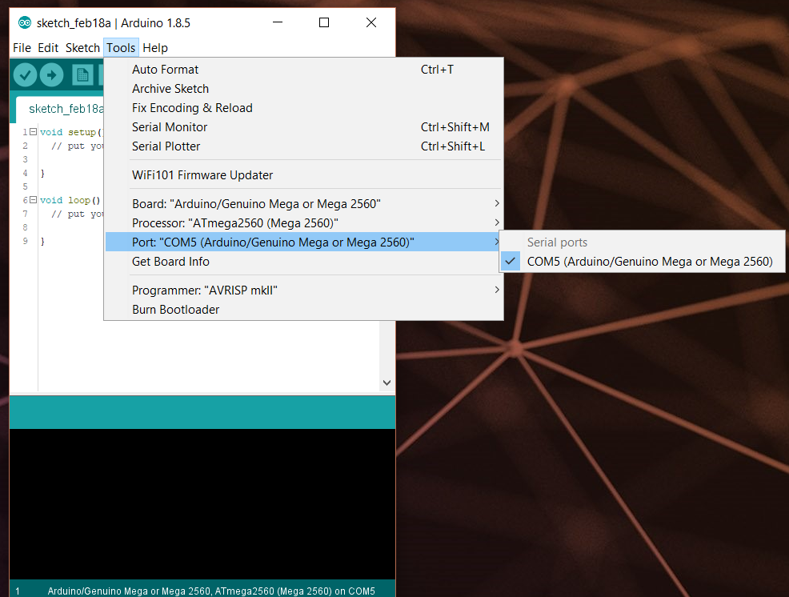
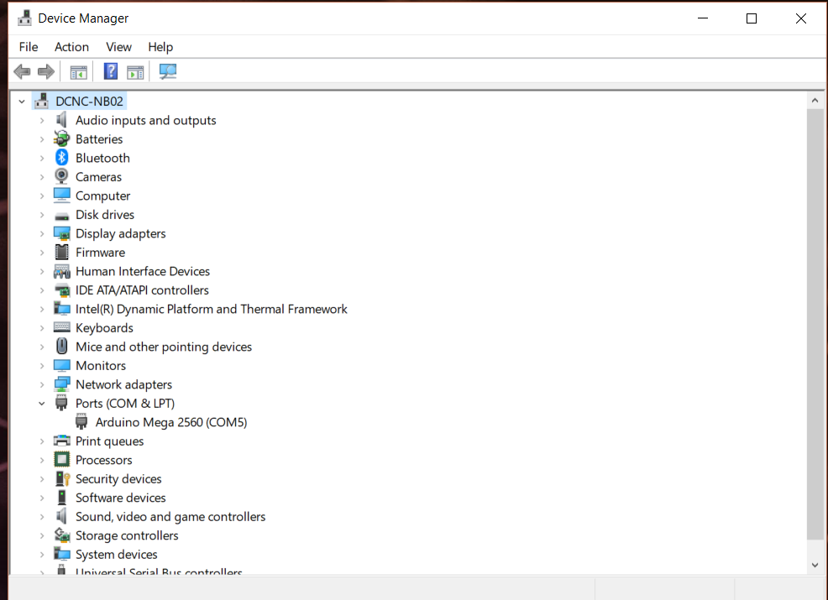
[ ] Check if your system detects your Arduino or not.
By default driver (for the original Arduino board) will be installed with Arduino IDE installation
Driver installed successfully ☺

Slide 3
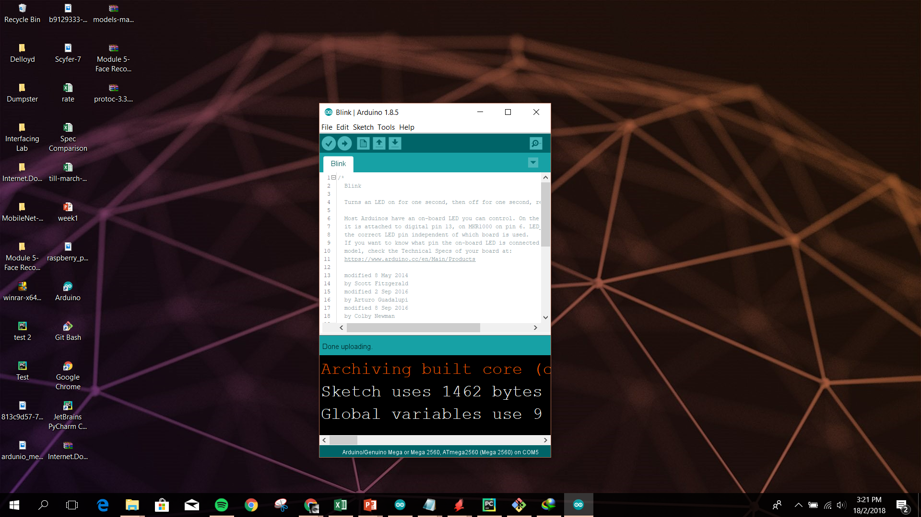
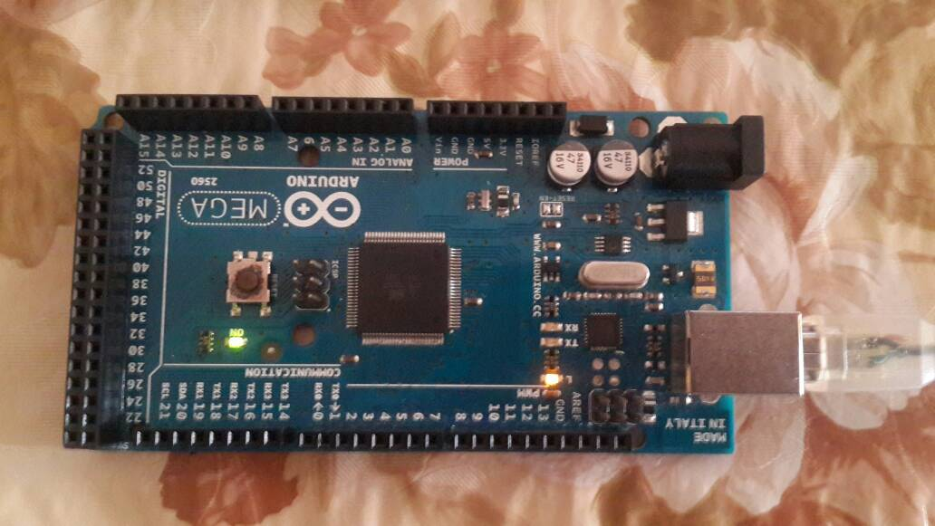
[ ] Run blink example code and see if it uploads successfully. If it does, and your on-board LED blinks congrats your hardware and software development items are working ☺
On-board LED

