Slide 1

Climate Sensitive Growth and Yield Modeling of Québec Tree Species
Committee Meeting December 3, 2020
Christina Howard
BSC, MSC, PHD STUDENT
Department of Forest Resources Management
FACULTY OF FORESTRY, UBC

Slide 2
Outline
Background
My previous courses, research, and degrees
Introduction
Topic overview
Chapters
Three unique chapters
Next steps
Tentative schedule for my degree

Slide 3
Background
Introduction
Chapter 1
Chapter 2
Chapter 3
Next Steps
Previous degrees
M.Sc. (Forestry)
2020 - University of British Columbia
Honours Designation
Thesis title: “Climate change mitigation in British Columbia's forest sector : utilizing harvest residues to produce regional power and liquid biofuels”
Advisor – Verena Griess
B.Sc. (Natural Resources Conservation)
2017 – University of British Columbia
Honours Designation
Full co-op work experience designation
Major in science and management

Slide 4
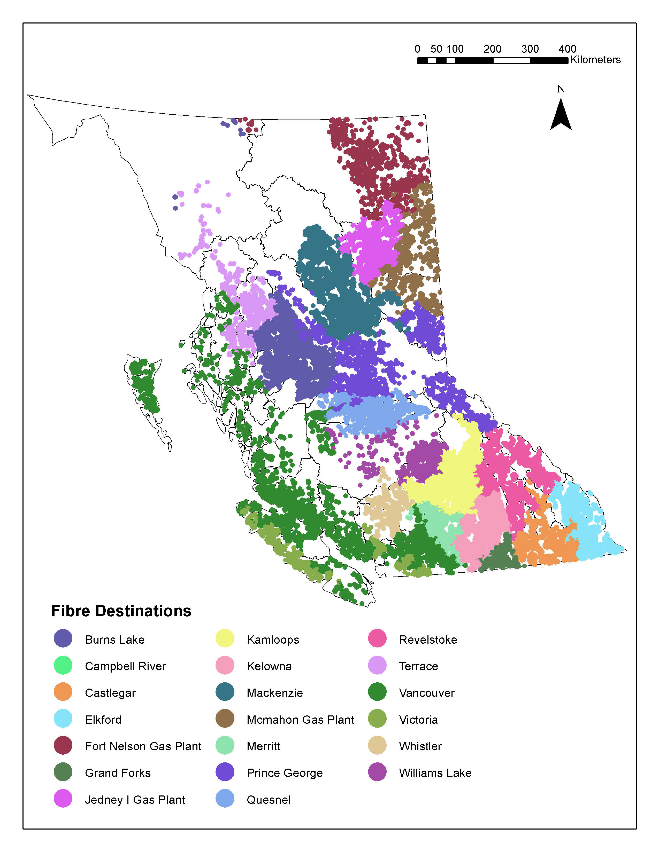
Background
Introduction
Chapter 1
Chapter 2
Chapter 3
Next Steps
M.Sc. (Forestry)
Research Question:
What is the climate change mitigation potential of using harvest residues for bioenergy in British Columbia?
Conclusions:
Determined the optimal end use for harvest residues in BC is within community bioenergy facilities to displace fossil fuel heat generation
Resulting Impact:
Currently co-author in two submitted journal articles which use my model to determine avoided emissions
The model is still being used within NRCan to analyse and compare the use of harvest residues for bioenergy as a potential mitigation strategy
Fibre destinations for the zero energy scenario.

Slide 5
Background
Introduction
Chapter 1
Chapter 2
Chapter 3
Next Steps
Relevant Courses Taken
BSc:
FRST 232 (Computer Applications in Forestry)
When I took the course it was mostly excel VBA, but nonetheless, made me comfortable with software
FRST 231 (Introduction to Biometrics)
Basic theories of probability and statistics
various conservation/forestry courses involving data analyses (ANOVA, biodiversity index, population dynamics)
MSc:
FRE 474 (Causal Inference in the Economics of Natural Resource Conservation)
Essentially recreating resource economic white papers using linear regression, exclusively using R
PhD:
FRST 533 (Problems in Statistical Methods)
Analysis of variance, multiple regression, and analysis of covariance
FRST 530 (Advanced Modelling Methods for Natural Resources Applications)
Linear, nonlinear, and generalized linear models, including mixed effects versions of each

Slide 6
Background
Introduction
Chapter 1
Chapter 2
Chapter 3
Next Steps
it is important for Canada to acknowledge the contribution of forests in the carbon cycle (Kurz et al., 2009)
several mitigation strategies that have been proposed and analyzed within the Canadian forest sector (Dugan et al., 2018; T. C. Lemprière et al., 2017; Olguin et al., 2018; Xu et al. 2018)
Among these forest management strategies is assisted migration (Gómez-Ruiz and Londig-Cisneros, 2017)
Implementing assisted migration relies on forest managers to have accurate and reliable climate-sensitive forecasts of where particular tree species are likely to survive
However, current operational growth models are not fully climate-sensitive or only consider a limited number of species

Slide 7
Background
Introduction
Chapter 1
Chapter 2
Chapter 3
Next Steps
Objective - fill this information gap by developing climate-sensitive growth projections for tree species within Canada
This will be accomplished by finishing an in-progress tree-growth model focused on Québec, which will integrate
forest harvest
natural disturbances
tree mortality and recruitment
differing climate futures
I will develop climate-sensitive models of tree mortality and link them to existing work related to climate-sensitive tree recruitment and diameter increment (Fortin et al., in prep) to simulate species distribution shifts in the northern temperate and boreal forest ecosystems in Québec
I will then use this species-specific information to model the suitable area of tree species into the future under three different potential climate scenarios

Slide 8
Background
Introduction
Chapter 1
Chapter 2
Chapter 3
Next Steps
Three chapters:
Determine rate of mortality of tree species due to changing climate
Combine mortality rates with previously established tree recruitment rates and growth model components to model climate-sensitive forest growth
Use growth model to analyze effects of other climate change mitigation strategies in the forest sector
My research is a part of the larger NSERC funded Silva21 research program, which has the aim to provide data, tools, and practical solutions to improve the resilience of Canadian forests to disturbances and sources of stress
My work is also funded by a NSERC PGSD scholarship

Slide 9
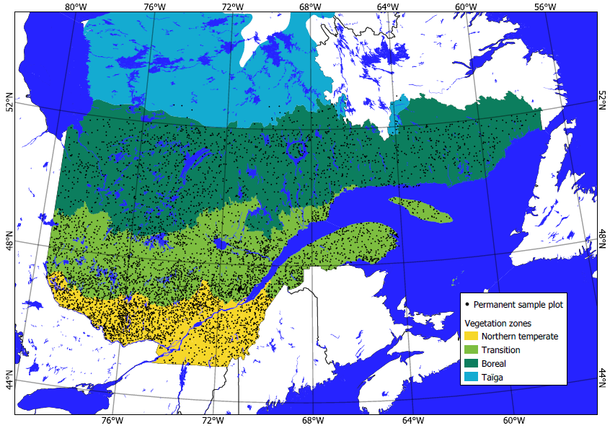
Background
Introduction
Chapter 1
Chapter 2
Chapter 3
Next Steps
Determine rate of mortality of tree species due to changing climate
The Quebec Ministry of Forests, Wildlife and Parks monitors forest growth through a network of permanent sample plots
It was established in 1970, and now today encompasses 12000 plots, remeasured every 10 to 15 years
Sampling intensity decreases South to North - the database is freely available online
Locations of the permanent sample plots in the different vegetation zones of the province of Quebec, Canada.

Slide 10
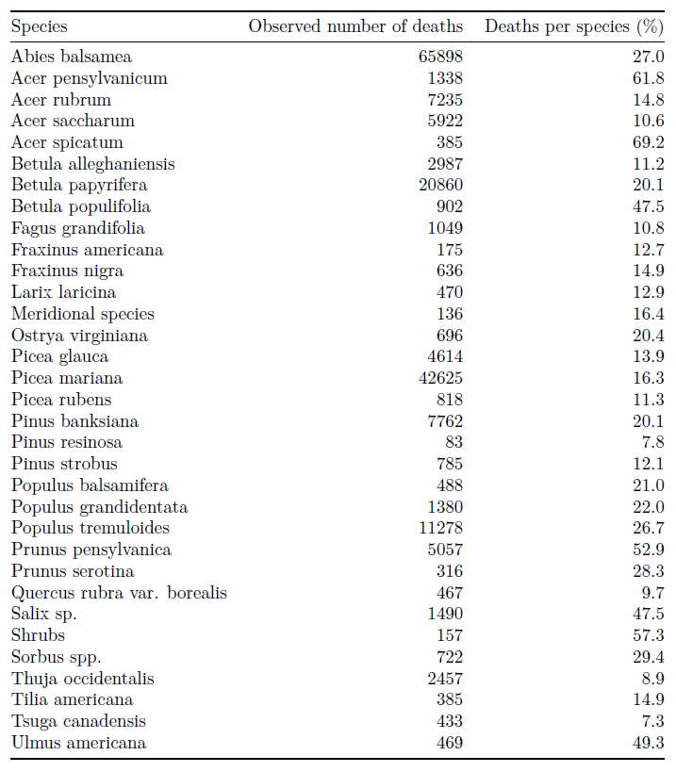
Background
Introduction
Chapter 1
Chapter 2
Chapter 3
Next Steps
There are 190,475 non overlapping intervals, for 33 species and species groups:

Slide 11
Background
Introduction
Chapter 1
Chapter 2
Chapter 3
Next Steps
nearly all tree-level mortality models use logistic regression (Weiskittel et al. 2011) as mortality tree data are generally binary
For the link function component of mortality models, logit link functions are widely used
However, for this research I will use a complementary log-log link function because we have uneven interval lengths (Fortin et al. 2008)
Currently working on fitting a model for sugar maple
Next step to fit a model for species that includes climate variables

Slide 12
Background
Introduction
Chapter 1
Chapter 2
Chapter 3
Next Steps
Combine mortality rates with previously established tree recruitment rates and growth model components to model climate-sensitive forest growth
These climate-sensitive models will be used to model forest growth in Québec into the future under three different climate scenarios based on the Intergovernmental Panel on Climate Change (IPCC) adopted representative concentration pathways;
RCP 4.5, RCP 8.5, and constant climate (IPCC, 2013)
This forest growth will be modeled in tandem with harvest, providing further insight into how forest management interacts with climate on species distribution shifts
This modeling will predict tree species migration, along with providing a framework within which to model and analyze the effects of other climate change mitigation strategies in the forest sector

Slide 13
Background
Introduction
Chapter 1
Chapter 2
Chapter 3
Next Steps
Use growth model to analyze effects of other climate change mitigation strategies in the forest sector
There is flexibility here:
Due to my previous research and experience, I would really like to explore more optimization modeling
However, I am interested in receiving suggestions as to what forest management strategies I should consider focusing on
I am excited to be creative with this chapter, but could use some suggestions as to what aspects of forest management in Québec are of budding interest and/or could use more analysis

Slide 14
Background
Introduction
Chapter 1
Chapter 2
Chapter 3
Next Steps
Insert gantt schedule here for future plans

Slide 15
Thank you for being involved with my PhD as a member of my committee!
I appreciate your on-going support with this next step in my academic career. I am always open to suggestions or feedback!
Christina Howard
BSC, MSC, PHD STUDENT
Department of Forest Resources Management
FACULTY OF FORESTRY, UBC

Slide 16
References
Kurz, W. A., Dymond, C. C., White, T. M., Stinson, G., Shaw, C. H., Rampley, G. J., Smyth, C., Simpson, B. N., Neilson, E. T., Trofymow, J. A., Metsaranta, J., & Apps, M. J. (2009). CBM-CFS3: A model of carbon-dynamics in forestry and land-use change implementing IPCC standards. Ecological Modelling. https://doi.org/10.1016/j.ecolmodel.2008.10.018

