Slide 1

BioPAX:
An overview of changes
from Level 2 to Level 3

Slide 2
States and Generics

Slide 3
States in Level
2
Physical Entity:
Name, Sequence,
etc
Physical Entity
Participant:
State, location
stoichiometry
Interactions

Slide 4
States in Level
3
stoichiometry
Interactions
Physical Entity Reference:
Name, Sequence,
etc
Physical Entity
Participant:
State, location
stoichiometry

Slide 5
Feature / notFeature
P@21
?@19
P@21
?@19
P@21
P@19
P@21
P@19
P@21

Slide 6
Subclasses of Feature
Entity Feature
  ModificationFeature
    CovalentBindingFeature
  BindingFeature
    CovalentBindingFeature
  FragmentFeature

Slide 7
Binding Feature
b@31
b@R
b@T
b@R
b@T

Slide 8
Complexes
Complexes have no complex reference
Multiple complexes can re-use members

Slide 9
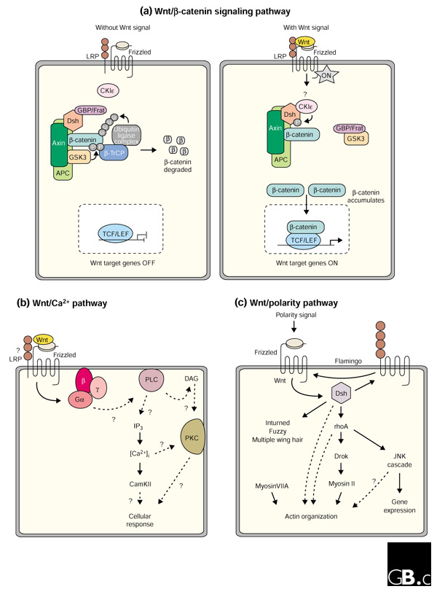
Generics

Slide 10
Generics
WNT
rWNT
rWNT1
rWNT2

Slide 11
Generics
WNT
rWNT
rWNT1
WNT
P@x
P@21
rWNT2
P@45

Slide 12
Gene Regulation
Template Reaction → for transcription and translation
  Template
  Product
Template Reaction Regulation → subclass of control
DNARegion, RNARegion for representing subsequences in nucleic acids
Support for promoters and transcription units

Slide 13
Gene Regulation
TF
AS
TemplateReactionRegulation
DNARegion
Template
Product
Protein
Template
Reaction

Slide 14
Genetic Interactions
A separate non-causal, non-physical interaction : GeneticIntereaction
A separate non-physical entity : Gene
Phenotype: e.g. viability
InteractionScore: strength of interaction

Slide 15
Controlled Vocabulary subclasses
Cellular Location Vocabulary (GO)
Relationship Type Vocabulary (Orphan)
Sequence Modification Vocabulary(PSI-MI for protein, orphan for others)
Experimental Form Vocabulary (PSI-MI for proteins, orphan for others)
Tissue Vocabulary (BTO)

Slide 16
Controlled Vocabulary subclasses
Cell Vocabulary (CL)
Evidence Code Vocabulary (PSI-MI for proteomics)
Entity Reference Type Vocabulary ( Orphan)
Phenotype Vocabulary ( PATO)
Interaction Vocabulary ( PSI-MI)

Slide 17
Refactorings
All class names are now CamelCase
All property names are now lower case
All property names are now singular
Some classes were renamed to better reflect biology/common terminology

Slide 18
Refactorings
Better handling of data source, method score, provenance
SYNONYMS, NAME, SHORT-NAME
Name, Standard Name, Display Name
Pathways can now control reactions
Pathway Step improved to cover context specific direction of reversible reactions.
Member Entity is transitive

Slide 19
What is included in the release
Ontology specification | Web Ontology Language (OWL) XML file, developed using free Protégé ontology editor software[57].
Ontology documentation | Explanation of BioPAX entities, example documentation, best practice recommendations, use cases, how to.
Example files | Example files for biochemical pathway, protein and genetic interaction, protein phosphorylation, insulin maturation, gene regulation, generic molecules in OWL XML.
Graphical representation | Recommendations for graphical representation using Systems Biology Graphical Notation (SBGN) as a guide.
Paxtools software | Java programming library supporting import/export, conversion, validation. Can be used to add BioPAX support to software.
List of data sources & supporting software | Databases making data available in BioPAX format, software systems for storing, visualizing and analyzing BioPAX pathways.

