Slide 1

Introduction to the BioPAX Java API (Paxtools) and the Pathway Commons API
MSKCC
Augustin Luna
lunaa@cbio.mskcc.org

Slide 2
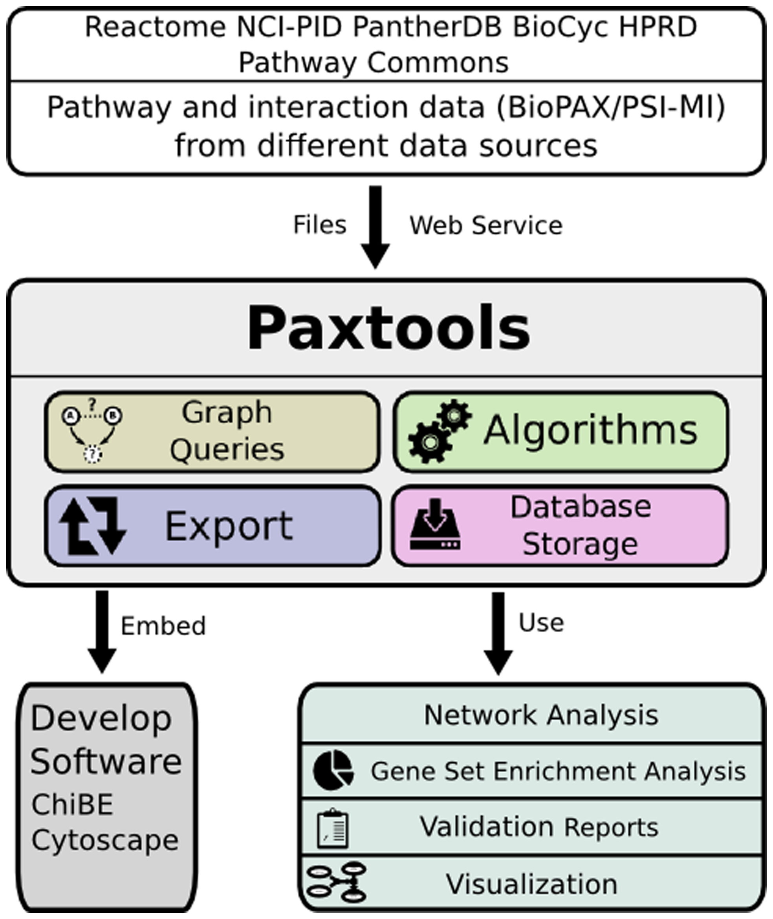
Paxtools: Biological Pathway Exchange (BioPAX) Format Java API
Demir et al (2013)
Notes:
BioPAX, now in Level 3, has been stable for a while

Slide 3
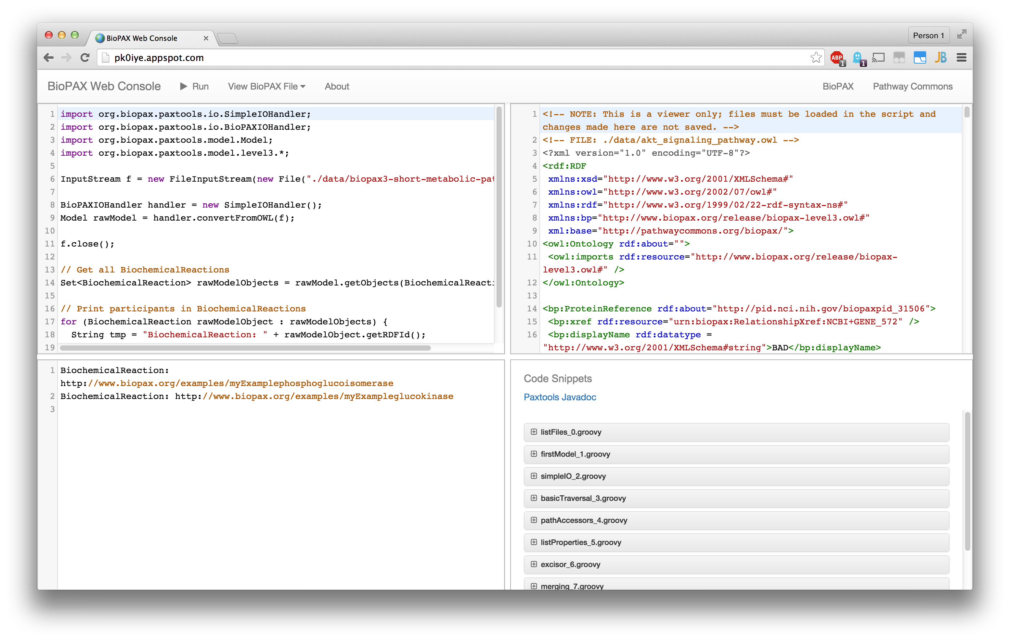
BioPAX Web Console
Code Editor
BioPAX OWL File
Output
Code Examples
URL: http://pk0iye.appspot.com

Slide 4
BioPAX Web Console Overview
BioPAX Web Console is an environment to try out Paxtools
Features
Uses Groovy, a dynamic language compatible with Java
Sample programs and OWL files provided
Some basic IDE features: syntax highlighting, matching braces, code folding, search by regex
Limitations
Cannot access URLs
Cannot save state for later use
No local file saving or reading
Covered examples closely mirror Paxtools manual
http://sourceforge.net/projects/biopax/files/paxtools/paxtools.pdf
URL: http://pk0iye.appspot.com
Code: https://github.com/cannin/biopaxWebConsole

Slide 5
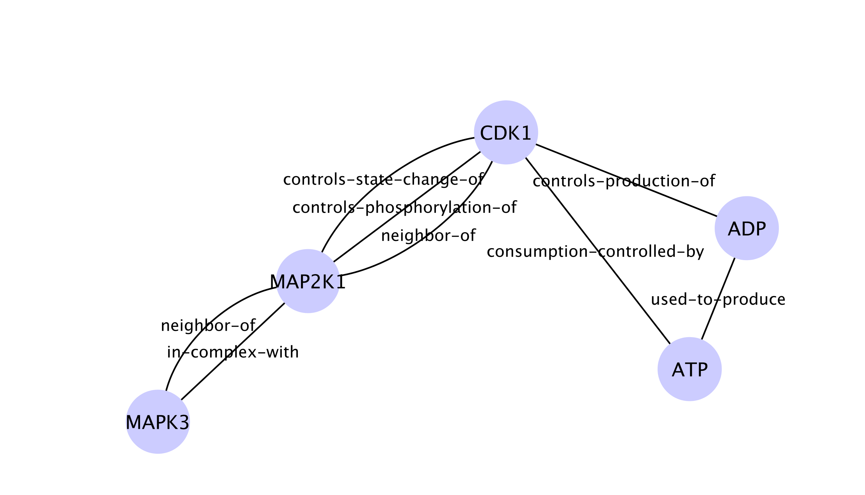
Visualizing SIF Output in Cytoscape
SIF Output from BioPAX Web Console CombinedExample Code Snippet

Slide 7
Setting Up Full Java Paxtools Projects
Paxtools Quickstart
https://github.com/cannin/biopaxTutorial
Apache Maven is used as the build system and dependency manager
Maven Archetype is used as the project templating toolkit

Slide 8
Examples of Writing BioPAX
Several converters written as part of GSOC 2014 by Arman Askoy
Website: https://bitbucket.org/armish/gsoc14
Databases
Recon X (a SBML-to-BioPAX converter)
Comparative Toxicogenomics Database
DrugBank
MiRTarBase
MSigDB

Slide 9
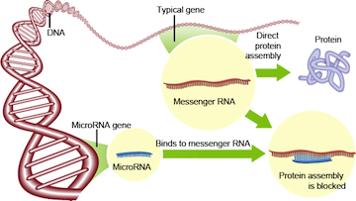
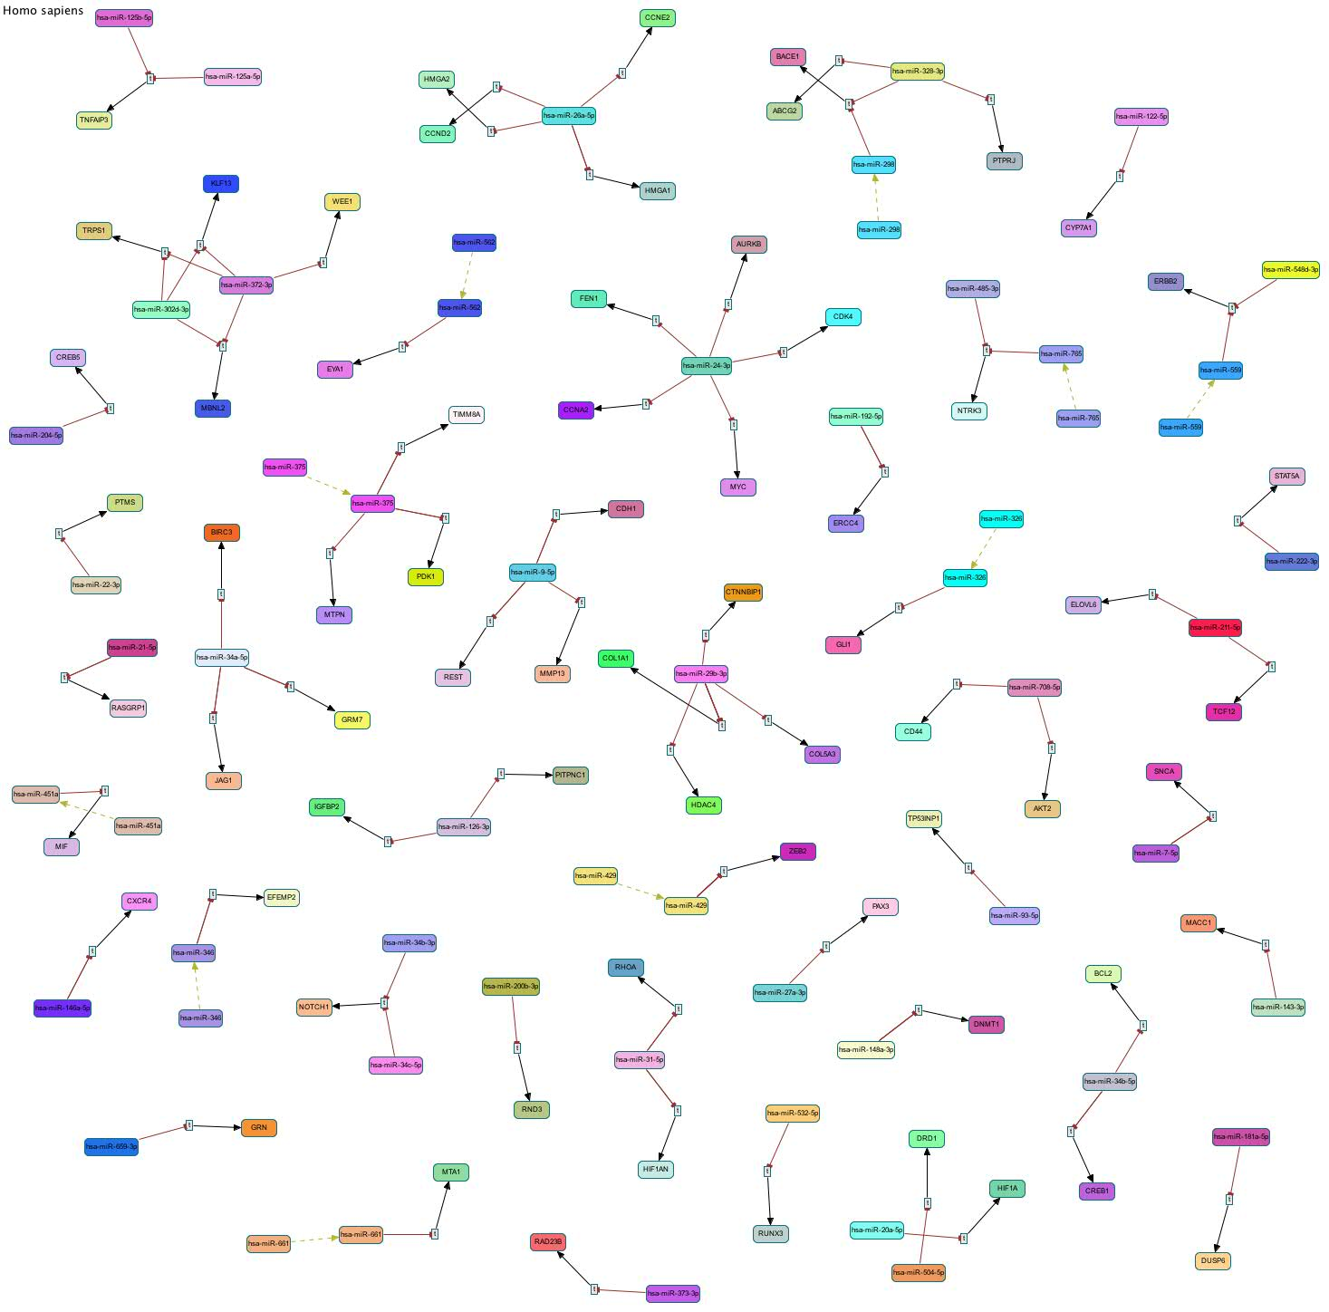
MiRTarBase Converter Overview
miRNA-target relationships encoded as TemplateReactions where a gene product is produced
The TemplateReaction is inhibited by the corresponding miRNA
miRNAs are represented by Rna objects, where they have RelationshipXrefs to MiRTarBase (not in MIRIAM) and UnificationXrefs to miRBase (in MIRIAM)
MIRIAM Registry unique and perennial identifiers for life science
If miRNA name is associated with multiple unique miRNAs, then this information is captured in the RnaReference
Conversion Visualization of MiRTarBase in ChiBE
Notes:
TemplateReaction has no source

Slide 11
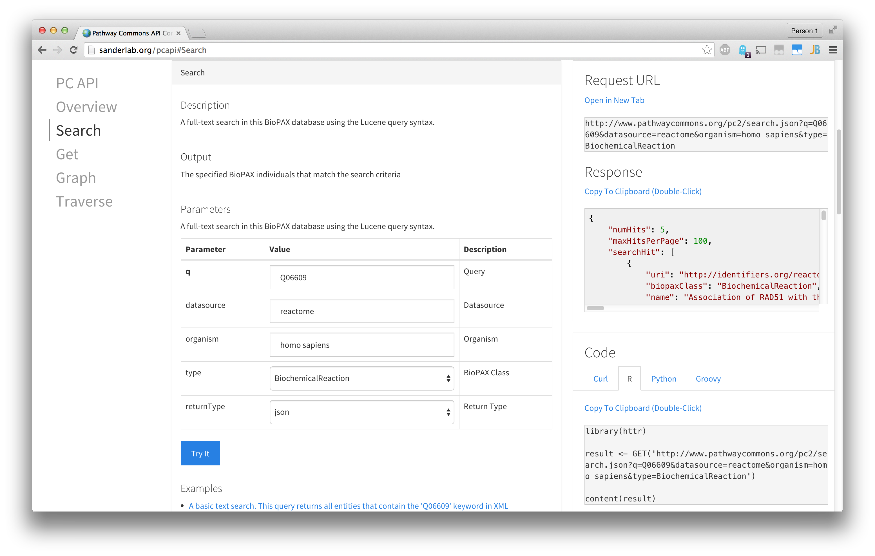
Pathway Commons (PC) Interactive API
API Call URL
XML/JSON Response
Parameters
(Required in Bold)
API Call Code
Clicking Examples Modifies Parameters
Notes:
SLFN11: Q7Z7L1

Slide 12
PC Interactive API Site Overview
Features
Provides documentation, generated API call, results and code snippets in multiple languages
Limitations
Not all PC functions are supported
Documentation is minimal
Full API Documentation
http://www.pathwaycommons.org/pc2/

