Slide 1
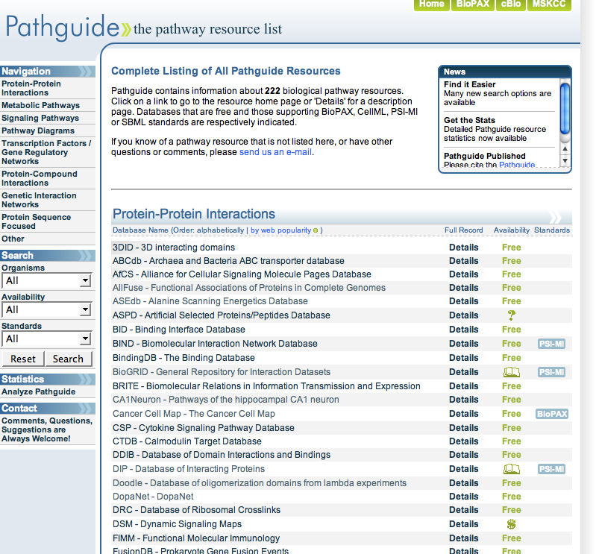
http://pathguide.org
Vuk Pavlovic

Slide 2
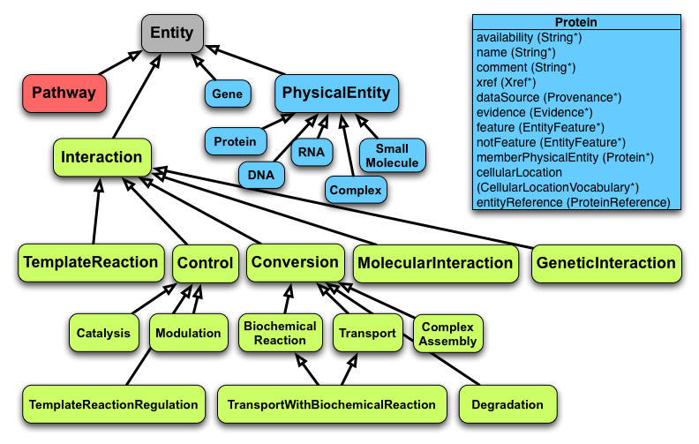

Slide 3
