Slide 1

Introduction to the Biological Pathway Exchange (BioPAX) Format, Pathway Commons, and PaxtoolsR
metaRbolomics
Augustin Luna
aluna@jimmy.harvard.edu
BioPAX: biopax.org
Pathway Commons: pathwaycommons.org
Paxtools: bioconductor.org/packages/release/bioc/html/paxtoolsr.html
Notes:
15 minute presentations

Slide 2
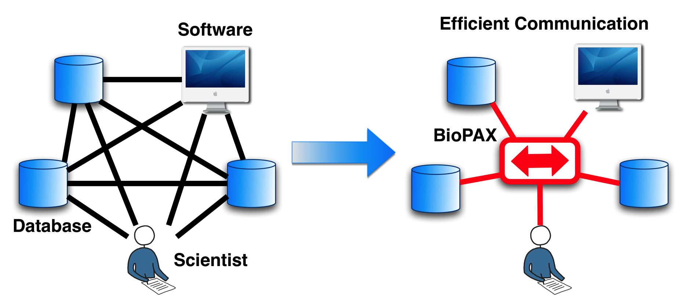
BioPAX Scope/Goals
To represent biological interactions and pathways
Pathways are collections of interactions that biologists have found useful to group together for organizational, historic, biophysical or other reasons
Types
Metabolic pathways
Signaling pathways
Protein-protein, molecular interactions
Gene regulatory pathways
Encourage a community-wide effort to distribute pathway data in standard format; over 500 databases listed on pathguide.org

Slide 3
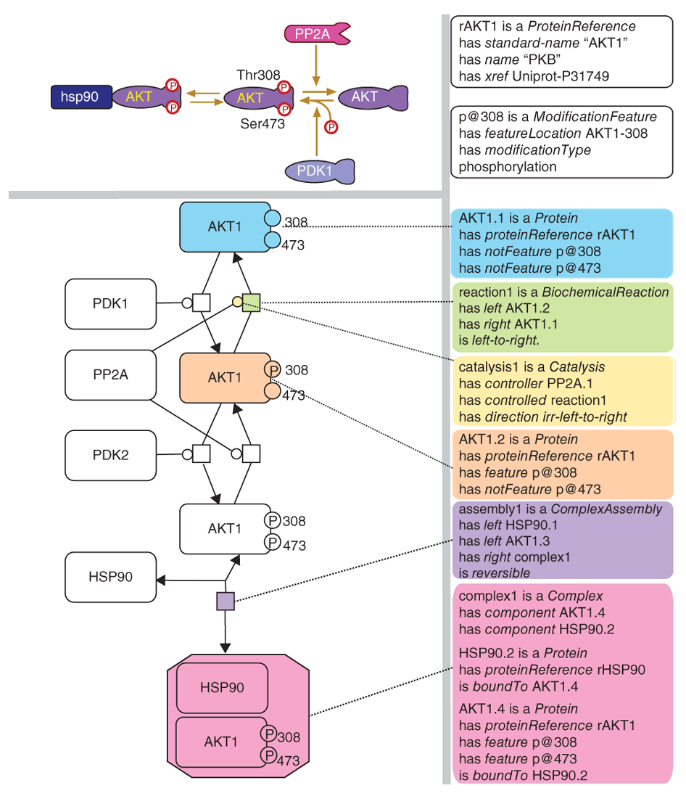
From Pathway Diagrams to BioPAX

Slide 4
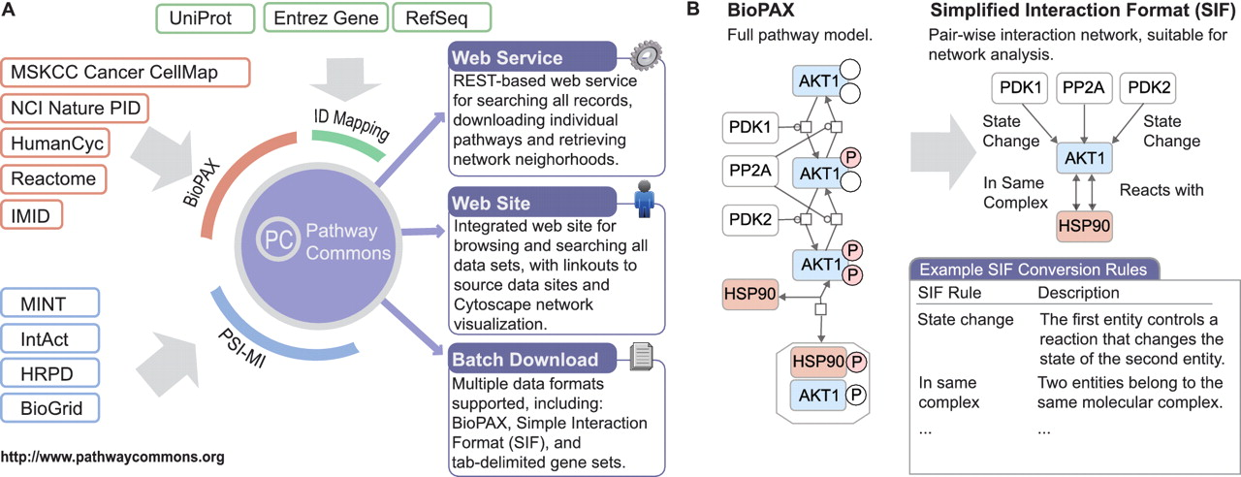
Pathway Commons Database (pathwaycommons.org)
Includes signaling, drug/target, metabolic, regulatory, etc DBs
Reactome | 11924
NCI PID | 16017
PhosphoSitePlus | 13642
HumanCyc | 7024
HPRD | 40618
PantherDB | 5282
DIP | 7102
BioGRID | 244843
InAct | 98347
BIND | 35566
TRANSFAC | 261624
mirTarBase | 51214
DrugBank | 19159
Recon X | 10910
CTD | 313174
KEGG | 4472
Total Interactions | 1140918
Cerami et al (2011)

Slide 5
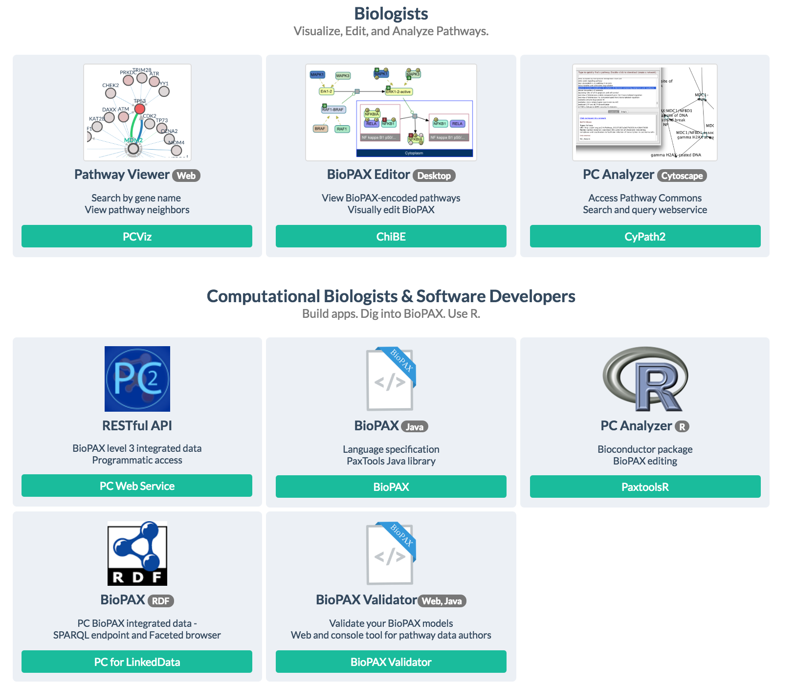
BioPAX/Pathway Commons Software Ecosystem
http://www.pathwaycommons.org/

Slide 6
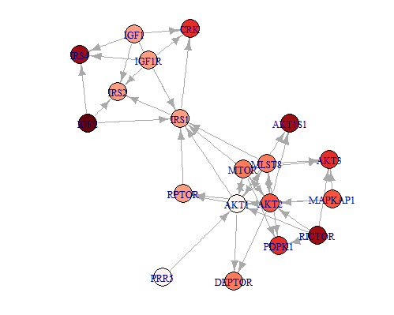
paxtoolsr
Use core functions from Paxtools
Access Pathway Commons (PC) API
Provide R-specific tutorials for PC data (e.g. gene set enrichment)
~1500 downloads from unique IPs in 2015
Major Update (Oct 2015)
Readers for PC formats
Speed improvements using data.table
Upgraded to Paxtools 4.3.1
ID Extraction
ID Conversion
igraph export
Cached files
Split interactions by pathway
Provide mechanism for filtering PC interactions
Network queried from PC, converted to binary network, and overlayed with example data
Luna A., et al. Bioinformatics. 2015

Slide 7
Acknowledgements: Main Team
Dana-Farber Cancer Institute/Harvard Medical School
Augustin Luna
Chris Sander
Bilkent University
Ugur Dogrusoz
University of Toronto
Jeffrey Wong
Igor Rodchenkov
Gary Bader
Oregon Health Sciences University
Ozgun Babur
Emek Demir
Notes:
Add Ed and Rileen

Slide 8
Acknowledgements (2)
Current Participants
SRI Bioinformatics Research Group: P. Karp, S. Paley, J. Pick
Université Libre de Bruxelles: C. Lemer
CBRC Japan: K. Fukuda
Dana Farber Cancer Institute: J. Zucker
Millennium: J. Rees, A. Ruttenberg
Cold Spring Harbor/EBI: G. Wu, M. Gillespie, P. D'Eustachio, I. Vastrik, L. Stein
BioPathways Consortium: J. Luciano, E. Neumann, A. Regev, V. Schachter
Argonne National Laboratory: N. Maltsev, E. Marland, M.Syed
Harvard: F. Gibbons
AstraZeneca: E. Pichler
BIOBASE: E. Wingender, F. Schacherer
NCI: M. Aladjem, C. Schaefer
Università di Milano Bicocca, Pasteur, Rennes: A. Splendiani
Vassar College: K. Dahlquist
Columbia: A. Rzhetsky
Collaborating Organizations
Proteomics Standards Initiative (PSI)
Systems Biology Markup Language (SBML)
CellML
Chemical Markup Language (CML)
Additional Projects
Gene Ontology
CHEBI
SwissProt
UniChem
Protégé, U.Manchester, Stanford
Notes:
Many other people have contributed in discussions in person and on the mailing list and we would like to thank them as well.

Slide 10
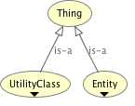
BioPAX Structure (biopax.org)
BioPAX is an ontology composed of two top-level classes: Entity and UtilityClass
Entities are discrete biological units that participate in pathways
Utility classes annotate Entities without themselves being entities.
Java API: Paxtools (biopax.github.io/Paxtools)
Access, query, and export to other formats
Visualized using Protégé: http://protege.stanford.edu/products.php

Slide 11
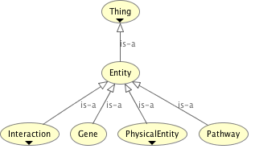
BioPAX Structure: Entity Classes
Pathway: A set of interactions (e.g. glycolysis, MAPK, apoptosis)
Interaction: A basic relationship between a set of entities (e.g. biochemical reactions, catalysis)
Physical Entity: A building block of simple interactions (e.g. small molecule, protein, DNA, RNA)
Gene: An entity that encodes inheritable information (e.g. BRCA1 gene); for use only with genetic interactions (e.g. synthetic lethal interactions)

Slide 12
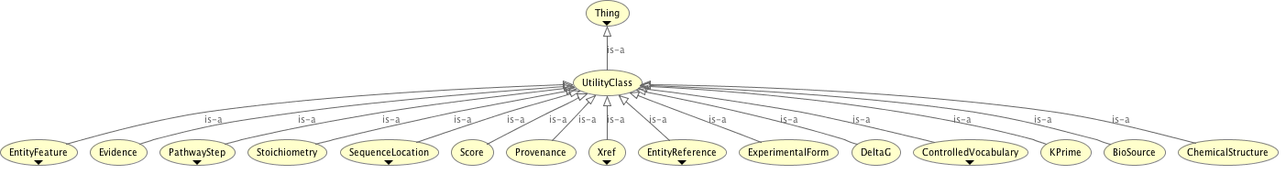
BioPAX Structure: Utility Classes
Select examples
Xref: Cross-references to external databases
EntityReference: A grouping of entities that share common properties (e.g. AKT for AKT1, AKT2, AKT3 or pAKT)
Stoichiometry: Used to define reaction stoichiometry
Biosource: Source of entity (e.g. human)
EntityFeature: An aspect of an Entity that can be modified without changing its basic biological identity (e.g. post-translational modifications)
ControlledVocabulary: Reference to external vocabularies (e.g. Gene Ontology)

Slide 13
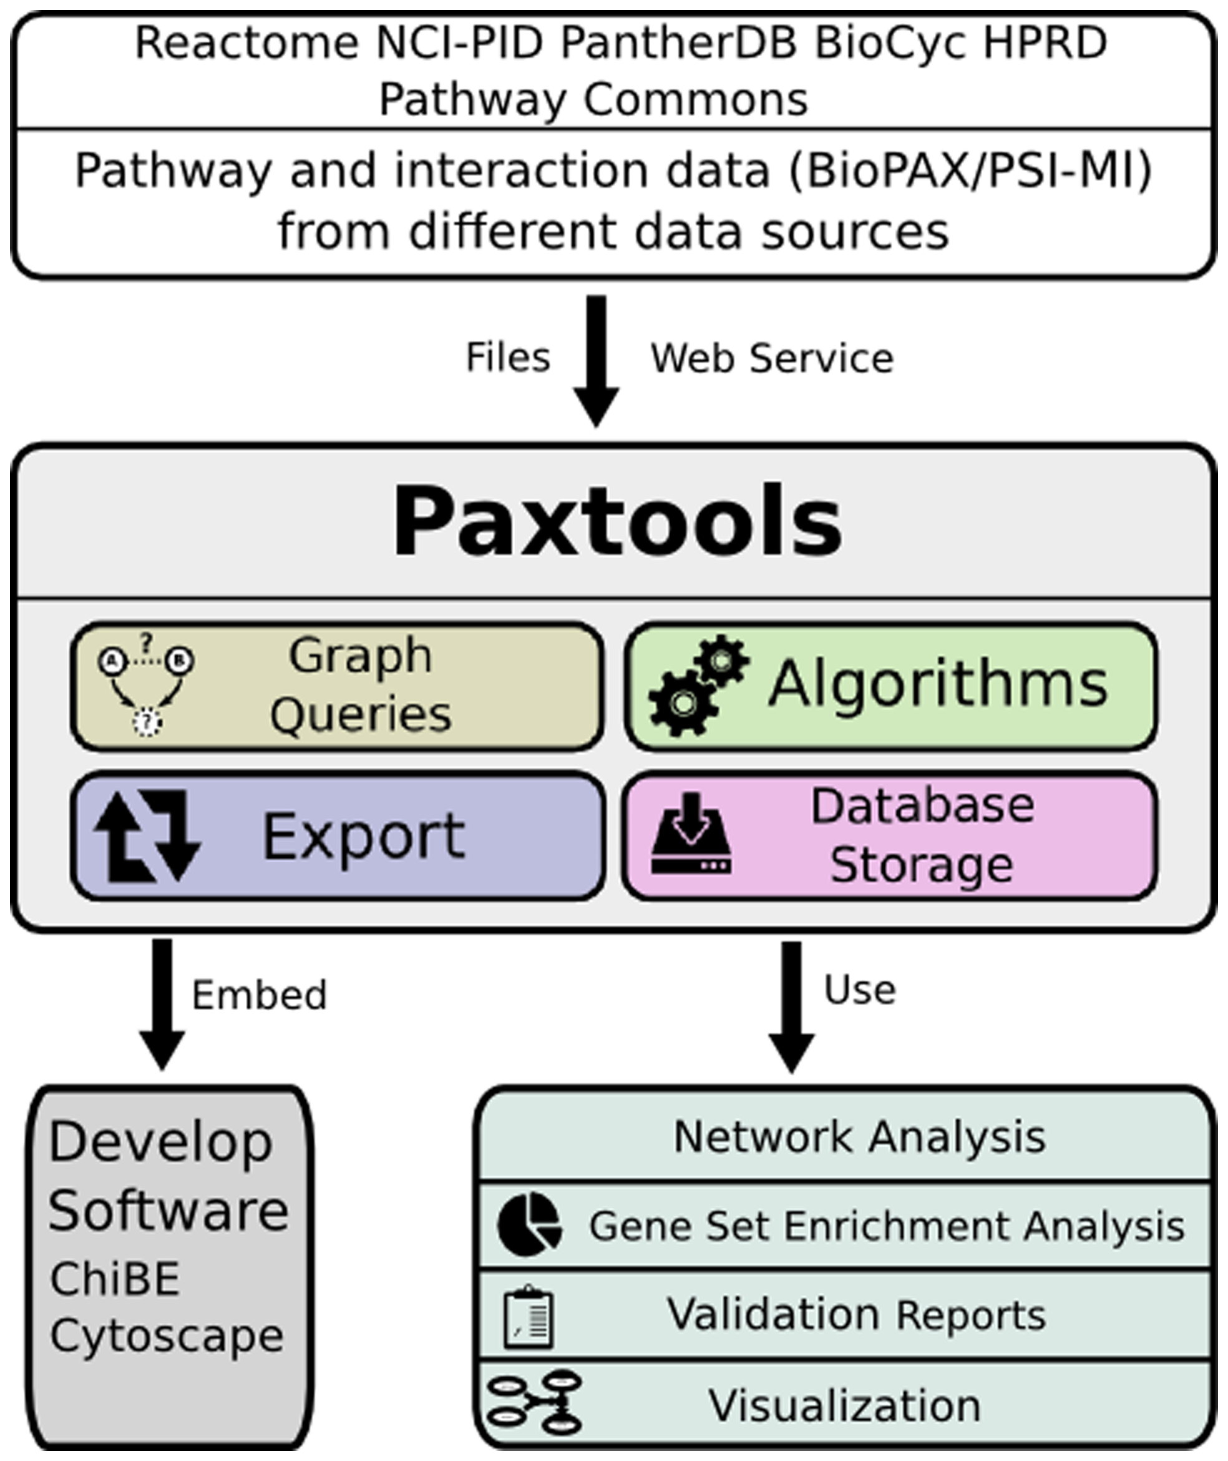
Paxtools: Biological Pathway Exchange (BioPAX) Format Java API
Demir et al (2013)

