Slide 1

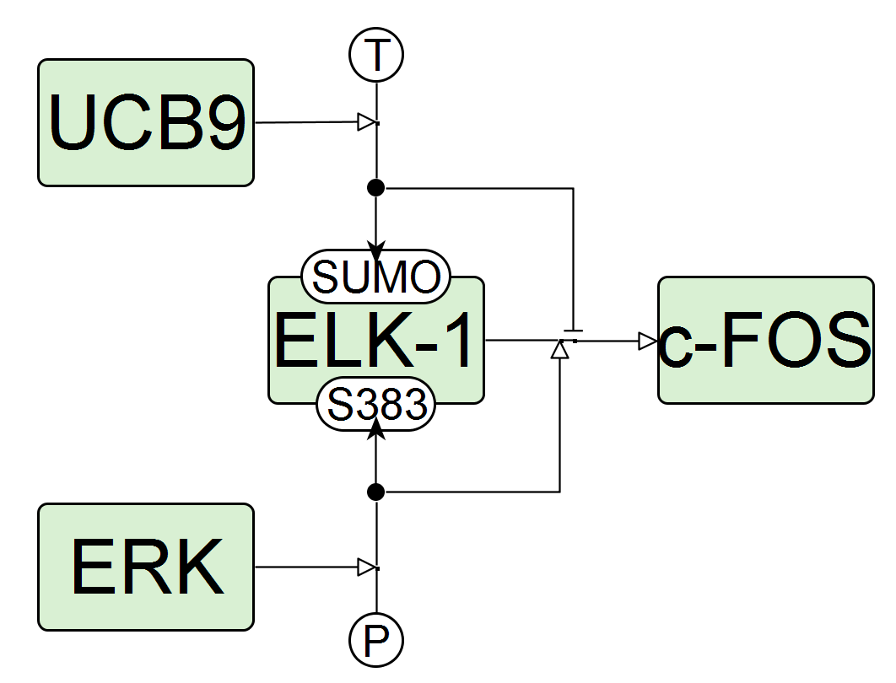
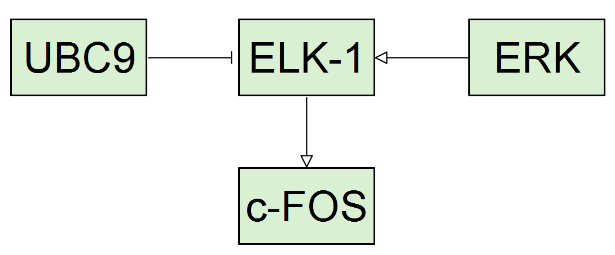
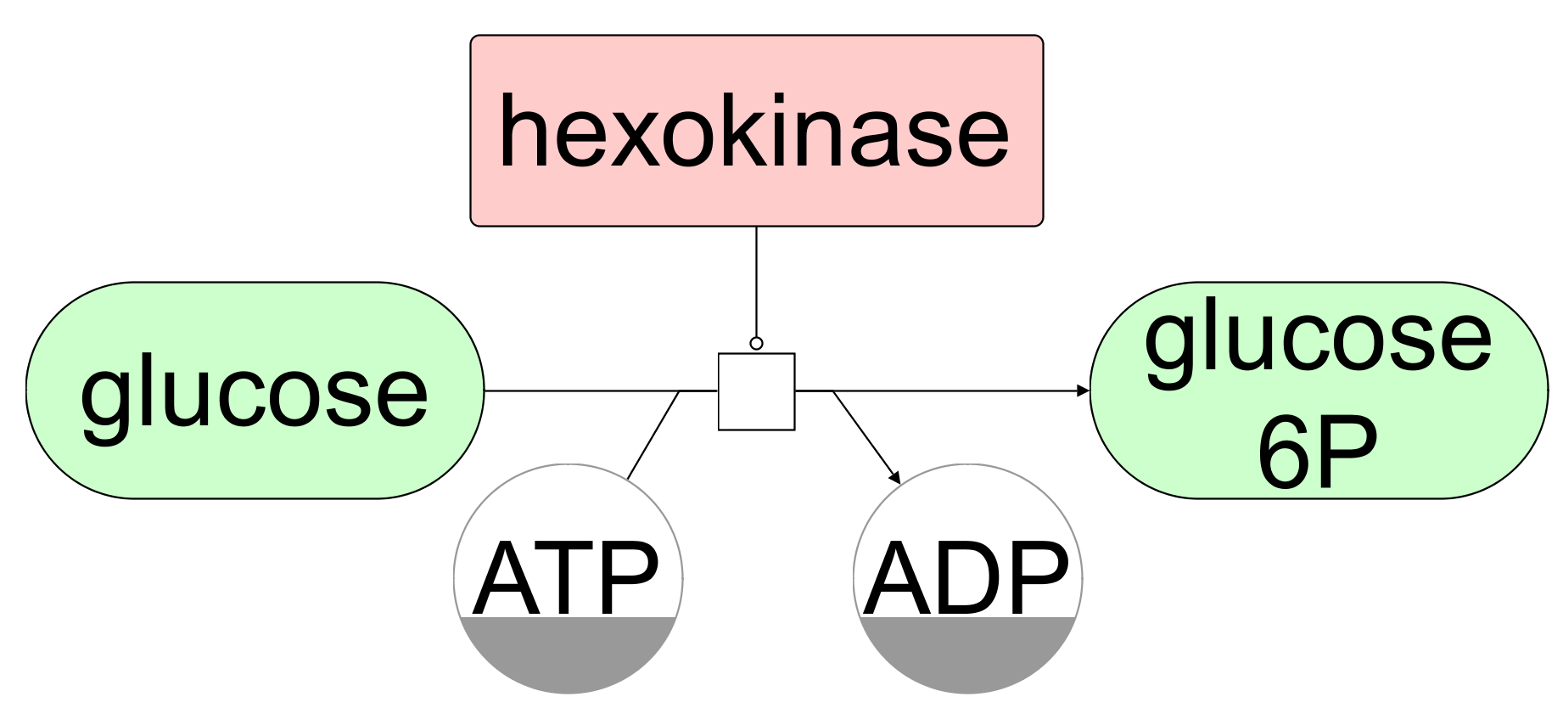

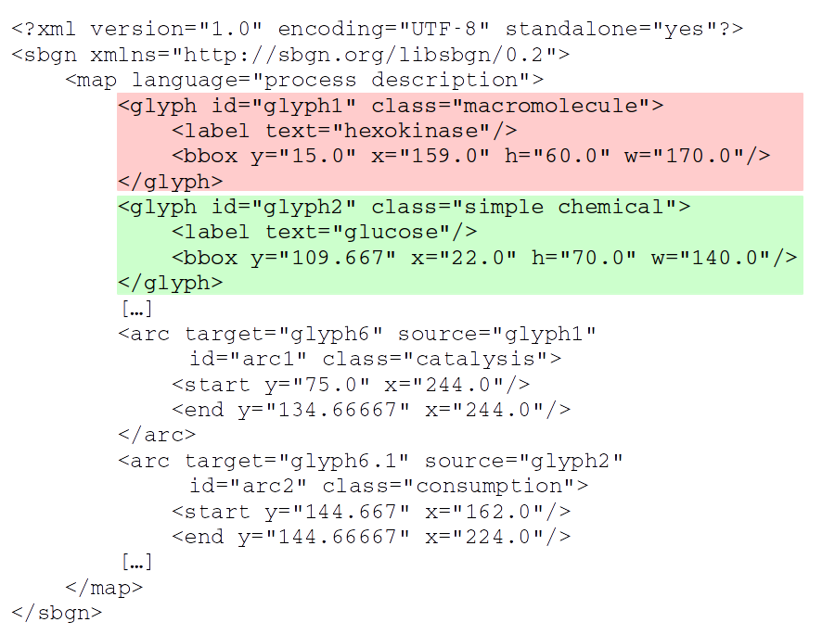
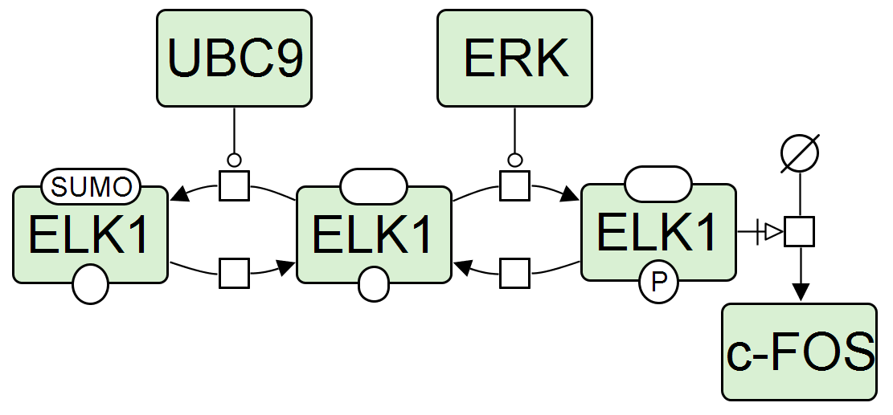
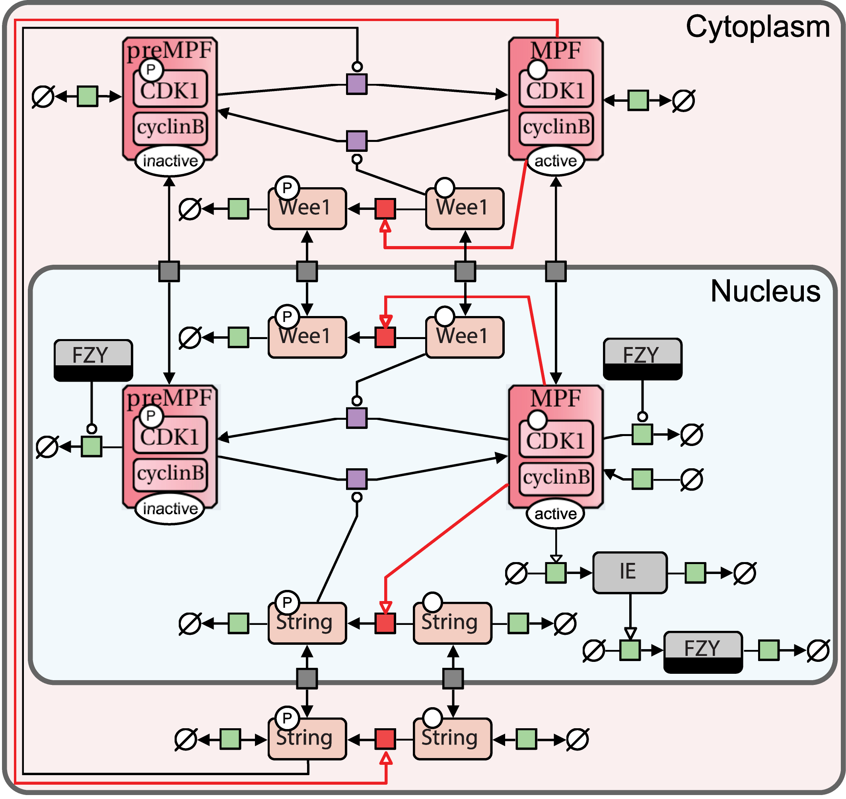
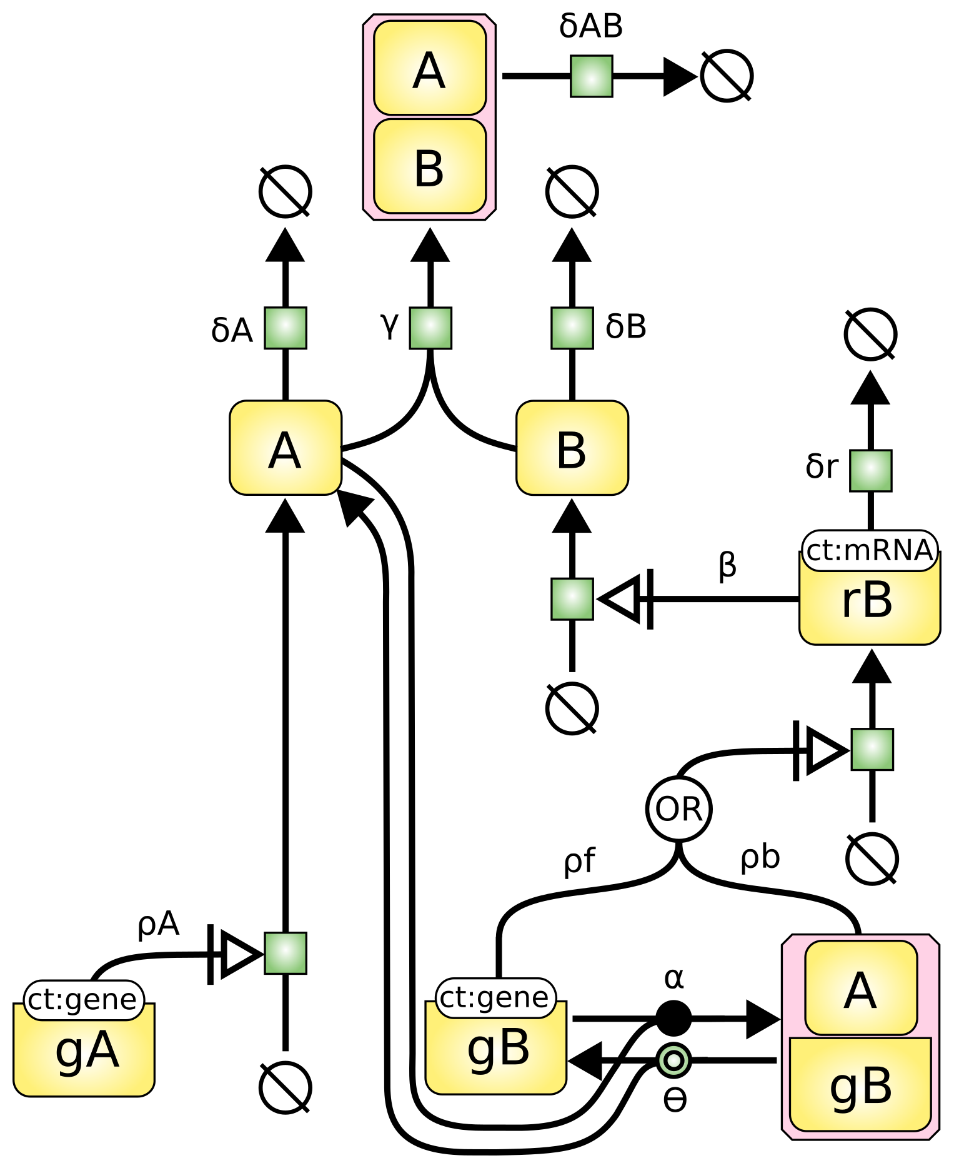





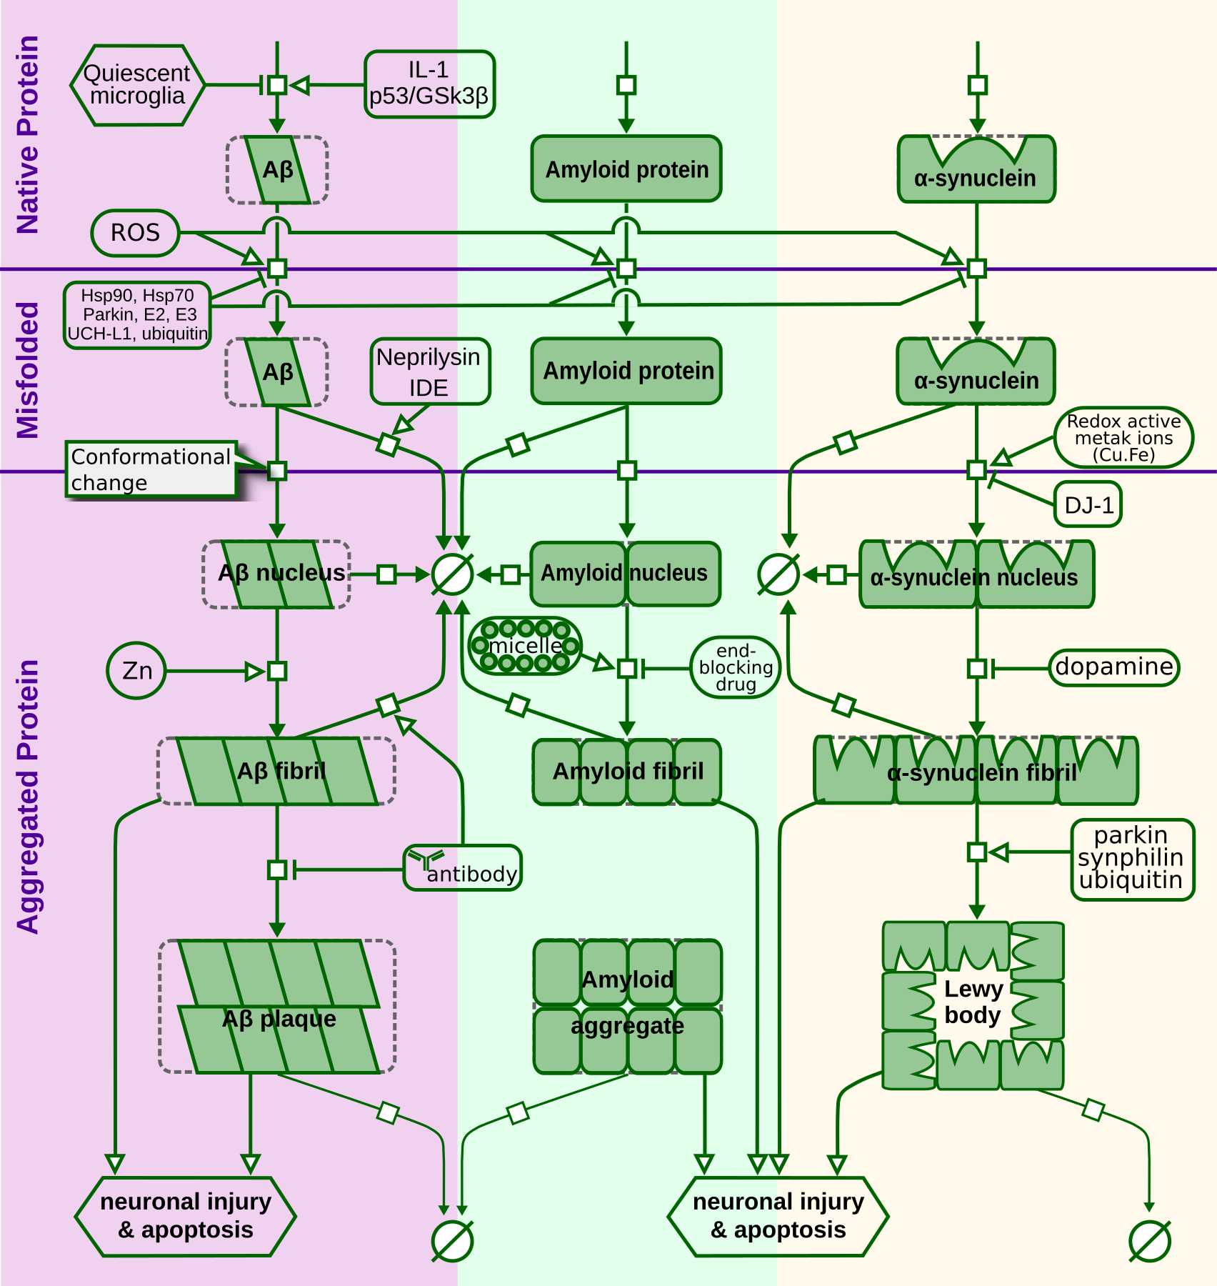

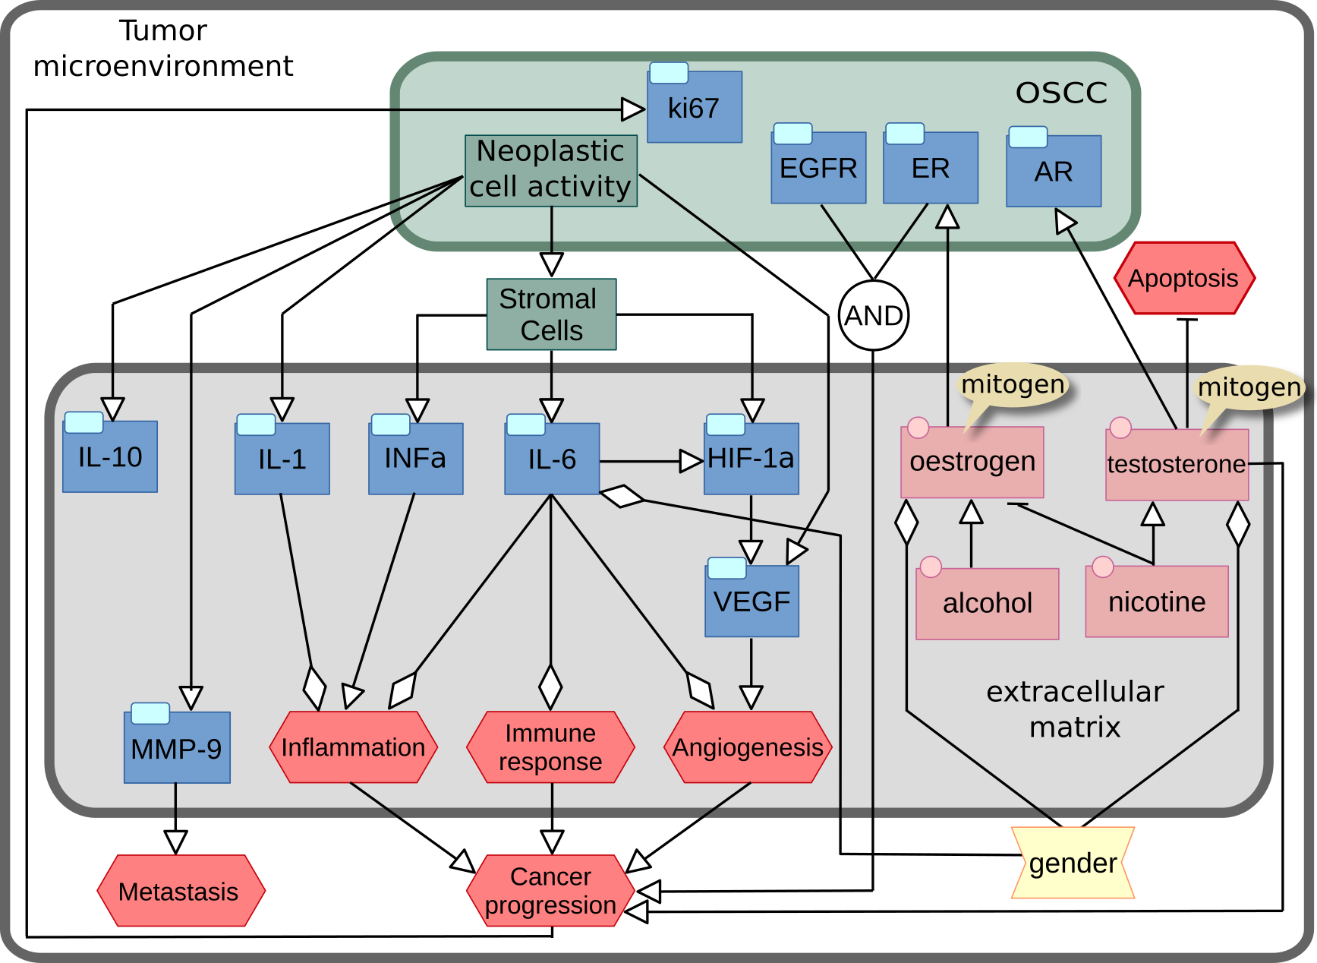

The Systems Biology Graphical Notation: a standardised representation of biological maps
Vasundra Touré¹, Alexander Mazein², Adrien Rougny³, Andreas Dräger⁴, Ugur Dogrusoz⁵, Augustin Luna⁶
1 Department of Biology, Norwegian University of Science and Technology, Trondheim, Norway
2 European Institute for Systems Biology and Medicine, CIRI UMR5308, CNRS-ENS-UCBL-INSERM, Université de Lyon, 50 Avenue Tony Garnier, 69007 Lyon, France
3 Biotechnology Research Institute for Drug Discovery, National Institute of Advanced Industrial Science and Technology, Aomi, Tokyo 135-0064, Japan
4 Center for Bioinformatics Tübingen (ZBIT), University of Tübingen, Tübingen, Germany
5 Computer Engineering Department, Bilkent University, Ankara 06800, Turkey
6 cBio Center, Dana-Farber Cancer Institute, Boston, MA; Department of Cell Biology, Harvard Medical School, Boston, MA 02215, USA
Visualization of biological processes plays an essential role in life science research. Over time, diverse forms of diagrammatic representations, akin to circuit diagrams, have evolved without well-defined semantics potentially leading to ambiguous network interpretations and difficult programmatic processing. The Systems Biology Graphical Notation (SBGN) is a standard developed to reduce ambiguity in the visual representation of biomolecular networks. It provides specific sets of well-defined symbols to represent various types of biological concepts.
SBGN comprises three complementary languages: Process Description (PD, [2]), Entity Relationship (ER, [3]), and Activity Flow (AF, [4])​:
SBGN is both human readable and machine readable [5]
Networks below are redesigned from Le Novère (2015): Quantitative and logic modelling of molecular and gene networks. doi:10.1038/nrg3885
The Entity Relationship
The Activity Flow
SBGN
Independent interactions between
features of biological entities that
avoids combinatorial explosions.
Cascades of influences between the activities carried by biomolecular
entities (e.g., stimulation, inhibition).
Directed
SBGN-ML
Directed
Sequential
Mechanistic
Mechanistic
Sequential
The Process Description
Based on reactions and well-suited for detailed sequential biochemical mechanisms.
Directed
Sequential
Mechanistic
Examples of published maps
Tips to create your own SBGN map [6]
Additional information
PD map of the Drosophila cell cycle, doi:10.1371/journal.pcbi.1005740
PD map of two-gene system behaviour, doi:10.1038/nrg3885
​1. Know the message your network should convey​
2. Know your audience​
3. Choose the right SBGN language​
4. Define components and interactions in the network​
5. Select the right level of granularity for your map​
6. Design your SBGN map​
7. Beautify your SBGN map​
8. Manage your SBGN map and its content​
9. Link the original data to your SBGN map​
10. Seek help from the SBGN community.​
An elected editorial board is the voice and the hand of the community.
Bi-annual meetings with the COMBINE community.
Website http://sbgn.org
Development https://github.com/sbgn
Contact us, follow and participate in discussions.
sbgn-discuss@googlegroups.com
PD map of protein aggregation, doi:10.1002/psp4.12155
AF map of interactions in a tumor microenvironment, doi:10.5301/tj.5000673
[1] Nicolas Le Novère, Michael Hucka, Huaiyu Mi, et al. 2009. “The Systems Biology Graphical Notation.” Nature Biotechnology 27 (8): 735–41. doi:10.1038/nbt.1558.
[2] Stuart Moodie, Nicolas Le Novère, Emek Demir, et al. 2010 “Systems Biology Graphical Notation: Process Description language Level 1 Version 1.3.” doi:10.2390/biecoll-jib-2015-263.
[3] Anatoly Sorokin, Nicolas Le Novère, Augustin Luna, et al. 2015. “Systems Biology Graphical Notation: Entity Relationship language Level 1, Version 2.” doi:10.2390/biecoll-jib-2015-264.
[4] Huaiyu Mi, Falk Schreiber, Stuart Moodie, et al. 2015. “Systems Biology Graphical Notation: Activity Flow language Level 1, Version 1.2.” doi:10.2390/biecoll-jib-2015-265.
[5] Martijn van Iersel, Alice Villéger, Tobias Czauderna, et al. 2012. “Software support for SBGN maps: SBGN-ML and LibSBGN.” Bioinformatics. doi:10.1093/bioinformatics/bts270.
[6] Vasundra Touré, Nicolas Le Novère, Dagmar Waltemath, et al. 2018. “Quick tips for creating effective and impactful biological pathways using the Systems Biology Graphical Notation”. PLoS Comput Biol. doi:10.1371/journal.pcbi.1005740.
Publish your map in the SBGN format and get it advertised in our webpage!

