Slide 1
RASD
Requirement Analysis and specification Document

Slide 2
Scope
To build a software system able to manage and optimize taxi services in a large city.
Targeted both to the city public transportation management council and to the citizens as customers of the taxi service.
Passenger will be able to request a taxi by using the application and taxi drivers will be notified of these requests by the system.
Taxi drivers notified of passengers requests can then accept them.

Slide 3
Definitions
Passenger: A citizen recognized by the system as a registered user of My Taxi Service, using the system as a customer does, to call taxis and be served
Logged passenger: A passenger that is currently and correctly logged into the system
Taxi driver: A citizen recognized by the system as a registered user of My Taxi Service, using the system as a taxi driver, recognized by the parent company and of verified identity
Logged taxi driver: A taxi driver that is currently and correctly logged into the system

Slide 4
Definitions
Request for service: A passenger uses the mobile app or web application to send the central management system a formal and well-formed request to be served by a taxi. This request includes a departure time, an itinerary starting point and ending point and the number of people to be served.
Real time request: A request for service that is intended to serve a passenger immediately and is instantly relayed by the system to an available taxi driver.
Reservation: A request for service that is not meant to serve a passenger immediately and as such is stored by the system and only relayed to an available taxi driver once the correct time comes.

Slide 5
Product perspective
Web application running on a central server with access either through a standard browser or a specific mobile application (for passengers) or simply a mobile application (for taxi drivers).
Taxi drivers will need to own a smartphone with internet access.
There is no software system already in place with which My Taxi Service will need to be integrated.
A programmatic API will be part of the system, to allow for future expansion of its capabilities, such as taxi sharing management.

Slide 6
Product functions
Taxis in the city will be divided in queues, each one of which will be fairly managed.
Passengers will be registered and remembered by the system;
Passengers will be able to log in to their personal account;
Passengers will be able to request a taxi at their current position or at a position of their choice;
Passengers will be able to reserve a taxi in advance;
Passengers will be able to access their reservation history;
Passengers will be able to modify or delete elements from their reservation history;

Slide 7
Product functions
Passengers will be notified if their request for service is accepted and the estimated time of arrival of the incoming vehicle;
Passengers will be notified if their request for service cannot be met for whatever reason;
Taxi drivers will be registered and remembered by the system;
Taxi drivers will be able to log in to their personal account;
Taxi drivers will be able to inform the system of their availability;
Available taxi drivers will be notified when they are called to answer a request for service;

Slide 8
Product functions
Taxi drivers will be able to confirm that they are going to take care of the assigned request for service;
Available taxi drivers will be notified that they need to move to a different city zone to ensure a total coverage of possible passengers requests.

Slide 9
User characteristics
Passengers will require no special knowledge of the application to use it, for the user interface must be designed to be as intuitive and easy-to-use as possible.
Taxi drivers will have access to different functions, but the core principle should well remain the same: there is no requirement for in-depth training to use the system as an.

Slide 10
Constraints
Regulatory policies: My Taxi Service will need to meet any and all requirements imposed by the laws and policies of the city in which it will be deployed, with special regards to the rules concerning taxi services.
Parallel operation: My Taxi Service central system will need to constantly monitor the situation of taxis in the whole city in order to dispatch and manage them as best as possible. At the same time, it will need to be sized appropriately to support the many different connections and operations from clients to the central server.

Slide 11
Assumptions and dependencies
The city will be divided in several zones;
The system will minimize the risk of not being able to answer to a request for service due to lack of available taxis;
Users profiles are private and hidden;
The mobile app will be available for each major mobile operating system and will forward data to the central system in a uniformed way;
All taxi drivers own a suitable smartphone;

Slide 12
Assumptions and dependencies
All taxi drivers must own the My Taxi Service app and be registered users in order to work;
Taxis will be tracked by a GPS system;
The system will receive GPS readings from each taxi and will keep careful track of it;
The system knows the license plates of all taxi drivers’ cars and their associations with the corresponding GPS tracker mounted on the vehicle.

Slide 13
Functional requirements (example)
Goal: Available taxi drivers will be notified that they need to move to a different city zone to ensure a total coverage of possible passengers requests
Requirements:
  The system must analyse taxi locations and calculate their best possible distribution
  The system must choose which taxi drivers need to be moved to ensure total coverage of the city
  The system must notify taxi drivers in which city zone they have to move, as needed

Slide 14
Non-functional requirements
Performance
The system must support a certain number of terminals for taxi drivers: this number will be at first estimated and then extracted from a statistical analysis of the system usage in its first months of life;
The system must support a certain number of terminals for passengers;
The system must support the simultaneous use of 50% of the registered passengers;
The system must support the simultaneous use of 100% of the registered taxi drivers;
Taxi drivers notifications must be received in less than 5 seconds.

Slide 15
Non-functional requirements
Attributes
Reliability is an important factor, as that the system manages all taxis in the city and, were it to fall, the whole taxi circulation would be paralyzed.
Portability must be considered top priority as the mobile application will need to run on all major mobile operating systems.
Security is less critical since no confidential client information are registered on or exchanged by the system.

Slide 16
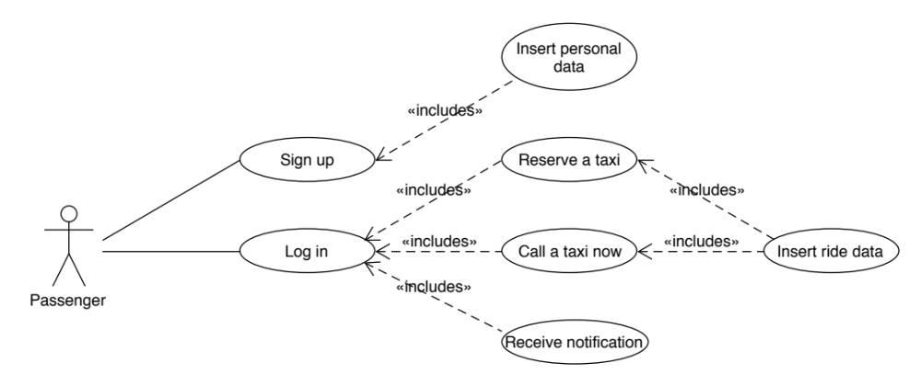
Passenger use cases overview

Slide 17
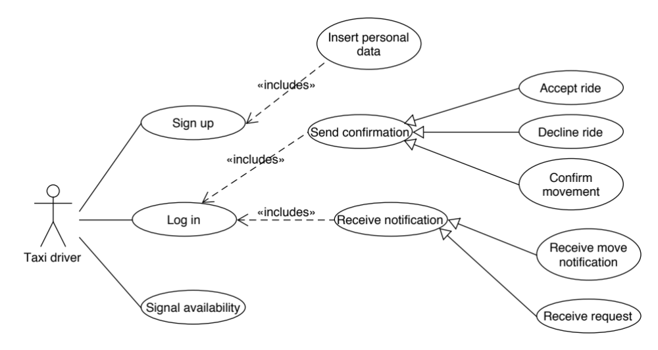
Taxi driver use cases overview

Slide 18
Request for service use case
Name | Request for service
Actors | Passenger Taxi driver
Entry Conditions | Passenger is logged into the system The system is showing user’s home page.

Slide 19
Request for service use case
Flow Of Events | The passenger taps the Call a taxi now button; The passenger inserts a destination address, the number of passengers, and if needed the starting address; The passenger confirms the request; The system receives the request; The system checks the taxi queue of the appropriate city zone and alerts the first taxi driver; The alerted taxi driver accepts the request and drives to the given address; The system informs the passenger that all went well and gives him the estimated time of arrival.

Slide 20
Request for service use case
Exit Conditions | A taxi driver accepts the request for service.
Exceptions | If the notified taxi driver declines, the system chooses the following in queue; If the request cannot be met for whatever reason, the system notifies the passenger.

Slide 21
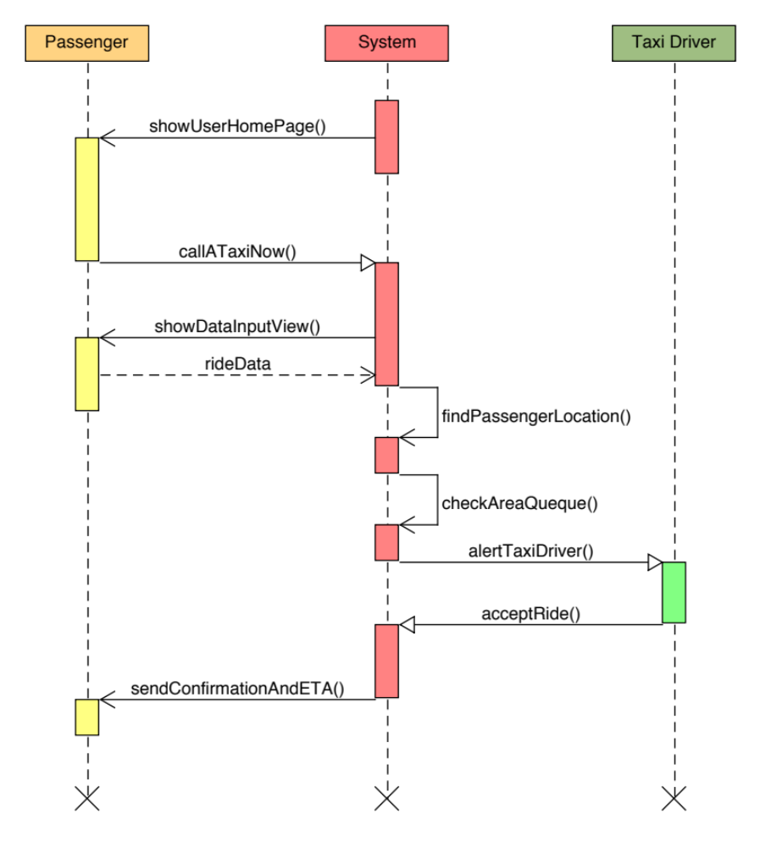

Slide 22
Modify reservation use case
Name | Modify Reservation
Actors | Passenger
Entry Conditions | Passenger is logged into the system The system is showing user’s home page

Slide 23
Modify reservation use case
Flow Of Events | The passenger clicks on the Reservation history button; The system shows him all his reservations; The user clicks on the reservation he wants to modify; The system shows him a pop up window with two options: Modify or Delete; The user clicks on the Modify button;

Slide 24
Modify reservation use case
Flow Of Events | The system shows him a form to be filled with all trip information (starting address, destination address, leaving date and time, number of passengers); The user adds all information and clicks on the Confirm button; The system checks the information, analyses the request and confirms with a message; The system generates a real time request at the right moment to satisfy user reservation.

Slide 25
Modify reservation use case
Exit Conditions | The reservation is correctly modified and stored.
Exceptions | If there is no reservation in the history, the system shows an error message; If it is too late to modify the reservation (less then two hours before the ride), the system shows an error message; If the information is wrong the system asks to rewrite it; If the reservation can’t be satisfied the system shows an error message.

Slide 26
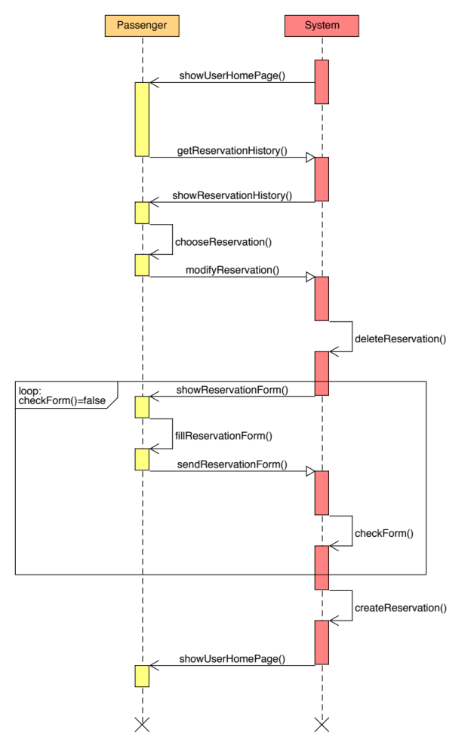

Slide 27
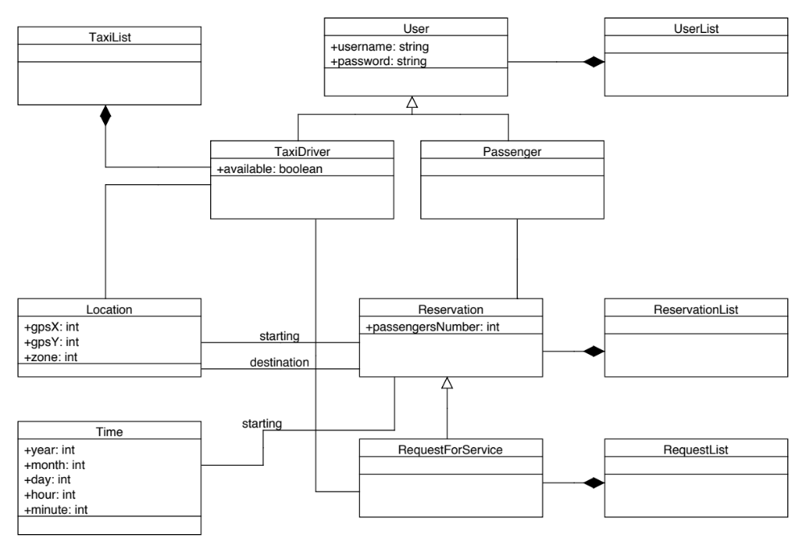
Class diagram

Slide 28
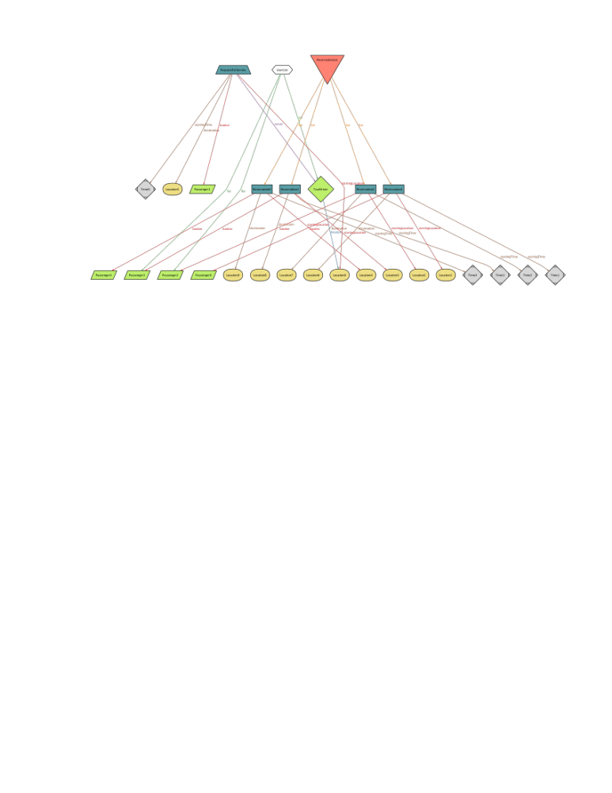
Alloy World

