Slide 1
Design Document
Architecture of the My Taxi Service project

Slide 2
Document goals
Describe the system in terms of:
  Architectural choices
  Design decisions
  Interactions between components
  User interaction
  Sample algorithms

Slide 3
Definitions
Passenger: Registered user that calls taxis
Logged passenger: A Passenger logged into the system
Taxi driver: Registered user that drives taxis
Logged taxi driver: A Taxi driver logged into the system
Request for service: Formal request for a ride (incl. location, time)
Real time request: Request for service to be served as soon as arrives
Reservation: Request for service deferred for another time

Slide 4
Architectural design
Following a top-down approach
Standard four-tiered architecture
High level components
  Client
    GUI, GPS, Messenger module
  Web
    Central messenger module
  Business
    All real application logic
  Data
    Passengers, taxis, requests and city zones databases

Slide 5
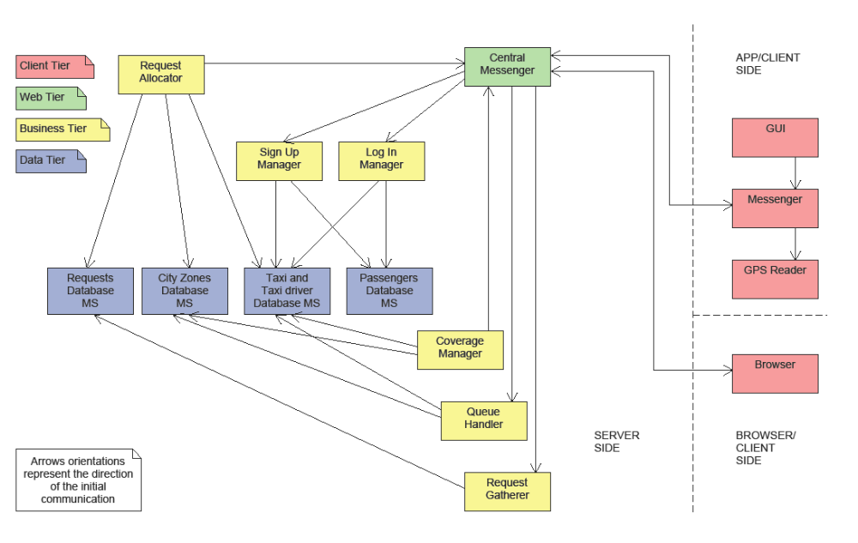
Architectural design - Components

Slide 6
Architectural design - Modules
Each high level component is divided in low level modules
Each module has a very specific task
Example: the Coverage manager component
  Analysis module: Performs coverage checks
  Data module: Interfaces with the related DB and extracts data
  Communication module: Forwards move orders to Taxi drivers via Central messenger
No time to examine them all here
  See related Design Document

Slide 7
Architectural design - Deployment
Deployment in two artifacts
Server artifact
  Operates on a cluster of servers
  Made of Web and Business tiers components
  Interfaces with Data tier databases
Client artifact
  My Taxi Service mobile app on client’s smartphone
  Made of Client tier components

Slide 8
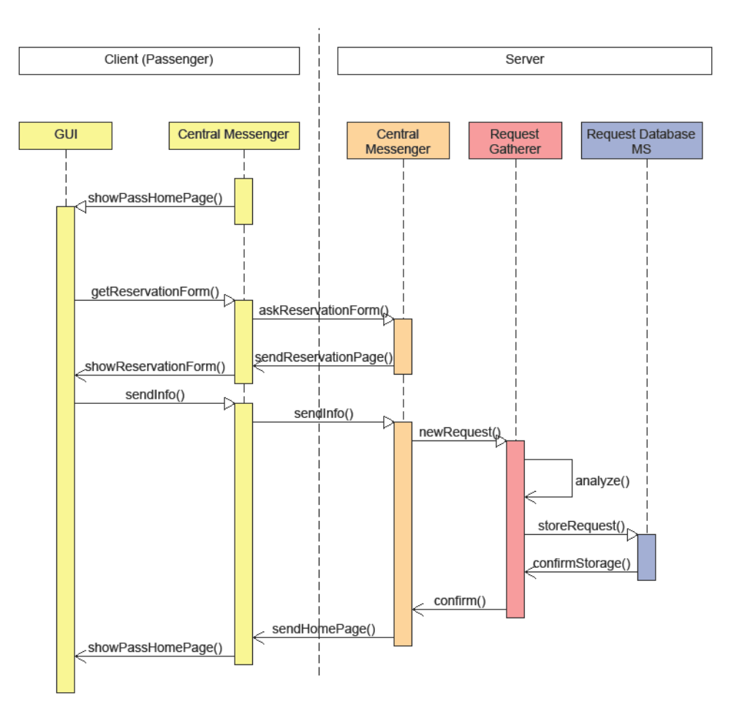
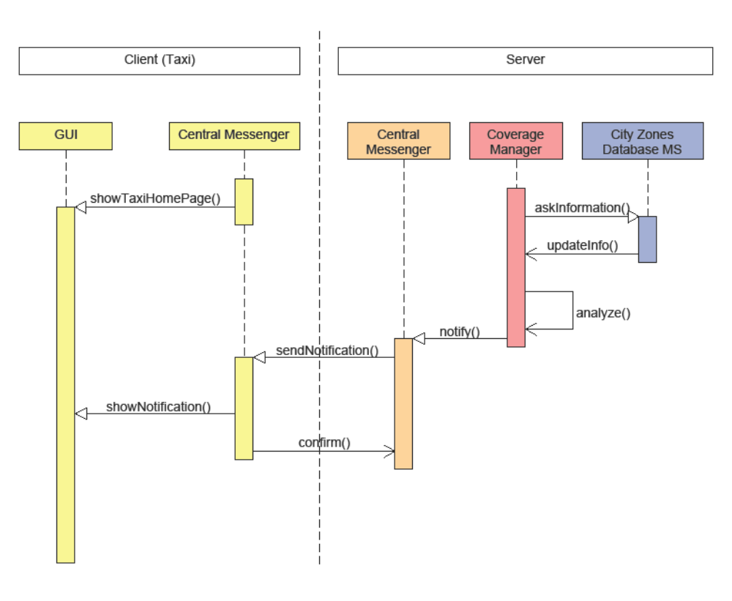
Architectural design - Runtime
New reservation
Coverage updates

Slide 9
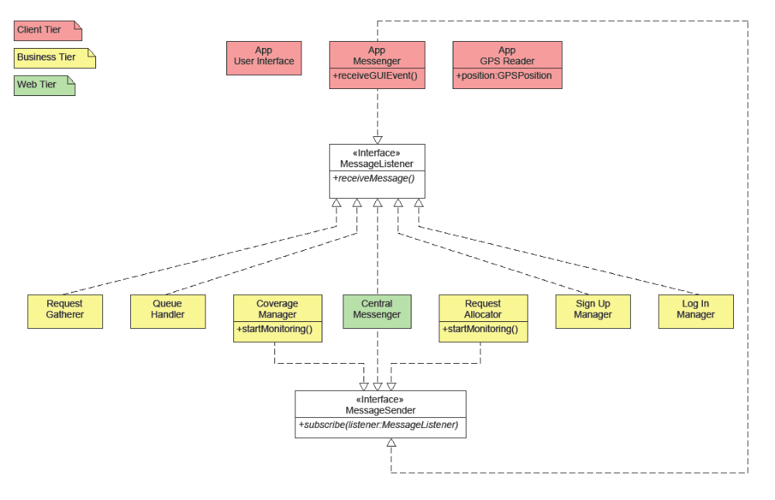
Architectural design - Interfaces

Slide 10
Architectural design - Patterns
Problem solution intrinsically client-server
  Fat server, thin client
Event-based message distribution among components
Fully modular structure allows for easy extensions

Slide 11
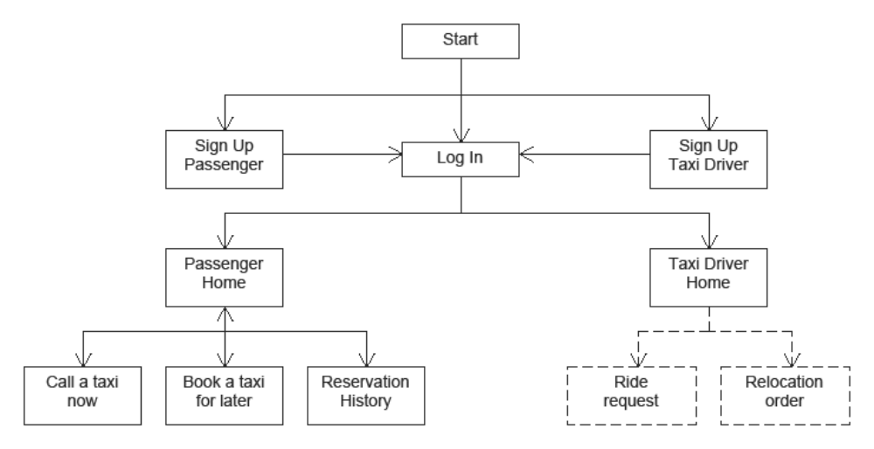
User interface design

Slide 12
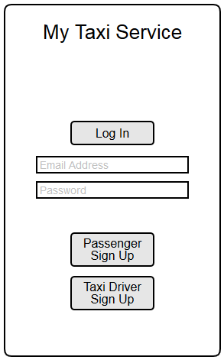
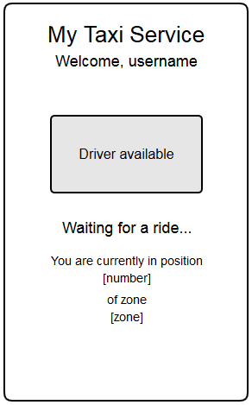
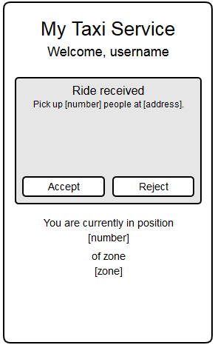
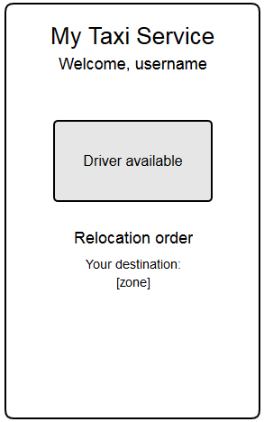
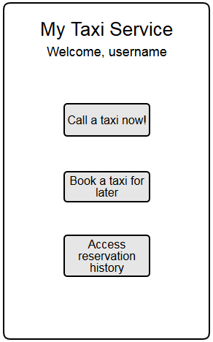
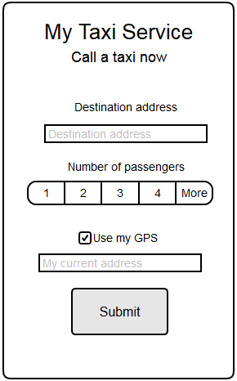
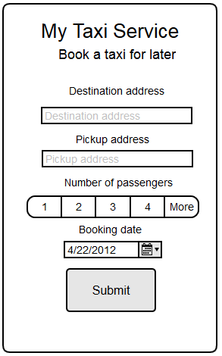
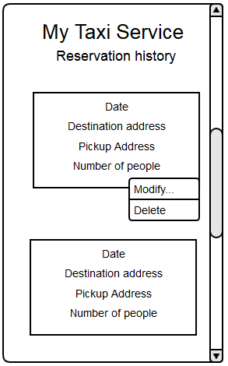
User interface design

Slide 13
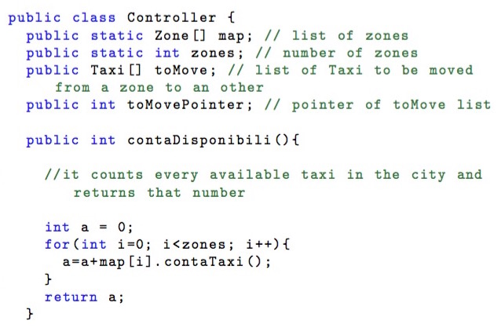
Algorithm design

Slide 14
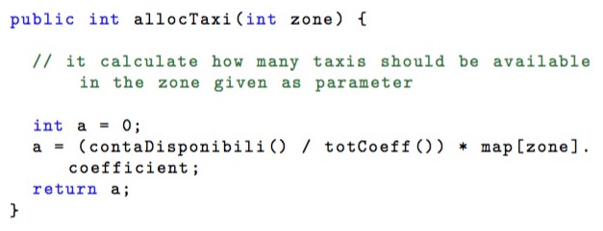
Algorithm design

Slide 15
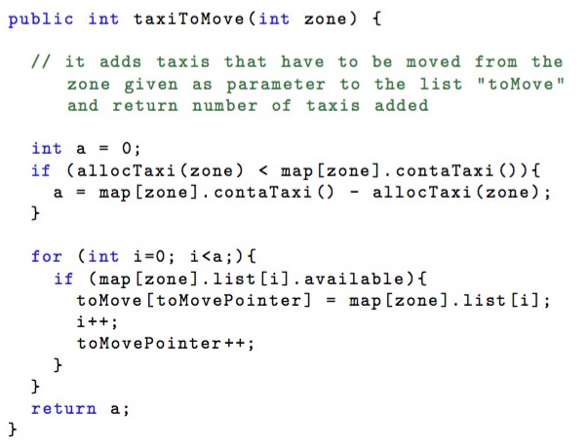
Algorithm design

Slide 16
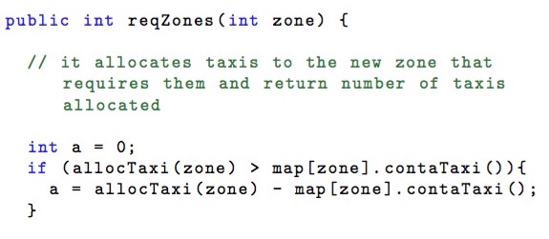
Algorithm design

Slide 17
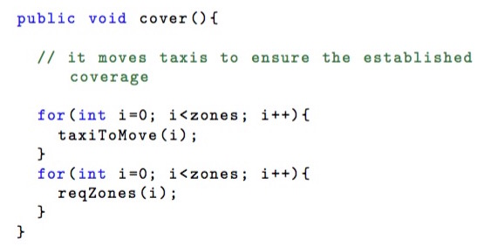
Algorithm design

Slide 18
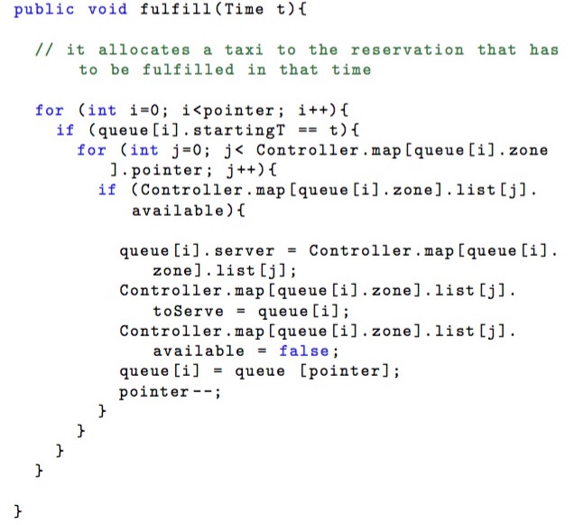
Algorithm design

Slide 19
Requirements traceability

