Slide 1
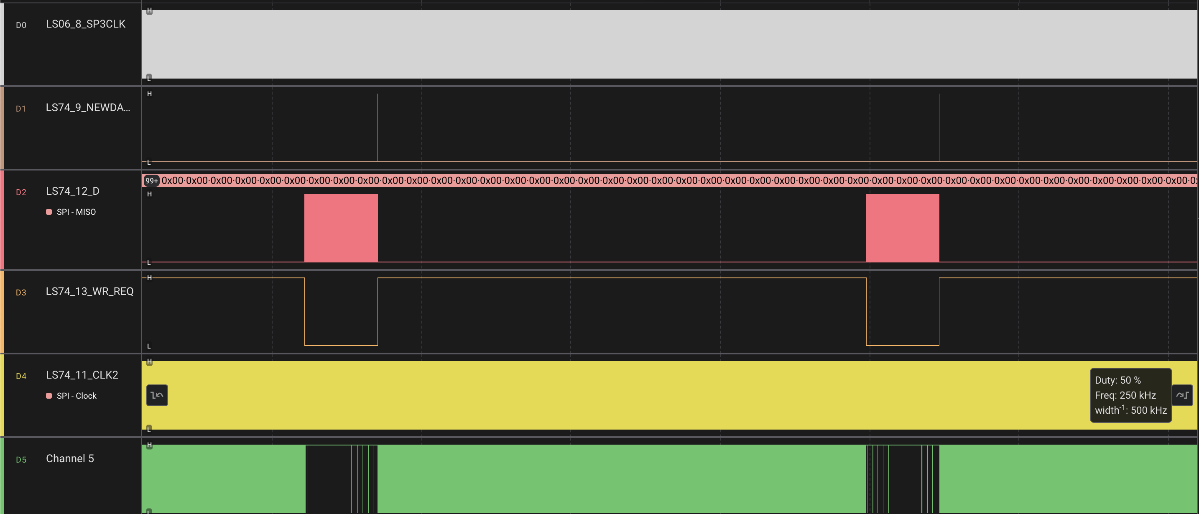
WRITE ZONE

Slide 2
DMA CIRCULAR RDDATA BUFFER
DESTINATION
Of WRDATA
B
A
WRDATA
C
D
DMA CIRCULAR WRDATA BUFFER

Slide 3
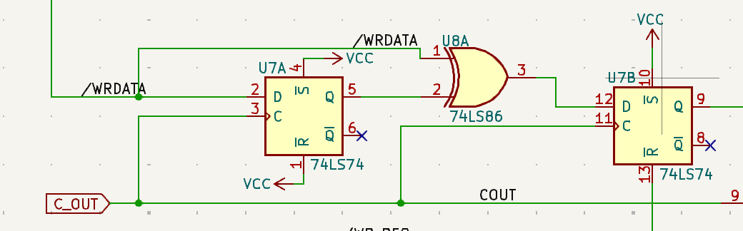

Slide 4
Case A1: RX_E > RX_S && TX_E > TX_S
DMA_RX
RX_S
RX_E
Case B2_1: RX_E < RX_S && TX_E < TX_S
end_tx_len=DMABSIZE-TX_E
P1=memcpy(DMA_TX+TX_S,DMA_RX+RX_S, end_tx_len)
Rx_offset=RX_S+ , end_tx_len
P2=memcpy(DMA_TX,DMA_RX+RX_offset,DMABSIZE-rx_offset)
Tx_offset=DMABSIZE-rx_offset
P3=memcpy(DMA_TX+tx_ofset,DMA_RX,RX_E)
RX
RX_E
RX_S
A
0
P1
DMABSIZE
P1=memcpy(DMA_TX+TX_S,DMA_RX+RS_S,RX_LEN)
DMA_TX
TX_S
TX_E
0
P3
P1
P2
DMABSIZE
TX
0
P1
DMABSIZE
A
TX_E
TX_S
end_tx_len
Case A2: RX_E>RX_S && TX_E < TX_S
0
P2
P3
P1
DMABSIZE
RX
RX_S
end_tx_len
A
RX_E
end_tx_len=DMABSIZE-TX_S
P1=memcpy(DMA_TX+TX_S,DMA_RX+RX_S, end_tx_len)
P2=memcpy(DMA_TX,DMA_RX+end_tx_len, TX_S)
0
P1
P2
DMABSIZE
Case B2_2: RX_E < RX_S && TX_E < TX_S
TX
TX_E
TX_S
RX
A
RX_E
RX_S
end_rx_len
end_tx_len
P2
P1
0
P1
DMABSIZE
0
DMABSIZE
P2
P3
TX
TX_E
TX_S
A
Case B1: RX_E < RX_S && TX_E < TX_S
0
P3
P1
P2
DMABSIZE
RX
RX_E
RX_S
end_rx_len
0
P2
P1
DMABSIZE
TX
end_rx_len=DMABSIZE-RX_S
P1=memcpy(DMA_TX+TX_S,DMA_RX+RX_E, end_rx_len)
P2=memcpy(DMA_TX+TX_S+end_rx_len,DMA_RX, RX_E)
end_rx_len=DMABSIZE-RX_S
P1=memcpy(DMA_TX+TX_S,DMA_RX+RX_S, end_rx_len)
Tx_offset=DMA_TX+TX_S+end_rx_len
P2=memcpy(DMA_TX+tx_offset,DMA_RX,DMABSIZE-tx_offset)
Rx_offset=DMABSIZE-tx_offset
P3=memcpy(DMA_TX,DMA_RX+Rx_offset,RX_E)
TX_S
end_rx_len
A
TX_E
0
P1
P2
DMABSIZE

