Slide 1
PFE · USTHB · 2025-2026
ErcTrack
IoT-Based Telecom Equipment Tracking & Management System
Supervisors: Dr. F.Z. Bellala · Dr. M. Bouchair
Jury: Dr. F.Z. Bellala · Mr. I. Khennak
TEAM
Reghiwi Abderrahim
Zadi Abderrouf
Guellil Souheil
Dellal Younes
Guerguadj M. Nazim
AI + Chef
Web Admin
Mobile App
Backend
IoT

Slide 2
CONTEXT
Reghiwi Abderrahim
Problem Statement
📍
📋
No Real-Time Tracking
Manual Handover
Equipment disappears after warehouse
No digital delivery confirmation
📄
📷
Inconsistent Reports
No Image Validation
No standard format
Bad photos accepted

Slide 3
SOLUTION
Reghiwi Abderrahim
ErcTrack — 4 Pillars
01
02
03
04
Live Tracking
Accountability
Smart Reports
Central Control
GPS from warehouse to site
Dual QR scan per delivery
AI-validated field photos
One dashboard for all ops

Slide 4
ARCHITECTURE
Reghiwi Abderrahim
System Architecture
📱 Mobile App
BACKEND
React Native
Driver + Tech
REST + WS
⚡ IoT Module
Node.js · Express
PostgreSQL · Socket.IO
JWT · TypeScript
ESP32 + NEO-6M
HiveMQ MQTT
~1.4s latency
MQTT
🌐 Web Admin
REST + WS
React 19 + Vite
Leaflet · Socket.IO
🤖 AI Service
Python · CLIP · OpenCV

Slide 5
IOT LAYER
Guerguadj Mohamed Nazim
IoT Module — ESP32 + NEO-6M GPS
Hardware
Data Flow
Microcontroller
ESP32 (Wi-Fi + Bluetooth)
1
GPS reads coords
GPS Module
NEO-6M via UART
2
MQTT Publish
MQTT Broker
HiveMQ Cloud
3
HiveMQ routes
Publish Rate
Every 10 seconds
4
Backend subscribes
E2E Latency
~1.4 seconds
5
Socket.IO → Dashboard

Slide 6
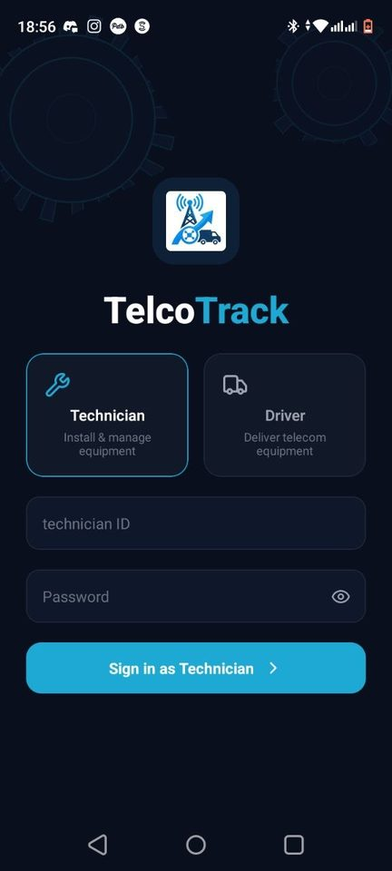
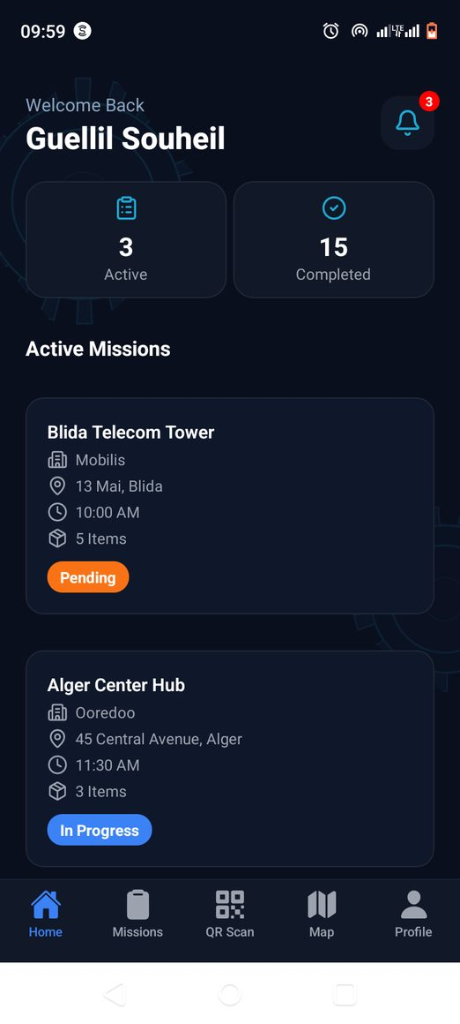
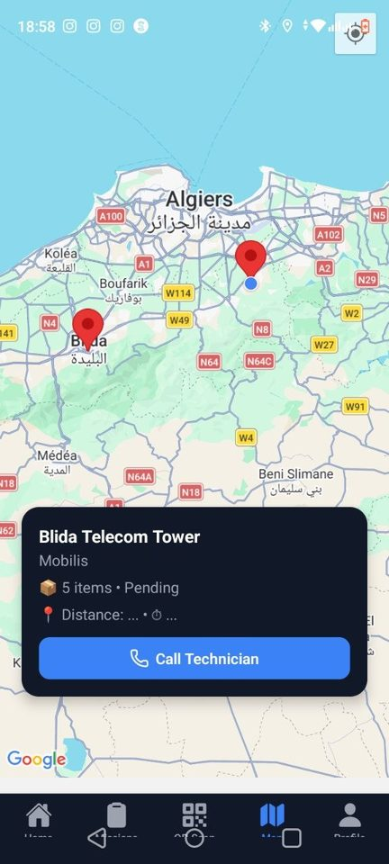
MOBILE APPLICATION
Guellil Souheil
Mobile App — React Native (Expo)
Driver
QR scan → Start delivery
GPS route tracking
Push notifications
Technician
QR scan → Confirm reception
Submit field report
Upload AI-validated photos
Expo SDK · Firebase FCM · Leaflet Maps
Login
Dashboard
GPS Map

Slide 7
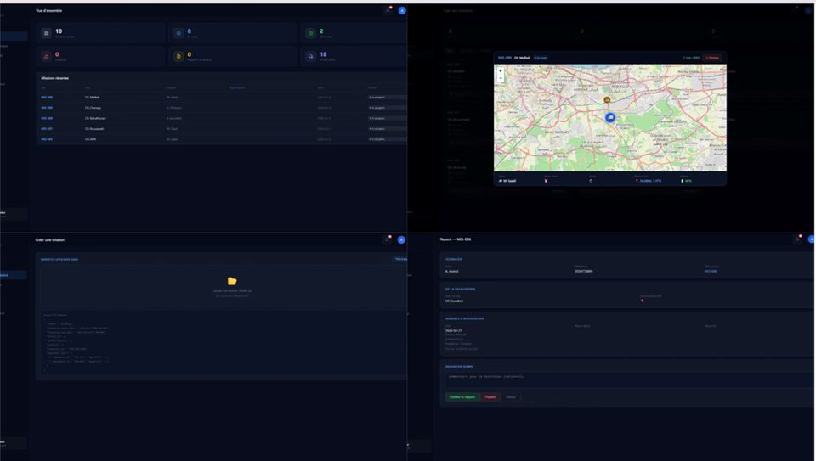
WEB ADMIN
Zadi Abderrouf
Web Admin Dashboard — React 19 + Vite
Key Features
📊
🗺️
KPIs
Live GPS Map
📋
📄
Missions
Reports
👥
🔔
Team Mgmt
Notifications
Live Web Dashboard
React 19 · Vite 8 · Leaflet.js · Socket.IO

Slide 8
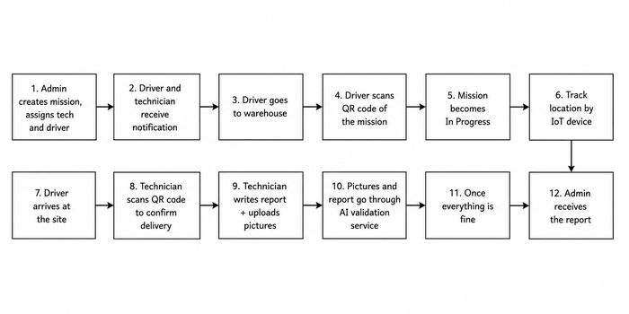
REAL-TIME TRACKING
Guellil Souheil
Real-Time GPS — End-to-End Flow
📡
☁️
🖥️
📡
🗺️
ESP32
NEO-6M
HiveMQ
Broker
Backend
Node.js
Socket.IO
WS
Leaflet
Map
End-to-End: ~1.4 seconds
COMPLETE MISSION WORKFLOW

Slide 9
DELIVERY VERIFICATION
Guellil Souheil
Dual QR Code Verification
Two independent scans create an immutable delivery record.
STEP 1
STEP 2
Driver Scan
Technician Confirm
Scans QR at warehouse departure
Scans QR at installation site
Records timestamp + GPS
Blocked if driver not scanned
Mission → "In Delivery"
Delivery confirmed + signed
THEN
Technician receives notification
Mission → "Delivered"

Slide 10
AI VALIDATION
Reghiwi Abderrahim
AI Image Validation — CLIP + OpenCV
Python microservice validates every photo before storage in Cloudinary.
01
02
03
🔍
☀️
🤖
Blur Detection
Brightness Check
Content Relevance
Laplacian Variance (OpenCV)
HSV Analysis (OpenCV)
CLIP Model (OpenAI)
If fails → REJECTED
If fails → REJECTED
If fails → REJECTED
VALID → Upload Cloudinary CDN
INVALID → Rejected + User notified

Slide 11
BACKEND
Dellal Younes
Backend & Infrastructure
Tech Stack
Cloud Services
Runtime
Node.js
📨 HiveMQ Cloud
MQTT Broker for IoT GPS
Framework
Express.js
📁 Cloudinary
Language
TypeScript
Image CDN storage
🔔 Firebase FCM
Database
PostgreSQL
Mobile push notifications
WebSocket
Socket.IO v4
🤖 AI Microservice
Python CLIP + OpenCV
Auth
JWT · bcrypt 12
📋 JSON Import
Bulk mission creation

Slide 12
SECURITY
Dellal Younes
Security — JWT + bcrypt + RBAC
🔑
🔒
👤
JWT Auth
bcrypt Hash
RBAC
HS256 signed tokens
Cost factor: 12
Admin — Full access
7-day expiry
Random salt per user
Technician — Reports
PrivateRoute guard
Rainbow-table proof
Driver — Missions + GPS

Slide 13
TECHNOLOGY
Reghiwi Abderrahim
Technology Stack
COMPONENT
TECHNOLOGY
📱 Mobile
React Native (Expo)
🌐 Web Admin
React 19 + Vite 8
🔧 Backend
Node.js + Express + TypeScript
🗄️ Database
PostgreSQL + Sequelize ORM
⚡ IoT
ESP32 + NEO-6M + HiveMQ MQTT
🤖 AI
Python + CLIP + OpenCV
☁️ Cloud
Cloudinary + Firebase FCM
🔐 Auth
JWT (HS256) + bcrypt (cost 12)

Slide 14
RESULTS
Reghiwi Abderrahim
Achievements & Results
5
<1.5s
99%
$0
Integrated
Components
GPS Latency
End-to-End
Uptime
Target
Cloud
Deployment
KEY ACHIEVEMENTS
✅ Full integration
5 components — IoT · Mobile · Web · Backend · AI
📱 Multi-role mobile
Android 8.0+ and iOS 13+
🤖 AI photo validation
Automated quality check — no manual review
☁️ Zero-cost deployment
HiveMQ · Cloudinary · Firebase · PostgreSQL (free)
⚡ < 1.5s GPS latency
Measured end-to-end from ESP32 to dashboard

Slide 15
Reghiwi Abderrahim
Project Summary
Future Work
Integrated IoT–Mobile–Web system
Physical ESP32 hardware
GPS tracking < 1.5s latency
Deep learning blur detection
Dual QR — full traceability
Offline-first mobile (SQLite)
AI photo validation
Predictive analytics
Zero-cost cloud deployment
ErcTrack — Thank You
Supervisors: Dr. F.Z. Bellala · Dr. M. Bouchair · Jury: Dr. F.Z. Bellala · Mr. I. Khennak
Reghiwi A.
Zadi A.
Guellil S.
Dellal Y.
Guerguadj M.N.

