Slide 1

Xadama Amusement Park
José Aldeguer Sastre
Mar Bonora Ortega
Andrés Cánovas Cutillas
Andrea Díaz Contra
Diego García Cutillas
Álvaro Martin Resel

Slide 2
Xadama
Home
About
Sign In
Zones
Hotels
Promos
Shop
Services
Tickets
Assistant

Slide 3
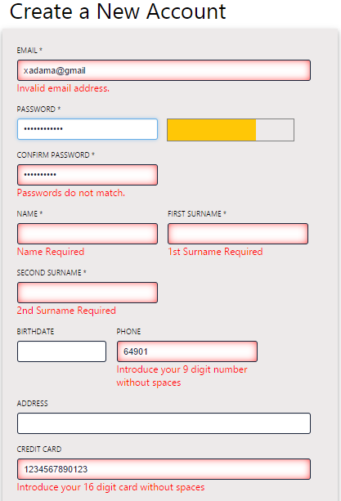
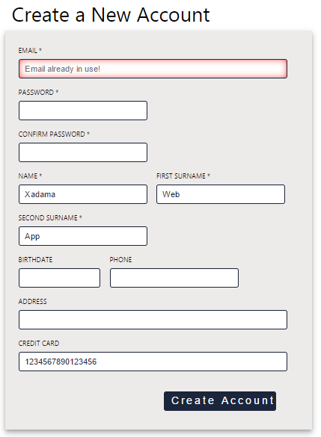
Xadama Sign in

Slide 4
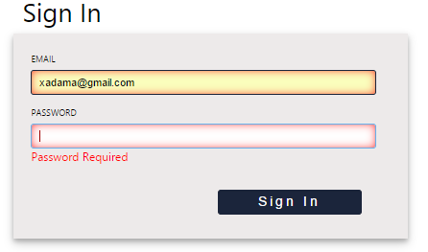
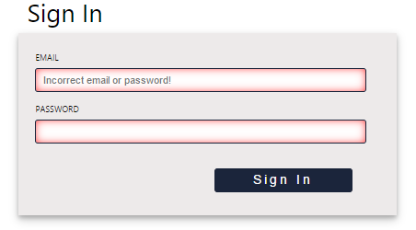
Xadama Sign in

Slide 5
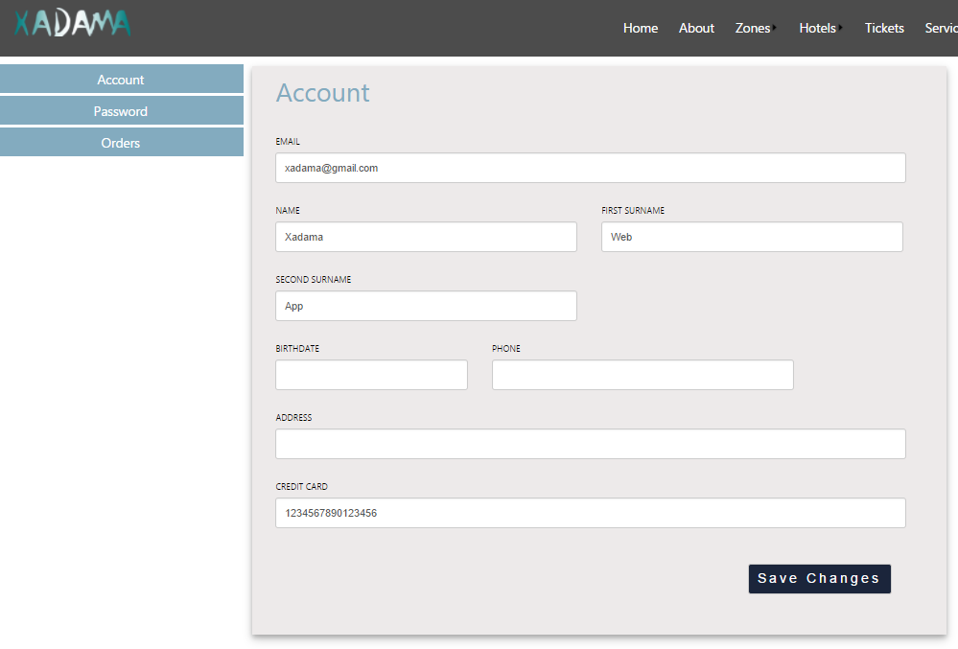
Xadama Sign in

Slide 6
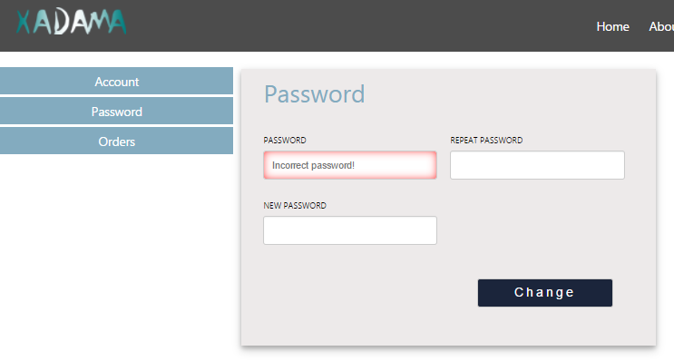
Xadama Sign in

Slide 7
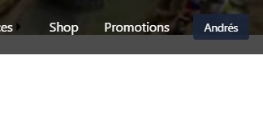
Xadama Login

Slide 8
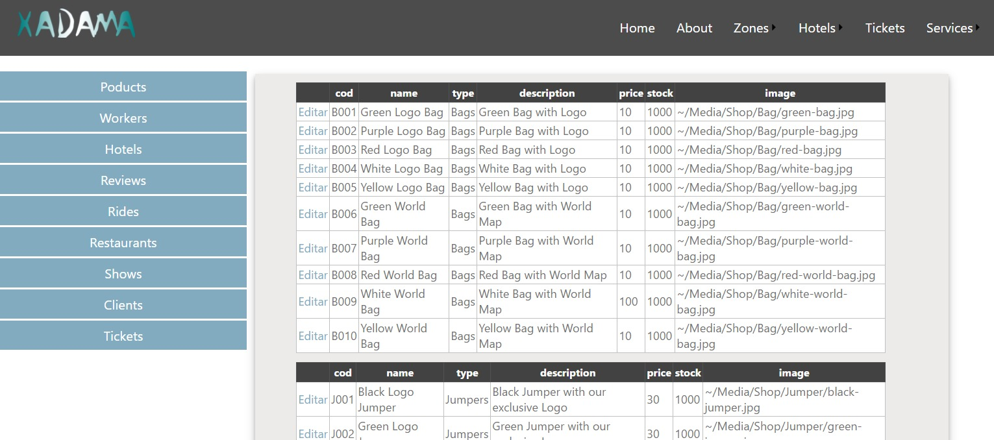
Xadama Admin

Slide 9
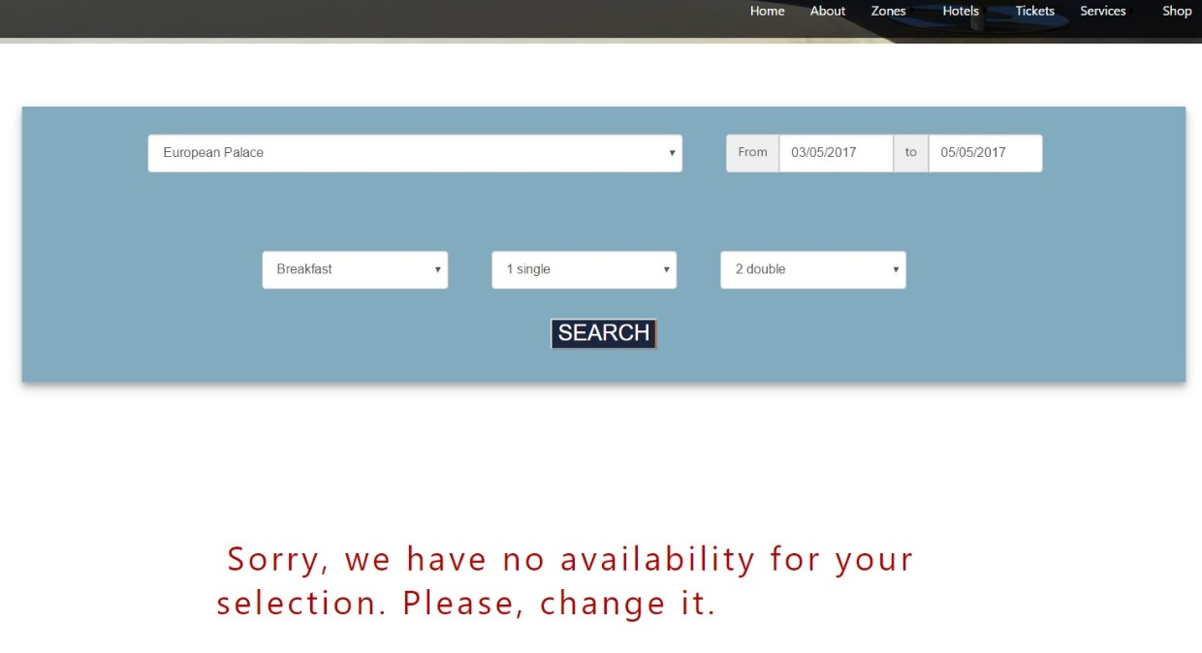
Xadama Book Hotel

Slide 10
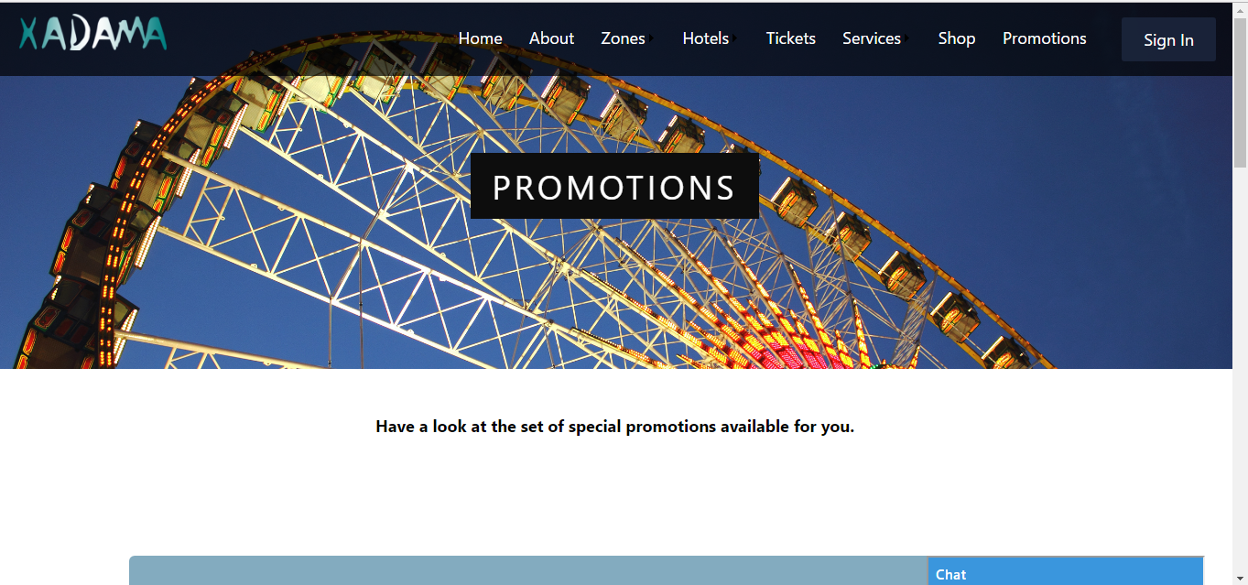
Xadama Promotions

Slide 11
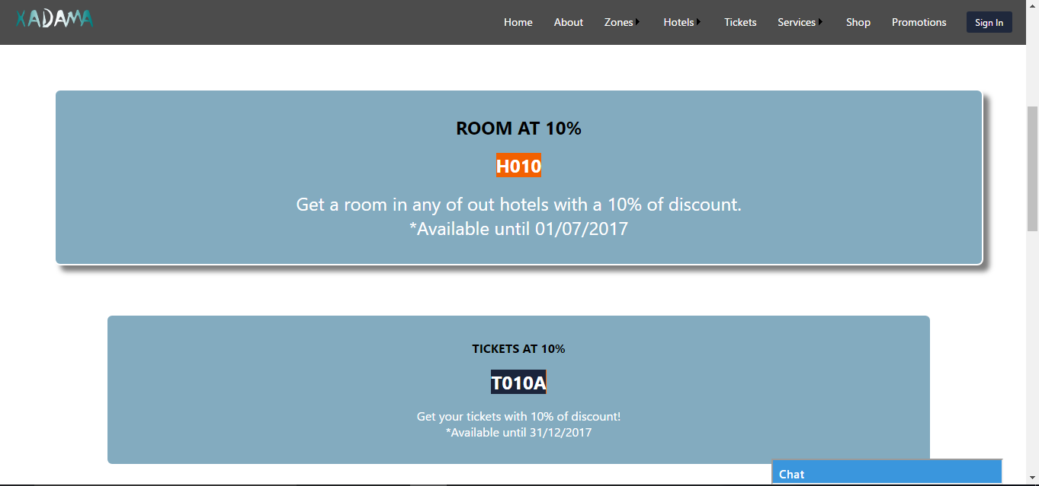
Xadama Promotions

Slide 12
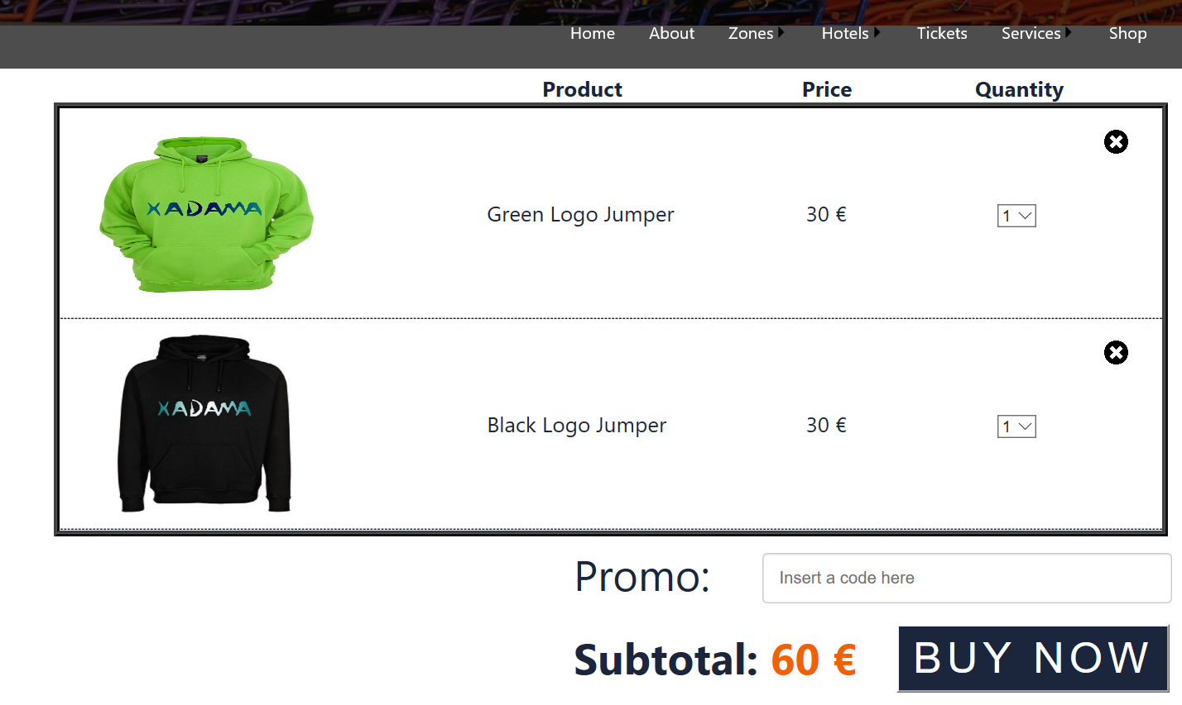
Xadama Shop

Slide 13
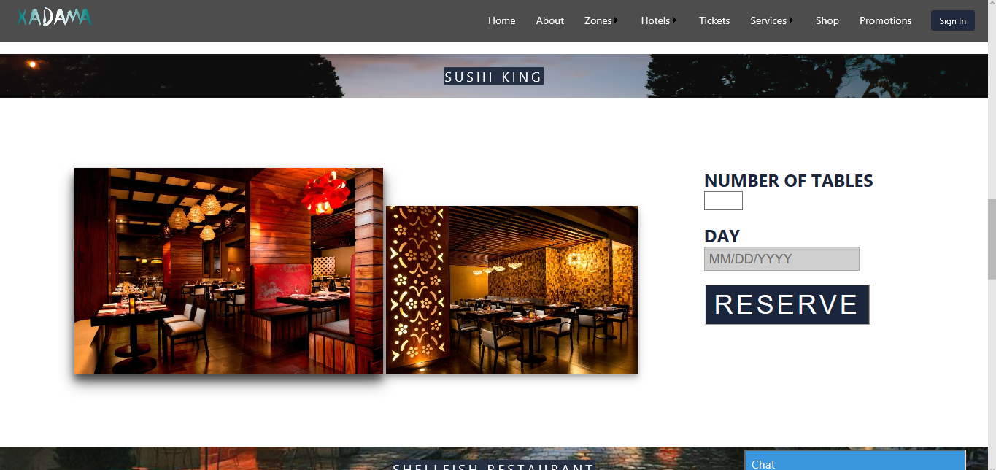
Xadama Services
Book Restaurant

Slide 14
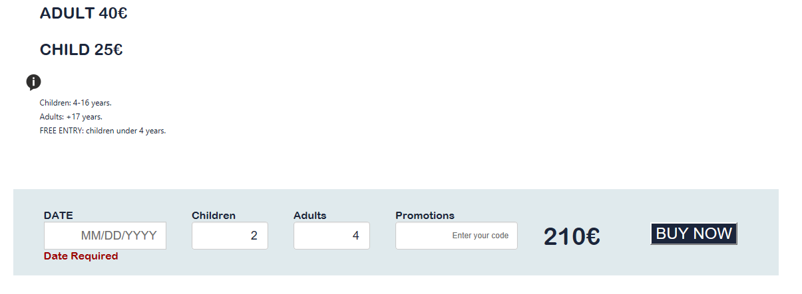
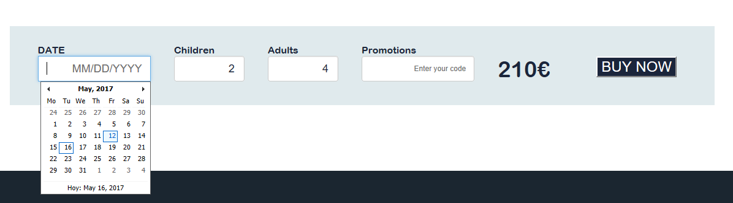
Xadama Tickets

