Slide 1
CMP 655 Wireless Networks
Project Proposal
Security Tests / Pentests on IoT Device(s)
Refik Can Öztaş

Slide 2
For CMP 655 Wireless Networks final project, I will be conducting active security tests on at least one IoT device. These security tests will be the IoT Penetration Test.

Slide 3
Definitions
Pentesting / Security testing:
Penetration testing, often abbreviated as "pen testing," is a cybersecurity practice used to assess the security of computer systems, networks, applications, and other digital assets. The primary goal of penetration testing is to identify vulnerabilities and weaknesses in these systems before malicious hackers or cybercriminals can exploit them.

Slide 4
IoT pentesting / security testing:
IoT (Internet of Things) penetration testing, also known as IoT security testing or IoT vulnerability assessment, is a specialized form of penetration testing focused on assessing the security of IoT devices and the ecosystems they are a part of. IoT devices are everyday objects, such as smart thermostats, security cameras, and wearable technology, that are connected to the internet and often collect and transmit data. Because of their unique characteristics, IoT devices present a set of security challenges that require specialized testing.

Slide 5
Methodology
In a full IoT security test, pentest is conducted to every component of the device. Those are:
Network
Web (Front & Backend and Web services)
Mobile App (Android & iOS)
Wireless Connectivity (Zigbee, WiFi, Bluetooth, etc)
Firmware Pentesting (OS of IoT Devices)
Hardware Hacking & Fault Injections & SCA Attacks
Storage Medium
I/O Ports
Although in this proposal and in the project every component will be explained and will be checked for security weaknesses, since this lecture’s main concepts are wireless networks and network connections, those areas will be covered in more detail.

Slide 6
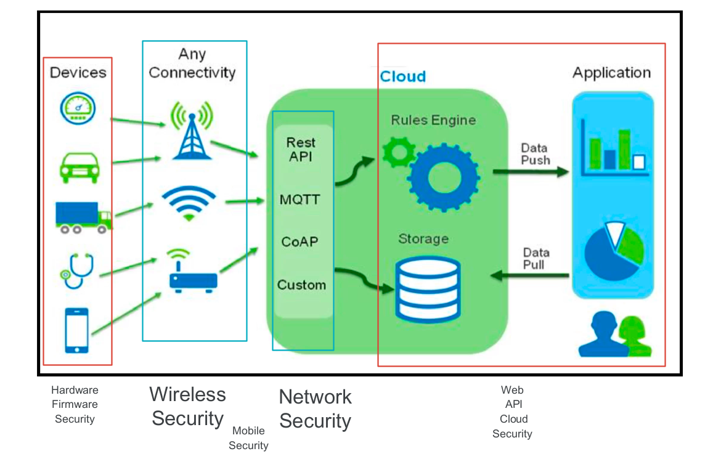

Slide 7
Network Penetration Testing:
Network Penetration Testing:
- Device Enumeration: Identify all IoT devices by analyzing network traffic, network scans, and device fingerprinting.
- Port Scanning: Discover open ports and services on IoT devices, potentially revealing entry points.
- Vulnerability Scanning: Assess vulnerabilities in IoT devices by conducting exhaustive testing.
- Traffic Analysis: Capture network traffic to understand communication patterns and data flows between devices.

Slide 8
Network Penetration Testing:
1. TCP/IP (Internet Protocol) Communication:
- Analyze the communication between IoT devices and backend servers using TCP/IP.
- Check for vulnerabilities in network protocols, like misconfigurations in the use of TCP/IP.
- Test for open ports and assess the security of the network perimeter.
2. HTTP/HTTPS (Web Communication):
- Assess web traffic between IoT devices and web applications.
- Examine the HTTP/HTTPS traffic for potential vulnerabilities such as data leakage, improper request validation, and missing security headers.
- Test for web services and API vulnerabilities in the communication process.

Slide 9
Network Penetration Testing:
3. MQTT (Message Queuing Telemetry Transport):
- Analyze MQTT traffic for potential security issues.
- Test for weak authentication and authorization mechanisms in MQTT.
- Check for misconfigured MQTT brokers, such as public access to sensitive data.
4. CoAP (Constrained Application Protocol):
- Assess CoAP communication for vulnerabilities, such as unprotected endpoints and resource enumeration.
- Check for security flaws in CoAP message exchange, including potential denial-of-service (DoS) vulnerabilities.
5. AMQP (Advanced Message Queuing Protocol):
- Examine AMQP communication for message queuing vulnerabilities.
- Test for issues in message routing and access controls within AMQP brokers.
- Analyze potential data leakage during message transmission.

Slide 10
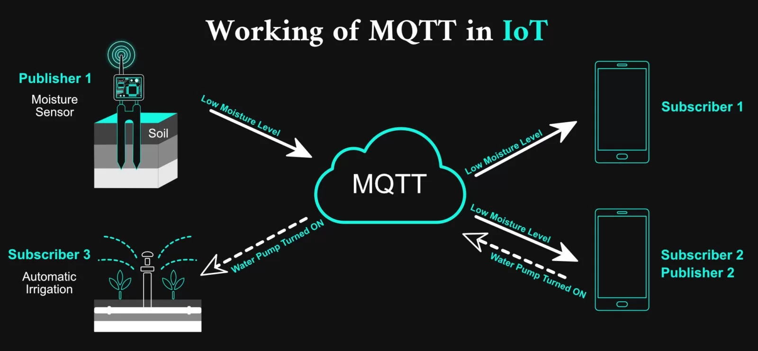
Notes:
client sends packet to mqtt broker
client can subscribe to traffics
when broker receives a messages unicasts to subscribers

Slide 11
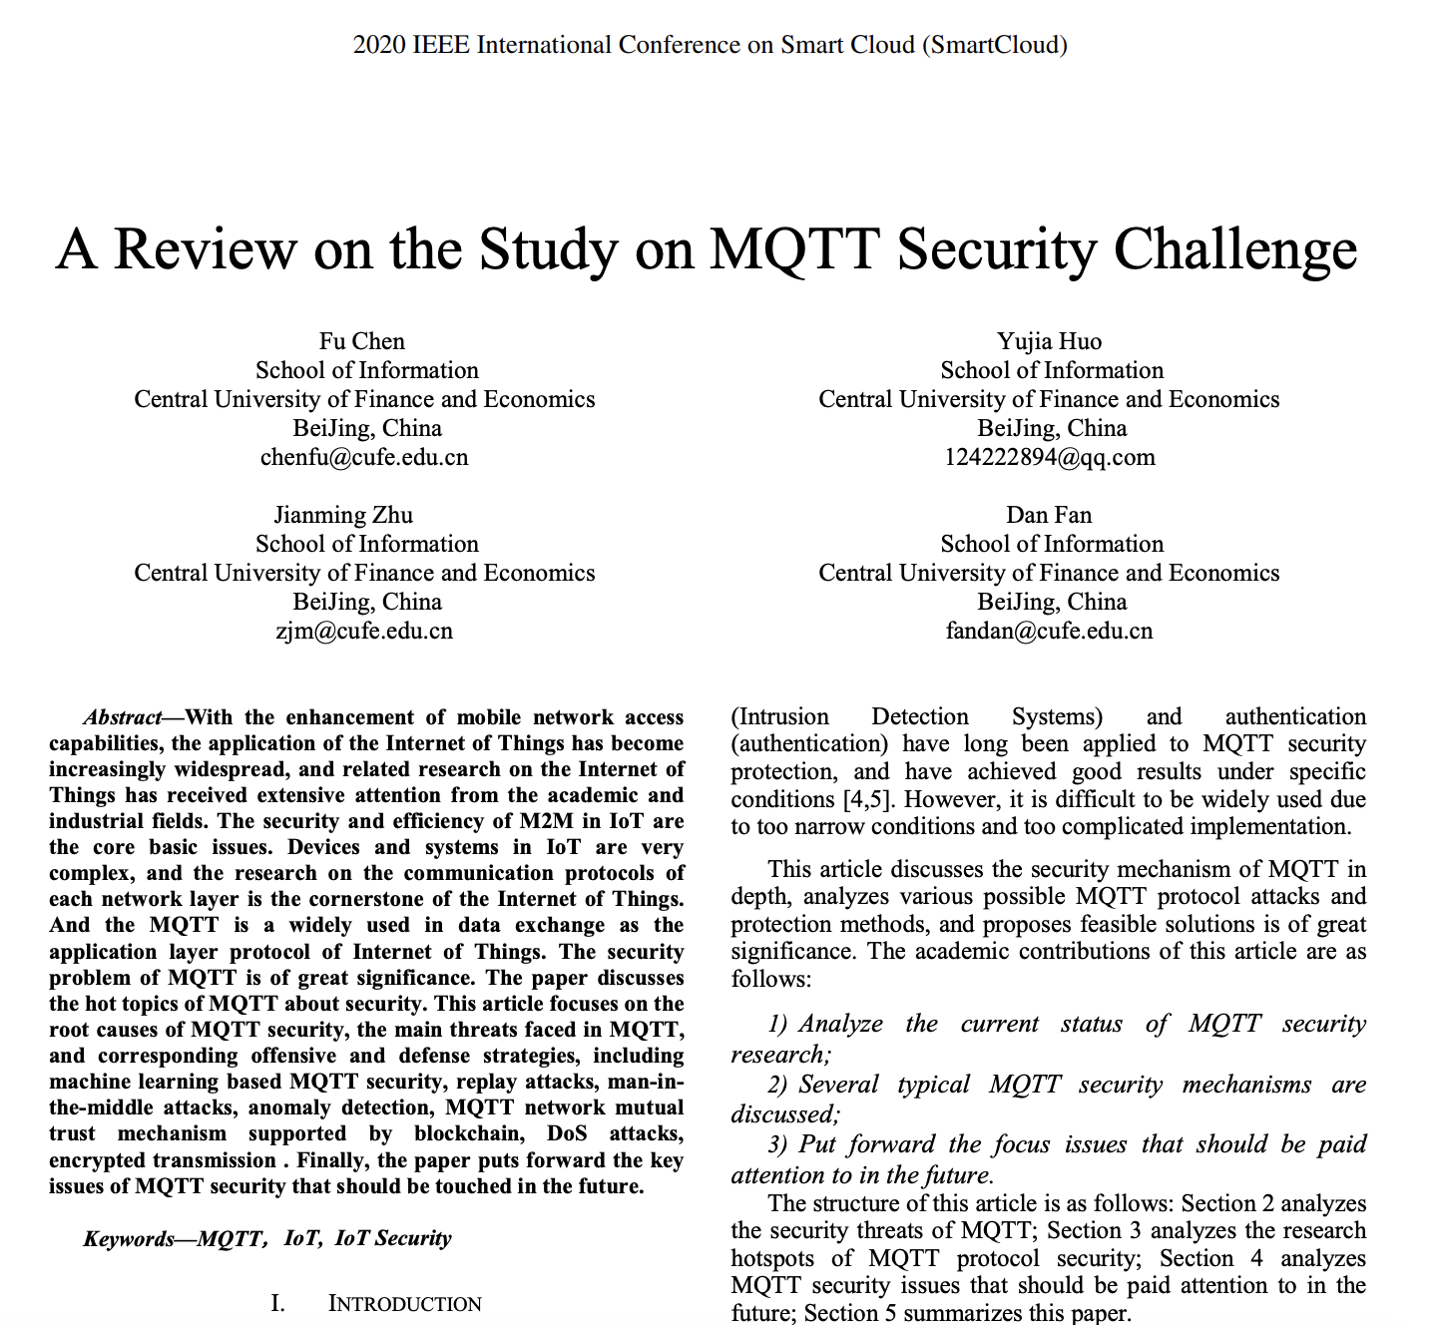

Slide 12
Wireless Connectivity Testing (Zigbee, WiFi, Bluetooth, etc.):
- Protocol Analysis: Capture and analyze wireless communication packets to understand data transmission and protocol vulnerabilities.
- Brute-Force and Sniffing: Attempt to crack wireless keys through brute-force attacks or sniff communication for sensitive data capture.
- Fuzzing: Inject unexpected data into wireless communication channels to assess device responses and security resilience.
For each of those communication protocols, penetration testing should focus on identifying weaknesses, analyzing encryption mechanisms, and assessing the strength of authentication and access controls. The goal is to ensure that data transmitted over these protocols is secure and that devices are protected from common network and wireless vulnerabilities.

Slide 13
Wireless Connectivity Testing (Zigbee, WiFi, Bluetooth, etc.):
Wireless Connectivity Testing (Zigbee, WiFi, Bluetooth, etc.):
- Protocol Analysis: Capture and analyze wireless communication packets to understand data transmission and protocol vulnerabilities.
- Brute-Force and Sniffing: Attempt to crack wireless keys through brute-force attacks or sniff communication for sensitive data capture.
- Fuzzing: Inject unexpected data into wireless communication channels to assess device responses and security resilience.
For each of those communication protocols, penetration testing should focus on identifying weaknesses, analyzing encryption mechanisms, and assessing the strength of authentication and access controls. The goal is to ensure that data transmitted over these protocols is secure and that devices are protected from common network and wireless vulnerabilities.
1. WiFi (802.11 Protocols):
- Analyze WiFi networks for vulnerabilities, such as weak encryption (e.g., WEP), and crack WPA/WPA2 keys through brute-force or dictionary attacks.
- Conduct rogue access point detection and test for open networks or weak password policies.
- Assess the strength of the wireless encryption mechanisms used by IoT devices.
2. Bluetooth (Classic and Low Energy):
- Analyze Bluetooth communication for security weaknesses, like unauthorized device pairing.
- Test for common vulnerabilities, such as BlueBorne, which could enable remote code execution.
- Assess Bluetooth security modes and encryption strength.

Slide 14
Wireless Connectivity Testing (Zigbee, WiFi, Bluetooth, etc.):
3. Zigbee:
- Investigate Zigbee communication for vulnerabilities in key exchange protocols.
- Check for the presence of insecure default keys or vulnerabilities in the Zigbee stack.
- Analyze potential weaknesses in the network layer and application profiles.
4. NFC (Near Field Communication):
- Test NFC communication for potential data leakage, eavesdropping, or unauthorized access.
- Assess the risk of relay attacks or man-in-the-middle (MITM) attacks during NFC communication.
- Examine NFC security features, such as secure element usage.
5. LoRa (Long-Range, Low-Power):
- Analyze LoRaWAN communication for vulnerabilities in key management and network access.
- Test for security flaws in LoRaWAN join requests and data transmissions.
- Assess the security of LoRa keys and sessions.
6. Cellular (3G/4G/5G):
- Investigate cellular IoT communication for potential vulnerabilities like SIM card cloning.
- Assess the security of cellular networks, including the use of encryption, mutual authentication, and secure channels.

Slide 15
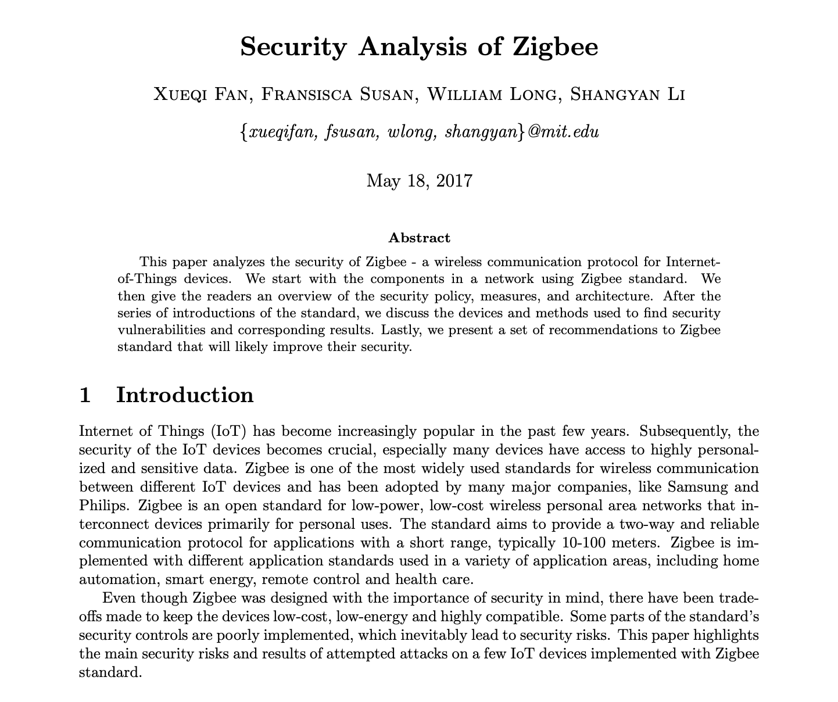
Notes:
Zigbee is a low-power wireless mesh network standard targeted at battery-powered devices in wireless control and monitoring applications. Zigbee delivers low-latency communication.
Implementation Vulnerabilities
Insecure key storage
Insecure key transportation
Reusing Initialization Vector (IV)
Protocol Vulnerabilities
Default link key values
Unauthenticated acknowledgement packets (ACK):
Man-in-the-middle attack
CSMA/CA trade-off:
Unencrypted keys:
Predictable PAN IDs and limited channels
Insufficient replay protections
Signal interference
Unauthorized network commissioning
Lack of DDoS Protection Mechanisms
Re-using link key
TouchLink Factory reset

Slide 16
Firmware Pentesting (OS of IoT Devices):
- Firmware Extraction: Extract and dissect firmware from IoT devices to analyze code, configuration, and encryption mechanisms.
- Static Analysis: Disassemble and inspect the firmware for potential vulnerabilities, backdoors, and hidden functions.
- Dynamic Analysis: Emulate the firmware to assess runtime behavior and discover security flaws.
- Hardening Analysis: Evaluate device security features such as secure boot, firmware updates, and code signing.
Hardware Hacking, Fault Injections, and SCA Attacks:
- Physical Access: Gain physical access to IoT devices to conduct hardware attacks, including voltage glitching and clock glitching.
- Side-Channel Analysis: Perform side-channel attacks to analyze power consumption or electromagnetic radiation, potentially revealing cryptographic keys.
- SCA Mitigation Bypass: Test the device's resistance to side-channel attacks and assess the effectiveness of countermeasures.

Slide 17
Storage Medium Testing:
- Data Extraction: Retrieve data from the storage medium, such as flash memory, and assess its security and encryption.
- Data Encryption Assessment: Analyze the encryption methods, algorithms, and keys used for data protection at rest.
- File System Analysis: Examine the file system for vulnerabilities and data exposure risks.
- Data Recovery: Assess data recovery possibilities, including methods to recover deleted data or bypass encryption.
I/O Ports Assessment:
- Input Validation Testing: Examine I/O ports for input validation vulnerabilities that could lead to buffer overflows, SQL injection, or other injection attacks.
- Output Analysis: Assess the handling of data output through I/O ports, looking for potential vulnerabilities in how data is displayed or processed.
- Peripheral Attacks: Analyze I/O peripherals for security vulnerabilities, including hardware keyloggers, Human Interface Device (HID) attacks, and more.

Slide 18
OWASP IoT Top 10
https://www.owasp.org/index.php/OWASP_Internet_of_Things_Project

Slide 19
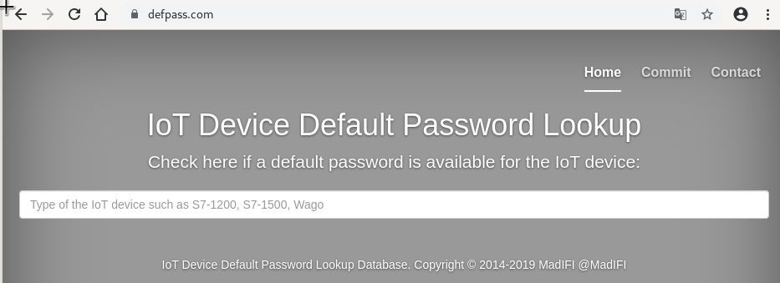
1. Weak, Guessable, or Hardcoded Passwords

Slide 20
1. Weak, Guessable, or Hardcoded Passwords
Use of:
Easily bruteforced
Publicly available
Unchangeable credentials
Including backdoors in firmware or client software that grants unauthorized access.

Slide 21
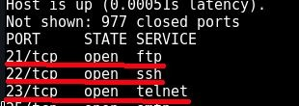
2. Insecure Network Services

Slide 22
2. Insecure Network Services
Unneeded or insecure network services running on the device itself, especially:
Those exposed to the Internet
Any that compromise the confidentiality, integrity/authenticity, or availability of information
Any service that allows unauthorized remote control

Slide 23
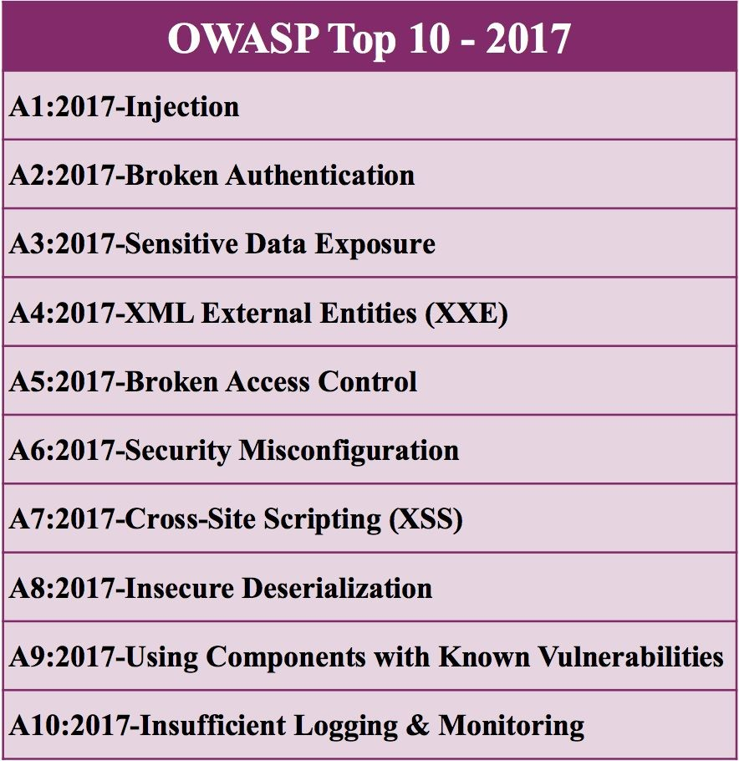
3. Insecure Ecosystem Interfaces
I swear they didn’t pay me to put this in here...

Slide 24
3. Insecure Ecosystem Interfaces
Insecure interfaces in the ecosystem outside the device:
Web
Backend API
Cloud
Mobile
Common issues:
Lack of authentication
Lack of authorization
Lacking or weak encryption
Lack of input and output filtering

Slide 25
4. Lack of Secure Update Mechanism
Lack of ability to securely update the device.
Lack of firmware validation on device
Lack of secure delivery (un-encrypted in transit)
Lack of anti-rollback mechanisms
Lack of notifications of security changes due to updates

Slide 26
4. Lack of Secure Update Mechanism
2016 Carnegie Mellon University Study
On Board Diagnostics: Risks and Vulnerabilities of the Connected Vehicle
Observations: insecure firmware updates and downloads
Researchers were able to make arbitrary firmware modifications and maliciously update remote firmware.
https://resources.sei.cmu.edu/library/asset-view.cfm?assetID=453871

Slide 27
5. Use of Insecure or Outdated Components
Use of deprecated or insecure software components/libraries that could allow the device to be compromised.
Insecure customization of operating system platforms
Third-party software libraries from a compromised supply chain
Third-party hardware components from a compromised supply chain

Slide 28



5. Use of Insecure or Outdated Components
Meltdown
Spectre
Heartbleed

Slide 29
6. Insufficient Privacy Protection
User’s personal information stored on the device or in the ecosystem that is used insecurely, improperly, or without permission.

Slide 30
6. Insufficient Privacy Protection
2017 Cornell University Study
A Smart Home is No Castle: Privacy Vulnerabilities of Encrypted IoT Traffic
“we examine four IoT smart home devices [...] and find that their network traffic rates can reveal potentially sensitive user interactions even when the traffic is encrypted”
https://arxiv.org/abs/1705.06805

Slide 31


7. Insecure Data Transfer and Storage
Lack of encryption or access control of sensitive data anywhere within the ecosystem, including at rest, in transit, or during processing.

Slide 32
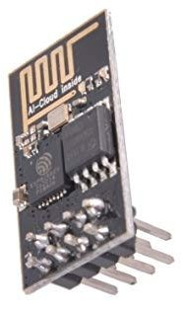
7. Insecure Data Transfer and Storage
“The Espressif ESP8266 chipset makes three-dollar ‘Internet of Things’ development boards an economic reality. According to the popular automatic
firmware-building site nodeMCU-builds, in the last 60 days there have been 13,341 custom firmware builds for that platform. Of those, only 19% have SSL support, and 10% include the cryptography module.”
https://hackaday.com/2017/06/20/practical-iot-cryptography-on-the-espressif-e sp8266/

Slide 33


8. Lack of Device Management
Lack of security support on devices deployed in production, including asset management, update management, secure decommissioning, systems monitoring, and response capabilities.

Slide 34
8. Lack of Device Management
We haven’t solved this for non-IoT environments yet..
25% still rely on Excel spreadsheets to track assets
56% verify asset location only once a year, while 10-15% verify only every five years
Staff spends 10+ hours weekly to resolve data accuracy issues
Nearly 66% of IT managers have an incomplete record of their IT assets
https://www.scmagazine.com/home/opinion/executive-insight/tighter-control-over-it
-asset-management-the-key-to-securing-your-enterprise/

Slide 35
9. Insecure Default Settings
Devices or systems shipped with insecure default settings or lack the ability to make the system more secure by restricting operators from modifying configurations.

Slide 36
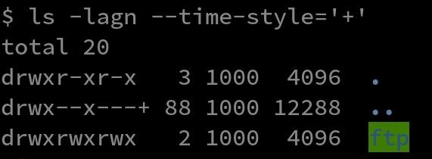
9. Insecure Default Settings
Bad filesystem permissions Exposed services running as root

Slide 37

10. Lack of Physical Hardening
Lack of physical hardening measures, allowing potential attackers to gain sensitive information that can help in a future remote attack or take local control of the device.

Slide 38
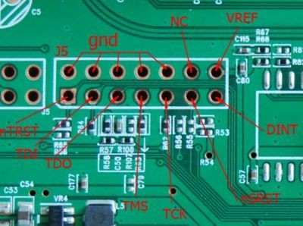

10. Lack of Physical Hardening
Easily Available Debug Port Discovery

