Slide 1
^Web Application Security^

Slide 2
whoami
can öztaş
ankara university - computer engineering
penetration tester
privacy & security research with ML
ctf player

Slide 3
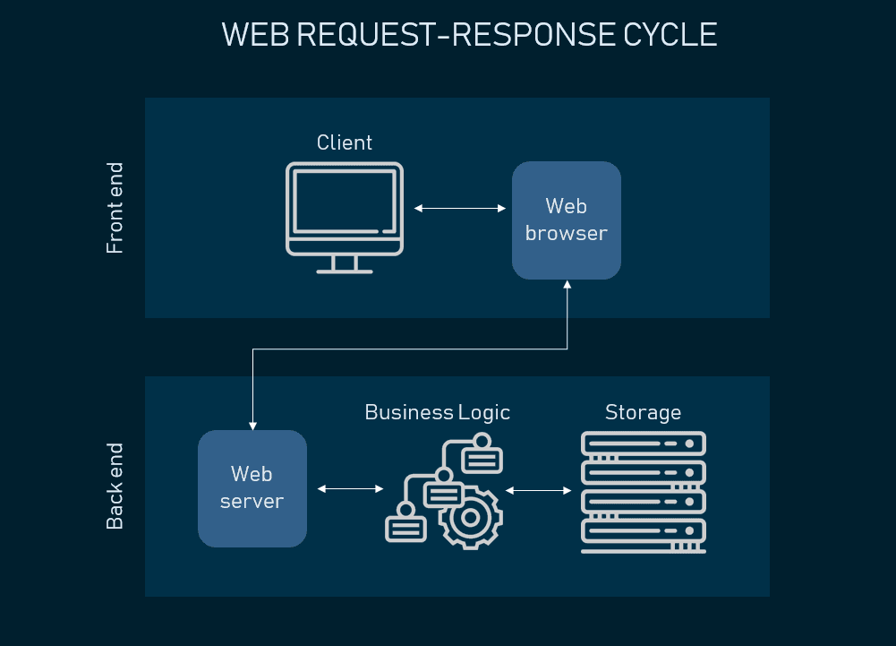
what is web app?

Slide 4
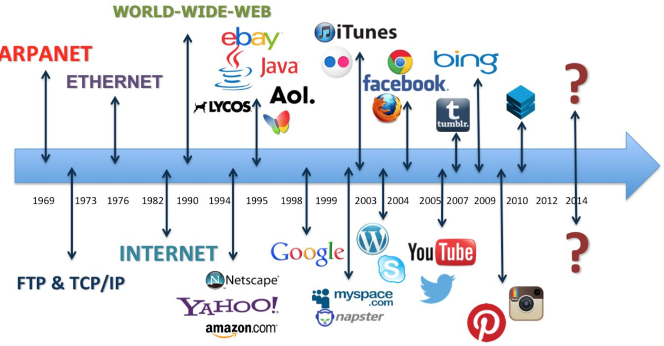
history

Slide 5
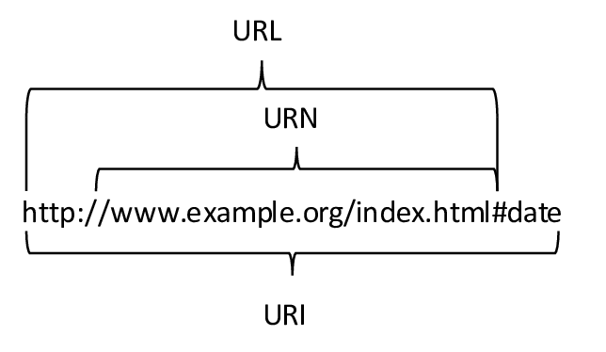

Slide 6
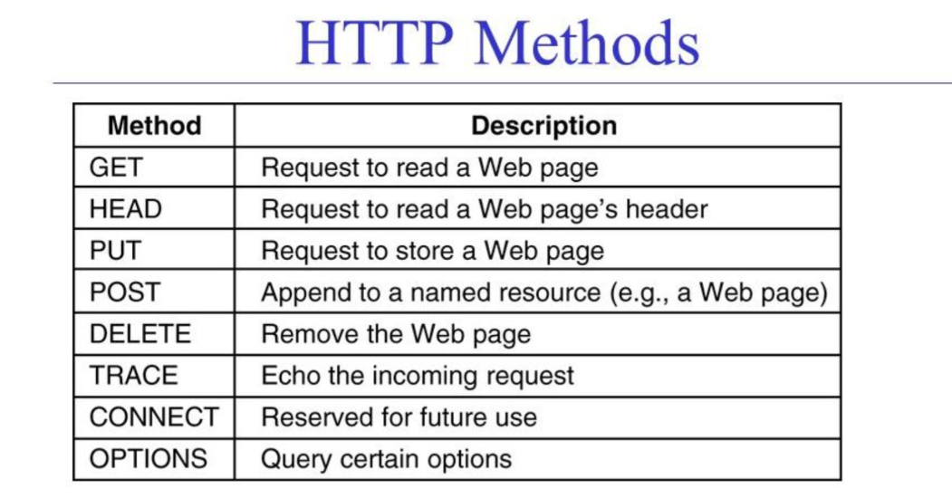

Slide 7
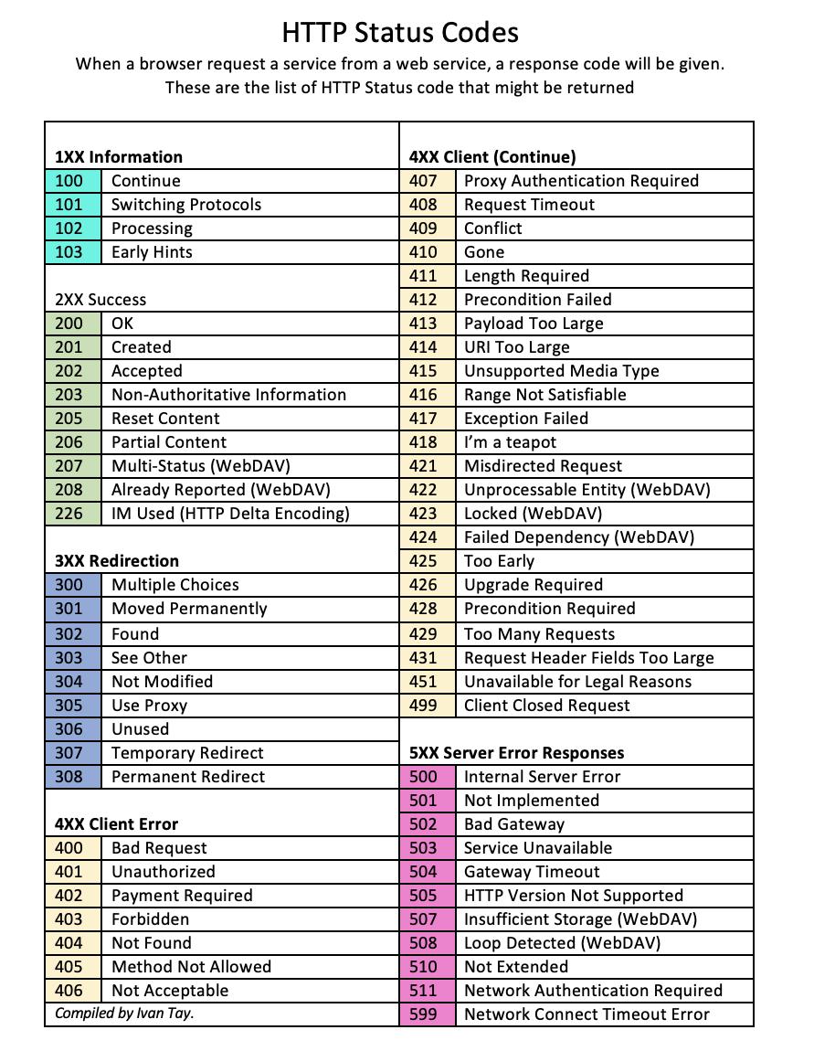
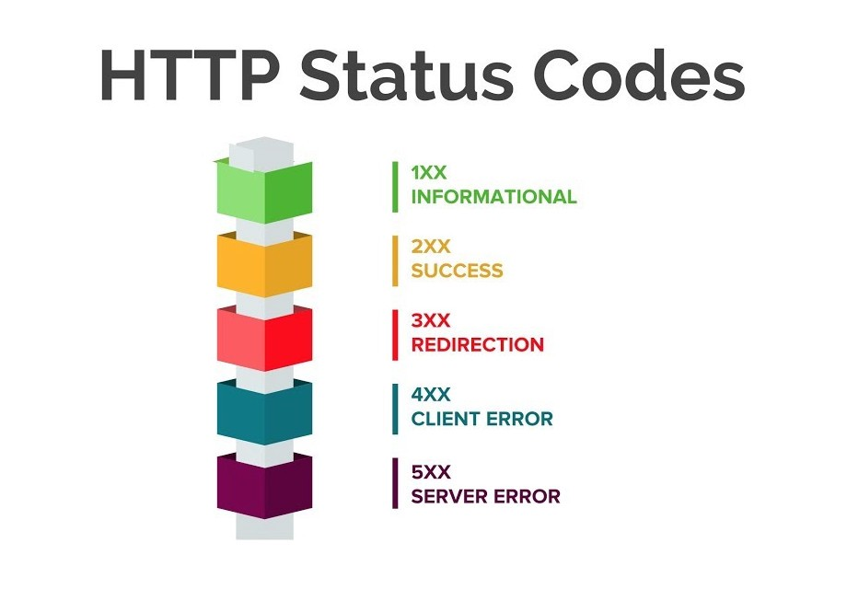

Slide 8
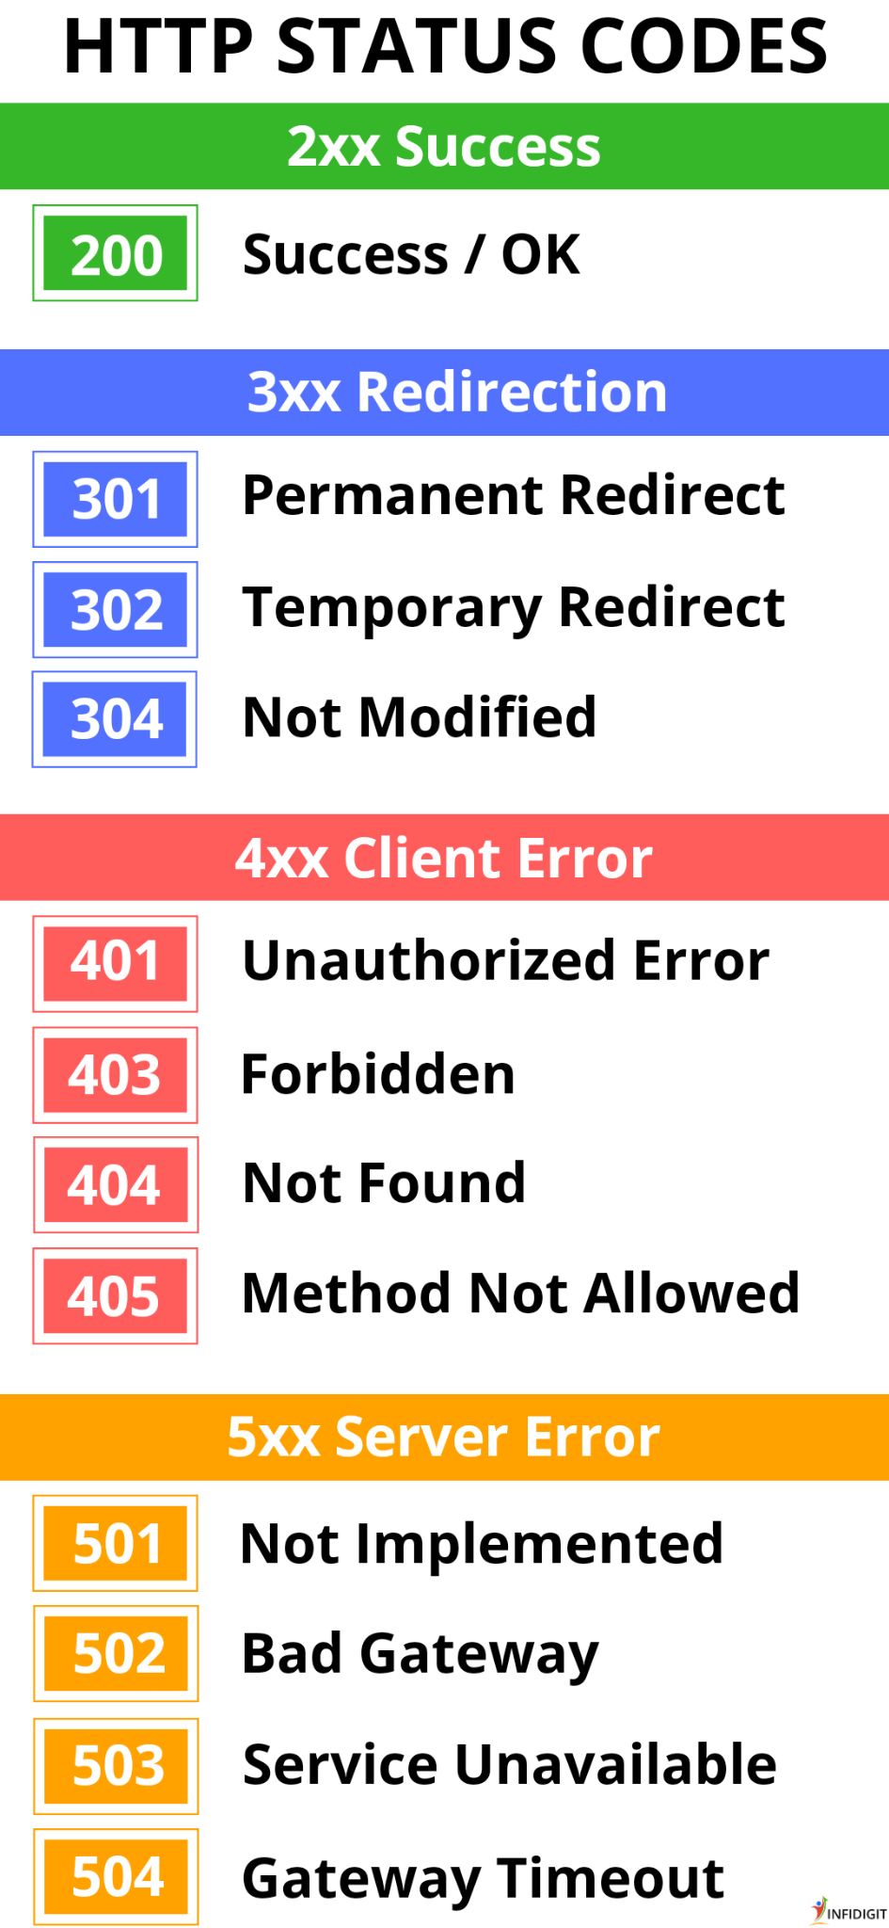
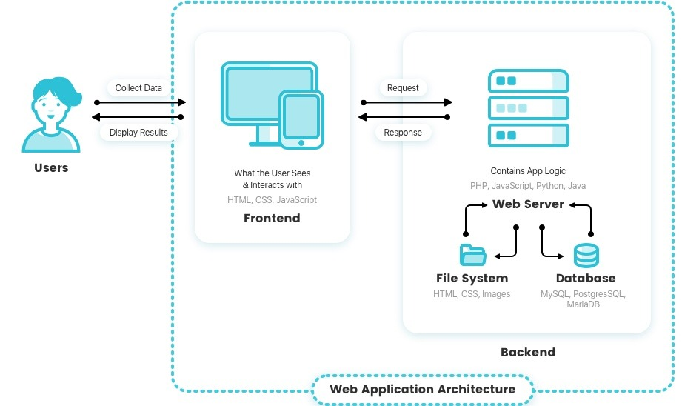

Slide 9
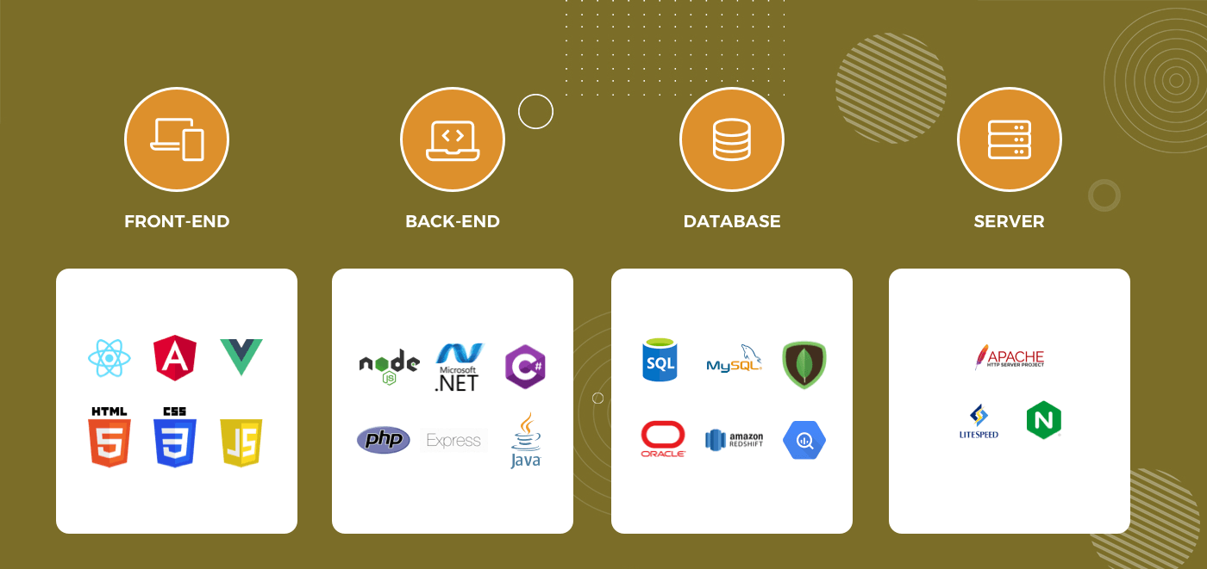

Slide 10

https://portswigger.net/web-security/information-disclosure/exploiting/lab-infoleak-in-error-messages
https://portswigger.net/web-security/information-disclosure/exploiting/lab-infoleak-via-backup-files
https://portswigger.net/web-security/information-disclosure/exploiting/lab-infoleak-authentication-bypass
https://portswigger.net/web-security/host-header/exploiting/lab-host-header-authentication-bypass
https://portswigger.net/web-security/authentication/other-mechanisms/lab-password-reset-broken-logic
https://portswigger.net/web-security/access-control/lab-unprotected-admin-functionality
https://portswigger.net/web-security/access-control/lab-user-role-controlled-by-request-parameter

Slide 11
https://portswigger.net/web-security/access-control/lab-insecure-direct-object-references
https://portswigger.net/web-security/access-control/lab-user-id-controlled-by-request-parameter-with-password-disclosure
https://portswigger.net/web-security/logic-flaws/examples/lab-logic-flaws-excessive-trust-in-client-side-controls
https://portswigger.net/web-security/logic-flaws/examples/lab-logic-flaws-high-level
https://portswigger.net/web-security/logic-flaws/examples/lab-logic-flaws-inconsistent-security-controls
https://portswigger.net/web-security/logic-flaws/examples/lab-logic-flaws-flawed-enforcement-of-business-rules
https://portswigger.net/web-security/os-command-injection/lab-simple
https://portswigger.net/web-security/all-labs#file-upload-vulnerabilities
https://portswigger.net/web-security/host-header/exploiting/password-reset-poisoning/lab-host-header-basic-password-reset-poisoning

Slide 12
$ crtl+d - 0x05 - eof $

