Slide 1
WEB UYGULAMA GÜVENLİĞİ

Slide 2
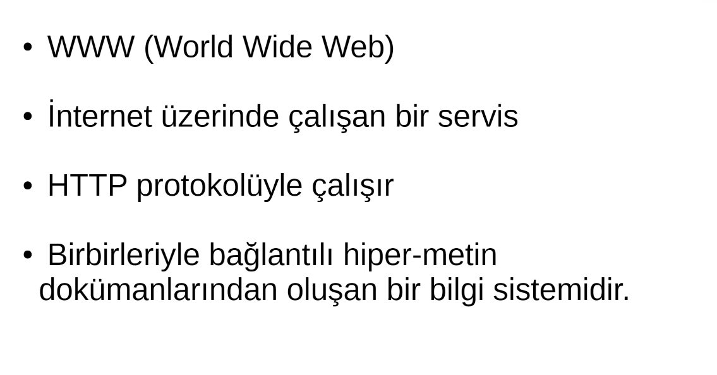
~ cat web_basics/introduction

Slide 3
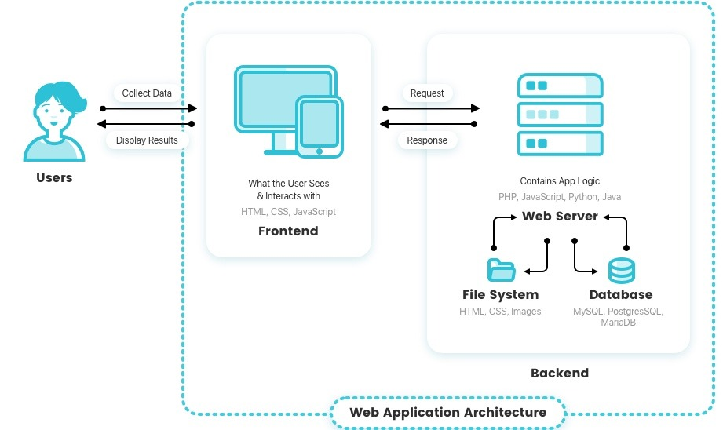
~ echo “how web works”

Slide 4
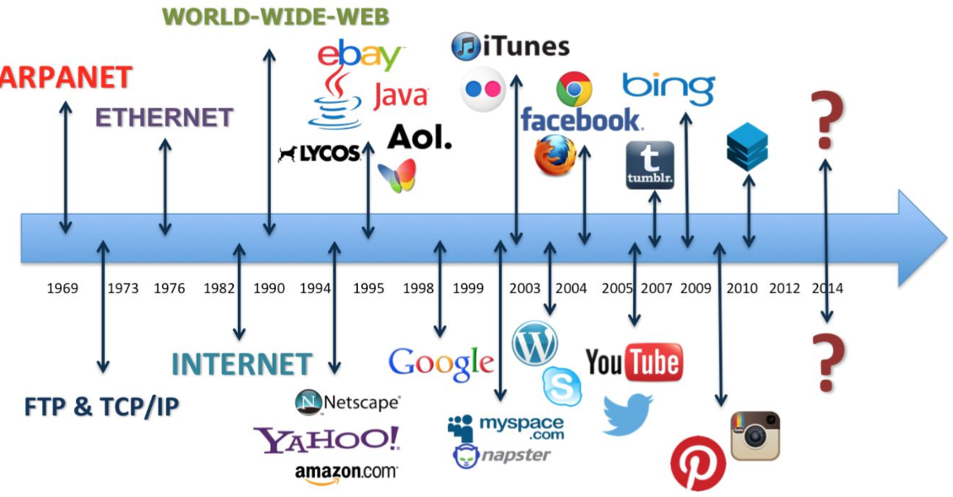
~ history

Slide 5
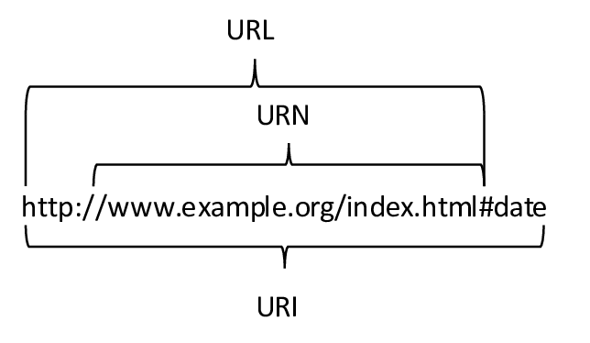
~ curl

Slide 6
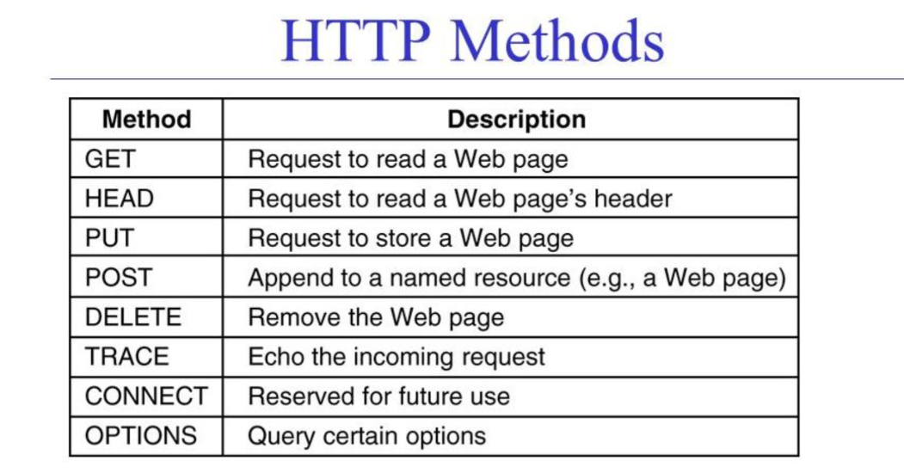
~ curl

Slide 7
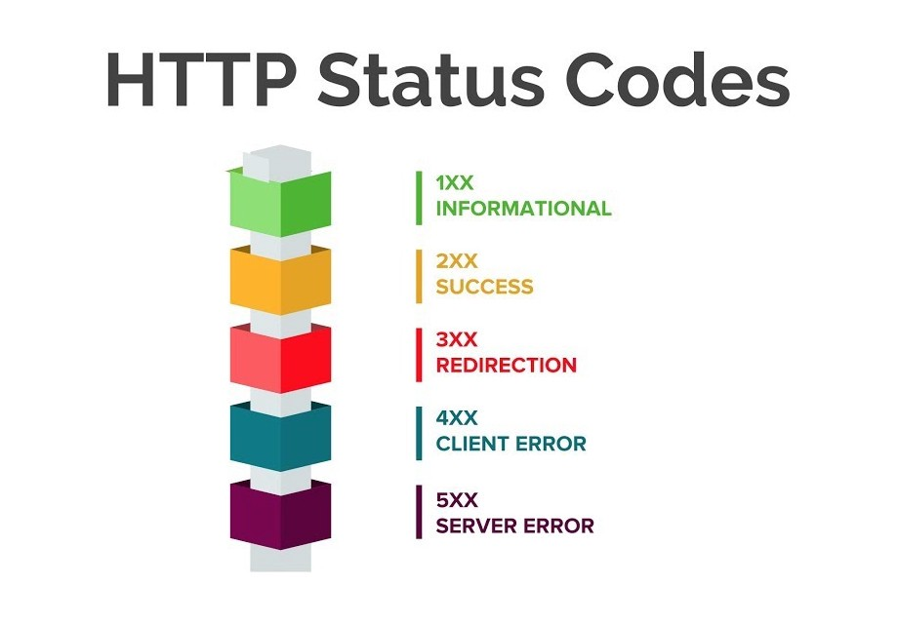
~ curl -X POST

Slide 8
~ curl https://owasp.org/www-project-top-ten/

Slide 9
uygulama

