Slide 1

Comparative Analysis of Differential Privacy over Multiple Data Sets
Refik Can Öztaş - Dr. Bülent Tuğrul
Ankara University, Department of Computer Engineering

Slide 2
Introduction
What is Differential Privacy ?
Why Differential Privacy ?
Machine Learning
Motivation and Method
Results
Conclusion
Q&A
8th International Scientific Conference “Telecommunications, Informatics, Energy and Management” – TIEM 2023

Slide 3

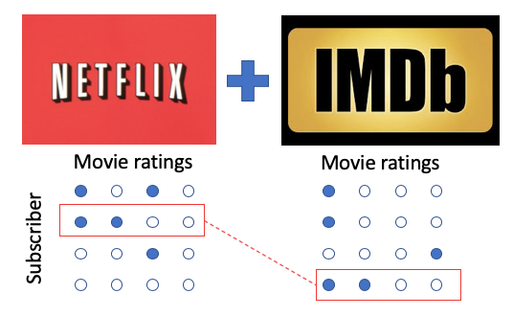
Introduction
Data Security + Data Privacy + Anonymization
8th International Scientific Conference “Telecommunications, Informatics, Energy and Management” – TIEM 2023

Slide 4
What is Differential Privacy ?
In simpler terms, it's a way to add noise or randomness to the data to protect individual privacy while still allowing for useful analysis of the overall dataset.
This process, known as data anonymization, involves removing personally identifiable information from data before releasing it.
It also helps to maintain the integrity of the data and prevent malicious actors from accessing sensitive information.
Ultimately, data anonymization helps to provide a secure environment for data analysis, while protecting the privacy of individuals.
8th International Scientific Conference “Telecommunications, Informatics, Energy and Management” – TIEM 2023

Slide 5
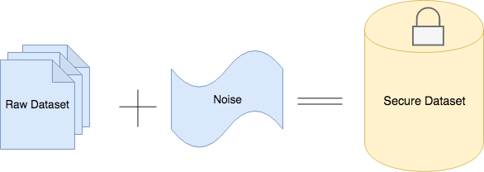
Why Differential Privacy ?
8th International Scientific Conference “Telecommunications, Informatics, Energy and Management” – TIEM 2023

Slide 6
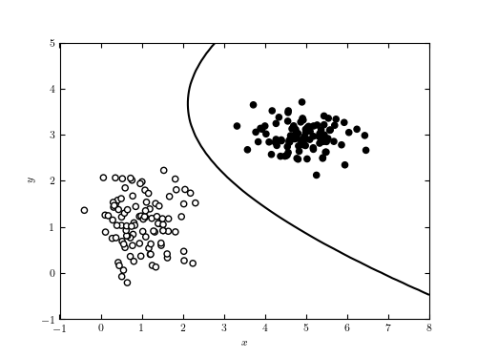
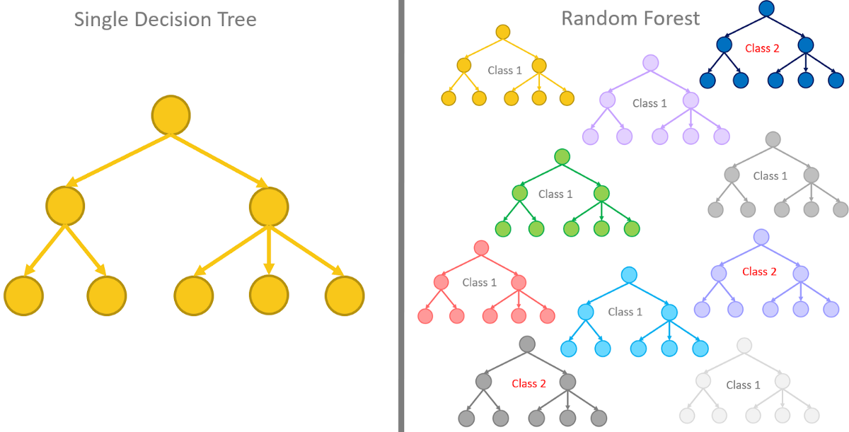
Machine Learning
8th International Scientific Conference “Telecommunications, Informatics, Energy and Management” – TIEM 2023

Slide 7
Motivation and Method
This research investigates the impact of adding noise within the concept of Differential Privacy on machine learning datasets.
The objective of this study is to analyze the effects of Differential Privacy on common machine learning methods.
Laplace Mechanism: It adds random noise from a Laplace distribution to the output of a query to protect individual privacy. The sensitivity of the query and the privacy parameter (ϵ) determine the amount of noise added. Decreasing ϵ provides stronger privacy protection.
8th International Scientific Conference “Telecommunications, Informatics, Energy and Management” – TIEM 2023

Slide 8
Motivation and Method
Gaussian Naive Bayes (GNB): Naive Bayes is a classification algorithm that utilizes probability and is based on Bayes’ theorem. Gaussian Naive Bayes is a particular version of Naive Bayes that assumes the features in the dataset conform to a normal (Gaussian) distribution.
Random Forest (RF): A decision tree is a model for predicting outcomes in data mining and machine learning for both regression and classification tasks.
Logistic Regression (LG): Logistic regression is a statistical method utilized for binary classification to assess the probability of an outcome.
8th International Scientific Conference “Telecommunications, Informatics, Energy and Management” – TIEM 2023

Slide 9
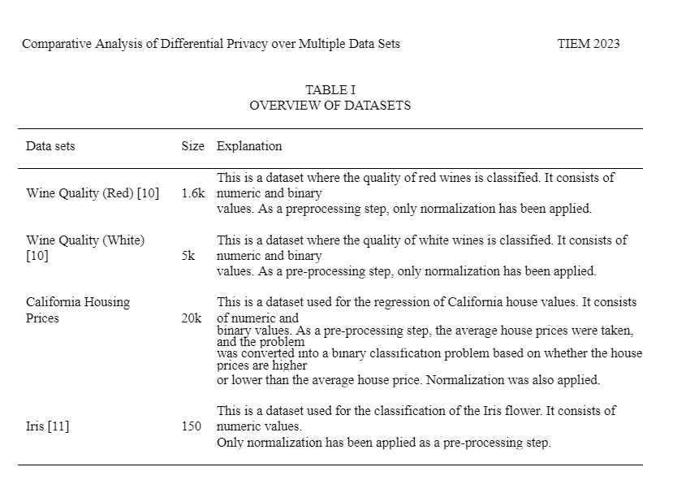
Data sets
8th International Scientific Conference “Telecommunications, Informatics, Energy and Management” – TIEM 2023

Slide 10
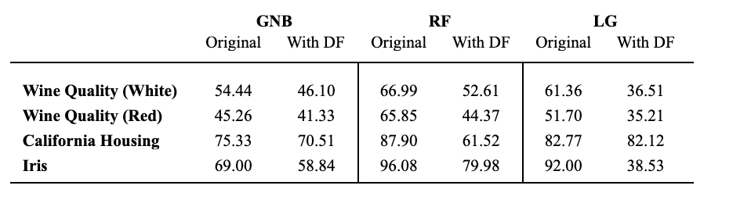
Analysis and Results
8th International Scientific Conference “Telecommunications, Informatics, Energy and Management” – TIEM 2023

Slide 11
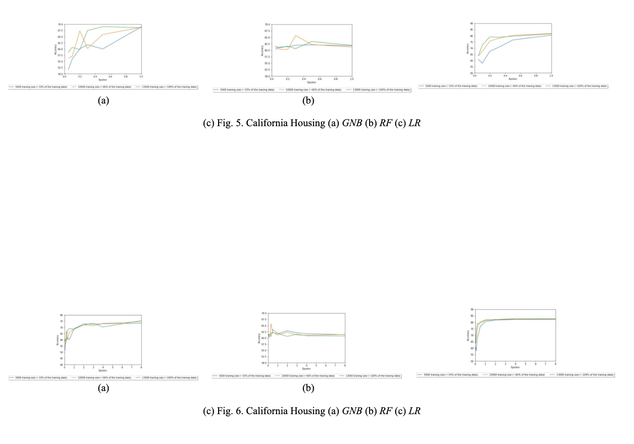
Analysis and Results
8th International Scientific Conference “Telecommunications, Informatics, Energy and Management” – TIEM 2023
Notes:
The following results were obtained by varying three pa-rameters and utilizing different algorithms, as shown in detail in the graphs below. Throughout the procedure, a training set ratio of 0.66 and a test set ratio of 0.34 were deliberately chosen, with the algorithms being executed ten times and the average result being calculated. Simultaneously, the variable epsilon (ϵ) was analyzed in two separate graphs ranging from 0 to 1 and from 1 to 8. The epsilon values utilized in all algorithms are listed below: ϵ = [0.05, 0.1, 0.2, 0.3, 0.5, 1.0, 2.0, 3.0, 4.0, 8.0].
The results indicate an expected direct relationship between the training size and accuracy. When we use larger training sizes with the same ϵ values, our machine learning algorithm using Differential Privacy approaches the accuracy achieved in its non-private state. The curve slopes exhibit similar patterns between the intervals 0-1 and 1-8. In addition, contrary to expectations, a continuous increase in accuracy is not observed as ϵ increases. An ”elbow” point is observed in all the graphs, and the elbow method can be used for selecting the optimal value in a real-world application of Differential Privacy.

Slide 12
Conclusion
Maintaining data security is crucial to safeguard sensitive and valuable information from malicious individuals, hackers, or cybercriminals who may view, steal, or manipulate data.
However, despite implementing several security measures and products, incidents of hacking still occur.
Differential privacy is a popular technique used in sensitive domains because it has a significant impact on machine learning models, and it offers provable privacy guarantees.
A trade-off between privacy and utility exists when using differential privacy, which can reduce learning accuracy.
Therefore, differential privacy is an important tool for ensuring data privacy while mitigating the risk of hacking, but its use should be carefully evaluated before it is implemented.
8th International Scientific Conference “Telecommunications, Informatics, Energy and Management” – TIEM 2023

Slide 13
Q&A
8th International Scientific Conference “Telecommunications, Informatics, Energy and Management” – TIEM 2023

