Slide 1


CAN PESKERSOY

Slide 2
AGENDA
Background
Simple Page Applications (SPAs)
Model View Whatever (MVW or MV*)
Framework Features

Slide 3
BACKGROUND
JavaScript-based open-source front-end web application framework.
Developed in 2009 by Miško Hevery and now maintain by Google.
Extends HTML with new attributes.
Perfect for Single Page Applications (SPAs).
Used for developing cross-platform mobile apps

Slide 4
SINGLE PAGE APPLICATIONS
WHAT?
Web application/site that fits on a single web page.
WHY?
To provide a user experience similar to that of a desktop application.
HOW?
Retrieve all necessary codes (HTML, JavaScript, CSS) with a single page load.
Load/Add appropriate resources dynamically to the page.

Slide 5
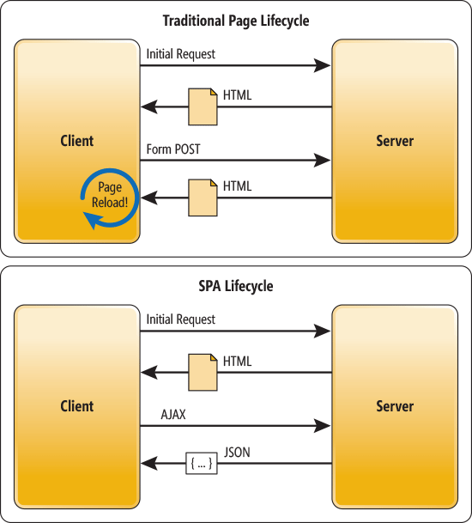
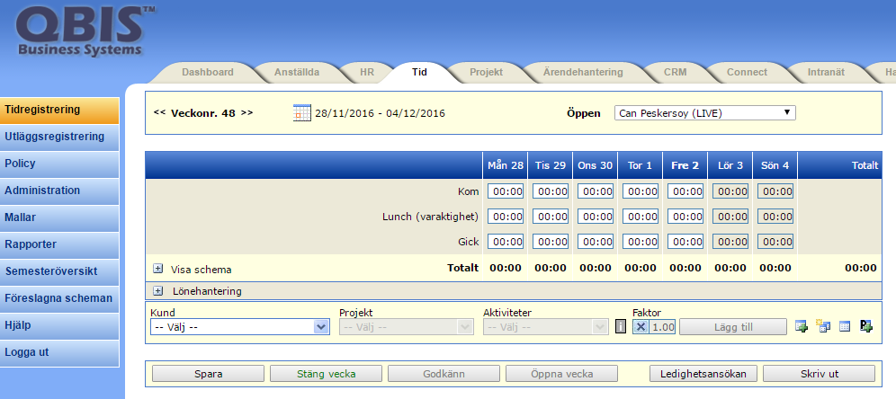
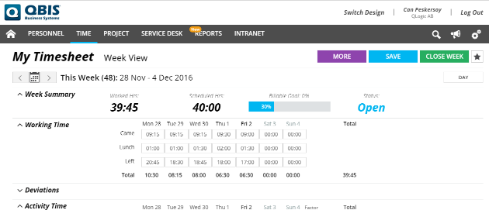
SPA vs Traditional
In a traditional Web app, every time the app calls the server, the server renders a new HTML page. This triggers a page refresh in the browser.
In an SPA, after the first page loads, all interaction with the server happens through AJAX calls. These AJAX calls return data—not markup—usually in JSON format. The app uses the JSON data to update the page dynamically, without reloading the page.

Slide 6
SPA is good BUT?
How we are going to deal with client side complexity and all those manual works?
Example from QBIS:

Slide 7
Model View Whatever (MVW or MV*) “whatever works for you”
WHY?
Complexity of managing DOM (HTML) and all of the logic, the data on the background.
Could it better if we update one side (model or view) and then the other is updated automatically.
SO?!?
Capability of AngularJS framework eliminates the this complexity and manual modifications with simple attribute directives.

Slide 8
Custom Data Attributes (data-*)
WHY?
Store information associated with different DOM elements.
BUT WHY NOT “class” THEN?
Not to meant to store data, only style information
Each additional piece of information requires us to add new class (harder to parse later)
SO?!?
Use Custom Data Attributes to store information in better way.
“data-” prefix with letters, numbers, hyphen (-), dot (.), color (:), underscore (_)
No capital letters!!!

Slide 9
Attribute Directives (ng-*)

