Slide 1


CAN PESKERSOY

Slide 2
AGENDA
Background
Simple Page Applications (SPAs)
Model View Whatever (MVW or MV*)
Framework Features
Directives, Filters, Data Binding
View, Controllers, Scope
Module, Routers, Factories Next Time!

Slide 3
BACKGROUND
JavaScript-based open-source front-end web application framework.
Developed in 2009 by Miško Hevery and now maintain by Google.
Extends HTML with new attributes.
Perfect for Single Page Applications (SPAs).
Used for developing cross-platform mobile apps

Slide 4
SINGLE PAGE APPLICATIONS
WHAT?
Web application/site that fits on a single web page.
WHY?
To provide a user experience similar to that of a desktop application.
HOW?
Retrieve all necessary codes (HTML, JavaScript, CSS) with a single page load.
Load/Add appropriate resources dynamically to the page.

Slide 5
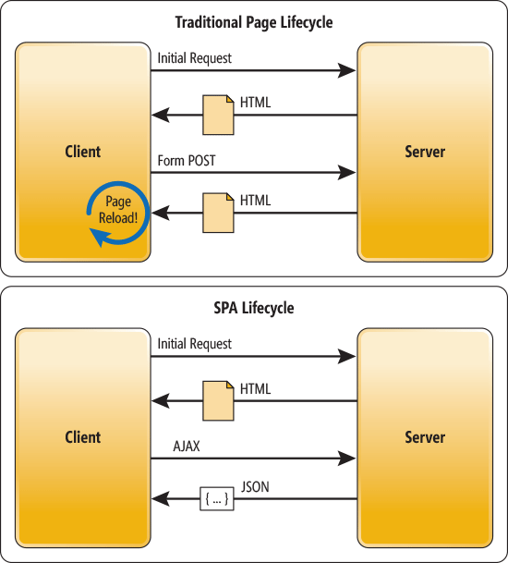
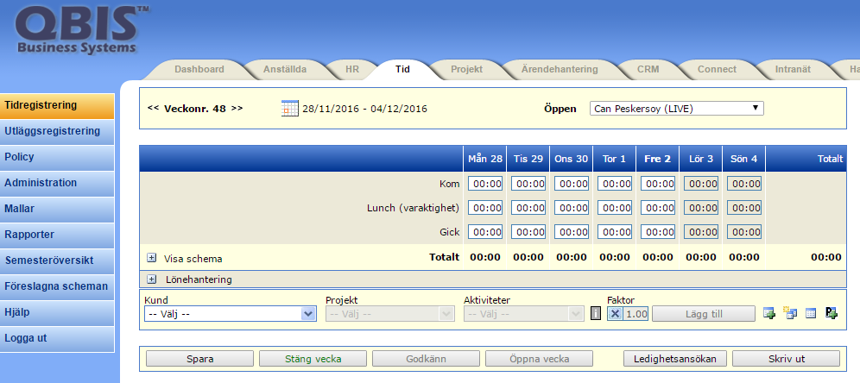
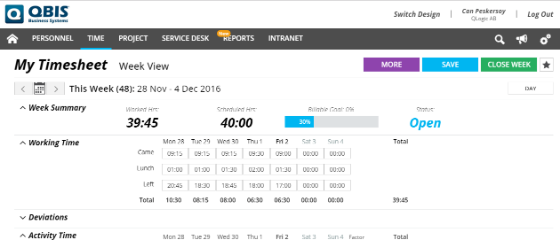
SPA vs Traditional
In a traditional Web app, every time the app calls the server, the server renders a new HTML page. This triggers a page refresh in the browser.
In an SPA, after the first page loads, all interaction with the server happens through AJAX calls. These AJAX calls return data—not markup—usually in JSON format. The app uses the JSON data to update the page dynamically, without reloading the page.

Slide 6
SPA is good BUT?
How we are going to deal with client side complexity and all those manual works?
Example from QBIS:

Slide 7
Model View Whatever (MVW or MV*) “whatever works for you”
WHY?
Complexity of managing DOM (HTML) and all of the logic, the data on the background.
Could it better if we update one side (model or view) and then the other is updated automatically.
SO?!?
Capability of AngularJS framework eliminates the this complexity and manual modifications with simple attribute directives.

Slide 8
Framework Features
Directives
ng-app: tells AngularJS that the DOM element is the “owner” of the an AngularJS application.
ng-model: binds the value of the input field to the application variable name.
ng-init: initialize AngularJS application variables.
ng-bind: binds the innerHTML of the DOM element to the application variable name.
Data Binding
Data Binding is the synchronization between the model and the view.

Slide 9
Custom Data Attributes (data-*)
WHY?
Store information associated with different DOM elements.
BUT WHY NOT “class” THEN?
Not to meant to store data, only style information
Each additional piece of information requires us to add new class (harder to parse later)
SO?!?
Use Custom Data Attributes to store information in better way.
“data-” prefix with letters, numbers, hyphen (-), dot (.), color (:), underscore (_)
No capital letters!!!

Slide 10
Framework Features
Expressions
AngularJS expression can be written inside double braces: {{ expression }}
AngularJS expressions can also be written inside a directive: ng-bind=“expression”
AngularJS expression are much like JavaScript expression: They can contain literals, operators and variables.

Slide 11
Framework Features
Expressions (JavaScript vs AngularJS)
 | JavaScript | AngularJS
Context | are evaluated against global window. | are evaluated against a scope object.
Error Handle | generates ReferenceError or TypeError | generates undefined and null.
Filter | NAN | can use filters within expression to format.
Control Statements | Possible to use | cannot use conditionals, loops, exceptions.
Function Declaration | Possible to declare | cannot declare functions, even inside ng-init.
Regular Expression | Possible to create | cannot create regular expressions.
Object Creation | Possible to create | cannot use new operator.
Bitwise, Comma, Void | Possible to use | cannot use Bitwise, comma, void

Slide 12
Framework Features
More Directives
ng-repeat: clones an HTML elements once for each item in a collection.
They are used on an array of objects.
DEMO: example-2
Filters
AngularJS provides filters to transform data.
Filters can be added to expression by using pipe character “|”.
Filters can be used within both Directives and Expressions.
DEMO: example-3

Slide 13
Framework Features
Scope
Binding part between HTML (view) and the JavaScript (Controller).
It is an object with the available properties and methods.
It is available for both the view and the controller.
Controller
They control the data of the AngularJS applications.
They are regular JavaScript objects.
They are created by a standard JavaScript object constructor.
DEMO: example-4

Slide 14

THANKS FOR LISTENING
github.com/canpe/AngularJS-Examples

