Slide 1
Finding the red dot: end-to-end observability on OpenShift
Phase 1 design: mesh metrics, distributed tracing, access logs and external systems via ServiceEntries
Notes:
Purpose: agree the Phase 1 design for locating failures across the transaction path, starting from the OpenShift integration layer.

Slide 2
We can't see where a transaction fails today
!
The problem
1
Phase 1 scope
When a customer journey fails, teams can't pinpoint which hop is responsible.
Every transaction crosses OpenShift, so the integration layer sees the whole path.
The service mesh and sidecars are already in place, but metrics, traces and access logs are not yet collected or connected.
In scope
Mesh metrics, Kiali service graph, distributed tracing, Envoy access logs, OTel auto-instrumentation
External VMs and databases registered as ServiceEntries
Not in this phase
Agents or exporters on VMs and database servers
Channel-side tracing (mobile, web, API gateway)
Notes:
Phase 1 stays inside OpenShift. External systems become visible as hops without installing anything on them.

Slide 3
Target architecture
Customer channels
OpenShift cluster | service mesh, sidecars already injected
Key
Ingress gateway
Trace starts here
Prometheus (UWM)
Scrapes Envoy metrics
Mesh request path
Kiali
Live service graph
Observability stack
App pods
Envoy sidecar + OTel agent
OTel Collector
Spans and access logs (OTLP)
Outside cluster
OpenShift console
Dashboards, traces, logs
Red dot: failing hop
ServiceEntry + DR
Registers VMs and DBs
Tempo + Loki
Traces and access logs
Kiali turns an edge red when its error rate or latency crosses a threshold.
Legacy apps (VMs)
HTTP: full metrics + spans
Databases
TCP: connections only
Notes:
Purple is what exists today. Teal is what Phase 1 adds. Grey systems need no installation; ServiceEntries make them visible as named nodes.

Slide 4
Three telemetry flows, one view
Metrics
Envoy sidecar
Rate, errors, latency
PodMonitor
Per mesh namespace
Prometheus (UWM)
Cluster monitoring
Kiali + alerts
Graph, dashboards
Answers: which hop is failing or slow, right now.
Traces
Envoy + OTel agent
Spans per hop and call
OTel Collector
OTLP, tail sampling
Tempo
Trace storage
Console tracing UI
Linked from Kiali
Answers: where the time went inside one specific transaction, including DB calls.
Logs
Envoy access log
Every request, response flags
OTel Collector
OTLP, journey tagging
Loki
Log storage
Grafana + dashboard
Linked to traces by trace ID
Answers: why the hop failed: timeout, refused connection or no healthy upstream (Envoy flags UT, UF, UH).
Notes:
Metrics find the red dot; traces show where the time went; access logs say why the hop failed. Tail sampling keeps every error trace and about 10 percent of the rest (verified in the POC). Every access log carries the trace ID, so a log line opens its trace.

Slide 5
What we see for external systems, with no installs
External call | Metrics | Traces | What to configure
Legacy VM over HTTP | Full: rate, status codes, latency | Outbound span per call | ServiceEntry with protocol HTTP
Legacy VM over HTTPS (app does TLS) | TCP only: bytes, connections | None | Move TLS to the sidecar (see next row)
Legacy VM over HTTPS (sidecar does TLS) | Full: rate, status codes, latency | Outbound span per call | App calls http://, DestinationRule TLS SIMPLE or MUTUAL
Database (Oracle, PostgreSQL, etc.) | TCP only: connections, failures | None from the mesh | ServiceEntry with protocol TCP
Database via app instrumentation | Query timing in spans | JDBC span per query | OTel auto-instrumentation on app pods
Also enable Envoy access logs: response flags UF, UH and UT separate connection failures from errors returned by the target.
Notes:
Without installing anything on VMs or DB servers, we still learn whether the hop to them is the problem. The why needs app instrumentation or agents later.

Slide 6
How the telemetry pipeline works
Collection, processing, storage and visualization in detail. Every number in this section was measured in the local POC that mirrors this design.
Notes:
Deep dive for the technical audience. The POC runs the upstream projects behind the OpenShift observability stack on a local kind cluster, with the same CRDs, so the flows and numbers carry over.

Slide 7
The stack: one component per job
Job | OpenShift (target) | Local POC (upstream, same CRDs) | How we use it
Telemetry source | OpenShift Service Mesh 3.4 (Istio 1.30) | Sail Operator + Istio 1.30.5 | Envoy sidecars emit metrics, spans and access logs for every hop, no code change
App instrumentation | Red Hat build of OpenTelemetry | OpenTelemetry Operator 0.160 | Instrumentation CR injects the OTel agent: app and DB spans, baggage propagation
Telemetry pipeline | Red Hat build of OpenTelemetry Collector | OTel Collector (contrib) 0.160 | Receives OTLP, tags journeys, tail-samples traces, routes to Tempo and Loki
Metrics and alerts | OpenShift Monitoring (user workload): Prometheus, Thanos Querier, Alertmanager | kube-prometheus-stack: Prometheus 3, Alertmanager | Scrapes sidecars and istiod; evaluates hop and journey alert rules
Trace store | Tempo Operator: TempoMonolithic, then TempoStack | Tempo Operator 0.22, Tempo 2.10 | Stores sampled traces; TraceQL search by journey, flag, service
Log store | Loki Operator: LokiStack | Loki 3.6 (single binary) | Stores Envoy access logs; LogQL by flag, hop, trace ID
Visualization | Kiali, OpenShift console, Grafana Operator | Kiali 2.27, Grafana 13, red-dot dashboard | Live graph, journey drill-down, NOC view with the failing hop and its owner
Same CRDs on both sides, so manifests move to OpenShift almost unchanged. Nothing is installed on VMs or database servers.
Notes:
Left column is what we deploy on OpenShift; the POC uses the upstream project with the same CRDs. Versions follow OpenShift Service Mesh 3.4 (Istio 1.30, Kiali 2.27).

Slide 8
End-to-end data flow: three signals, two directions
SOURCES
COLLECTION
PROCESSING
STORAGE
VIEWS
Envoy sidecars + gateway
Counters, histograms per hop
PodMonitor / ServiceMonitor
Prometheus pulls :15020 every 15 s
Prometheus rules
5 alert rules, every 15 s
Prometheus TSDB
Head + WAL, 2 h blocks
Kiali
Graph from metrics, traces
Grafana
Metrics, logs, traces
Envoy + app OTel agent
Spans; traceparent + baggage
OTLP push
Envoy gRPC :4317, apps HTTP :4318
OTel Collector
Journey tagging
Tail sampling (traces)
Batching, routing
Tempo
vParquet4 blocks
Red-dot dashboard
All four + annotations
Envoy access log
Every request, response flags
OTLP push (Envoy ALS)
gRPC :4317, every request
Loki
Chunks + TSDB index
Alertmanager
Rules from Prometheus
Pull for metrics, push for traces and logs. Shared keys (hop, journey, trace ID) link the three signals.
Notes:
Metrics are pulled: Prometheus scrapes each sidecar every 15 s. Traces and logs are pushed over OTLP to the collector. All three carry the same keys (source, destination, journey, trace ID), which is what lets every view jump from one signal to the next.

Slide 9
Metrics: how Prometheus finds and scrapes every sidecar
1
PodMonitor / ServiceMonitor CRs
PodMonitor for sidecars, ServiceMonitor for istiod
A ServiceMonitor scrapes the endpoints behind a Service. Sidecar metrics belong to each pod, not to one Service port, so we select pods. istiod has a monitoring Service (port 15014).
Declare what to scrape: every pod with an istio-proxy container (one PodMonitor per mesh namespace) and the istiod Service.
2
Prometheus Operator
Watches the CRs and generates the Prometheus scrape configuration. Nobody edits prometheus.yml.
One sample, every label we need
istio_requests_total{
source_workload="payments-svc",
destination_service_name="core-banking",
response_code="504", response_flags="UT",
journey="fund-transfer", channel="mobile"}
3
Kubernetes service discovery
Prometheus lists pods through the Kubernetes API. Relabeling keeps istio-proxy and reads the prometheus.io/port annotation.
4
Scrape every 15 s
HTTP GET :15020/stats/prometheus on each sidecar: request counts, status codes, flags and latency histograms per hop.
5
Store, evaluate, alert
OpenShift: user workload monitoring runs this Prometheus; Kiali and dashboards query Thanos Querier on port 9091 with a token.
Samples go to the TSDB; alert rules run every 15 s; firing alerts go to Alertmanager. Views query with PromQL.
Notes:
ServiceMonitor scrapes endpoints behind a Service; sidecar metrics belong to every pod, so we select pods directly with a PodMonitor. On OpenShift user workload monitoring, a PodMonitor only sees its own namespace, so there is one per mesh namespace.

Slide 10
Inside the OpenTelemetry Collector
RECEIVER
PROCESSORS (in order)
EXPORTERS
otlp
gRPC :4317
Envoy spans + access logs
HTTP :4318
app agents
traces
memory_limiter
transform/journey
tail_sampling
batch
otlp to Tempo :4317
logs
memory_limiter
transform/journey
batch
otlphttp to Loki /otlp
memory_limiter
Refuses data at 80% of the memory limit, so a burst slows senders instead of crashing the collector.
transform/journey
OTTL extracts journey and channel from the W3C baggage tag (fixed list only) and names the Loki stream after the workload.
tail_sampling
Holds each trace for 15 s, then keeps errors, 5xx, Envoy failure flags, traces over 1.5 s and 10% of the rest.
batch
Sends up to 1,024 items or every 2 s, so Tempo and Loki get fewer, larger writes.
Notes:
One OpenTelemetryCollector CR, deployed by the operator. Two pipelines share the OTLP receiver. One replica keeps all spans of a trace together for tail sampling; to scale out, add a load-balancing exporter tier that routes by trace ID.

Slide 11
Tail sampling: keep every failure, about 10% of the rest
Envoy samples 100%
KEEP POLICIES
9%
Status ERROR any span failed
of healthy traces stored
Collector holds each trace 15 s
HTTP 5xx on any hop
102 of 1,103 in a 90 s sample
Envoy flag UF, UH, UT, URX, ...
100%
Any policy matches: keep
of error traces stored
Slower than 1.5 s end to end
every UT / UF / UH failure
Decision cache for late spans
10% probabilistic baseline sample
12 / 12
Tempo
spans in a fund transfer
was 3 of 12 before the decision cache
Notes:
Head sampling in Envoy decides before the request finishes, so at 10% it drops 9 of 10 error traces. Tail sampling decides after the whole trace is seen. The decision cache matters: spans arrive on different timers, and without it late spans are re-sampled and traces lose hops.

Slide 12
Journey tagging: one label from gateway to every hop
Customer request
POST /api/transfers
x-channel: mobile
Ingress gateway
Route sets baggage:
journey=fund-transfer,
channel=mobile
payments-svc
OTel agent forwards
baggage on each call
core-banking hop
Sidecar sees the same
baggage header
Every sidecar and the collector turn that one header into three outputs:
Metric label
Telemetry API tagOverrides (CEL) maps baggage to a fixed label value
istio_requests_total{
journey="fund-transfer"}
Span attribute
Envoy records baggage as a span tag; the collector's OTTL turns it into span.journey
{ span.journey =
"fund-transfer" }
Log field
Access log carries %REQ(BAGGAGE)%; the collector extracts journey for Loki
{service_name="payments-svc"}
| journey="fund-transfer"
Fixed list: fund-transfer, balance-check, card-payment, login, loan-application. Anything else becomes "other". Adding a journey is a deliberate change in three places: Telemetry CEL, collector regex, gateway route.
Notes:
The gateway route stamps the journey into W3C baggage and overwrites anything the client sent, so it cannot be spoofed. The OTel agent forwards baggage on every outbound call. The label is computed from a fixed list, so cardinality stays bounded. Never put customer or account IDs in labels.

Slide 13
Where the data lives
Signal | Store and format | Local POC | OpenShift production | Retention | Query
Metrics | Prometheus TSDB: in-memory head + write-ahead log, compacted 2-hour blocks | emptyDir in the pod (lost on restart) | UWM Prometheus on a PVC; Thanos Querier for queries | 2 days | PromQL
Traces | Tempo: WAL, then Apache Parquet blocks (vParquet4) with bloom filters | 5 Gi persistent volume, local backend | TempoStack on S3-compatible object storage (ODF, MinIO) | 14 days (default 336 h) | TraceQL
Logs | Loki: compressed chunks + TSDB index; labels service_name, namespace; other fields as structured metadata | 5 Gi persistent volume, filesystem | LokiStack on object storage | 48 h set, not yet enforced | LogQL
Alerts | Alertmanager: alert state and silences | emptyDir | Platform or UWM Alertmanager | While firing | API v2
Dashboards | Grafana: dashboards as code (ConfigMap), SQLite for settings | In the pod | Grafana Operator CRs | Versioned in Git | -
Red = POC gaps to close before production: persistent Prometheus storage, enforced Loki retention.
Notes:
POC storage is deliberately small and local. Production moves traces and logs to object storage through TempoStack and LokiStack. Gaps found in the POC: Prometheus uses an emptyDir (metrics lost on restart), and Loki's 48 h retention is not enforced because compactor retention is not enabled.

Slide 14
Envoy access logs: the why behind a red edge
One access-log record (payments-svc)
upstream_cluster = outbound|80||core-banking
response_code = 504
response_flags = UT
duration_ms = 3001
journey = fund-transfer
trace_id = 2ba91a03eb16...
Path: Envoy > OTLP access-log provider (gRPC) > Collector > Loki
trace_id links the log line to its trace in Tempo
Flag | Meaning | Seen in the POC when | Call
UT | Upstream request timeout | Core banking slower than the 3 s route timeout | Owner of the target
UF | Upstream connection failure | Database or card switch refuses connections | Owner or network
UH | No healthy upstream | Card switch ejected by outlier detection | Owner of the target
URX | Retry limit exceeded | Paired with UF after Envoy retried | As for UF
UC | Connection closed mid-request | Sidecar sent plaintext to a TLS port (config) | Mesh config
Example LogQL: {service_name="payments-svc"} | response_flags != "-"
Notes:
Every request is sent to Loki through the OTel access-log provider; errors also go to stdout. The flag separates 'the target answered with an error' from 'we could not reach the target', which decides which team is called.

Slide 15
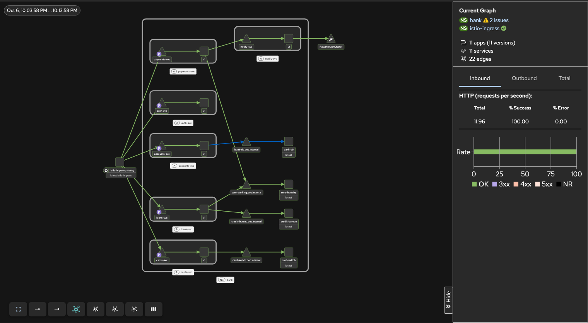
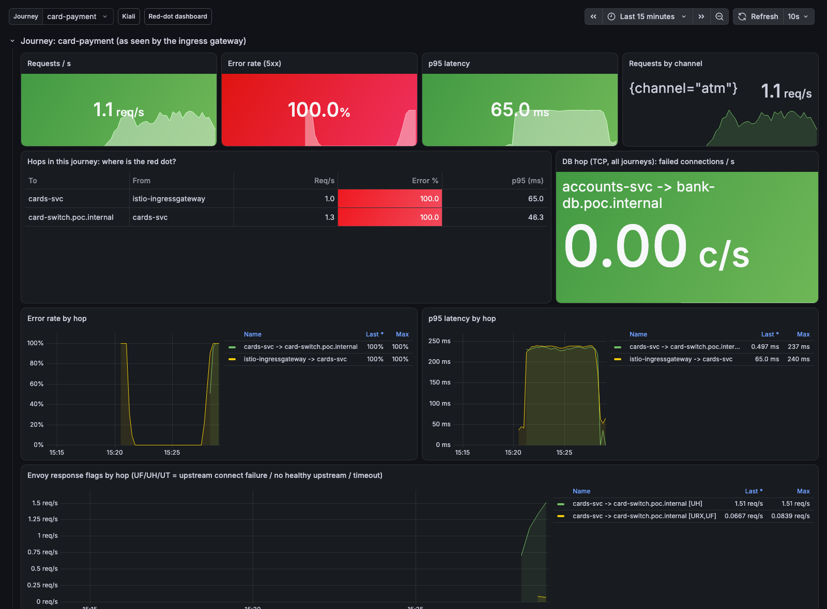
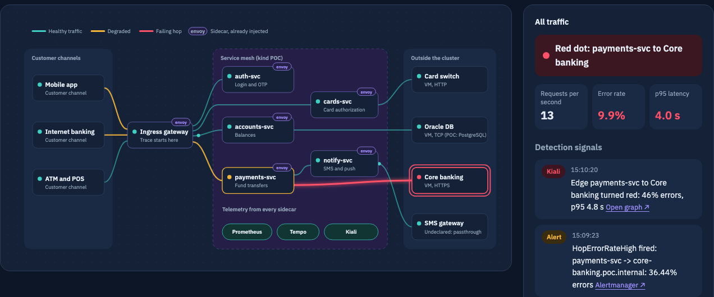
Four views on the same data
Kiali
Grafana journey dashboard
Red-dot dashboard
Live graph from Prometheus; traces from Tempo per node. Audience: mesh engineers.
Journey variable; hops, flags, Loki logs, Tempo traces. Audience: service owners.
Topology discovered from metrics; red dot, evidence and owner. Audience: NOC.
Alertmanager (on-call): 5 rules from Prometheus. Hop error rate over 5%, hop p95 over 1 s, TCP connect failures, journey error rate over 5%, journey p95 over 2 s. Each fires after 1 minute.
Notes:
Kiali for engineers troubleshooting the mesh; Grafana for service owners drilling into one journey; the red-dot dashboard for the NOC, which discovers the topology itself and names the owning team; Alertmanager for on-call.

Slide 16
From symptom to owner in under two minutes
0 s
~30 s
~60-90 s
Seconds
Same view
Fault starts
Edge turns red (1 m rate)
Alert fires (for: 1m)
Trace + access-log flag
Owner team named
Scenario (injected) | Red dot found | Envoy flag | Alerts after | Routed to
Core banking slow (1-4 s) | payments-svc to Core banking, 35-46% errors | UT | 82-96 s | Core banking team
Oracle DB unreachable | accounts-svc to Oracle DB (TCP) | UF, URX | 31-91 s | DBA team
Card switch down | cards-svc to Card switch, 100% errors | UF, then UH | 72-96 s | Card switch team
New service added, then broken | loans-svc to Credit bureau (discovered in 41 s) | UF, URX | 31 s to red dot | Credit bureau partner desk
Each failure was found on the right hop, with the right flag, and routed to the right team.
Notes:
Measured in the POC by breaking the mocked external systems for real. Metrics react within a rate window; alerts need the 1-minute 'for' period; the trace and access log give the reason; the owner comes from the observability.bank/owner annotation.

Slide 17
Moving the POC to OpenShift
1
Install
2
Metrics
3
Storage
OperatorHub (OLM) instead of Helm; no cert-manager, service-ca issues webhook certificates.
Do not install kube-prometheus-stack. Enable user workload monitoring; query Thanos Querier with a token.
TempoStack and LokiStack on S3-compatible object storage; persistent Prometheus.
4
Exposure
5
External TLS
6
Unchanged
Routes with OAuth instead of NodePorts; Kiali uses the openshift auth strategy.
Bank CA in a ConfigMap, credentialName configmap://. A Secret without workloadSelector is ignored.
Istio, IstioCNI, Telemetry, ServiceEntries, OTel CRs, TempoMonolithic, PodMonitors, alert rules.
Notes:
Mesh, OpenTelemetry, Tempo and Kiali resources carry over almost unchanged. What changes is how operators are installed, where metrics live and how things are exposed. Full mapping in docs/openshift-mapping.md.

Slide 18
Implementation steps
1
2
3
4
Enable user workload monitoring
Scrape the mesh
Connect Kiali
Deploy trace and log stores
cluster-monitoring-config: enableUserWorkload
PodMonitor for sidecars, ServiceMonitor for istiod
Point to Thanos Querier; service graph live
Tempo, Loki and Red Hat build of OpenTelemetry
5
6
7
8
Send traces and access logs
Fix trace propagation
Register externals
Verify end to end
Telemetry API providers; tail sampling keeps all errors
OTel auto-instrumentation via annotations
ServiceEntries, DestinationRules for TLS
Kiali nodes named, one unbroken trace
Notes:
Steps 1-3 give metrics and the red-dot graph. Steps 4-6 give traces and access logs. Steps 7-8 bring external systems in and validate. Check field names against the Red Hat docs for the installed Service Mesh version.

Slide 19
Start with one journey, then scale
1
2
3
4
Decisions needed
Pilot
One critical journey, e.g. mobile fund transfer
Validate
Unbroken traces, named external nodes
Roll out
Namespace by namespace
Tune
Sampling, alert thresholds, dashboards
Service Mesh version (2.x or 3.x) and upgrade timing
Tempo and Loki storage: monolithic for pilot, object storage for production
Sampling policy and trace and log retention
Pilot journey and owning team
Who owns dashboards and alert routing
Phase 2: channel-side tracing and agents on VMs and databases.
Notes:
Close by agreeing the pilot journey and the open decisions.

