Slide 1

Comparison Top100 ranks from various service provider
Donghyun Kang
2018.02.13
Data Scientist Fellow
NYC Data Science Academy

Slide 2
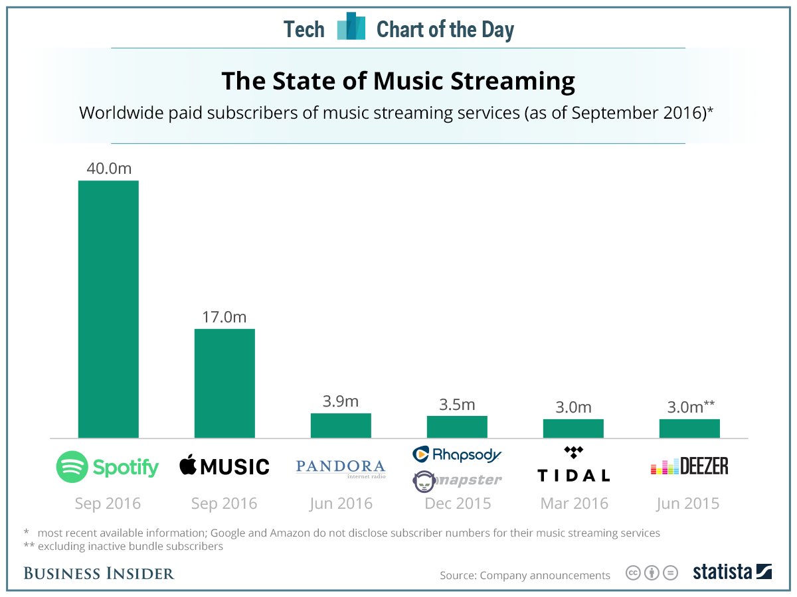
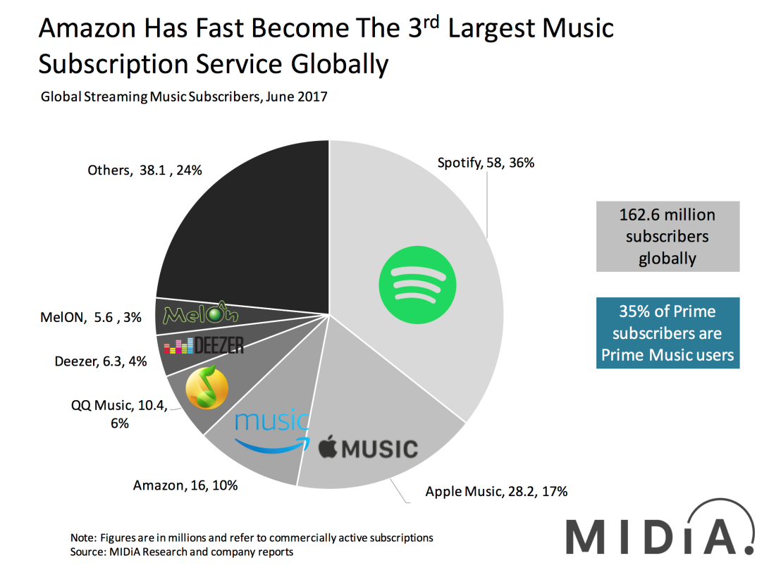
Motivation

Slide 3
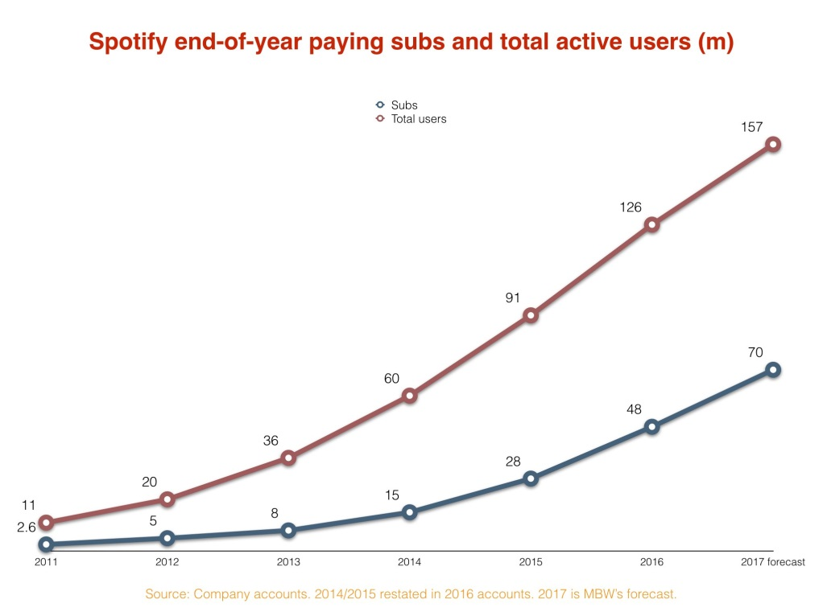
Motivation

Slide 4
Motivation
- Spotify is really making a music trend?
- Why many people uses Spotify’s data?
- Are these reliable?

Slide 5
Analysis points
- Spotify is really making a music trend?
→ Compare with others’ list
- Why many people uses Spotify’s data?
→ Web scraping and using it
Are these reliable?
→ …

Slide 6
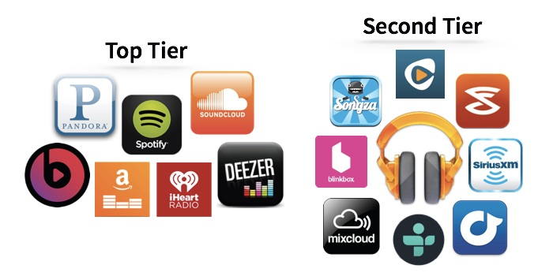
exploratory candidates

Slide 7
Data Sets by Web-scraping
Spotify Weekly Top 100
(https://spotifycharts.com/regional/us/daily/latest)
YouTube Music Chart Top 100
(https://artists.youtube.com/charts/tracks)
Billboard the hot 100
(https://www.billboard.com/charts/hot-100)
I Tunes
– for Genre

Slide 8
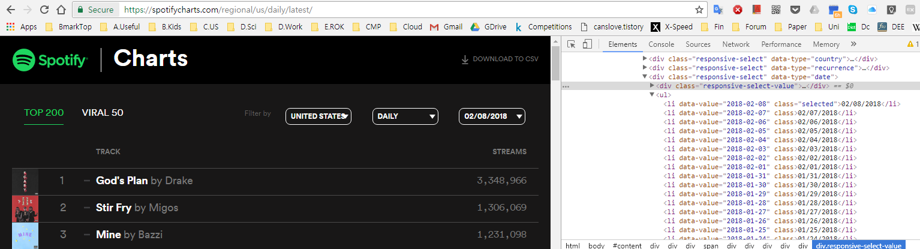
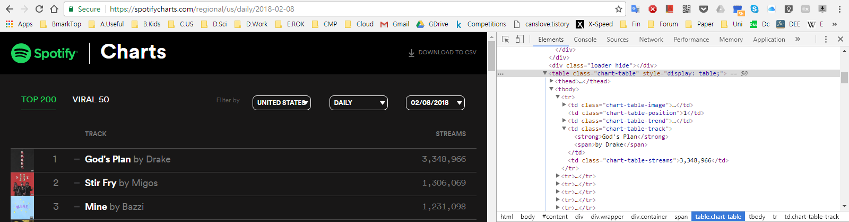
Spotify scraping
Scrapy

Slide 9
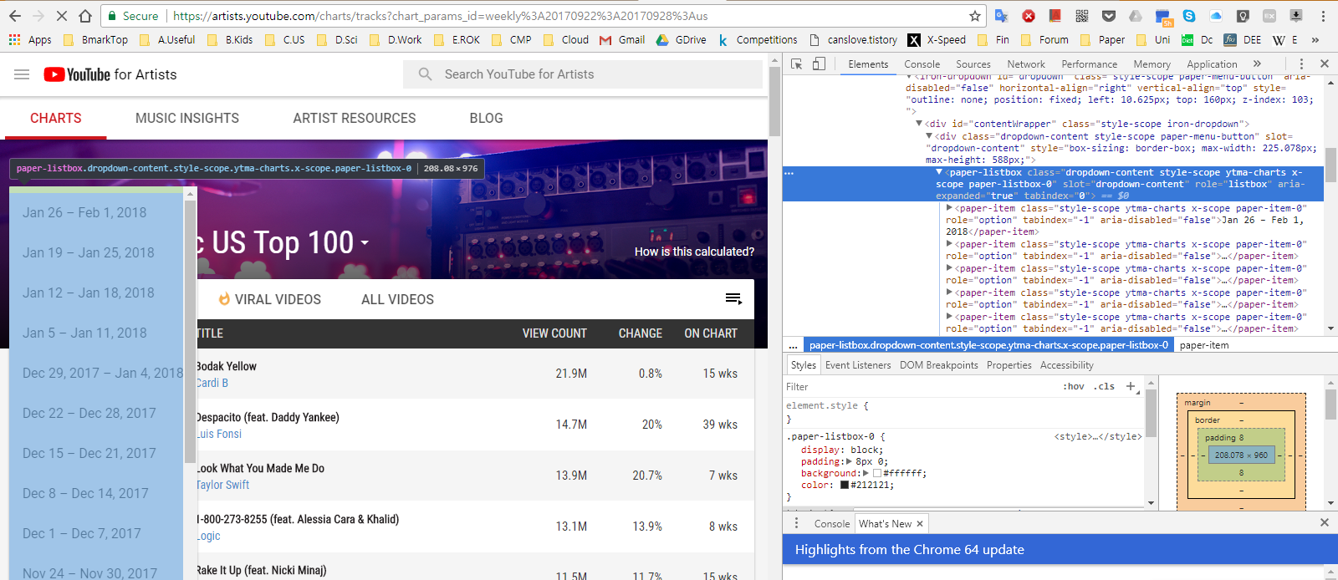
YouTube scraping
Selenium

Slide 10
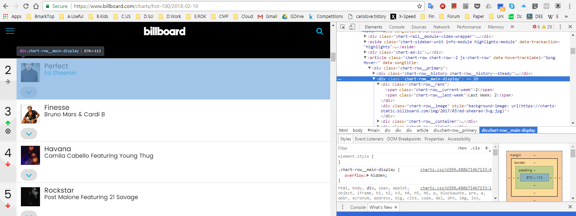
Billboard scraping
Scrapy

Slide 11
Why Spotify’s dataset ?
Easy to web-scrape
Easy to get (without web-scrape)
Provide various data set
Regional, Daily, Weekly
Long term monitored data
Every year
Quick update

Slide 12
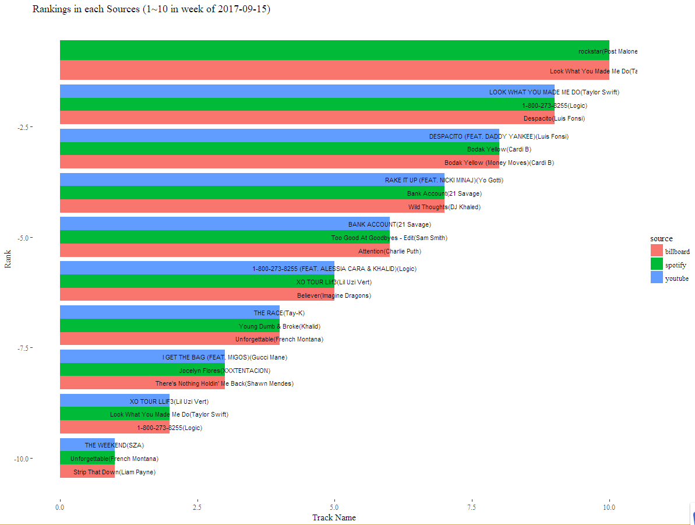
Rank Top10 Comparison

Slide 13
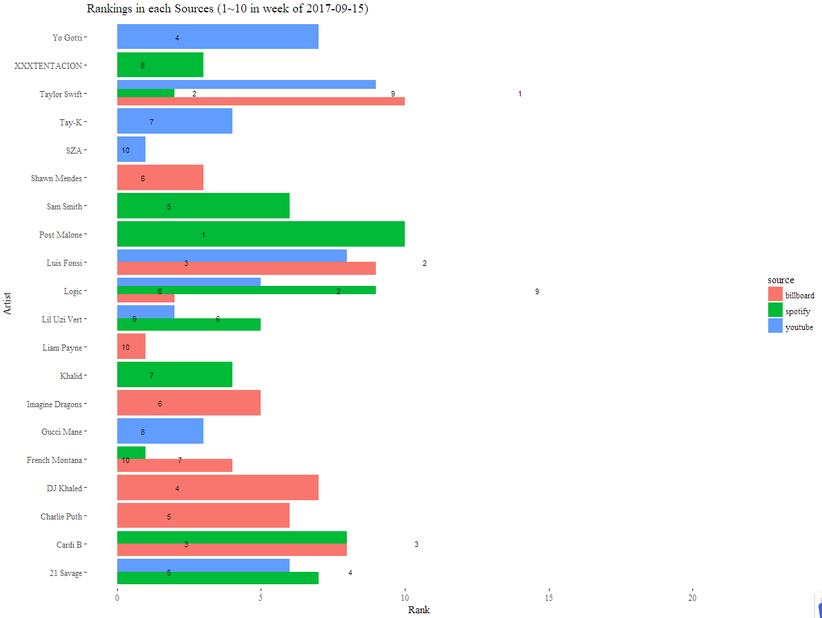
Rank Top10 Comparison

Slide 14
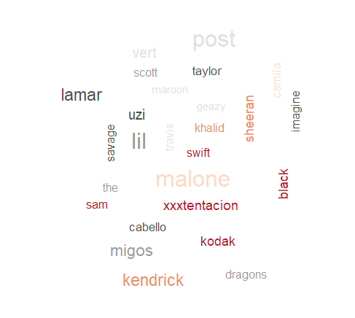



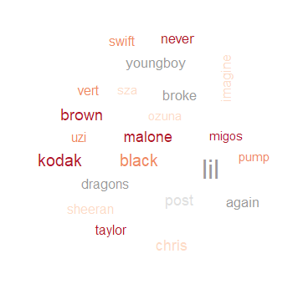
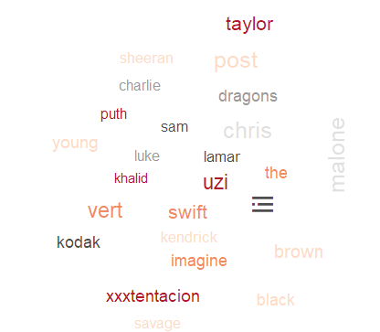
Significant factor selection

Slide 15
Significant factor selection
# 'Post Malone' : c("rockstar","congratulations","go flex","candy paint", "i fall apart", "white iverson")
# 'Kodak Black' : c("roll in peace", "transportin", "tunnel vision", "codeine dreaming", "no flockin", "patty cake","halloween", "patty cake", "too much money", "roll in peace") )
# 'Taylor swift' : c(""Look What You Made Me Do", "...ready for it?", "gorgeous", "call it what you want", "end game", "i did something bad", "delicate")
# 'Ed Sheeran' : c("shape of you", "perfect", "thinking out loud") # derivative should be merged again
# 'Imagine Dragons' : c("thunder", "believer")

Slide 16
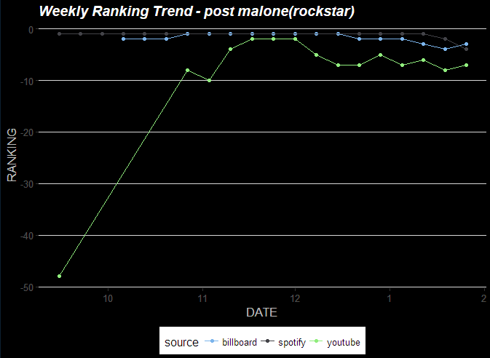
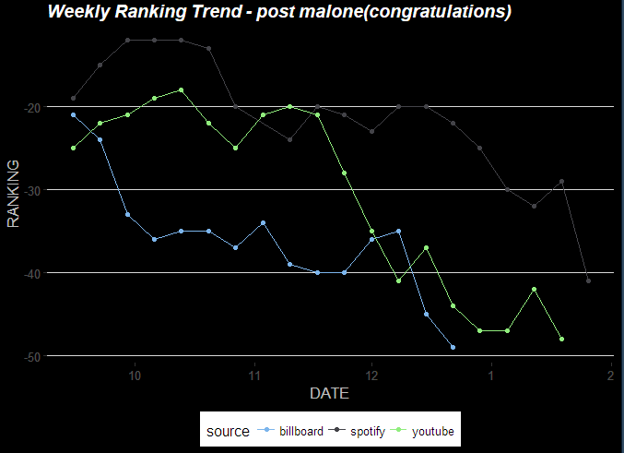
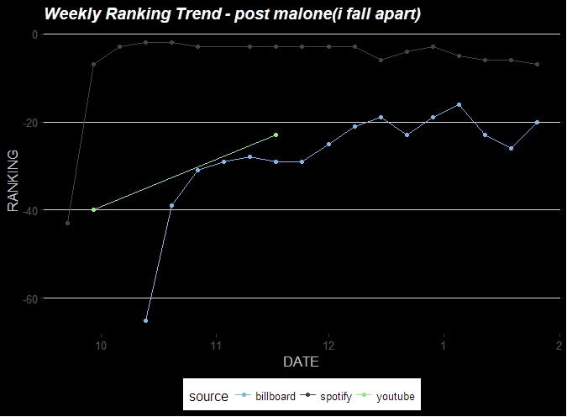
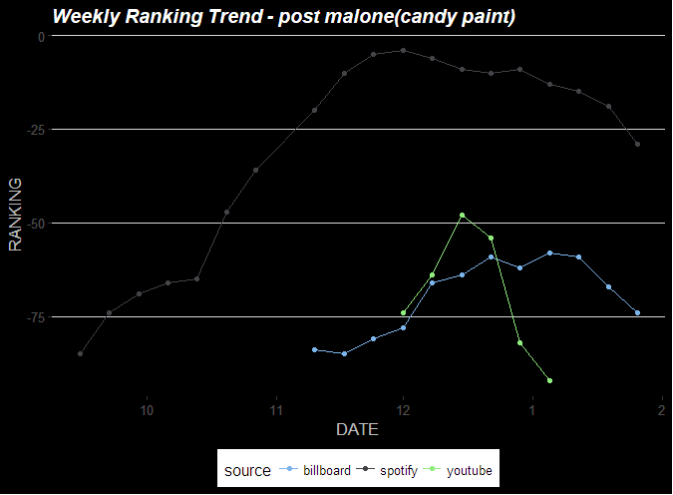

Slide 17
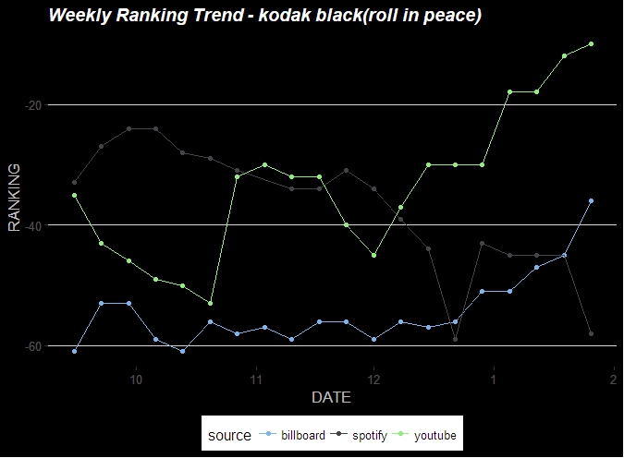

Slide 18
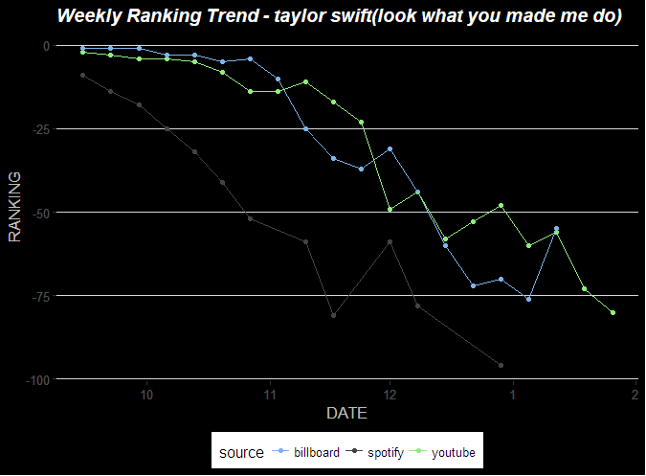
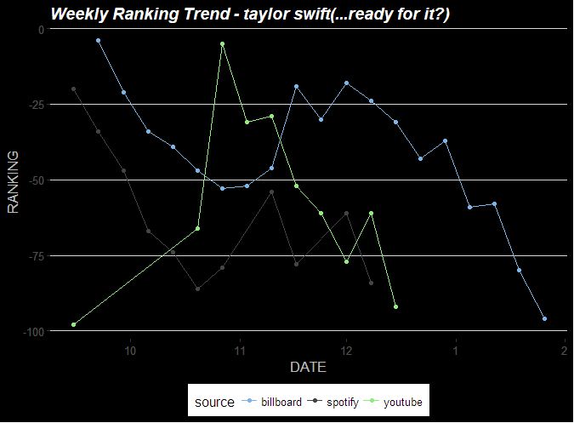
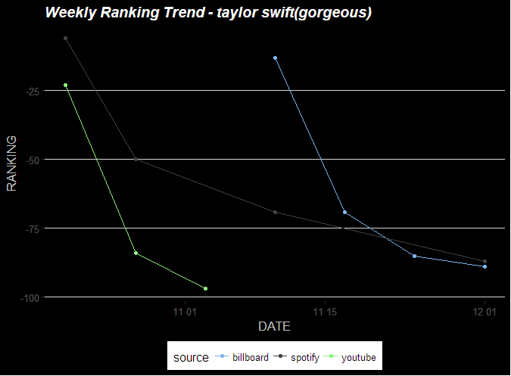
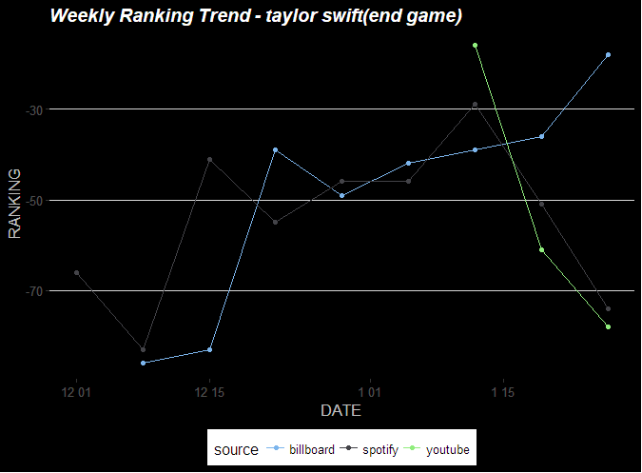

Slide 19
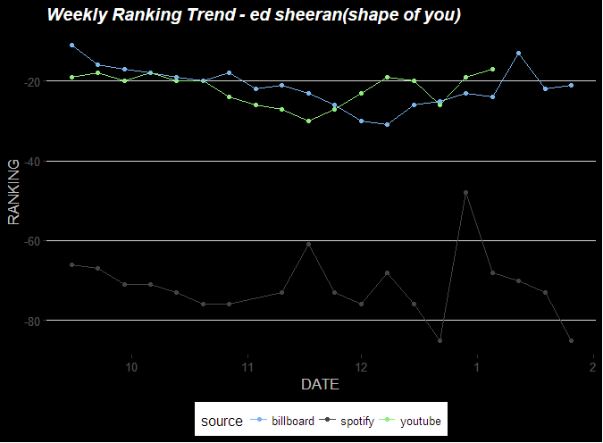
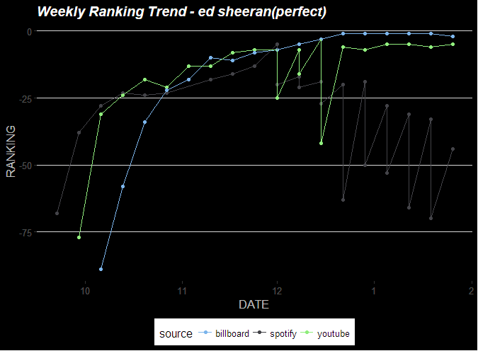

Slide 20
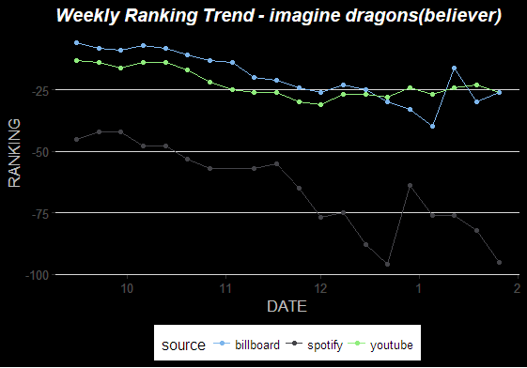
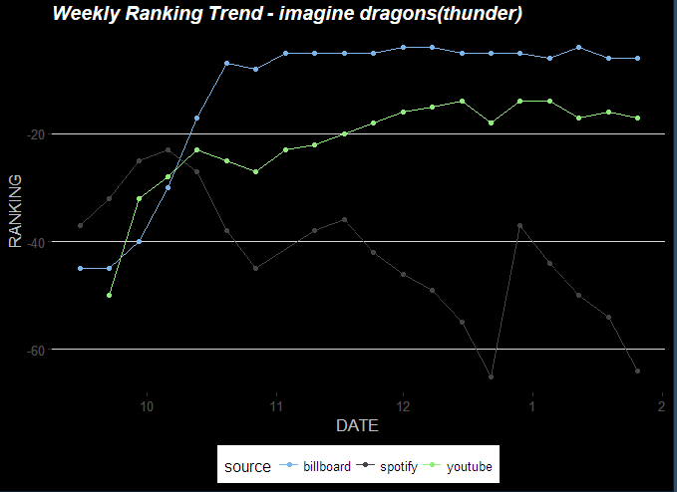

Slide 21
Observation
Spotify’s ranking line is on the left-side than YouTube music and Billboard’s
Spotify provide first viral hit and followed by YouTube music and Billboard’s
But,
long-term data comparison is needed

Slide 22
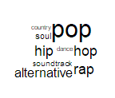
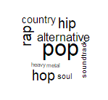
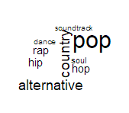
Genre positioning in Top100
Genre frequency in Week Top100 (2017-09-15 ~ 2018-01-26)
 | Spotify |  |  | Youtube |  |  | Billboard
 | pop | 49.6% |  | pop | 44.0% |  | pop | 40.5%
 | hip hop/ rap | 21.2% |  | hip hop/rap | 21.4% |  | country | 18.6%
 | alternative | 18.7% |  | alternative | 15.7% |  | alternative | 18.3%
 | R&B/Soul | 5.7% |  | country | 11.1% |  | hip hop/rap | 11.9%
 | Soundtrack | 4.2% |  | R&B/Soul | 4.7% |  | R&B/Soul | 4.5%
 | Country | 0.2% |  | Soundtrack | 2.9% |  | Soundtrack | 3.6%
 | Dance | 0.2% |  | Heavy metal | 0.2% |  | Dance | 2.7%

Slide 23
How to Rank ….
Total number of downloaded stream
Total number of viewed music on YouTube by video, artist, track, and viral score
Radio airplay audience impressions as measured by Nielsen Music,
sales data as compiled by Nielsen Music and streaming activity data provided by online music sources
Simple,
but
Fast, and effective !

Slide 24
Future Work
Data Survey
Regional subscriber distribution
Weather, Airplay data
Analysis
Free vs. charged subscriber
By age, gender, occupation
By weather, date
Visualization

Slide 25
Thank you for attention !

