Slide 1
Intelligent music streaming service based on the analysis of Top streams Songs and Artists on Spotify
Donghyun Kang
2018.01.31
Data Scientist Fellow
NYC Data Science Academy

Slide 2
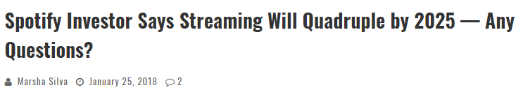
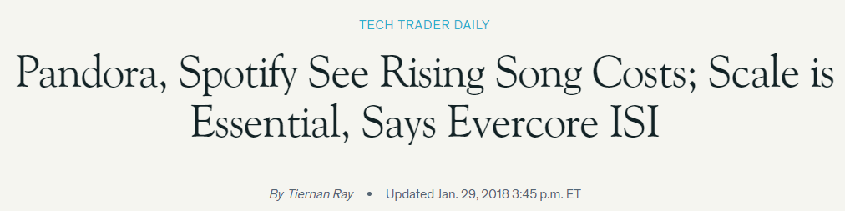

Motivation
The trend analysis will give us to explore how artists and songs' popularity varies in time.

Slide 3
Insights
By using the daily ranking of the 200 most listened songs in 53 countries by Spotify users,
Can you PREDICT what is the rank position or the number of streams a song will have in the future?
Does people SHARE the very same top ranking songs on countries far away from each other?
If then we can make some BUSINESS MODELS closely related to the tendency?
How long time does a top ranking song takes to get into the ranking of neighbor countries?
Make A DISTRIBUTION MAP, and INFLUENCE MAP by region, country, genre(music categories), and other information (such as season, weather, social event, etc)
Check a possibility to develop A Music Recommendation Service based on user-preference?

Slide 4
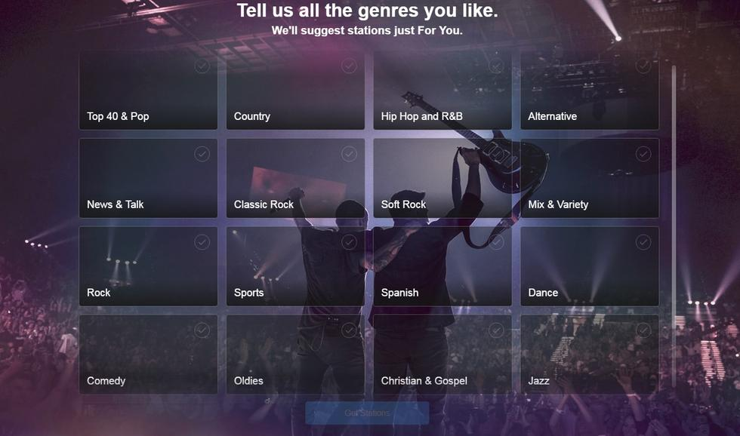
Analysis points
By Artist
By Genre
By Lyrics
By Gender
By Age
By Weather condition
By Social effect

Slide 5

Data Sets
spotifys-worldwide-daily-song-ranking.zip
top-tracks-of-2017.zip
top-tracks-of-2016.zip
every-song-you-have-heard-almost.zip
As references,
SiriusXM Internet Radio
Apple Music
Amazon Music Unlimited
Google Play Music
Pandora Internet Radio

Slide 6
Limitation
Data Set is Too huge to visualize
To find any statistical approach to guarantee the reliability of the reduced set

Slide 7
Future Work
Analysis
Countryside spread
Worldwide spread
Reference comparison
Web scraping
Data mining : Another Data Sets
Develop Predict Model

Slide 8
Appendix

Slide 9
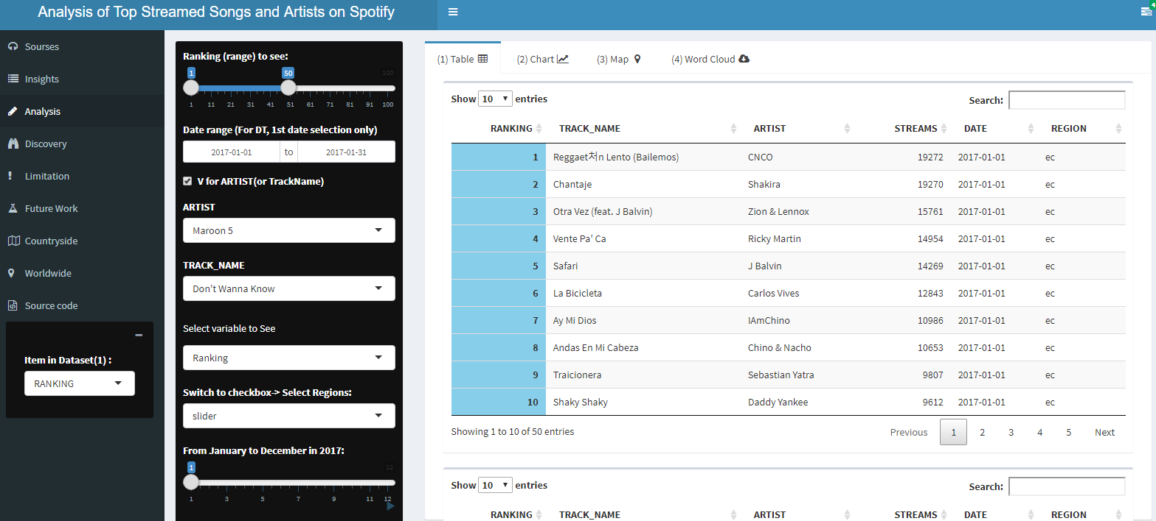
Table

Slide 10
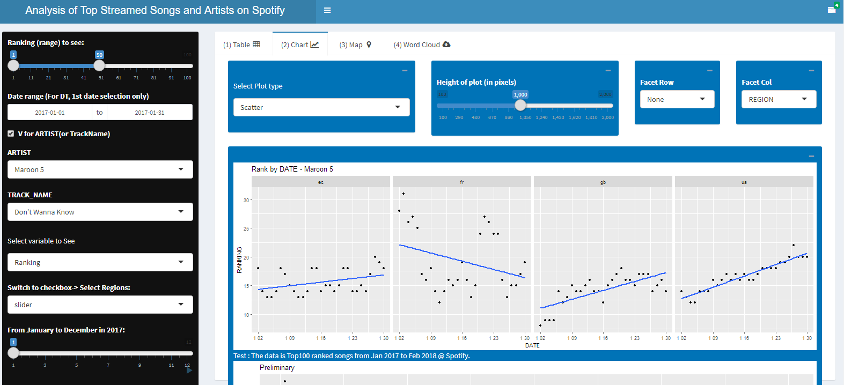
Chart

Slide 11
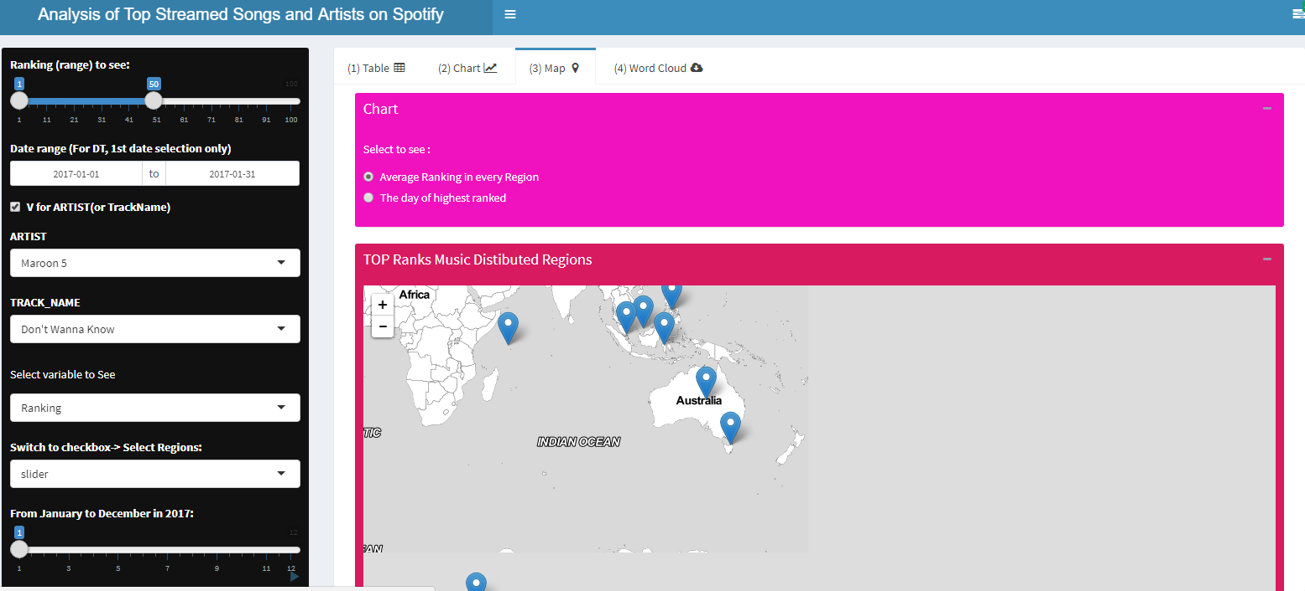
Map

Slide 12
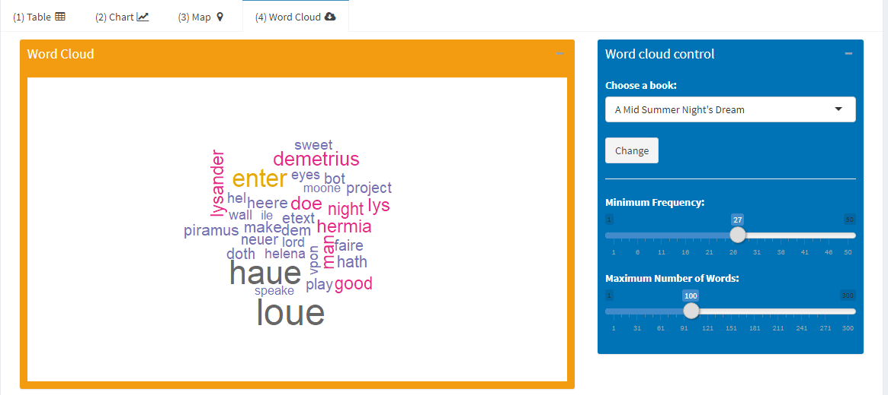
Word cloud

