Slide 1

Illicit Object Detection in X-ray Baggage Images
YOLOv8n Evaluation on OPIXray
Course Project Practical Part - Artificial Vision and Computer Learning
Cansu Karagöz
30 May 2026

Slide 2
Contents
01
Introduction and project scope
02
Proposed solutions and selected method
03
Datasets and OPIXray preparation
04
Metrics and experimental setup
05
Overall and class-level results
06
Qualitative evidence and discussion
07
Conclusions and delivery checklist
08
References

Slide 3
1. Introduction and Project Scope
Goal: detect prohibited knife/cutter-like objects in cluttered X-ray baggage images.
Why it matters
Core challenges
Project scope
- Security operators must inspect many overlapping objects quickly.
- Computer vision can flag suspicious regions and reduce missed detections.
- Real-time detection is important for practical screening workflows.
- X-ray colors are not natural RGB object colors.
- Items are often occluded, transparent, small, or visually similar.
- Class imbalance makes rare objects harder to learn.
- One selected method: YOLOv8n.
- One selected dataset: OPIXray full train/test split.
- Evaluation uses Precision, Recall, mAP@50, mAP@50:95, and speed.

Slide 4
2. Proposed Solutions
The selected implementation favors a real-time one-stage detector while keeping standard detection metrics.
Method
Year
Main idea
Representative result
Fit for this project
Faster R-CNN
2015
Two-stage detector: region proposals plus classification/regression.
5 FPS reported with VGG-16; strong accuracy on VOC/COCO.
Accurate but heavier for Colab and real-time use.
YOLO
2016
Single neural network predicts boxes and classes in one pass.
45 FPS base model; Fast YOLO 155 FPS.
Good speed baseline for inspection scenarios.
DETR
2020
Transformer set prediction removes anchors and non-maximum suppression.
Accuracy/runtime comparable to Faster R-CNN on COCO.
Conceptually strong, but slower to train on limited resources.
YOLOv8n
2023
Ultralytics real-time detector with anchor-free split head and light nano model.
This project: 0.862 mAP@50 on OPIXray.
Selected: best balance of reproducibility, speed, and available tooling.
Sources: Ren et al. 2015; Redmon et al. 2016; Carion et al. 2020; Ultralytics YOLOv8 docs.

Slide 5
3. Datasets for X-ray Prohibited-Item Detection
OPIXray is the selected benchmark because it directly targets occluded cutter-like objects.
Dataset
Year
Scale
Classes / annotations
Relevance
OPIXray
2020
8,885 images
5 cutter-like prohibited classes; bounding boxes; occlusion levels.
Selected dataset. Matches the project target: hidden/occluded knives and cutters.
SIXray
2019
1,059,231 images
6 prohibited classes; 8,929 positive samples.
Large-scale screening benchmark with heavy class imbalance.
PIDray
2021
47,677 images
12 prohibited categories; boxes and segmentation masks.
Real-world hidden item benchmark with easy/hard/hidden splits.
HiXray
2021
102,928 instances
8 prohibited categories annotated by security inspectors.
High-quality airport security dataset focused on overlap and low contrast.
Dataset facts: OPIXray, SIXray, PIDray, and HiXray papers.

Slide 6
4. OPIXray Dataset Preparation
The notebook converts all 8,885 images from OPIXray text annotations into YOLO format.
Full split used
Original annotation
YOLO annotation
Train images: 7,109
Validation images: 1,776
Train labels: 7,109
Validation labels: 1,776
Skipped files: 0
image_name class_name xmin ymin xmax ymax
Example fields are converted from pixel coordinates into normalized center and size values.
class_id x_center y_center width height
All box coordinates are normalized between 0 and 1, then referenced from data.yaml.
Class order: Folding_Knife, Straight_Knife, Scissor, Utility_Knife, Multi-tool_Knife
Dataset GitHub link: https://github.com/OPIXray-author/OPIXray

Slide 7
5. Selected Method: YOLOv8n
YOLOv8n was selected for reproducible, fast object detection under Colab GPU constraints.
Input X-ray
Backbone + neck
Anchor-free head
Outputs
640 x 640 image
>
feature extraction and fusion
>
boxes + class probabilities
>
5 prohibited-item classes
Why this implementation
- Ultralytics provides train, validation, prediction and export workflows.
- YOLOv8n is the lightest model variant, suitable for Tesla T4 memory and fast inference.
- The framework automatically produces standard plots and metric summaries.

Slide 8
6. Experimental Setup
Pipeline was verified on a small subset, then trained/evaluated on the full OPIXray split.
Parameter
Value
Execution protocol
Platform
Google Colab
1. Verify folders and annotation counts.
2. Convert OPIXray labels to YOLO format.
3. Train YOLOv8n on the full training split.
4. Validate on 1,776 validation images.
5. Save model weights, plots, predictions, and metrics.
GPU
Tesla T4
Framework
Ultralytics 8.4.56
Model
YOLOv8n pretrained weights
Epochs / image size
20 epochs / 640 x 640
Batch / optimizer
8 / AdamW
Dataset format
YOLO
Evaluation split
Full OPIXray validation set

Slide 9
7. Performance Metrics
Metrics separate classification confidence, object coverage, localization quality, and runtime.
Precision
Recall
mAP@50
TP / (TP + FP)
TP / (TP + FN)
IoU = 0.50
How many predicted detections are correct.
How many true objects the model finds.
Mean average precision at one permissive overlap threshold.
mAP@50:95
Speed
IoU sweep
ms/image, FPS
Average over stricter thresholds from 0.50 to 0.95.
Separate inference-only speed from full preprocess-to-postprocess speed.

Slide 10
8. Overall Results
YOLOv8n reaches strong mAP@50 while stricter mAP@50:95 shows room for better localization.
Precision
Recall
mAP@50
0.859
0.792
0.862
Predicted boxes are usually correct.
Some objects are still missed.
Strong detection at IoU 0.50.
mAP@50:95
Inference
End-to-end
0.405
2.5 ms
5.2 ms
Localization degrades under stricter IoU.
400 FPS inference-only estimate.
192.31 FPS including pre/postprocess.
Interpretation: high mAP@50 means the model usually finds the prohibited item; the gap to mAP@50:95 indicates that tighter box alignment remains the main technical limitation.

Slide 11
9. Class-Level Results
Scissor is the strongest class; Straight_Knife is the main bottleneck.
Class
Prec.
Recall
mAP50
mAP50:95
mAP@50 by class
Folding_Knife
0.859
0.822
0.895
0.422
Folding_Knife
0.895
Straight_Knife
0.798
0.498
0.681
0.268
Straight_Knife
0.681
Scissor
0.962
0.970
0.979
0.517
Scissor
0.979
Utility_Knife
0.846
0.783
0.833
0.401
Utility_Knife
0.833
Multi-tool_Knife
0.833
0.883
0.921
0.419
Multi-tool_Knife
0.921
Straight_Knife has the lowest recall (0.498), so the model often misses this class even when precision remains acceptable.

Slide 12
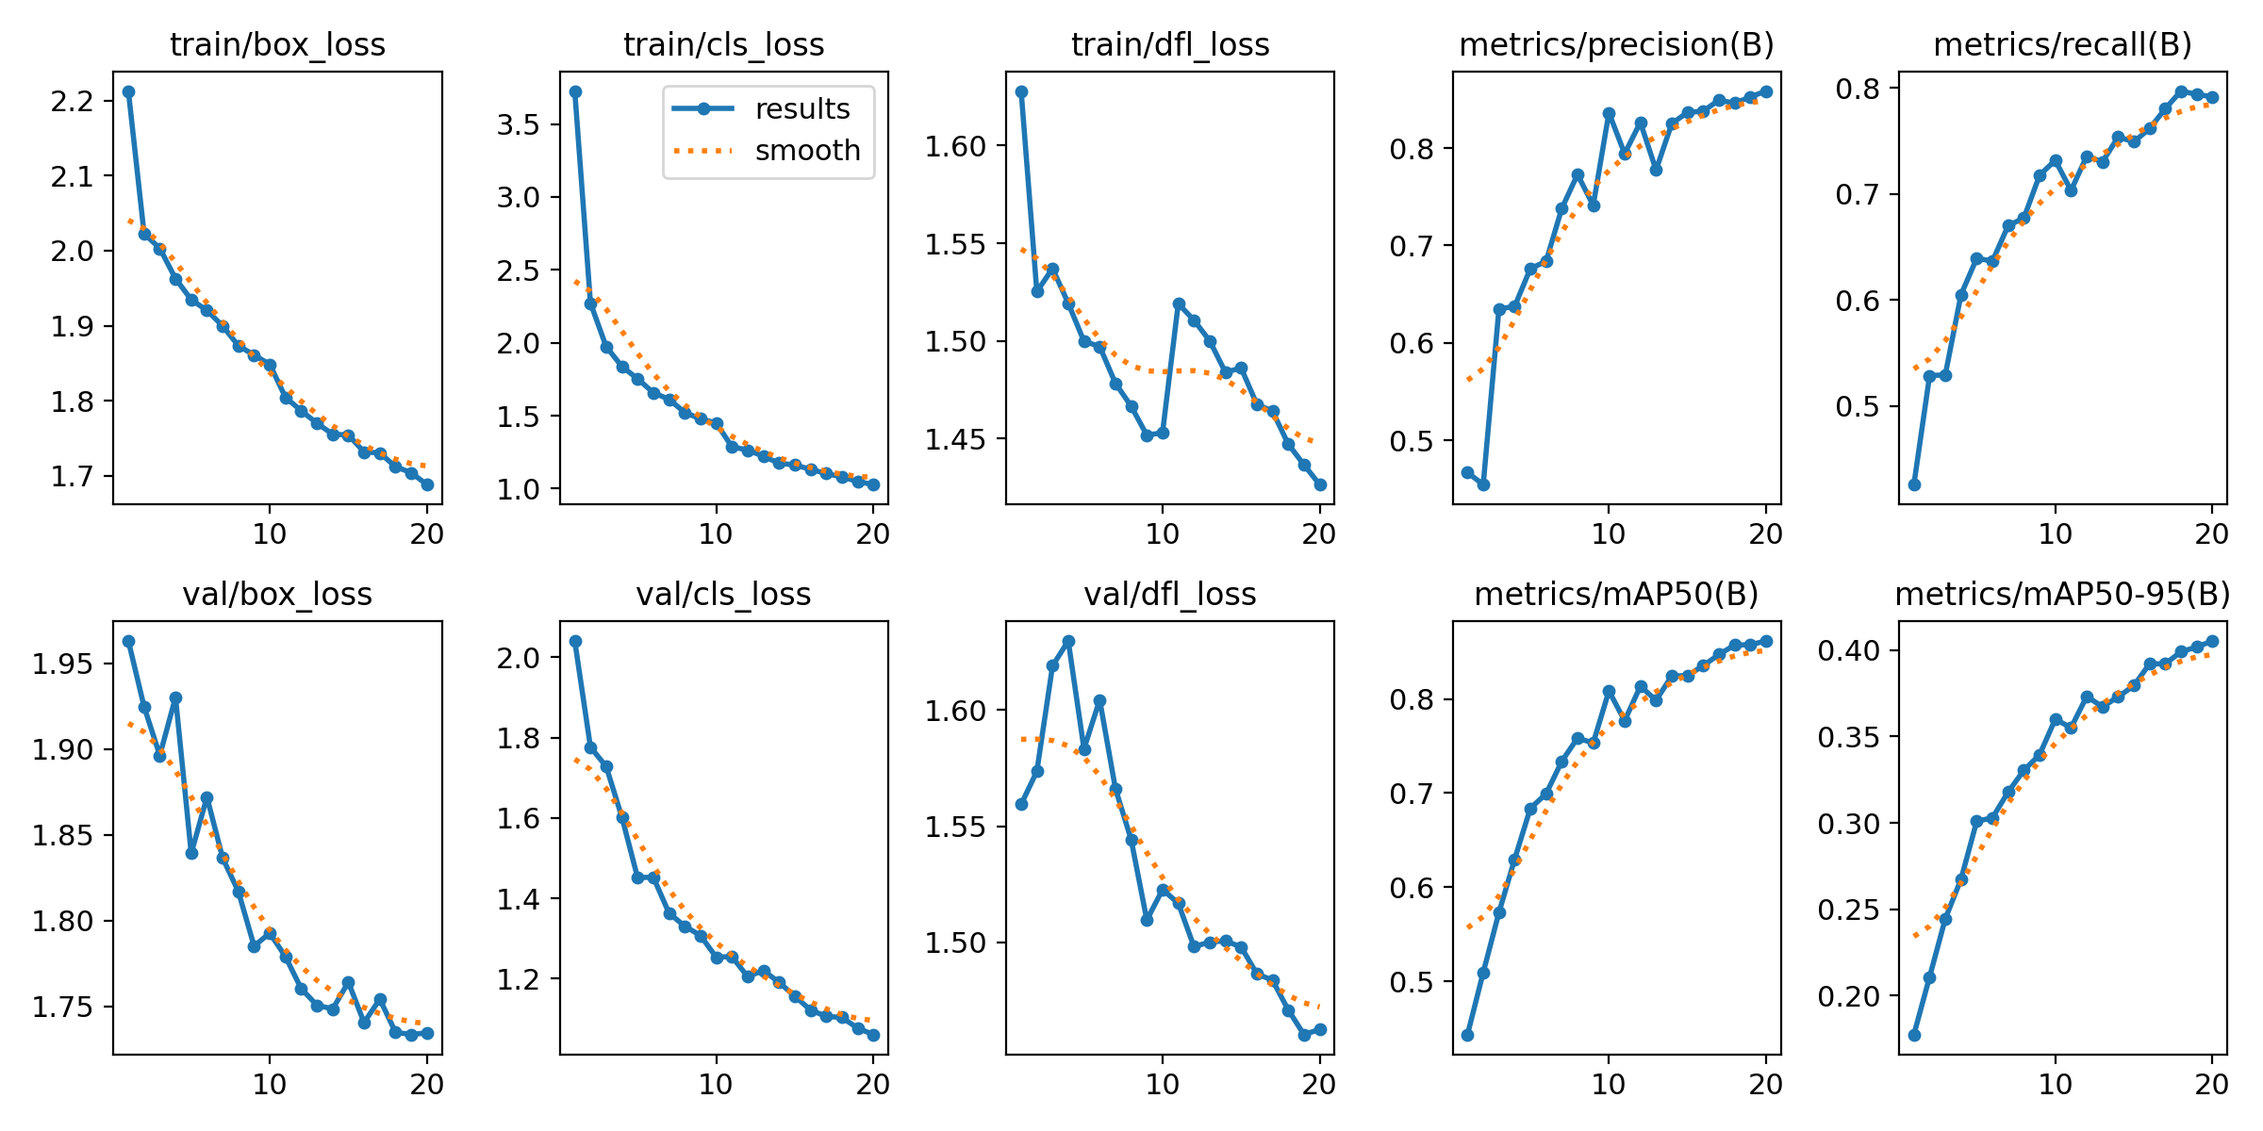
10. Training Curves
Losses decrease over 20 epochs while validation metrics improve, with no obvious late collapse.
What the curves show
- Box, class, and distribution focal losses trend downward.
- Precision and recall improve during training.
- Validation curves still fluctuate, which is expected with occluded and imbalanced classes.

Slide 13
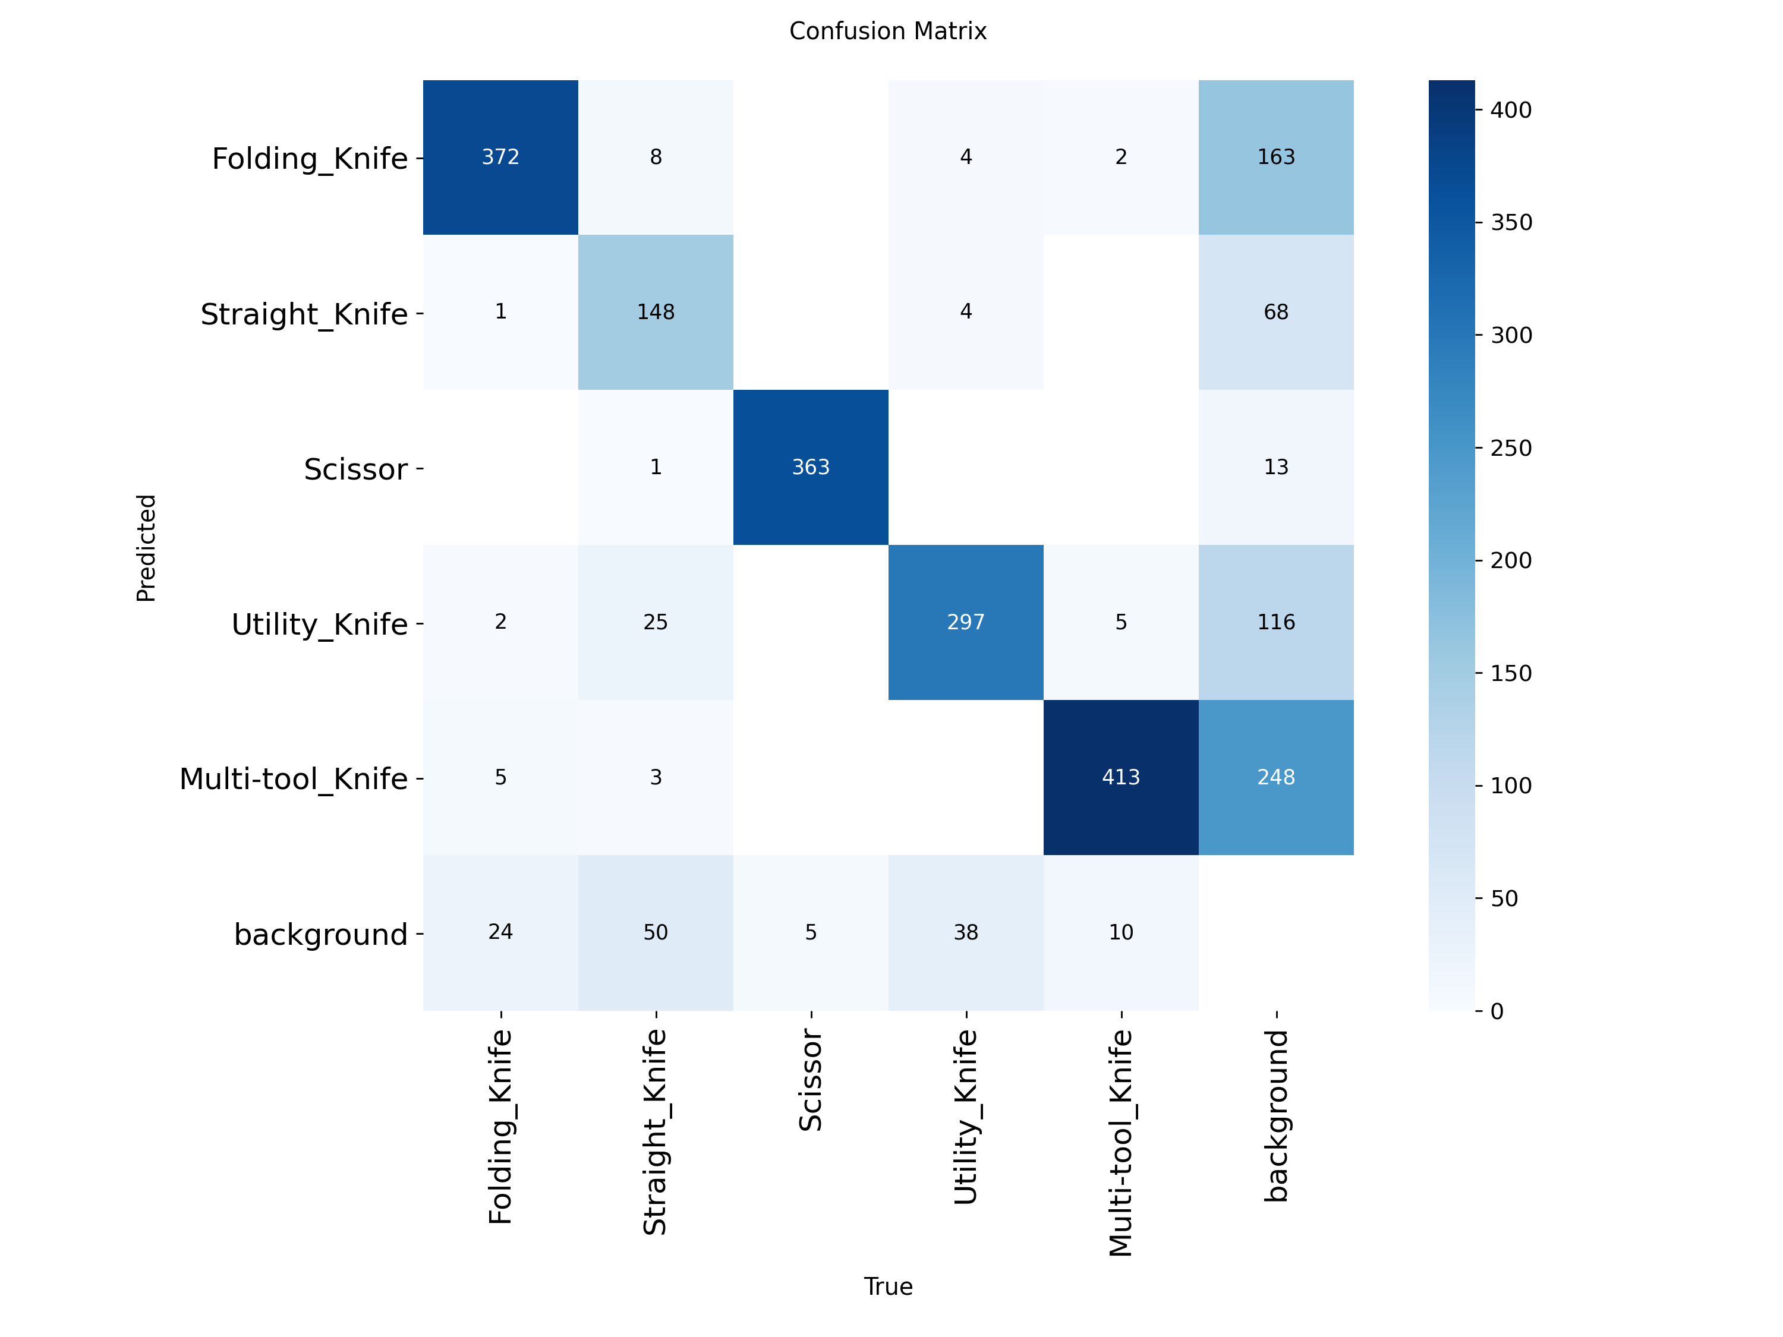
11. Confusion Matrix
Most classes are recognized, but Straight_Knife shows the clearest confusion and missed detections.
Reading the matrix
- Strong diagonal cells indicate correct class assignments.
- Straight_Knife has lower recall and more misses.
- Background errors matter because a missed prohibited item is operationally costly.

Slide 14
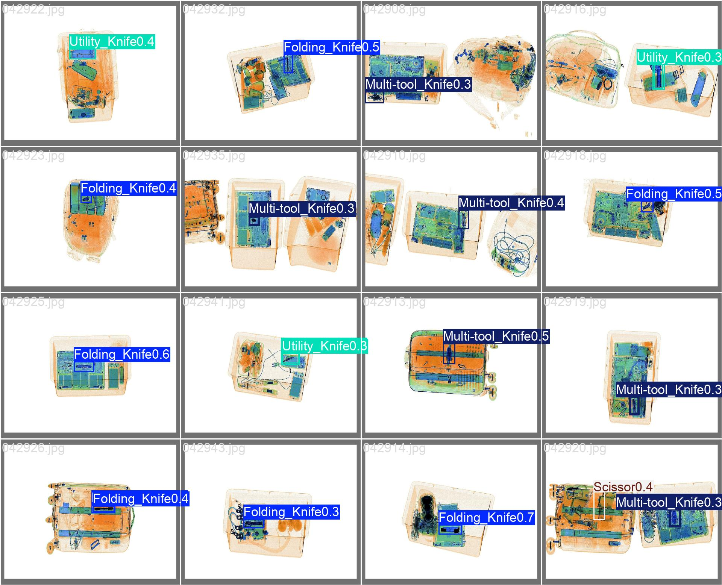
12. Qualitative Results
Predicted boxes show that the detector can localize prohibited items inside cluttered X-ray baggage.
Visual evidence
- Predictions use the final YOLOv8n run.
- Boxes highlight the detected prohibited item class.
- Remaining errors are expected when objects are tiny, occluded, or visually similar.

Slide 15
13. Results and Discussion
The model is fast and reliable at coarse localization, but class imbalance and occlusion still shape the errors.
What worked
Main bottlenecks
Implication
- Overall precision is high at 0.859.
- mAP@50 reaches 0.862.
- Scissor and Multi-tool_Knife perform especially well.
- Runtime supports real-time inspection scenarios.
- Straight_Knife has the weakest recall.
- mAP@50:95 drops to 0.405.
- Occlusion and similar shapes create missed or loose boxes.
- The dataset has class imbalance.
- YOLOv8n is a strong lightweight baseline.
- A larger model or targeted augmentation should focus on Straight_Knife.
- Future work should compare YOLOv8 variants and occlusion-aware modules.

Slide 16
14. Conclusions
The project satisfies the practical evaluation requirement using one implementation and one complete dataset.
Main conclusions
Future work
- YOLOv8n was successfully trained and evaluated on the full OPIXray split.
- The final model achieved 0.862 mAP@50 and 0.859 precision.
- End-to-end processing is about 5.2 ms/image, or 192.31 FPS.
- Performance varies by class; Straight_Knife needs the most improvement.
- Train larger YOLOv8/YOLO11 variants.
- Add targeted augmentation for low-recall classes.
- Compare against Faster R-CNN, DETR, and occlusion-attention methods.
- Test on additional datasets such as PIDray or HiXray.

Slide 17
References
[1] Ren, S. et al. Faster R-CNN: Towards Real-Time Object Detection with Region Proposal Networks. NeurIPS, 2015.
[2] Redmon, J. et al. You Only Look Once: Unified, Real-Time Object Detection. CVPR, 2016.
[3] Carion, N. et al. End-to-End Object Detection with Transformers. ECCV, 2020.
[4] Jocher, G., Chaurasia, A., Qiu, J. Ultralytics YOLOv8 documentation and software, 2023.
[5] Wei, Y. et al. OPIXray: X-ray security inspection benchmark and DOAM. ACM Multimedia, 2020.
[6] Miao, C. et al. SIXray: Large-scale Security Inspection X-ray Benchmark. CVPR, 2019.
[7] Wang, B. et al. PIDray: Large-scale X-ray Benchmark for Real-World Prohibited Item Detection. ICCV, 2021.
[8] Tao, R. et al. HiXray and Lateral Inhibition Module for Prohibited Items Detection. 2021.
[9] Project notebook: Object_Detection.ipynb; OPIXray full YOLOv8n run and exported results.

Slide 18
Thank you for your attention

