Slide 1

CS102 Project Presentation
Music Time
Sec03/7
Cansu Canan Ceyhan
Giray Baha Kezer
Aslı Alpman
Kenan Şahin
Semih Teker

Slide 2
Purpose: Developing a music quiz application
Targeted Users: No specific group targeted
Desired Features:
A wide variety of questions which are
categorized according to their types and difficulty levels
Keeping scores by creating unique users’ account
Lifelines options which are similar to Who Wants To Be a Millionaire?
Provide users to test their music knowledge

Slide 3
Requirements
Scoring and ranking system:
Every user has an account which keeps scores.
Highest scores are shown in main page.
Question Classification System
Categorized in music genres
Classified according to their difficulty levels
Additional Features
Lifelines
Profiles are formed by users’ preferences

Slide 4
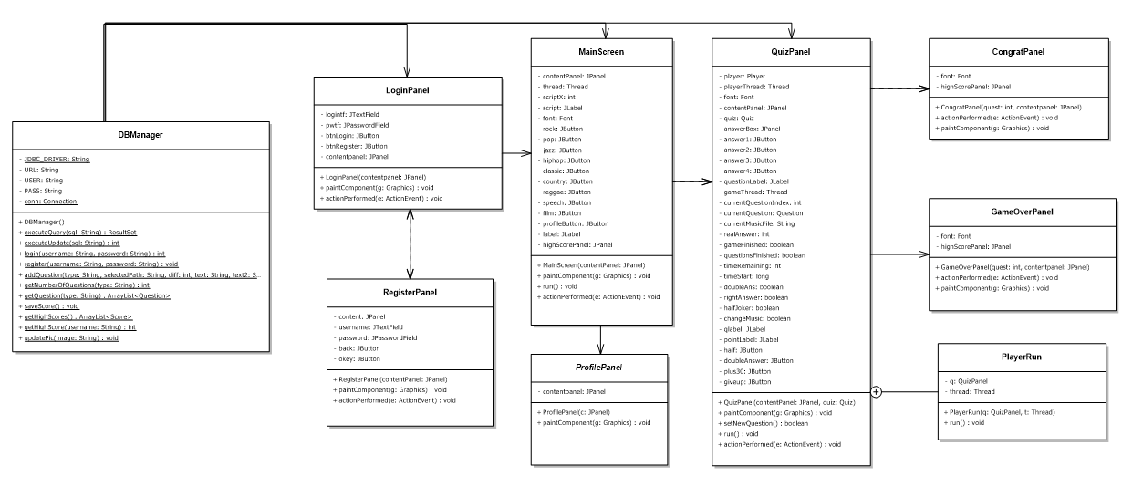

Slide 5
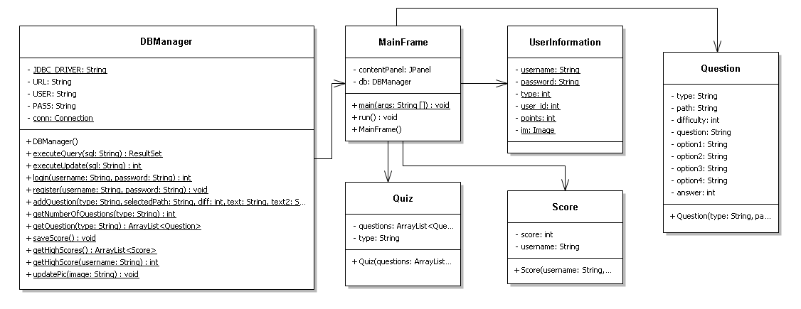

Slide 6
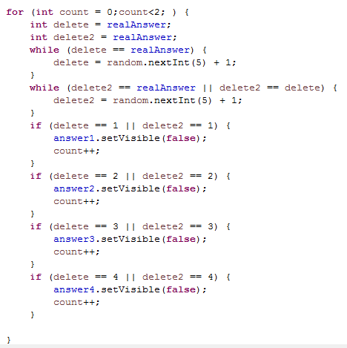
Important Methods
Algorithm of 50/50 lifeline
Define two int variables which indicates the number of options which will be deleted.
Assigning values to these variable until they are not the correct answer and equal to each other.
Delete these answers until two answer deleted.

Slide 7
public static int login(String username, String password)
Creates a string with username and password.
Query the database with this string and return a ResultSet.
If this ResultSet object is not null, get the username, id, password and image information provided by database.

Slide 8
public static ArrayList<Question> getQuestions(String type)
Creates an arraylist of Question.
Collecting data from database by their genre and difficulty.
Return data as ResultSet object.
As long as there is another row in ResultSet object, it creates a new question with the information provided by database.
Question created is added to arraylist.
Return the arraylist.

Slide 9
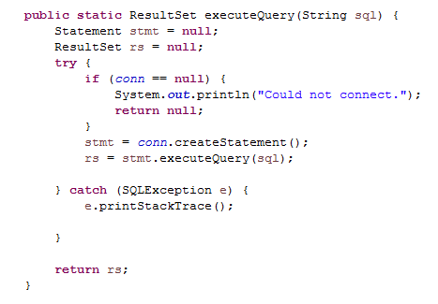
public static ResultSet executeQuery(String sql)
Firstly, checks whether there is a connection between database and java.
If there is, create a statement which is the object used for executing a SQL statement and returning the results it produces
Over this statement, we execute query with the string given as parameter which is edited for database.
Return the result of this query as ResultSet object

Slide 10
Satisfied Requirements
Account creating
Lifelines
Keeping scores
A familiar quiz design
Unsatisfied Requirements
Multiplayer Option
Android Application
Ranking System
Threshold System
Insufficient number of questions
Data Structure
Arraylist
ArrayList < Question > : Arraylist of Question objects
ArrayList < Score> : Arraylist of Score objects

Slide 11
Semih
MainFrame
MainScreen
GameOverPanel
Kenan
QuizPanel
Quiz
Question
Cansu
DBManager
Score
UserInformation
Aslı
LoginPanel
RegisterPanel
ProfilePanel
CongratPanel

Slide 12
Thank You!

