Slide 1

My pınterest analysıs
Elif Cansu Ipek

Slide 2

Table of content
Overview of the Project
Data Source
Hypothesis
Methods Used in Color Analysis
Analysis of Results
Methods Used in Theme Analysis
Analysis of Results
Conclusion
Limitations and Future Work

Slide 3
Overvıew of the Project
This project is designed to analyse my pinterest mainboard’s dominant colors and themes.
I wanted to chose this as project because Pinterest is the app I spend the most time in compared to other social media apps and its algorithm shapes my mainpage very quickly into what I am interested in those days.

Slide 4

Data source
I used my own pinterest mainpage as data source. I saved different versions of it several times to analyze it correct. I will be sharing only one html file to be able to keep track of the data easier.

Slide 5
hypothesıs
I mostly use pinterest for outfit inspirations and usually pins in bright colors catches my attention and I save them. Therefore, my hypothesis for the project are the followings;
The most used colors in my pins are white and pink.
The themes of the pins are mostly about fashion.

Slide 6
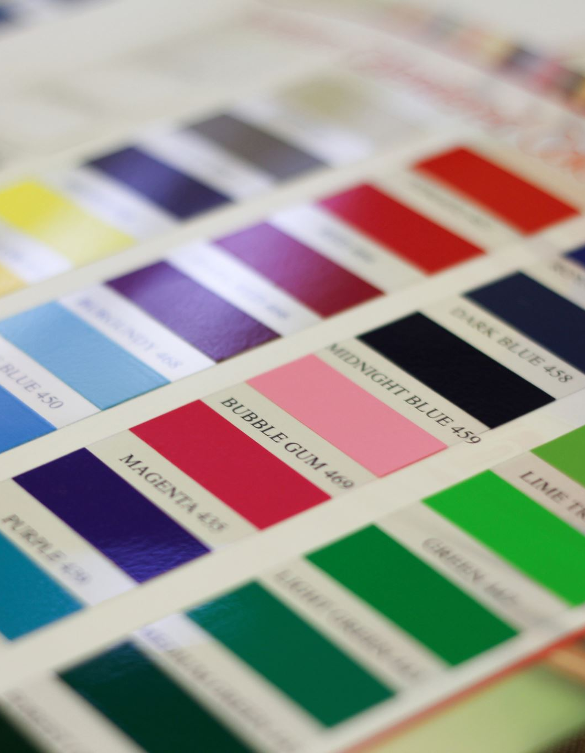
Methods used ın Color analysıs
I firstly used ColorThief library to find the dominant colors from the images on my board and I kept a counter.
I visualized the dominant colors of the images.
  The colors were very similar but they were identified with different names and counts were almost 1 for each. So, I categorized them into more general colors.
Then I grouped the dominant colors into more general color names using webcolors library and visualized color categories.

Slide 7
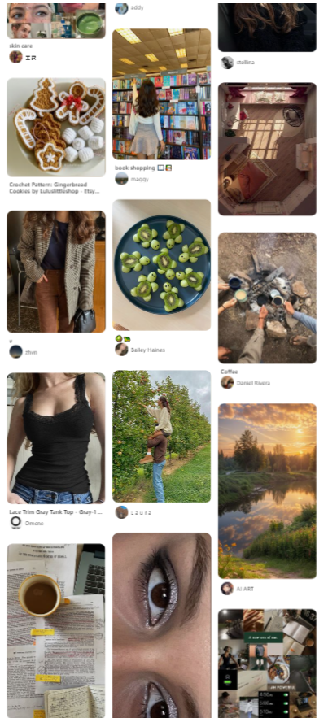
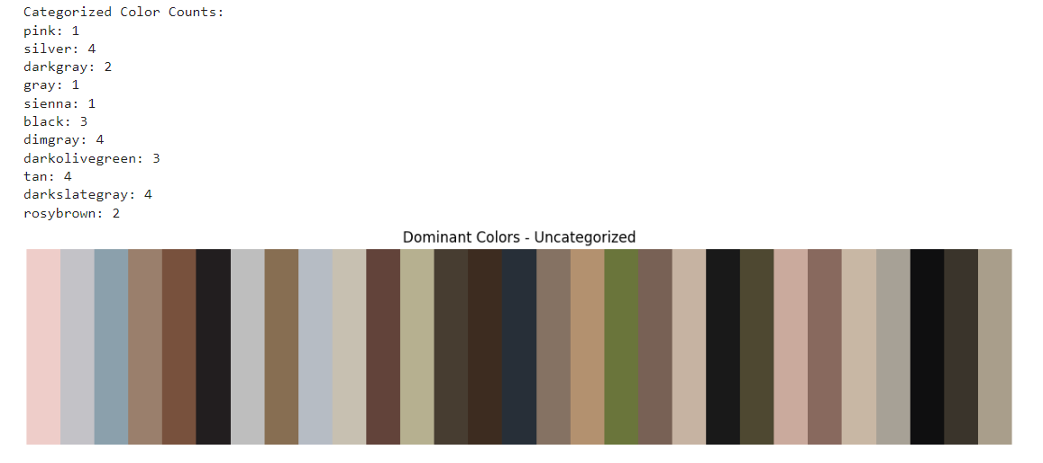
analysıs
The dominant colors are given for the pinterest page provided on the left. It is seen that there are similar colors but they are put under different categories so, their counts are low even though the shade is dominant.
Therefore, similar colors are grouped and the counts are given.

Slide 8
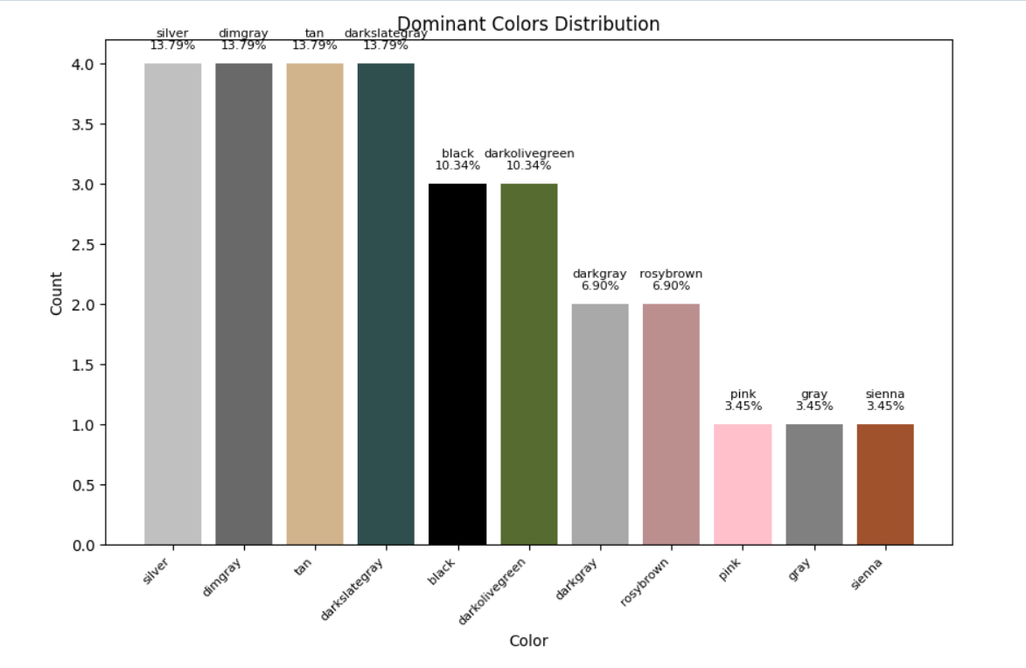
analysıs
By analyzing the graph, it is seen that mostly shades of gray, green and brown are dominant which indicates that the results did not align with the hypothesis.
It shows that I usually look at pictures with darker shades than I have expected.

Slide 9

METHODS used ın theme analysıs
I used a pre-trained deep learning model MobileNetV2 to classify the images. Because it does not correctly predict the content category and usually finds different categories even though they are similar, I used some other techniques as well.

Slide 10
METHODS used ın theme analysıs
The texts written under the images and the filenames are extracted. I predefined categories as themes and associated with list of keywords.
To put the images under the right category a scoring mechanism is applied. The weights of increasing the score is different for accuracy.(TensorFlow predictions increases the score by 2, and texts increases by one)

Slide 11
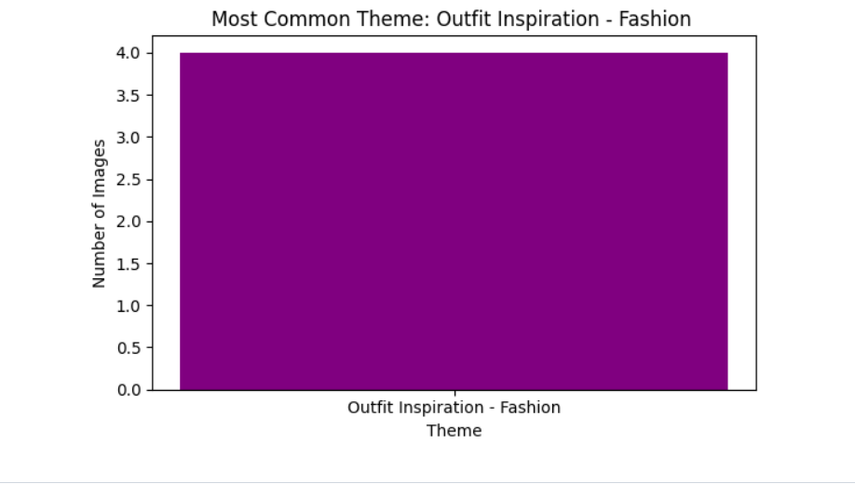
analysıs
As shown in the graph, the most common theme is found as ‘Outfit Inspiration- Fashion’. This result matches up with my expectations and hypothesis.

Slide 12
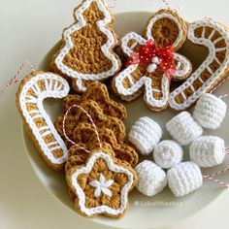
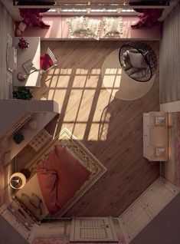
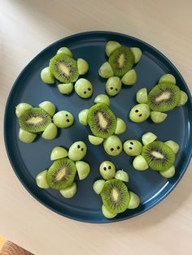
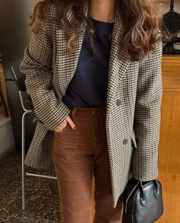
Analysıs
A small example of the categorization
Image 'e11f4b5f1cf6ca2b67f211edc3455210.jpg' (URL: ./ucuncuPinterest_files/e11f4b5f1cf6ca2b67f211edc3455210.jpg) categorized under theme: Knitting
Image '5827d11016045e7090f07a5b17ec9867.jpg' (URL: ./ucuncuPinterest_files/5827d11016045e7090f07a5b17ec9867.jpg) categorized under theme: Decoration
Image 'b38277049a20544d5e59e249b31b3e8e.jpg' (URL: ./ucuncuPinterest_files/b38277049a20544d5e59e249b31b3e8e.jpg) categorized under theme: Healthy life
This is the output of TensorFlow:[('cucumber', 0.5955384), ('zucchini', 0.14771935), ('tray', 0.040342342)]
Image 'f2158a52bc0e1fa7952e830033d3d86b.jpg' (URL: ./ucuncuPinterest_files/f2158a52bc0e1fa7952e830033d3d86b.jpg) categorized under theme: Outfit inspiration
From these examples, we can understand that the methods used gives meaningful results.

Slide 13
conclusıon
As conclusion, it is analyzed that the pictures on my mainboard are not mostly pink and white. The hypothesis at the beginning was wrong and it should be corrected as mostly gray and green. From the aspect of themes analysis, the result aligns with the hypothesis. I have more interaction with fashion pins on Pinterest. Therefore, the number of this category is more than others.

Slide 14
LIMITATIONS AND FUTURE WORK
If I was able to analyze my mainpage without turning it to html, I would be able to extract more images which would result in better accuracy. Also if the number of theme_keywords get larger, the accuracy of putting an image under a category would have been better.

Slide 15
THANK YOU!
Elif Cansu İpek
30662
cansu.ipek@sabanciuniv.edu

