Slide 1
UniCATS: A Unified Context-Aware Text-to-Speech Framework with Contextual VQ-Diffusion and Vocoding
Chenpeng Du¹, Yiwei Guo¹, Feiyu Shen¹, Zhijun Liu¹, Zheng Liang¹, Xie Chen¹,
Shuai Wang², Hui Zhang³, Kai Yu¹
¹MoE Key Lab of Artificial Intelligence, AI Institute
X-LANCE Lab, Department of Computer Science and Engineering, Shanghai Jiao Tong University, China
²Shenzhen Research Institute of Big Data, China
³AISpeech Ltd, China

Slide 2
Contents
1
Motivation
2
Architecture of UniCATS
3
Experimental Results
4
Conclusion

Slide 3
Motivation
Discrete speech tokens have been proven superior to traditional acoustic features in terms of naturalness and robustness in text-to-speech models.
Two kinds of discrete speech tokens so far:
Semantic Tokens: from self-supervision models for discriminative tasks
Discrete Speech Tokens
e.g. vq-wav2vec, wav2vec2.0, w2v-BERT, HuBERT (KMeans), WavLM (KMeans)…
Acoustic Tokens: from audio codec models for reconstruction
e.g. SoundStream, EnCodec…

Slide 4
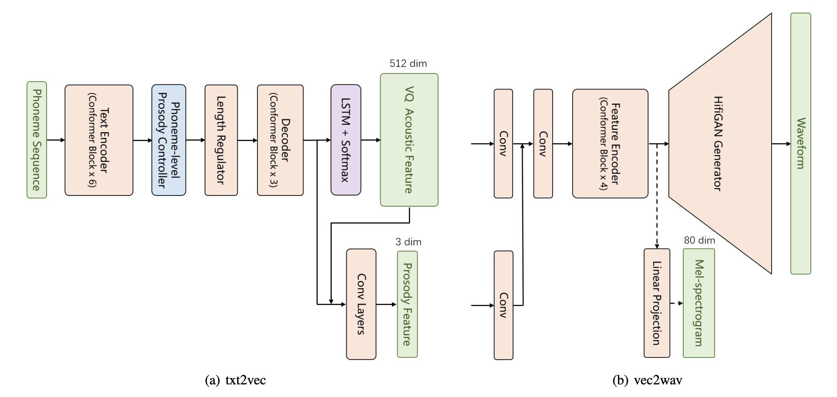
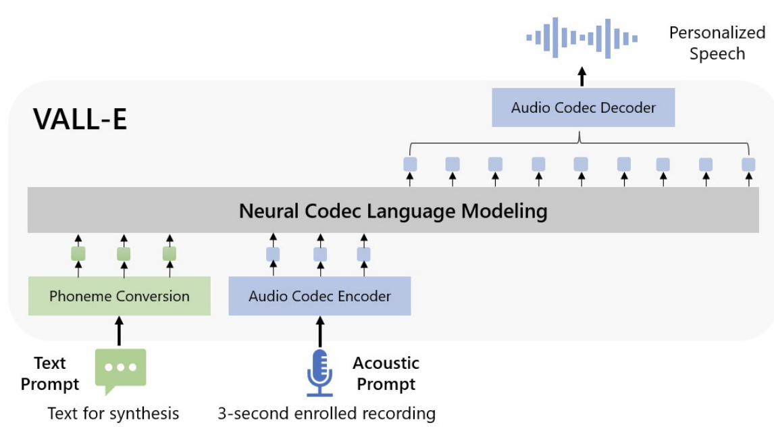
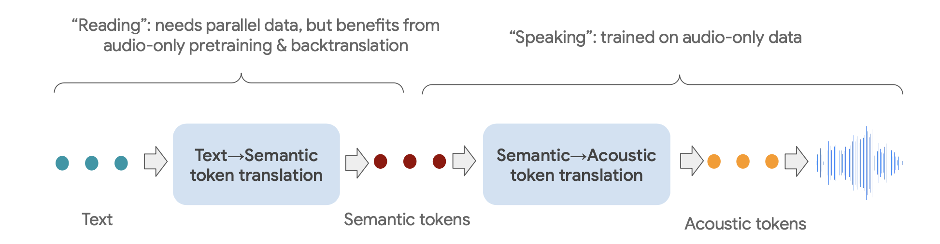
Motivation
VQTTS (Du et al., 2022)
Non-autoregressive, semantic tokens
VALLE (Wang et al., 2023)
Autoregressive, acoustic tokens
SpearTTS (Kharitonov et al., 2023)
Autoregressive, semantic + acoustic tokens

Slide 5
Motivation
Discrete speech tokens have been proven superior to traditional acoustic features in terms of naturalness and robustness in text-to-speech models.
Acoustic tokens are often restricted by the reconstruction ability of its codec model, and the sequence is usually lengthy because of the residual quantizer.
Autoregressive models performs zero-shot TTS by speech continuation. But they can only take consideration of uni-directional contexts, but never those at the back. This makes them not feasible for speech editing tasks.

Slide 6
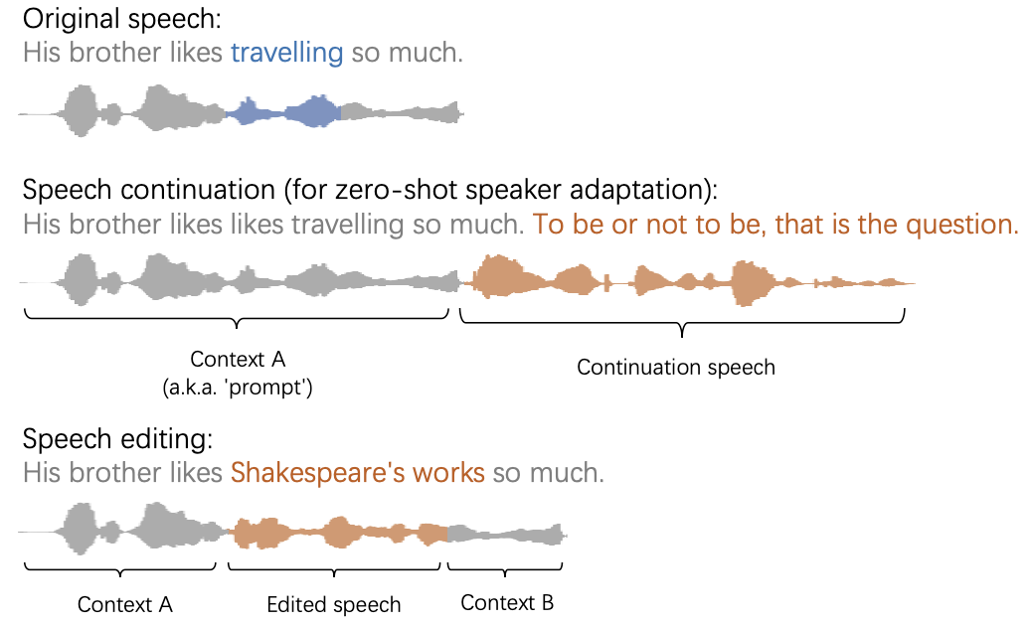
Motivation
We need a model that can learn contexts from both directions, so that we can unify speech continuation and speech editing.
Unified Context-Aware
Text-to-Speech Framework

Slide 7
Contents
1
Motivation
2
Architecture of UniCATS
3
Experimental Results
4
Conclusion

Slide 8
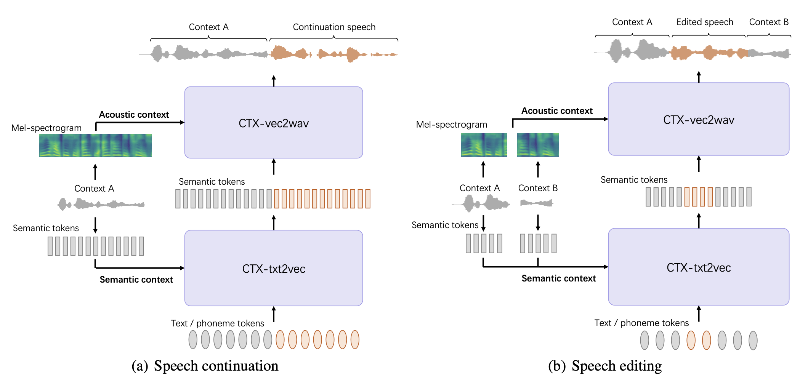
UniCATS: Overview
Acoustic Model: text to semantic token

Slide 9
UniCATS: Overview
Vocoder: semantic token to waveform

Slide 10
UniCATS: Overview
Semantic token: vq-wav2vec (Baevski et al. 2019)

Slide 11
UniCATS: Overview
Context (prompt)

Slide 12

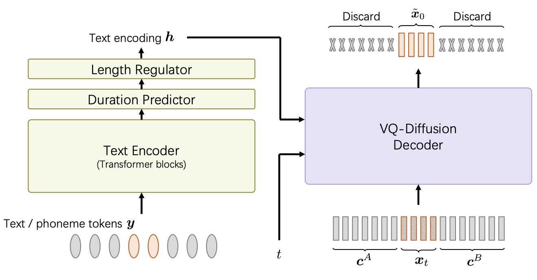
UniCATS: Acoustic model CTX-txt2vec
The acoustic model CTX-txt2vec is a non-autoregressive TTS model based on VQ-diffusion.
VQ-diffusion is a type of diffusion generative model in discrete state spaces.
Forward process: add noise to discrete data by randomly masking or replacing.
Apply a neural network to recover the original discrete data from noisy ones.

Slide 13

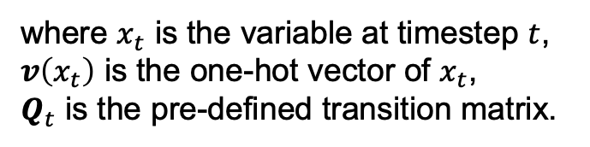

UniCATS: Acoustic model CTX-txt2vec
The acoustic model CTX-txt2vec is a non-autoregressive TTS model based on VQ-diffusion.
VQ-diffusion is a type of diffusion generative model in discrete state spaces.
Forward process:
$$q\left(x_{t} | x_{t−1}\right)=v^{T}\left(x_{t}\right)Q_{t}v\left(x_{t−1}\right)$$
where $x_{t}$ is the variable at timestep $t$,
$v\left(x_{t}\right)$ is the one-hot vector of $x_{t}$,
$Q_{t}$ is the pre-defined transition matrix.
In CTX-txt2vec, we aim to model
$$p_{θ}({\tilde{x}}_{0}|x_{t},y,c^{A},c^{B})$$
i.e. the probability of original semantic tokens given noisy ones, together with text input and contexts from both front and back.

Slide 14
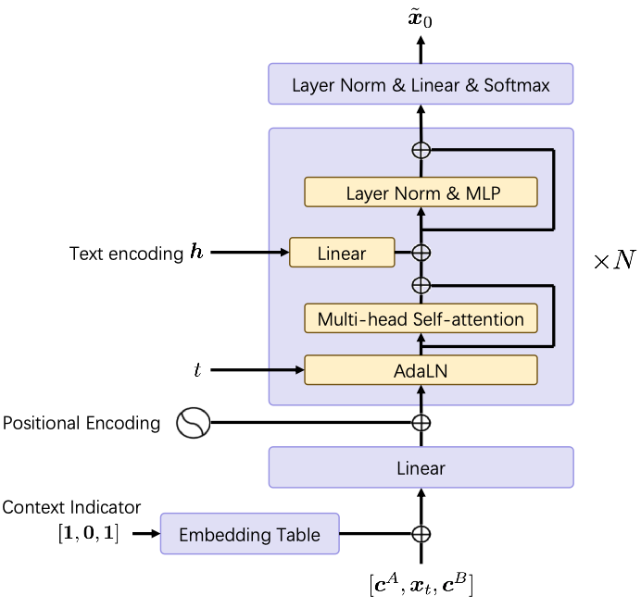
UniCATS: Acoustic model CTX-txt2vec
The acoustic model CTX-txt2vec is a non-autoregressive TTS model based on VQ-diffusion.
The VQ-diffusion decoder takes the architecture of common transformers, except there is a context indicator as input.
Training objective is the combination of VQ-diffusion and duration prediction loss.

Slide 15
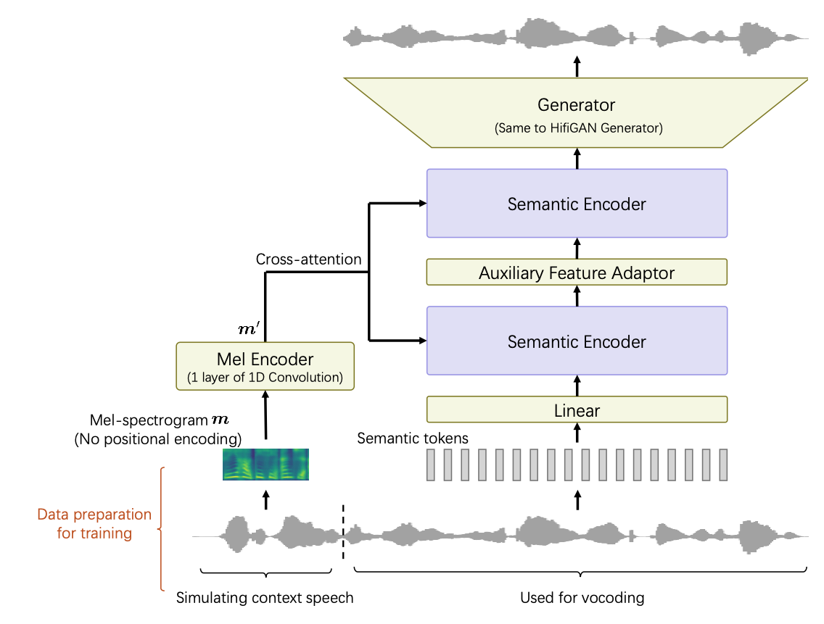
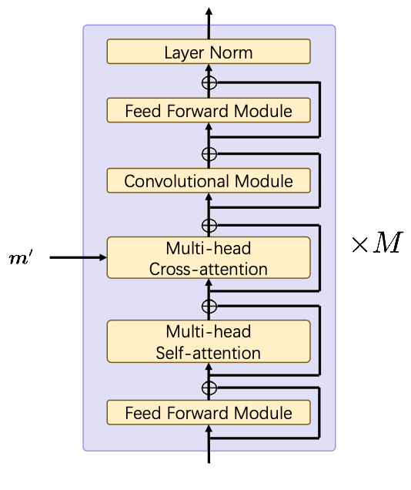
UniCATS: Vocoder CTX-vec2wav
The vocoder CTX-vec2wav is a HifiGAN-based vocoder to convert semantic tokens into waveforms, with the help of acoustic prompt in the form of mel-spectrograms.

Slide 16
UniCATS: Vocoder CTX-vec2wav
The vocoder CTX-vec2wav is a HifiGAN-based vocoder to convert semantic tokens into waveforms, with the help of acoustic prompt in the form of mel-spectrograms.
The acoustic prompt provides strong speaker timbre-related information.
No positional encoding is applied, because timbre is a global feature.

Slide 17
UniCATS: Vocoder CTX-vec2wav
The vocoder CTX-vec2wav is a HifiGAN-based vocoder to convert semantic tokens into waveforms, with the help of acoustic prompt in the form of mel-spectrograms.
Auxiliary feature adaptor predicts prosodic features (pitch, probability of voice, and energy) based on semantic tokens and prompt.

Slide 18
UniCATS: Vocoder CTX-vec2wav
The vocoder CTX-vec2wav is a HifiGAN-based vocoder to convert semantic tokens into waveforms, with the help of acoustic prompt in the form of mel-spectrograms.
No speaker-label is required. We cut a segment from the utterance itself to treat as a prompt. The prompt is no longer than 3 seconds.

Slide 19
Contents
1
Motivation
2
Architecture of UniCATS
3
Experimental Results
4
Conclusion

Slide 20
Experimental Results: Configurations
Dataset: LibriTTS, with around 580-hour speech and 2306 speakers.
Test split:
Test set A comprises 500 utterances of 369 seen speakers in training.
Test set B contains 500 utterances from 37 unseen speakers. Prompt length is around 3s.
Test set C follows that of RetrieverTTS (Yin et al., 2022) for speech editing.
Model configuration:
CTX-txt2vec has 12 transformer blocks, each with 8 heads and 512 hidden dim.
CTX-txt2vec was trained for 50 epochs.
Semantic token: pretrained Kmeans-based vq-wav2vec from FAIR.
Diffusion steps in training: 100
CTX-vec2wav has 2 conformer blocks in each semantic encoder.
CTX-vec2wav was trained for 800k steps.

Slide 21
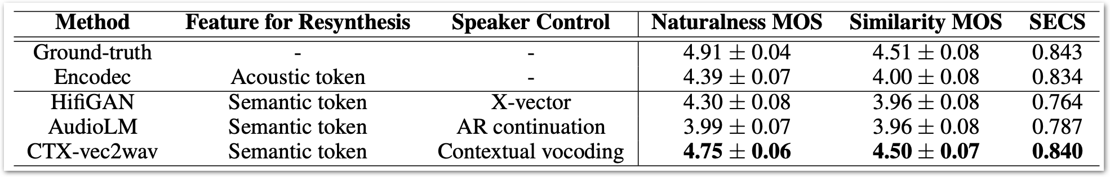

Experimental Results: Speech Resynthesis
We performed speech resynthesis (reconstruction) with CTX-vec2wav only, on test set B.
Compared with Encodec, HifiGAN (from semantic tokens), AudioLM.
SECS: speaker embedding cosine similarity score rated by a speaker verification model.
Achieves significantly higher naturalness MOS and speaker similarity against baselines. Especially, CTX-vec2wav reconstructs speech pretty well on unseen speakers.
GT
Encodec
AudioLM
CTX-vec2wav

Slide 22
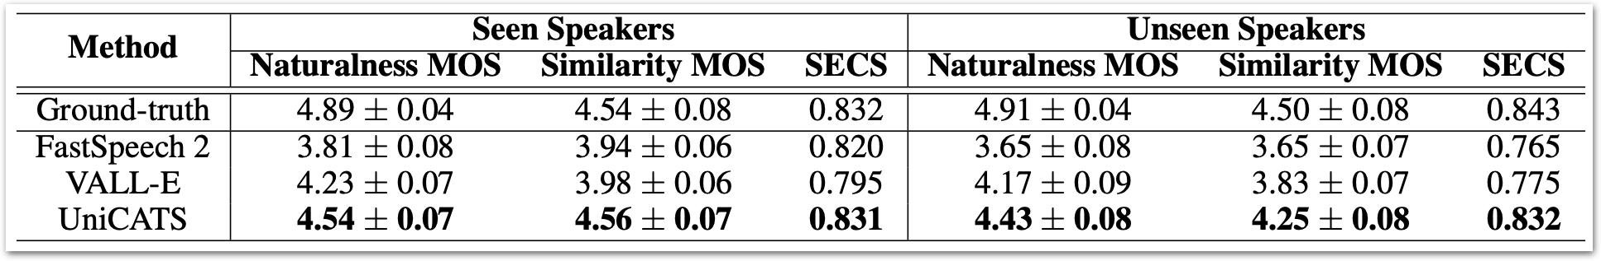
Experimental Results: Zero-shot Speaker Adaptive TTS
We performed speaker adaptive TTS by speech continuation (only front contexts).
Evaluated both on seen speakers and unseen speakers.
Exhibited strong zero-shot TTS ability.
Yet the two have often been confused in the popular mind. [Continuation] He was unjustly charged with favoring secession; but the charge was soon disproved.
A sudden wave of scarlet swept over Eliza's face. [Continuation] Then he deliberately locked Kenneth and Beth in with the forger, and retreated along the passage.

Slide 23
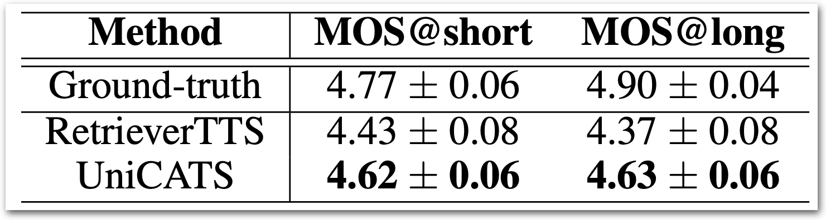
Experimental Results: Speech Editing
We performed speech editing by providing both front and back contexts.
Evaluated on both short and long editing lengths up to 2s.
I remained there alone for many hours, but I must acknowledge that before I left the chambers I had gradually brought myself to look at the matter in another light.

Slide 24
Contents
1
Motivation
2
Architecture of UniCATS
3
Experimental Results
4
Conclusion

Slide 25

Conclusion
We proposed a unified context-aware TTS framework called UniCATS.
UniCATS is a non-autoregressive semantic-token-based model, able to handle both speech continuation and editing tasks.
No speaker embedding is required.
Comprises of CTX-txt2vec, the acoustic model based on contextual VQ-diffusion, and CTX-vec2wav, the vocoder with acoustic prompts.
Exhibited strong speech resynthesis, zero-shot TTS and speech editing ability.
Audio demo and code is available.

Slide 26
Thank You

