Slide 1
GETTING STARTED WITH DOCKER
2022-August-11
Luke Pendo
https://gitlab.com/cantankerous-impurity/Documentation/-/blob/core/GettingStarted.pdf

Slide 2
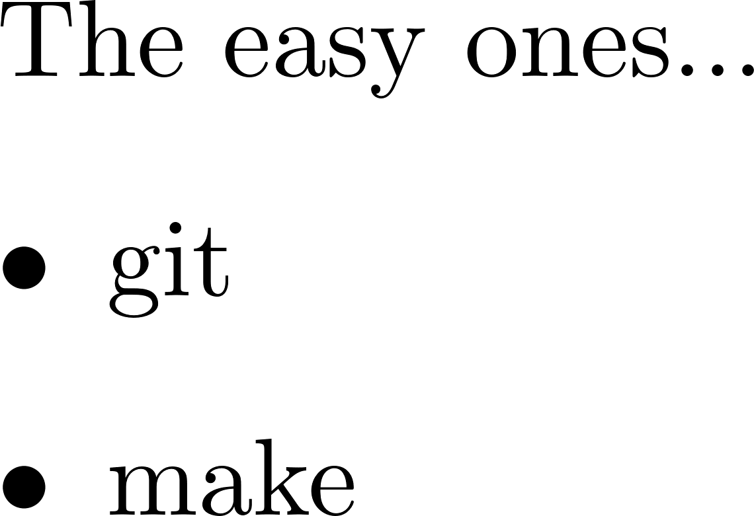
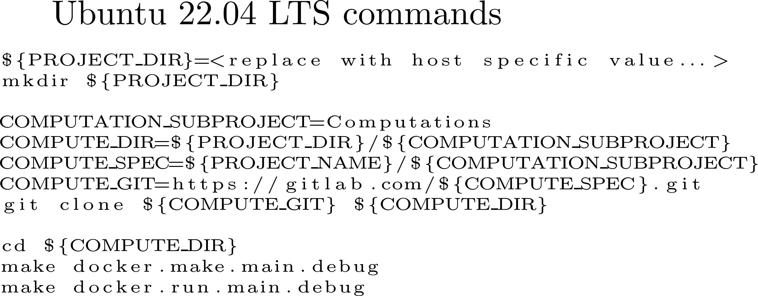
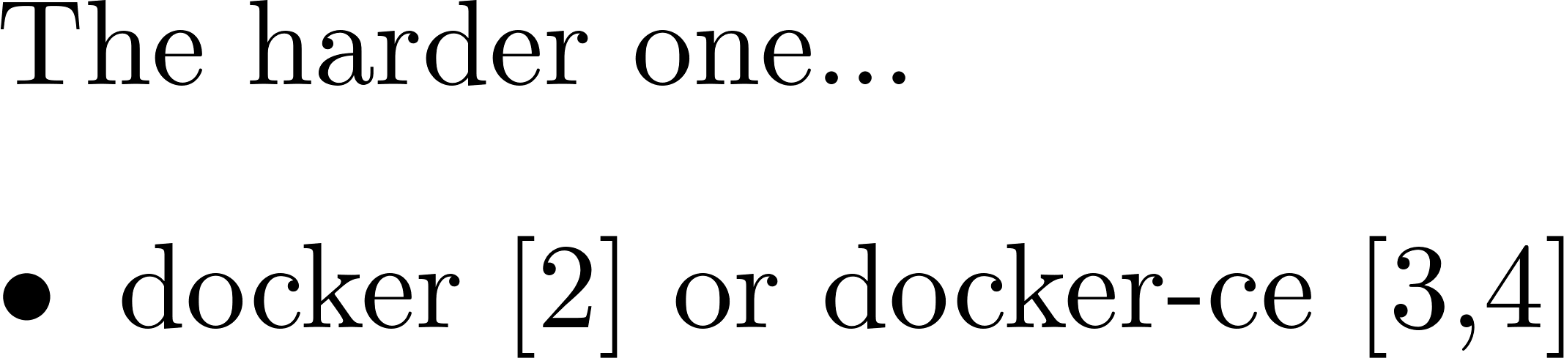
Using Docker to run cantankerous-impurity
Dependencies required
[2] Information on installing the closed source Docker Desktop for Windows, Apple Mac, and Linux can be found here.
[3] Information about installing the open source version of docker (docker community edition) on Ubuntu can be found here.
[4] Installing docker-ce on WSL requires some extra work. A good method to do so is covered in this blog post by Jonathan Bowman

