Slide 1
GETTING STARTED
2022-August-11
Luke Pendo
https://gitlab.com/cantankerous-impurity/Documentation/-/blob/core/GettingStarted.pdf

Slide 2
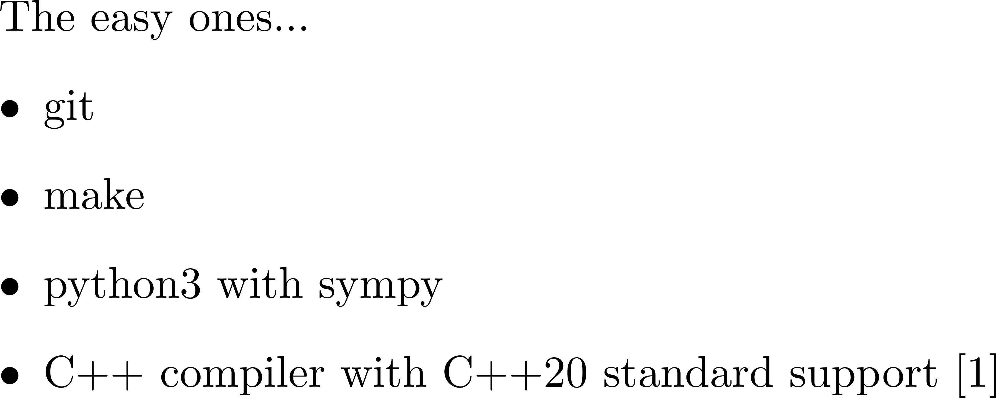
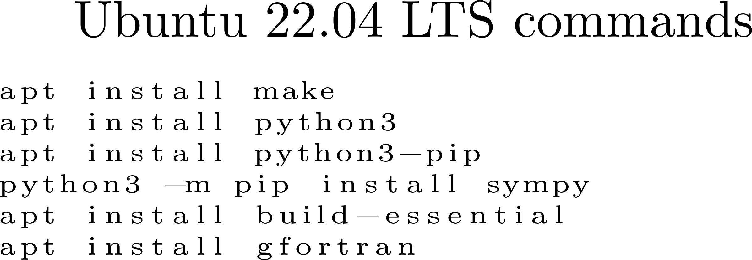
How to make the code go…
Required dependencies
[1] In particular, support for concepts and constraints is required. Check here for a list of compliant compilers.

Slide 3
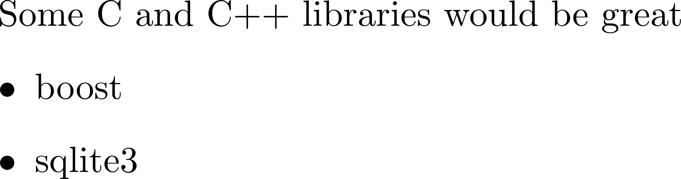

To make the code go… How?
Dependencies required

Slide 4
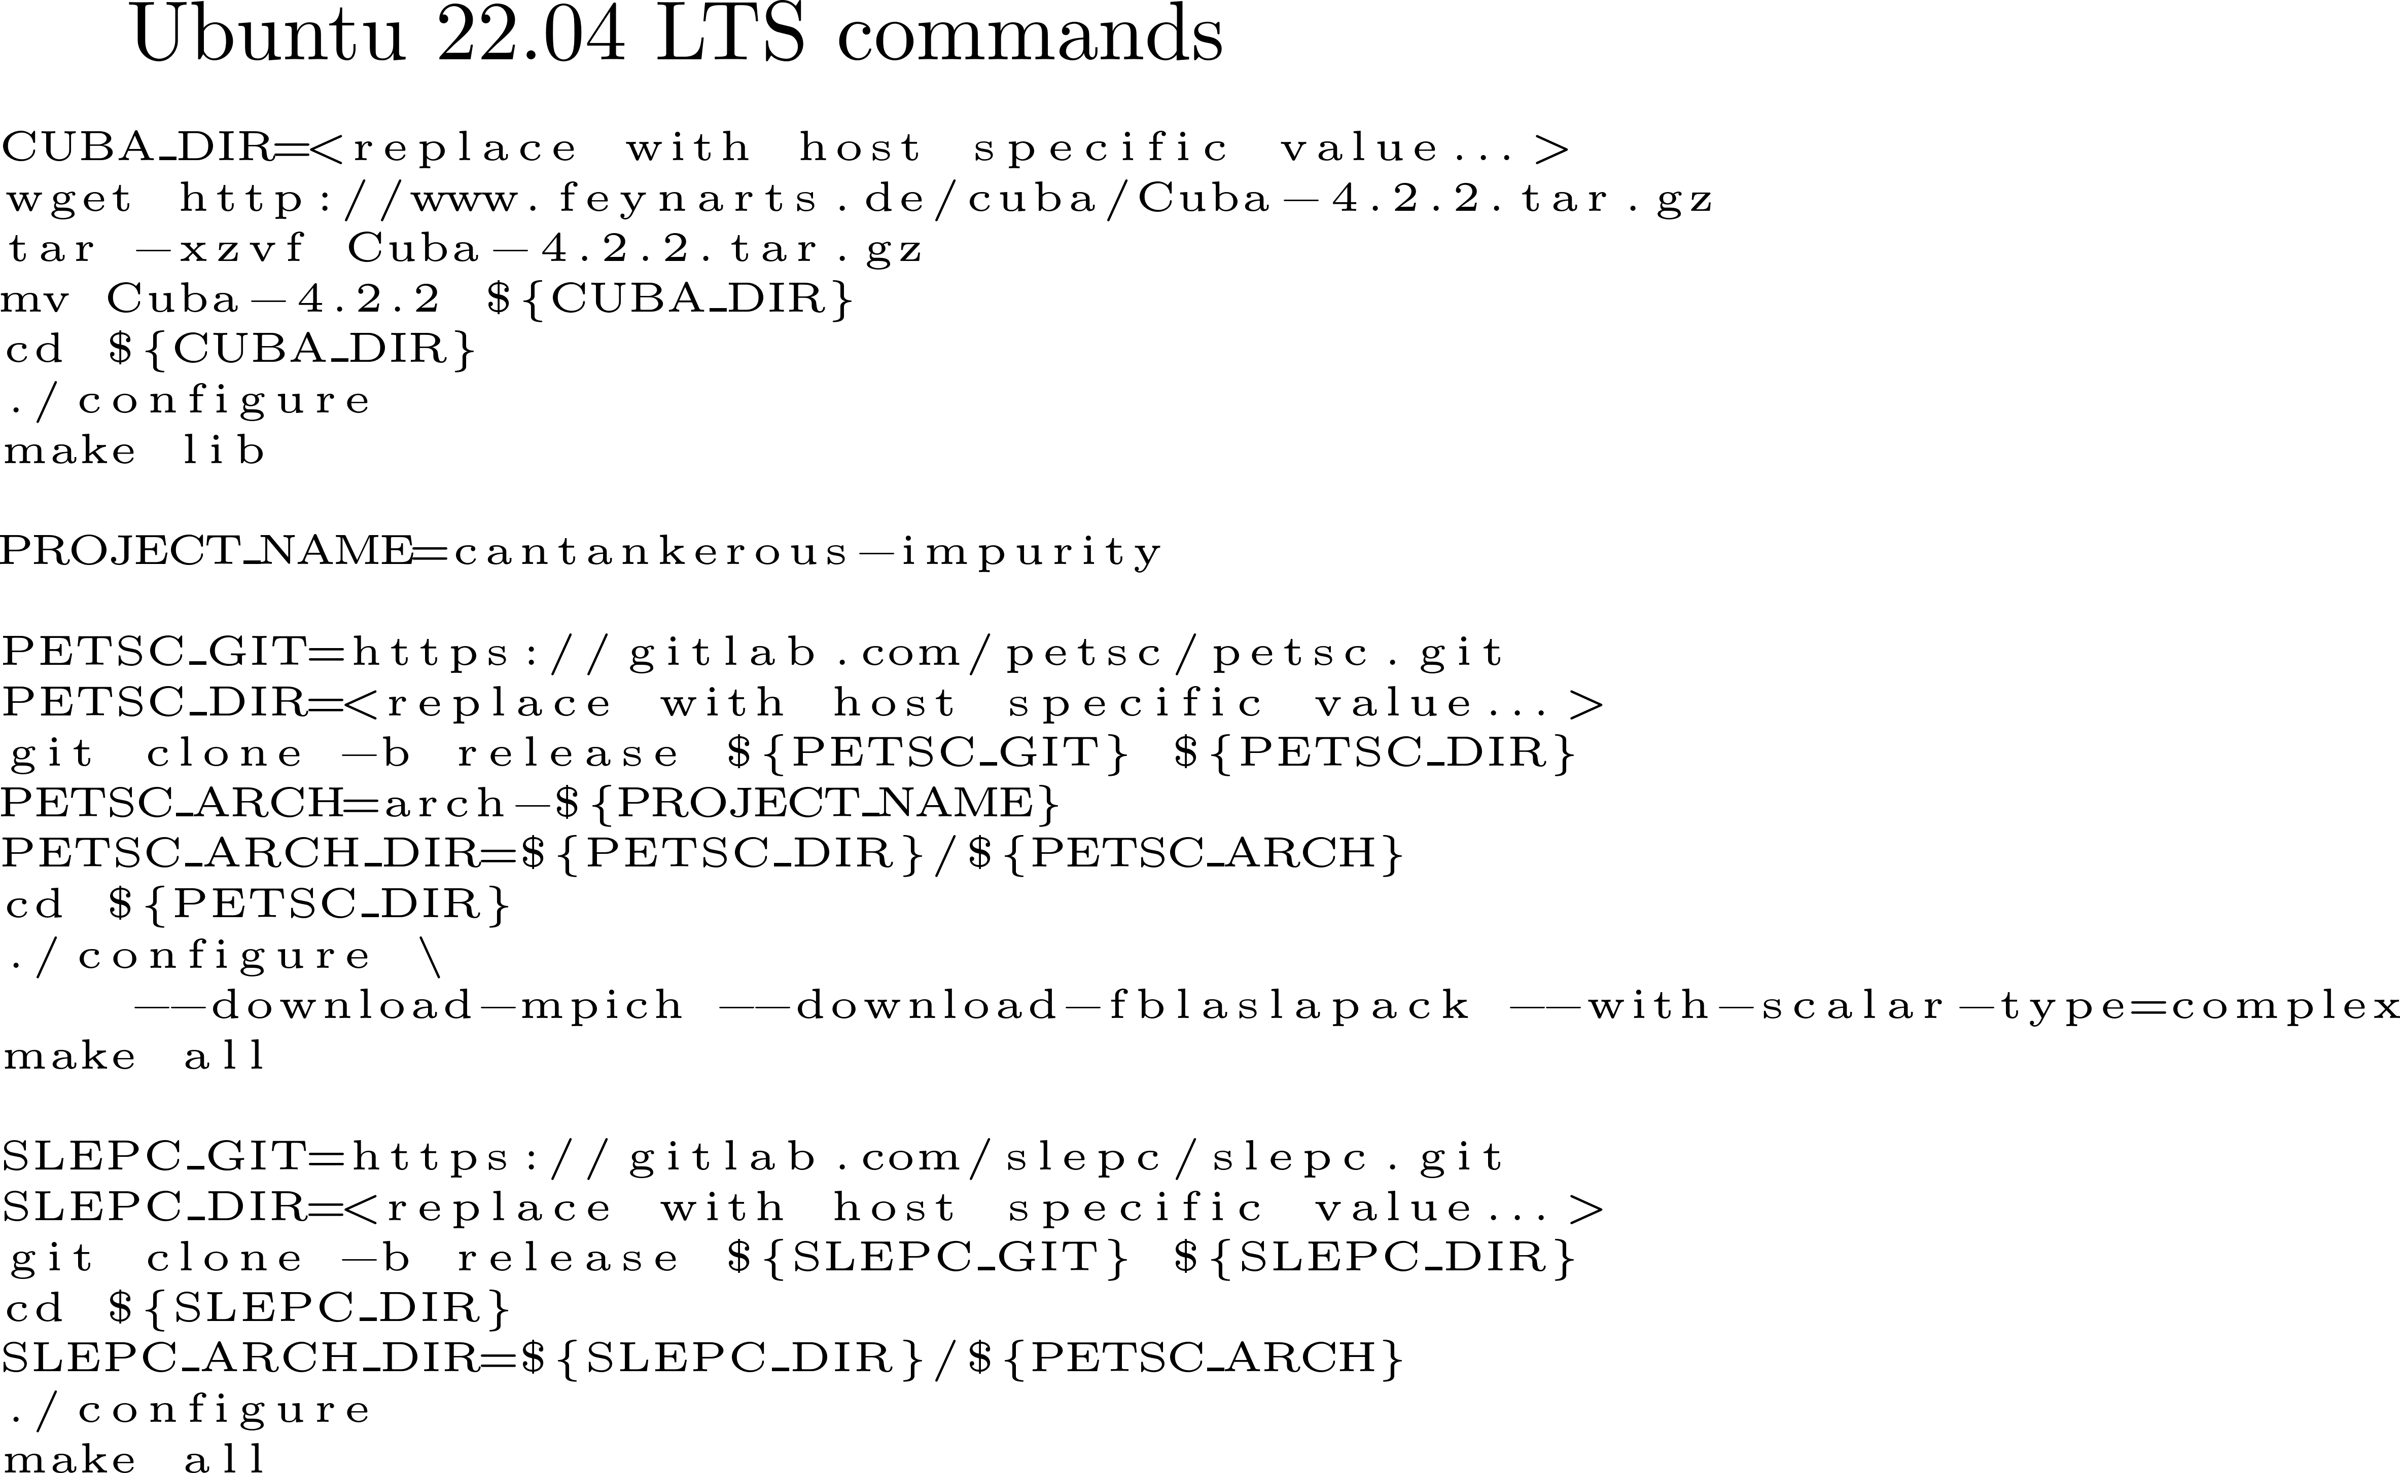
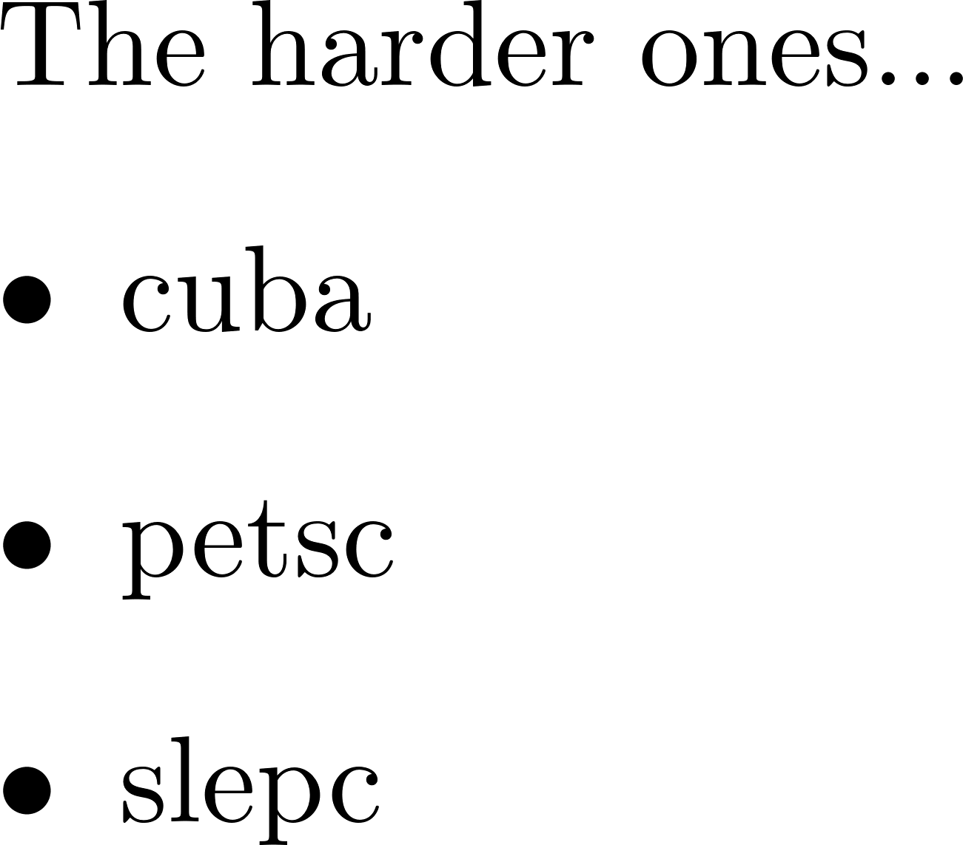
How make the code to go…
Necessary antecedents

Slide 5
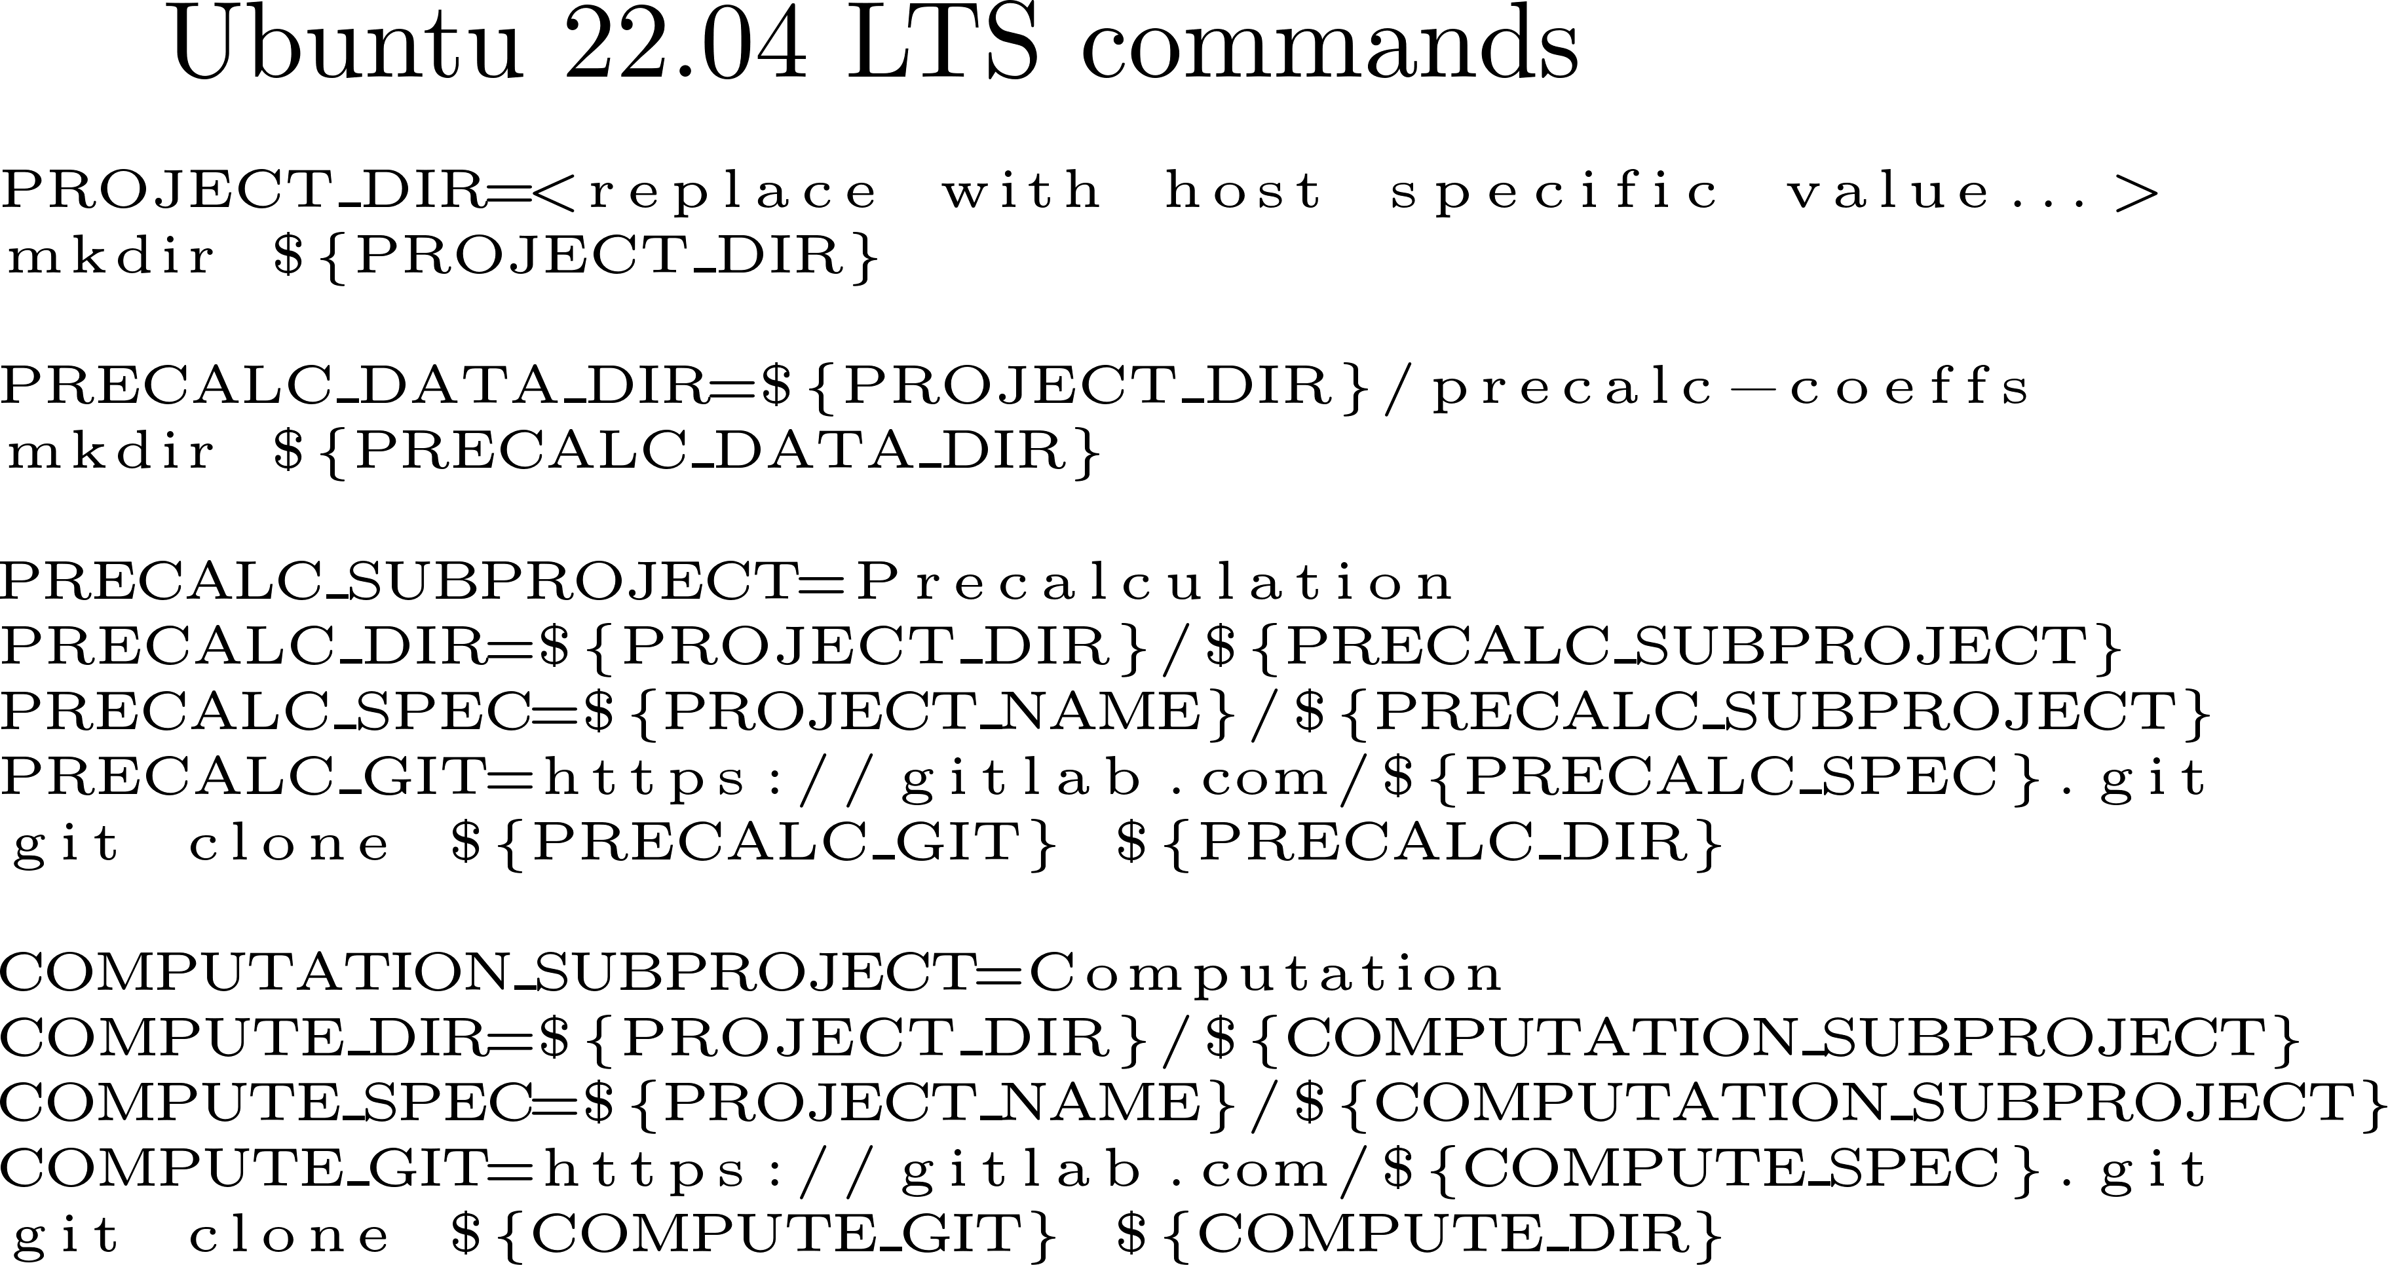
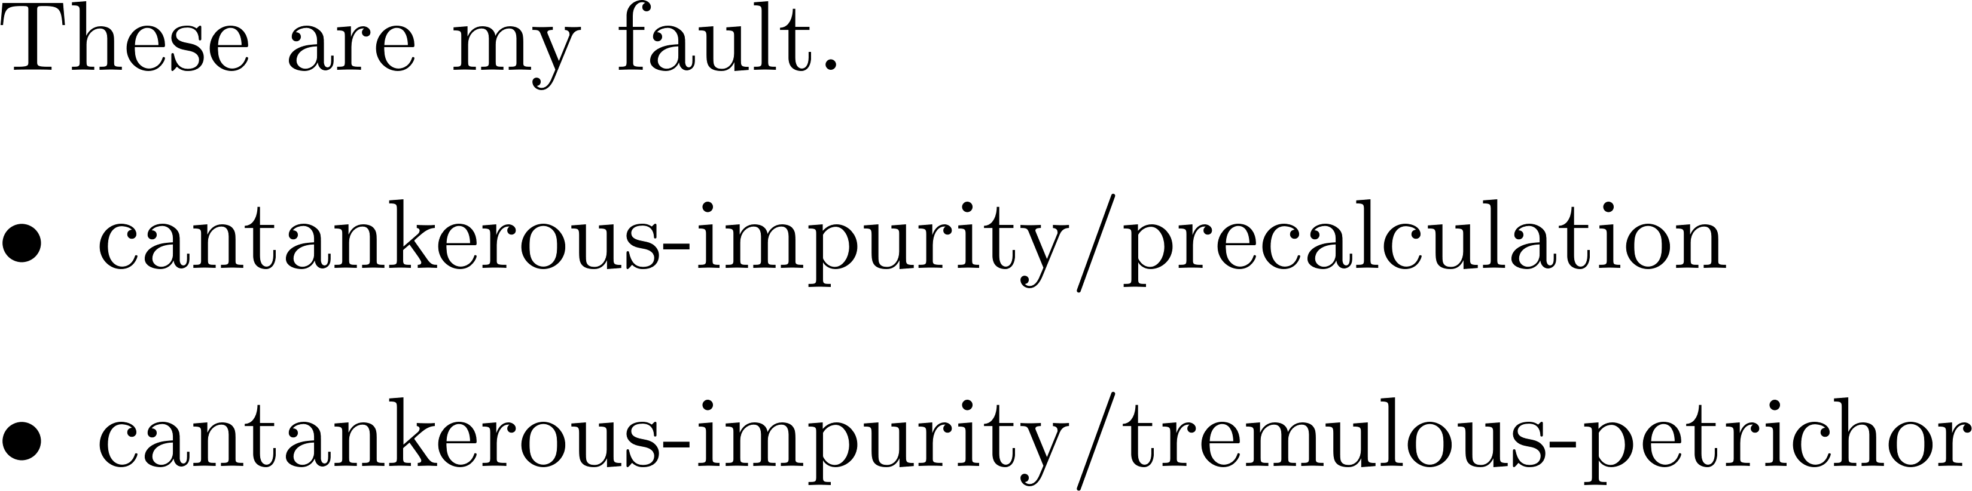
Code how go to make the
Deepen dent seas wreck wired
These work… as long as the dependencies have been correctly installed and configured…

