Slide 1
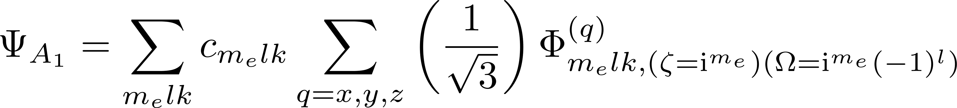
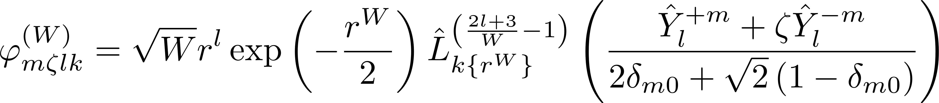
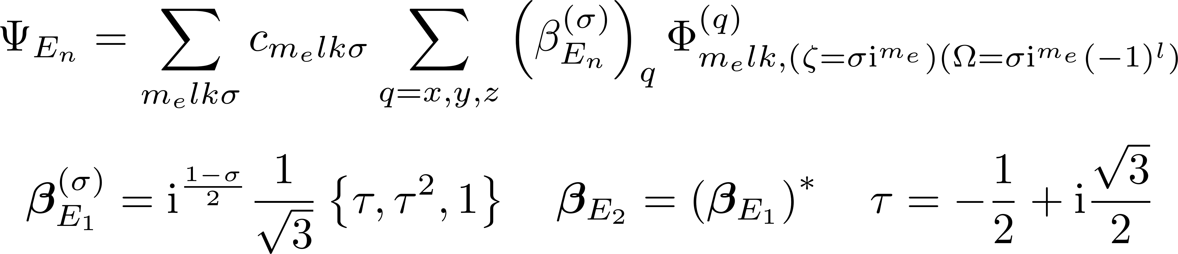
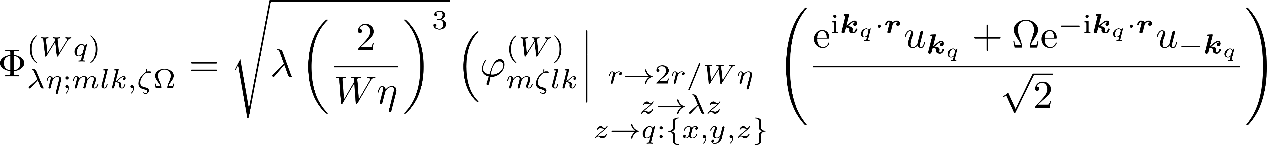
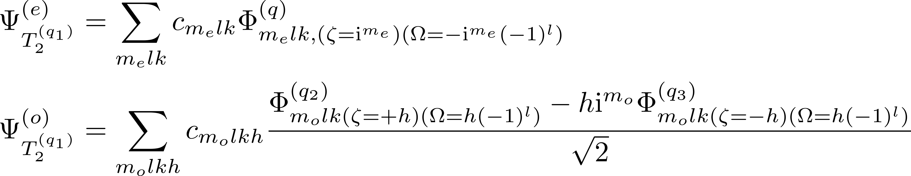

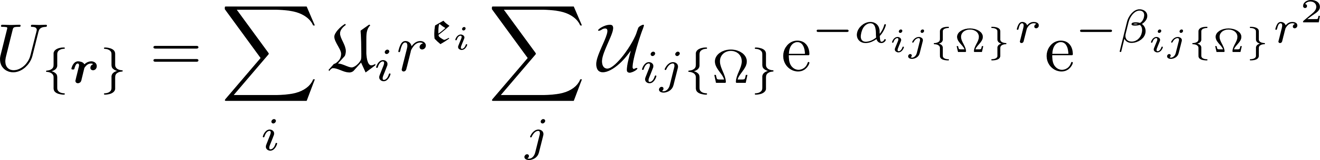
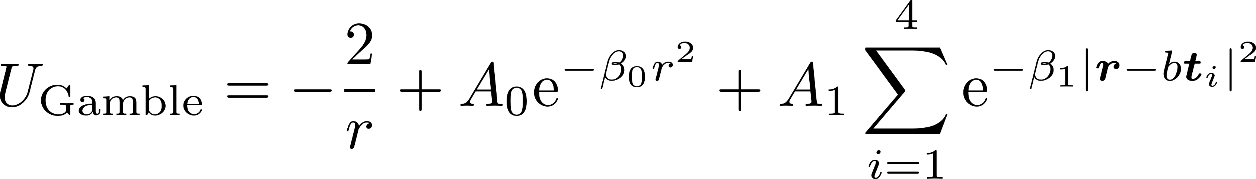

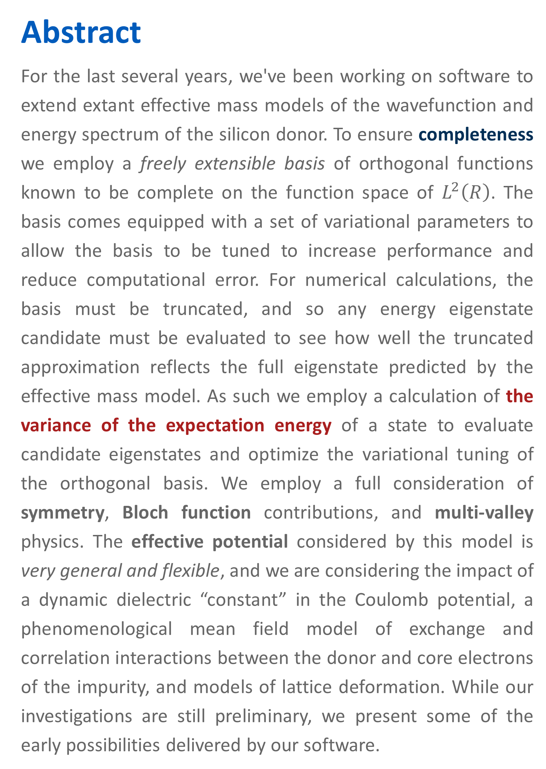
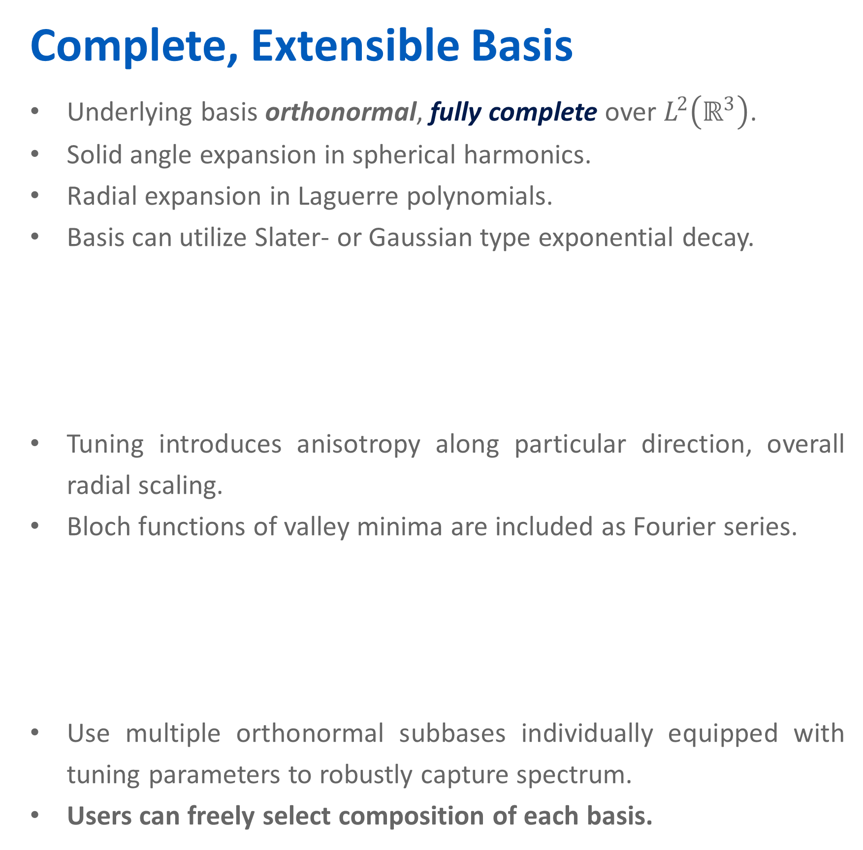

A computational suite to extend the effective mass model of the silicon donor Luke Pendo and Xuedong Hu
https://gitlab.com/cantankerous-impurity
Abstract
For the last several years, we've been working on software to extend extant effective mass models of the wavefunction and energy spectrum of the silicon donor. To ensure completeness we employ a freely extensible basis of orthogonal functions known to be complete on the function space of $L^{2}\left(R\right)$. The basis comes equipped with a set of variational parameters to allow the basis to be tuned to increase performance and reduce computational error. For numerical calculations, the basis must be truncated, and so any energy eigenstate candidate must be evaluated to see how well the truncated approximation reflects the full eigenstate predicted by the effective mass model. As such we employ a calculation of the variance of the expectation energy of a state to evaluate candidate eigenstates and optimize the variational tuning of the orthogonal basis. We employ a full consideration of symmetry, Bloch function contributions, and multi-valley physics. The effective potential considered by this model is very general and flexible, and we are considering the impact of a dynamic dielectric “constant” in the Coulomb potential, a phenomenological mean field model of exchange and correlation interactions between the donor and core electrons of the impurity, and models of lattice deformation. While our investigations are still preliminary, we present some of the early possibilities delivered by our software.
Complete, Extensible Basis
Underlying basis orthonormal, fully complete over $L^{2}\left(ℝ^{3}\right)$.
Solid angle expansion in spherical harmonics.
Radial expansion in Laguerre polynomials.
Basis can utilize Slater- or Gaussian type exponential decay.
Tuning introduces anisotropy along particular direction, overall radial scaling.
Bloch functions of valley minima are included as Fourier series.
Use multiple orthonormal subbases individually equipped with tuning parameters to robustly capture spectrum.
Users can freely select composition of each basis.
Full Accounting of Symmetry
Basis functions are symmetrized according to T_{d} symmetry of silicon. Forms for A₂ and T₁ are also known.
User specified potentials can be decomposed by symmetry at runtime.
Selection rules for all symmetries are analytically known, but have not yet been implemented in code.
Caveats and challenges
The complete basis requires computations sums of numbers of alternating signs. Within floating point computations this can lead to substantial round off error.
We perform these alternating sign computations symbolically using the python module Sympy. The results are then stored in an SQLite database to be retrieved by the C++ code at runtime.
The precalculation of these coefficients symbolically does take substantial time, though fortunately this represents a one-time investment.
Another factor is the size of the SQLite database – on the order of GBs. This makes network distribution difficult, and currently requires the user to assume computation and storage responsibilities.
The current largest bottleneck within runtime is importation of the precalculated coefficients into memory. We are exploring if this bottleneck can be mitigated through other database solutions.
Variational tuning of the code currently requires hand-tuning and recompilation. As such, hand-tuning of the parameters means not only recompilation, but the cumbersome reimportation of the precalculated coefficients. Earlier version of the project implemented an Artificial Bee Colony stochastic optimization algorithm for variational optimization, and we are currently working on reimplementing this code within the project to allow efficient variational optimization within runtime.
We are eagerly seeking critique of this project, and hope to find collaborators.
Flexible Potential Model
To facilitate deep exploration of the effective model, we wanted our code to have a very general potential model. To this end, we have implemented the above equation into our software.
The fraktur letters represent [mostly complex] constants that can be set by users of the software.
This includes constants such as the radial exponent $𝖊$ or the polynomial coefficients $𝖋$. This potential form can be used to represent most extant models of the effective silicon donor potential, such as the potential used by Gamble [4] and the dynamic dielectric model [5,6].
Background
Descriptions of silicon donors that employ effective mass approximations often present an attractively intuitive physical picture of the state of the donor electron, while also less computationally expensive as compared to ab initio and tight-binding models. While this paradigm has been able to predict the energies of spatially extended excited states of donors [1,2], effective mass theories struggle to present a quantatively persuasive pictures of the ground state manifold. For the authors, it remains an open question if these difficulties can be resolved by incorporating additional phenomenological corrections or if they are evidence of a more fundamental breakdown of the effective mass approximation itself.
References
R.A. Faulkner, Phys. Rev. 184, 713 (1969)
A.K. Ramdas and S. Rogriguez, Rep Prog Phys. 44, 1297 (1981)
J.K. Gamble et al., Phys. Rev. B 91, 235318 (2015)
A.Q. Sarker, J. Phys. C 10 2617 (1977)
M. Usman, et al., J. Phys.:Condens. Matter 27 154207 (2015)
K. Shindo and H. Nara, J. Phys. Soc. Jpn. 40, 1640 (1970)
Acknowledgements
We thank financial support by US ARO via grant W911NF1710257.

Slide 2
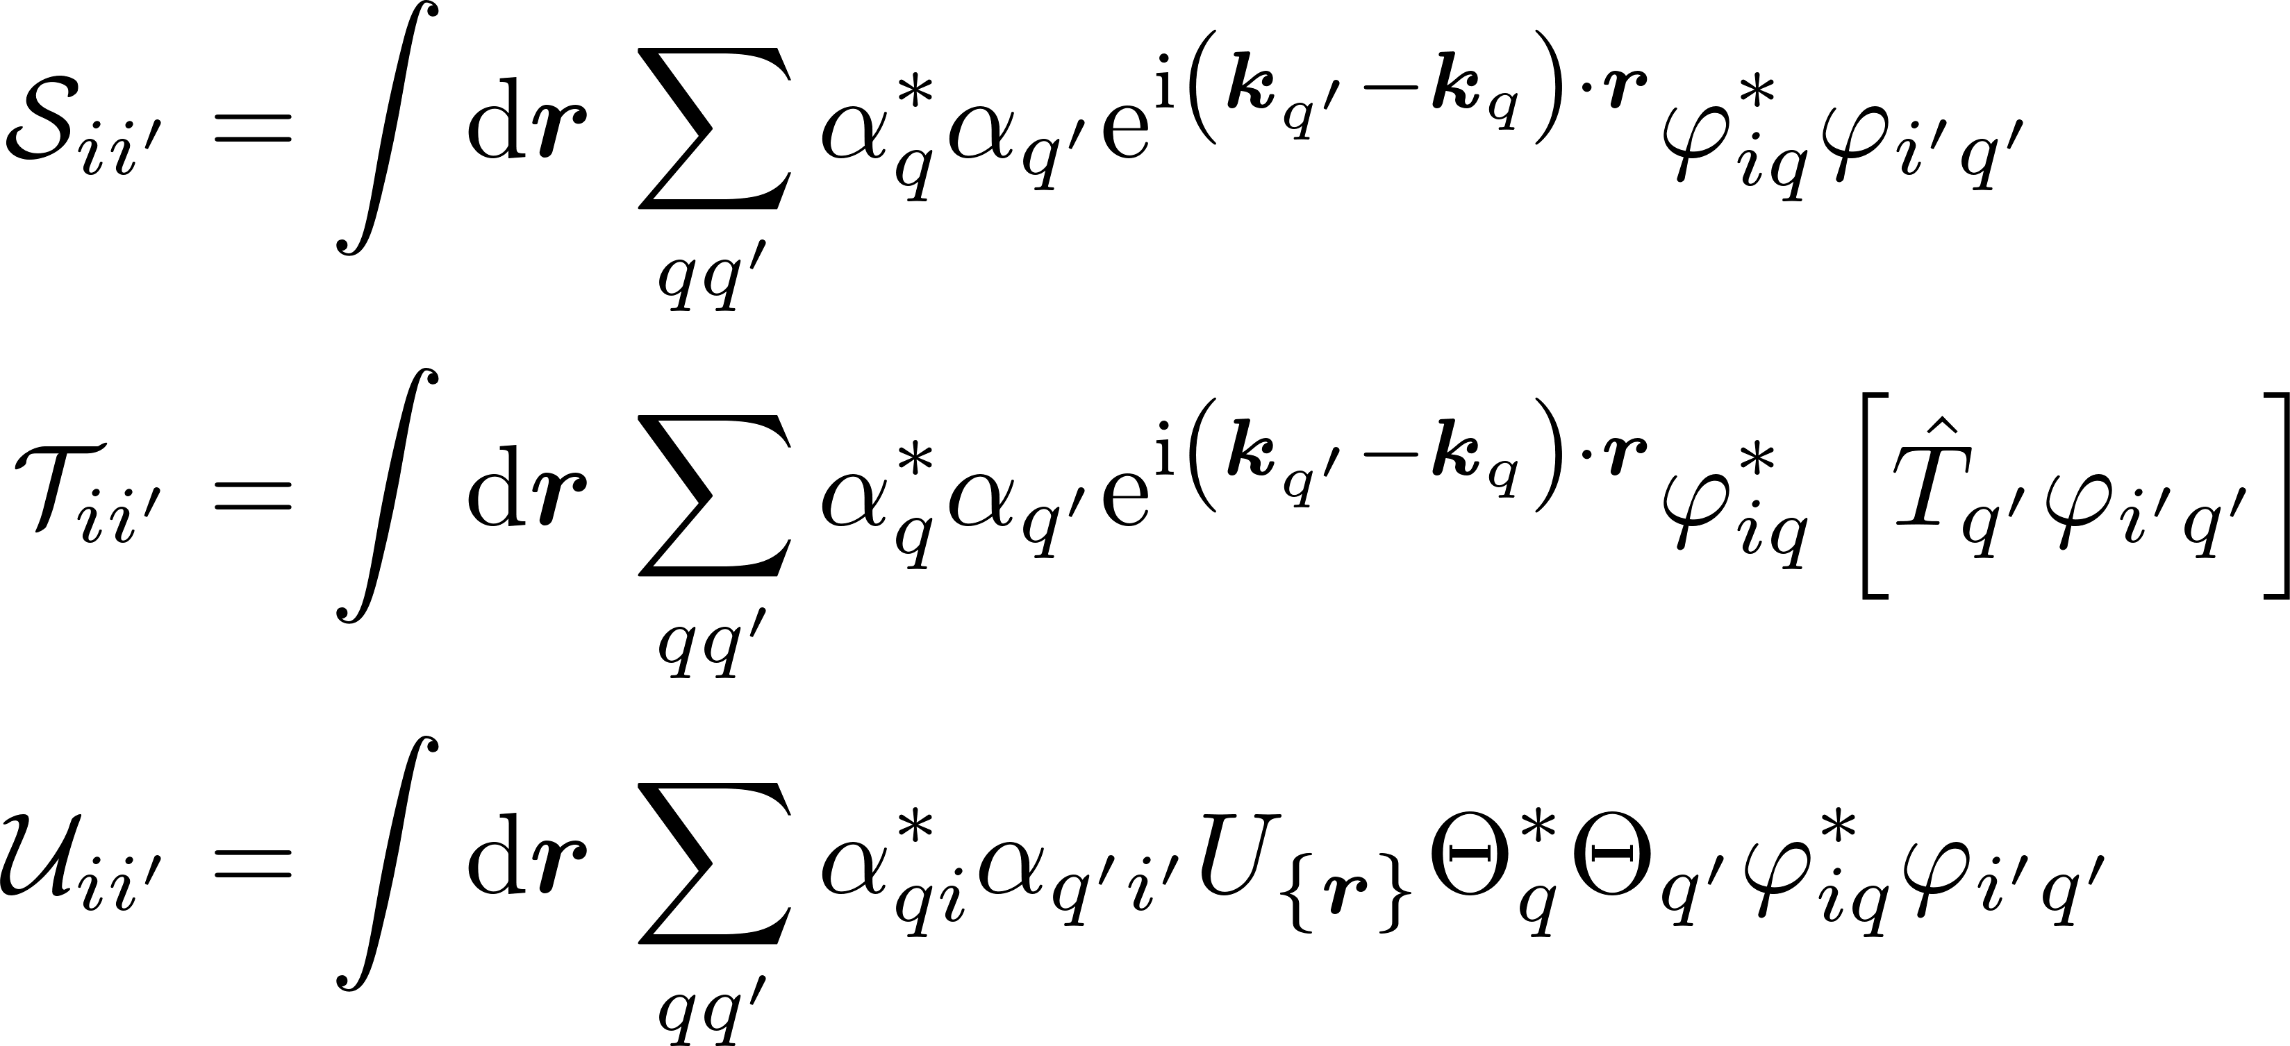
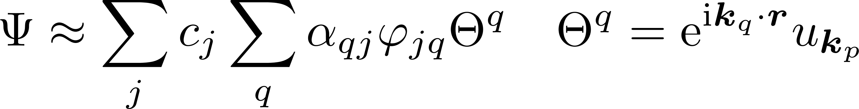
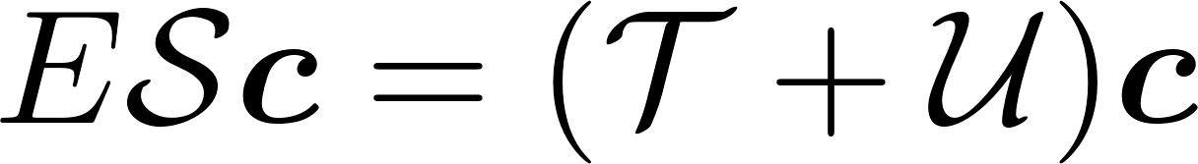
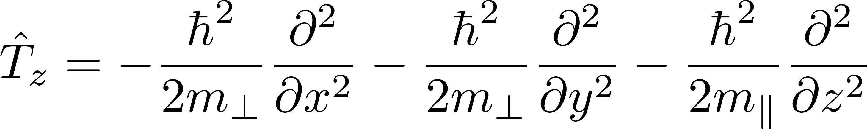
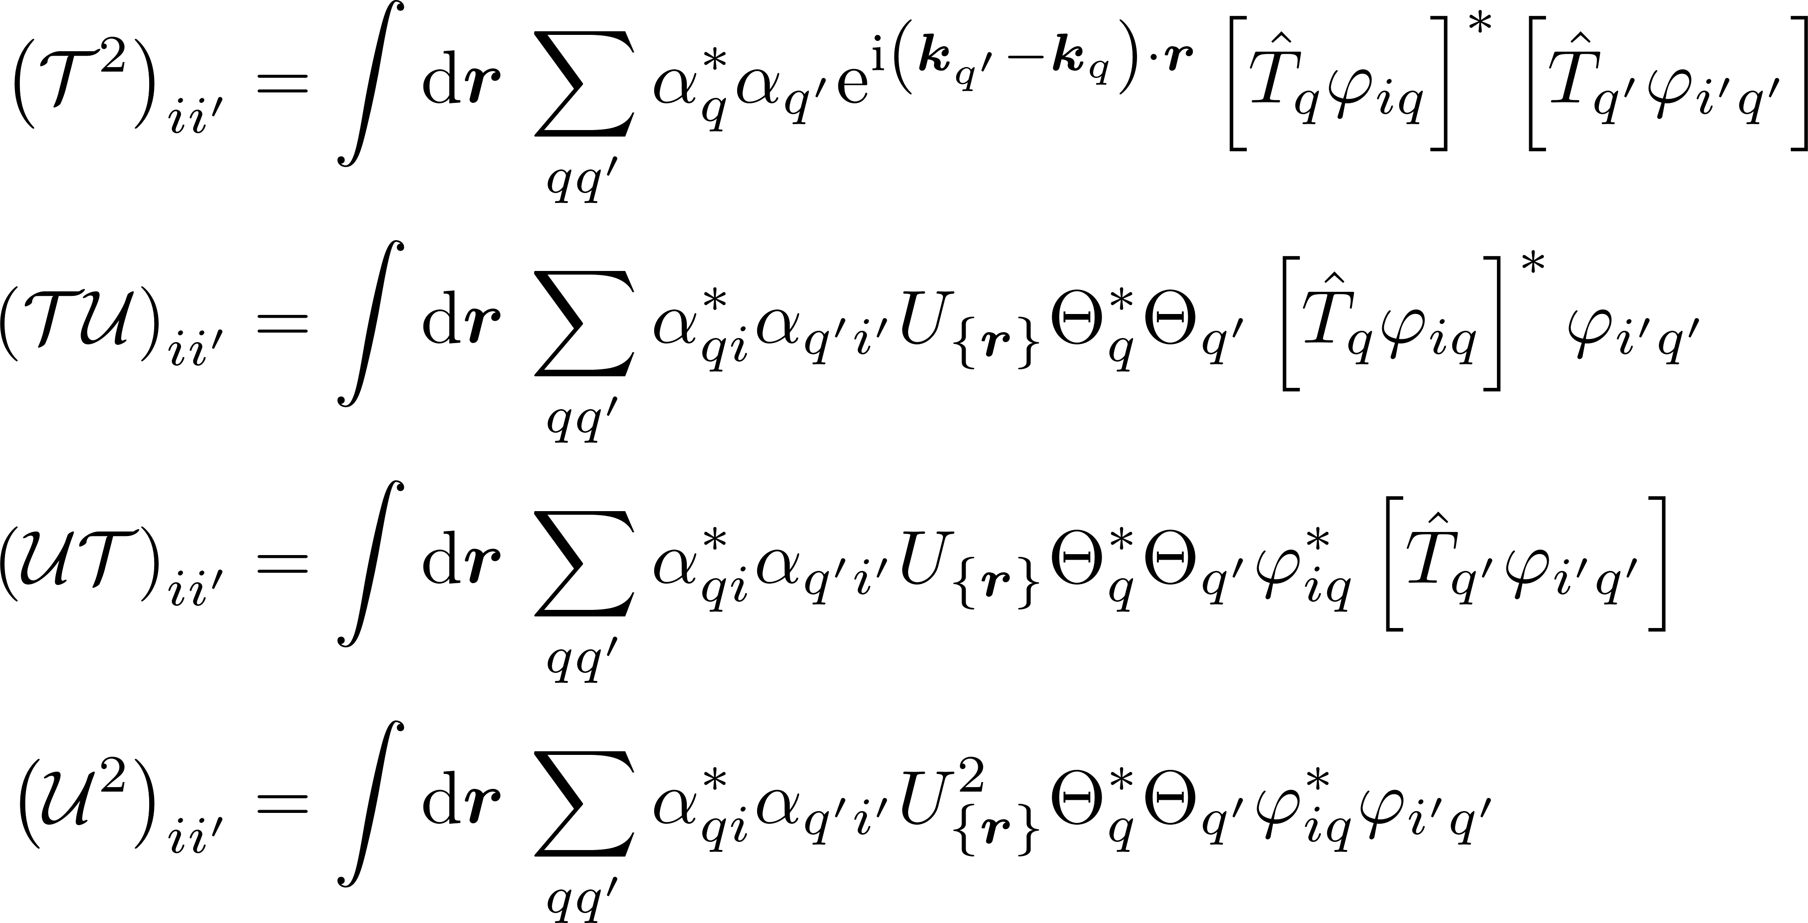
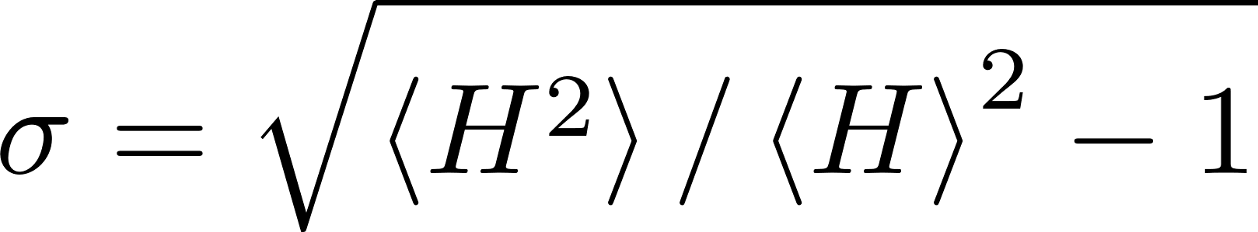
Hamiltonian Model – Modified Shindo-Nara Equation
Modified Shindo-Nara Effective Mass Model_{[6]}
Wavefunction in terms of symmetrized basis, with Bloch function η_{q} of qth conduction band valley.
Shindo-Nara equation recast as generalized eigenvalue problem.
H² for the Shindo-Nara Model
<H²> derived by following Shindo and Nara’s derivation of <H>.
Note that the intervalley components of the kinetic squared term have been explicitly included, as with the overlap and kinetic matrix elements above.
Measuring completeness
Relative deviation σ can be used as a completeness measure.

Slide 3
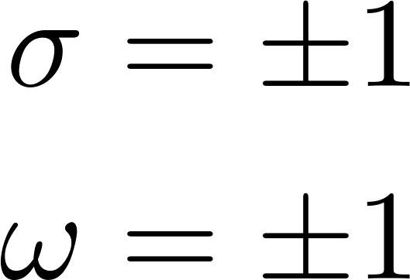
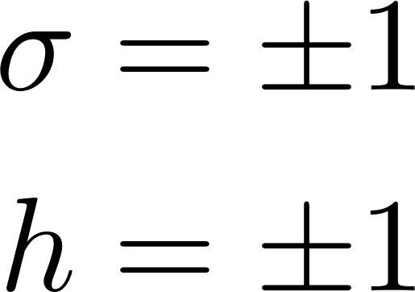
Symmetry considerations
States with m even are indexed by inversion (ω) and acyclic (σ) symmetry.
States with m odd are indexed by acyclic (σ) symmetry and a free index (h).
m odd states only have odd inversion.

Slide 4
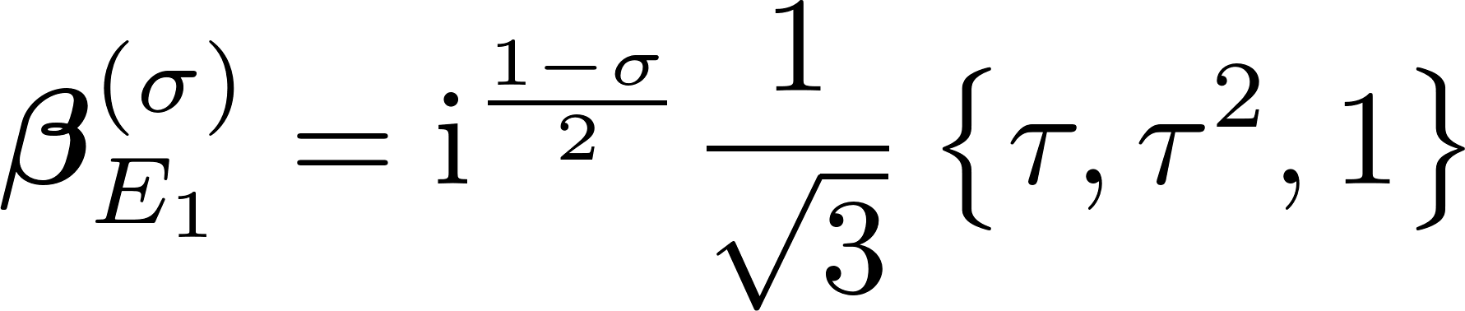
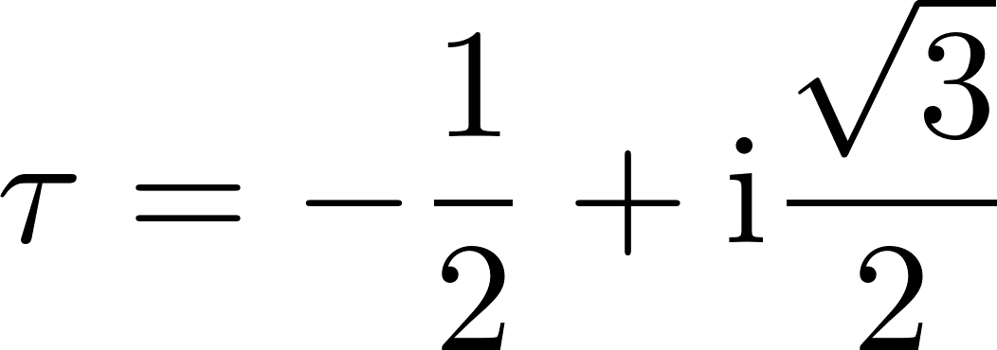
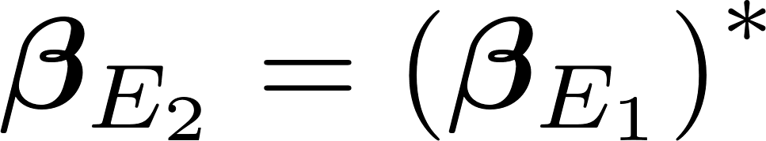
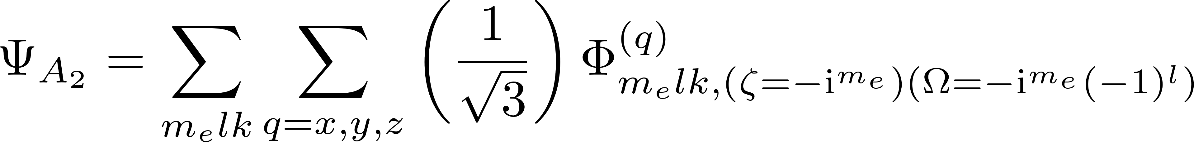
Fully symmetrized wavefunctions

