Slide 1
An open source software package to compare and extend effective mass models of the phosphorus donor in silicon
Luke Pendo and Xuedong Hu
Presentation Date: Monday, March 6, 2023 4:36 pm
gitlab.com/cantankerous-impurity
We thank financial support by US ARO via grant W911NF1710257.

Slide 2
Our PrOBlem

Slide 3
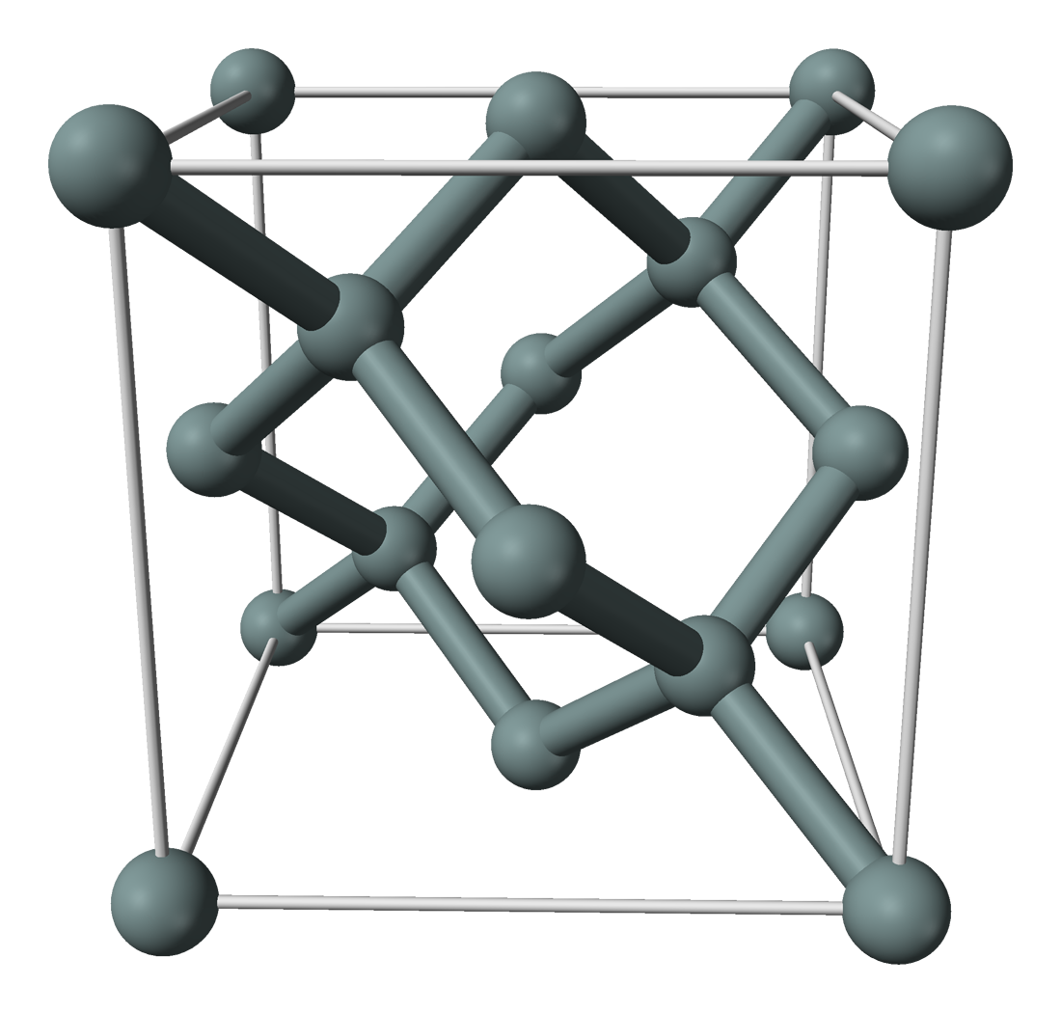
System description
Infinite silicon crystal bulk.
One silicon replaced by an isolated pnictogen (Series V/Group 15).
Specifically we consider the phosphorous substitutional donor.
System is symmetric about the impurity under operations of point group T_{d}.
Excess electric charge of phosphorous nuclear attracts excess electron.
P
Original crystal structure picture by Ben Mills, public domain.
https://commons.wikimedia.org/w/index.php?curid=2722584
Modified by L. Pendo for presentation.
The back of the envelope idea
Excess electron is affected by a periodic mean field potential, and weakly bound to donor potential.
Short-range: looks like a Bloch wave.
Long-range: attenuated on a radial scale much longer then lattice parameter.

Slide 4
The Model

Slide 5
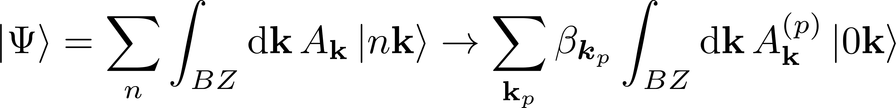
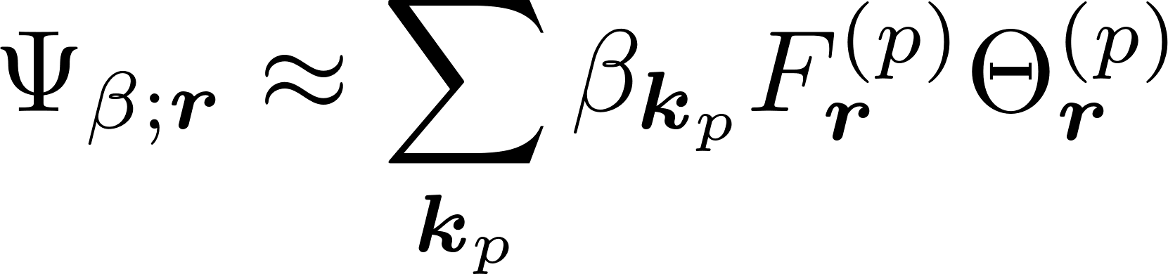
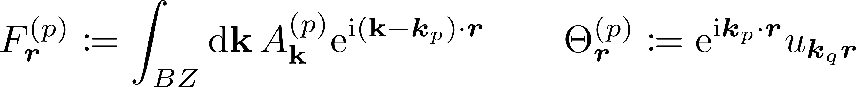
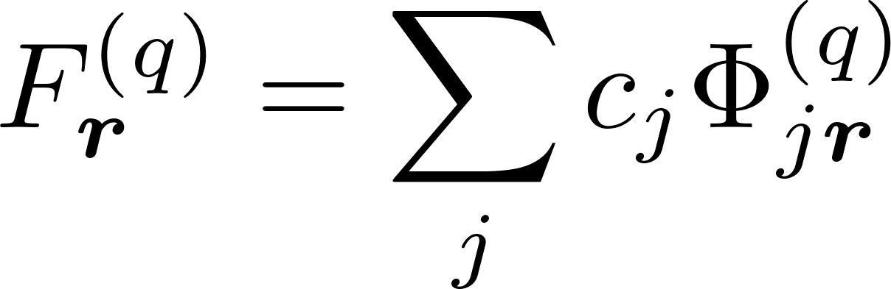
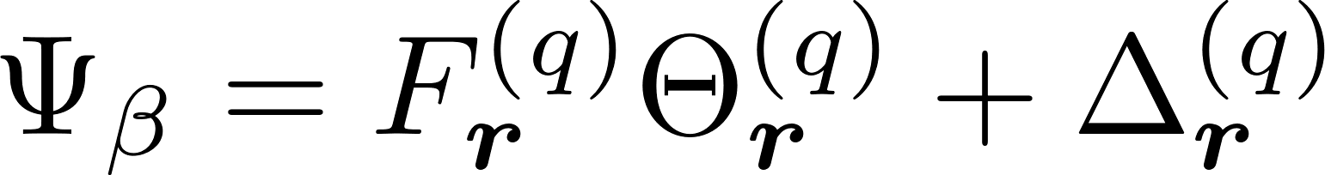
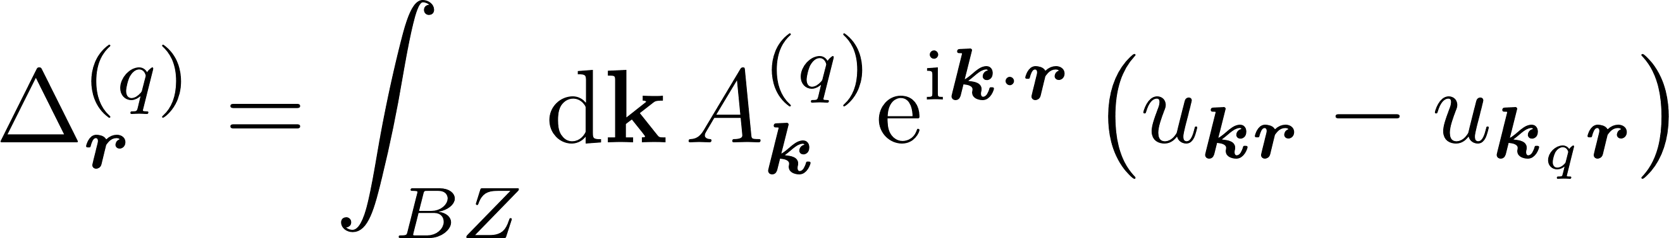
The effective mass approximation
EMA: Assume the donor electron is localized in k-space at the six-fold degenerate minima of the silicon conduction band.
Short-range: Bloch wave.
Long-range: Envelope function.
We expand the envelope function with a set of basis functions.

Slide 6
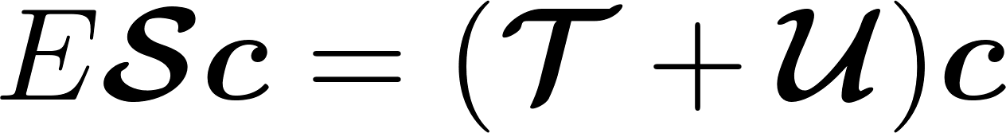
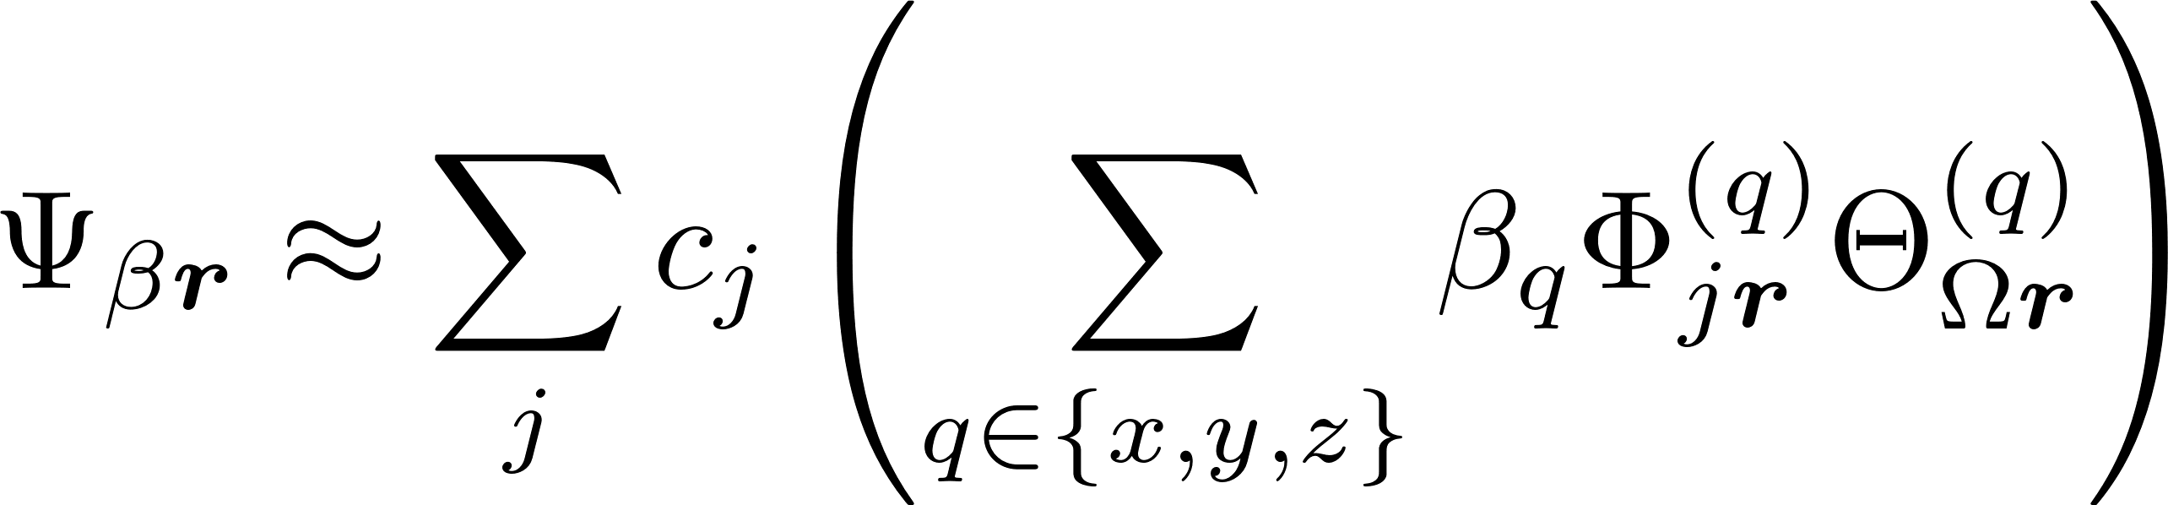
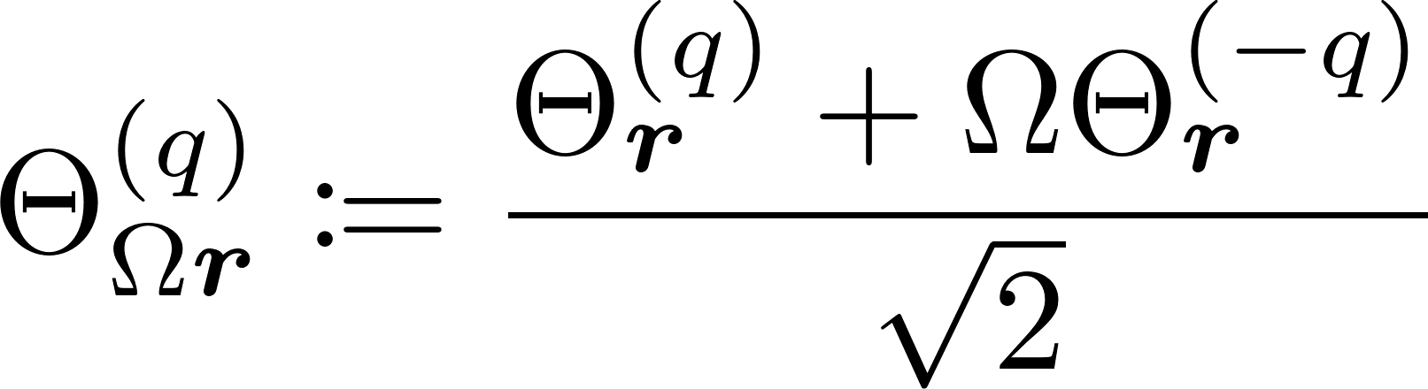
The Generalized Eigenvalue Problem
[1] K. Shindo and H. Nara, J. Phys. Soc. Jpn. 40, 1640 (1970)
[2] J. K. Gamble et al., Phys. Rev. B 91, 235318 (2015)
“Modified” Shindo-Nara effective mass equation[1] cast as a generalized eigenvalue problem[2].
H₀ is intended to model the pure silicon potential.
U is intended to model all deviations from the pure silicon potential.
symmetrized anisotropic basis states
Bloch functions of opposed valley minima are included as Fourier series:

Slide 7
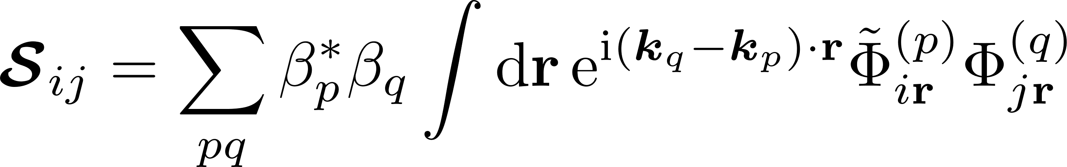
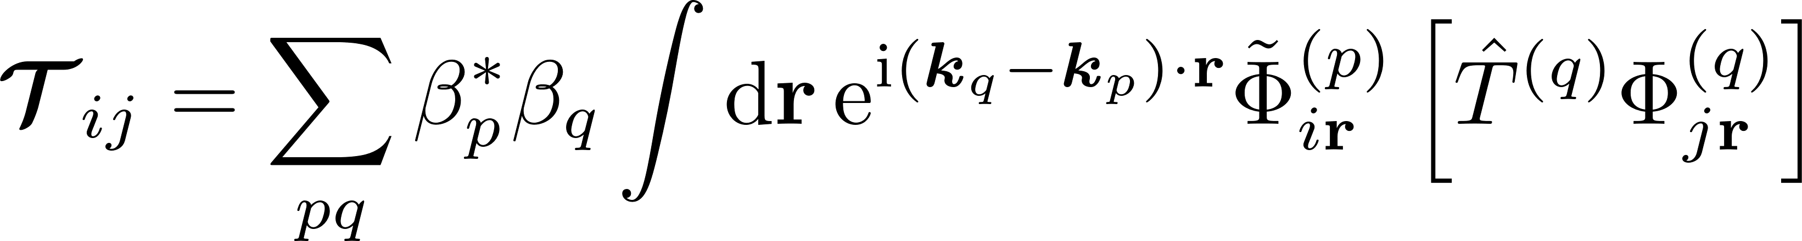
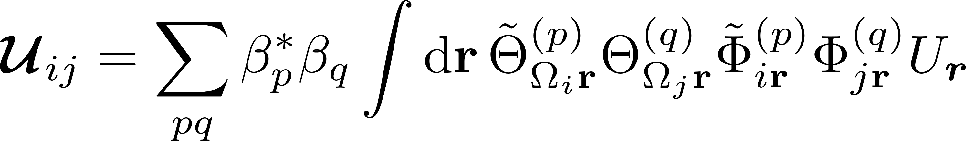
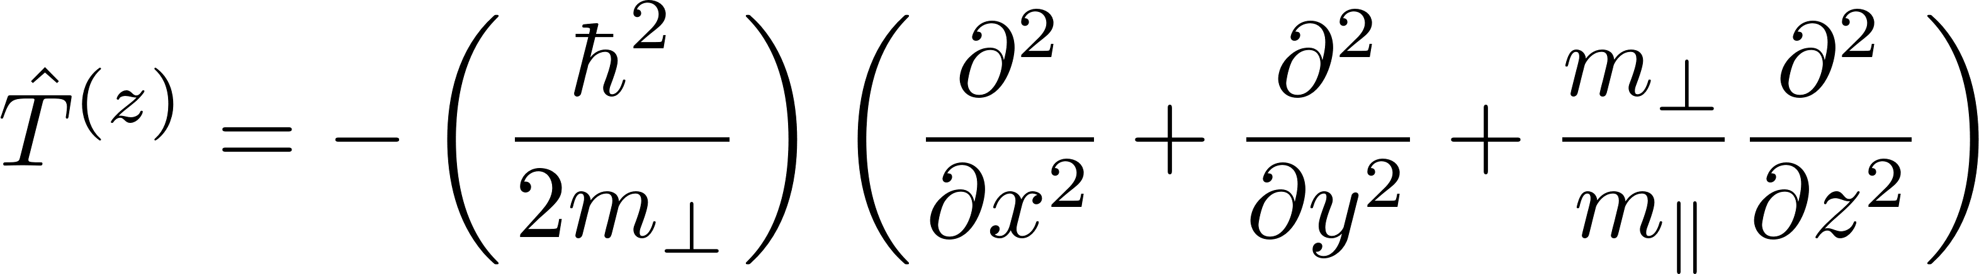
Matrix Construction – Overlap, Hamiltonian

Slide 8
Views on the effective mass approximation
[1] R.A. Faulkner, Phys. Rev. 184, 713 (1969)
[2] A.K. Ramdas and S. Rogriguez, Rep Prog Phys. 44, 1297 (1981)
An attractively intuitive physical picture of the state of the donor electron.
Less computationally expensive as compared to ab initio and tight-binding models.
Predicts the energies of spatially extended excited states of donors [1,2].
Struggles to present a quantitively persuasive picture of the ground state manifold
Few agreed upon criteria for refutability (beyond agreement with energy spectrum).
Lots of freedom to generate different schemes through reasonable but ad hoc assumptions.
Is further improvement of effective mass methods possible?
Notes:
For the authors, it remains an open question if these difficulties can be resolved by incorporating additional phenomenological corrections or if they are evidence of a more fundamental breakdown of the effective mass approximation itself.

Slide 9
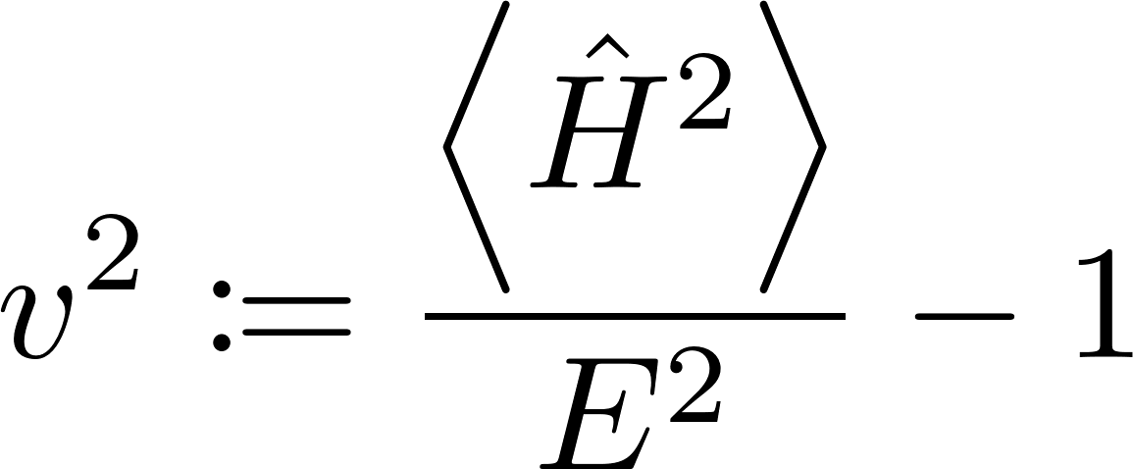
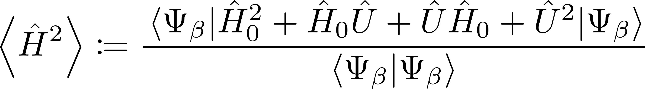
Model evaluation
Background
[*] arXiv:2302.04919
In-model
Out of model
Consistency
How well does the model play by its own rules?
Verisimilitude
How well does the model resemble reality?
Completeness
Can the model answer questions posed to it?
V-score[*]: Metric for model completeness
Is the trial eigenstate well-converged to an actual eigenstate?

Slide 10
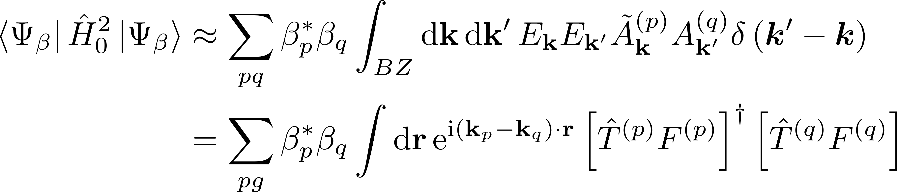
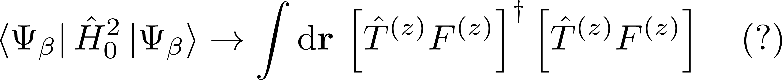
“Modified” Shindo-Nara equation?
It is a reasonable assumption for verisimilitude that the kinetic term doesn’t mix the valleys.
However, to ensure that the square of the V-score is positive definite, the previously dropped terms must be kept.

Slide 11
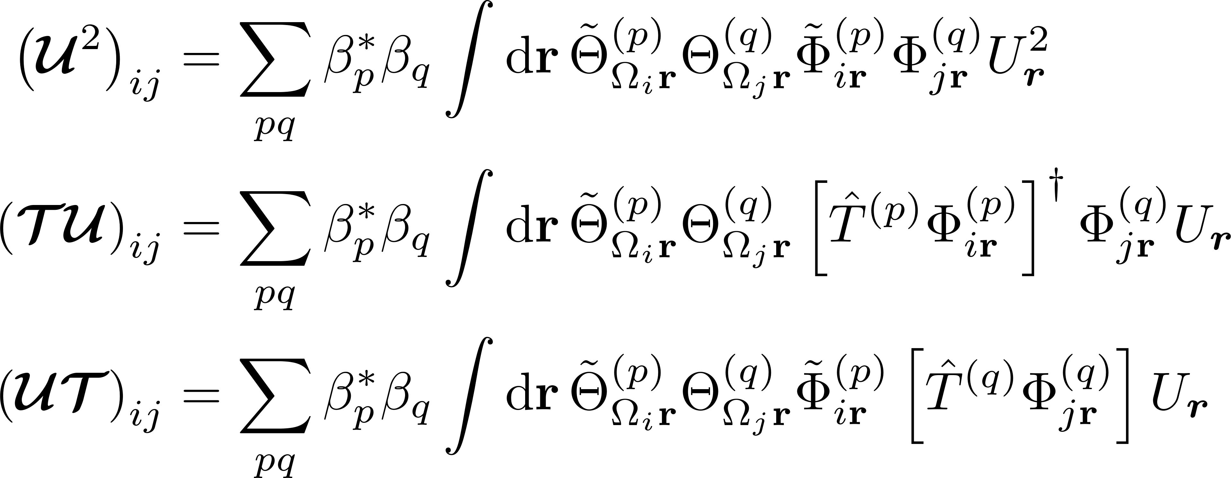
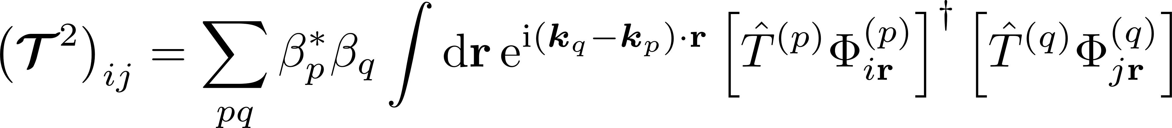
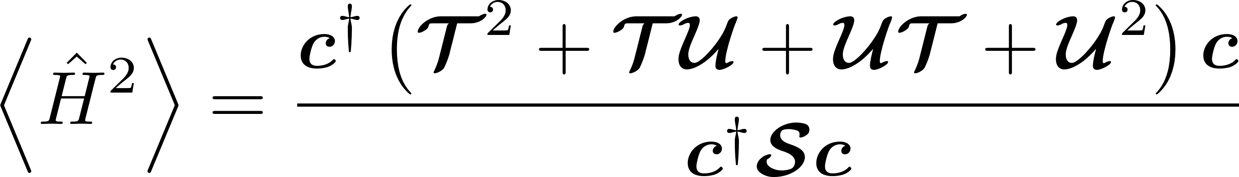
Matrix Construction – Hamiltonian Squared

Slide 12
The Basis

Slide 13
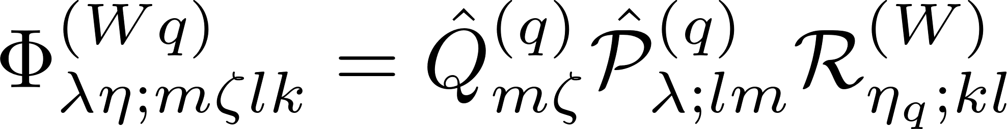
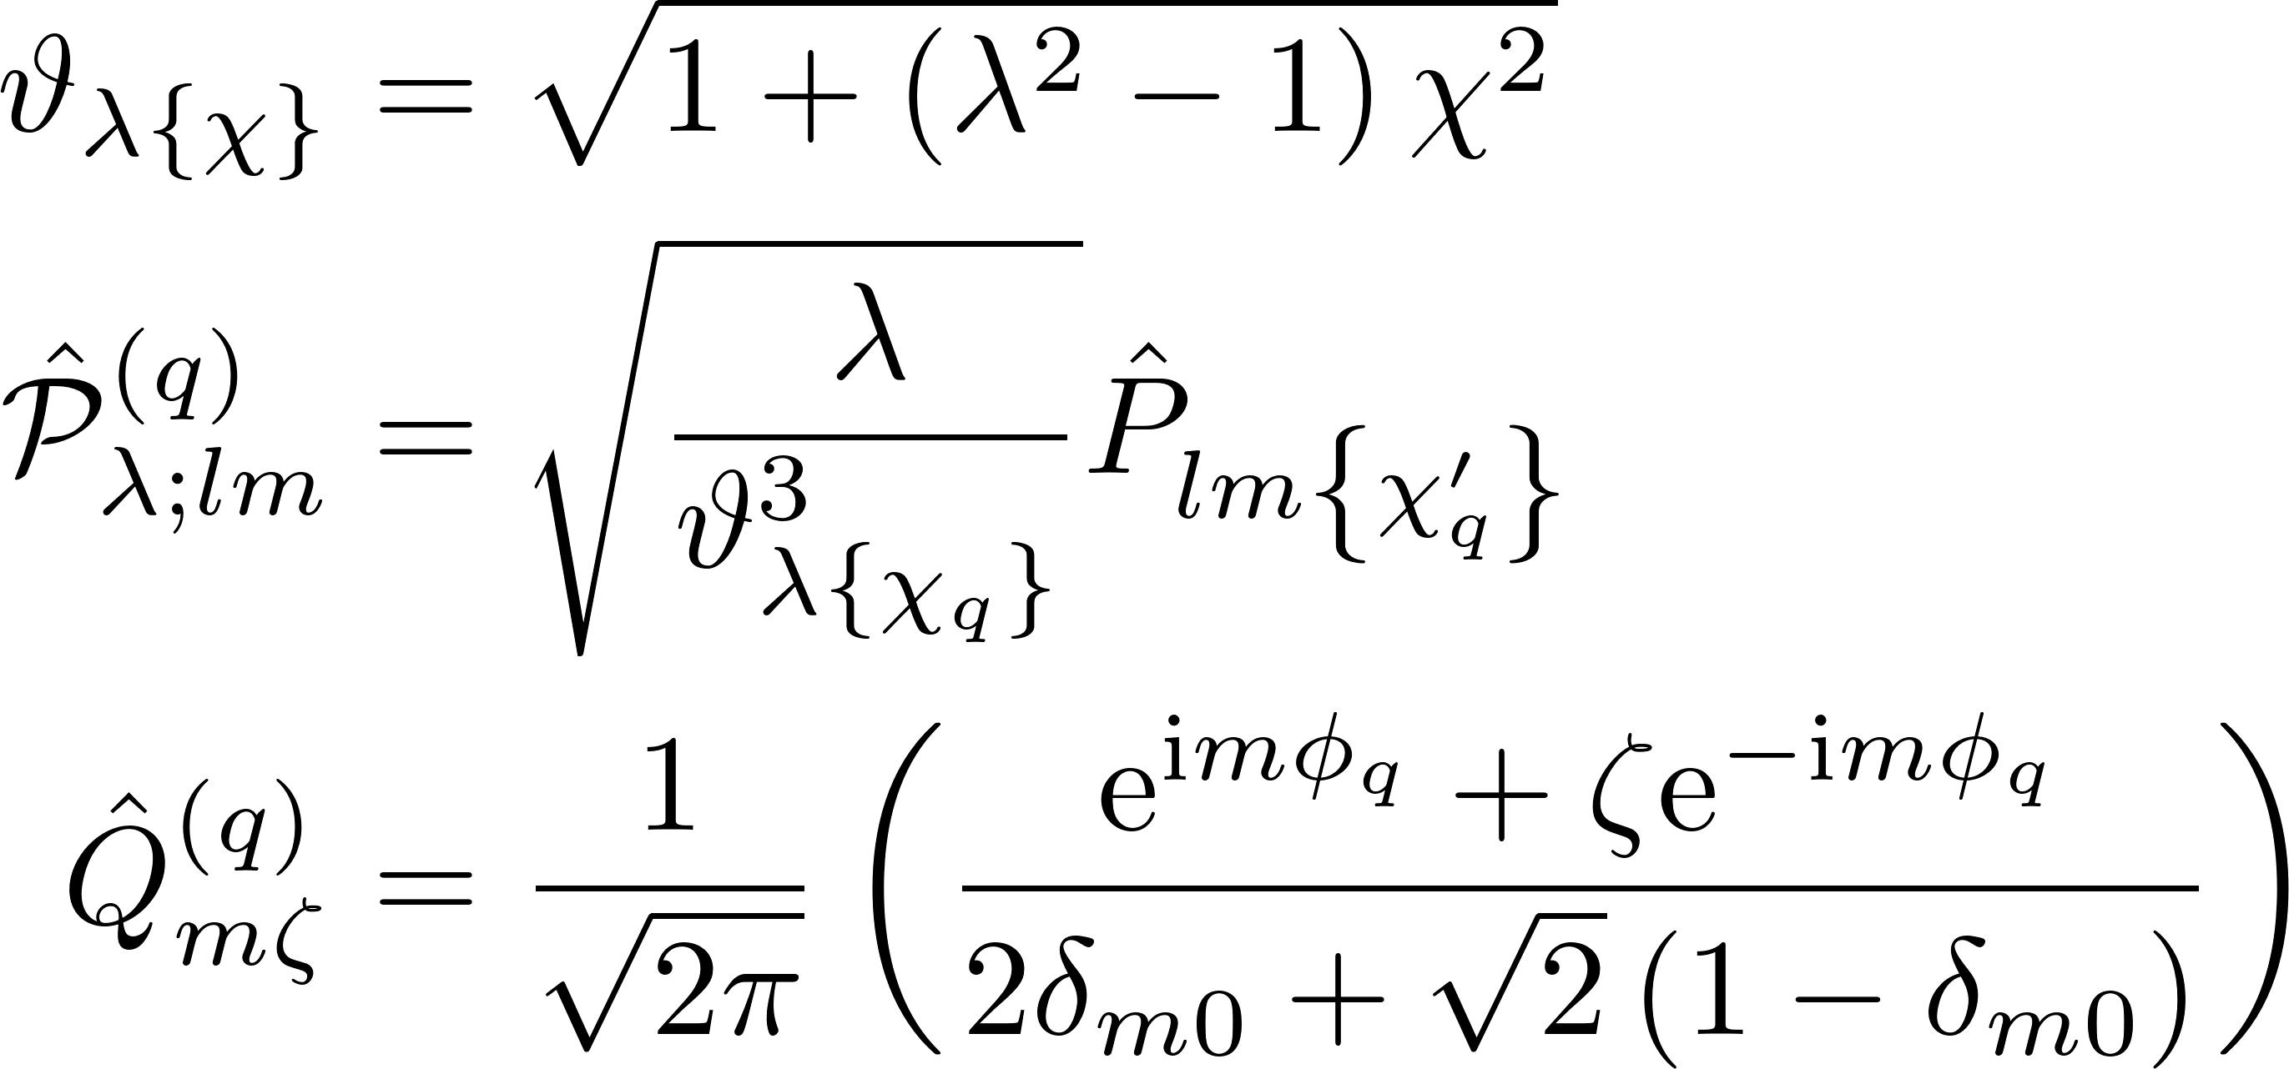
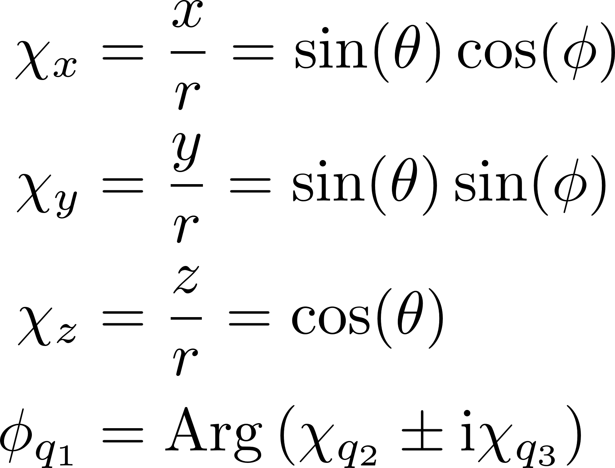
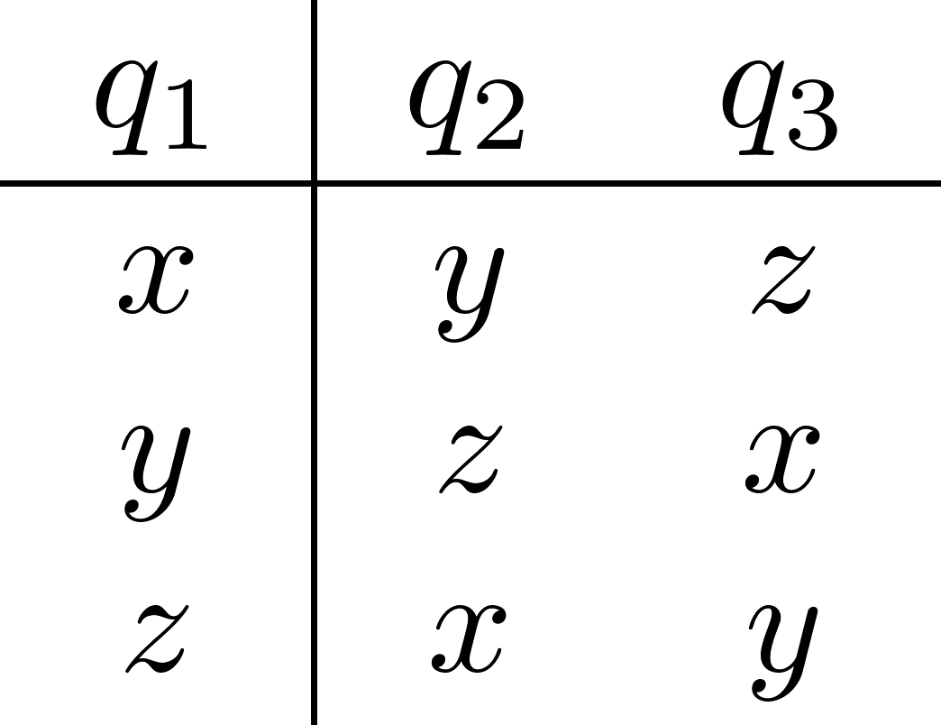
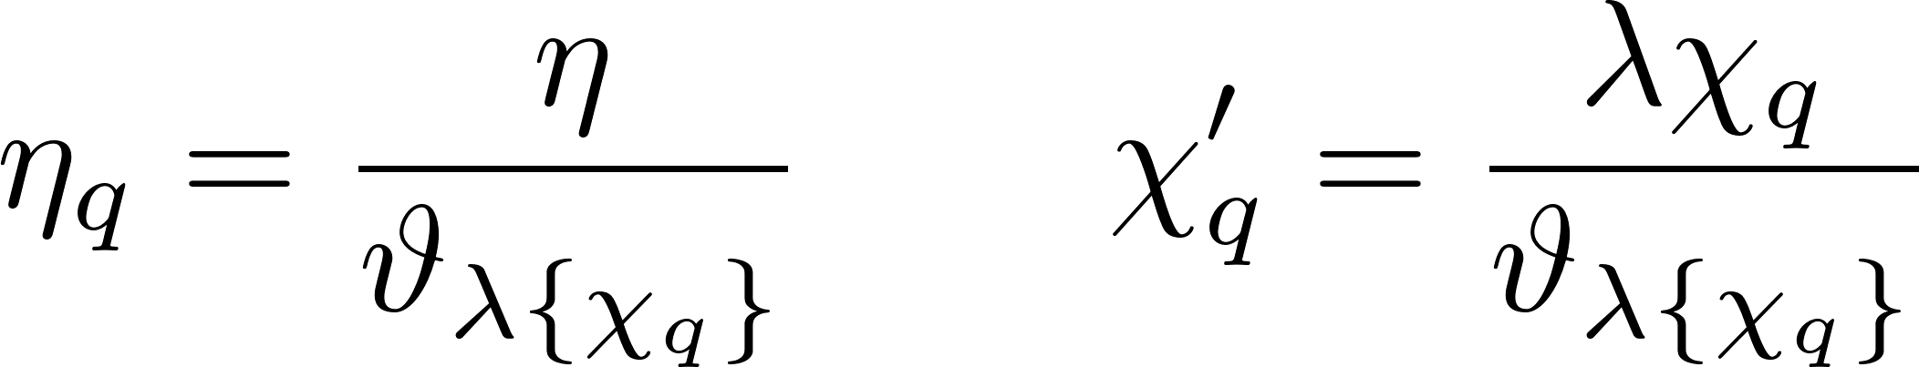
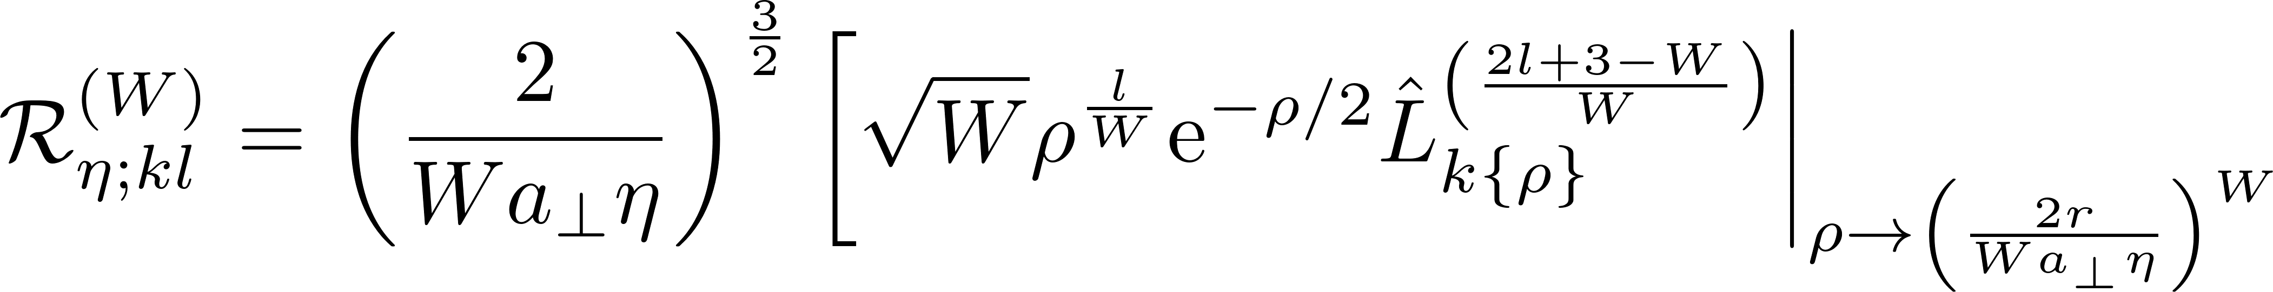
Naïve basis functions defined

Slide 14
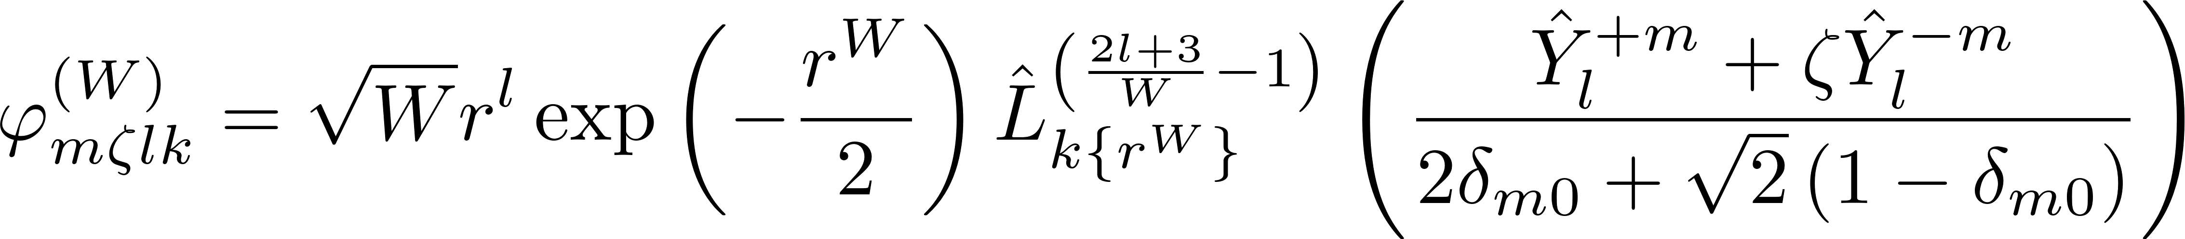
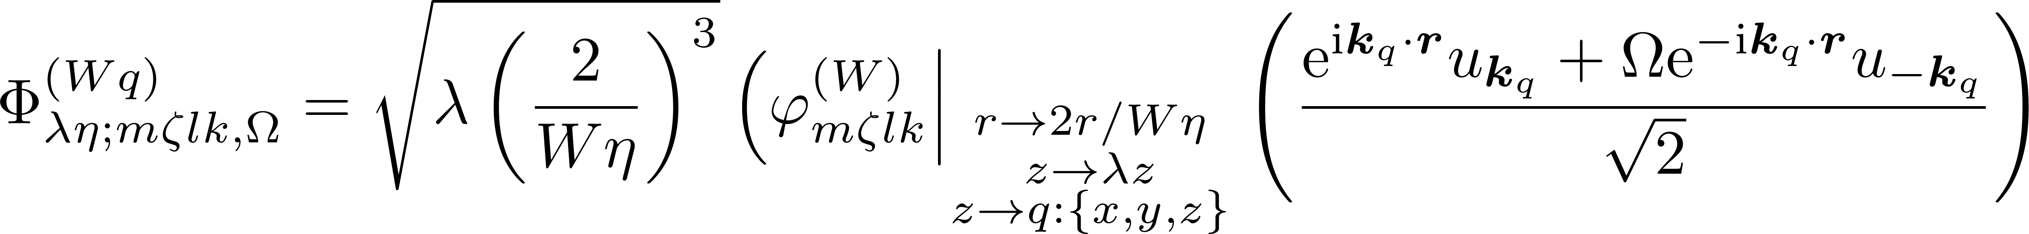

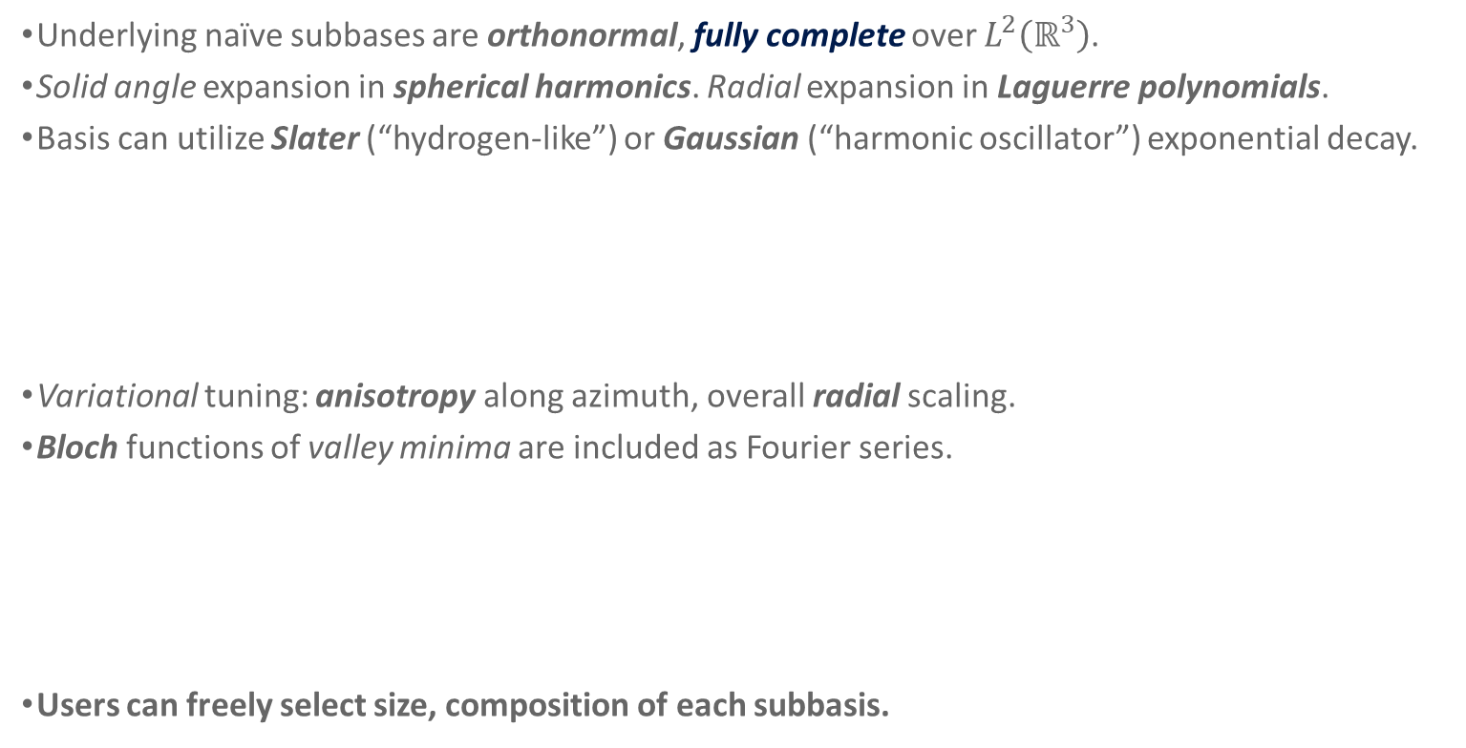
Complete, Extensible “Subbasis”
Underlying naïve subbases are orthonormal, fully complete over $L^{2}\left(ℝ^{3}\right)$.
Solid angle expansion in spherical harmonics. Radial expansion in Laguerre polynomials.
Basis can utilize Slater (“hydrogen-like”) or Gaussian (“harmonic oscillator”) exponential decay.
Variational tuning: anisotropy along azimuth, overall radial scaling.
Bloch functions of valley minima are included as Fourier series.
Users can freely select size, composition of each subbasis.

Slide 15
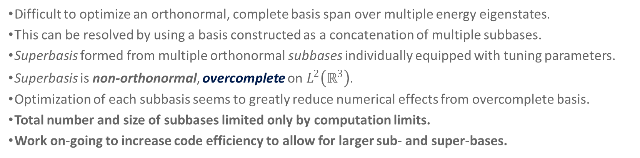
“Superbasis”
Difficult to optimize an orthonormal, complete basis span over multiple energy eigenstates.
This can be resolved by using a basis constructed as a concatenation of multiple subbases.
Superbasis formed from multiple orthonormal subbases individually equipped with tuning parameters.
Superbasis is non-orthonormal, overcomplete on $L^{2}\left(ℝ^{3}\right)$.
Optimization of each subbasis seems to greatly reduce numerical effects from overcomplete basis.
Total number and size of subbases limited only by computation limits.
Work on-going to increase code efficiency to allow for larger sub- and super-bases.

Slide 16
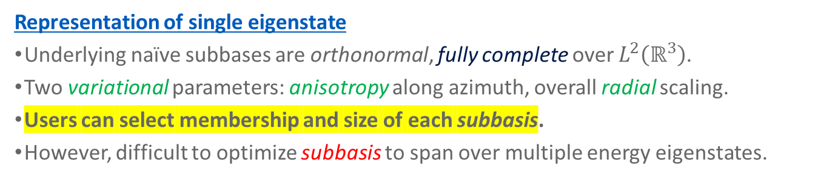
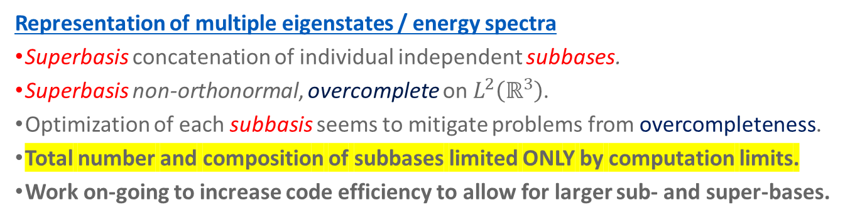
Complete, Extensible Basis
Representation of single eigenstate
Underlying naïve subbases are orthonormal, fully complete over $L^{2}\left(ℝ^{3}\right)$.
Two variational parameters: anisotropy along azimuth, overall radial scaling.
Users can select membership and size of each subbasis.
However, difficult to optimize subbasis to span over multiple energy eigenstates.
Representation of multiple eigenstates / energy spectra
Superbasis concatenation of individual independent subbases.
Superbasis non-orthonormal, overcomplete on $L^{2}\left(ℝ^{3}\right)$.
Optimization of each subbasis seems to mitigate problems from overcompleteness.
Total number and composition of subbases limited ONLY by computation limits.
Work on-going to increase code efficiency to allow for larger sub- and super-bases.

Slide 17
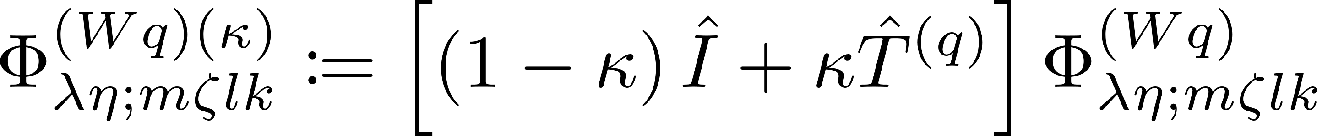
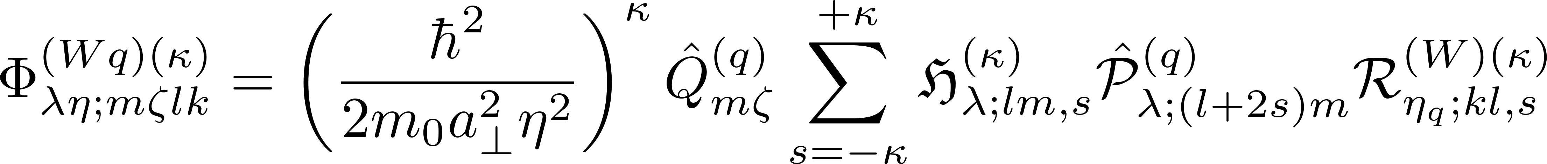
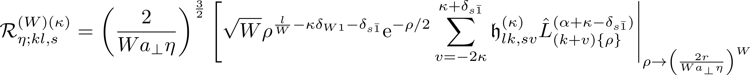
Generalized basis states -- I

Slide 18
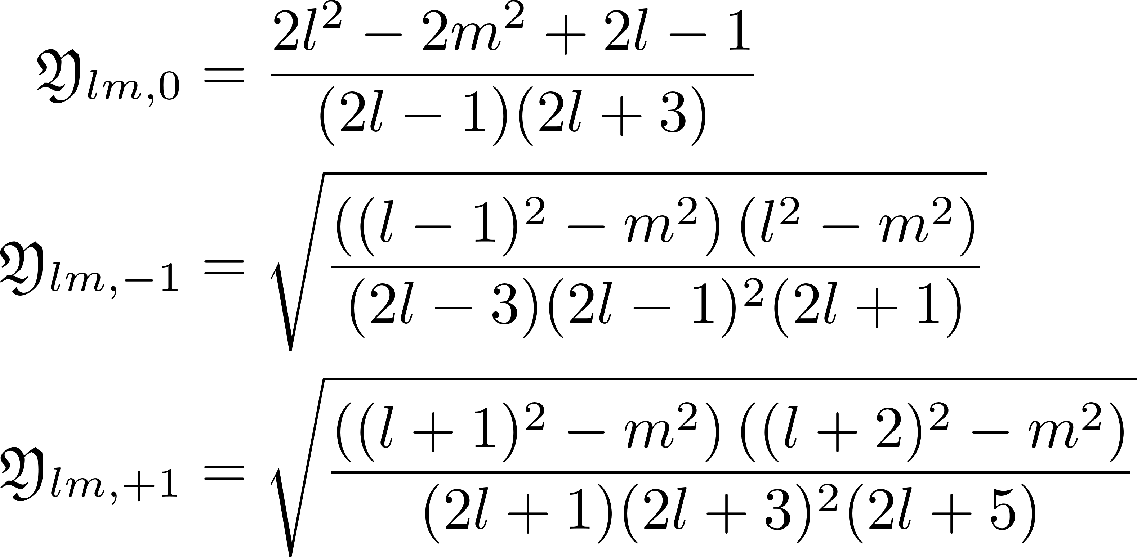
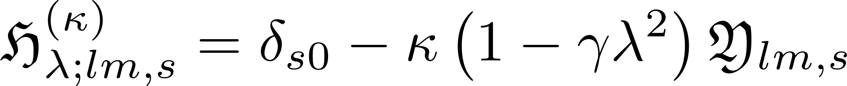
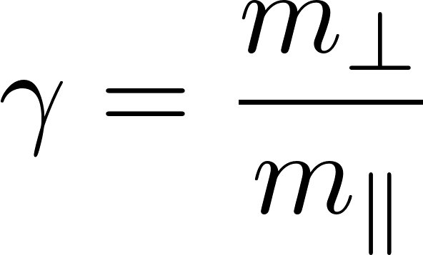
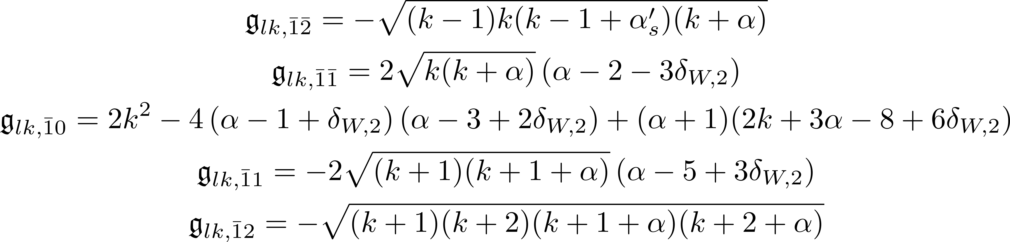
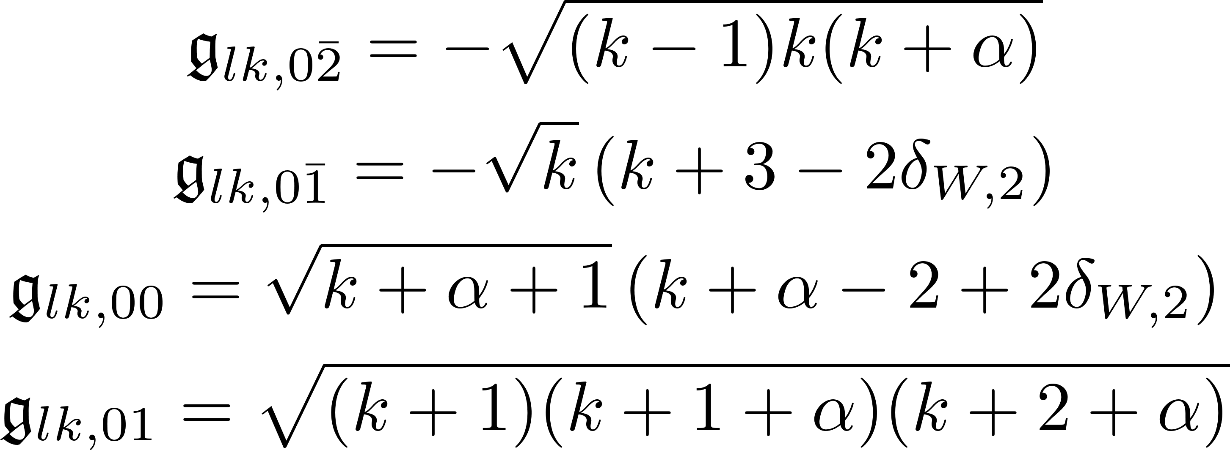
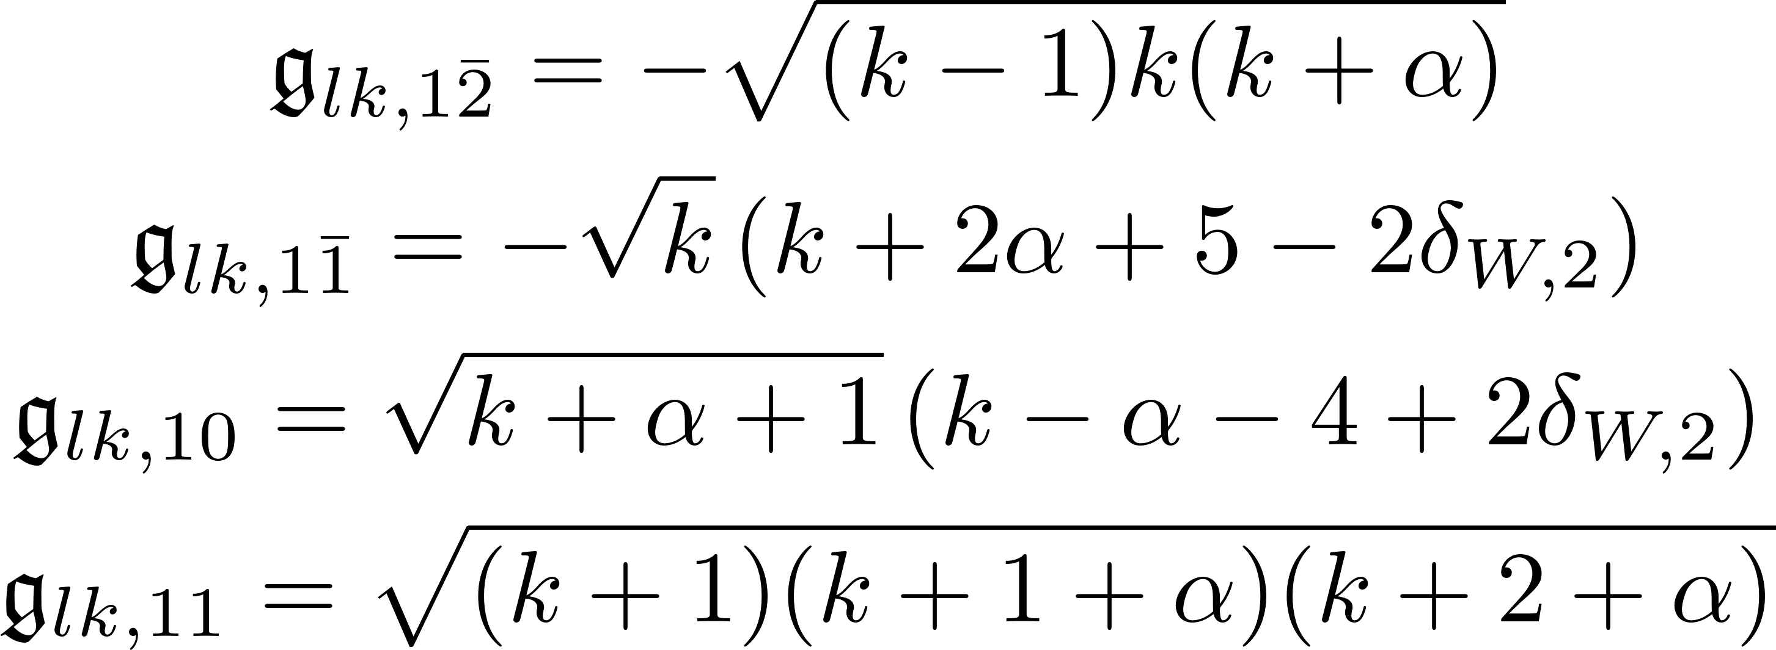
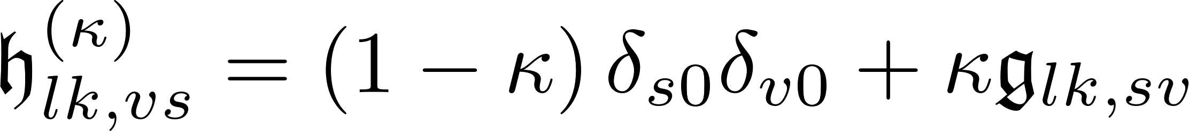
Generalized basis states -- II

Slide 19
The SYMMETRY

Slide 20
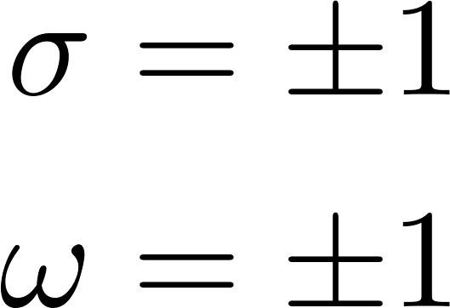
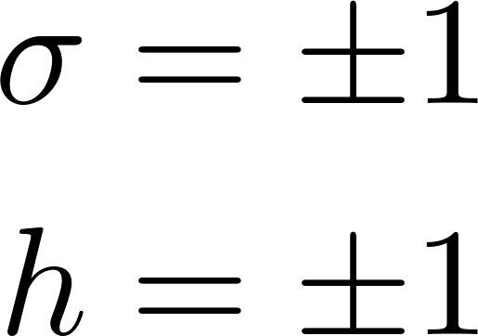
Symmetry considerations
States with m even are indexed by inversion (ω) and acyclic (σ) symmetry.
States with m odd are indexed by acyclic (σ) symmetry and a free index (h).
m odd states only have odd inversion.

Slide 21
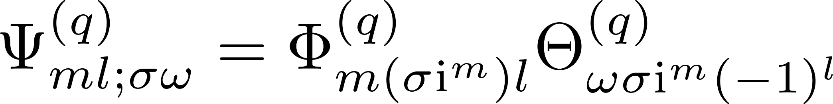
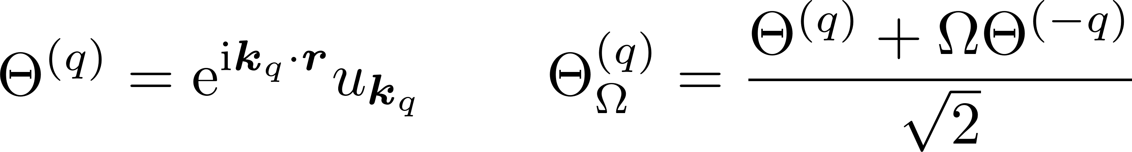
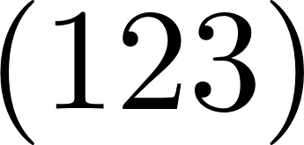
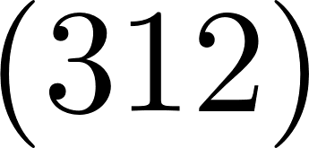
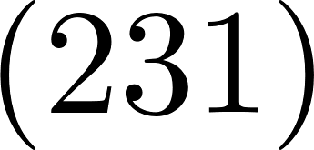














Effect of Td operations, including Bloch functions, m even
States indexed by inversion (ω) and acyclic (σ) symmetry as either even (+1) or odd (-1)
Cyclic permutations
Double inversion
Time-reversal
Acyclic permutations

Slide 22







Effect of Td operations, including Bloch functions, m odd
States indexed by acyclic (σ) symmetry as either even (+1) or odd (-1). m odd states have odd inversion (ω = -1).
Cyclic permutations
Double inversion
Time-reversal
Acyclic permutations

Slide 23


Full Accounting of Symmetry, Basis
Multi-valley basis functions are symmetrized according to T_{d} symmetry of silicon.
Forms for A₂ and T₁ are also known.
Selection rules for all symmetries are analytically known, but have not yet been implemented in code.

Slide 24
POTENTIAL Model

Slide 25



Flexible Potential Model
[1] J.K. Gamble et al., Phys. Rev. B 91, 235318 (2015)
[2] A.Q. Sarker, J. Phys. C 10 2617 (1977)
[3] M. Usman, et al., J. Phys.:Condens. Matter 27 154207 (2015)
To facilitate deep exploration, a very general potential model.
The fraktur constants can be freely set by users of the software.
Potential form represents most extant models of the effective silicon donor potential.
Examples include the tetrahedral potential used by Gamble [1] and the dynamic dielectric model [2,3].

Slide 26
Test Case
Single-Valley Wavefunctions
Beyond Kohn-Luttinger

Slide 27





Kohn-Luttinger (Historic)
Basis(m,l,k)
0,0,0

Slide 28




Expanded Single-Valley
Basis(m,l,k)
0,0,0
0,0,1
0,0,2
0,0,3
0,2,0
0,2,1
0,2,2
0,2,3
0,4,0
0,4,1
0,4,2
0,4,3
0,6,0
0,6,1
0,6,2
0,6,3

Slide 29
Conclusions

Slide 30
Caveats and Challenges -- I
Precalculations
Complete basis requires computation of alternating sign sums – floating point computation unstable.
Alternating sign computations performed symbolically with python module Sympy.
Results stored in SQLite database; retrieved at runtime.
Symbolic precalculation takes substantial time, but a one-time investment.
Database Access
Size of the precalculation SQLite database on the order of GBs.
Network distribution difficult. User assumes computation and storage responsibilities.
Importation into runtime memory presents a recurring bottleneck.

Slide 31
Caveats and Challenges -- II
Parameter Optimization
Variational tuning of subbases currently requires hand-tuning.
Superbasis concept introduces large multi-dimensional variational space, requires stochastic search.
Earlier proof of concept in Fortran implemented an Artificial Bee Colony stochastic optimization algorithm.
Working on integrating extant ABC code within current incarnation of project.
Numerical Stability and Verisimilitude
Computations involve numerical matrix and cubature methods.
Some regions of parameter space seem “sour”/“unstable” leading to unreliable or unbelievable results.
Multi-valley overlap, kinetic elements necessary for completeness and consistency, but detracts from verisimilitude.
Working on expanding unit testing of code, as well as runtime monitors for numerical stability.
Working on runtime analysis on breakdown and deviations from the EMA.

Slide 32
Prospects
https://gitlab.com/cantankerous-impurity
Specific focus of my PhD research on Si:P and the EMA, but framework is very general.
Want to make code and documentation available as an open science, open notes, open source GPL 3 licensed project.
Can be used to explore other Hamiltonians, other symmetries, other systems.
Extensions
Perturbations of T_{d} symmetry.
External fields, electric, magnetic.
Multi-center effects.
Multi-electron effects.
Forks
Different donors in silicon.
Different bulk materials.
2-D systems: quantum dots.

Slide 33
“The Pitch”
https://gitlab.com/cantankerous-impurity
Upshot: Want others to benefit from 10,000+ lines of code, thousands of work hours.
Opportunity for a collaboration led by PhD students, postdocs, early career scientists.
A chance to develop scientific, technical, logistic, communication, and management skills.
Python: Symbolic computations, data analysis, data visualization, SQL integration.
C++: Code analysis, optimization, documentation. Work with new features of latest C++ standard.
Fortran: Integration of scientific code from multiple languages.
Mathematics: Symmetry group theory. Numerical stability. Stochastic optimization. Function representation.
Interested?
E-mail: lukepend@buffalo.edu, luke.pendo@gmail.com
Gitlab repo: cantankerous-impurity

