Slide 1
Solving Central pOtential Problems With Generalized Fourier Series
Group Meeting (2022-April-28)
Luke Pendo
https://gitlab.com/cantankerous-impurity/cantankerous-impurity/-/blob/core/GroupMeetings/GroupMeeting_2022-04-28.pptx

Slide 2
What are we doing here?
A bite sized piece
Project has a ton of ( physical / theoretical / mathematical / practical / technical / computational ) details!
Even I can’t keep it all in my head and I’ve been soaking in it for 6+ years!
Aiming for a short digestible presentation of 15-20 minutes.
Planning to explore a few “simple” central potential problems (hydrogen atom, radial harmonic oscillator).
Solutions to these problems with complete orthogonal basis sets represents a significant technical benchmark.
More to chew on
Much more available for the curious!
Extant corpus of notes and code available online.
Project duration has lead to notes and comments being a somewhat scattered, holey mess.
To do: Need to standardize and complete project documentation.
Always open to direct questions from the curious.

Slide 3
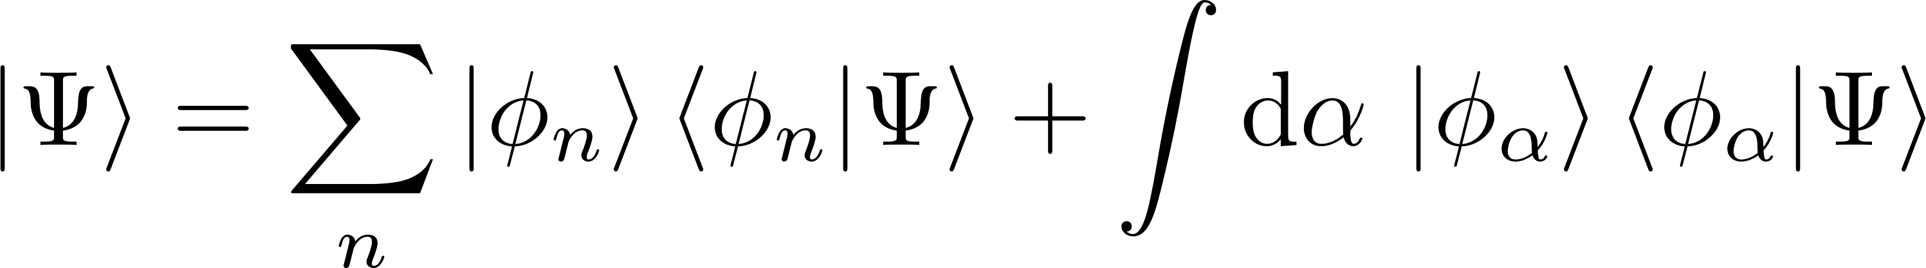
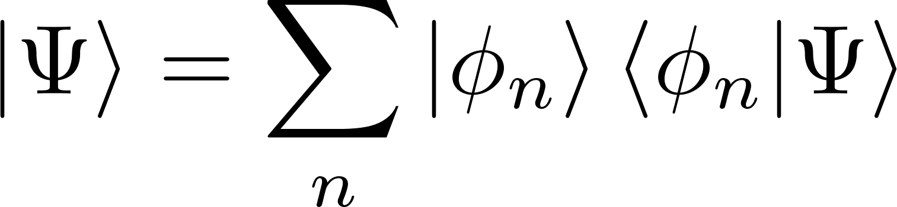
A few words on Hilbert spaces
Representations of states from Hilbert spaces
The pure states of a von Neumann quantum theory[*] reside in a complex Hilbert space. For a given Hilbert space there necessarily exist countable and uncountable sets of states whose union, called a basis, is an orthonormal set that spans the Hilbert space. Any arbitrary state in this Hilbert space may be represented using the basis as
Some Hilbert spaces in quantum mechanics are separable, meaning there exists a countable basis, so every state may represented as
We want to find a basis set for the Hilbert space formed from the set of complex-valued square-integrable functions defined on Euclidean space.
* J. von Neumann, N. A. Wheeler, Mathematical foundations of quantum mechanics (Princeton University Press, Princeton, 1955).

Slide 4
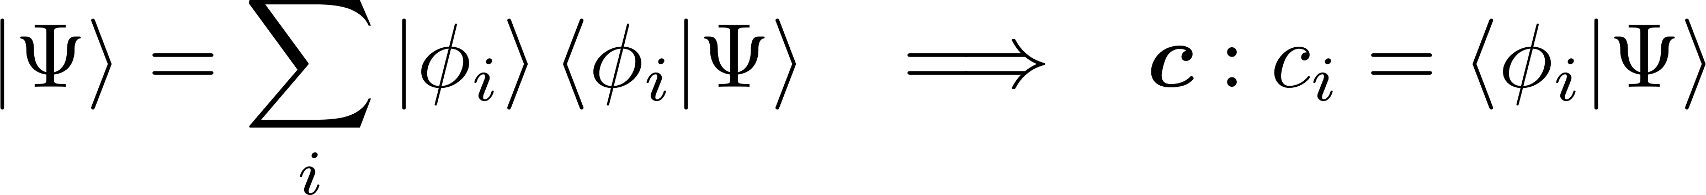
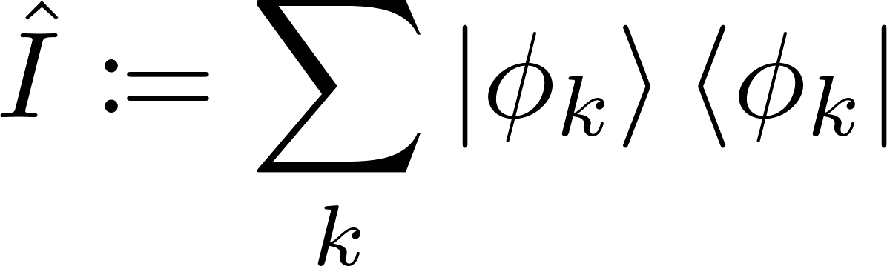
Understanding (complete) orthogonal bases
All infinite-dimensional separable Hilbert spaces are isomorphic

Slide 5
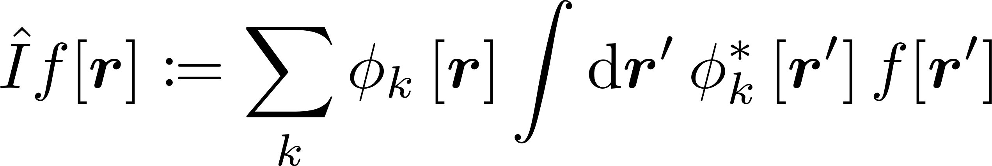
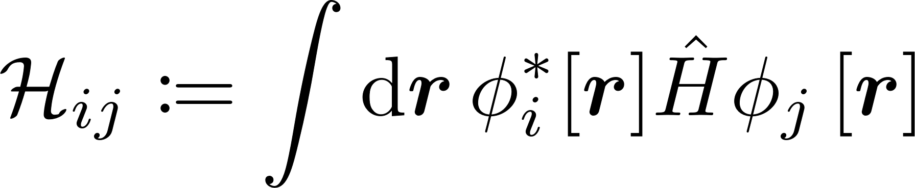
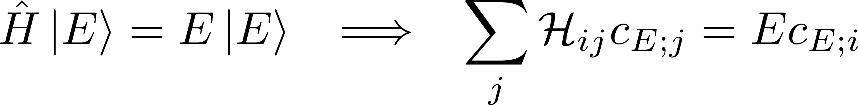
Understanding L²
The space of square-integrable functions is a separable Hilbert space

Slide 6
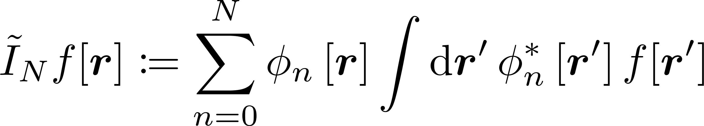
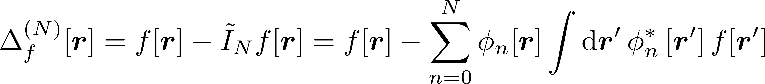
What ‘complete’ means on $L^{2}\left(ℝ^{3}\right)$

Slide 7
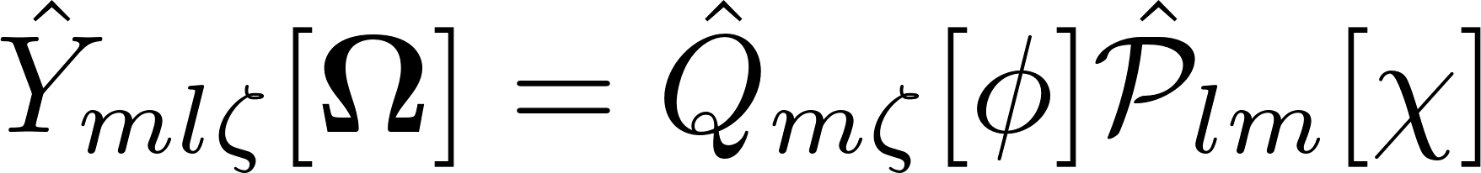
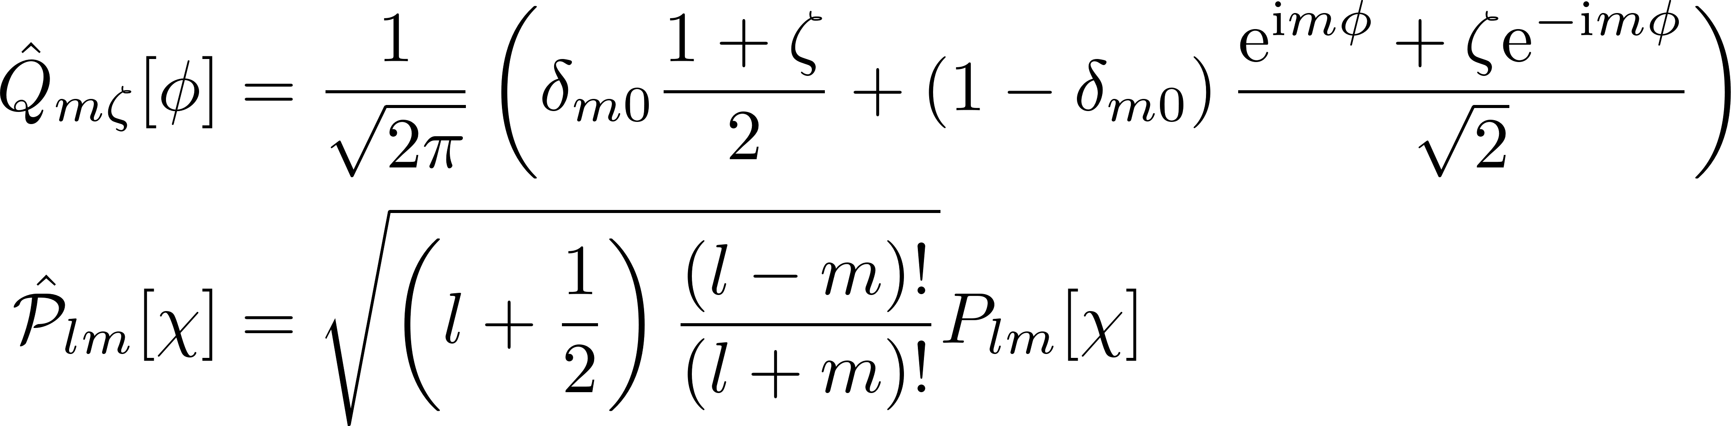
Our complete orthogonal basis set (solid angle)

Slide 8
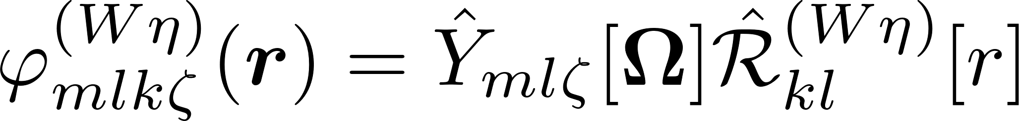
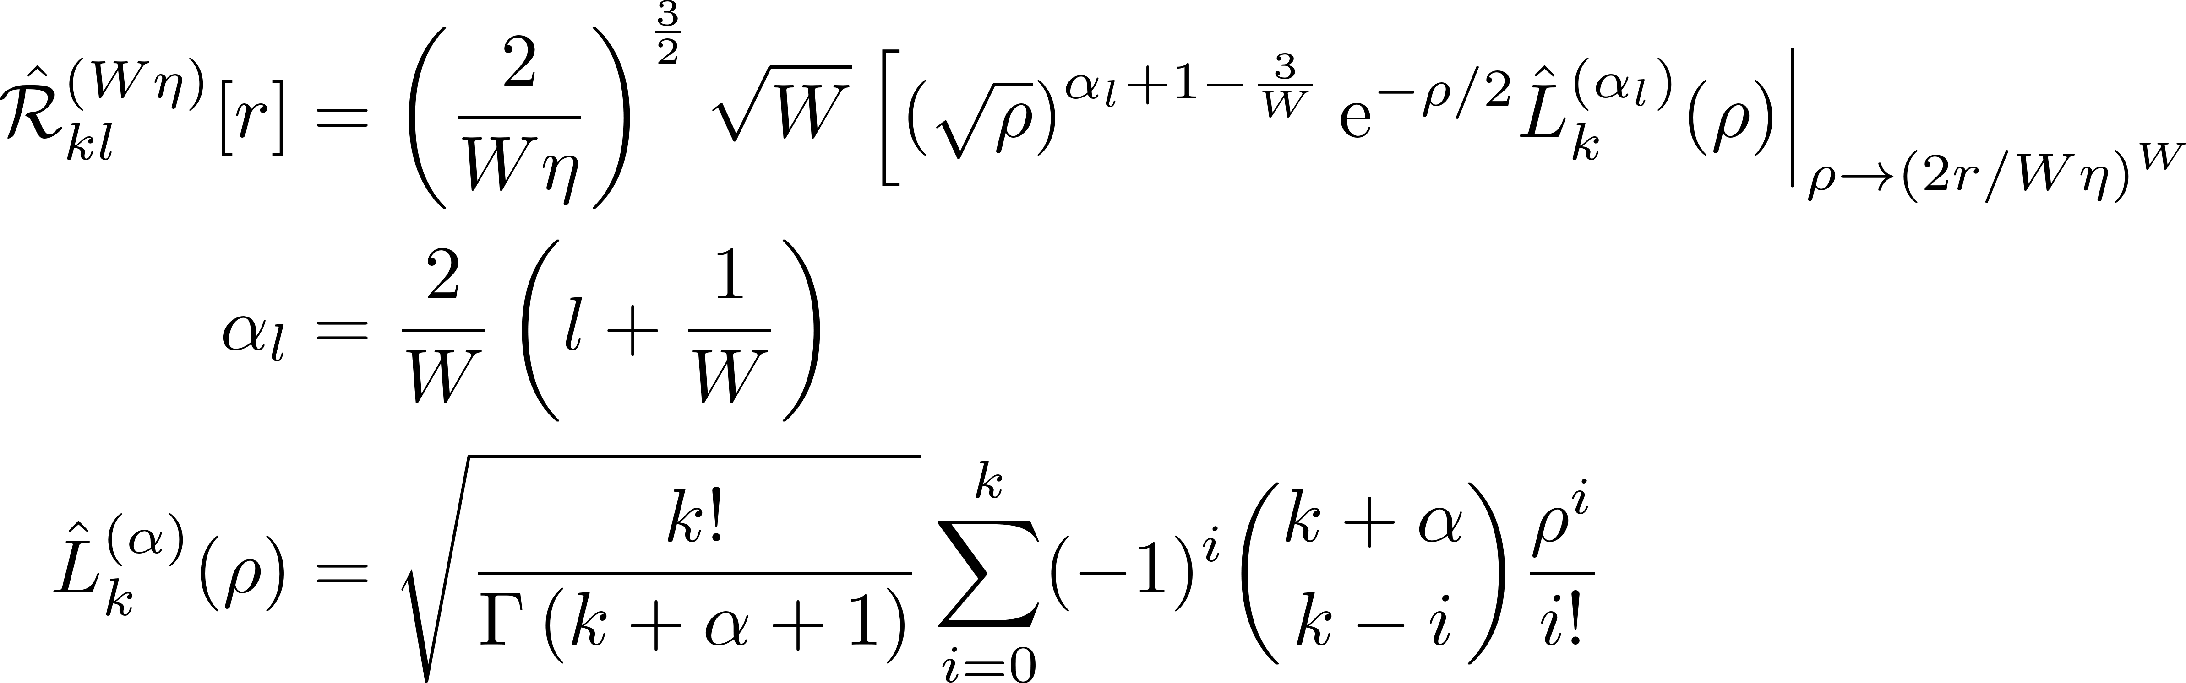
Our complete orthogonal basis set (radial part)

Slide 9
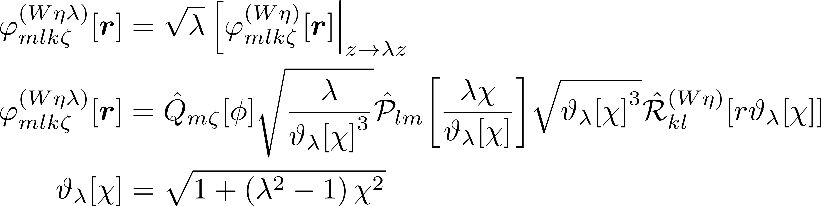
Our complete orthogonal basis set (introducing anisotropy)

Slide 10
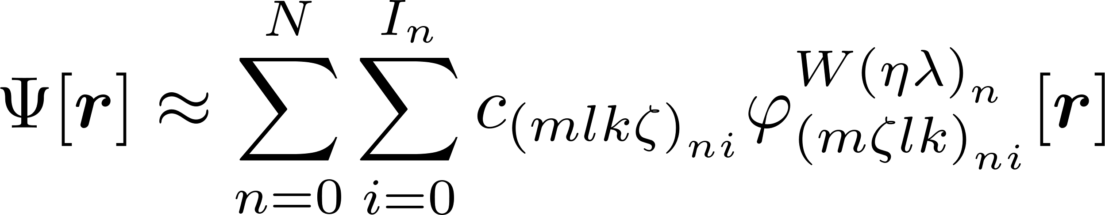
Introducing non-orthogonality -- subbases

Slide 11
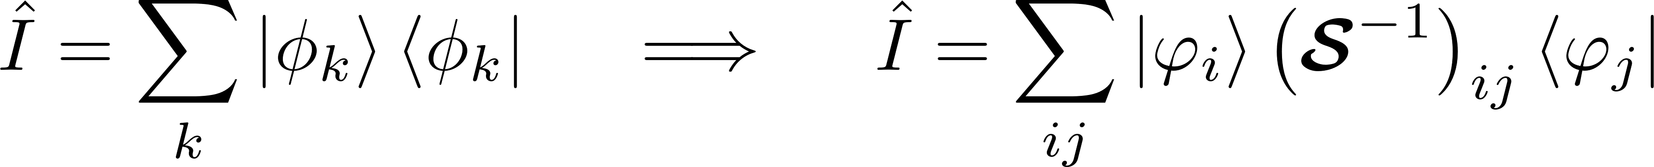
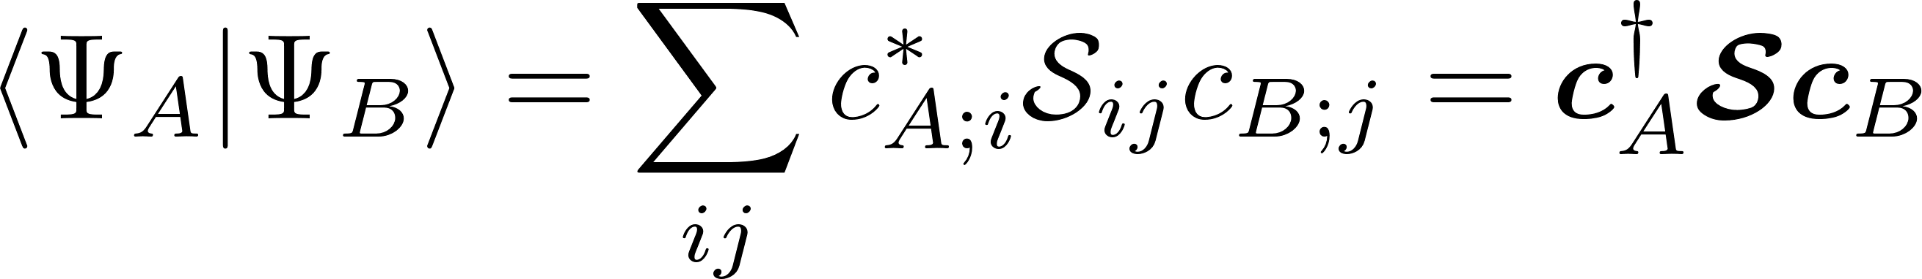
Understanding non-orthogonal bases

Slide 12

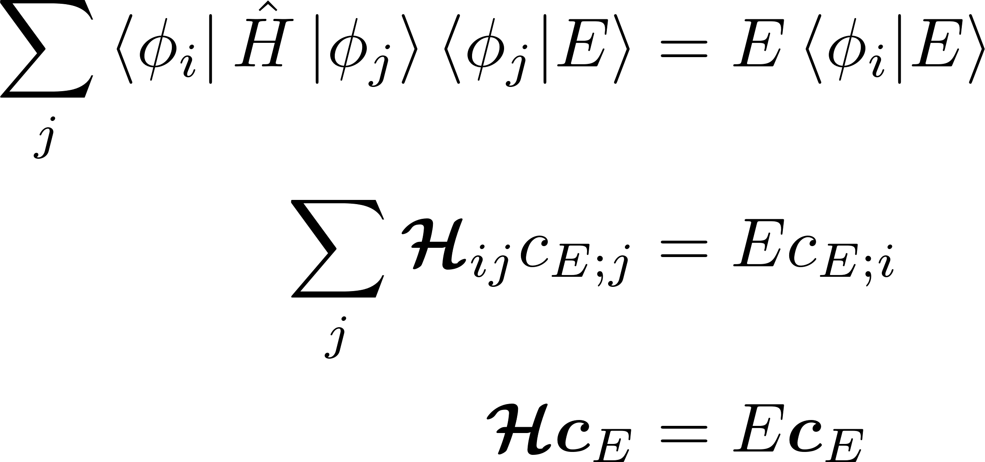
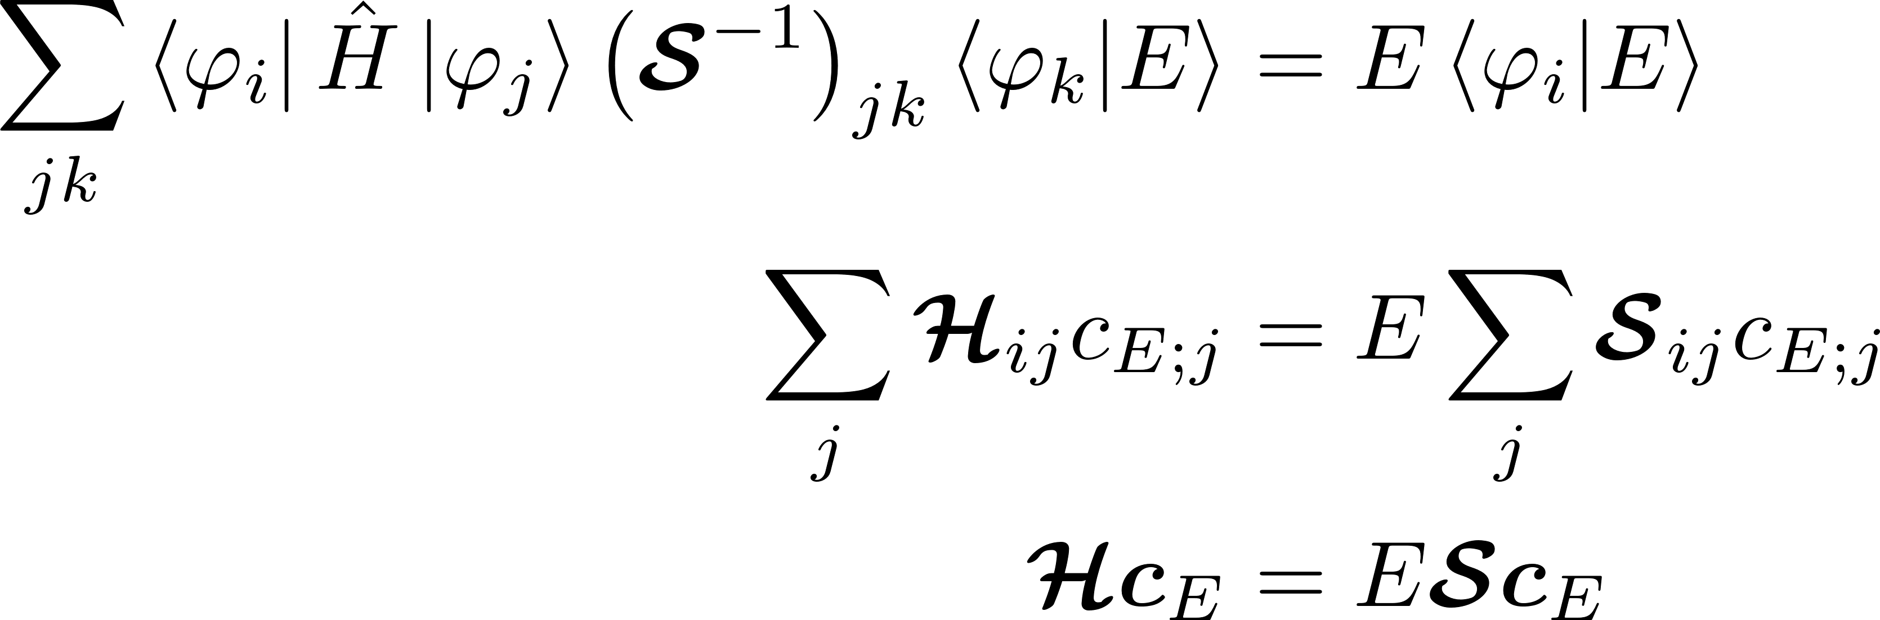
The eigenvalue problem in a non-orthogonal basis

Slide 13
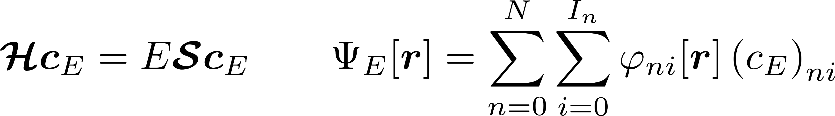
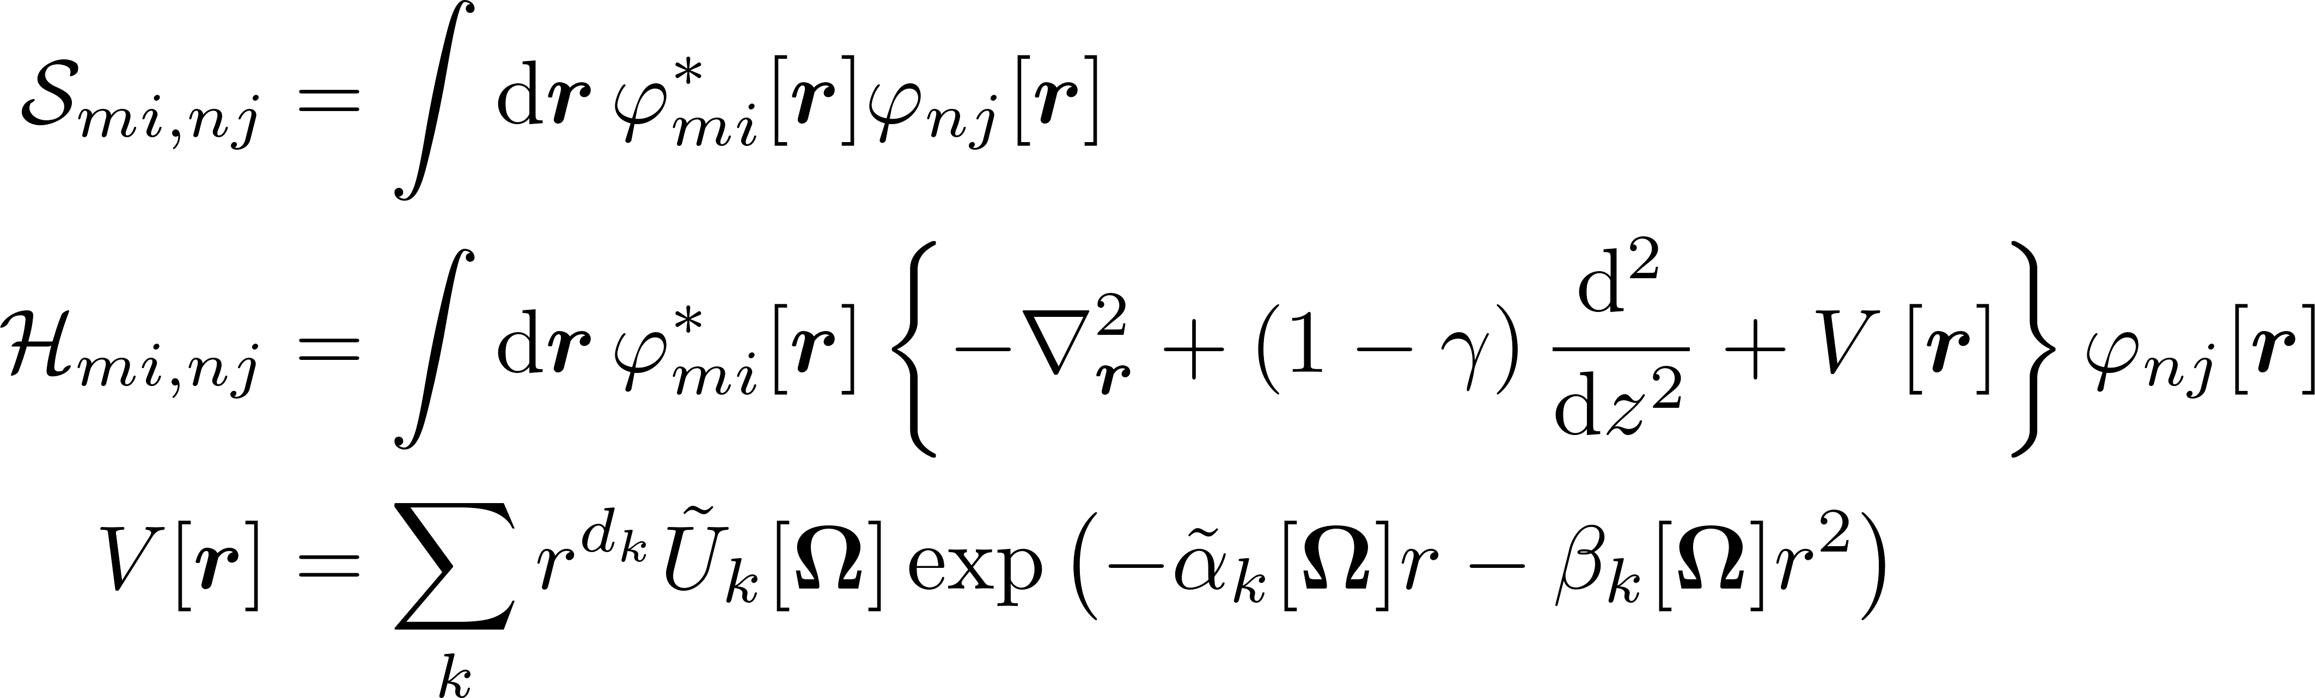
The general problem
The benefit of a generalist approach
This problem statement potentially encompasses a wide variety of problems our group might be interested in.
Note!: Expressions and formulae for all matrix elements have been computed, but not yet implemented in code.

Slide 14
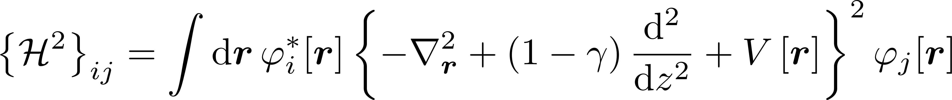
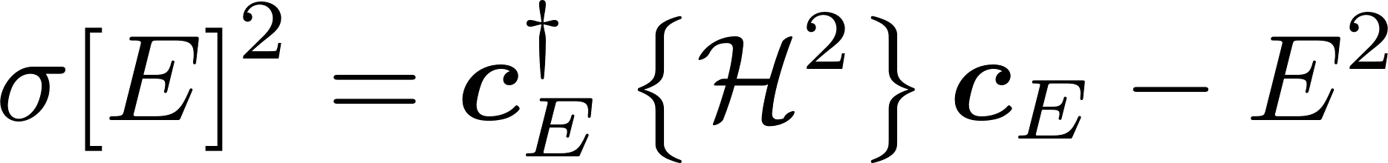

Variance calculation
The benefit of a generalist approach
This problem statement potentially encompasses a wide variety of problems our group might be interested in.
Note!: Expressions and formulae for all matrix elements have been computed, but not yet implemented in code.

Slide 15
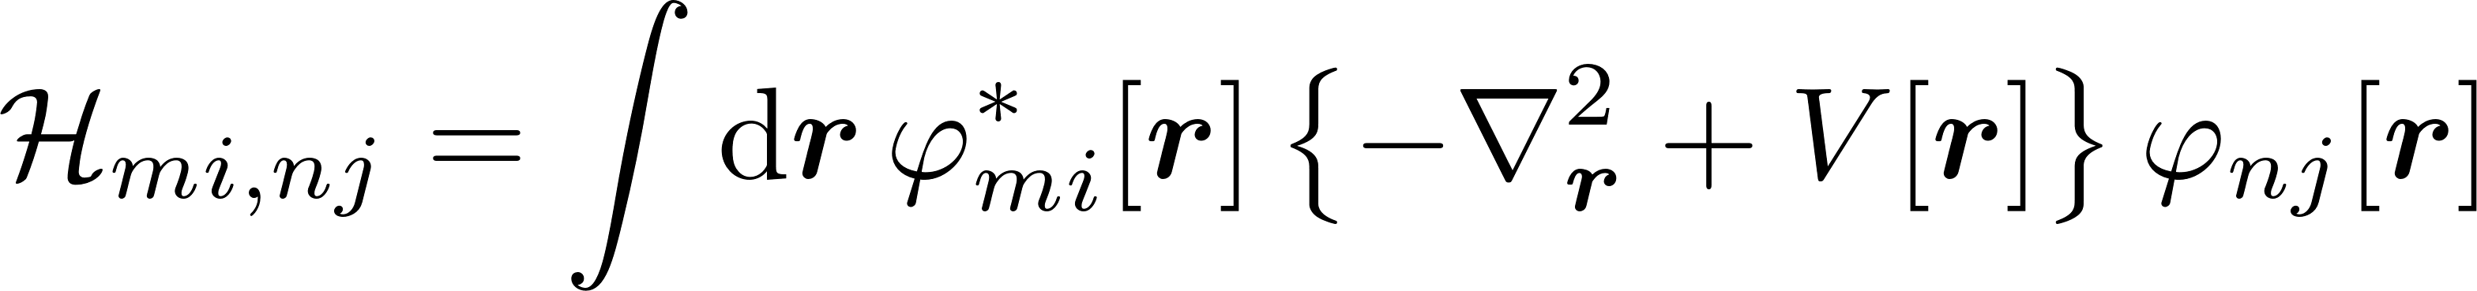
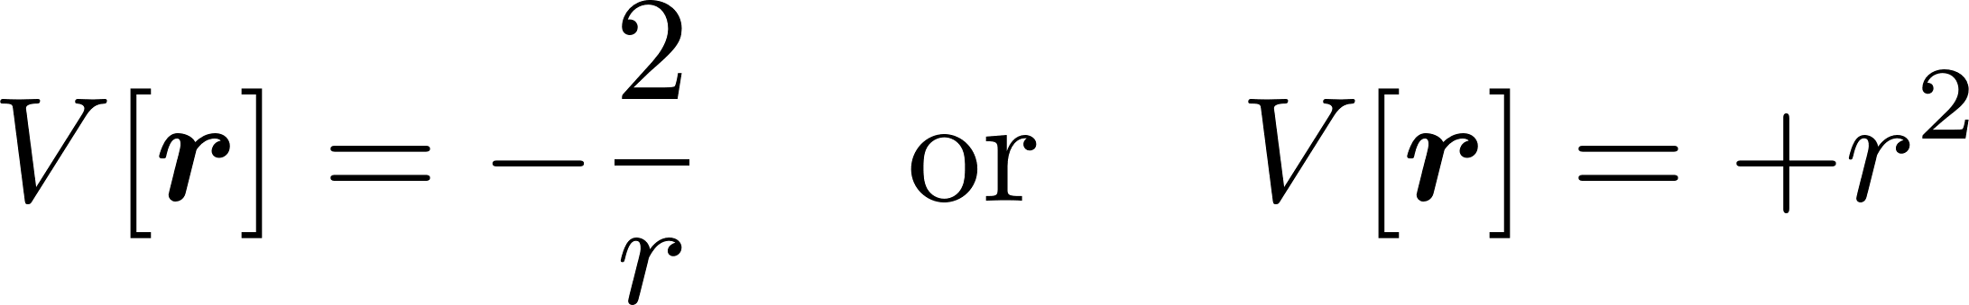
Central potential problems
Useful practical and numerical benchmark
The general problem statement can be simplified to investigate
the hydrogen atom,
the 3-d central harmonic oscillator.

