Slide 1
Working With Docker to Run Tremulous-Petrichor
Group Meeting (2022-August-11)
Luke Pendo
https://gitlab.com/cantankerous-impurity/cantankerous-impurity/-/blob/core/GroupMeetings/GroupMeeting_2022-08-11.pptx

Slide 2
What are we doing here?
Lotsa lotso dependencies
I am an open science / open research ideologue.
As such, I believe the work of science should not be just complete and transparent, but also accessible.
I want to make project onboarding for cantankerous-impurity short and easy to promote open collaboration.
However, the software dependencies of this project has delayed achieving the above goal…
Aiming for a very short digestible presentation of 5-10 minutes.

Slide 3
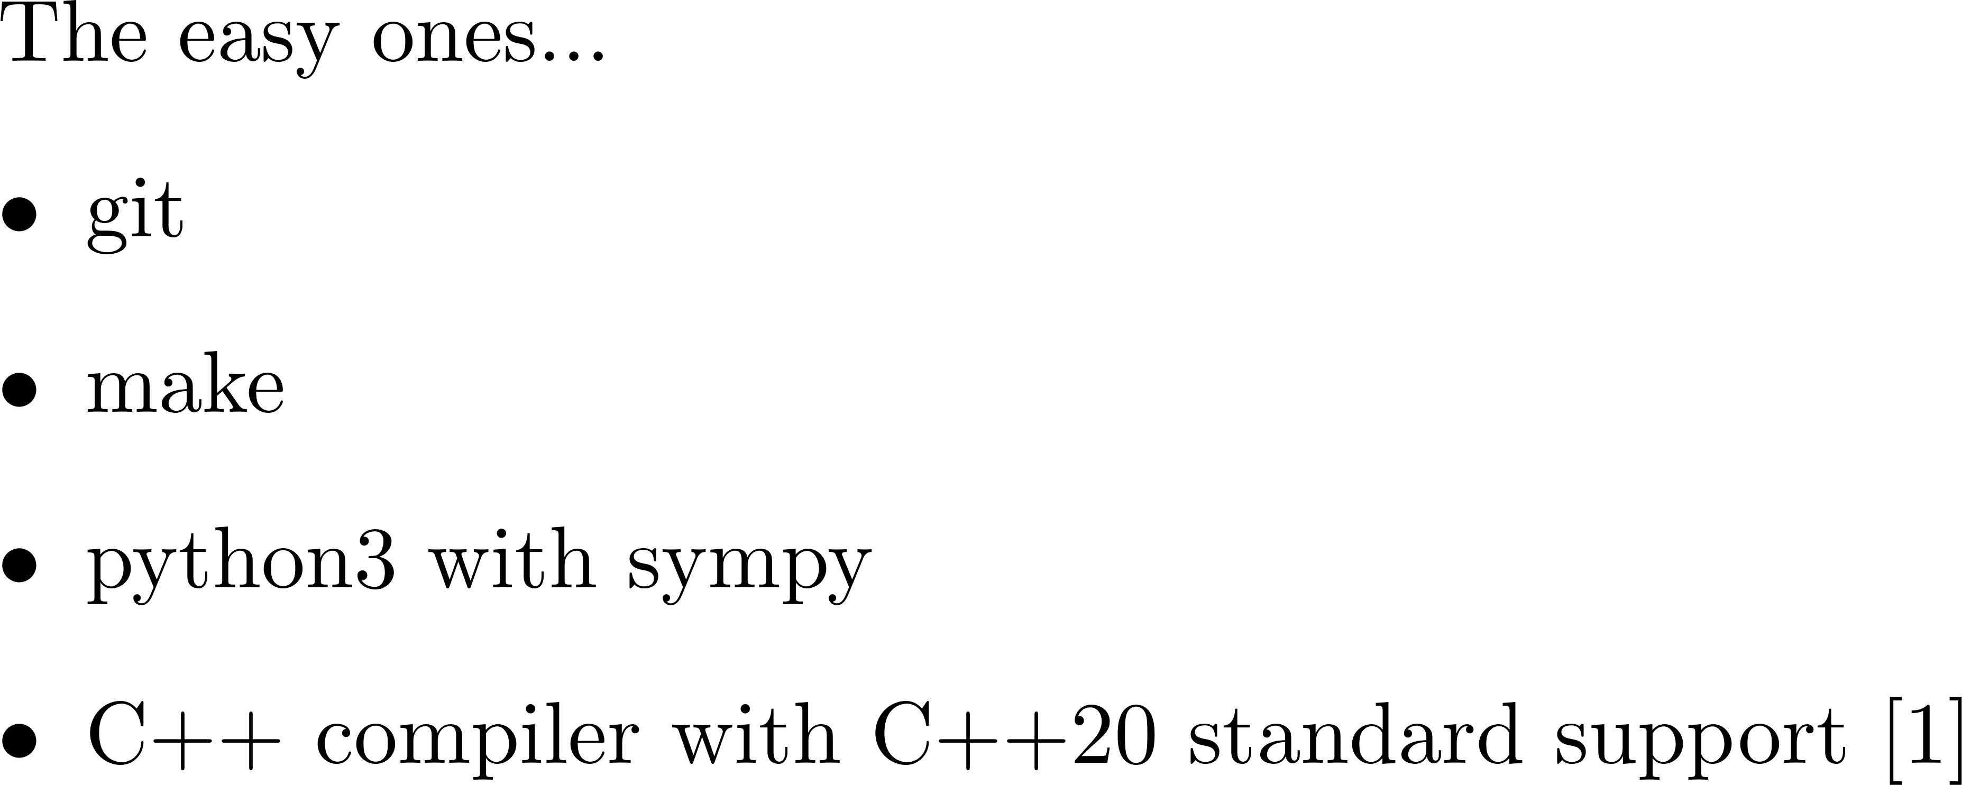
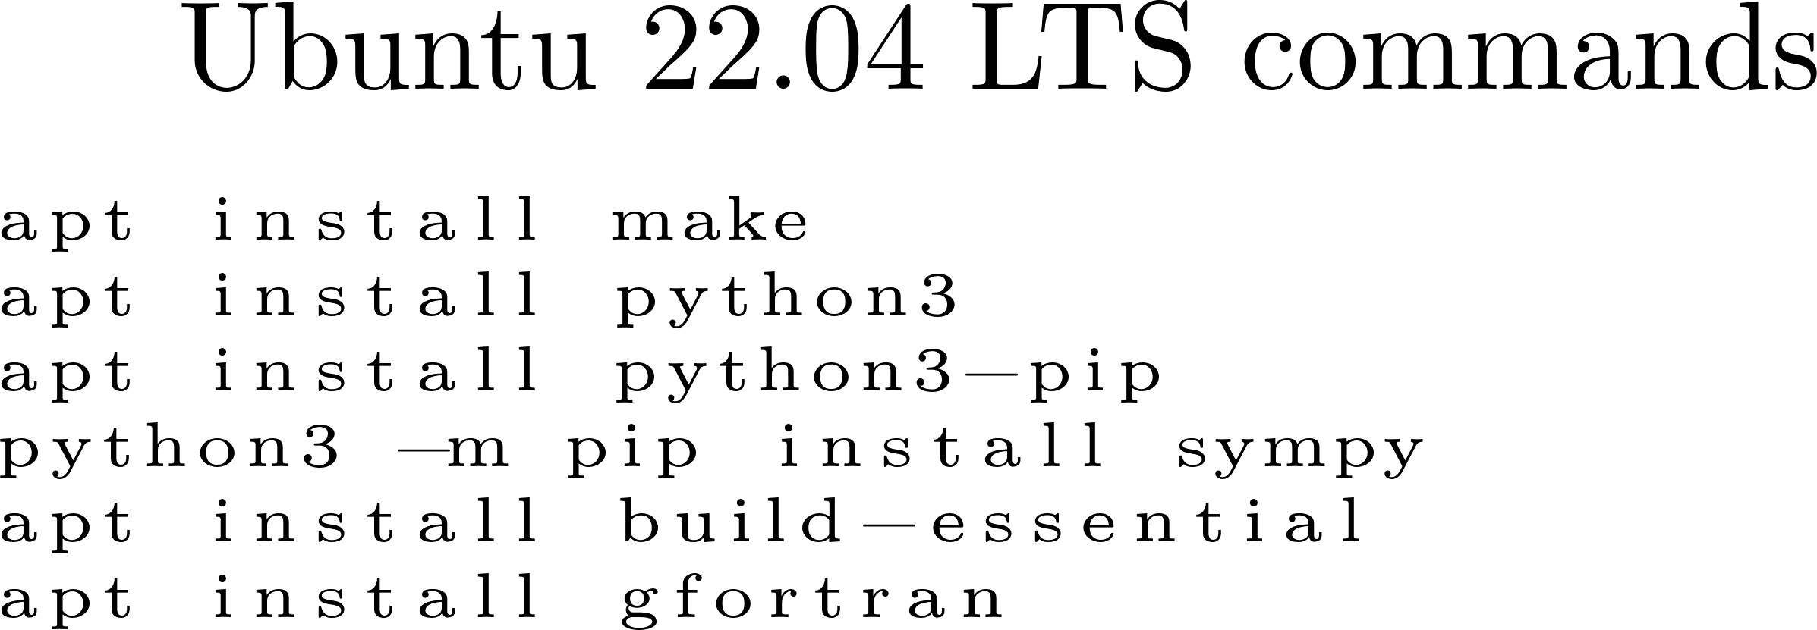
How to make the code go…
Required dependencies
[1] In particular, support for concepts and constraints is required. Check here for a list of compliant compilers.

Slide 4
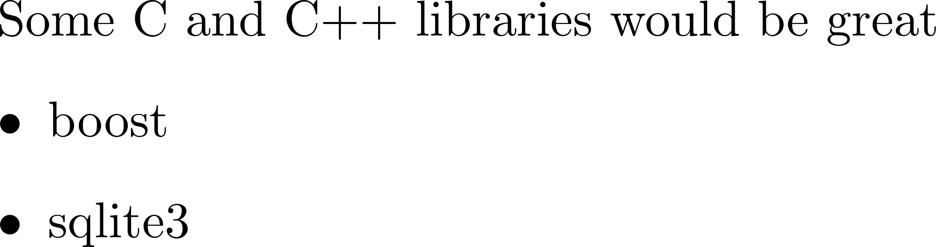

To make the code go… How?
Dependencies required

Slide 5
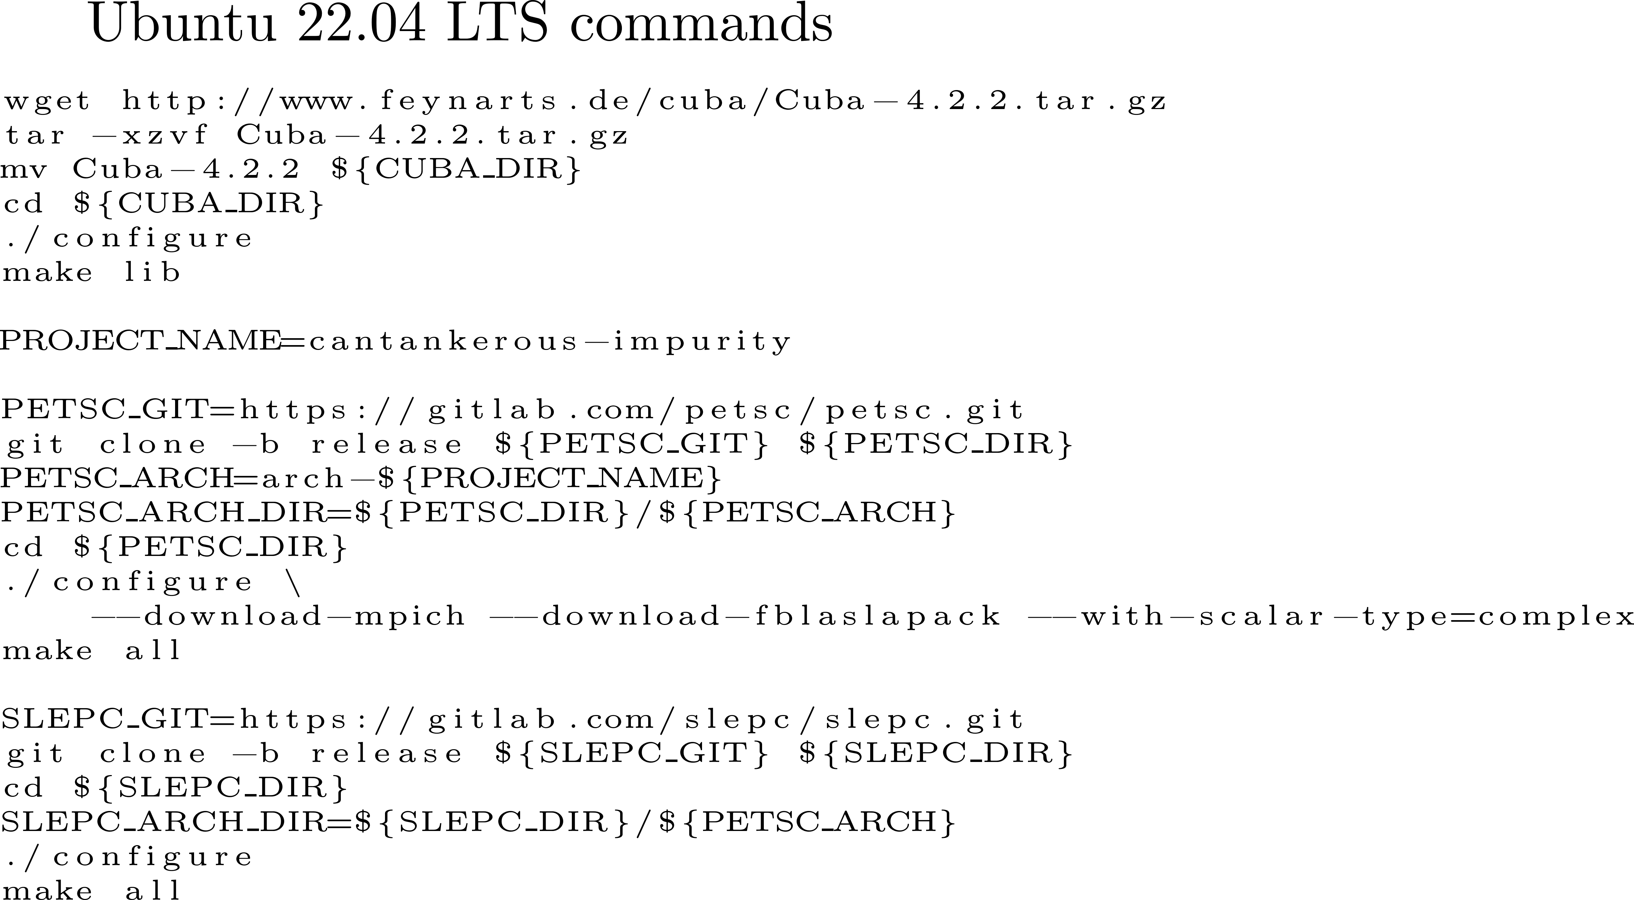
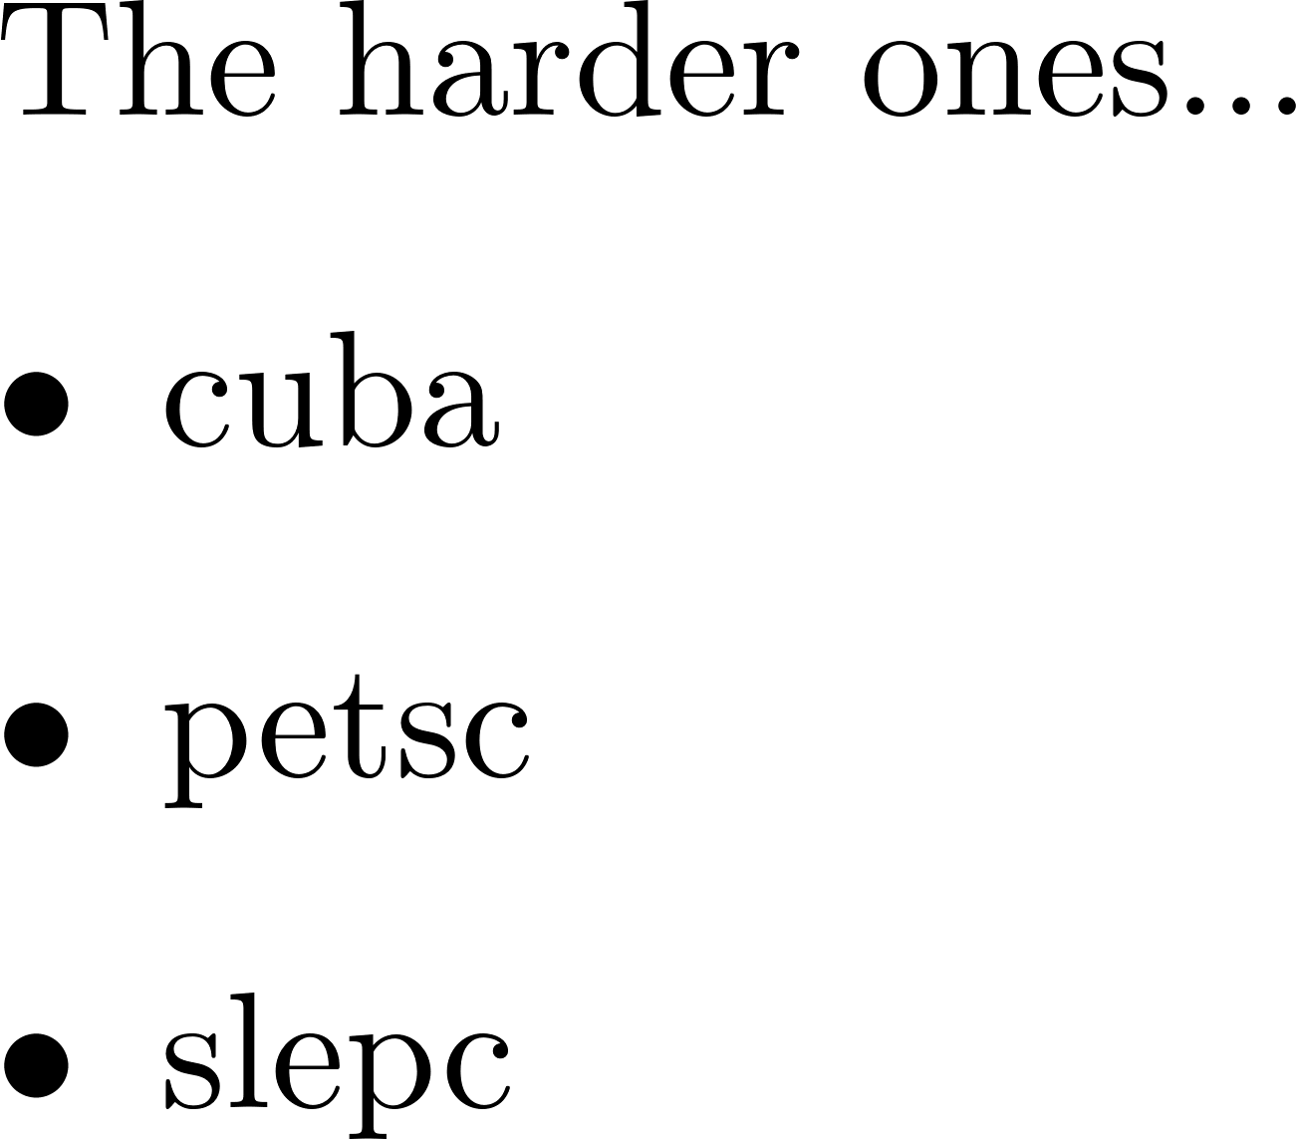
How make the code to go…
Necessary antecedents

Slide 6
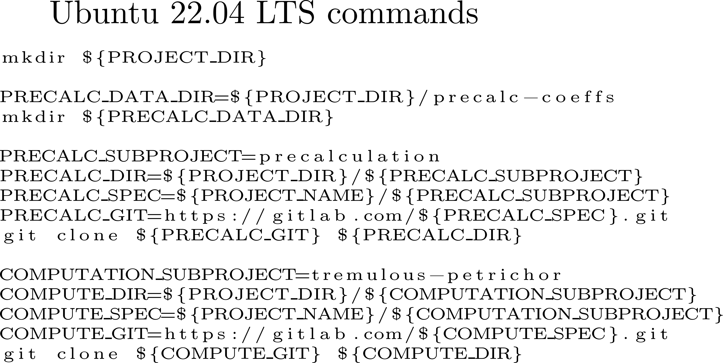
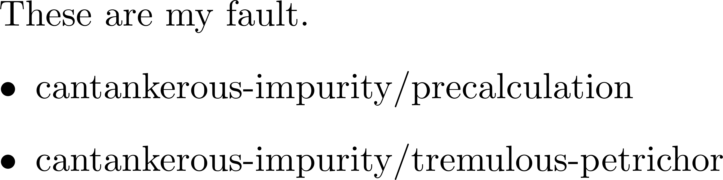
Code how go to make the
Deepen dent seas wreck wired
These work… as long as the dependencies have been correctly installed and configured…

Slide 7
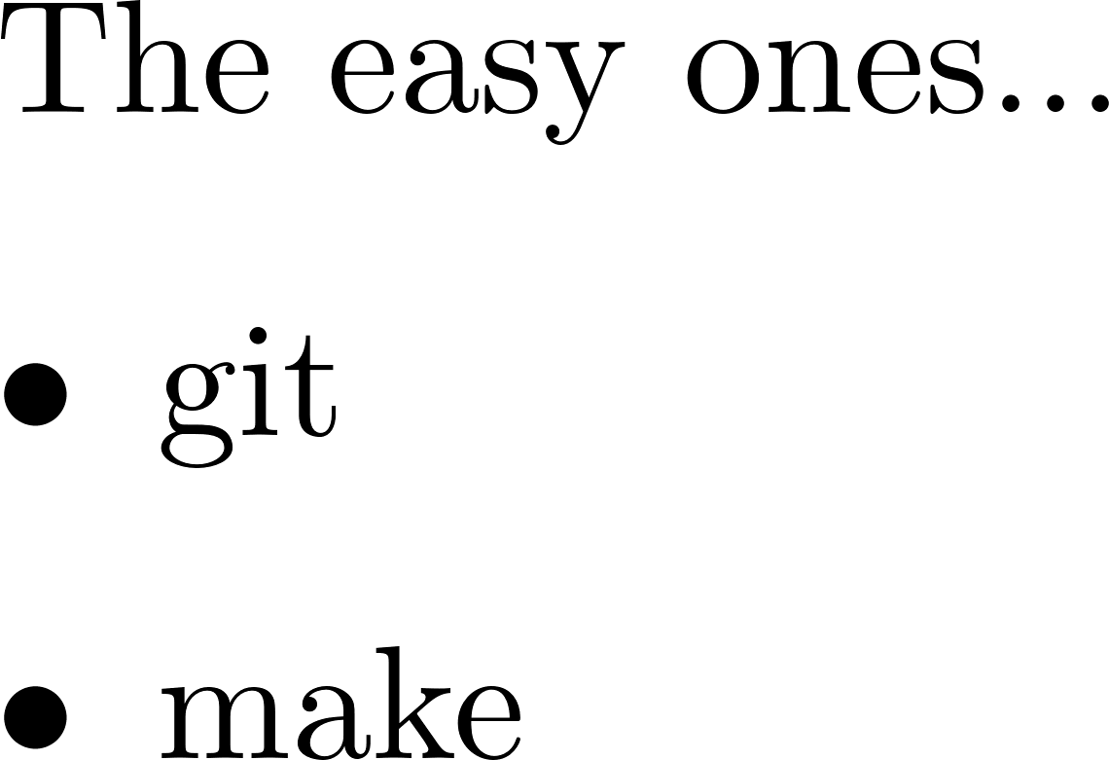
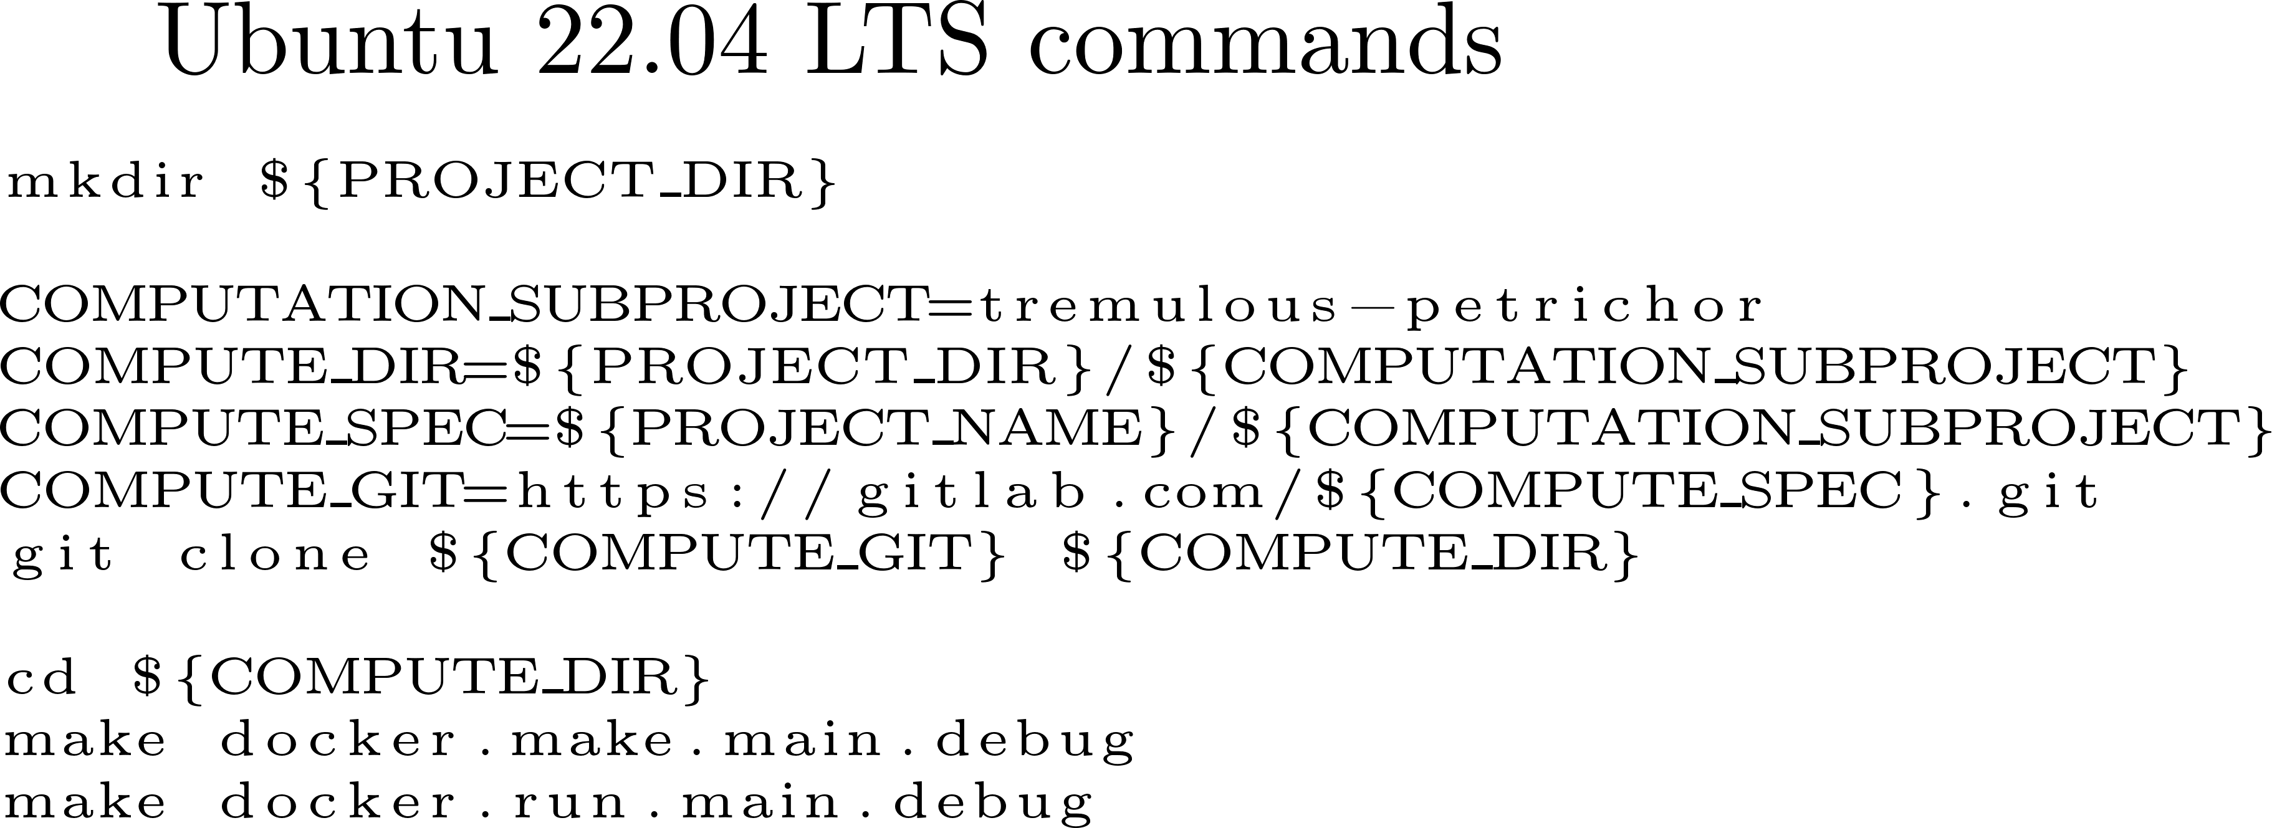
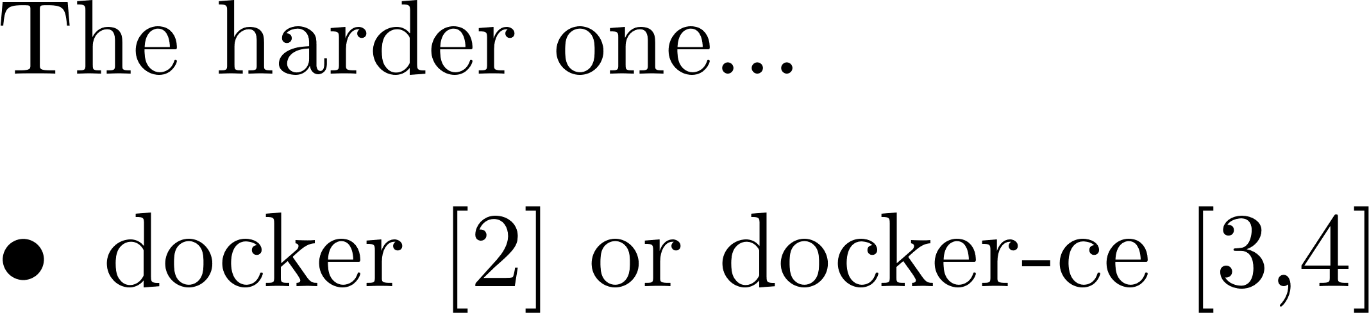
The Docker solution
Dependencies required
[2] Information on installing the closed source Docker Desktop for Windows, Apple Mac, and Linux can be found here.
[3] Information about installing the open source version of docker (docker community edition) on Ubuntu can be found here.
[4] Installing docker-ce on WSL requires some extra work. A good method to do so is covered in this blog post by Jonathan Bowman

