Slide 1
Evaluation of effective mass descriptions of the electronic structure of the isolated phosphorus silicon donor
PhD Defense – January 23rd, 2024
Luke Pendo
https://gitlab.com/cantankerous-impurity/cantankerous-impurity/-/blob/core/PhDDefense.pptx

Slide 2
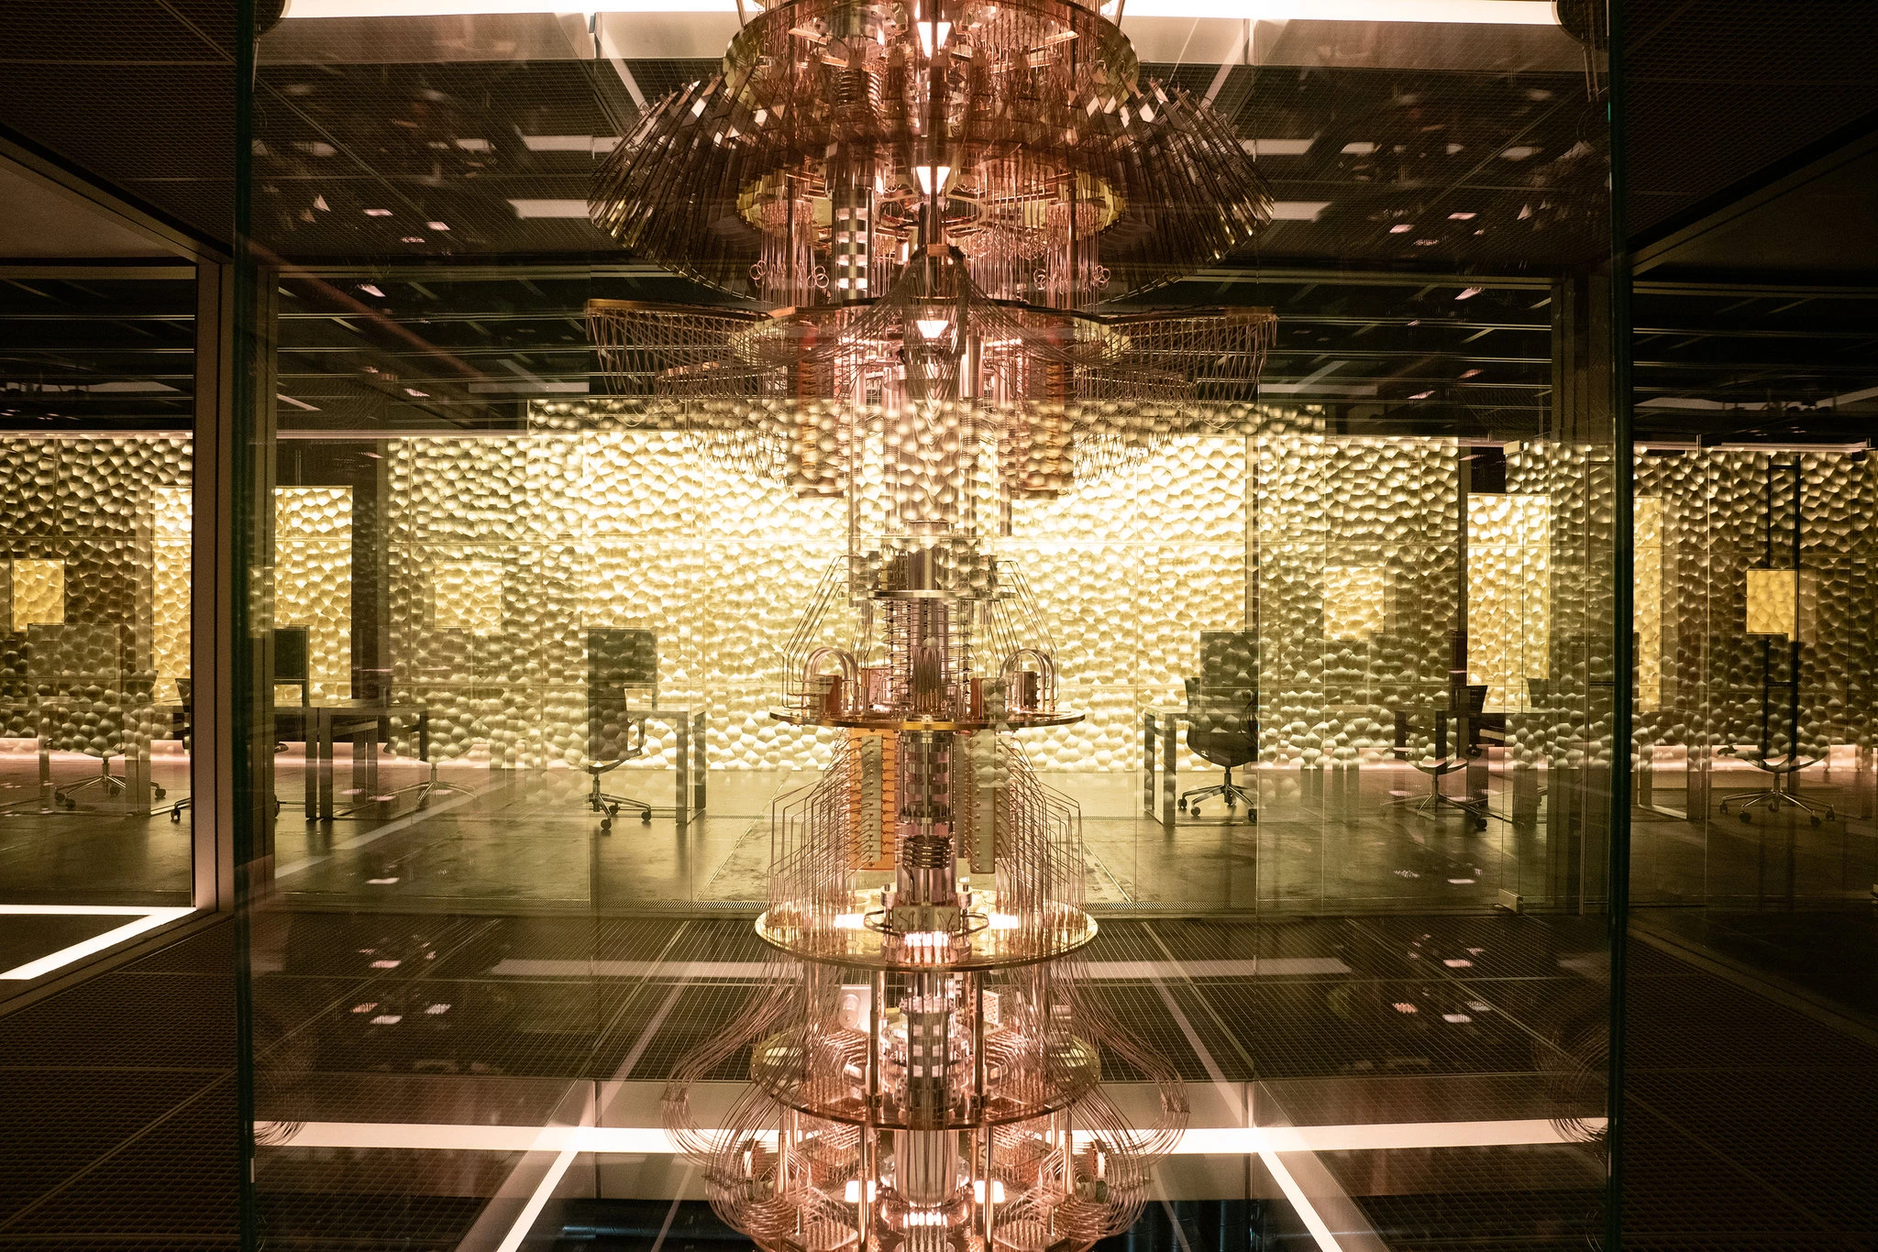
MOTIVATION
Quantum supercomputer from television miniseries Devs
Picture credited to M. Mizuno/FX.
From https://www.nytimes.com/2020/05/04/arts/television/westworld-finale-devs-sean-carroll.html

Slide 3
Why quantum computing?
Quantum advantage
There are [probably] some tasks [fault tolerant] quantum computers do much than better classical computers!
The quintessential example: Prime factorization of an integer. [1]
Classical – General number field sieve – Exponential time – exp(O[n^{1/3}])
Quantum – Shor’s algorithm – Polynomial time – O[ n² log (n) ]
Substantial implications for cryptography and cybersecurity!
The exciting idea: Quantum simulation
“Quantum algorithms can exponentially outperform classical ones when simulating a system with many quantum degrees of freedom, with applications including problems in chemistry, materials science, condensed matter, nuclear physics, and high-energy physics” [2]
Classically, representation of a quantum state grows with basis size (N), operators grow as (N²).
Hilbert space grows exponentially, so a classical computer can simulate only a small quantum system.
Quantum, only log₂(N) qubits and a finite series of gates of length O[ log^{c}(1/ε) ] [3].

Slide 4
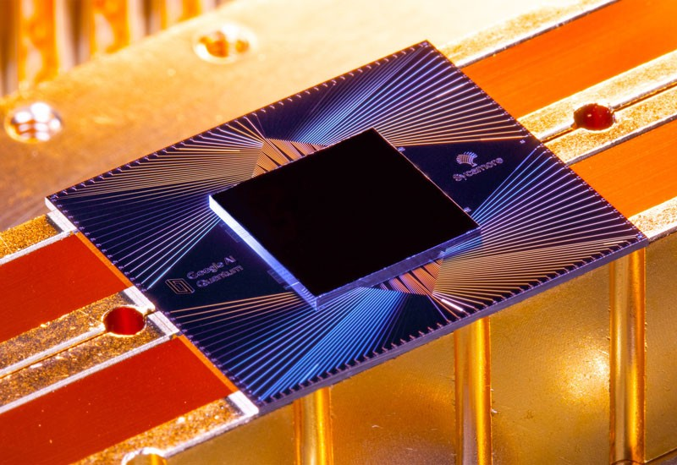
The caveats
Quantum advantage
There are [probably] some tasks [fault tolerant] quantum computers do much better than classical computers!
Fault tolerant quantum computers do not yet exist!
Quantum supremacy
“The demonstration of an efficient quantum computed solution to any problem intractable for classical computers.” [1,2]
Quantum supremacy (or something close to it) probably demonstrated by Google Sycamore [4,5].
NISQ – Noisy Intermediate-scale Quantum [6]
Quantum computing hardware is developing but still early days.
Continuing problems with scalability, noise.
Limited, lossy qubits.
Active search to find applications for NISQ devices.

Slide 5
Leading implementations of quantum computing
Superconducting qubits [8]
Lithographically defined superconducting electric circuits at millikelvin temperatures.
Types – transmon and flux qubits.
Transmon – Charge islands coupled by Josephson junction.
Flux – Magnetic flux states coupled by Josephson junction.
Many NISQ-era implementations! Google, IBM, Intel, etc.
Manipulation – microwave antenna.
Measurement – qubit-coupled resonator dispersive response.
Pros – Fast, high fidelity gates. Compatible with extant semiconductor fabrication tools.
Cons – Extensive refrigeration requirements. Superlinear calibration complexity to coordinate artificial atoms. Very large footprint per qubit.
Trapped ion qubits [7]
Atomic ions trapped in electromagnetic fields.
Types – optical and hyperfine qubits.
Optical – Different electronic states.
Hyperfine – Hyperfine split in ground state.
Manipulation – addressing via EM field.
Optical – laser exciting quadrupole transition.
Hyperfine – microwave antenna.
Hyperfine – microwave Raman transitions.
Measurement – photon scattering.
Pros – Mobile qubits.
Cons – Chains of trapped ions limited in number. Very slow gates.

Slide 6
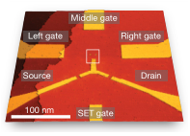
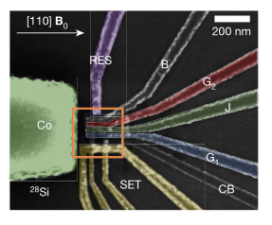
Silicon spin qubits [9]
Spins hosted by electrons confined in silicon.
Types – quantum dot and donor qubits.
Dot – Electrons confined by electric gates.
Donor – Electron confined by impurity charge.
Manipulation
Dot – electrical gating.
Donor – microwave antenna.
Measurement – Spin-to-charge conversion using spin blockade.
Pros: Long coherence times. Small physical footprint per qubit. Fast two-qubit gates.
Cons: Measurement relatively slow. No clear demonstration of a scalable two-qubit gate.
Silicon donor qubits
Y. He, et al., Nature 571, 371 (2019)
Gate-defined quantum dot
C. H. Yang, et al., Nature 580, 350 (2020)
High fidelity two-qubit gates requires spatial control of the number density of two electrons.
As such, we seek to understand how the bound electron spreads and scatters through the silicon crystal.

Slide 7
SILICON DONOR

Slide 8
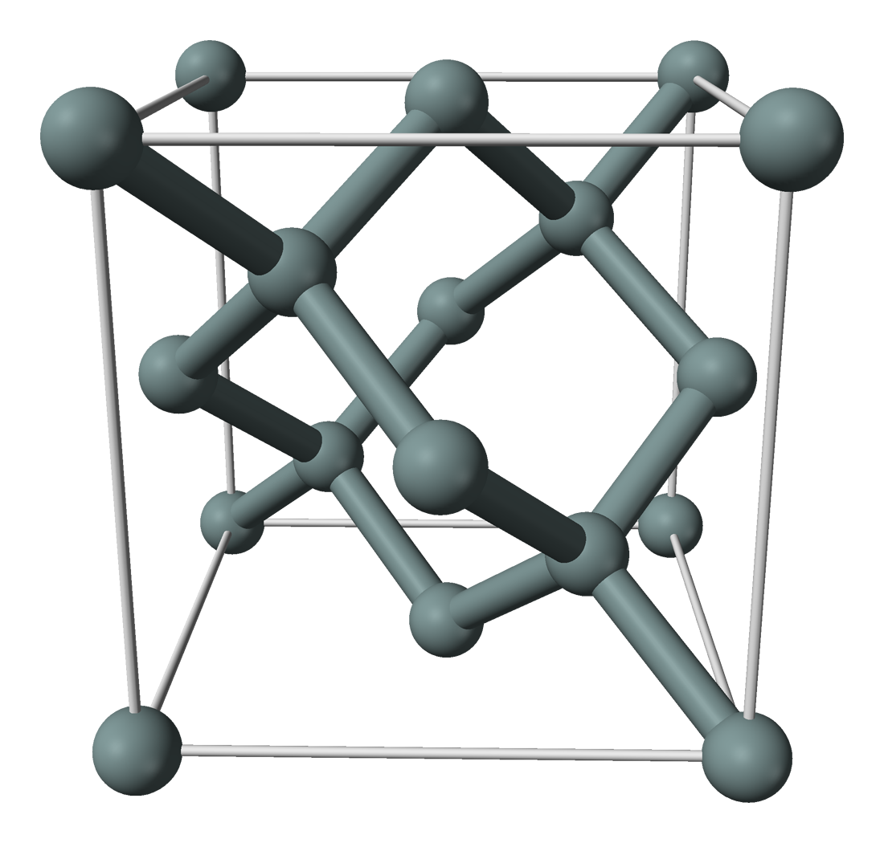
System description – Silicon donor
Infinite silicon crystal bulk.
Silicon replaced by an isolated pnictogen (Group V/Group 15) impurity, the donor.
The pnictogen we consider most often is phosphorous.
System is symmetric about the impurity under operations of point group T_{d}.
Excess proton of pnictogen attracts an excess electron.
Excess electron affected by periodic crystal potential, weakly bound to donor potential.
Small-scale: looks like a Bloch wave.
Long-scale: attenuated on scale longer then lattice parameter.
P
Picture modified by L. Pendo
Original crystal structure picture by B. Mills, public domain.
https://commons.wikimedia.org/w/index.php?curid=2722584

Slide 9
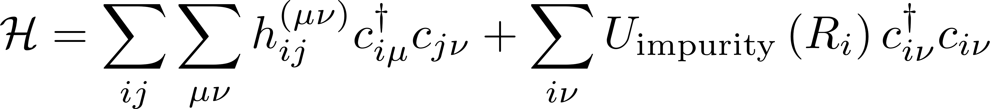
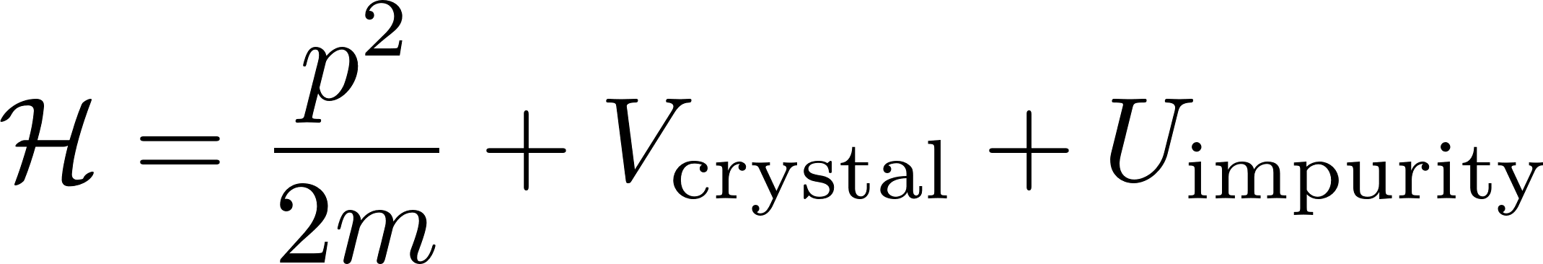
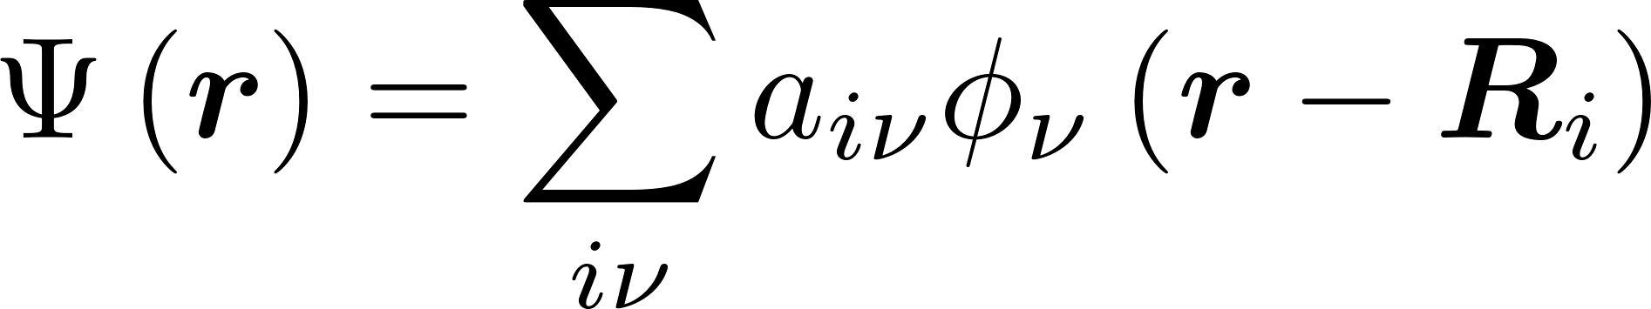
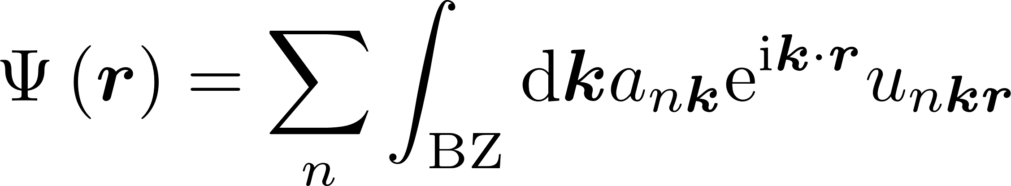
How to model the donor electron?
Tight binding
Wavefunction is superposition of atomic orbitals.
Hamiltonian is almost entirely empirical.
Quantitatively accurate.
Computationally expensive.
Effective mass
Wavefunction superposition of Bloch states from conduction band edge.
Better physical intuition and insight.
Much less computationally expensive.
Notes:
Caveat – can always make any calculation computionally expensive. Might suggest that being able to more quickly calculate electron structure allows for things like exhaustive enumeration of exchange couplings a la Gamble.

Slide 10
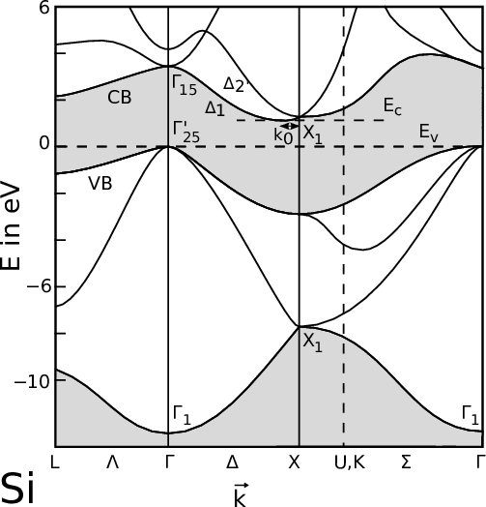
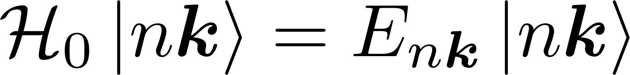
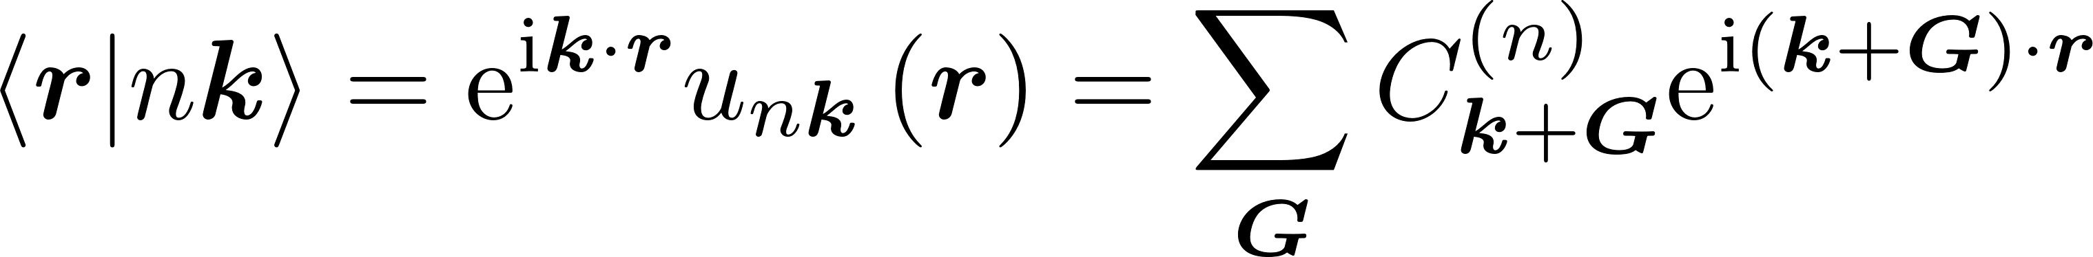
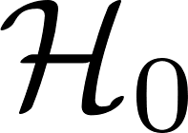
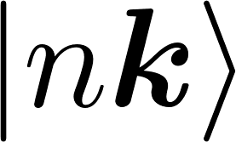
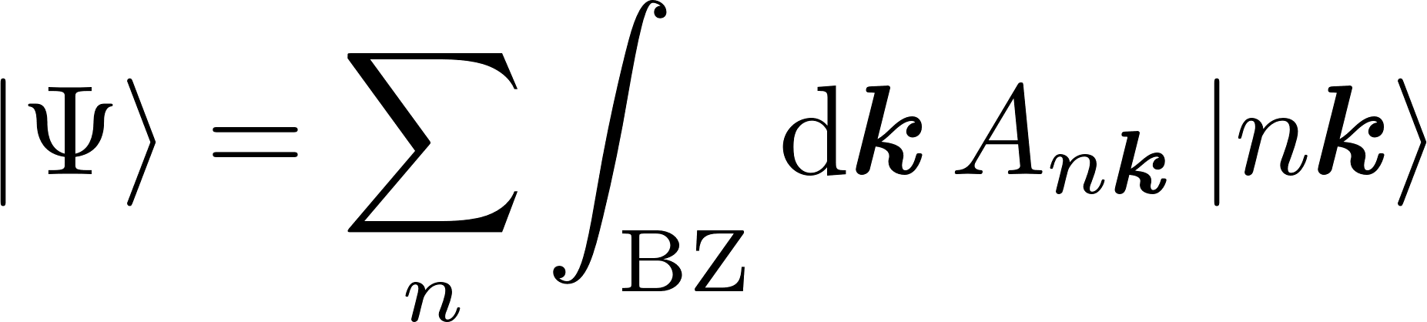
Pure crystal theory
Excess electron occupies a conduction band Bloch state.
is an unbounded Hermitian operator; set of forms complete basis.
As such, arbitrary states may be expanded in .
Band structure picture from J. Ghosh.
Dr.techn. Thesis, Vienna University of Technology, 2016.
https://www.iue.tuwien.ac.at/phd/ghosh/diss_htmse10.html

Slide 11
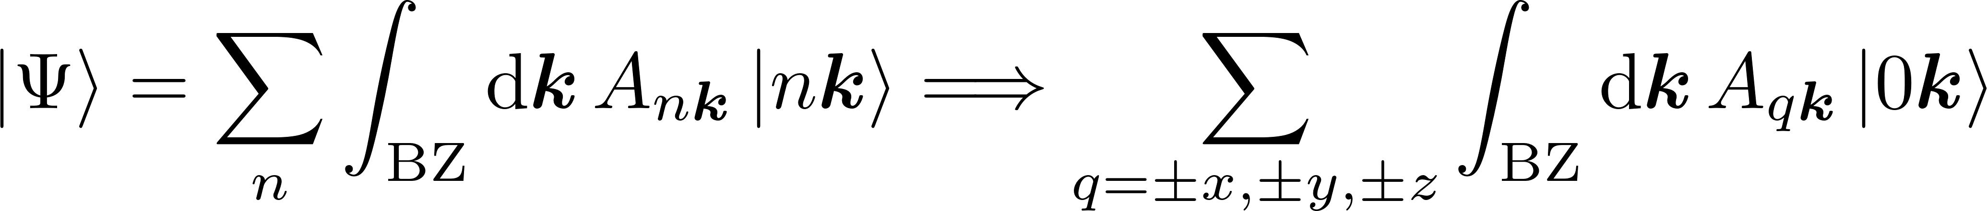
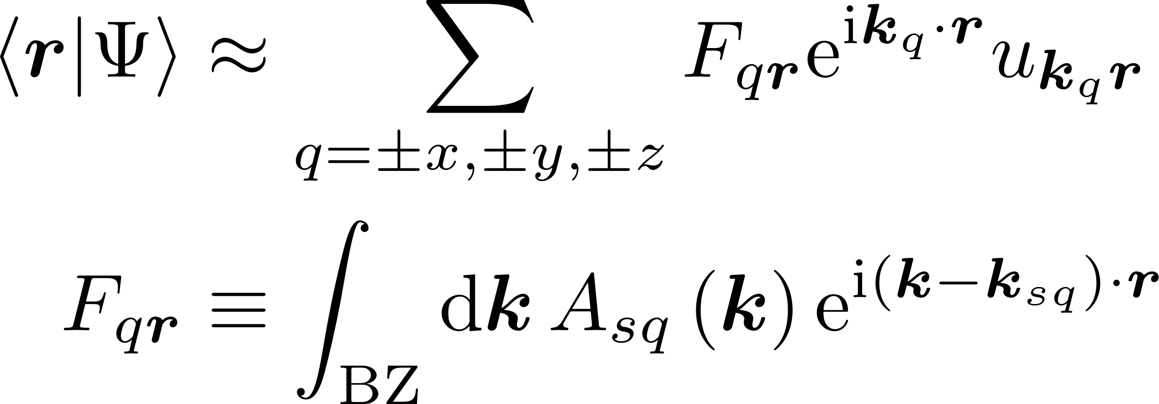
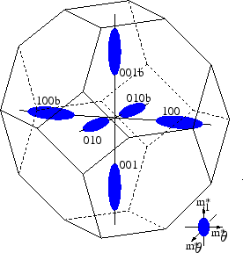
Introducing the fundamental effective mass approximation
EMA: Assume the donor electron is localized at the six-fold degenerate anisotropic minima of lowest conduction band.
Minima + Brillouin zone picture from S. Dhar.
Dr.techn. Thesis, Vienna University of Technology, 2007.
http://www.iue.tuwien.ac.at/phd/dhar/node18.html
Notes:
Need to point out that A_{qk} is a sharply peaked wave function at k = k_{q}.
Call F an “envelope function”.

Slide 12
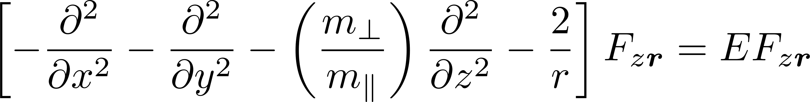
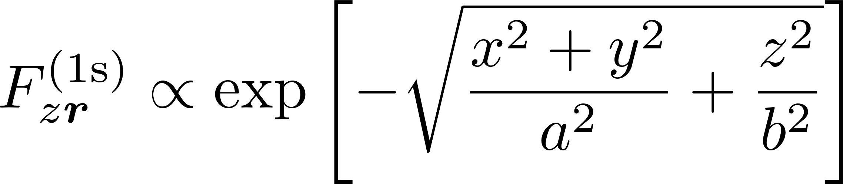
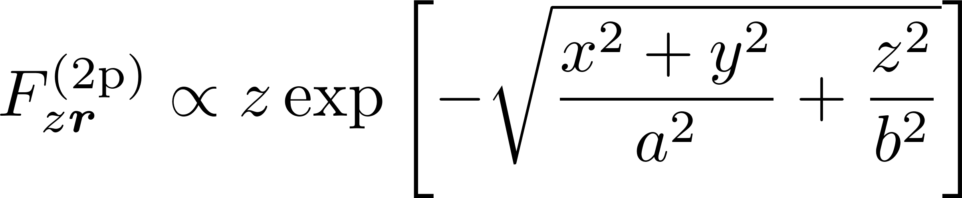
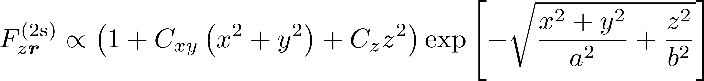
Kohn-Luttinger
EMA for degenerate conduction band minima: Motion of electrons and holes in perturbed periodic fields[10].
Applying the EMA to silicon donors : Theory of Donor States in Silicon[11].
Single-valley EMA eq. for envelope function:
Variational ansatz

Slide 13
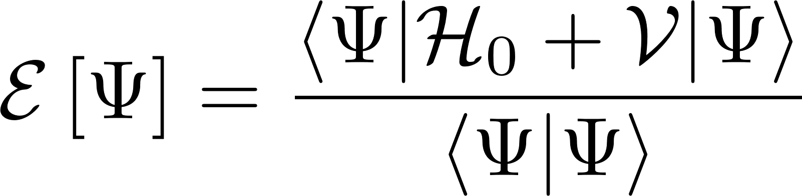
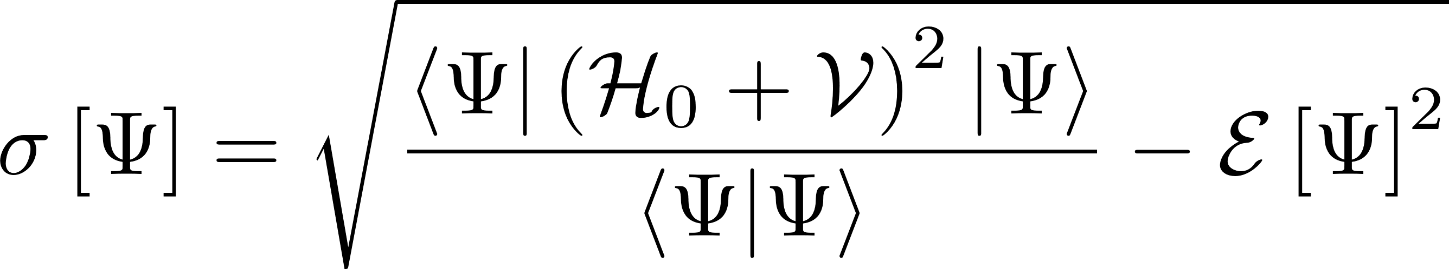
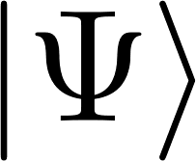

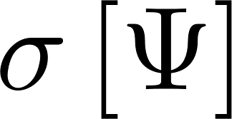
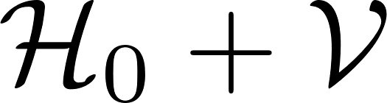
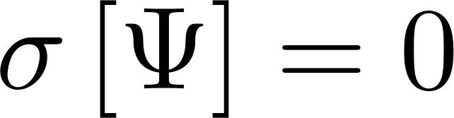
Variational method
Find an ansatz s.t. and are minimized.
Iff is exactly an eigenstate of then .
Dramatically reduces problem difficulty, but requires judicious choice of ansatz.
No clear method to refine ansatz to approach exact solution within desired numerical tolerances.

Slide 14
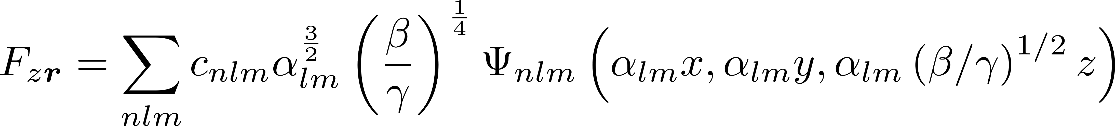
Faulkner
Single-valley EMA eq.:
Basis: Bound states of hydrogen
Good agreement with excited states.
Bound states of hydrogen do not span the separable Hilbert space.
Notes:
Good predict of excited states

Slide 15

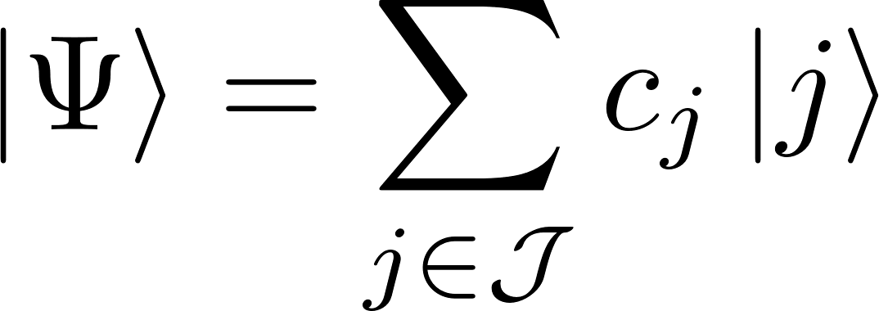
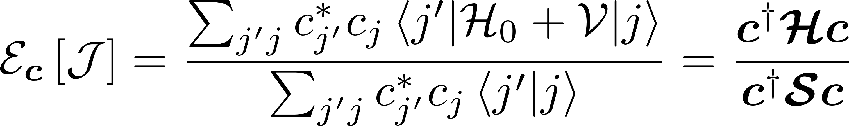
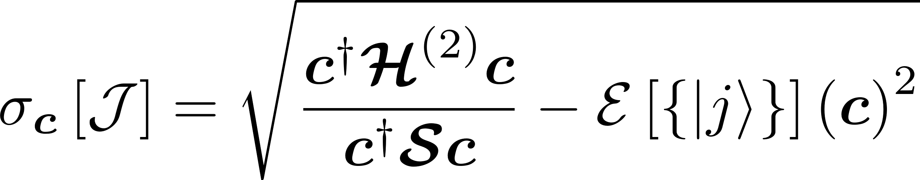
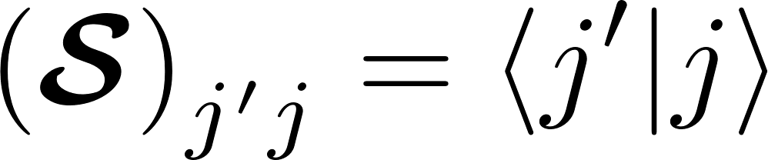
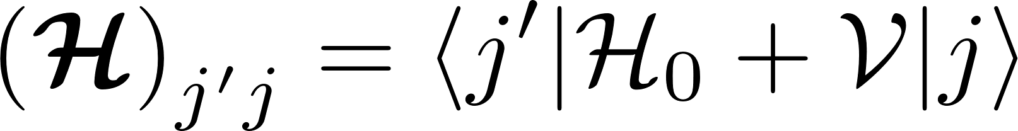
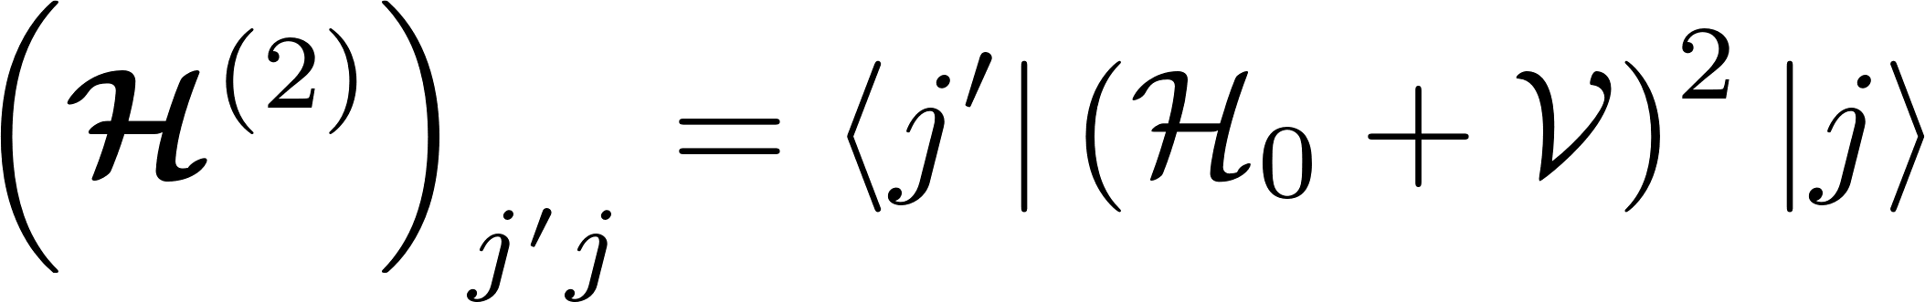


Ritz method
Express ansatz as a summation over a set of basis states .
Orthonormality not assumed.
If basis set is complete, ansatz approaches exact solution as terms are added.
Notes:
Ritz method is a general term. Comparison to LCAO, basis sets in quantum chemistry.
IN SHORT: Ritz method equivalent to (generalized) eigenvalue problem.
Accounting for longer, shorter range behavior. More complicated impurity potentials might not have clear physical ansatz.

Slide 16
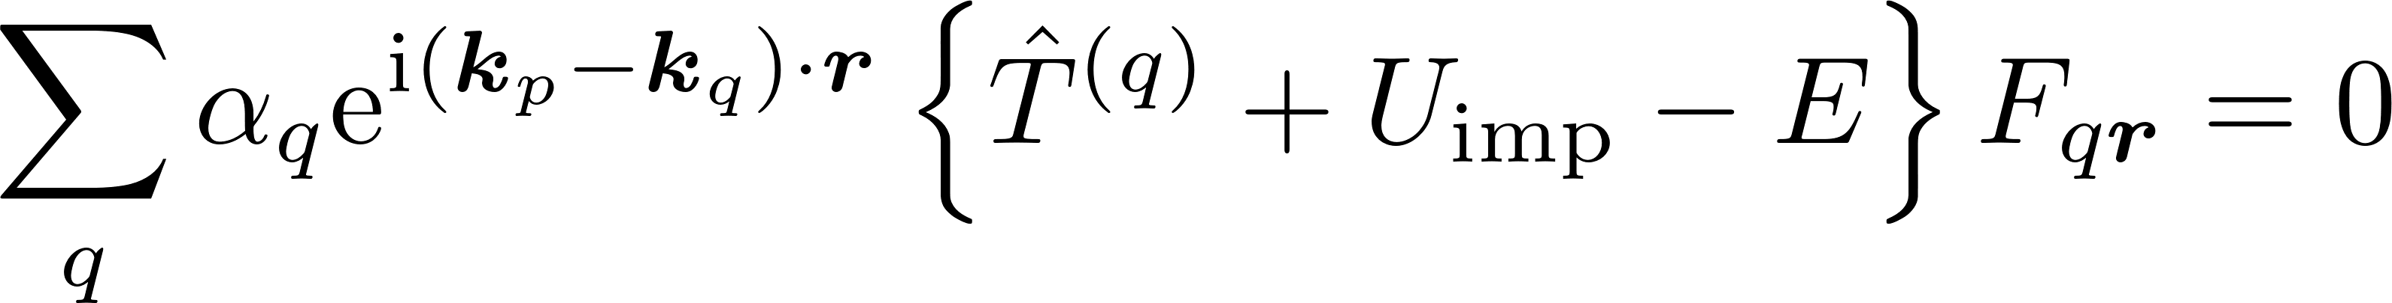
Twose and Shino-Nara
Twose multi-valley EMA:
Shindo-Nara multi-valley EMA:
“Tweaked” Shindo-Nara multi-valley EMA:
Notes:
Software designed to include options to turn on or off desired features.

Slide 17
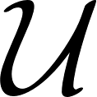
Introducing imperfections
Features that a candidate can include might be...
Dynamic dielectric constant, and break down of dielectric in core region.
Mismatch between silicon and impurity core and valence electron wavefunctions.
Exchange interactions between donor excess electron and donor core and valence electrons.
Lattice deformations.
External symmetry breaking fields.
The most useful form of effective potential is still an open question!

Slide 18
Concluding comments on effective mass theories
The current state of things
There are many different effective mass theories of the silicon donor [12-21, to name just a few].
They each make different, reasonable approximations to achieve the goals of a specific paper or calculation.
Substantial discrepancies in results between EMTs.
Problem: Hard to make sense of the global landscape of effective mass theories.
Problem: Hard to tell why a calculation might differ from experiment, or another theory.
Incorrect wavefunction ansatz?
Incorrect model of the impurity?
Fundamental problems with the effective mass approximation itself?
Need to a way to distinguish all three sources of error.
What we’re seeking
Metrics to quantify degree to which a candidate wavefunction ansatz is an eigenstate.
Strategy for converging ansatz eigenstates to actual eigenstates (at least in principle).
Computational tools to compare effective mass theories.
Explore the effect of common approximations in EMTs by selectively applying them.
Test models of the donor impurity.

Slide 19
Methods

Slide 20
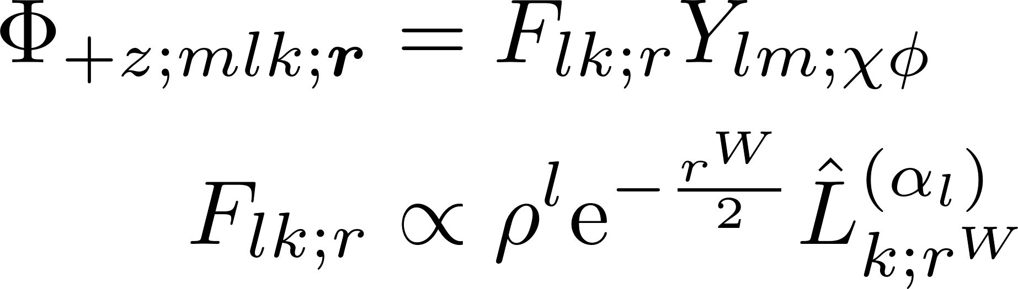
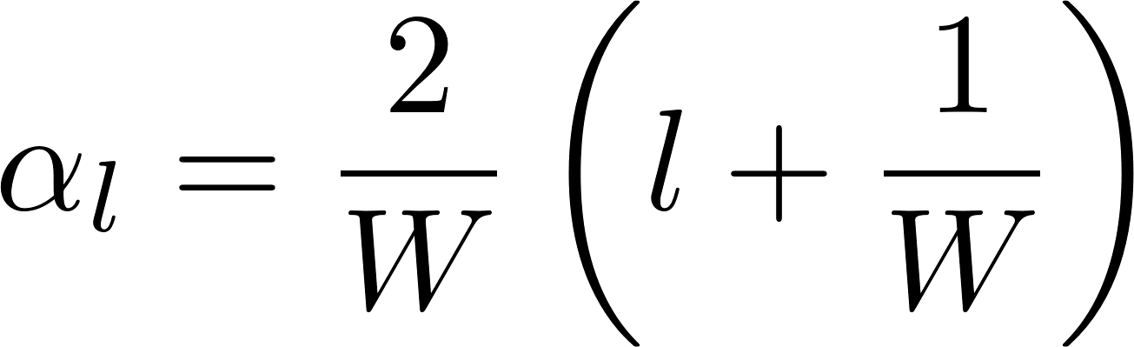
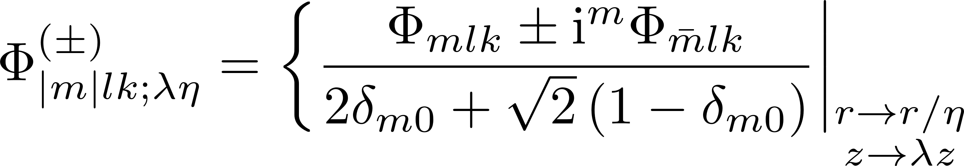
Fundamental basis state
Our naïve basis set
Spherical harmonics multiplied by Laguerre polynomials.
Complete set to represent square-integrable functions in real space.
Orthonormal.
Basis has choice of Slater (W = 1) or Gaussian decay (W = 2).
Introducing variational parameters
η controls overall size of ansatz.
λ introduces longitudinal anisotropy.
Rotate basis: eigenstates of coordinate swaps i.e. (xyz) -> (yxz)
Notes:
Make a note that these are not hydrogenic basis states – the hydrogenic bound states are not complete.
The rotation is some preliminary symmetrization. We’ll deal with more substantial and complete symmetrization on the next slide.

Slide 21
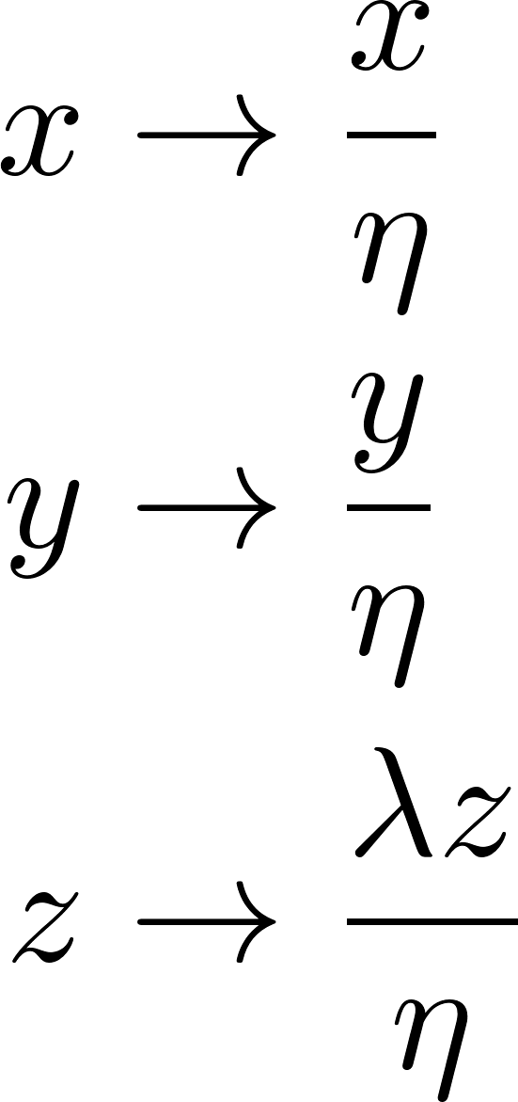
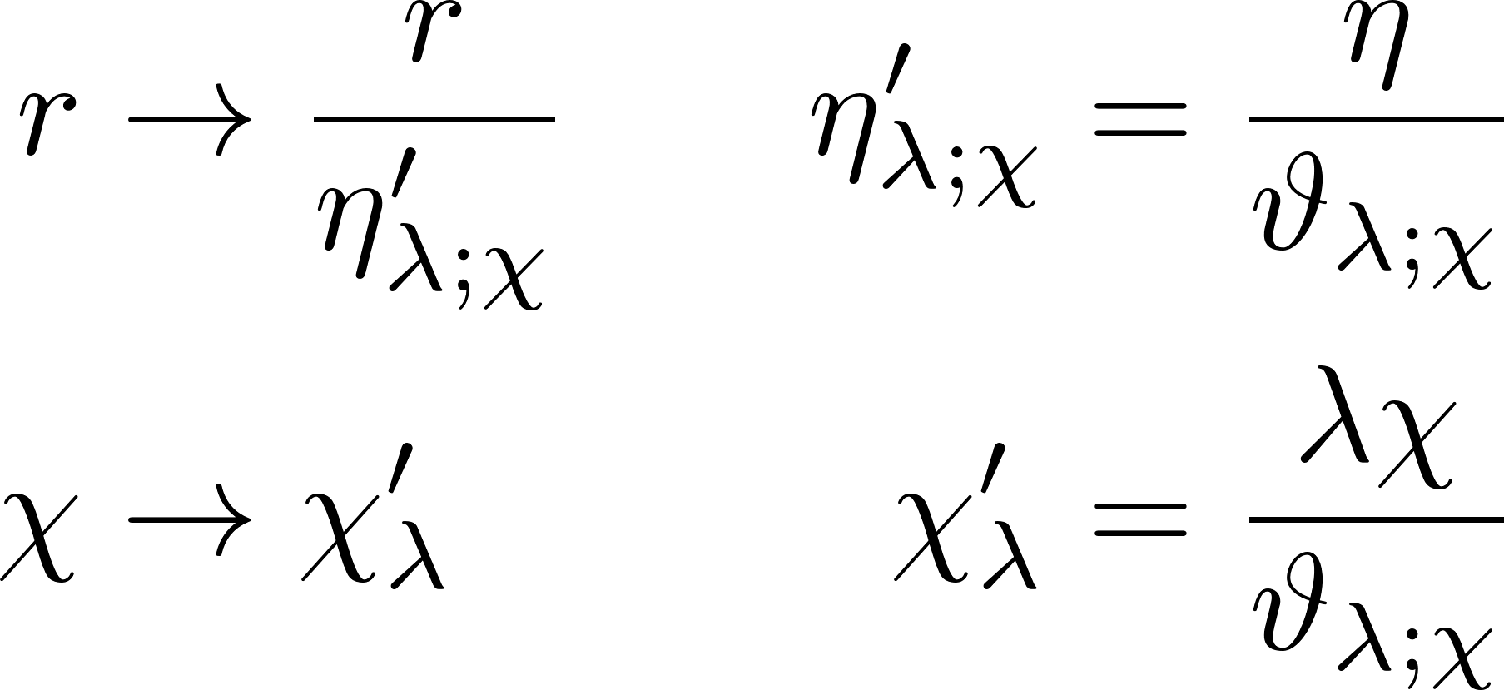
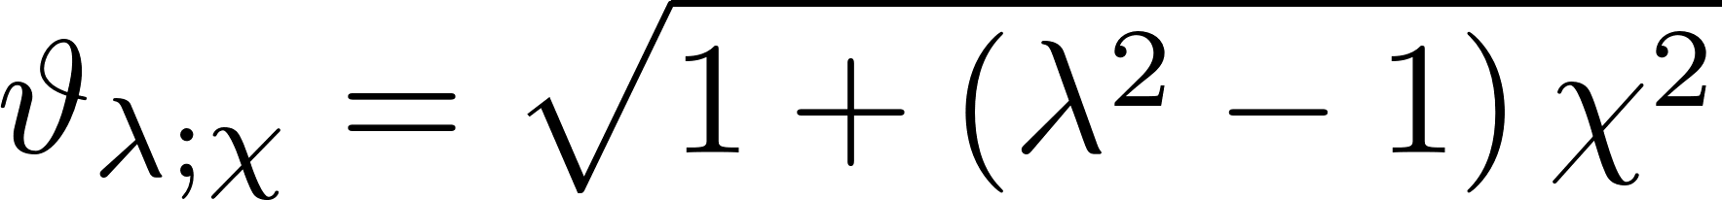
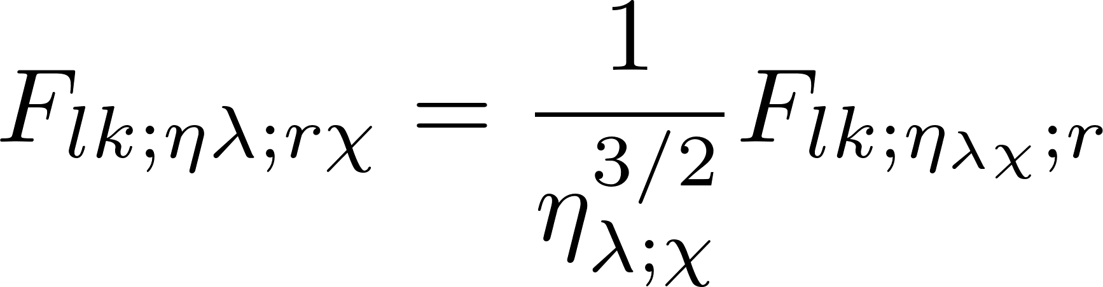
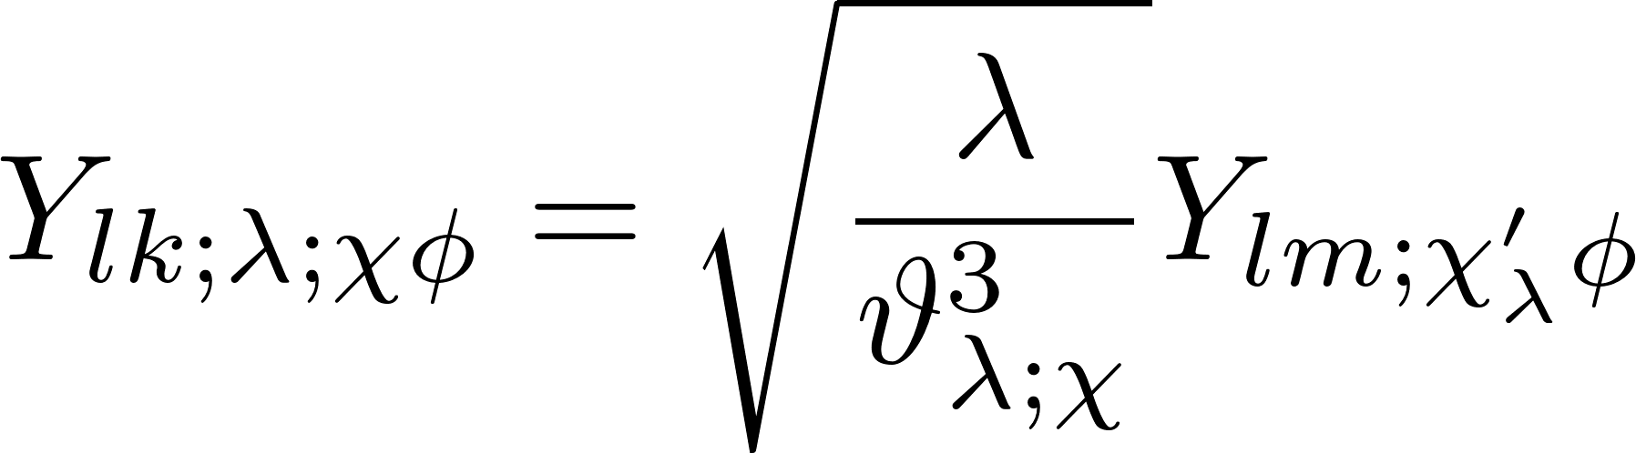
Variational basis state
Cartesian transformations:
Spherical transformations:
Notes:
Introducing variational parameters in a fashion equivalent to KL,Faulkner.

Slide 22
Subbasis and Superbasis
Subbasis: An orthonormal basis equipped with a set of independent variational/tuning parameters.
Superbasis: An orthonormal basis equipped with a set of independent variational/tuning parameters.
Use of the full Laguerre polynomials in our basis states allows free expansion of the subbases and superbasis without numerical instability.
Notes:
Introducing variational parameters in a fashion equivalent to KL,Faulkner.

Slide 23
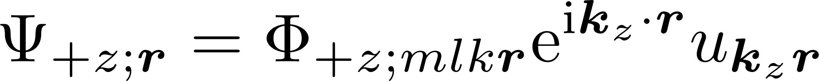
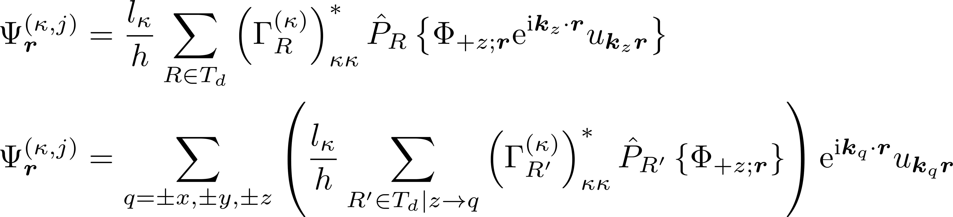
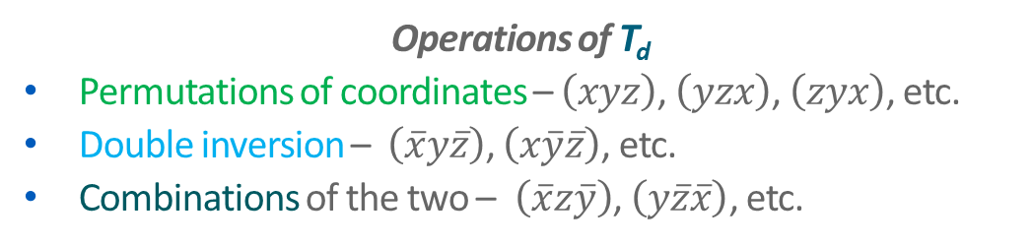
Symmetry and our effective mass wavefunctions
Operations of T_{d}
Permutations of coordinates – $\left(xyz\right)$, $\left(yzx\right)$, $\left(zyx\right)$, etc.
Double inversion – $\left(\overline{x}y\overline{z}\right)$, $\left(x\overline{y}\overline{z}\right)$, etc.
Combinations of the two – $\left(\overline{x}z\overline{y}\right)$, $\left(y\overline{z}\overline{x}\right)$, etc.
Second ansatz
Symmetrizes the first ansatz.
Notes:
Not sure how much detail regarding the group theory stuff to go into here. Maybe good to have a slide illustrating the idea in the appendix.

Slide 24
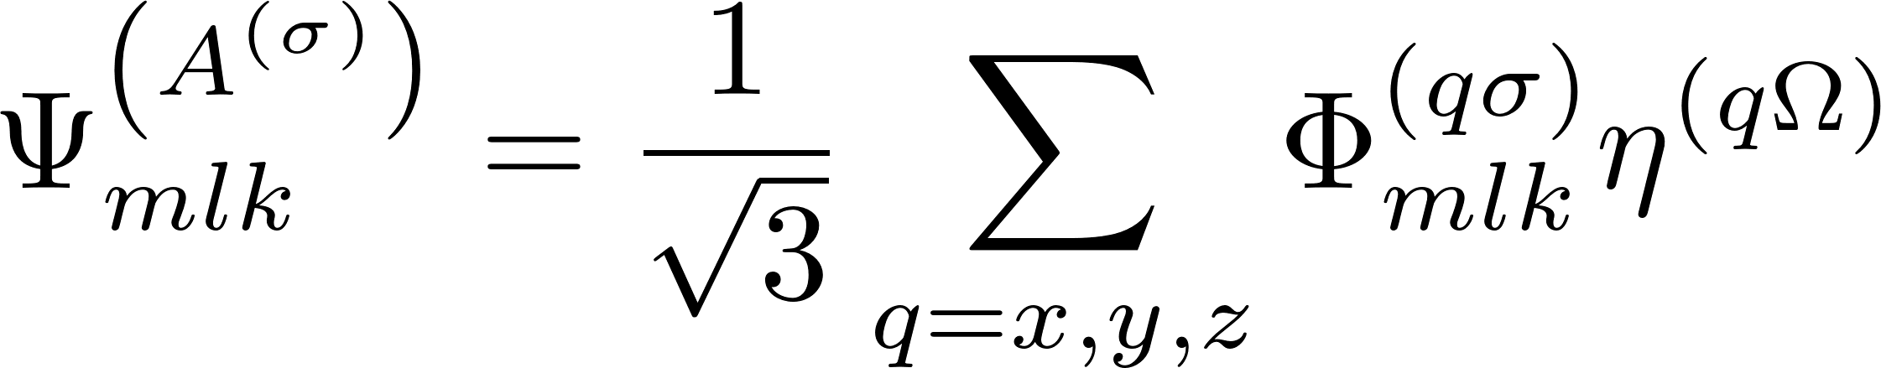
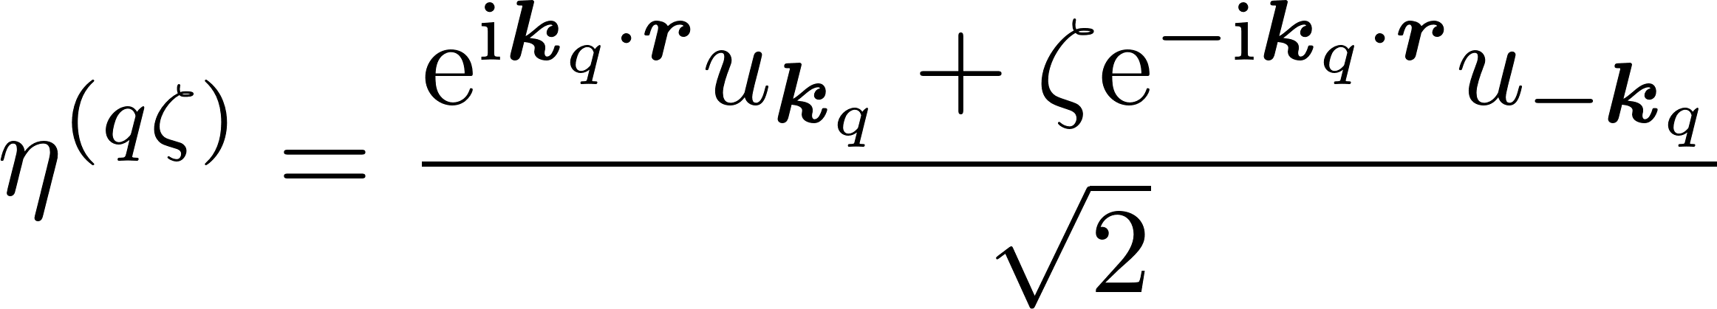










Symmetrized basis state
Notes:
Might be worthwhile to stress that you no longer have orthonormality.
Unique feature, haven’t seen this in the EMT silicon donor literature – more complicated symmetrization from more complicated ansatz wavefunction.

Slide 25

Software structure

Slide 26
RESULTS

Slide 27

Single-valley results -- Increasing subbasis size (1)

Slide 28

Single-valley results -- Increasing subbasis size (2)

Slide 29


Single-valley results -- Constructing superbases(1)

Slide 30

Single-valley results -- Constructing superbases(1)

Slide 31
REFERENCES

Slide 32
References
J. D. Hidary, Quantum Computing: An Applied Approach (Springer, Cham, 2019).
National Academies of Sciences, Engineering, and Medicine, Quantum Computing: Progress and Prospects (The National Academies Press, Washington, DC, 2018).
C. M. Dawson, M.A. Nielson, Quantum Information and Computation 6, 1 (2006).
F. Arute, et al., Nature 574, 505 (2019).
E. Pednault, et al., arXiv: 1910.09534v2 (unpublished).
J. Preskill, Quantum 2, 79 (2018).
C. D. Bruzewicz, J. Chiaverini, R. McConnell, J. M. Sage, Applied Physics Reviews 6, 021314 (2019).
M. Kjaergaard, et al., Annual Review of Condensed Matter Physics 11, 369 (2020).
L. M. K. Vandersypen, M. A. Eriksson, Physics Today 72, 38 (2019).
J. M. Luttinger, W. Kohn, Physical Review, 97, 869 (1955).
W. Kohn, J. M. Luttinger, Physical Review 98, 915 (1955).
A. Baldereschi, Physical Review B 1, 4673 (1970).
R. A. Faulkner, Physical Review 184, 713 (1969).
H. Hui, Solid State Communications 154, 19 (2013).
T. H. Ning, C. T. Sah, Physical Review B 4, 3468 (1971).
S. T. Pantelides, C. T. Sah, Physical Review B 10, 621 (1974).
A. L. Saraiva, et al., Journal of Physics: Condensed Matter 27, 154208 (2015).
J. K. Gamble, et al., Physical Review B 91, 235318 (2015).
K. Shindo, H. Nara, Journal of the Physical Society of Japan 40, 1640 (1976).
A. Debernardi, A. Baldereschi, M. Fanciulli, Physical Review B 74, 035202 (2006).

Slide 33
APPENDIX

Slide 34


Models of impurity potential
Statically screened Coulomb model. [11-14]
Excess proton charge is screened by surrounding silicon.
Permittivity is treated as a constant.
No central cell correction.
Dynamic screened Coulomb model. [15-17]
Excess proton charge is screened by surrounding silicon.
Permittivity is treated as a k-dependent function transformed to real space.
Not necessarily a central cell correction, depends on decay constants.

Slide 35



Models of impurity potential
Empirical tetrahedral symmetric potential. [18]
Potential goes beyond spherical symmetry.
Reflects symmetry of silicon lattice.
Decay constants consistent with central cell correction.
Center cell. [19]
Smoothed pseudopotential.
Empirical parameters.
Center cell. [20]
Based on mismatch of core electron densities numerically calculated by DFT.

Slide 36
RESULTS

Slide 37







Checking the completeness with the variance
Completeness
Is the basis well-converged to an eigenstate?
Variance formulae are derived following the method of the Shindo-Nara equation [19-20].

Slide 38








Multi-valley variance results – Shindo-Nara equation
We found a negative variance?
The effective potential was treated as Coulomb with static dielectric screening.
Results for one basis state.
Variance is only negative near the energetic minimum, suggests downward systematic error.
Adding more terms of the periodic part of the Bloch function to attenuate the potential had no useful effect.
Perhaps the kinetic part is being underestimated somehow?
Time to reassess the effective mass equation.
Notes:
“Energetic minimum” – minimum of the energy surface formed by varying state parameters

Slide 39


A problem with the Shindo-Nara equation?
It is a reasonable assumption for verisimilitude that the kinetic term doesn’t mix the valleys.
However, to ensure that the variance is positive definite, the valley-mixing terms must be kept.

Slide 40






Sensible variance with multivalley terms
Without intervalley kinetic and overlap terms
With intervalley kinetic and overlap terms
Results for one basis state.
Results for one basis state.
Including the intervalley terms makes the variance positive-definite over the whole parameter space.

Slide 41
Losing verisimilitude for a more consistent approach
Is this a fruitful course?
A problem:
Results are a worse match for experimental energies.
(E_{A} is highest, not lowest energy!)
Issue resolved by noting that not all points in the variational state space are valid.
Is the wavefunction collapse inconsistent?
Only portions of the state space that have small intervalley kinetic contributions should be a priori accepted as an ansatz.
Improving versimilitude?
The most appropriate form of the effective potential is still unknown.
May be possible to regain verisimilitude by finding useful effective potential.
Notes:
Is essence, rather then treating the wavefunction as an independent parameters (as we might in the variational approach) we treat the wavefunction as a dependent parameter, a result of our Hamiltonian and our impurity model.
Tension between rejecting some points of the variational state and treating the wavefunction as a dependent parameter. We can resolve this by suggesting that we seek model Hamiltonians that increase the energy of those points in state space, meaning variational optimization doesn’t pick them.

