Slide 1
Full State Description

Slide 2
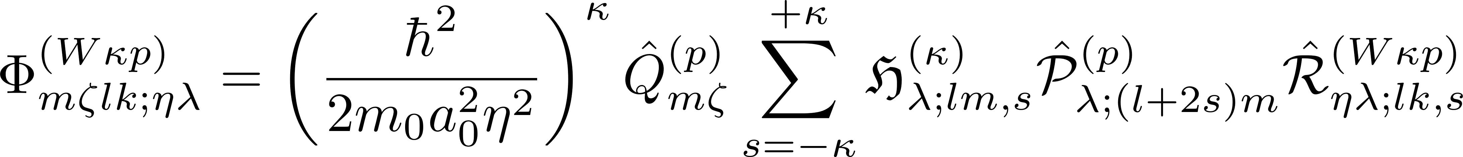
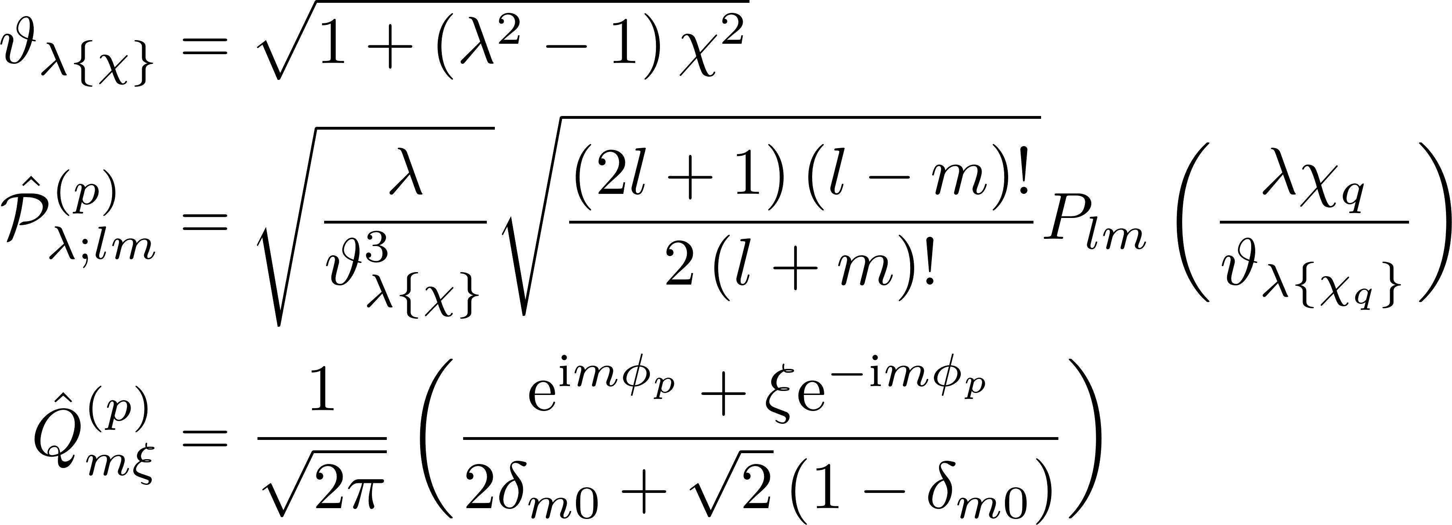
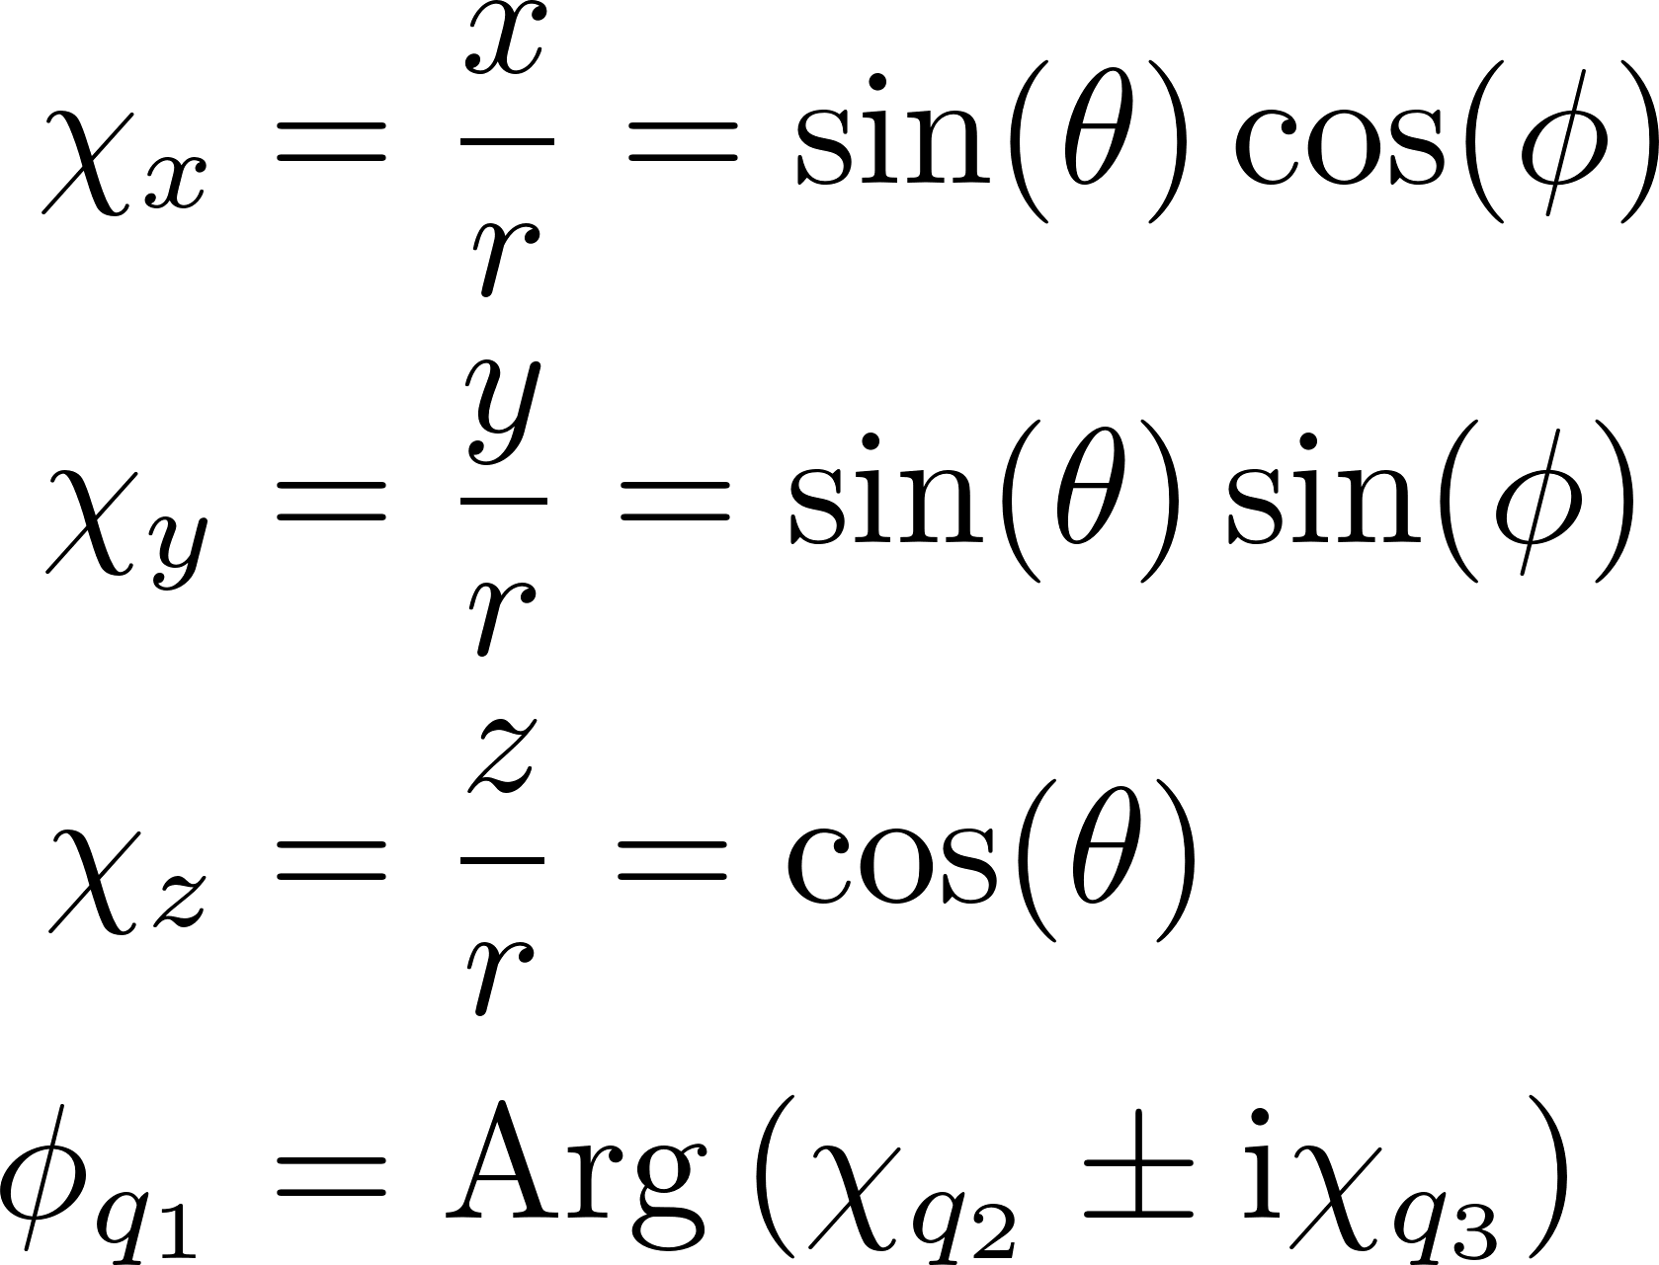
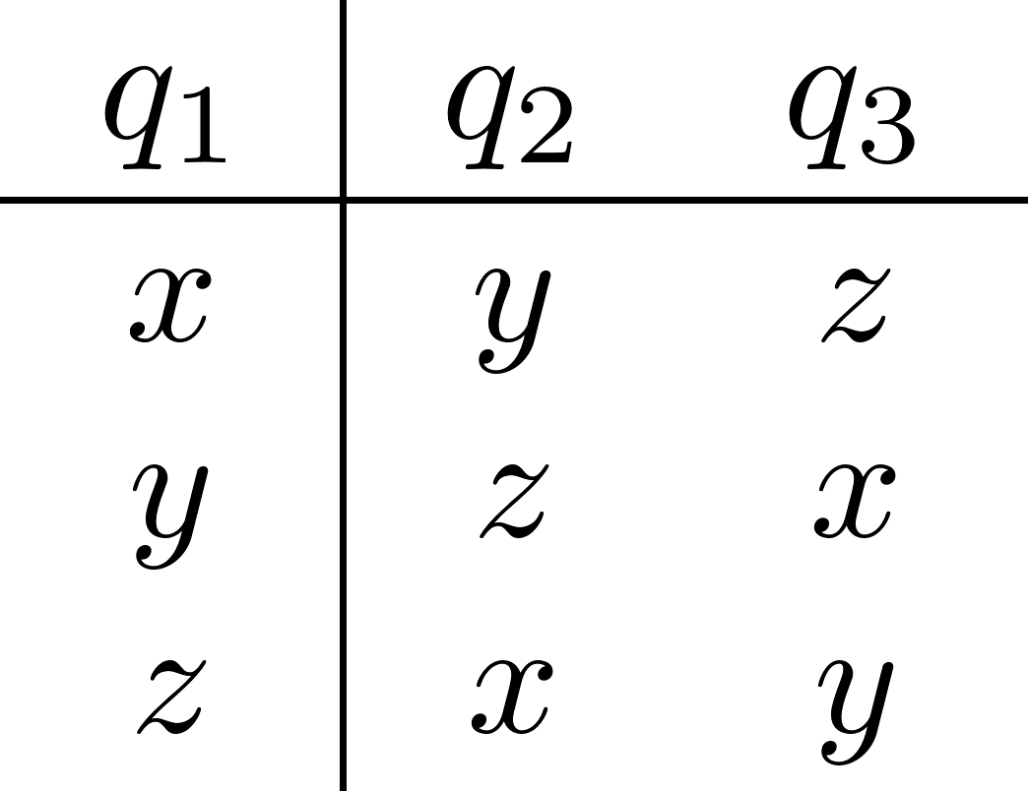
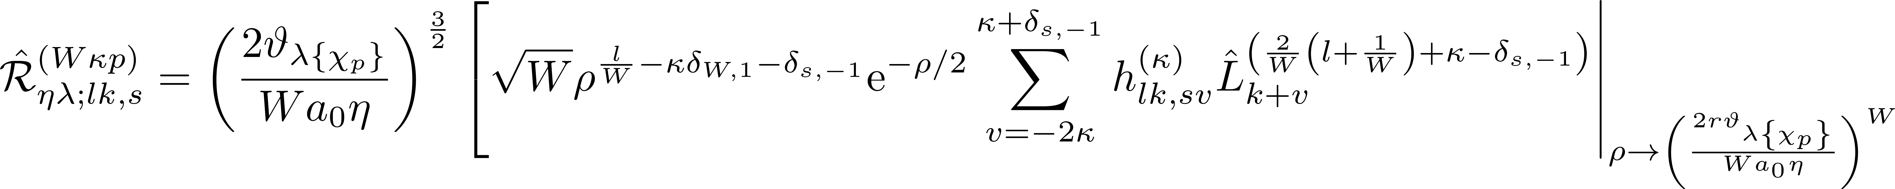
Generalized single-valley basis states

Slide 3
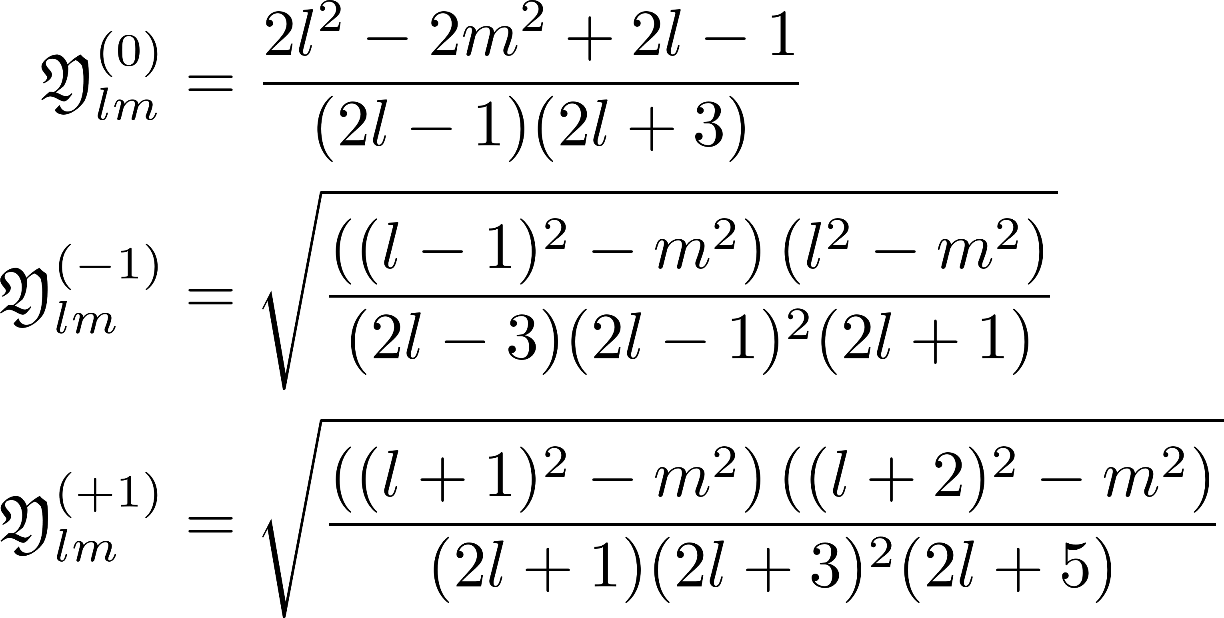
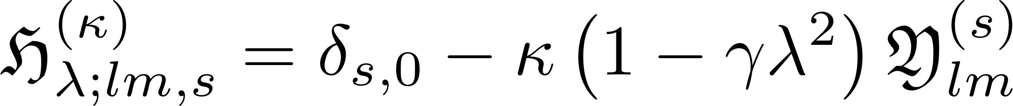
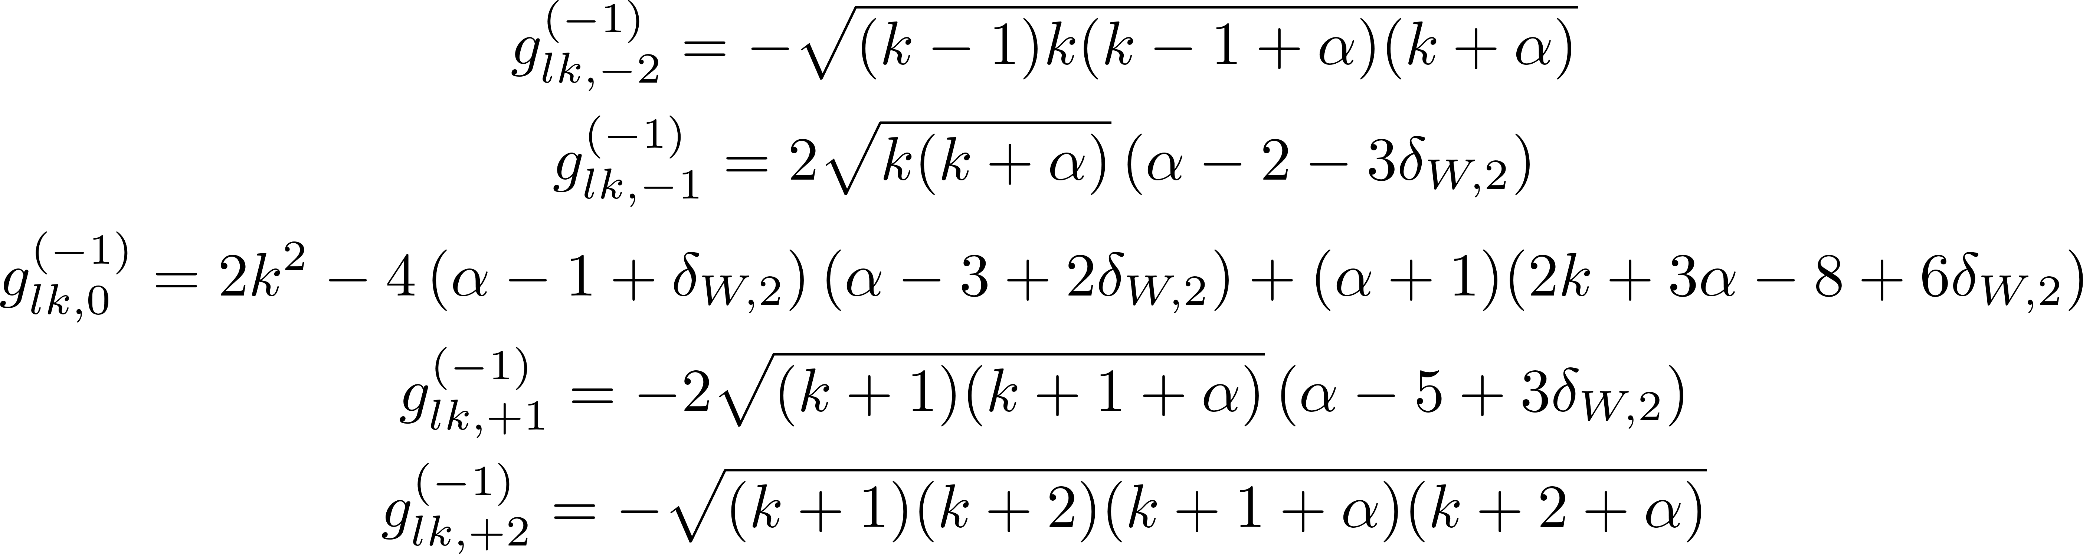
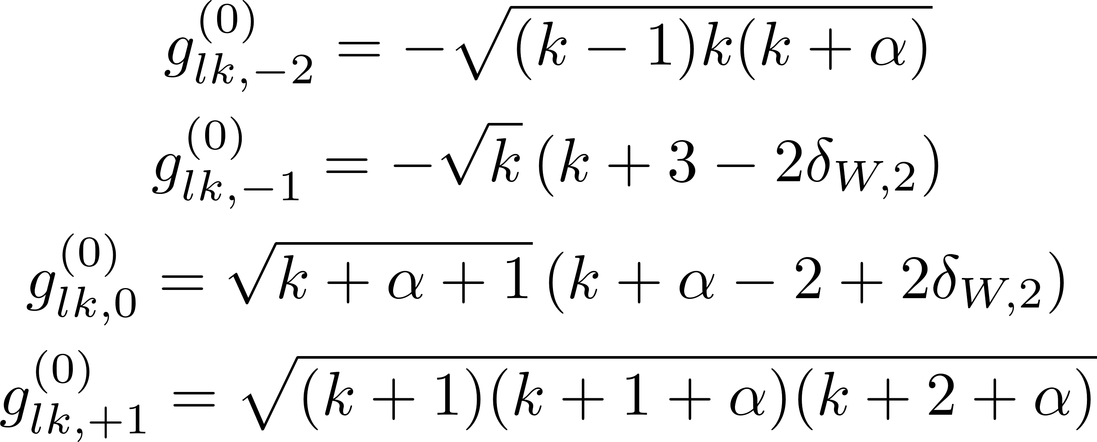
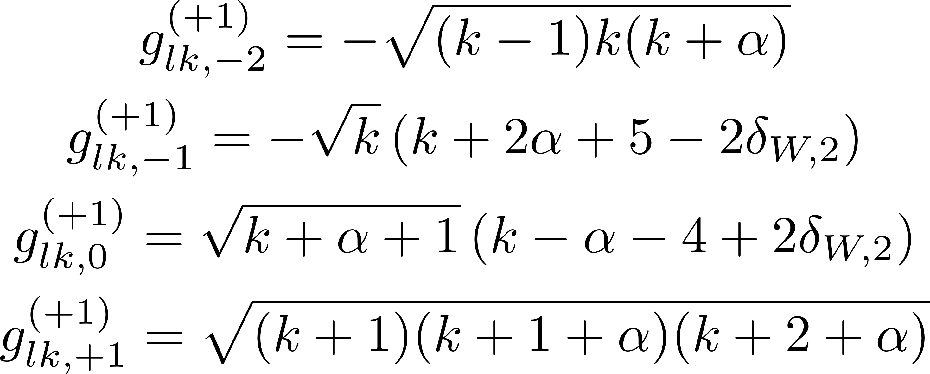
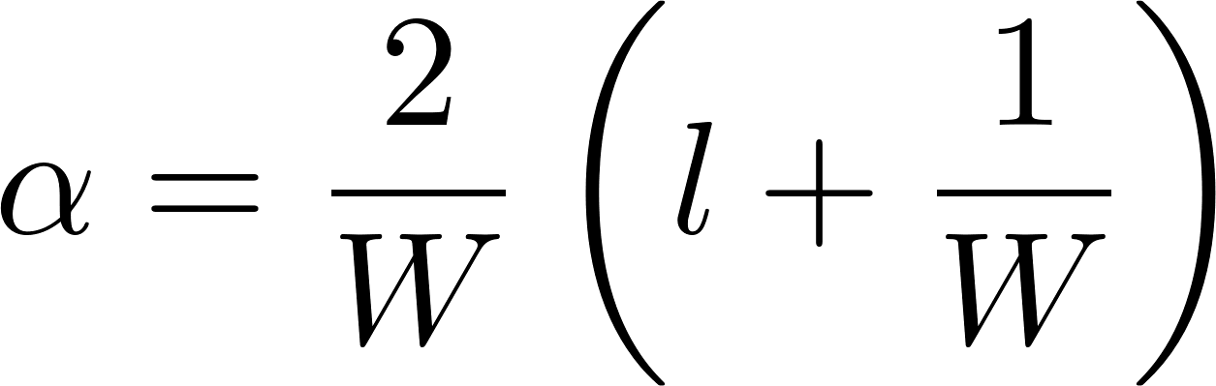
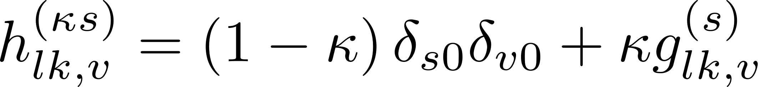
Generalized single-valley basis states

Slide 4
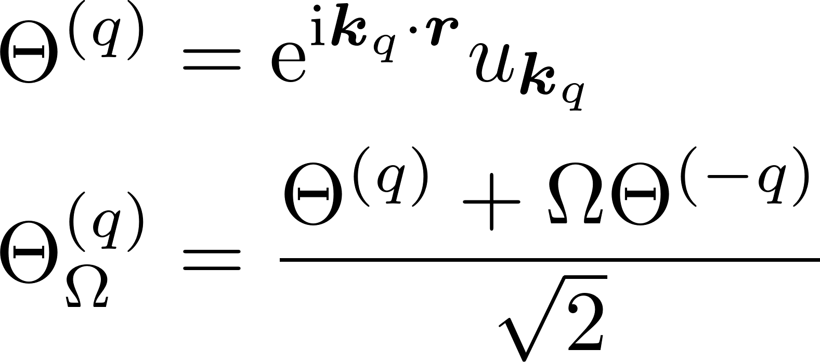
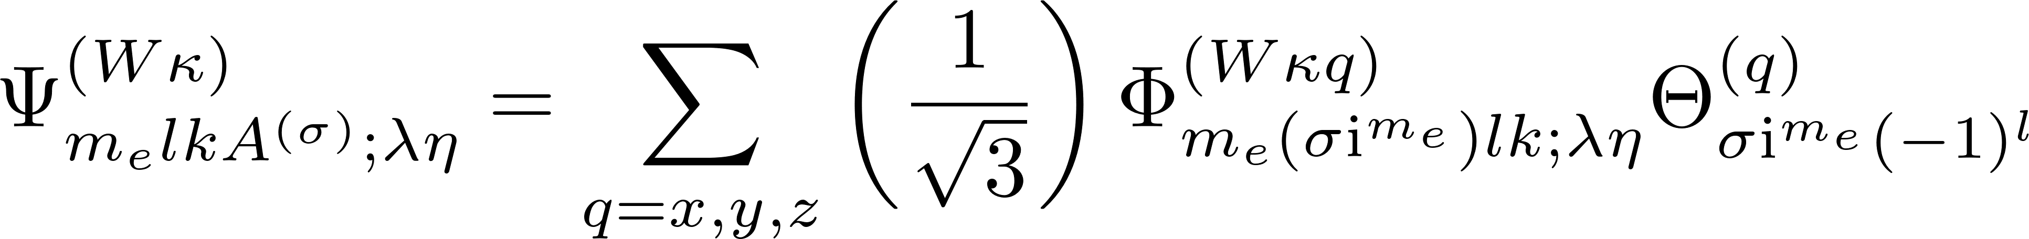
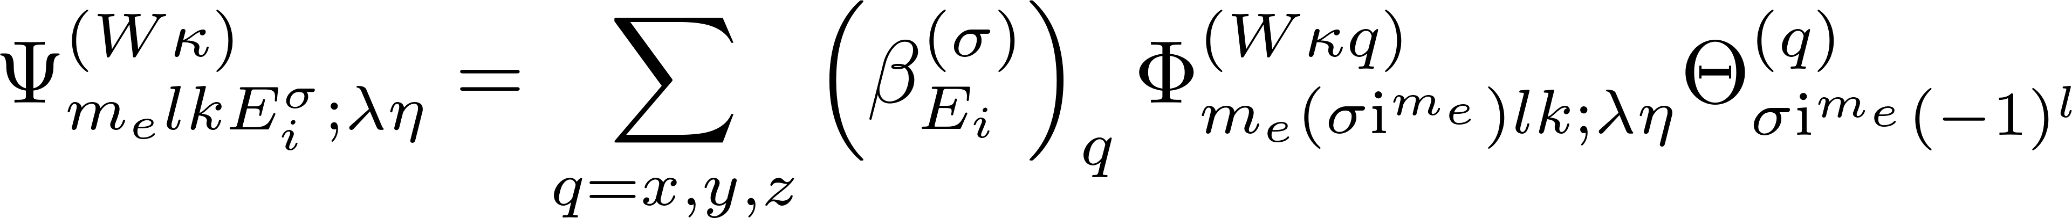
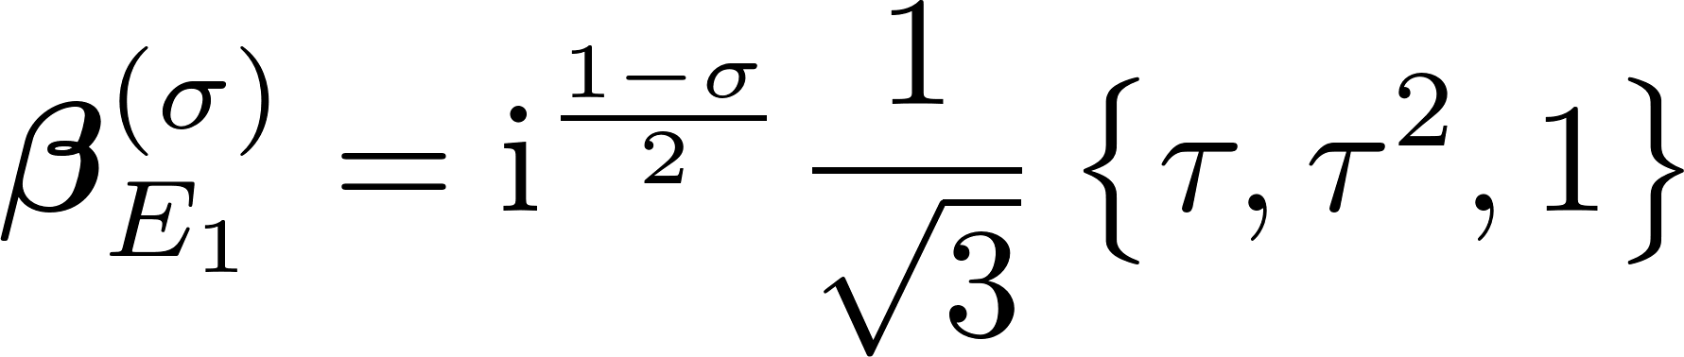
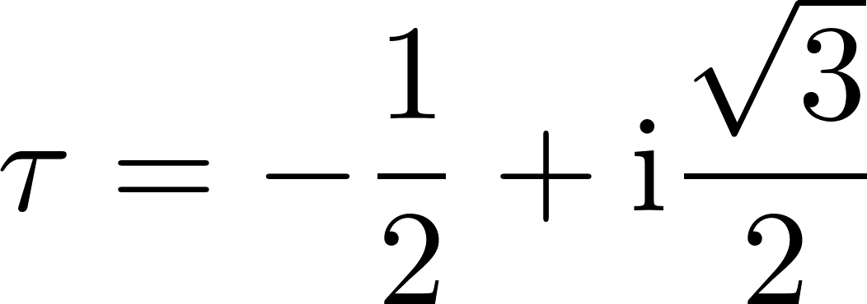
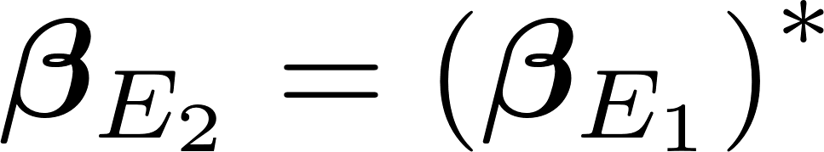
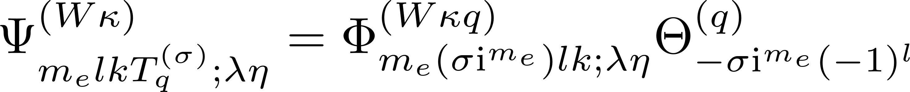
Symmetrized States, m even

Slide 5
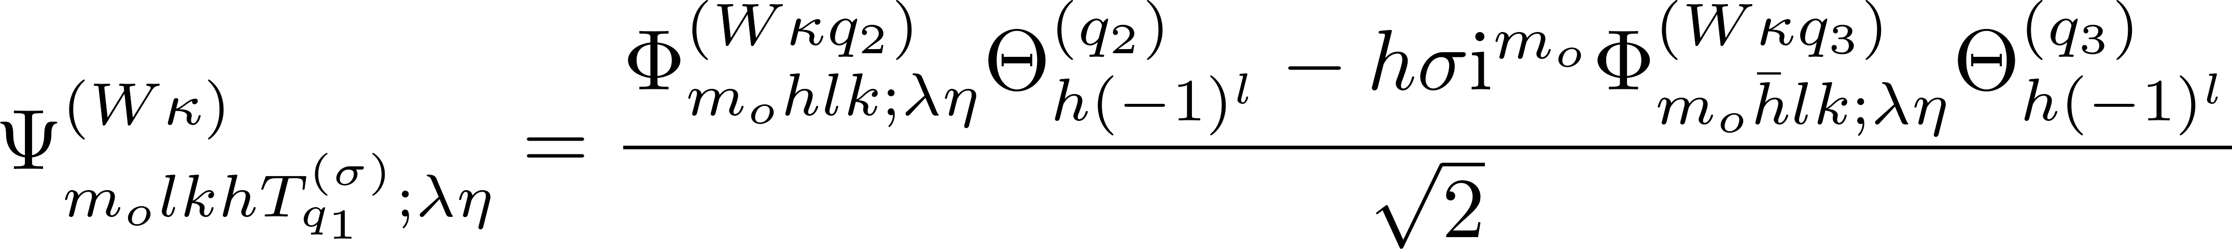
Symmetrized States, m odd

Slide 6
Integrable Potential Forms
Forms that might be used

Slide 7
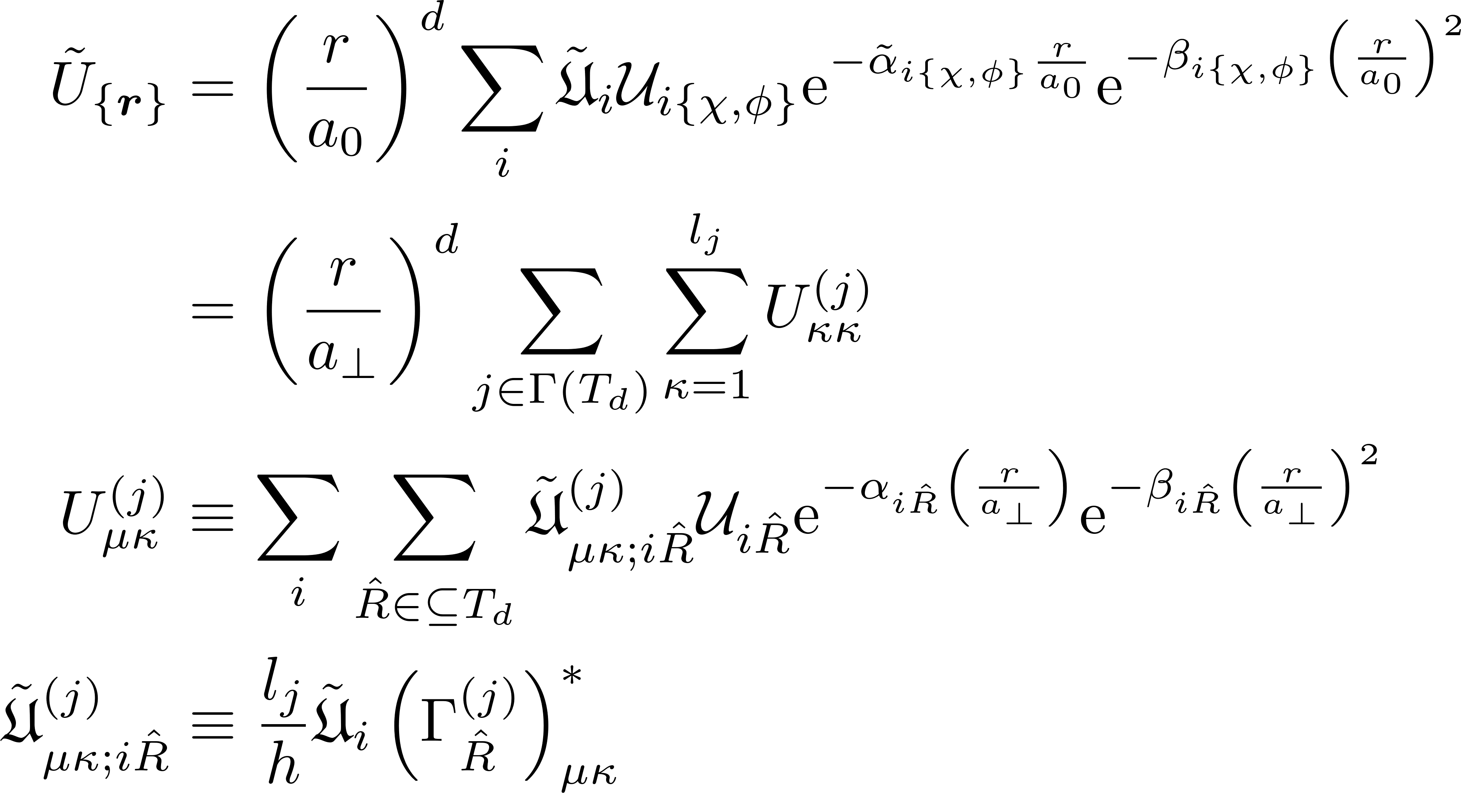
Raw potential

Slide 8
GENERAL MATRIX ELEMENT FORMULA
Finding a general form for the multivalley matrix element

Slide 9
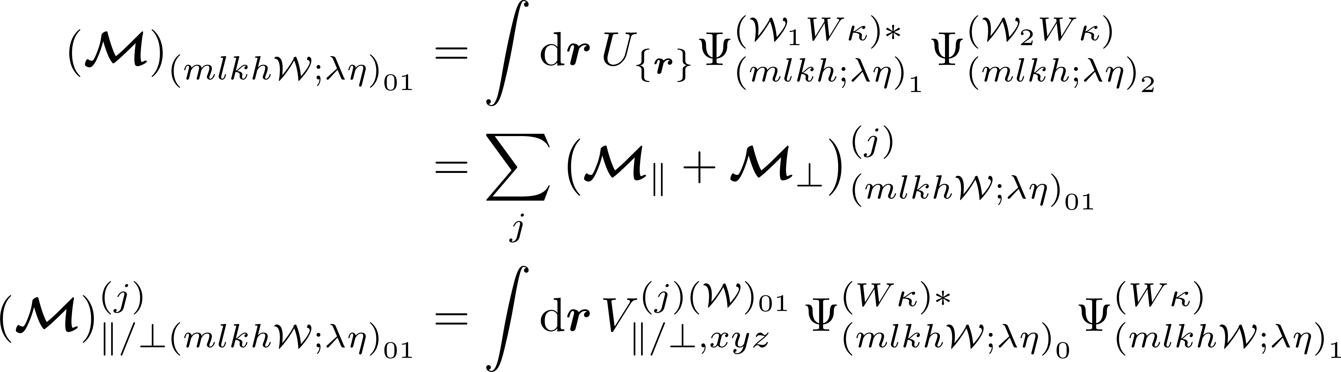
General matrix element formula

Slide 10
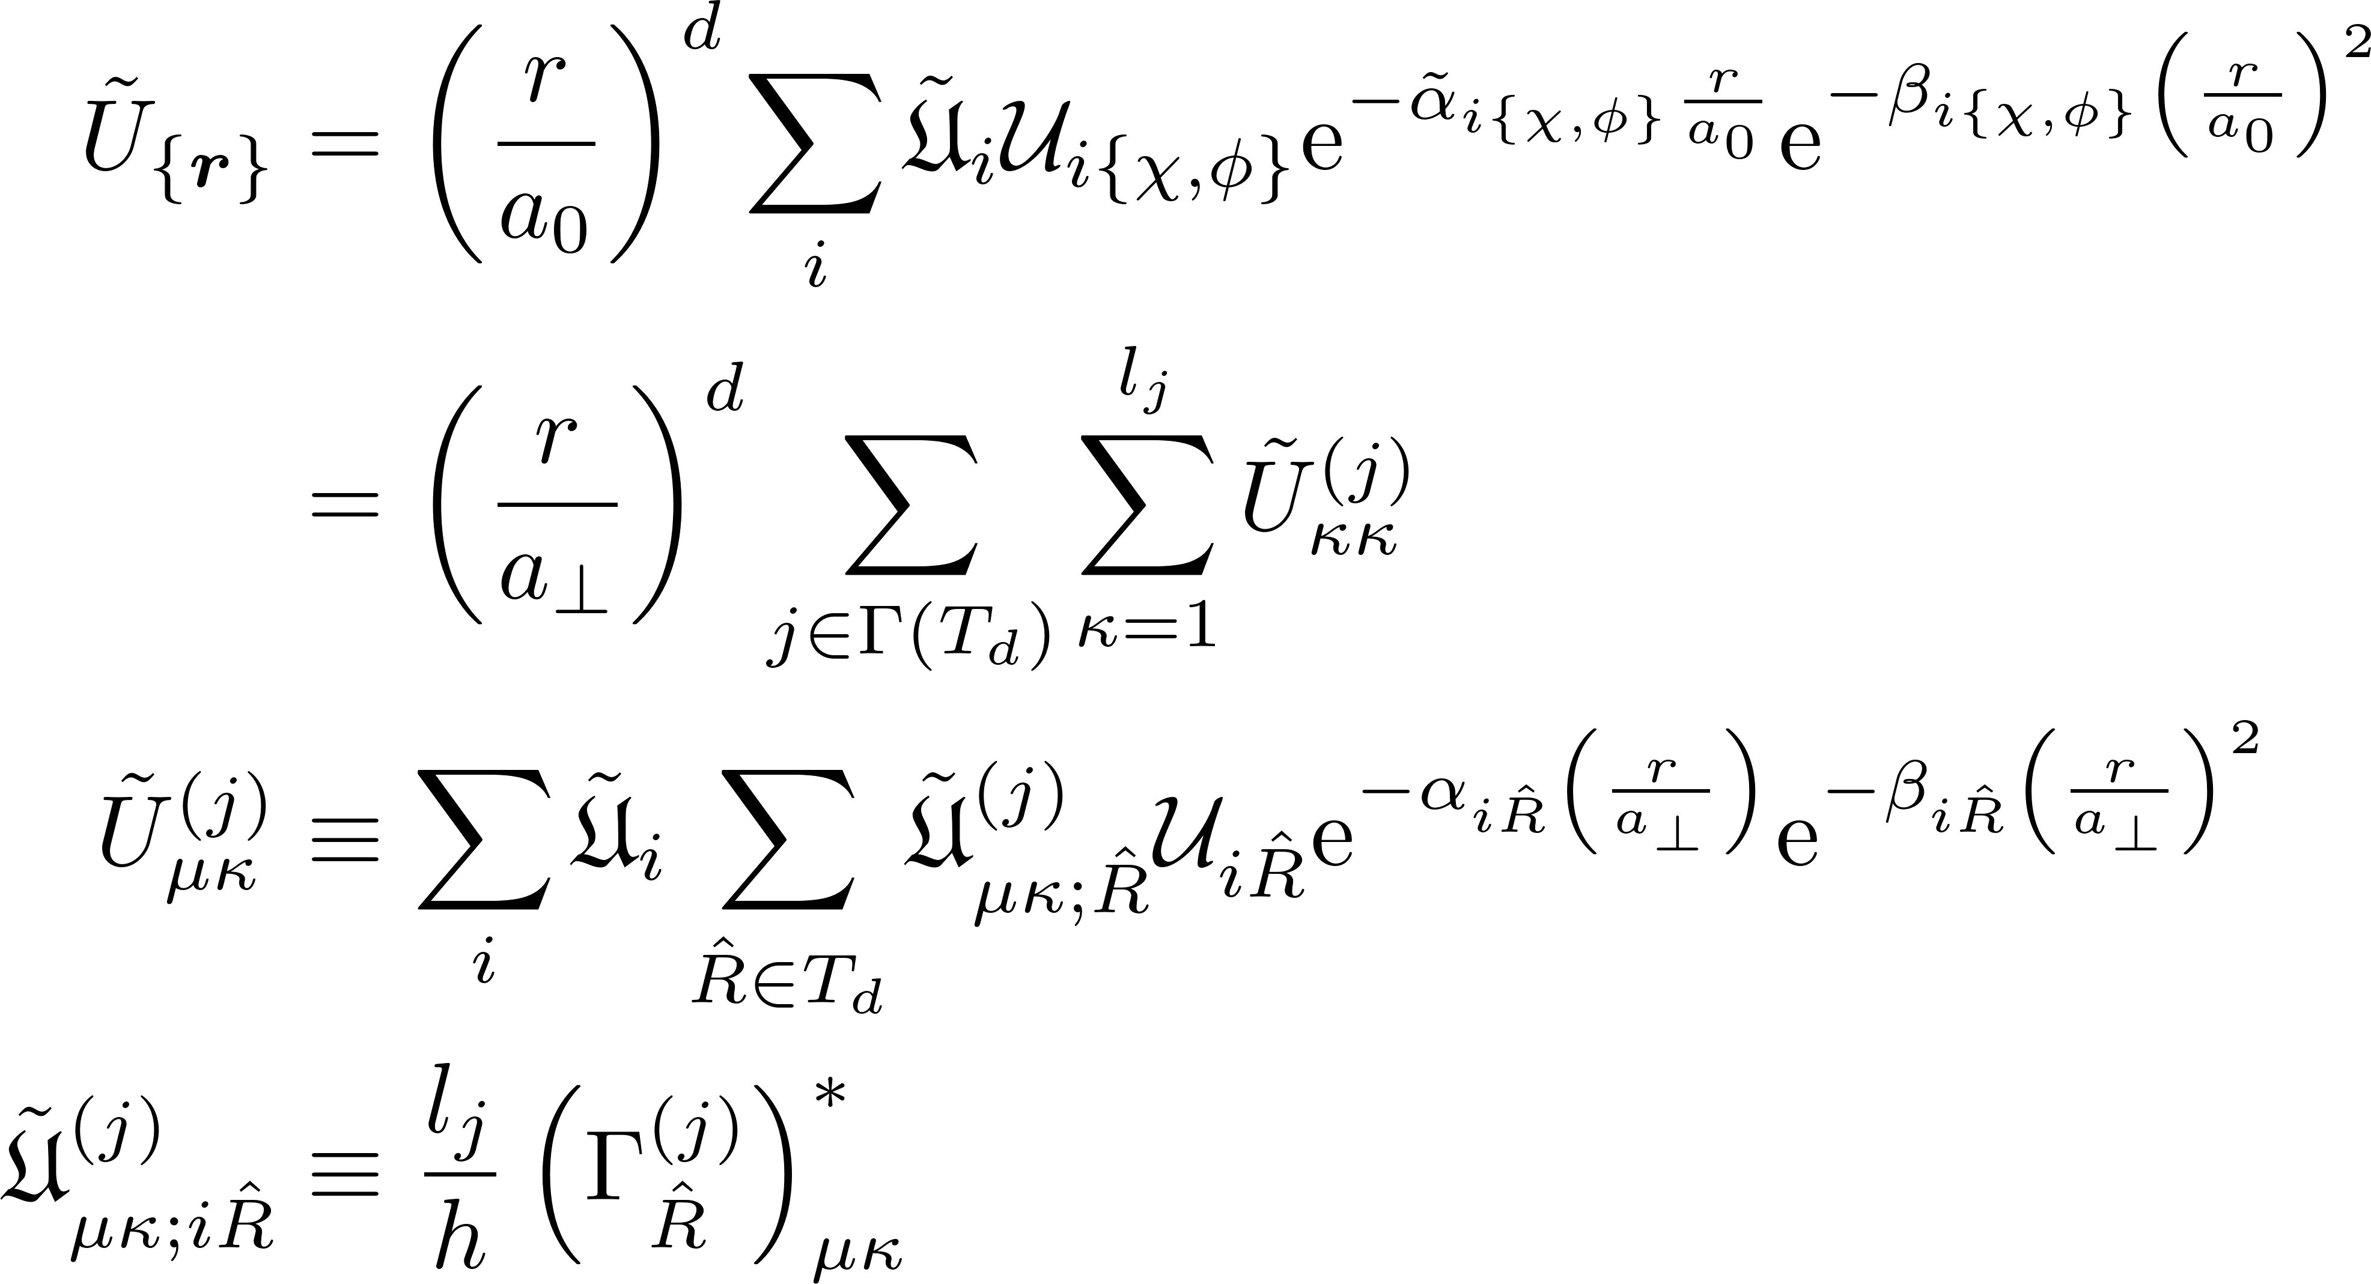
Raw potential

Slide 11
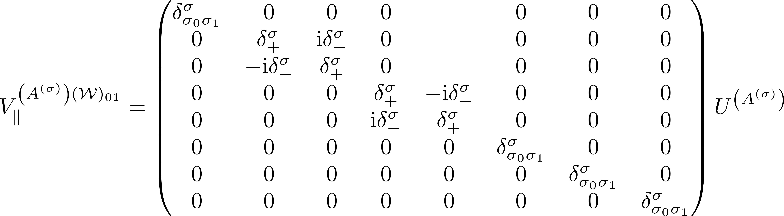
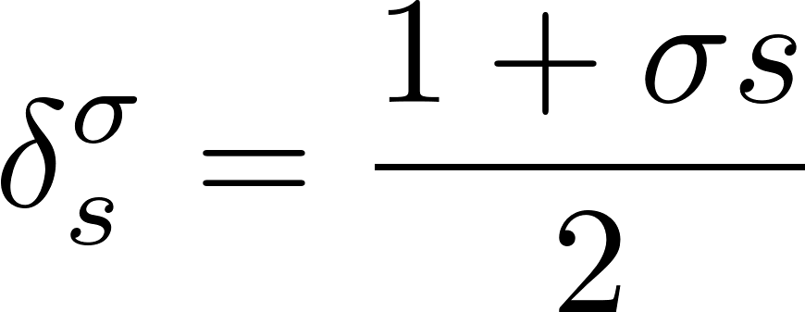
Filtered potential involving parallel valleys

Slide 12
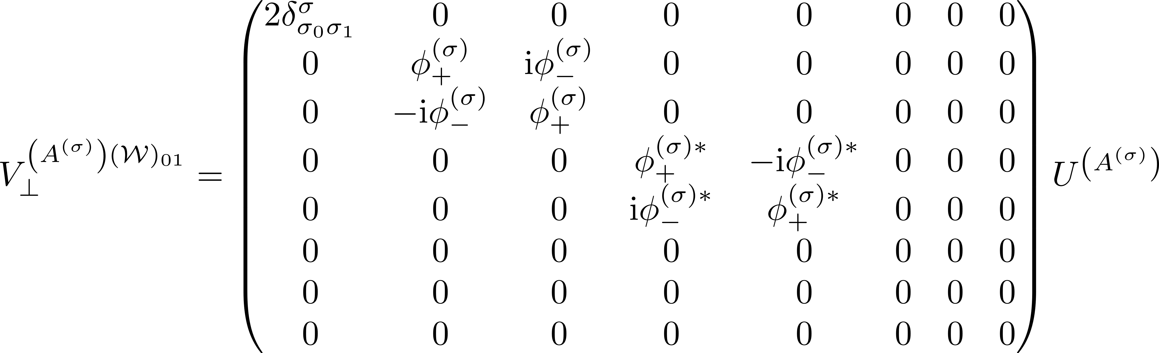
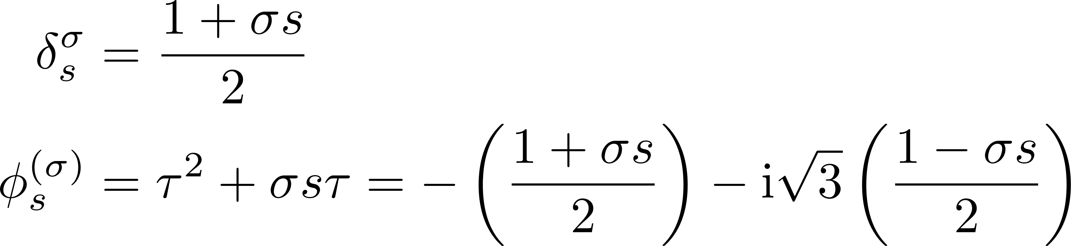
Filtered potential involving perpendicular valleys

Slide 13
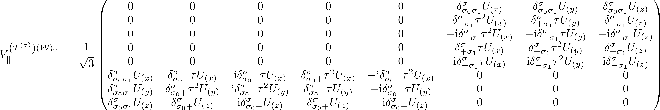
Filtered potential involving parallel valleys

Slide 14
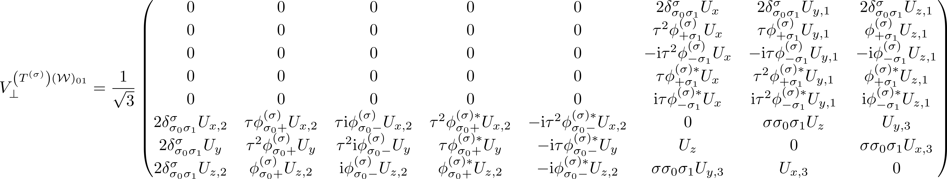

Inversion filtered potential involving perpendicular valleys

Slide 15
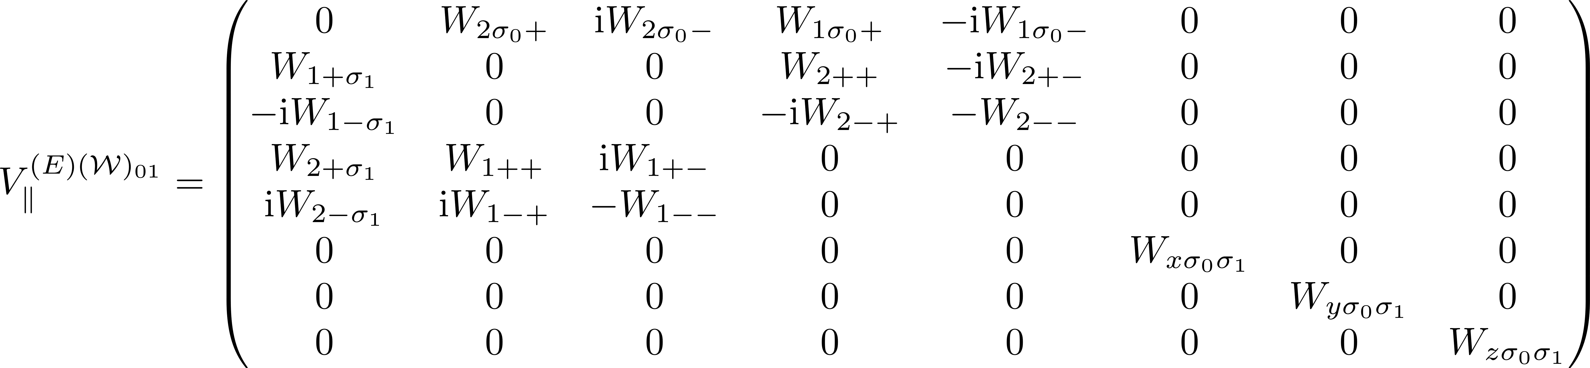
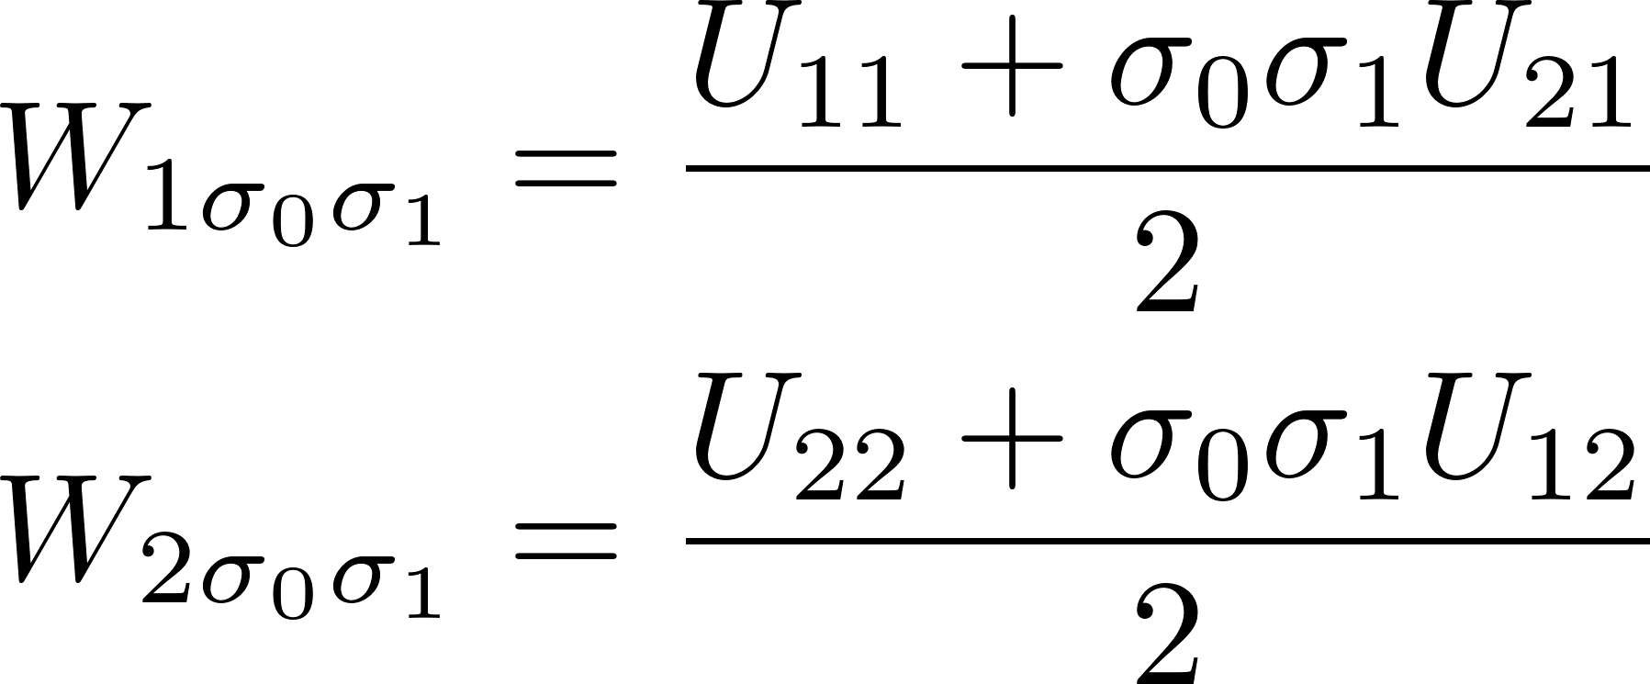
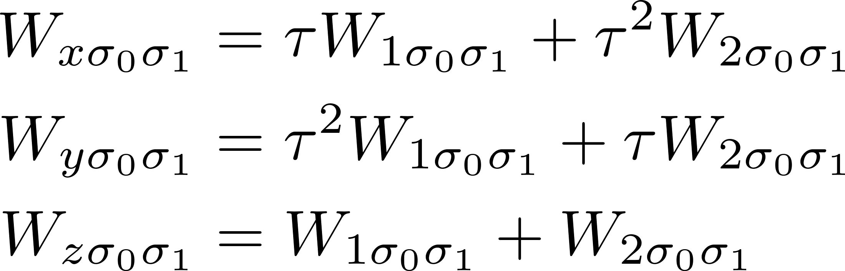
Filtered potential involving parallel valleys

Slide 16
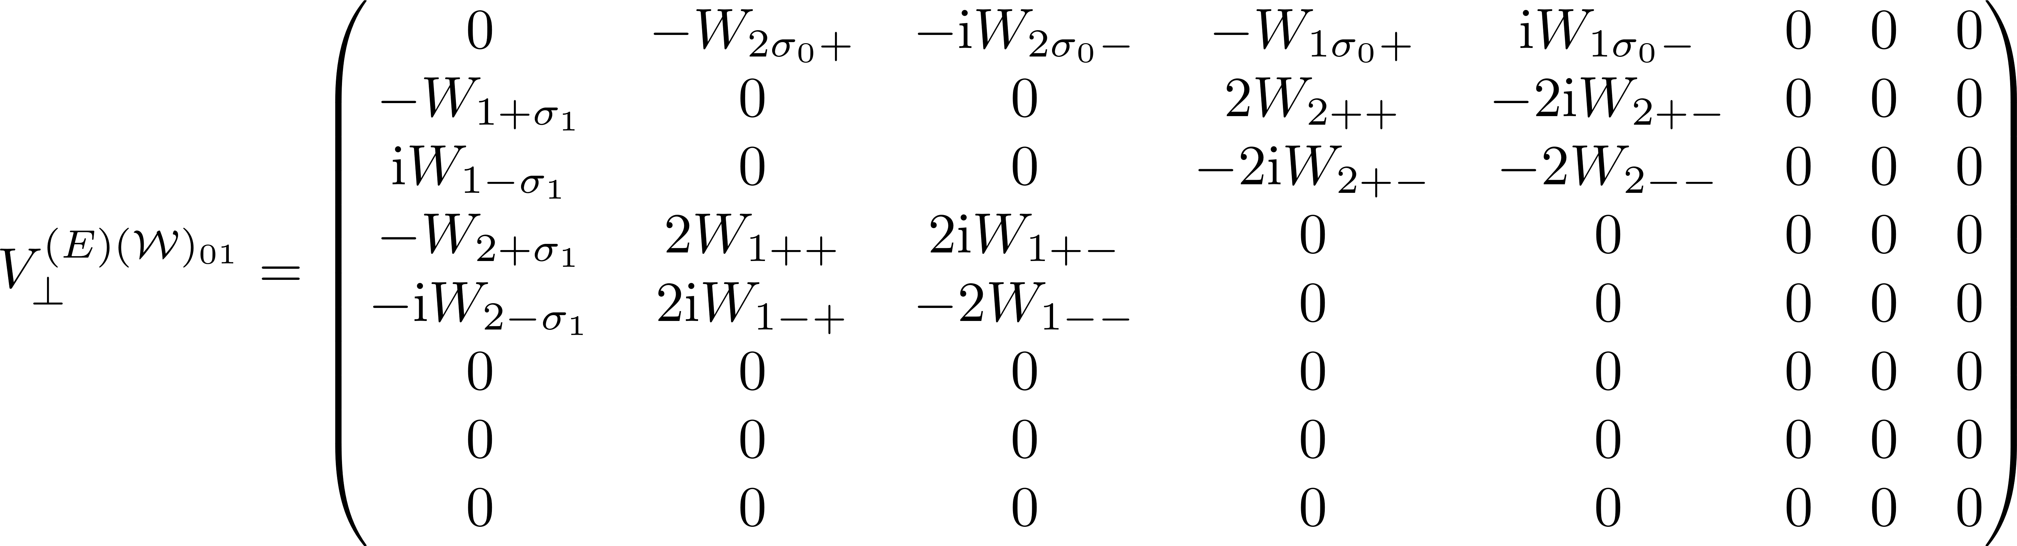
Filtered potential involving perpendicular valleys

Slide 17
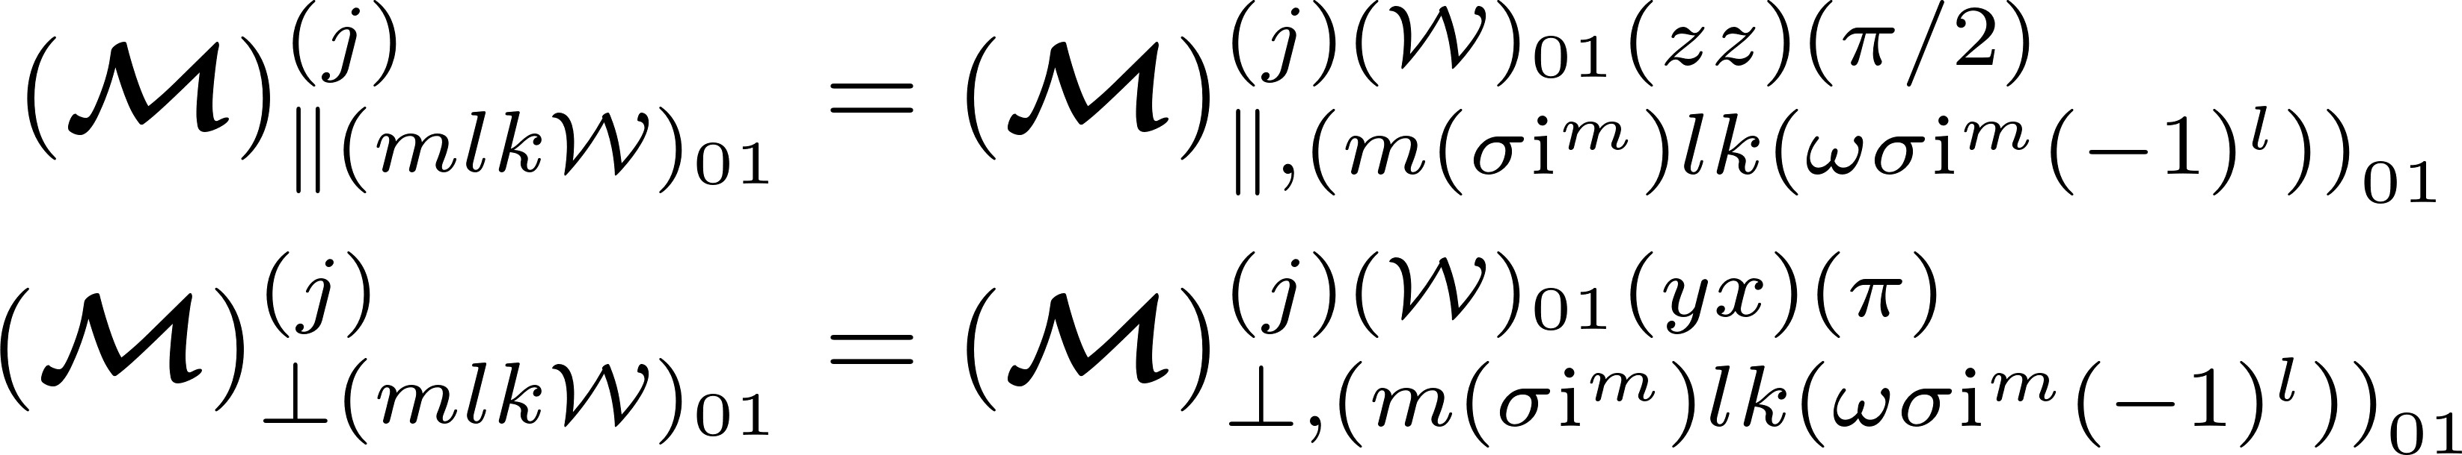
m₀ even, m₁ even – Final form

Slide 18
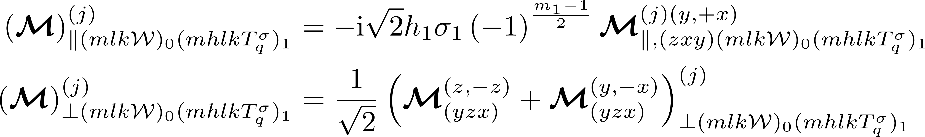
m₀ even, m₁ odd – Final form

Slide 19
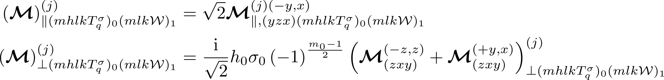
m₀ odd, m₁ even – Final form

Slide 20
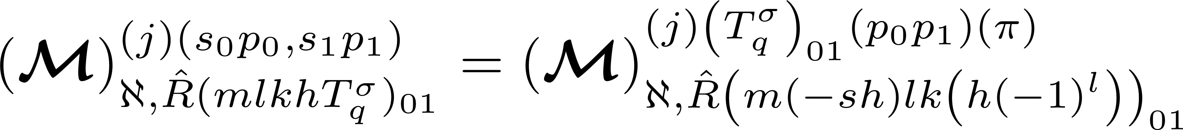
m₀ odd, m₁ odd – Final form

Slide 21
Base MATRIX ELEMENT FORMULA
Finding a base computational form for the multivalley matrix element

Slide 22
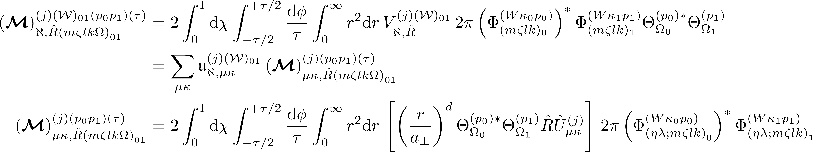
Base Integration Formula for Matrix Elements

Slide 23
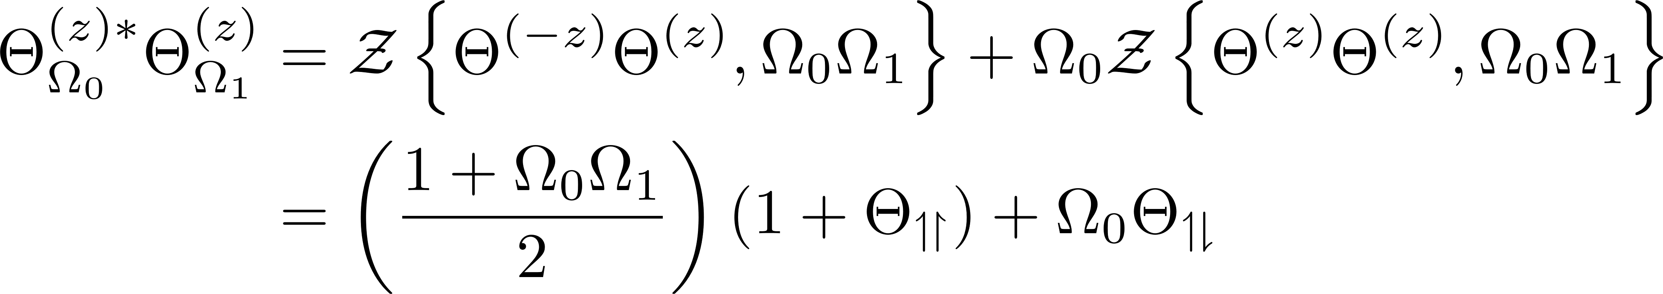
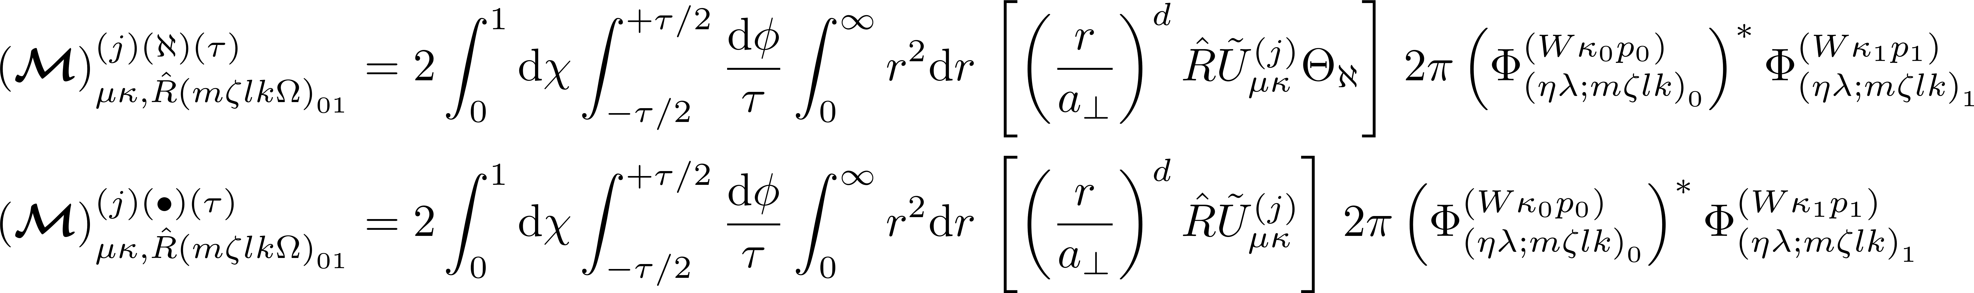
Elaboration of the Base Integration Formula

Slide 24
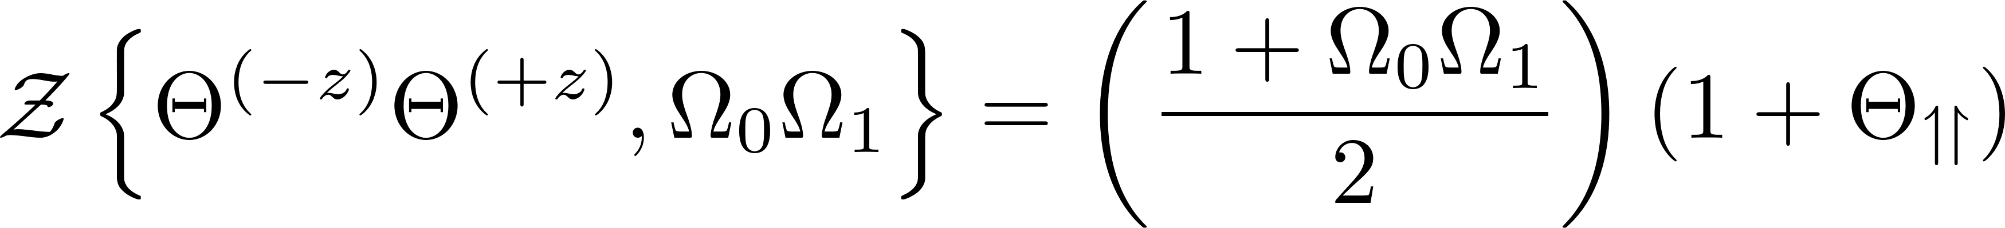
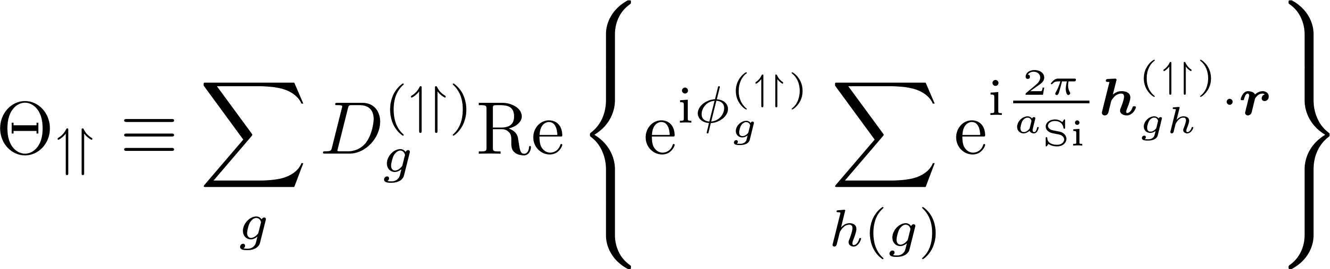
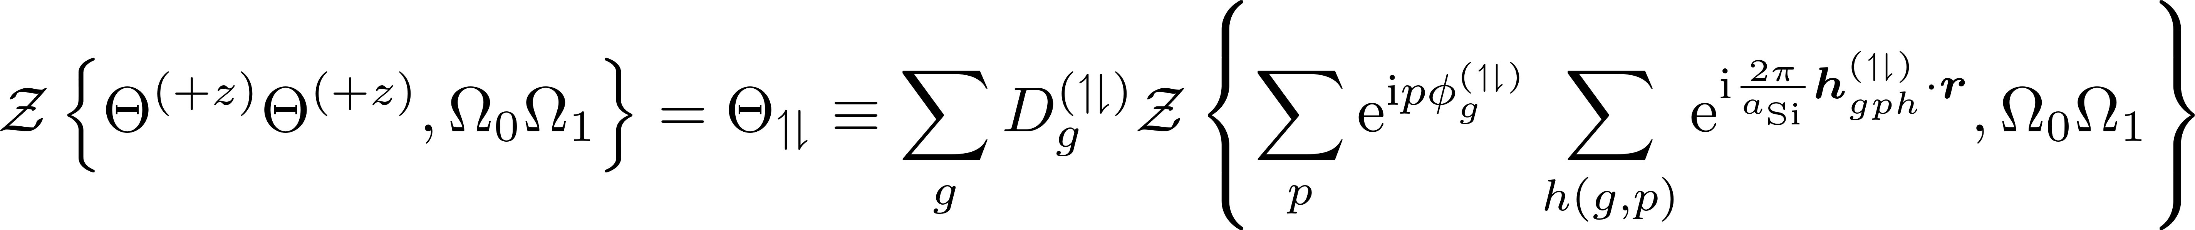
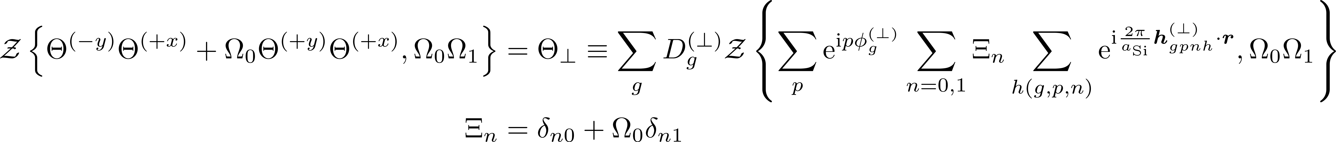
Bloch integrand

Slide 25
Generalizing Integration Formula

Slide 26
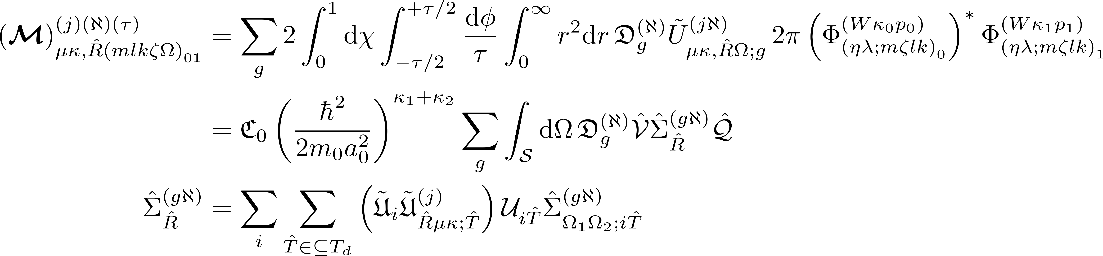
Generalizing Integration Formula

Slide 27
Computational FormulAe

Slide 28
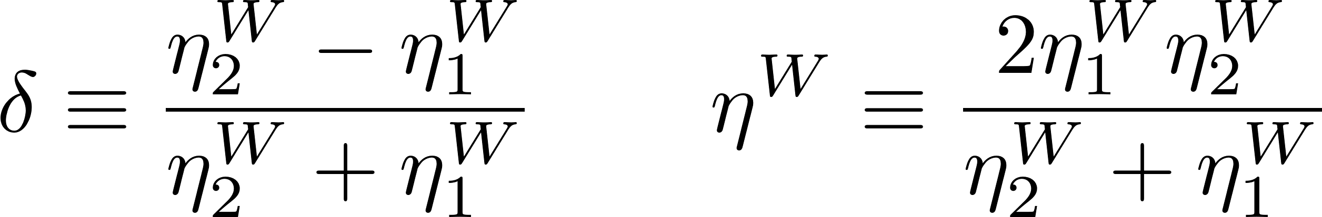
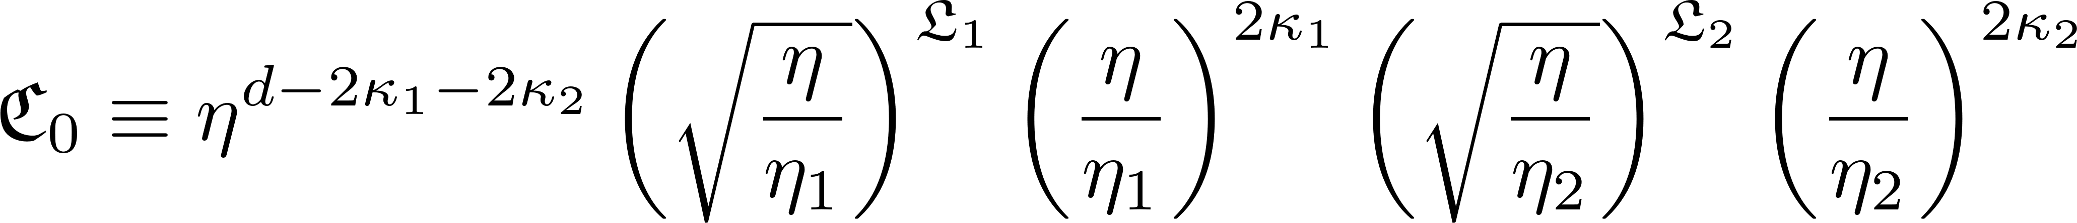
D1a. Before integration calculations

Slide 29
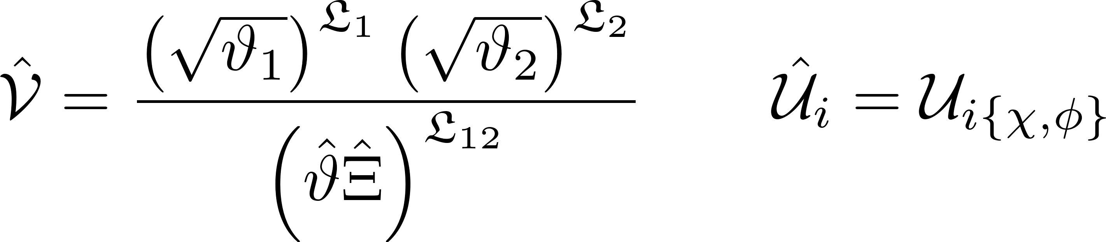
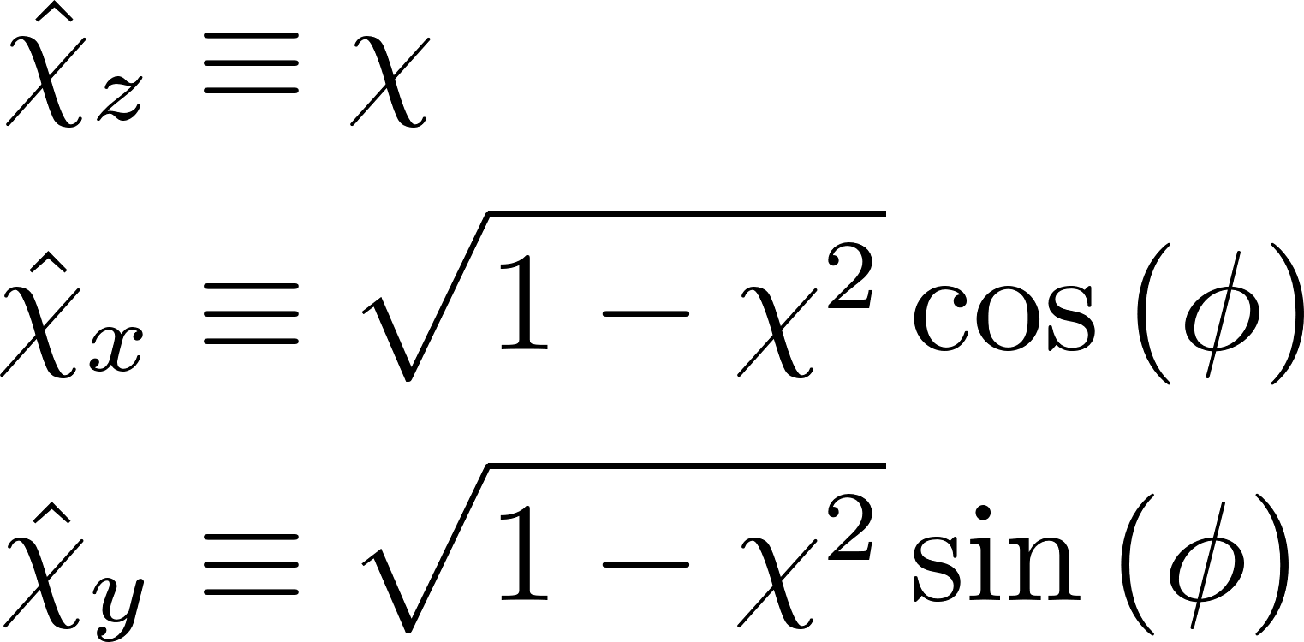
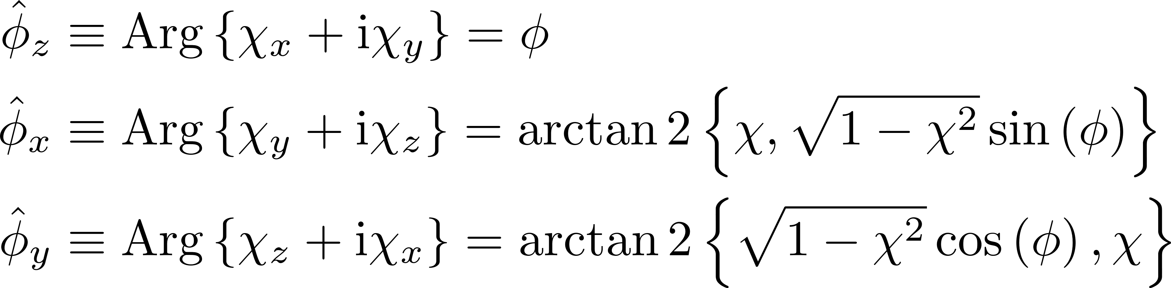
D1b. Initial integration calculations

Slide 30

D2. Full integral formalized

Slide 31

D3. Legendre functions for integrand

Slide 32


D4. Integral summation term restated

Slide 33

D4a. Integral summation term restated (Δ != 0, z != 1)

Slide 34


D4b. Integral summation term restated (Δ != 0, z = 1)

Slide 35

D4c. Integral summation term restated (Δ = 0, z != 1)

Slide 36


D4d. Integral summation term restated (Δ = 0, z = 1)

