Slide 1
MultI-Valley Basis
The basis states appropriately symmetrized

Slide 2
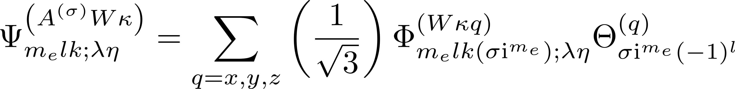
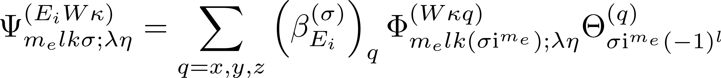
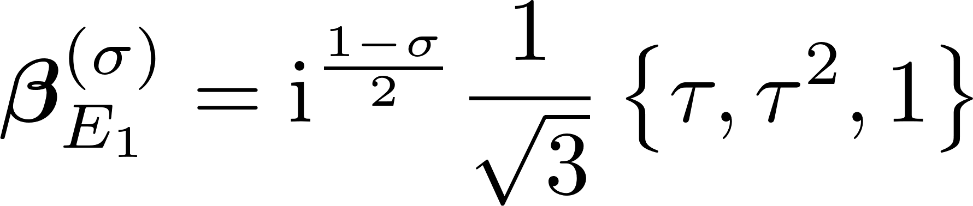
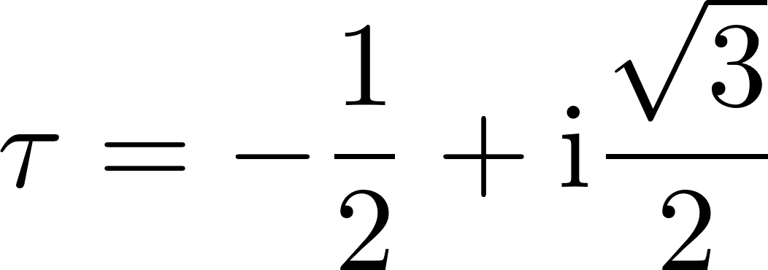
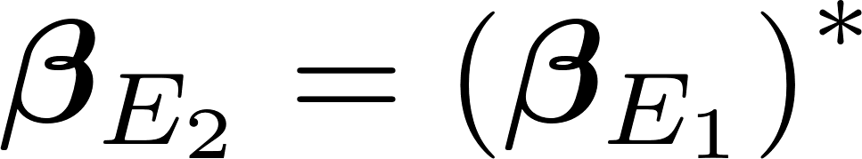
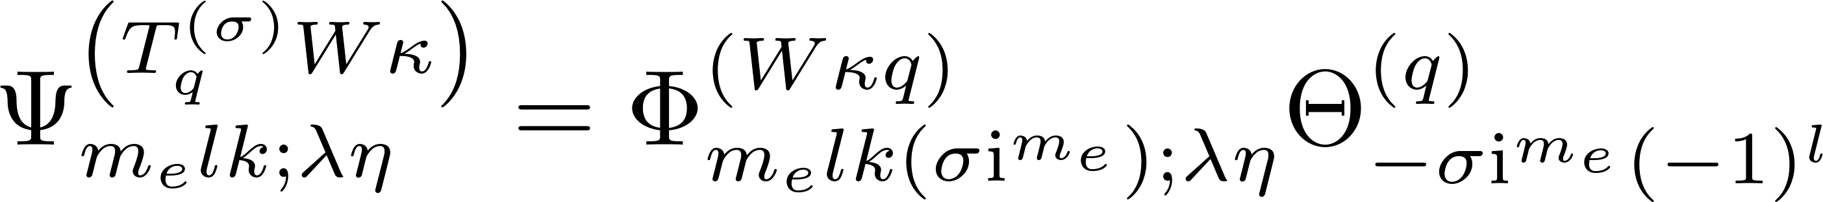
Symmetrized States, m even

Slide 3
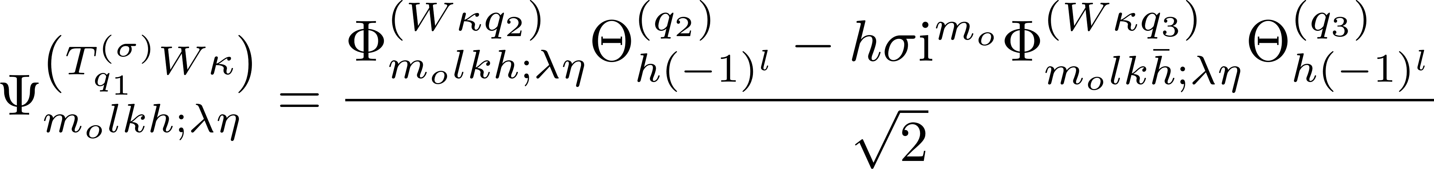
Symmetrized States, m odd

Slide 4
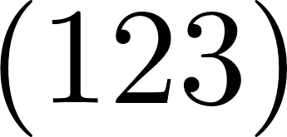
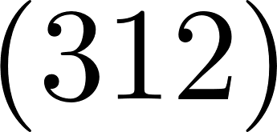
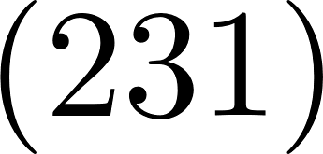
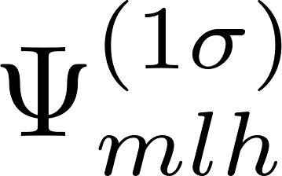
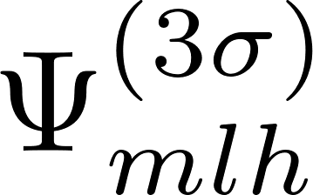
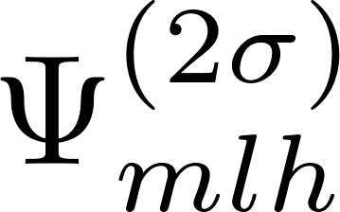
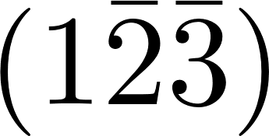
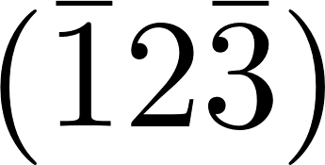
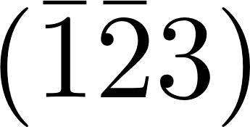
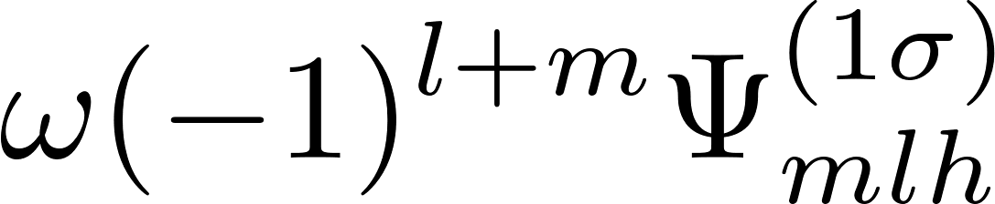
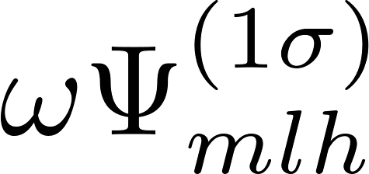
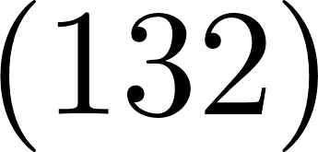
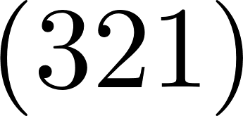
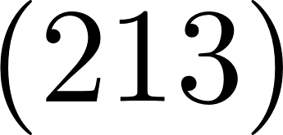
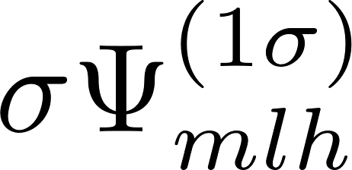
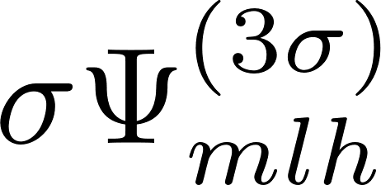
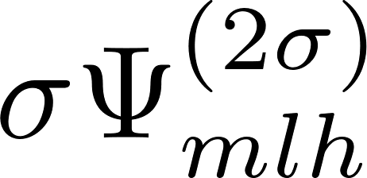
6. Effect of Td operations on symmetrized states
Cyclic permutations
Double inversion
Time-reversal
Acyclic permutations

Slide 5
General Potential
Expressing the matrix elements in terms of the multivalley basis

Slide 6
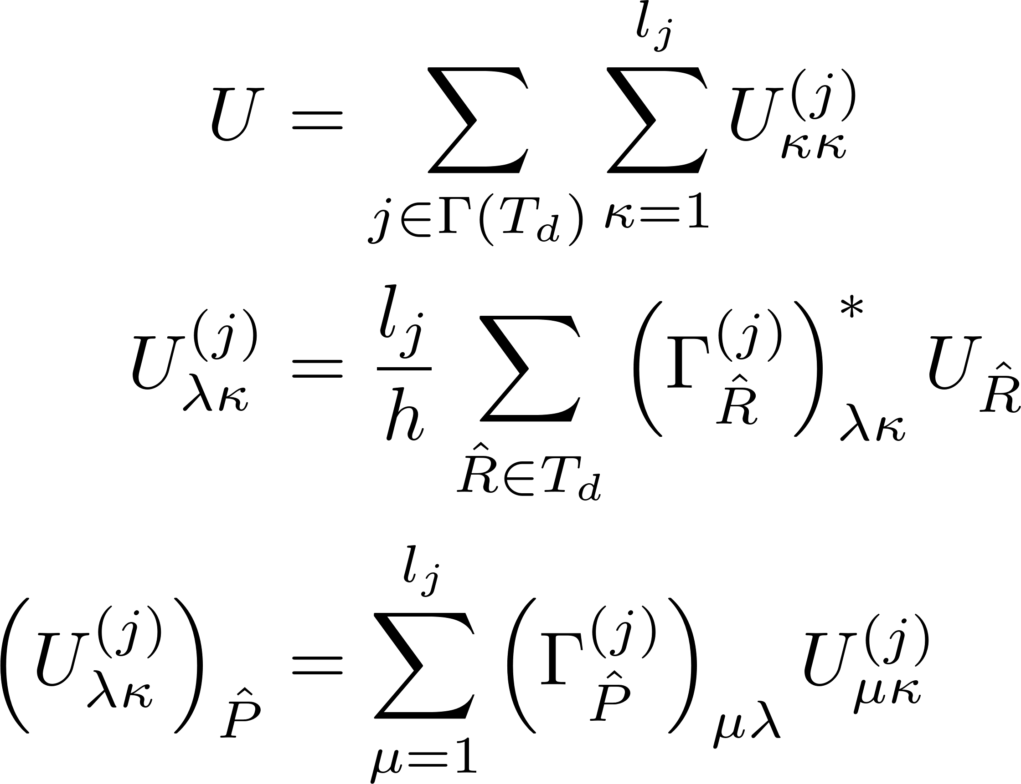
Potential projected onto symmetries of Td -- I

Slide 7
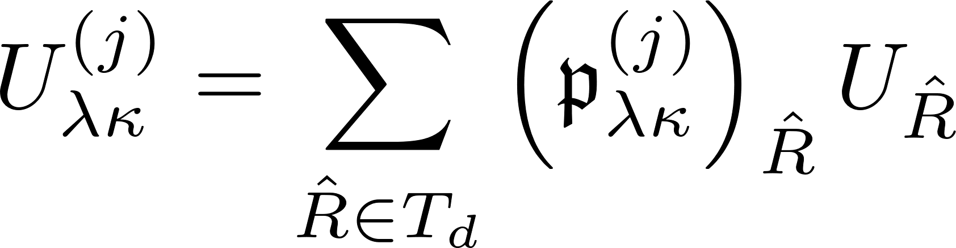
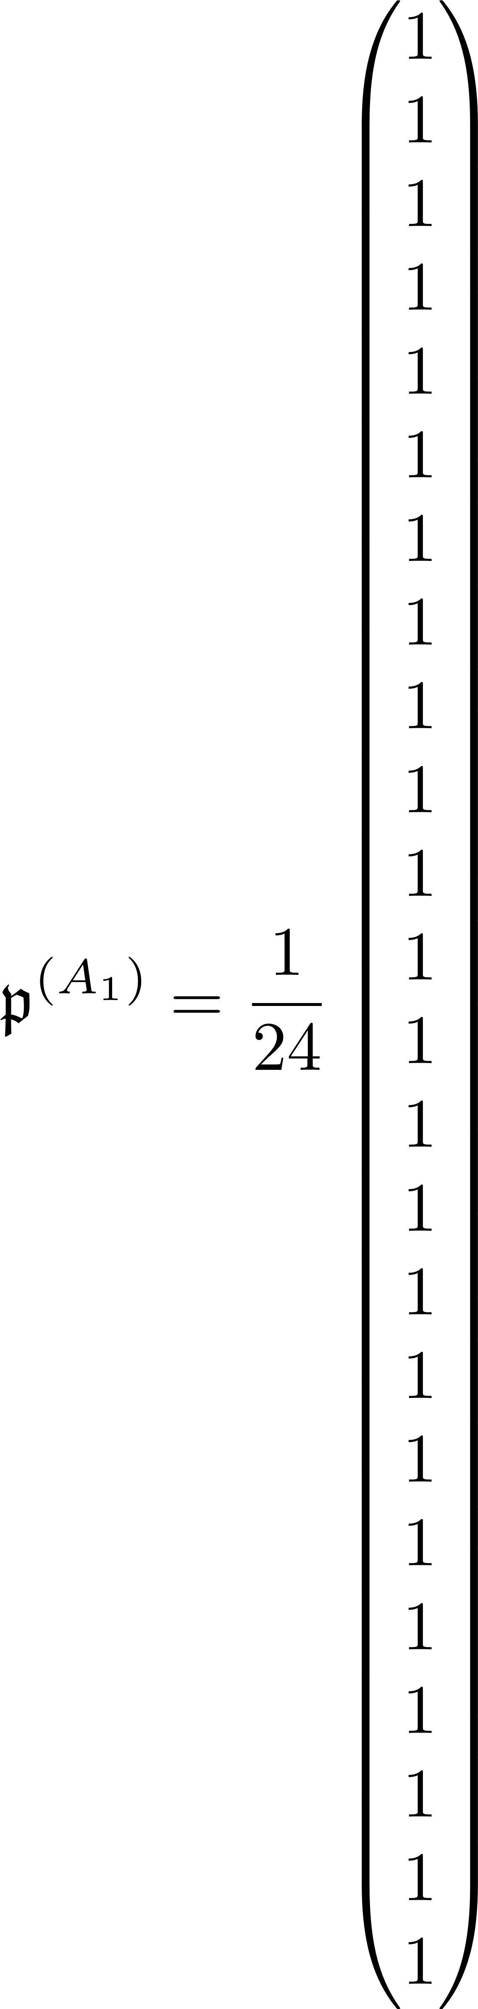
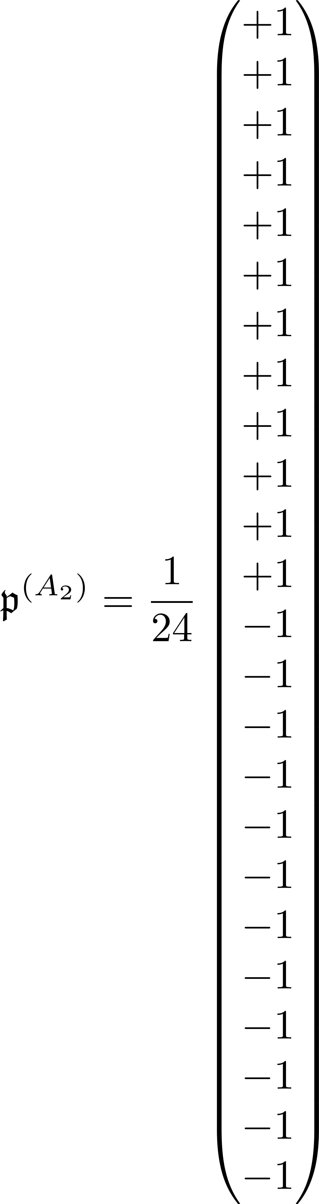
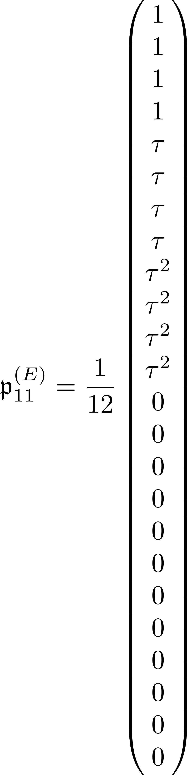
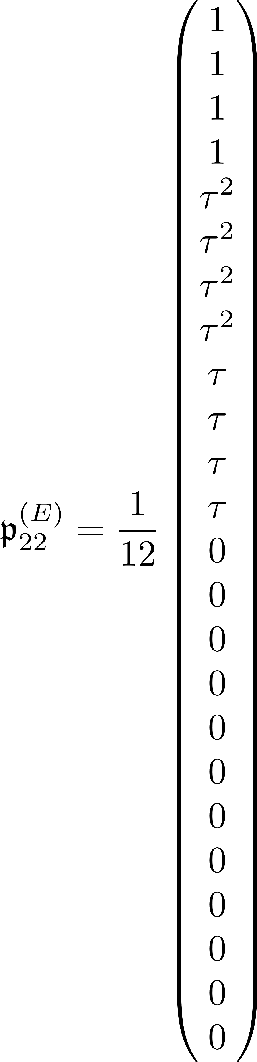
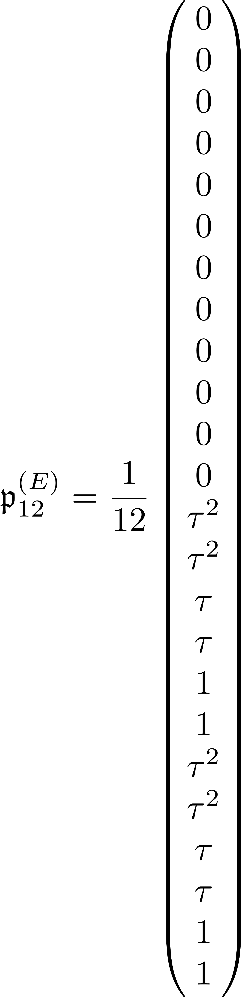
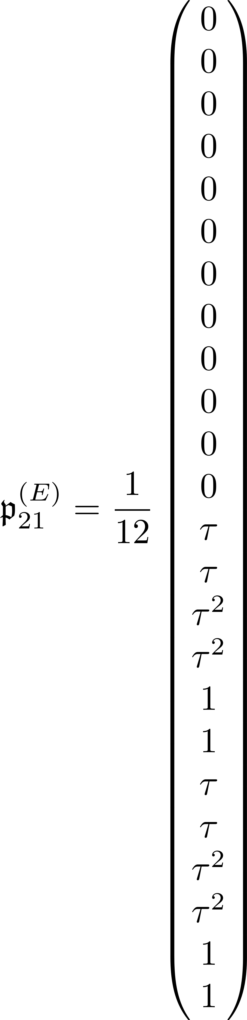
Symmetrized potential – A₁, A₂, and E

Slide 8
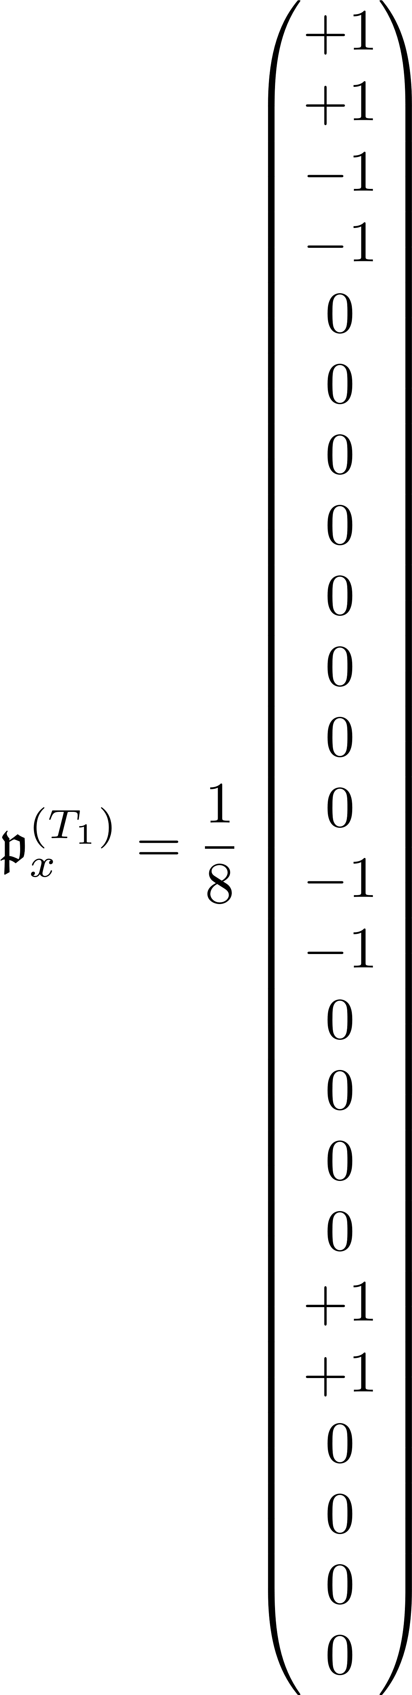
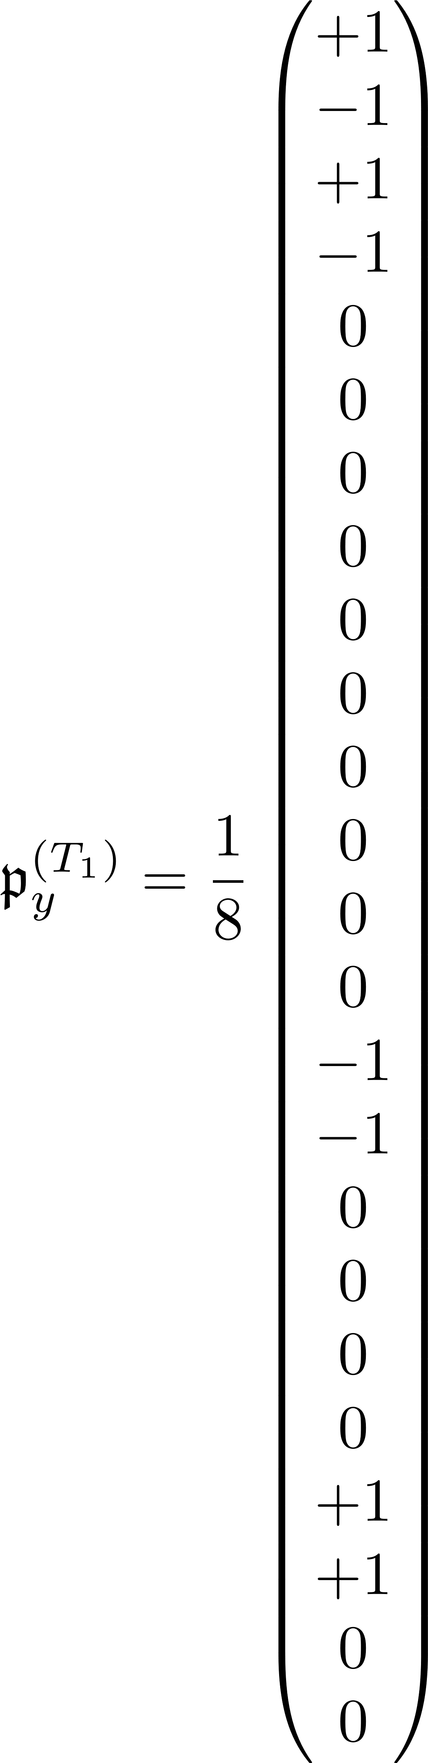
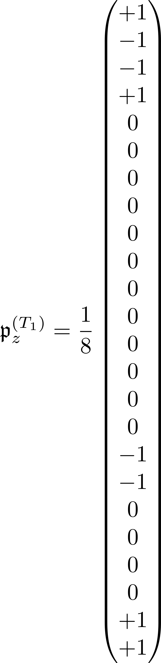
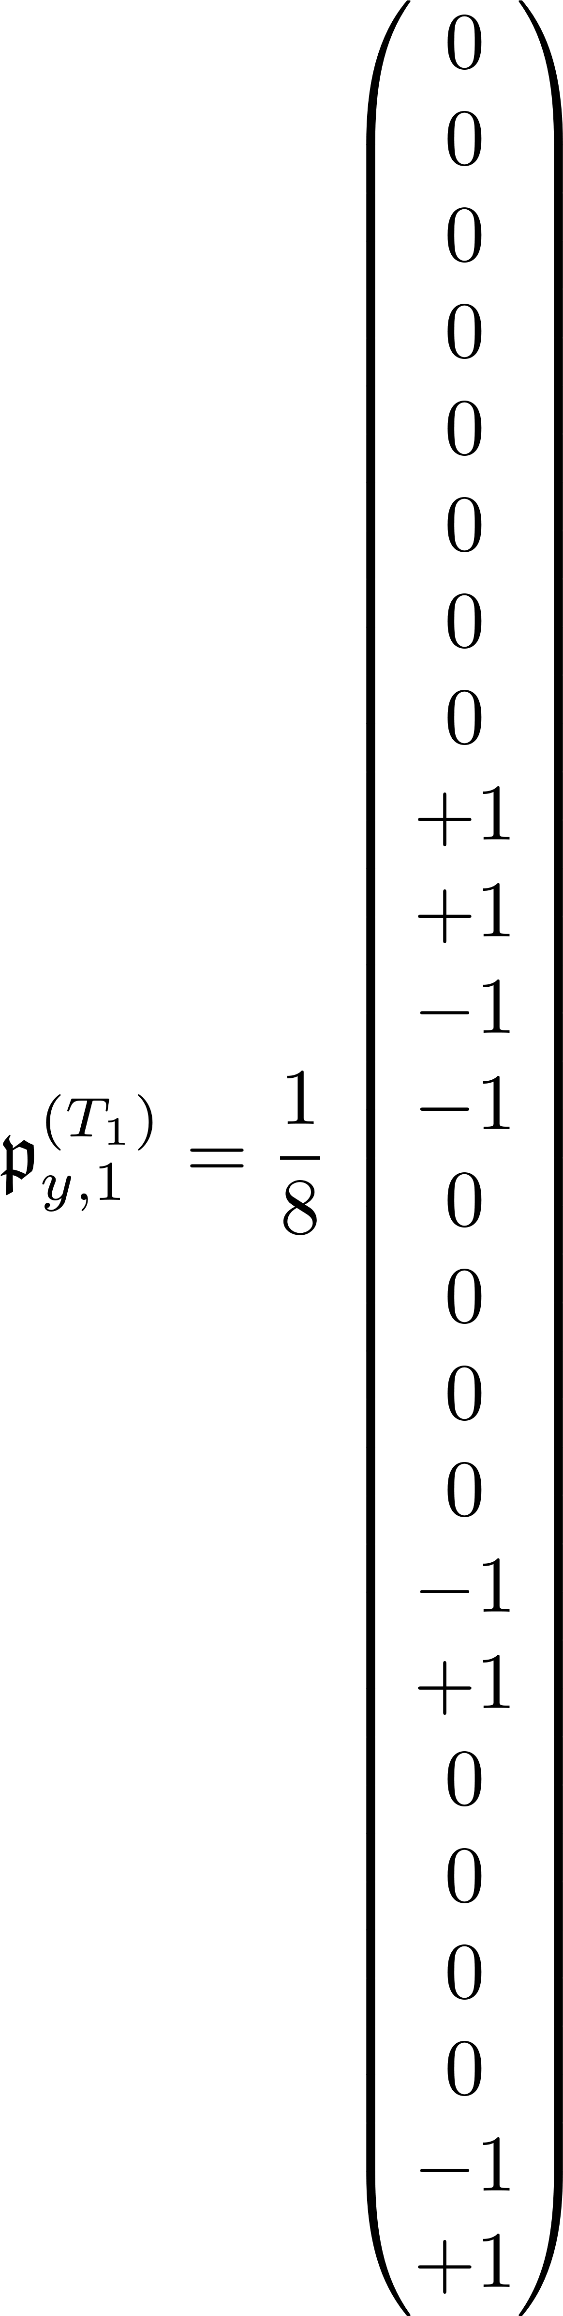
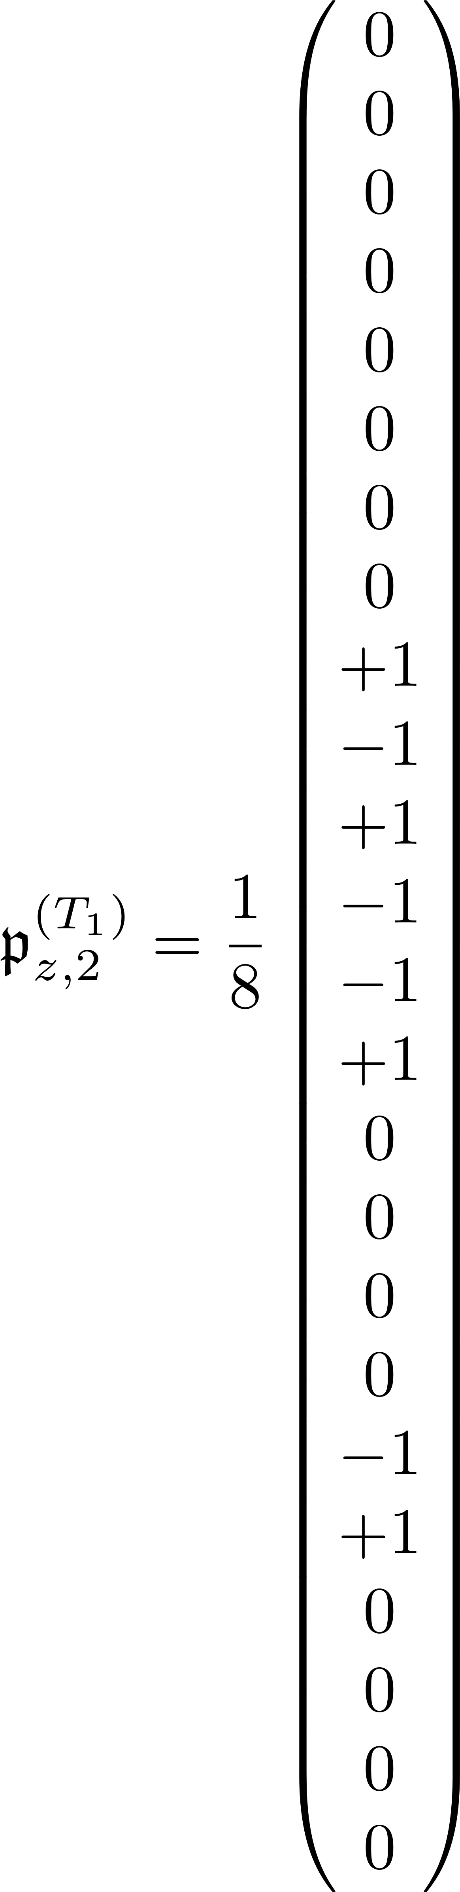
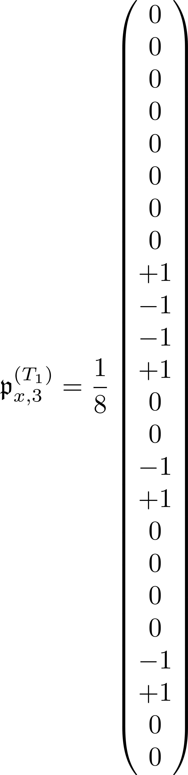
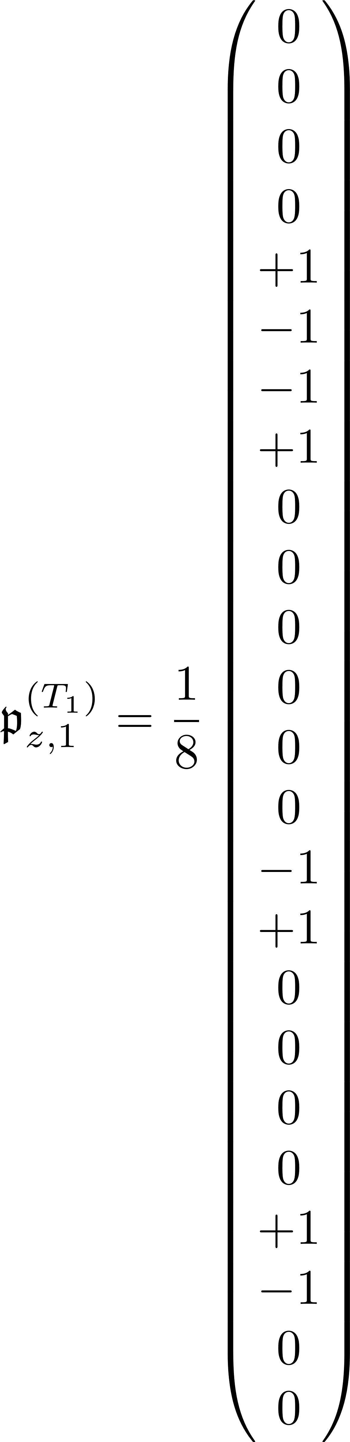
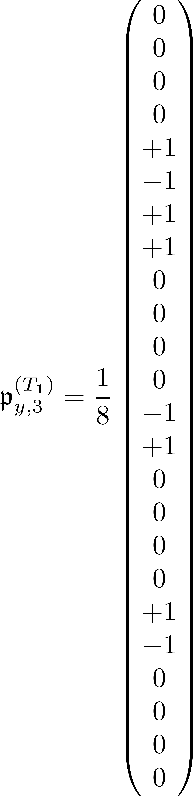
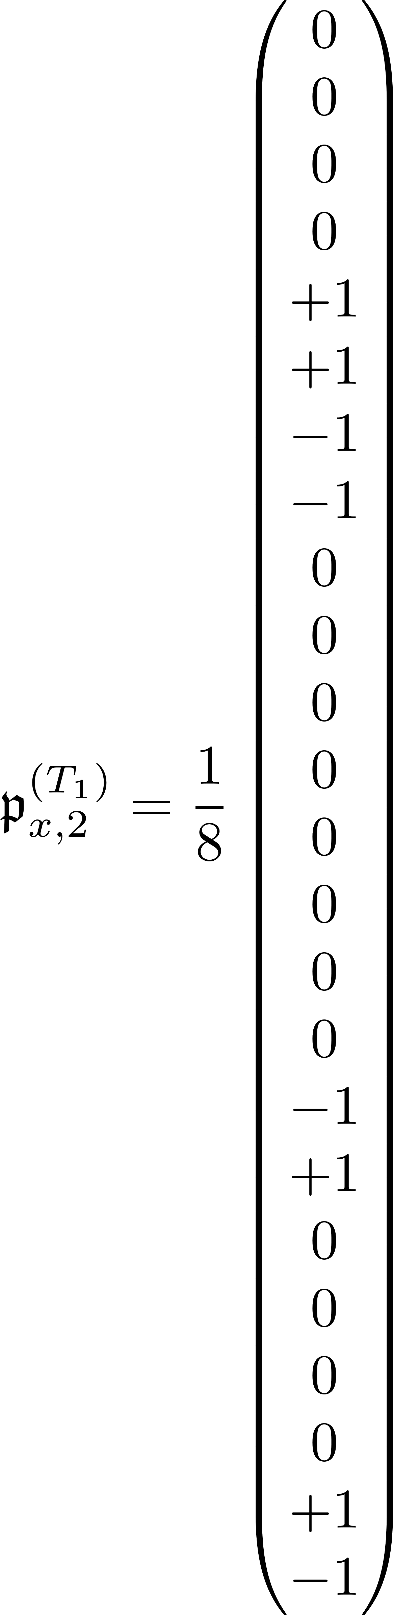
Symmetrized potential – T₁

Slide 9
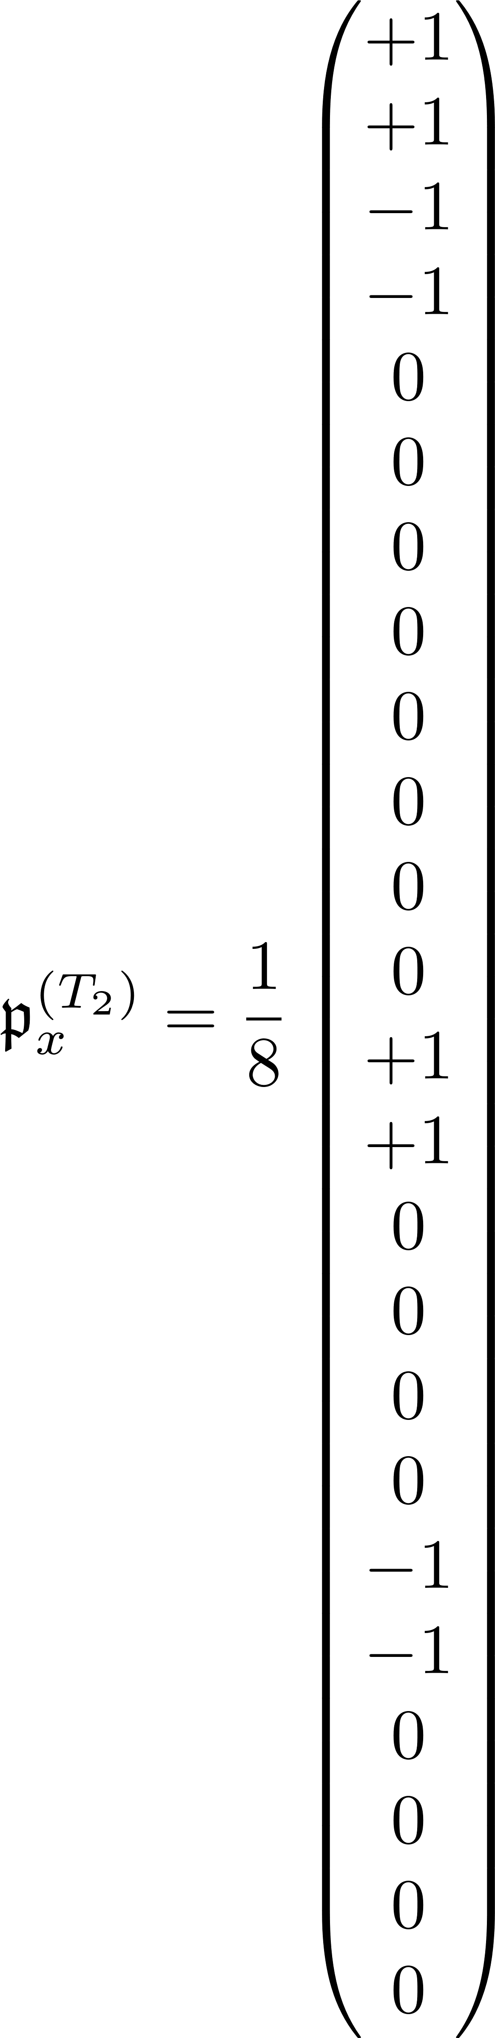
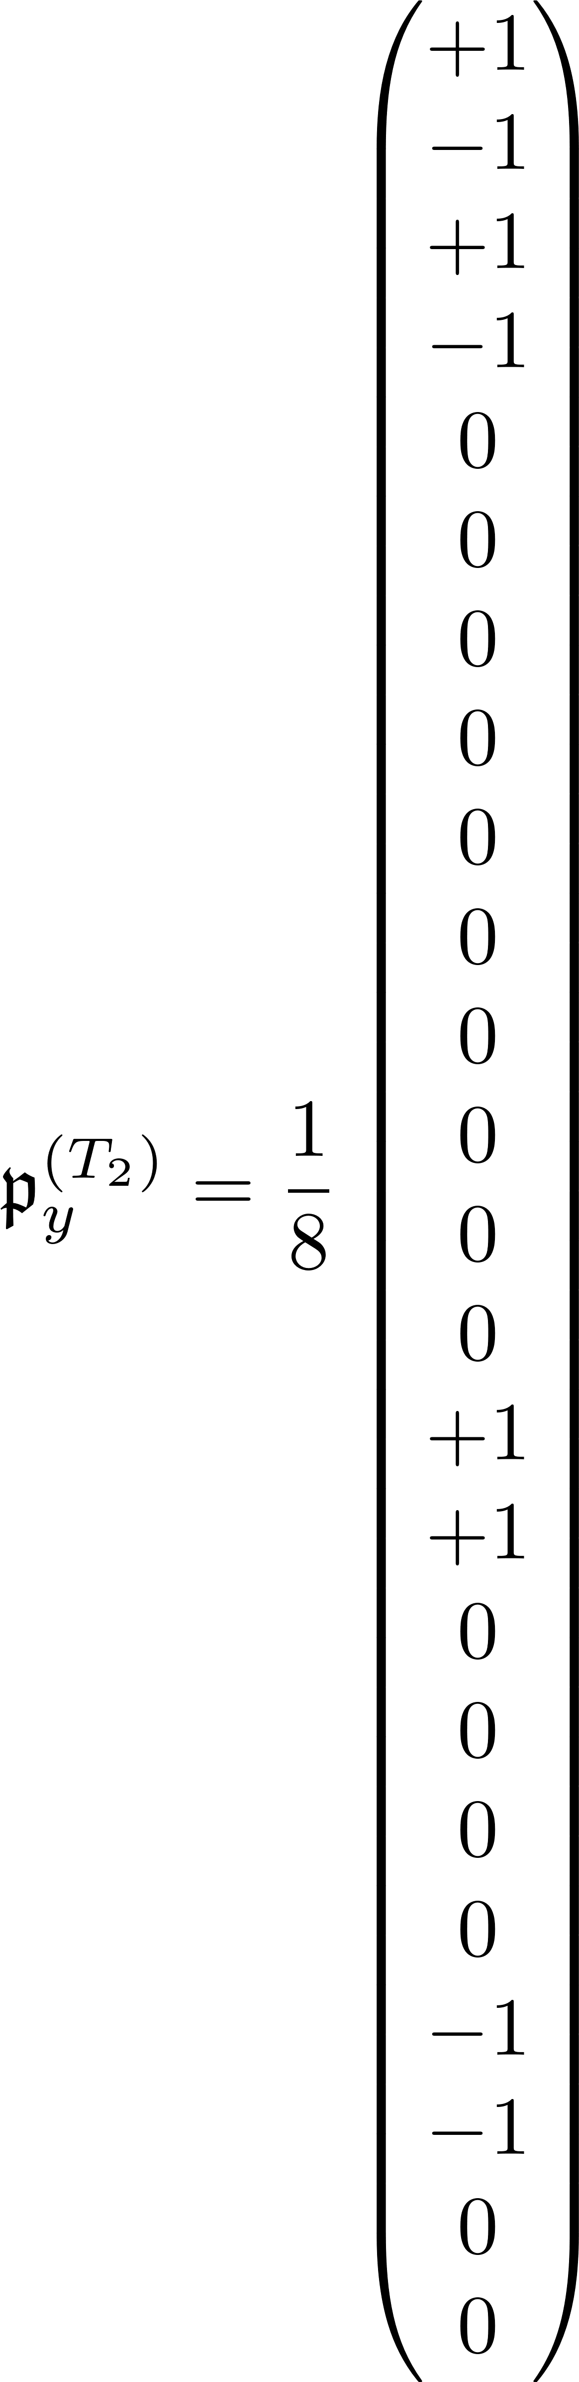
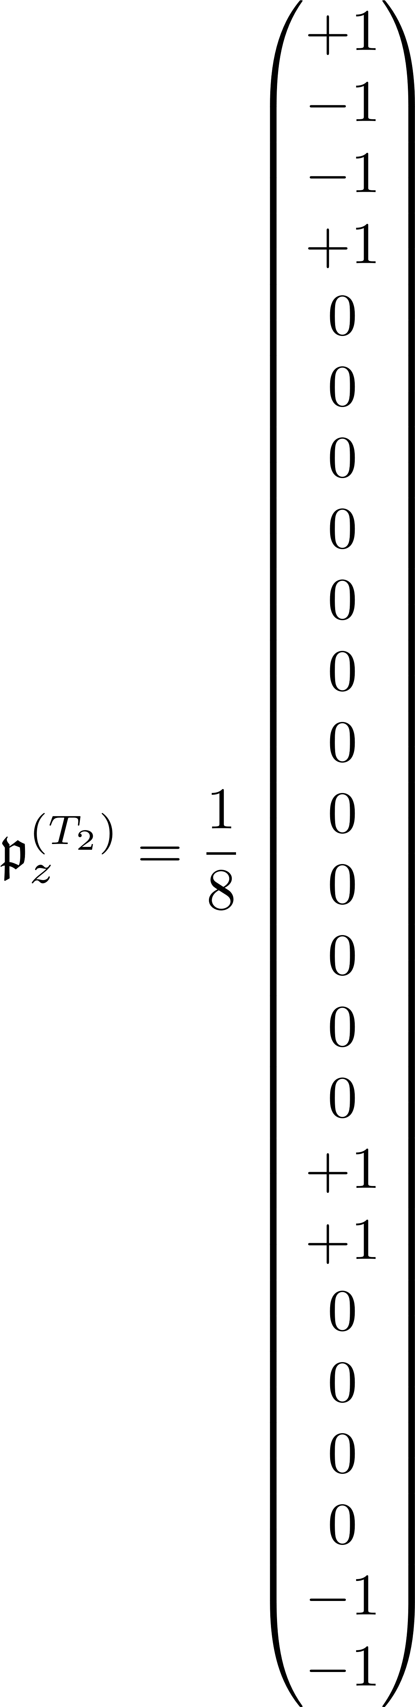
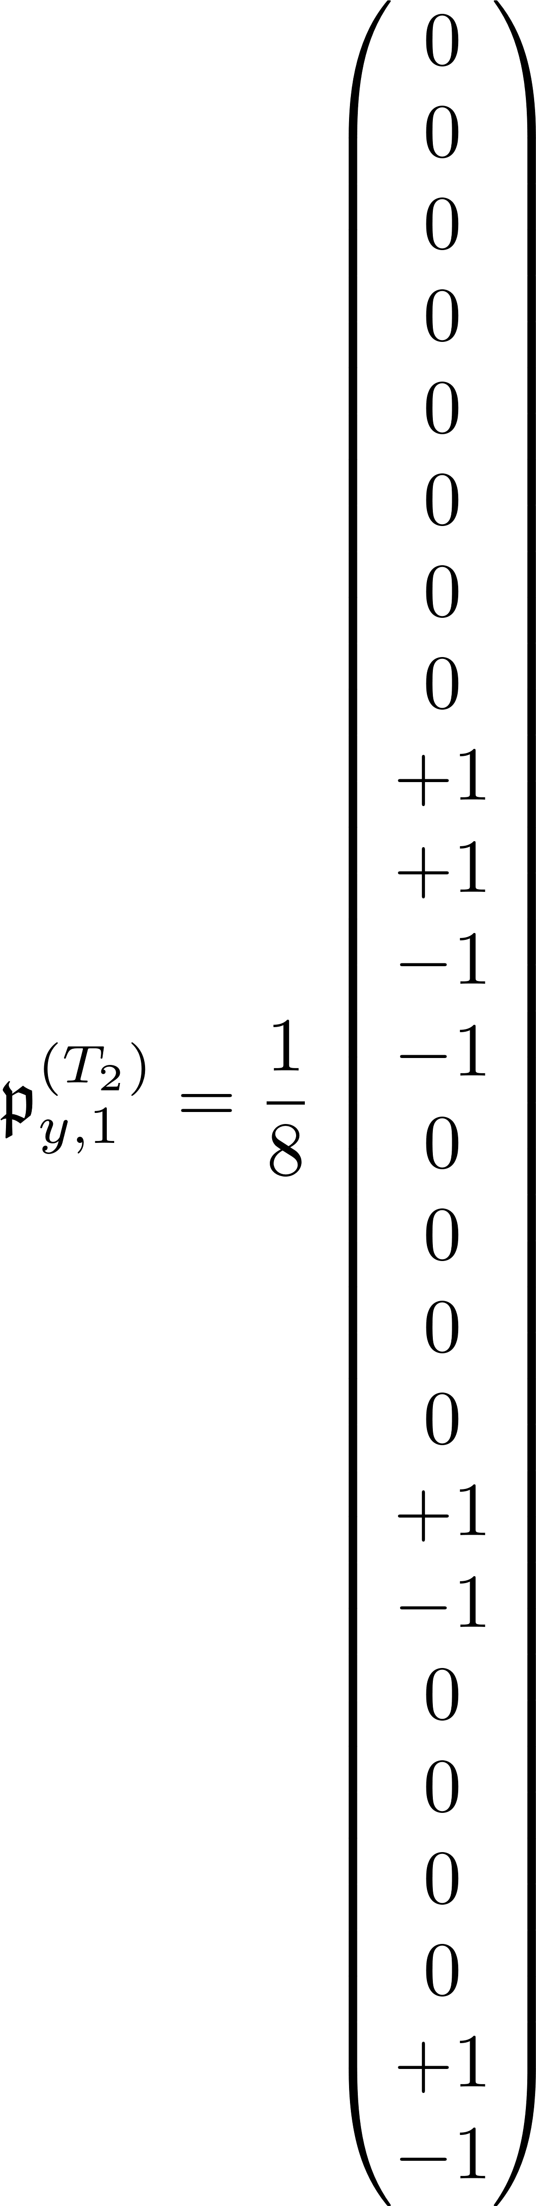
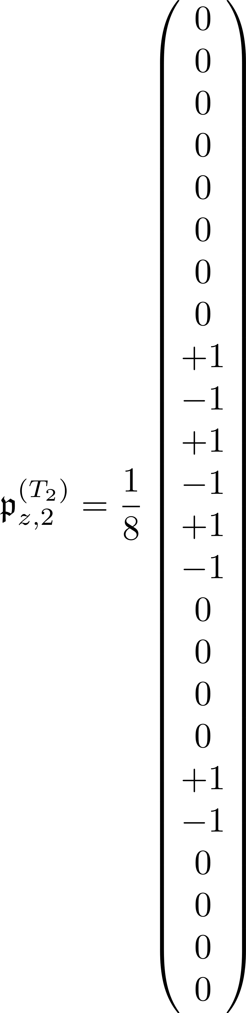
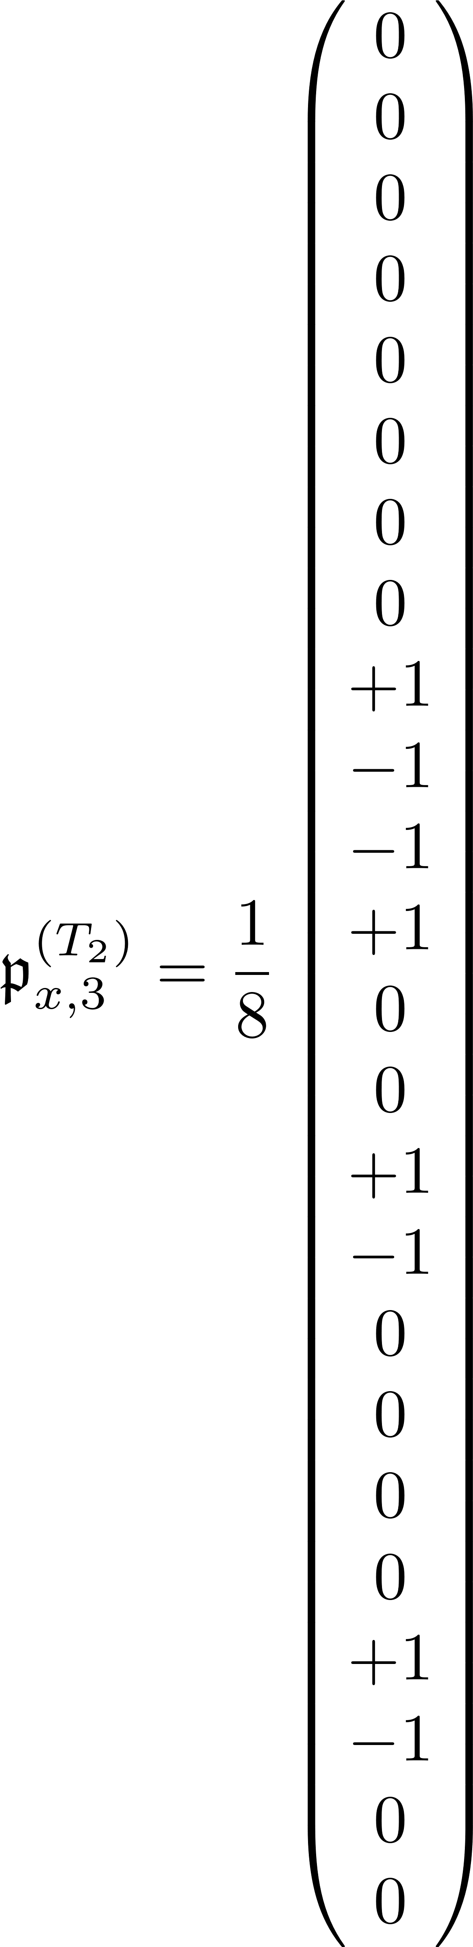
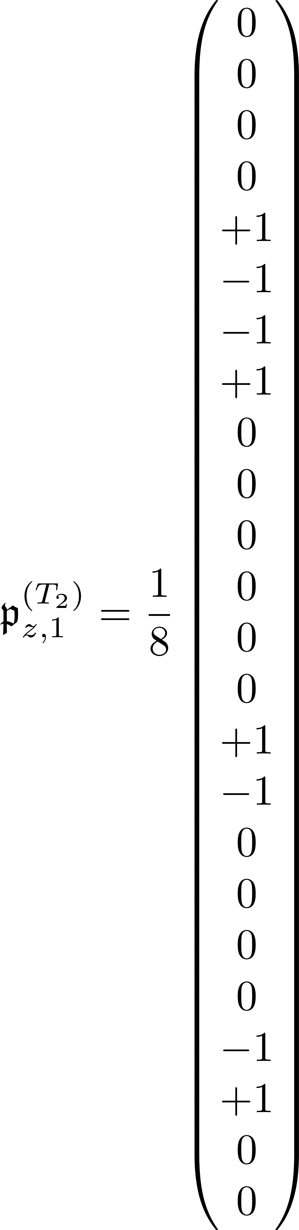
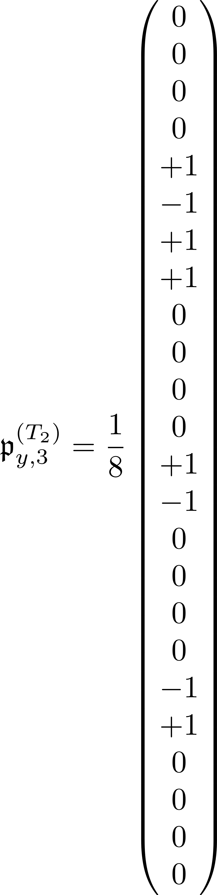
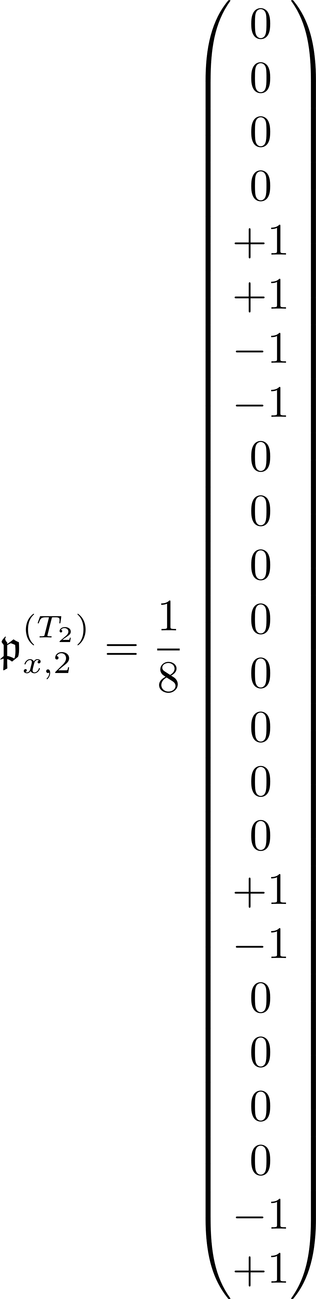
Symmetrized potential – T₂

Slide 10
General Potential
Expressing the matrix elements in terms of the multivalley basis

Slide 11




Reducing number of integrand terms using transformations

Slide 12

Can symmetrize further w/ coordinate inversions

Slide 13






“Folded over” potential form

Slide 14


Restatement of potential form

Slide 15

Filtered potential involving parallel valleys

Slide 16

Filtered potential involving perpendicular valleys

Slide 17






Terms of filtered potential matrices

Slide 18
Symmetric Potentials
Expressing the matrix elements in terms of the multivalley basis

Slide 19

Specific SYmmetry
$$A^{(σ)}$$

Slide 20


“Folded over” potential form -- $A^{(σ)}$

Slide 21







Terms of filtered potential matrices -- $A^{(σ)}$

Slide 22


Filtered potential involving parallel valleys

Slide 23


Filtered potential involving perpendicular valleys

Slide 24

Specific SYmmetry
$$T^{(σ)}$$

Slide 25



Matrix representation of T_{d} – T^{(σ)}

Slide 26



Matrix representation of T_{d} – T^{(σ)}

Slide 27


“Folded over” potential form

Slide 28

Filtered potential involving parallel valleys

Slide 29


Inversion filtered potential involving perpendicular valleys

Slide 30

Specific SYmmetry
$$E$$

Slide 31

Matrix representation of T_{d} – E

Slide 32




Terms of inversion filtering

Slide 33


Terms of filtered potential matrices

Slide 34



Filtered potential involving parallel valleys

Slide 35

Filtered potential involving perpendicular valleys

