Slide 1
PREFACTOR FORMULATION
Expressing the general matrix elements in terms of the multivalley basis using the prefactor formulation

Slide 2
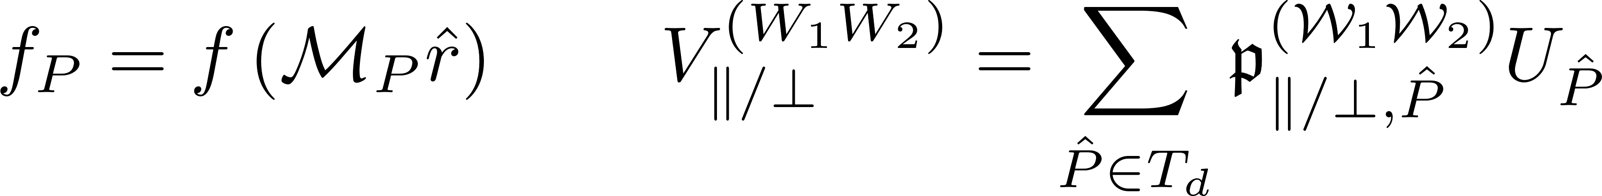
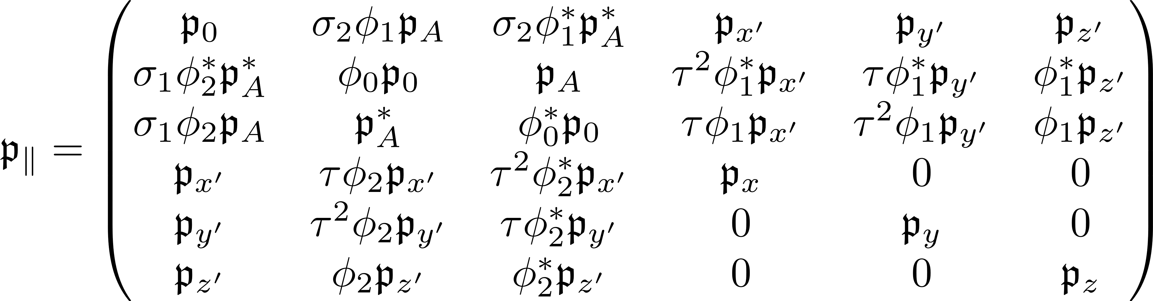
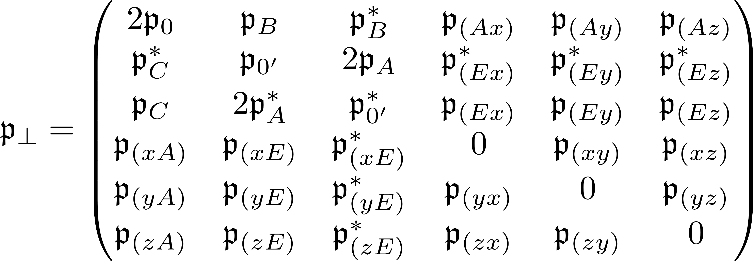
Prefactor vectors for potentials as seen by symmetric state basis

Slide 3
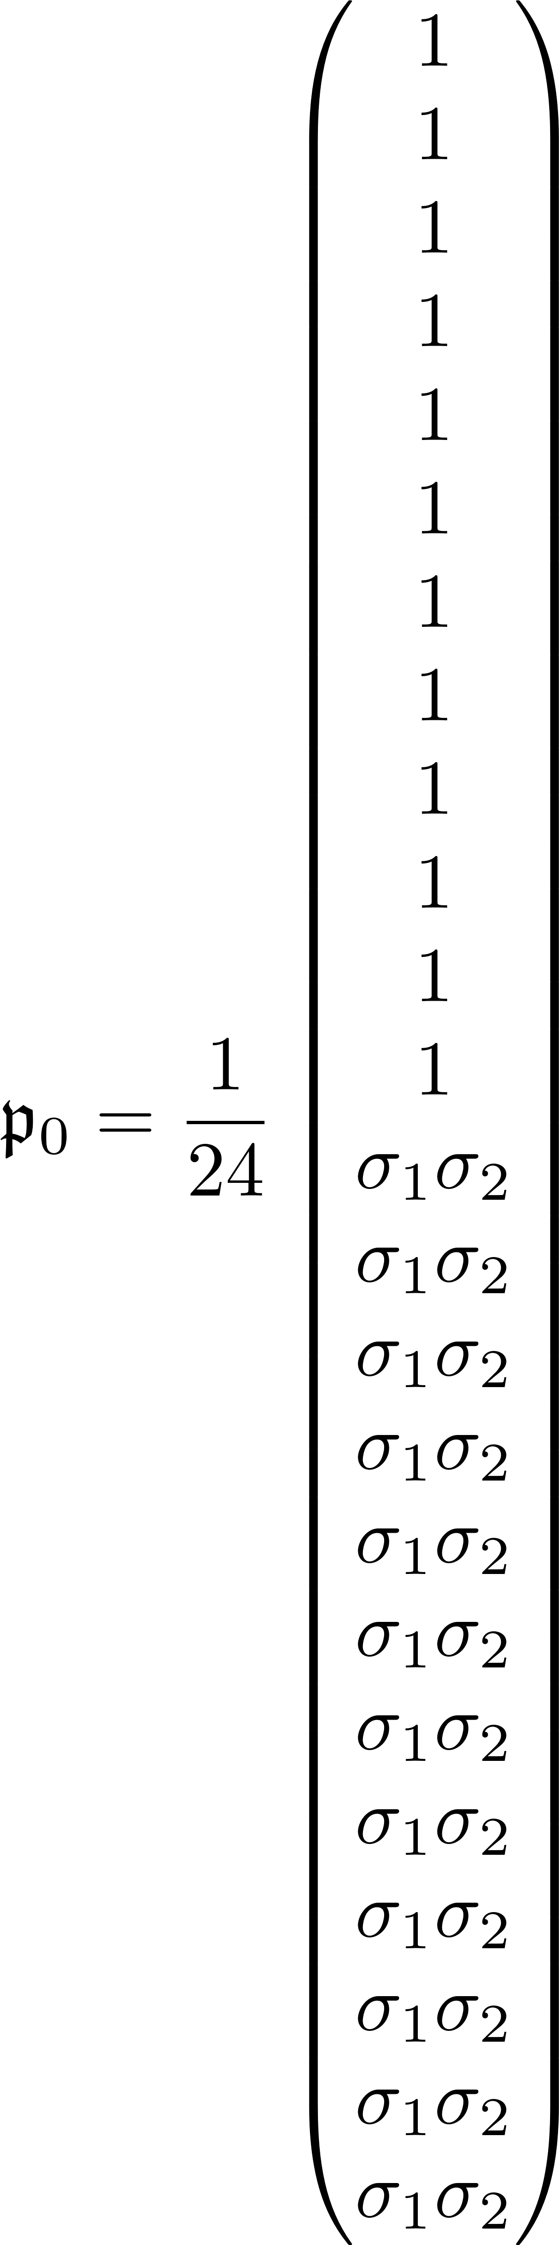
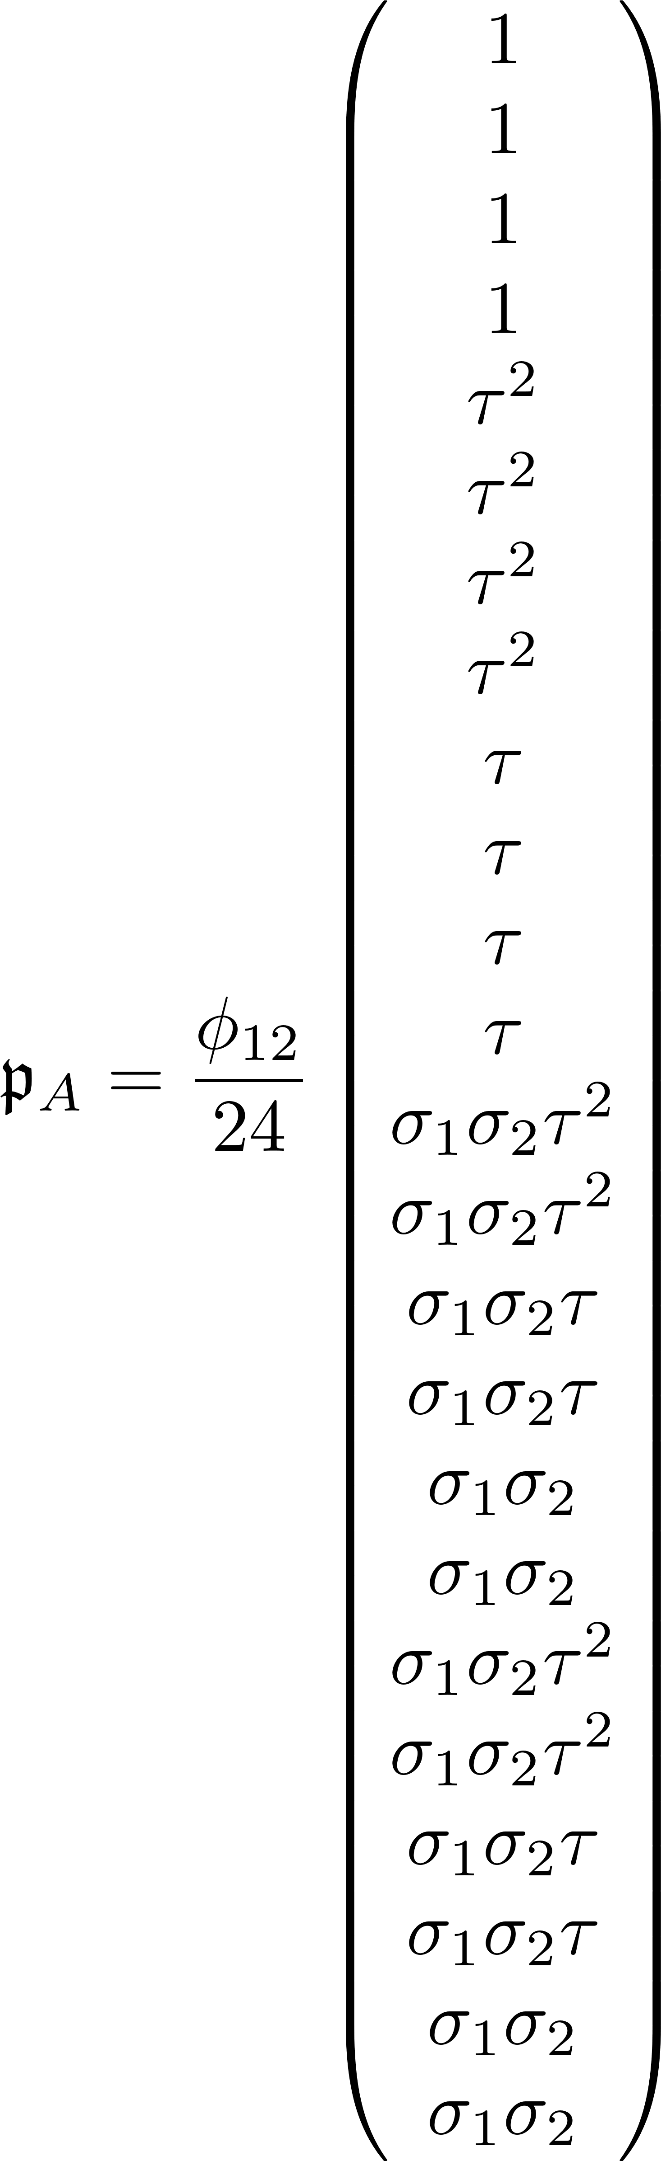
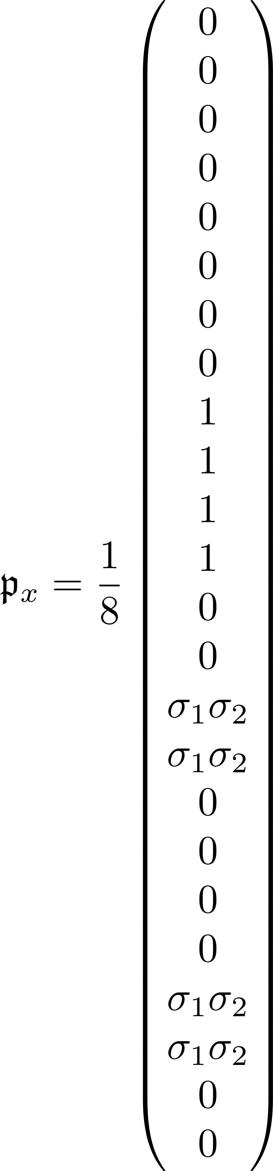
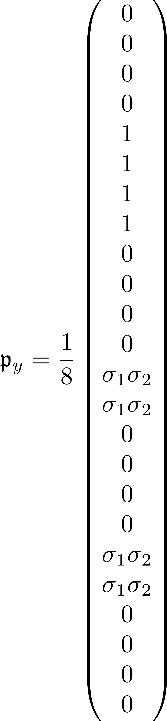
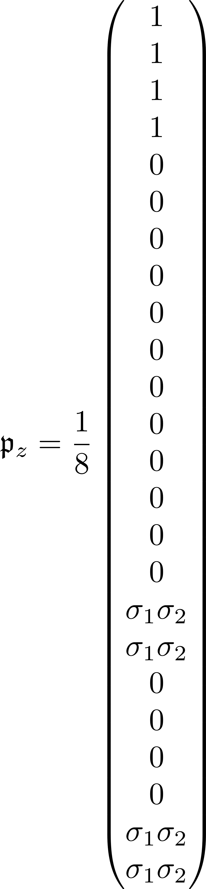
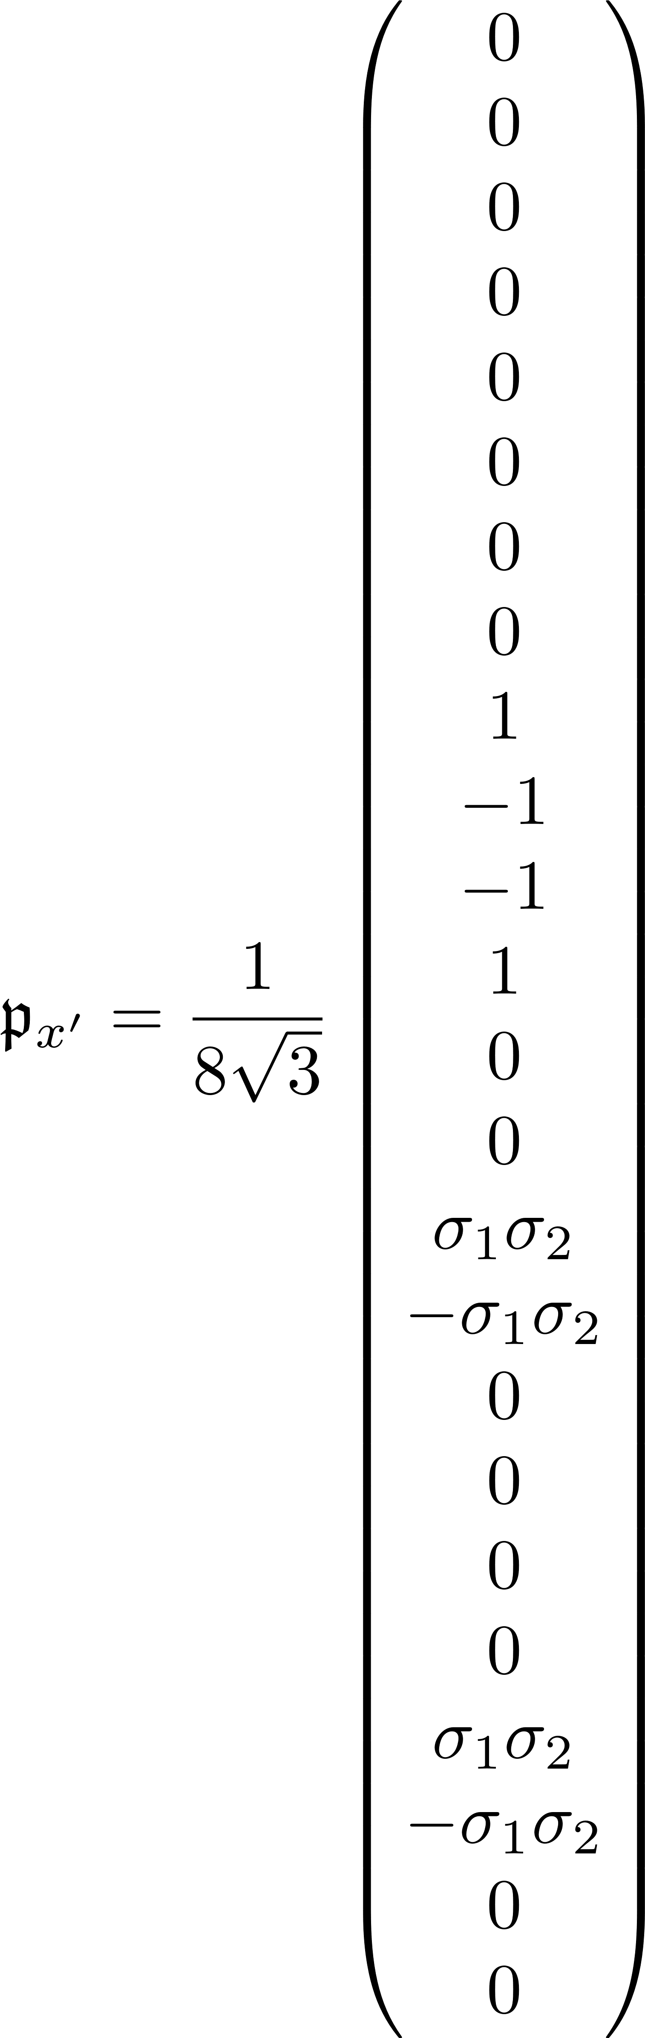
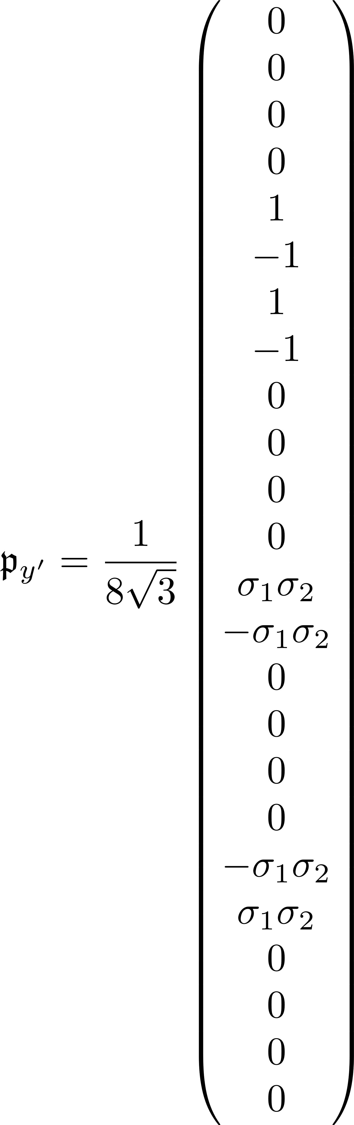
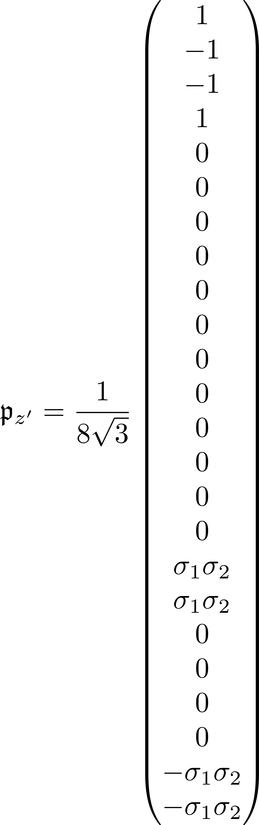
Prefactor vectors, same valley

Slide 4

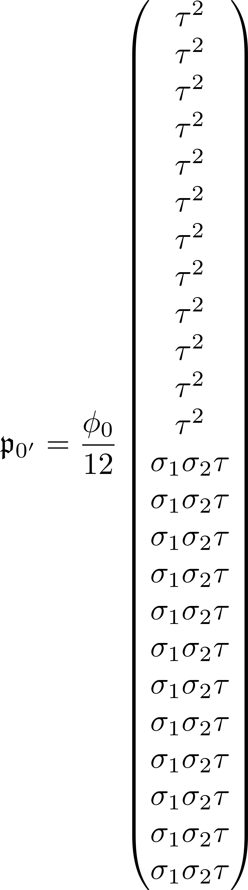
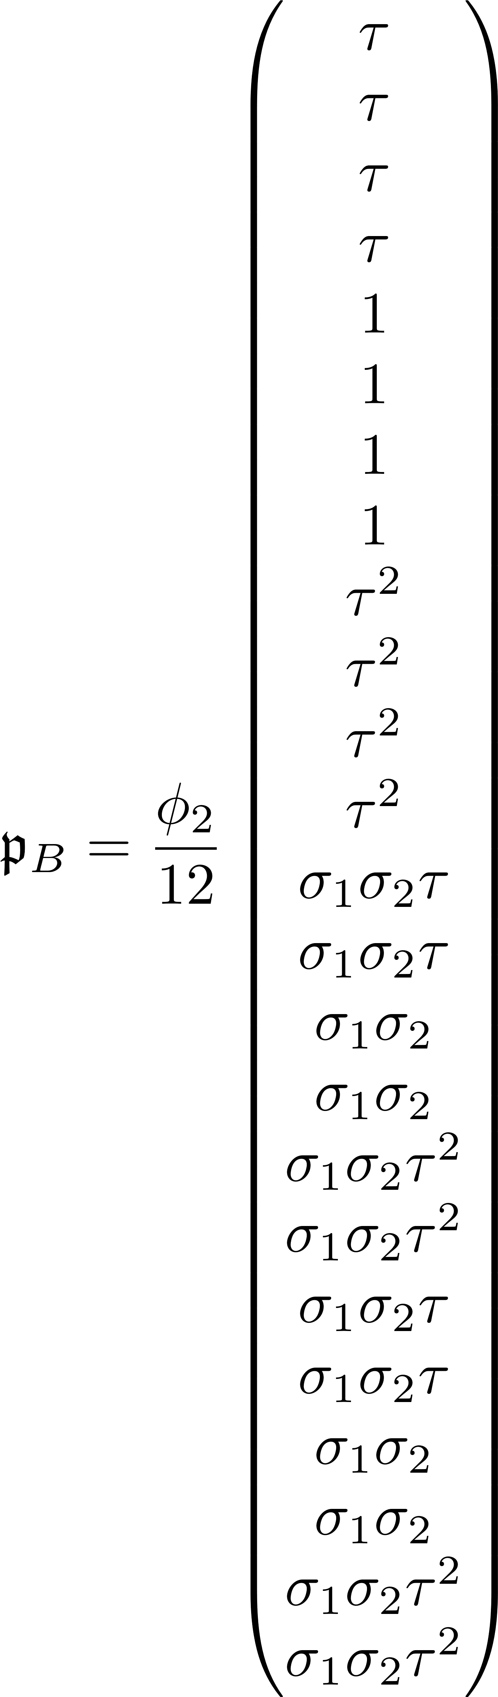
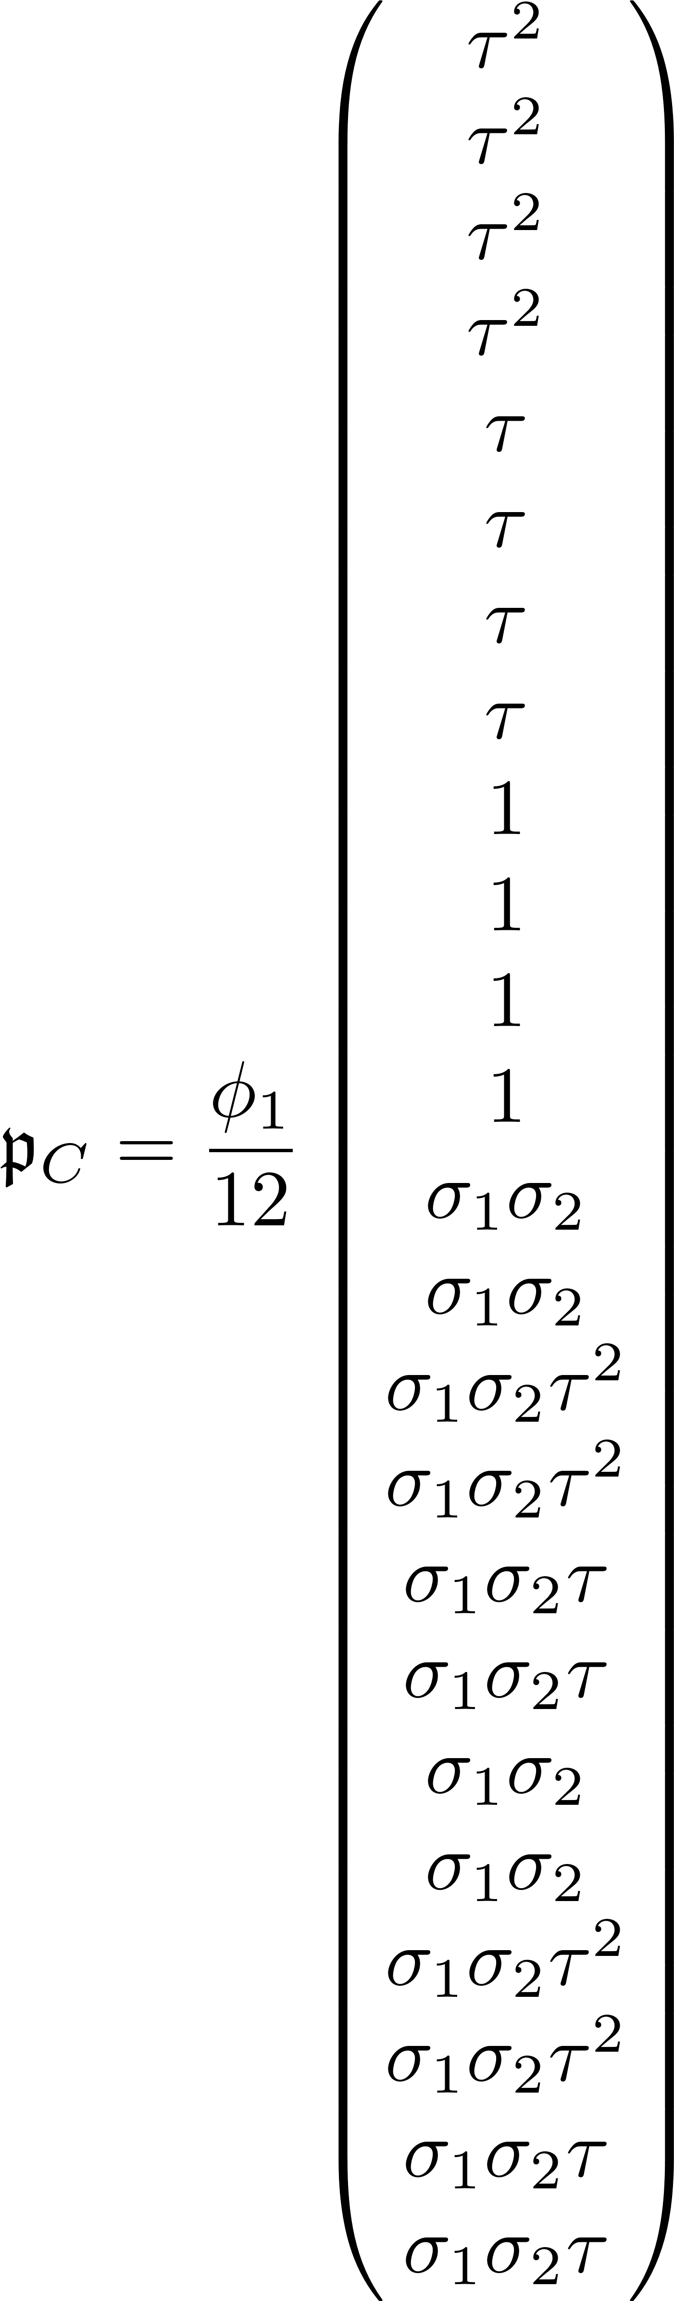
Prefactor vectors, opposite valley, even-even inversion symmetry

Slide 5
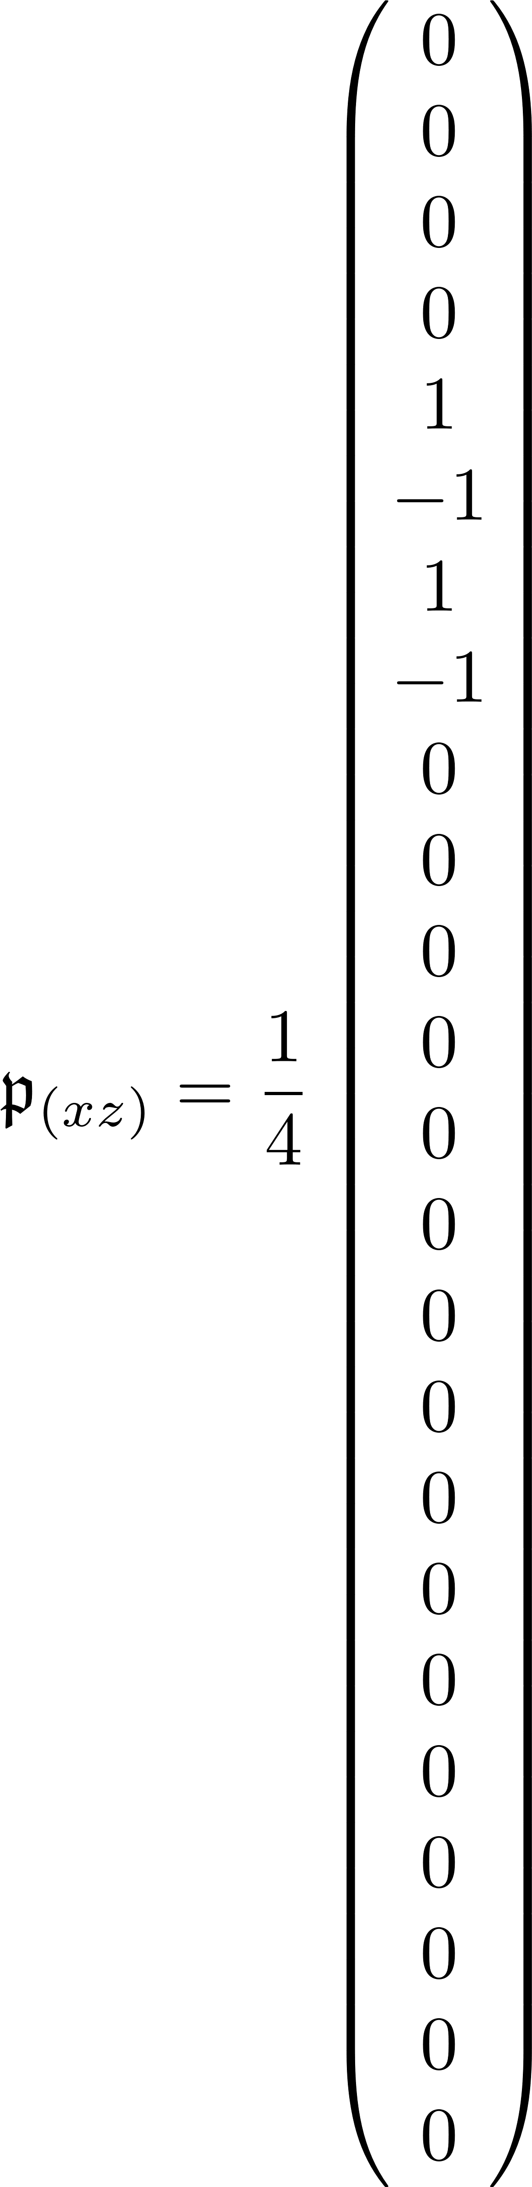
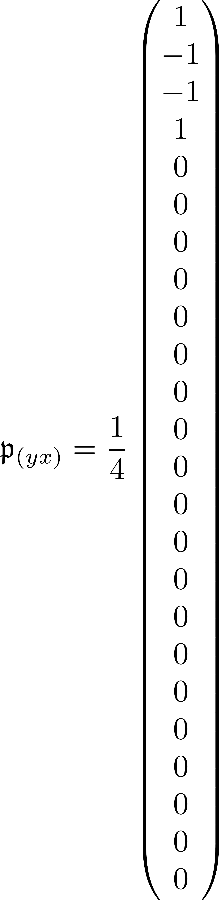
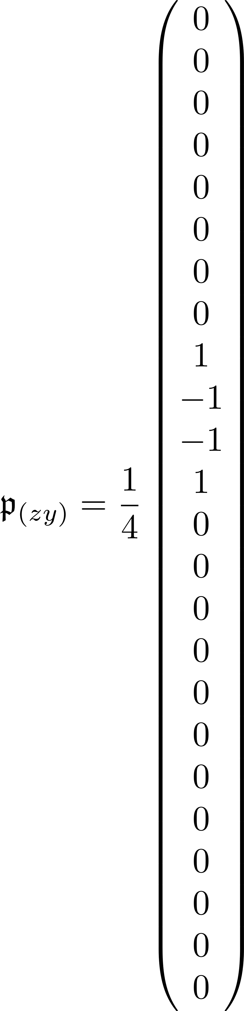
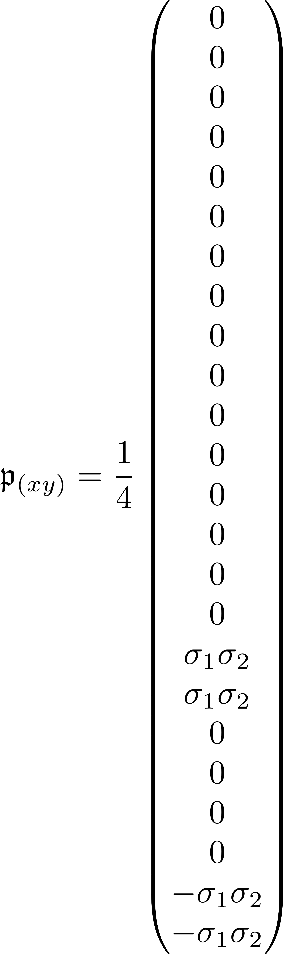
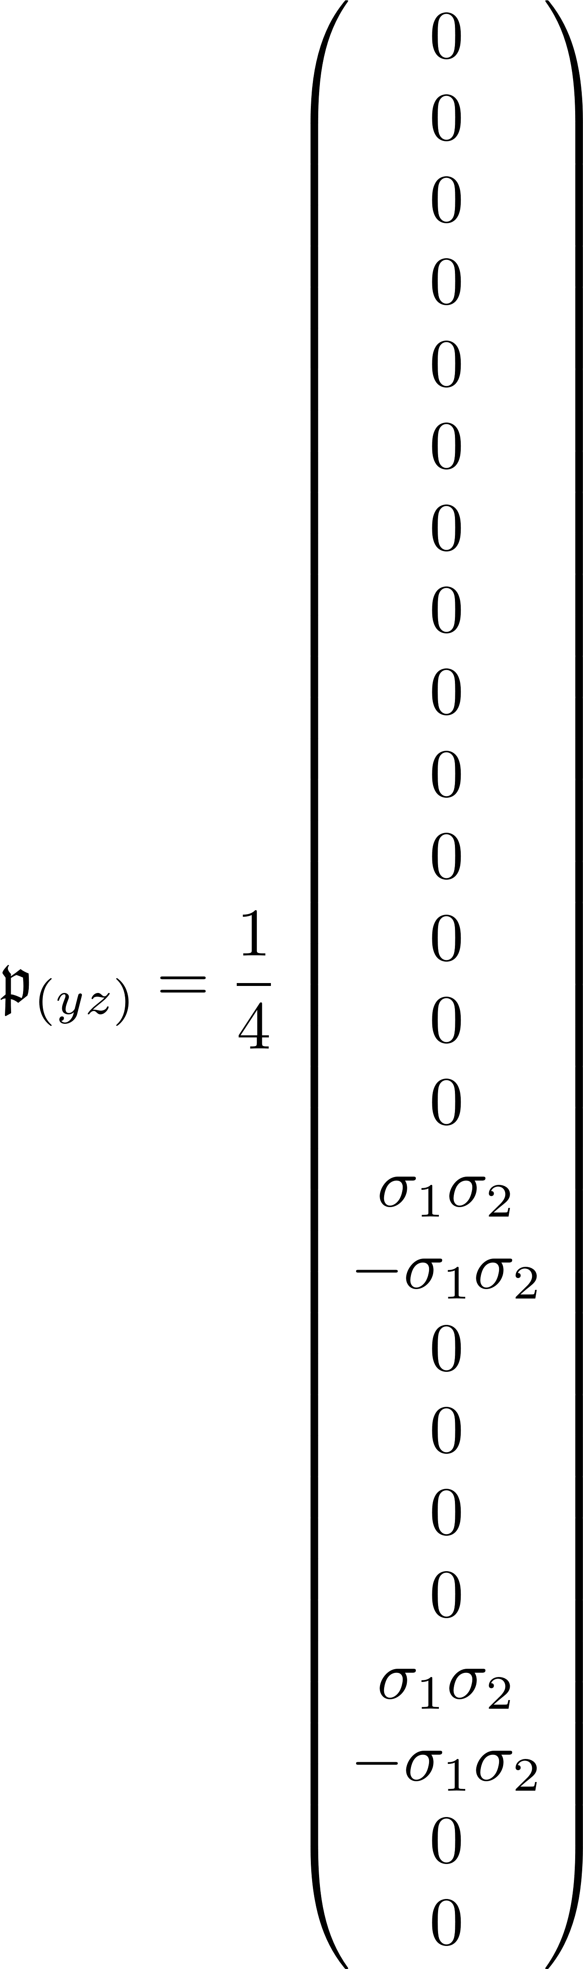
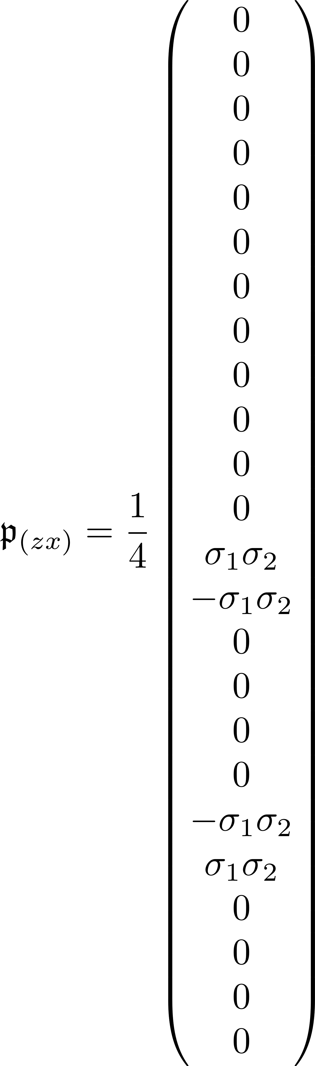
Prefactor vectors, opposite valley, odd-odd inversion symmetry

Slide 6
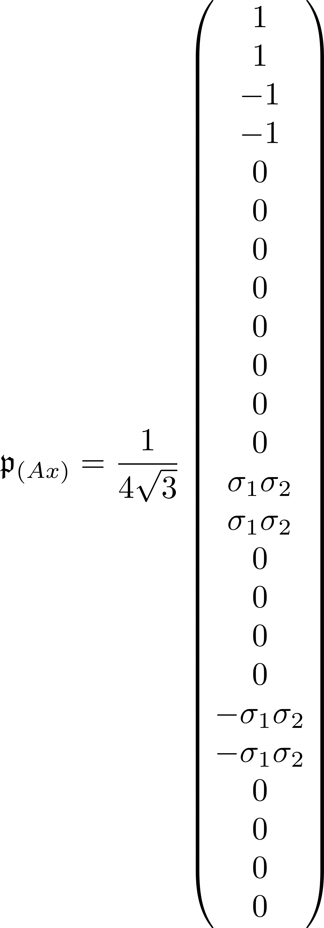
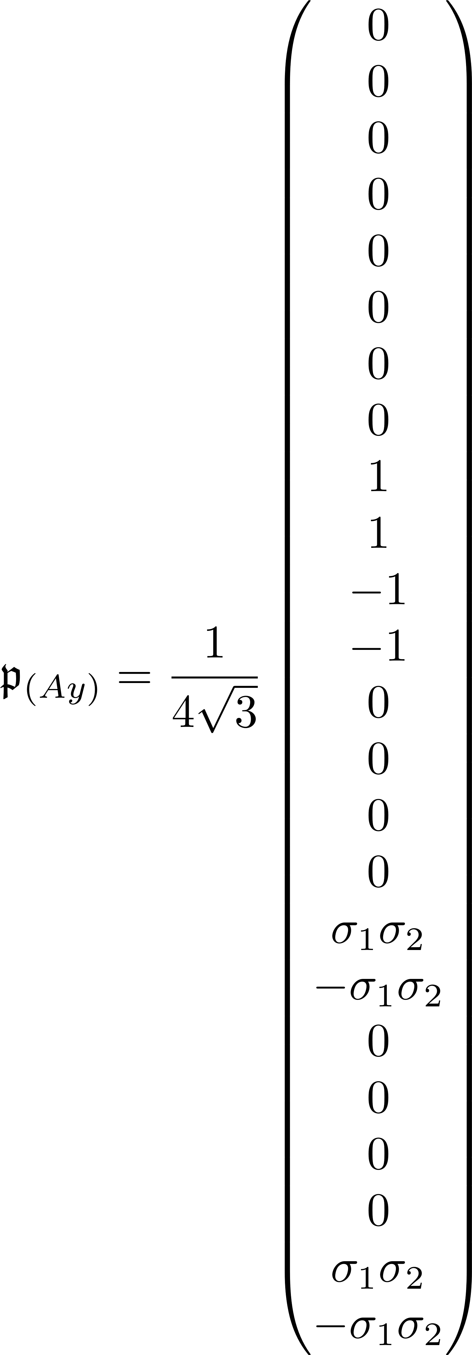
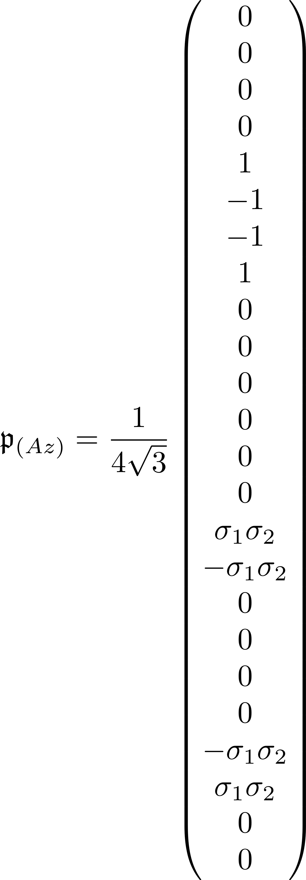
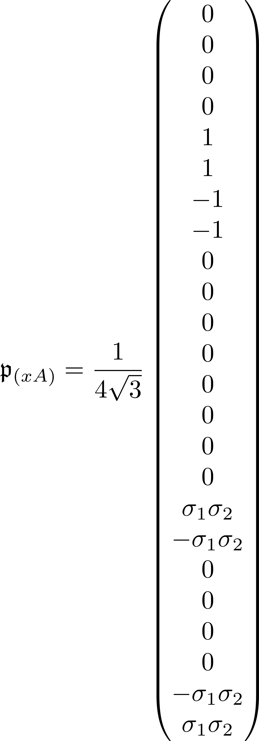
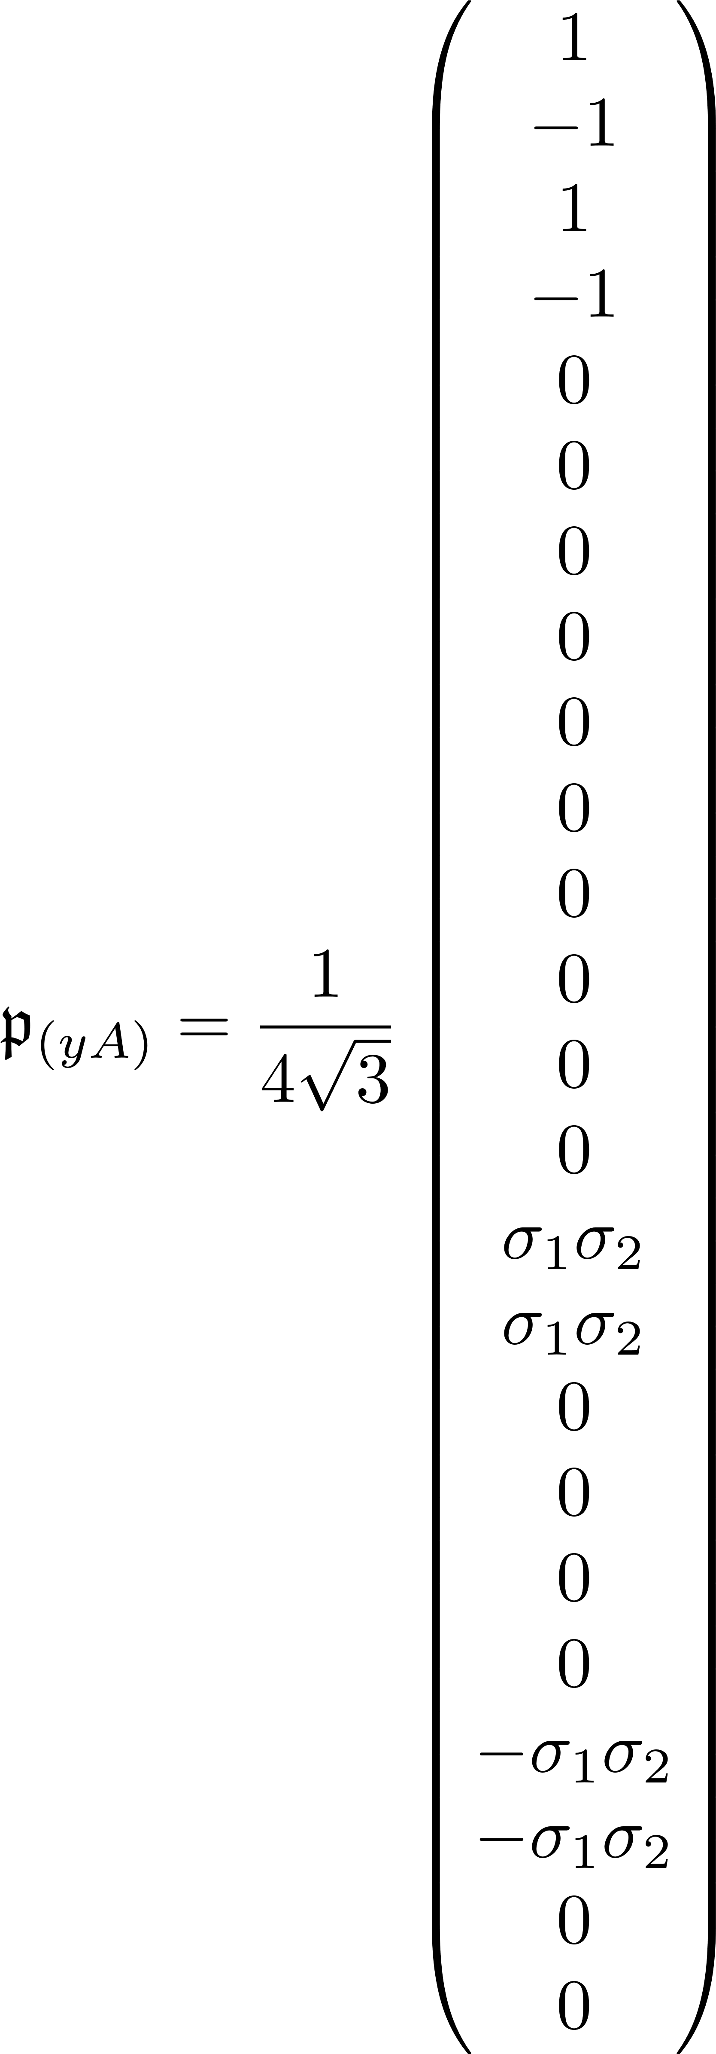
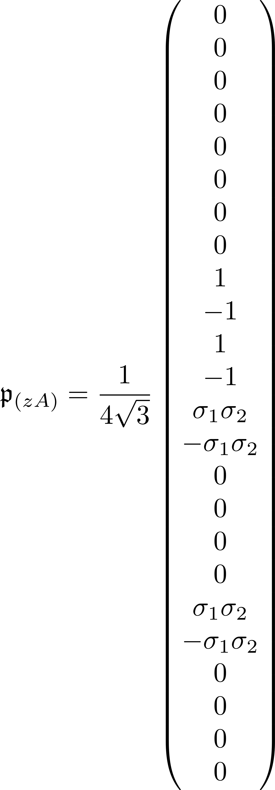
Prefactor vectors, opposite valley, btwn A and T states

Slide 7
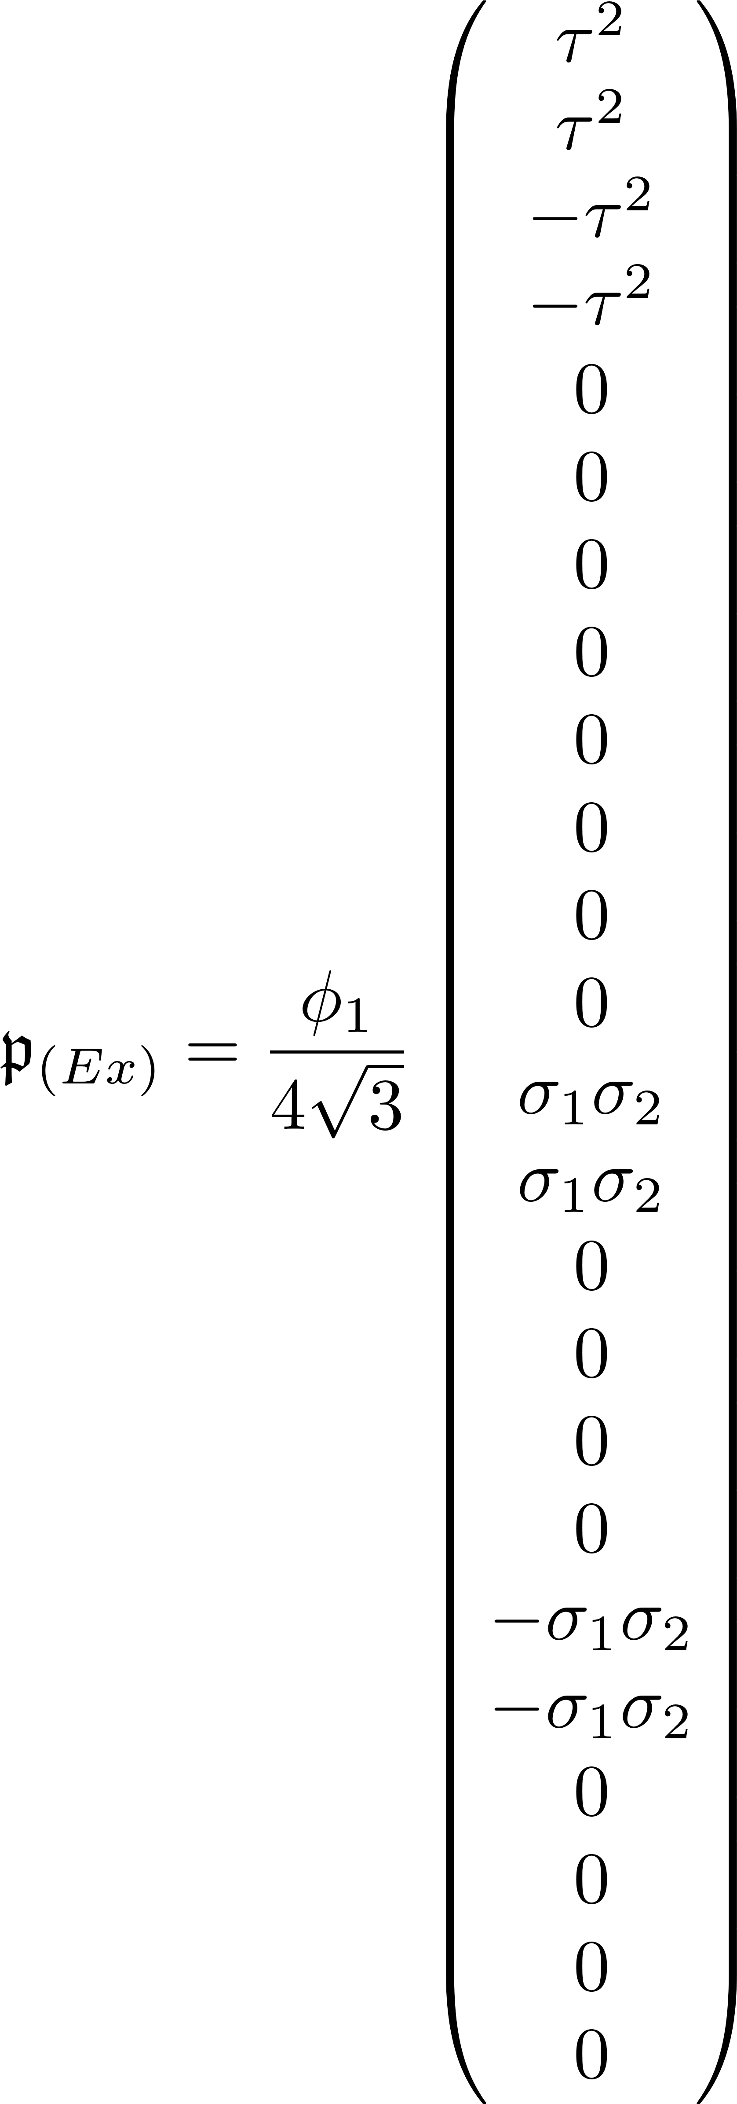
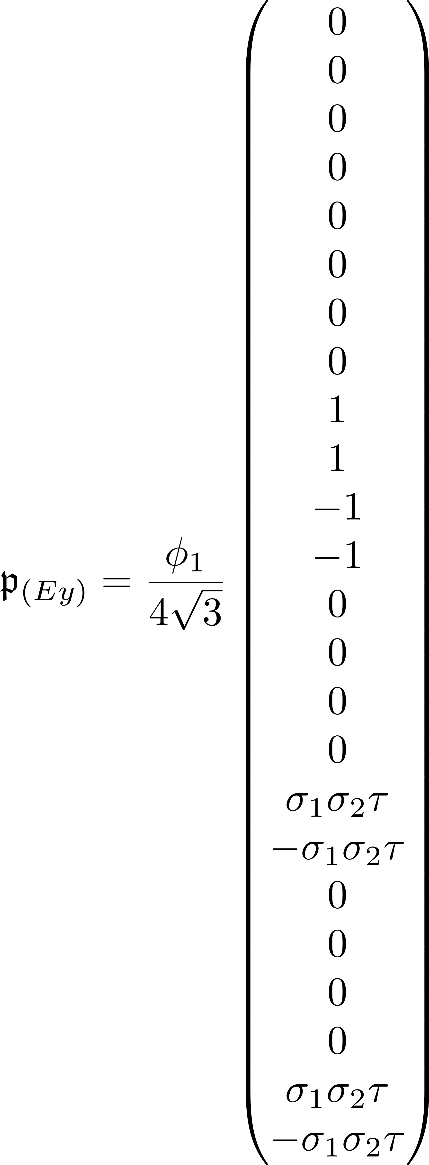
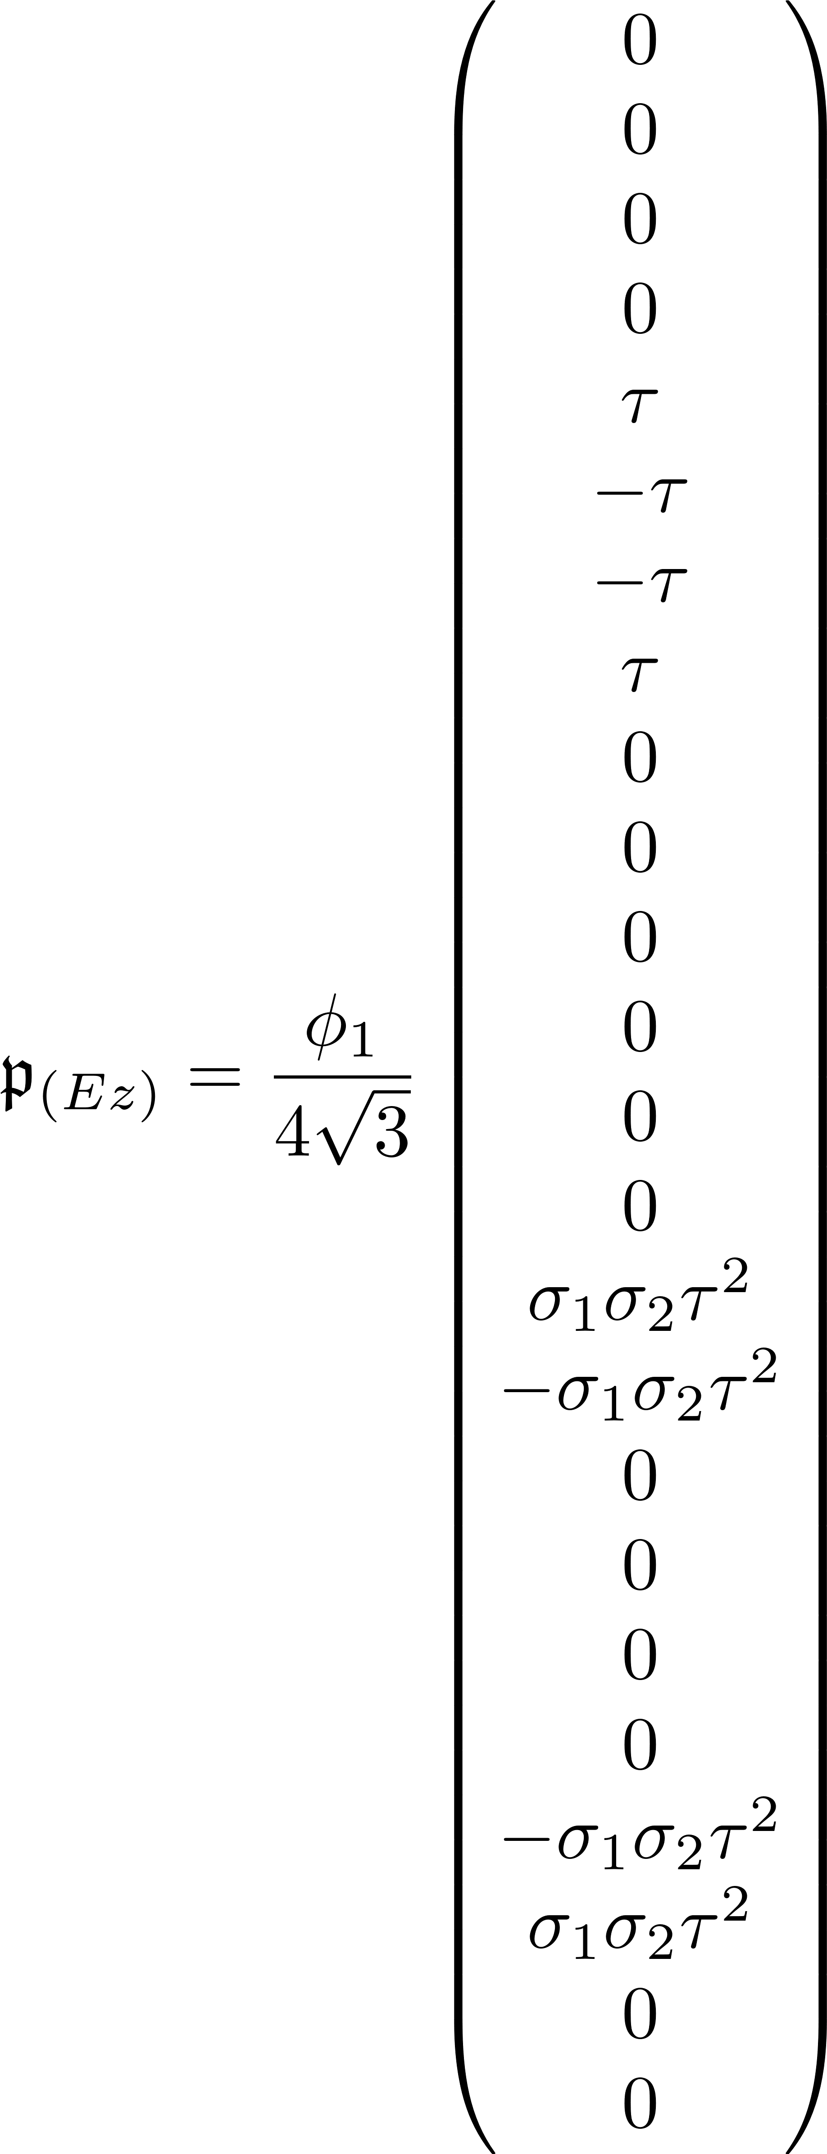
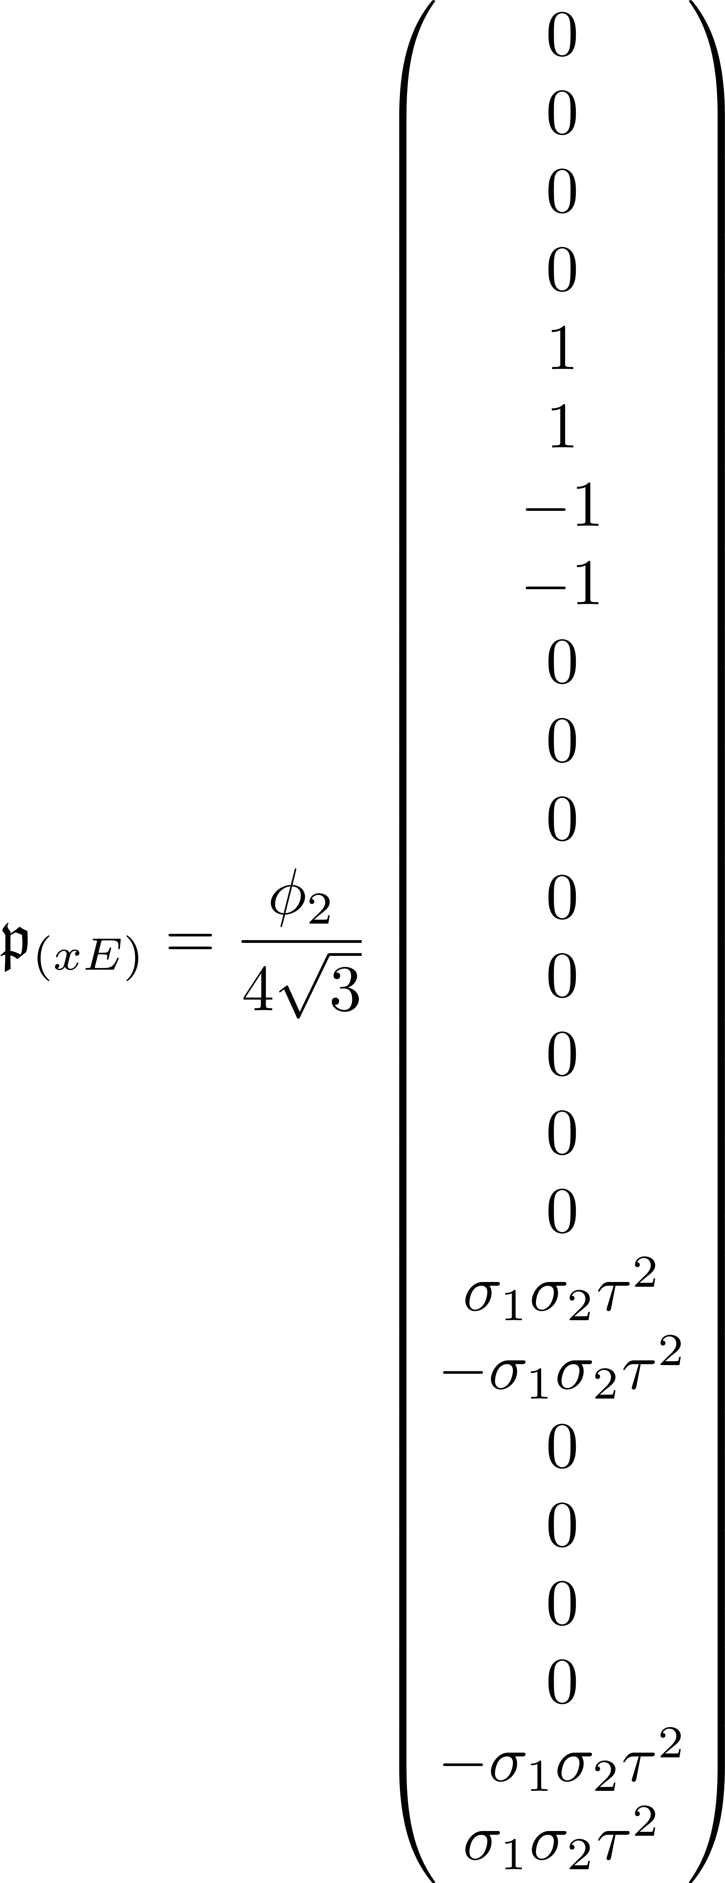
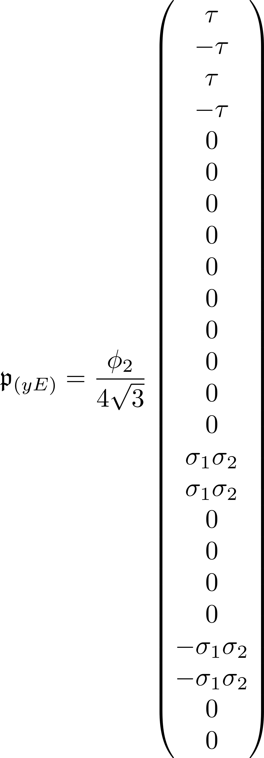
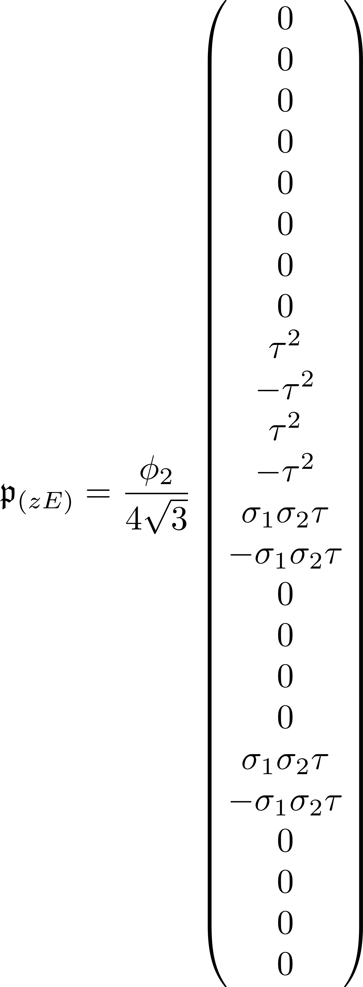
Prefactor vectors, opposite valley, btwn E and T states

Slide 8
GROUP THEORY
Resolving the input potential in terms of the irreducible representations of Td

Slide 9
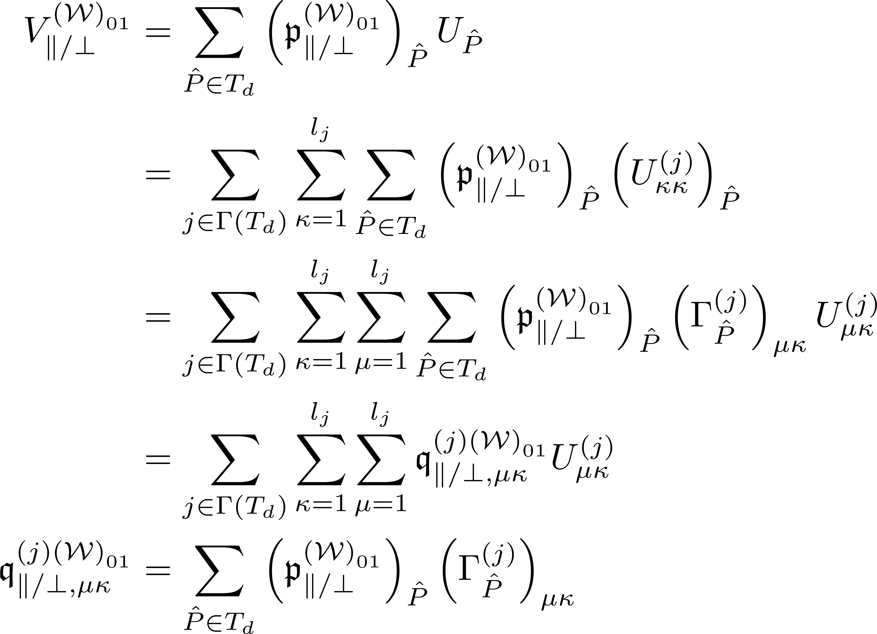
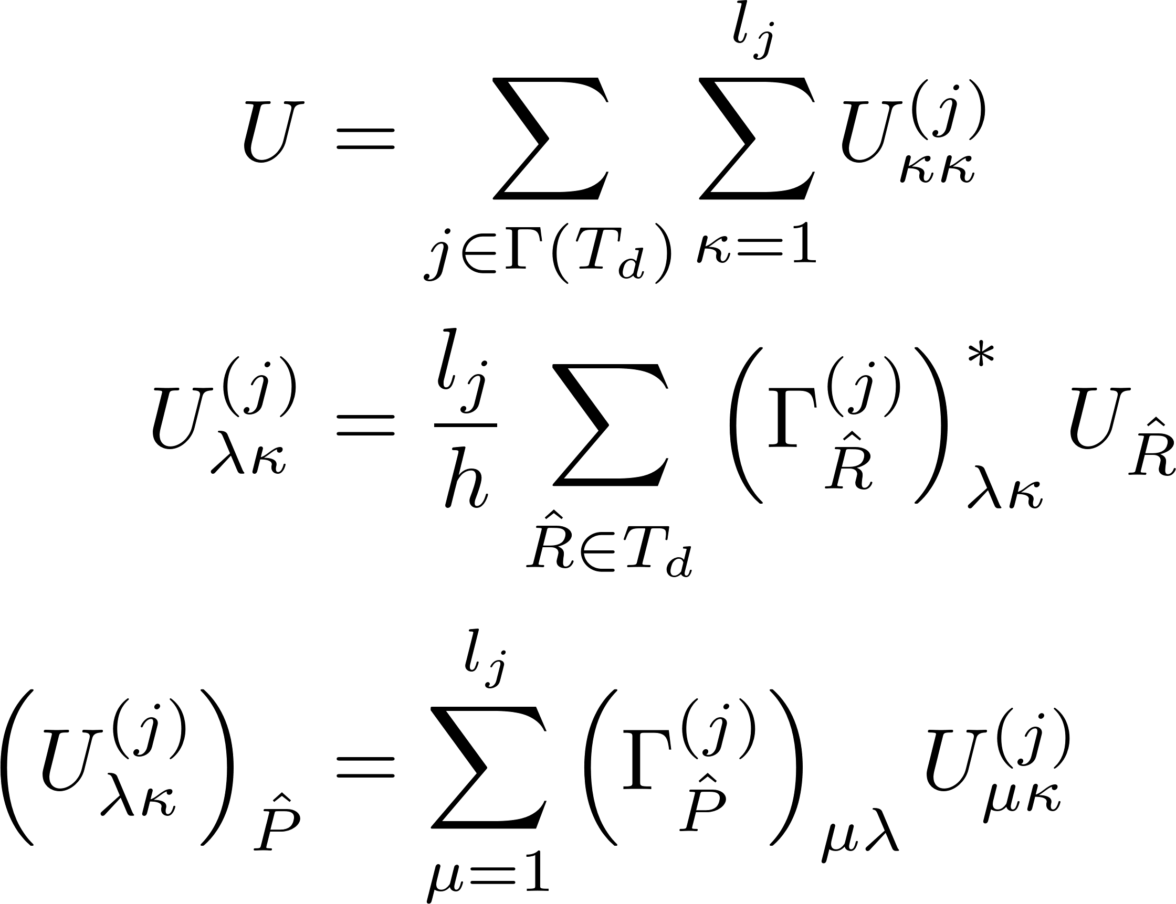
Symmetrized potential projected onto symmetries of Td -- I

Slide 10
Potential Matrix
Expressing how potentials slot into integrals given state symmetry

Slide 11
A1

Slide 12
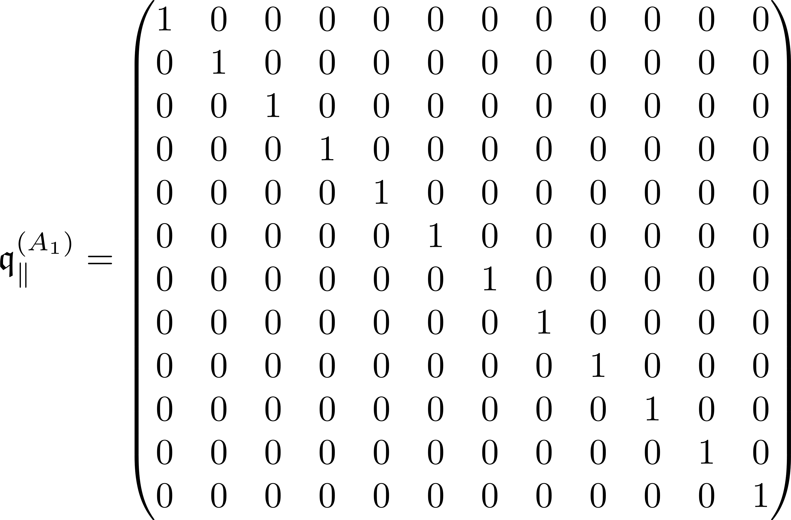
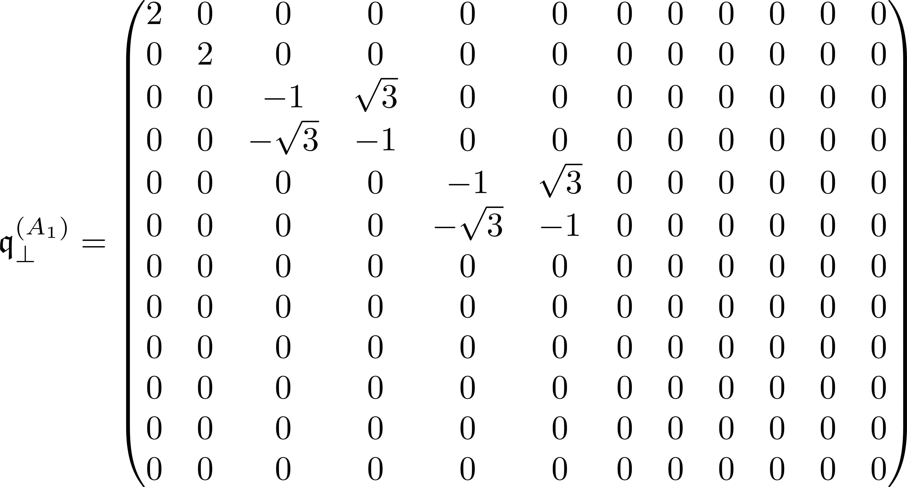
Effect of Td operations upon expanded symmetrized potential

Slide 13
A2

Slide 14
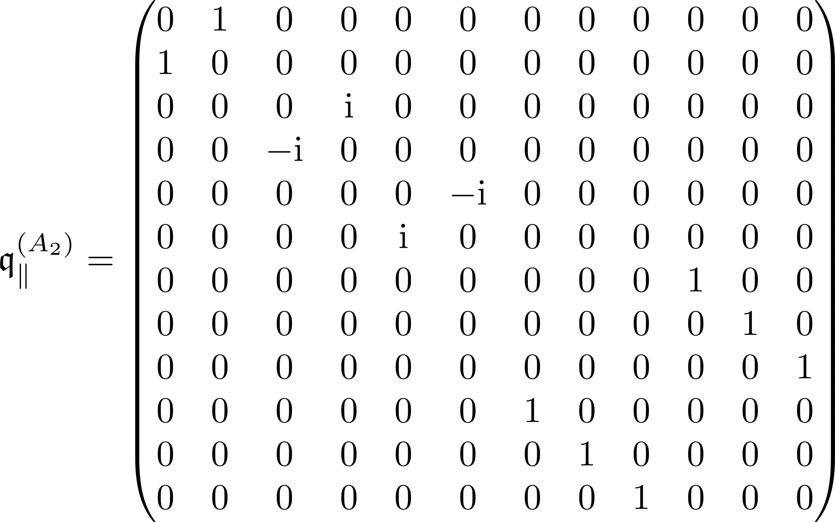
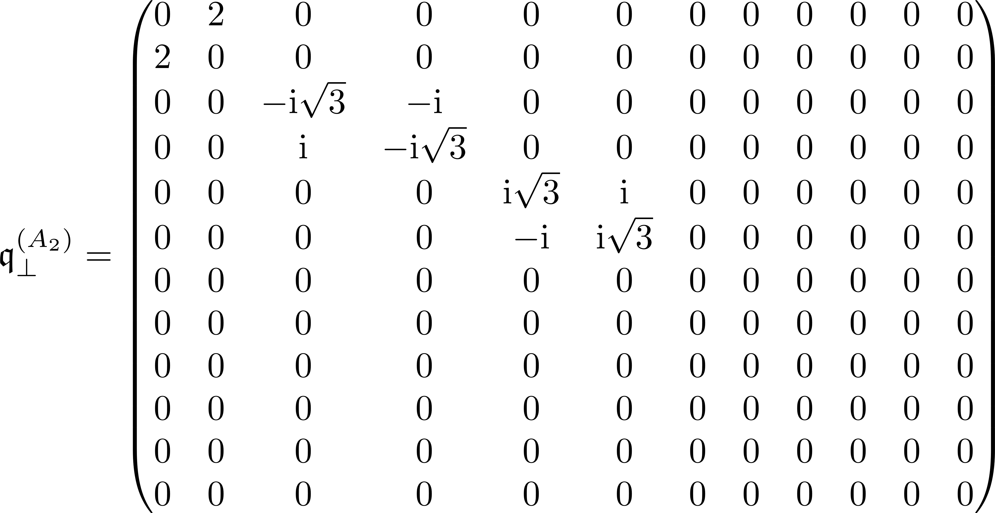
Effect of Td operations upon expanded symmetrized potential

Slide 15
E

Slide 16
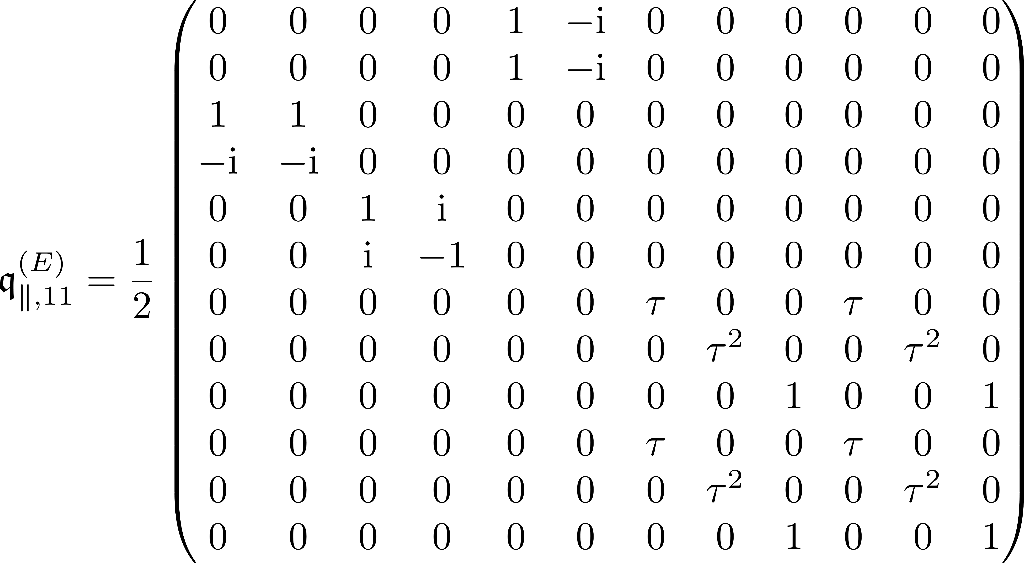
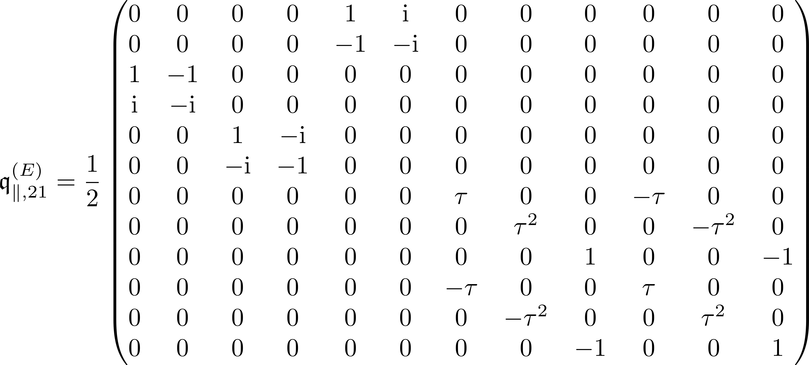
Effect of Td operations upon expanded symmetrized potential

Slide 17
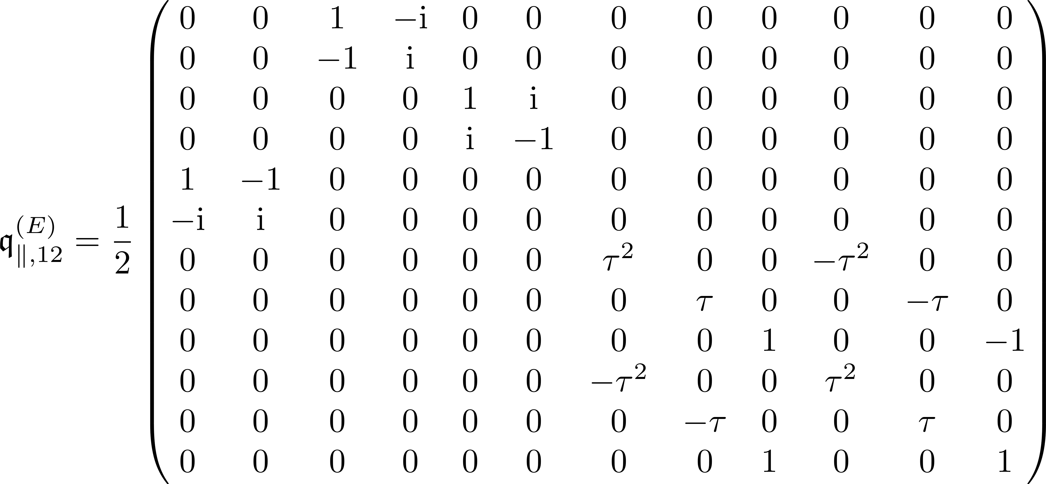
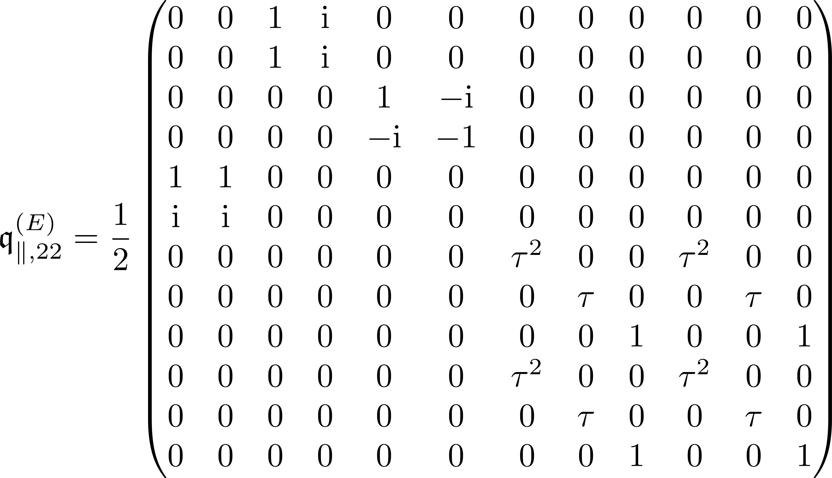
Effect of Td operations upon expanded symmetrized potential

Slide 18
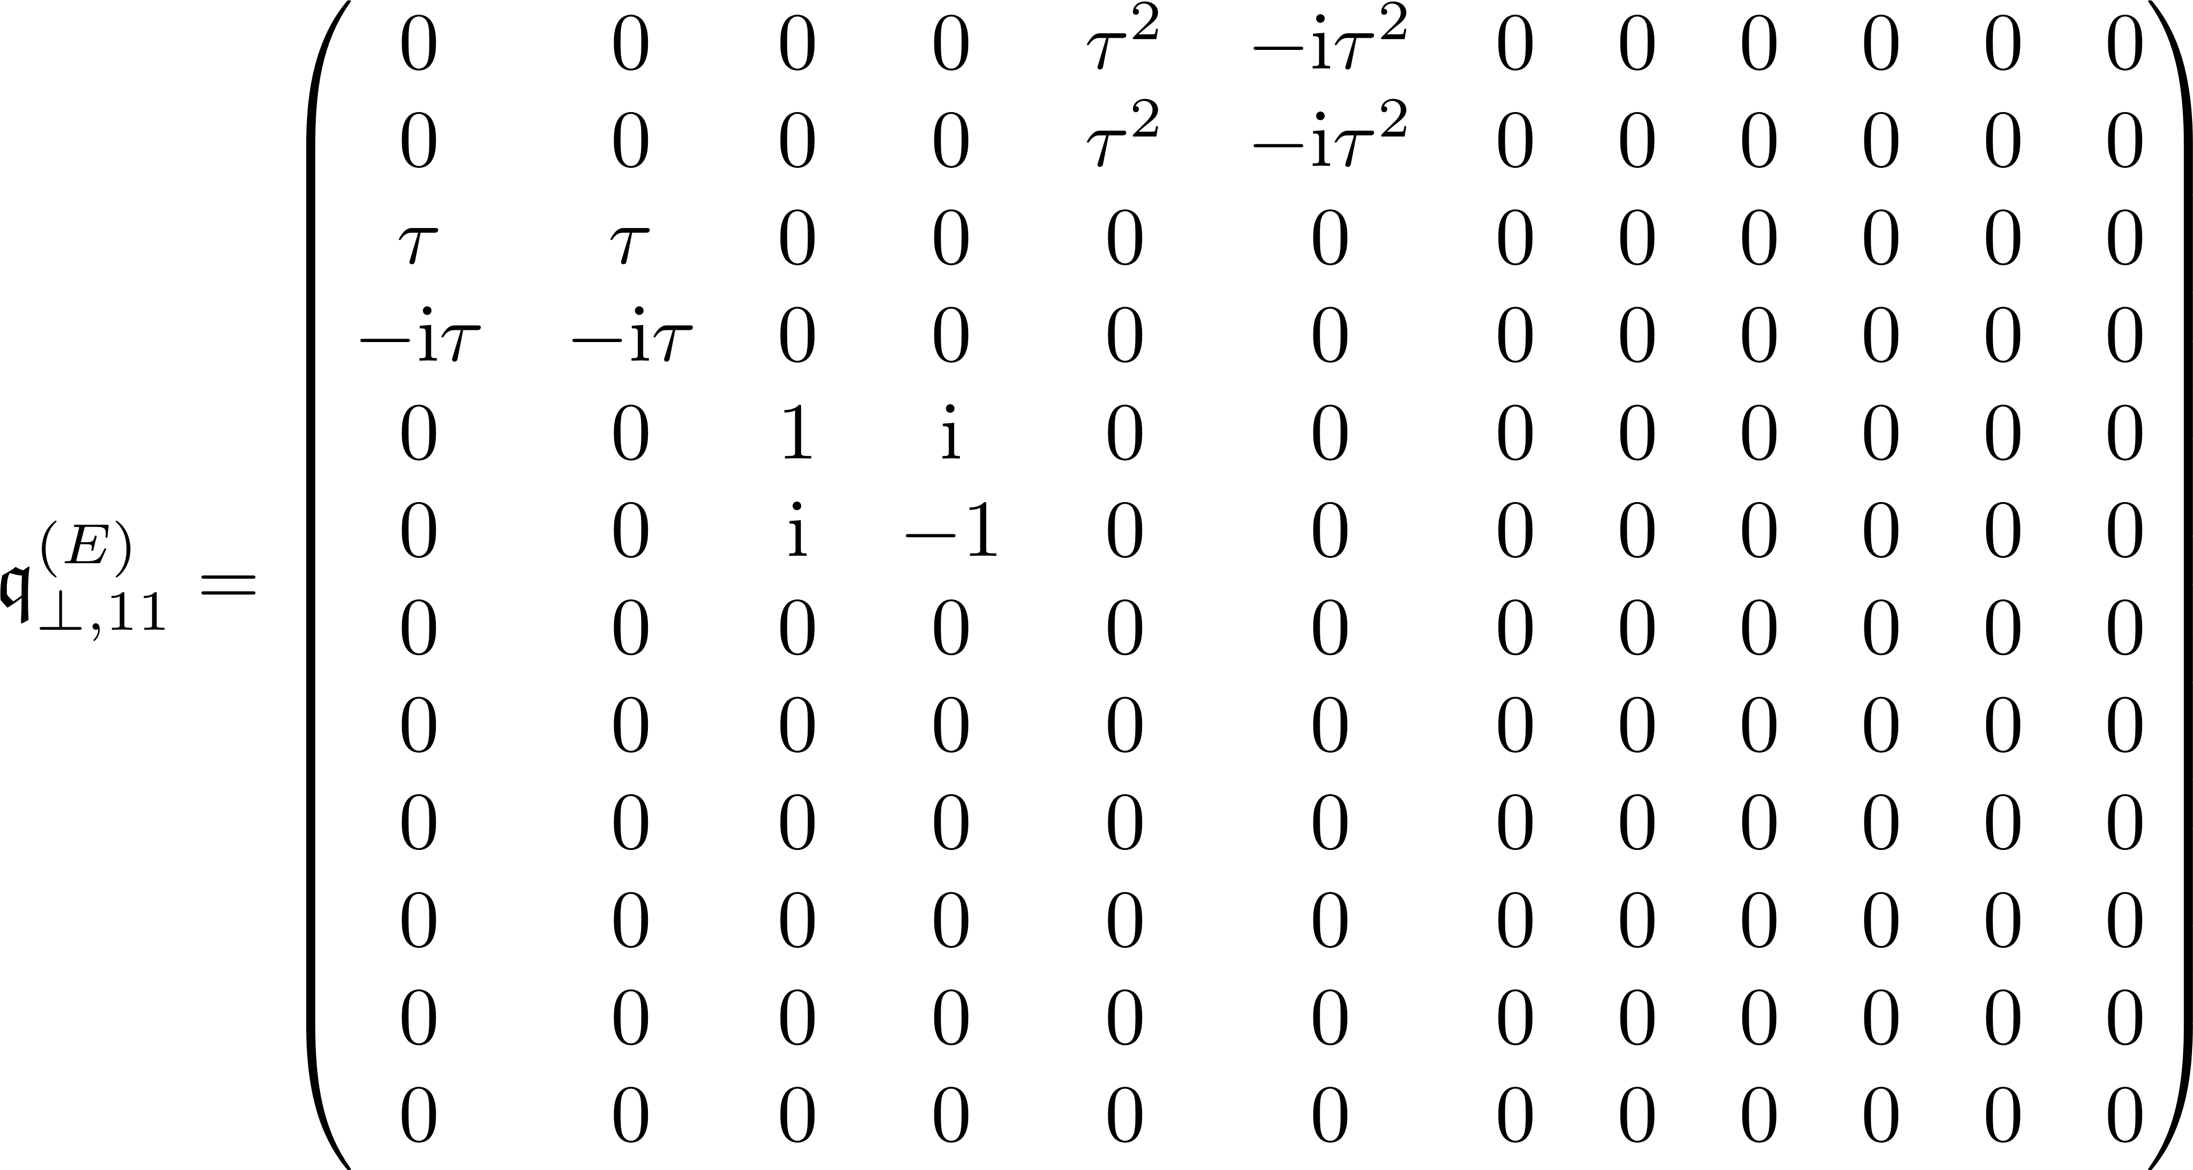
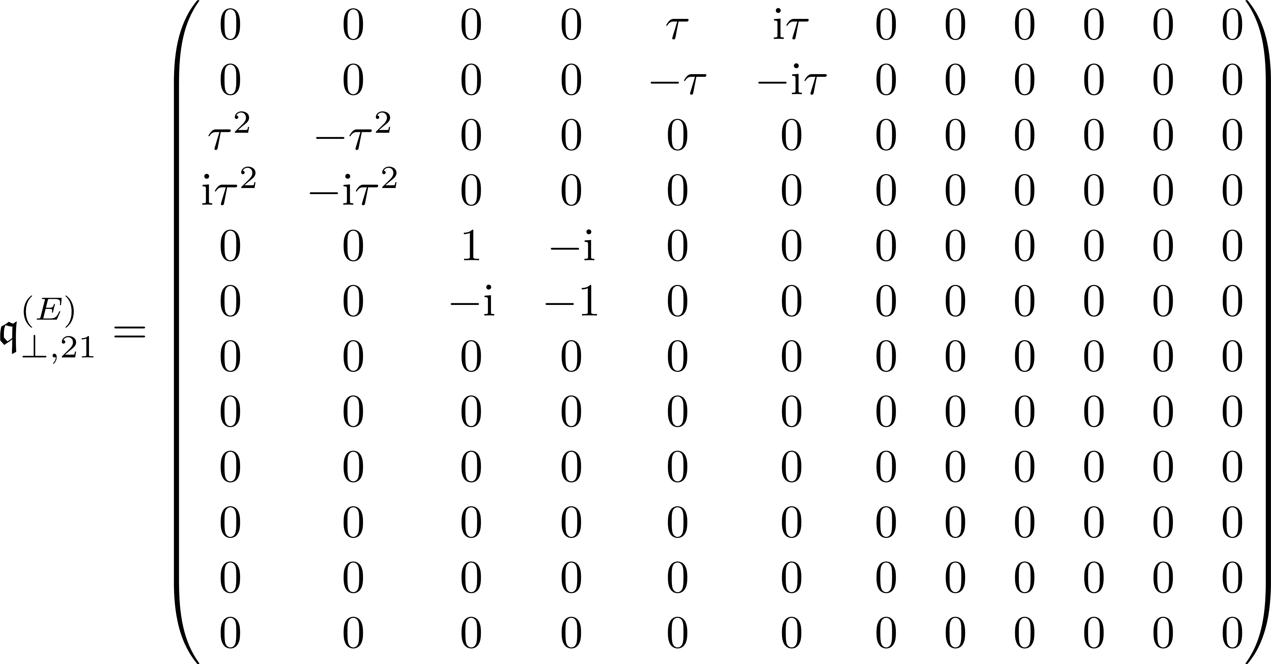
Effect of Td operations upon expanded symmetrized potential

Slide 19
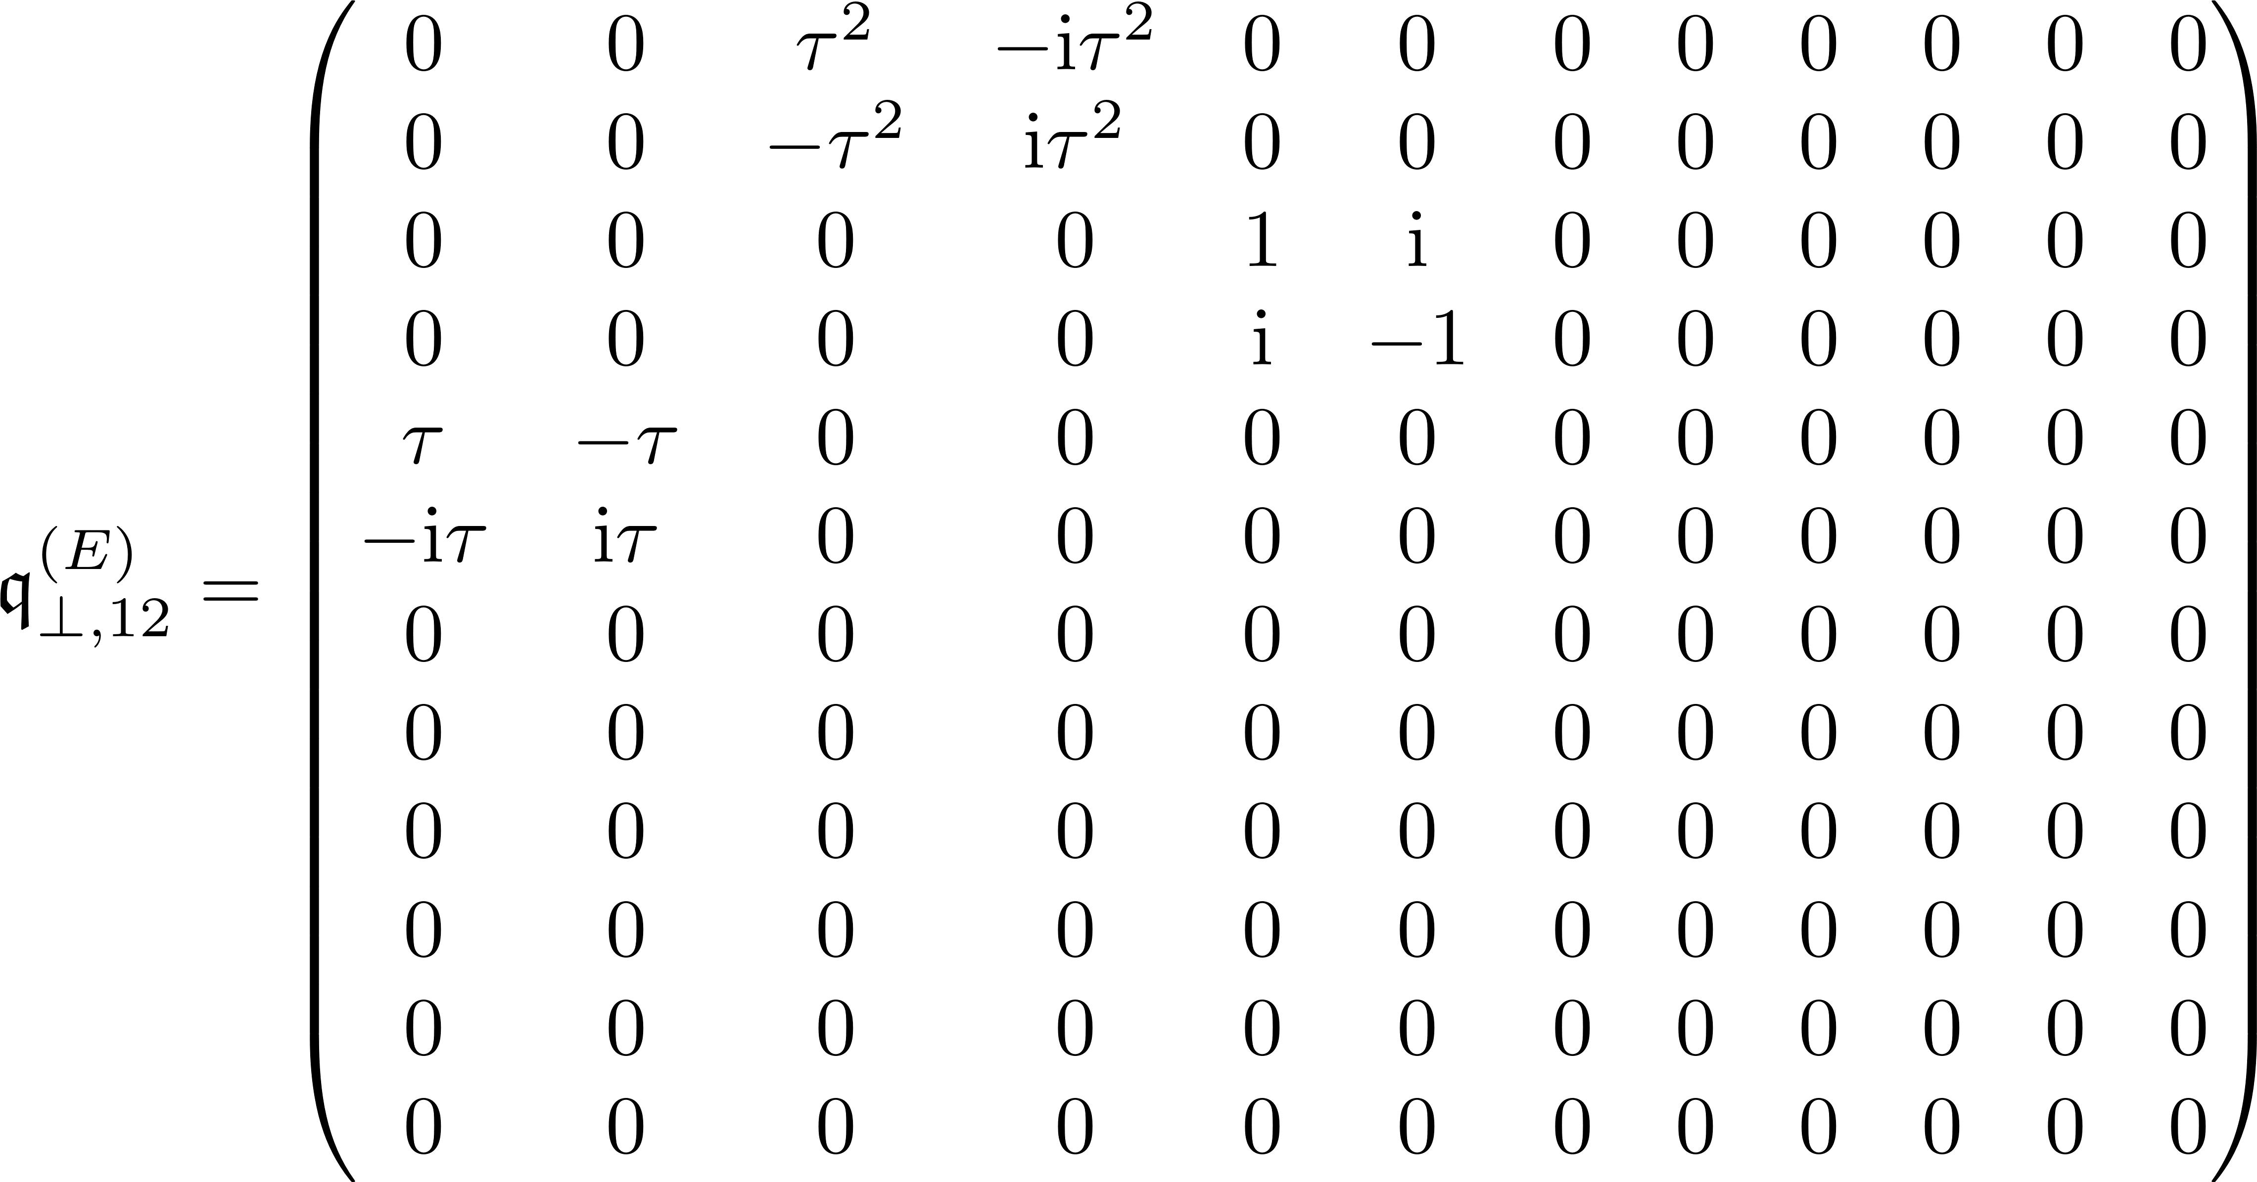
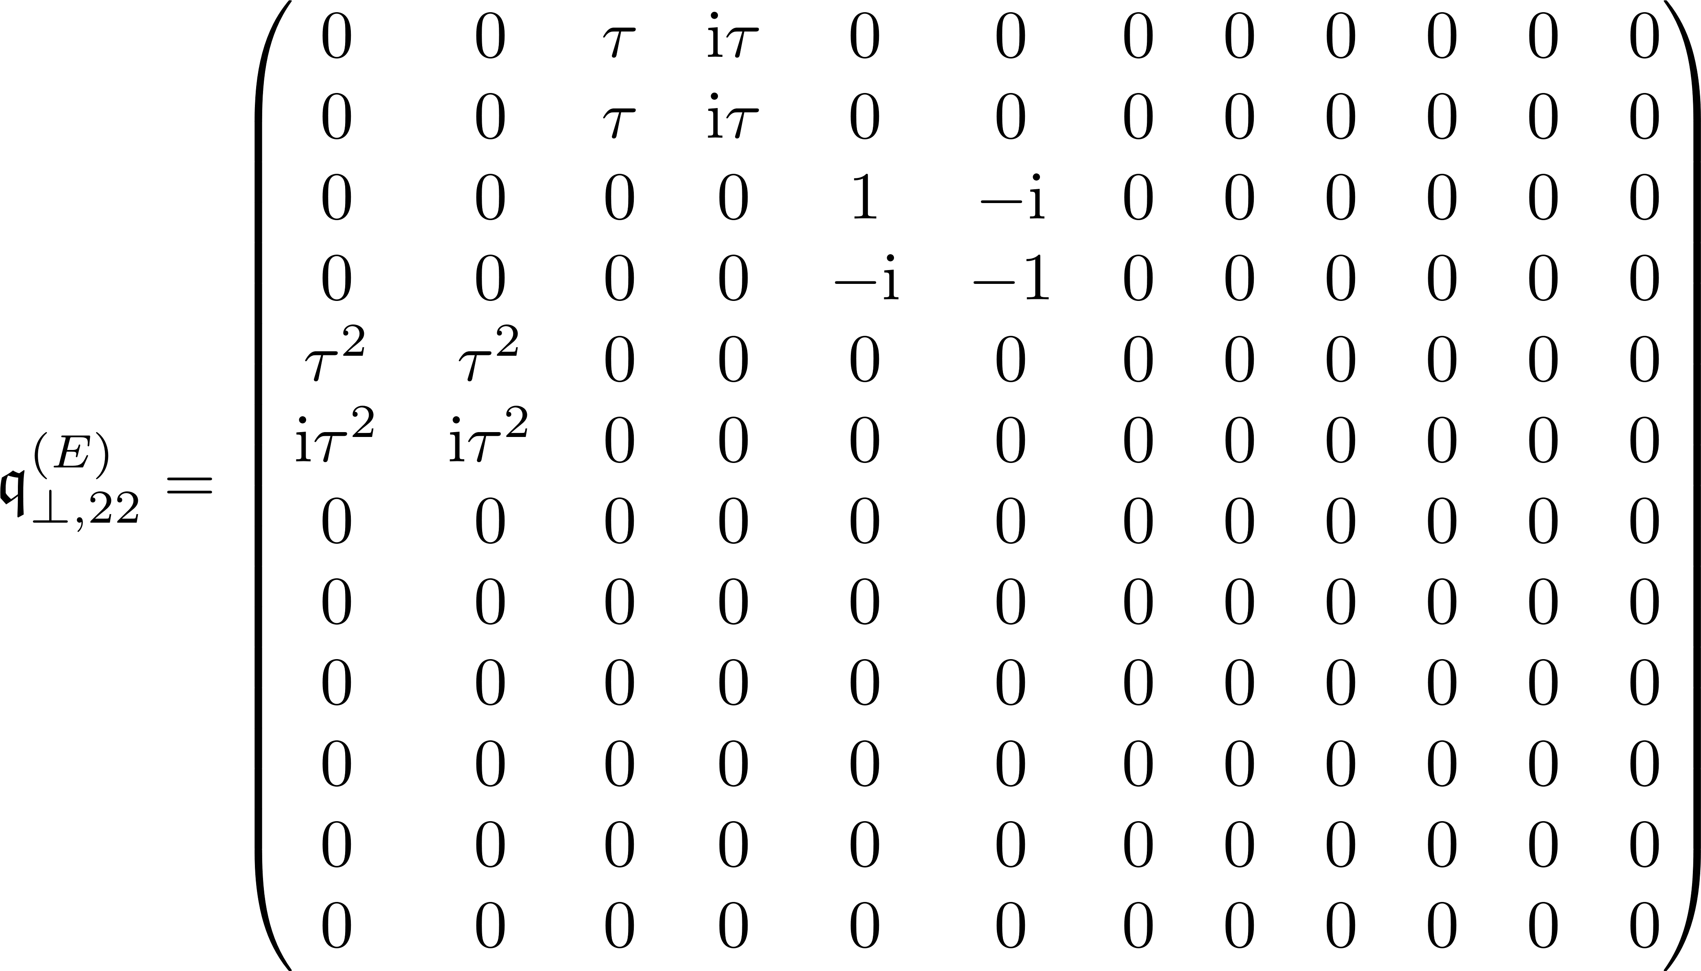
Effect of Td operations upon expanded symmetrized potential

Slide 20
T1

Slide 21
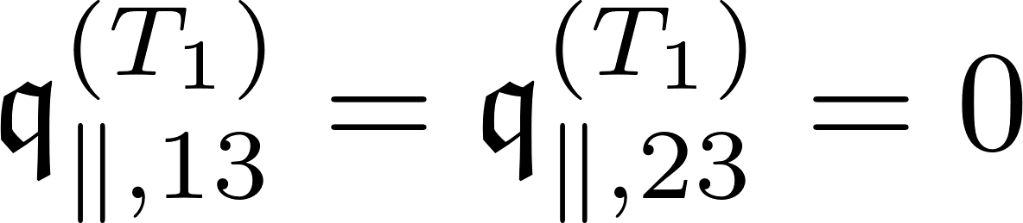
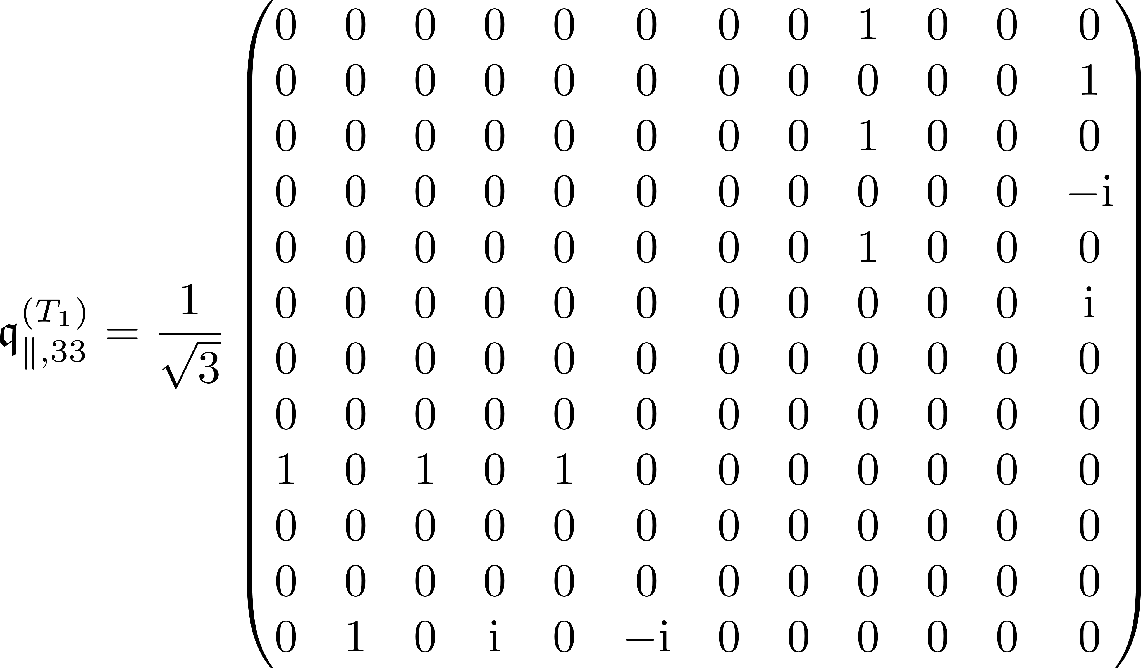
Effect of Td operations upon expanded symmetrized potential

Slide 22

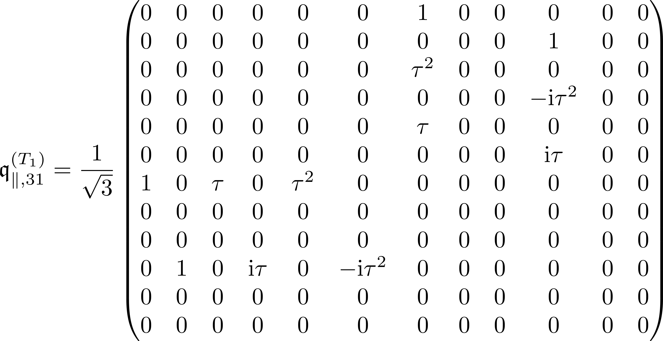
Effect of Td operations upon expanded symmetrized potential

Slide 23

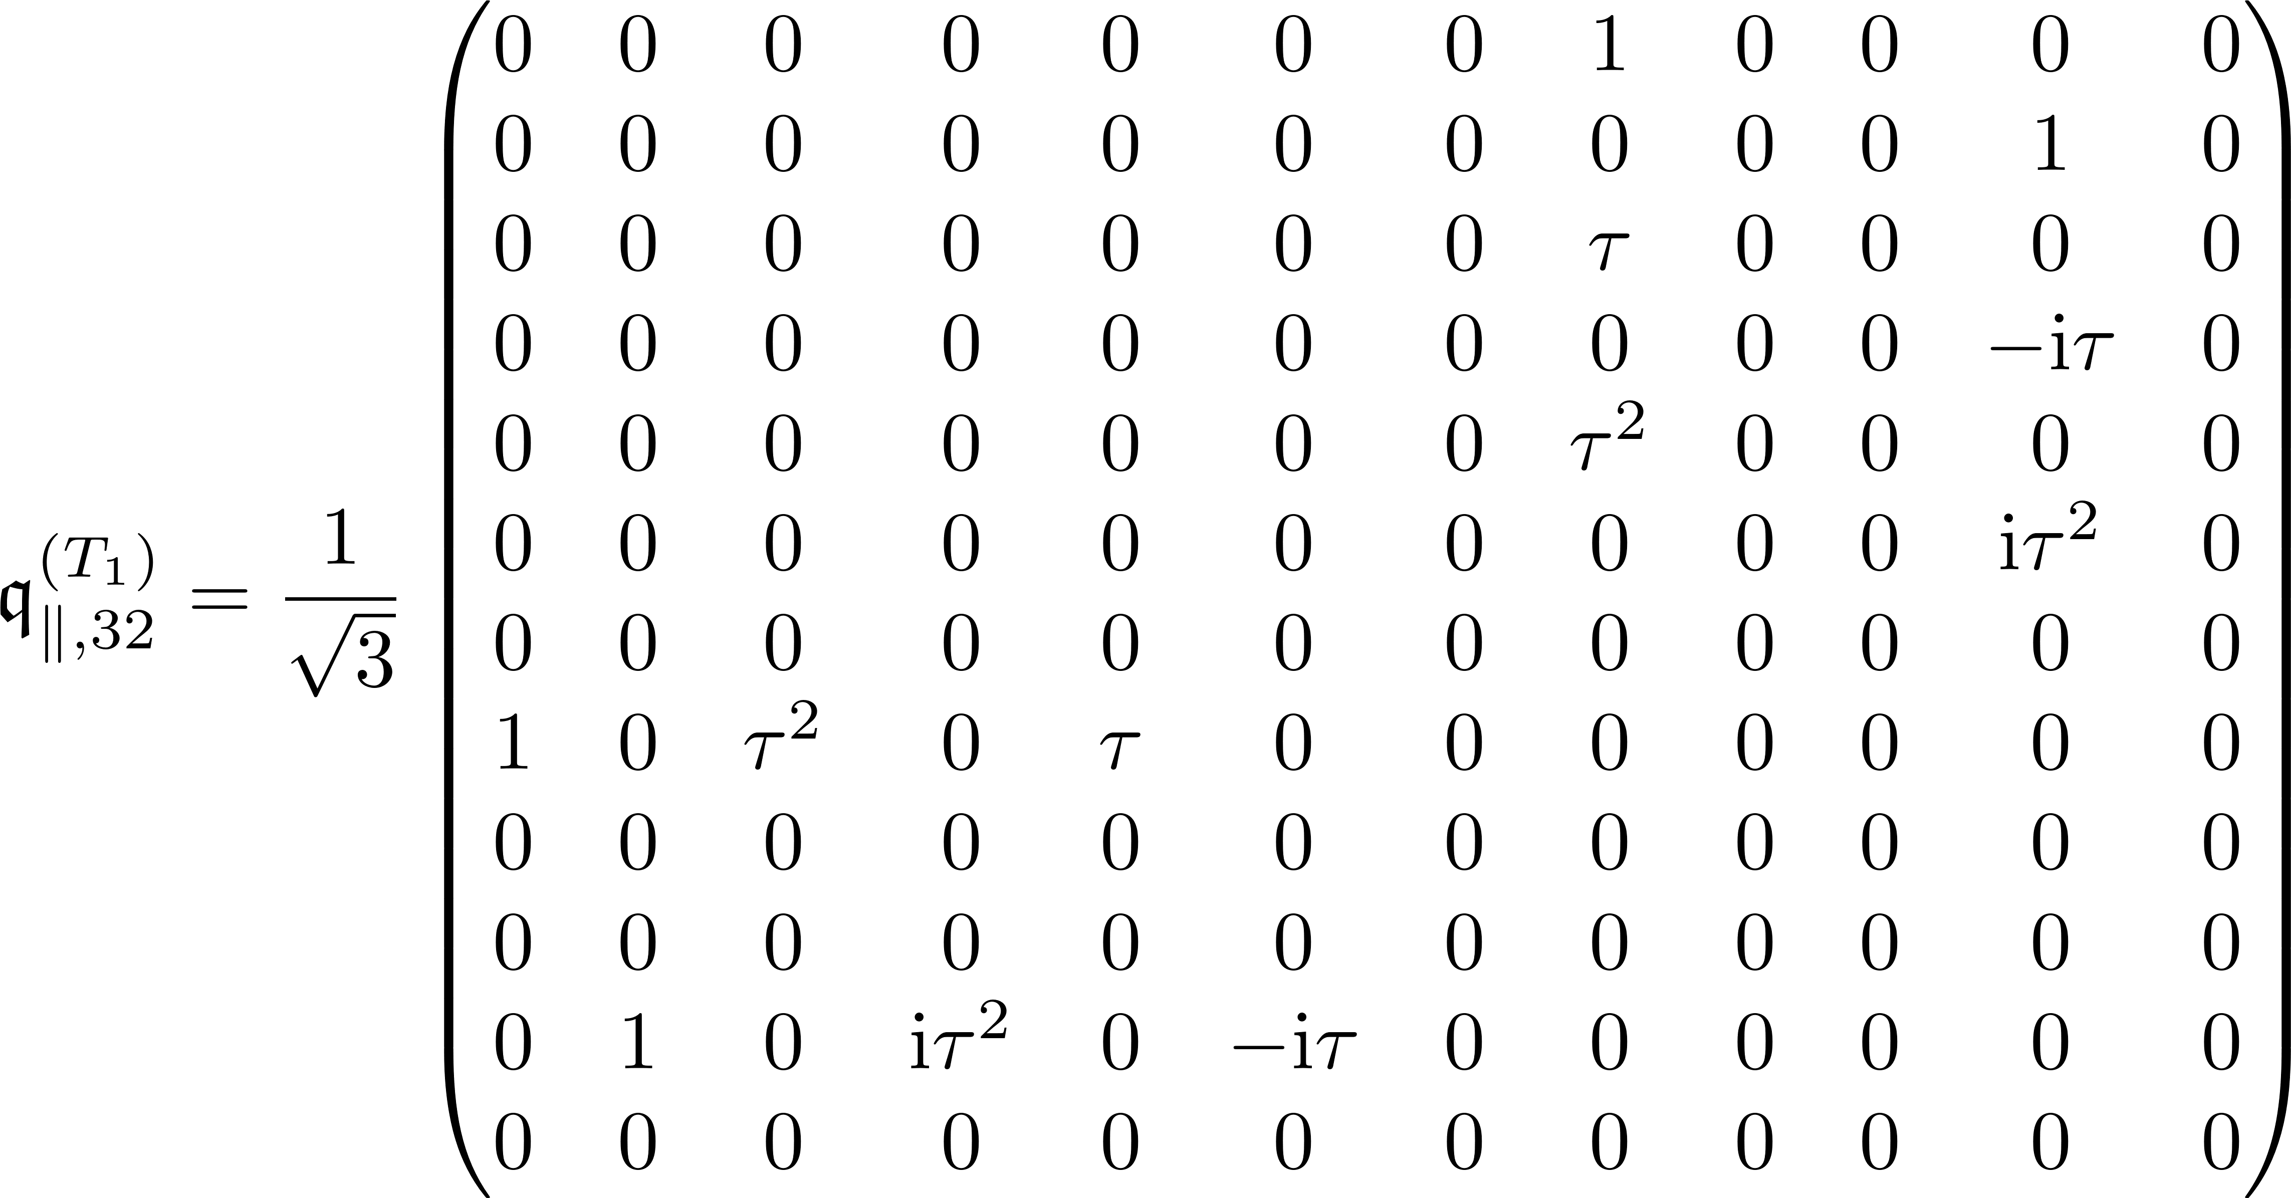
Effect of Td operations upon expanded symmetrized potential

Slide 24



Effect of Td operations upon expanded symmetrized potential

Slide 25

Effect of Td operations upon expanded symmetrized potential

Slide 26

Effect of Td operations upon expanded symmetrized potential

Slide 27

Effect of Td operations upon expanded symmetrized potential

Slide 28

Effect of Td operations upon expanded symmetrized potential

Slide 29

Effect of Td operations upon expanded symmetrized potential

Slide 30

Effect of Td operations upon expanded symmetrized potential

Slide 31
T2

Slide 32


Effect of Td operations upon expanded symmetrized potential

Slide 33


Effect of Td operations upon expanded symmetrized potential

Slide 34


Effect of Td operations upon expanded symmetrized potential

Slide 35



Effect of Td operations upon expanded symmetrized potential

Slide 36

Effect of Td operations upon expanded symmetrized potential

Slide 37

Effect of Td operations upon expanded symmetrized potential

Slide 38

Effect of Td operations upon expanded symmetrized potential

Slide 39

Effect of Td operations upon expanded symmetrized potential

Slide 40

Effect of Td operations upon expanded symmetrized potential

Slide 41

Effect of Td operations upon expanded symmetrized potential

