Slide 1
Full State Description

Slide 2
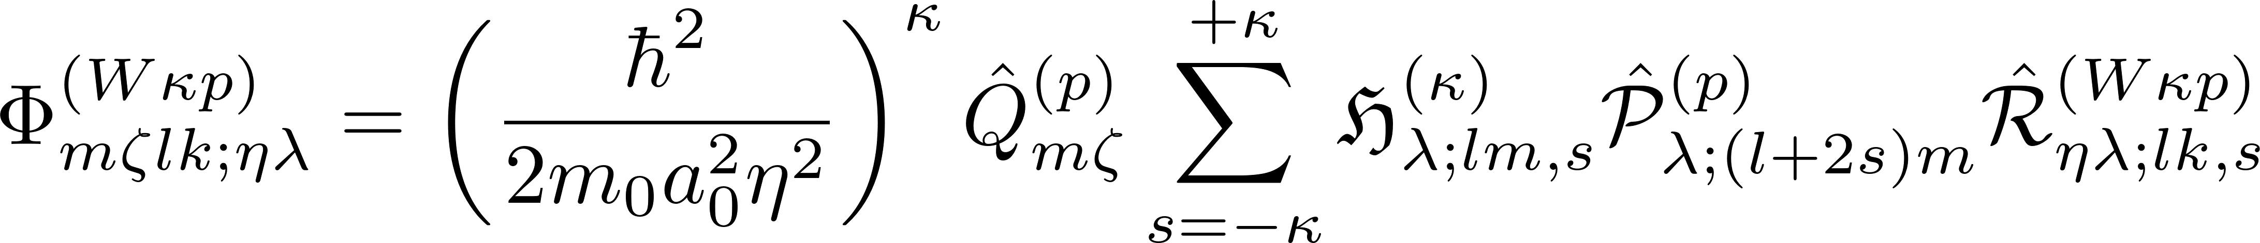
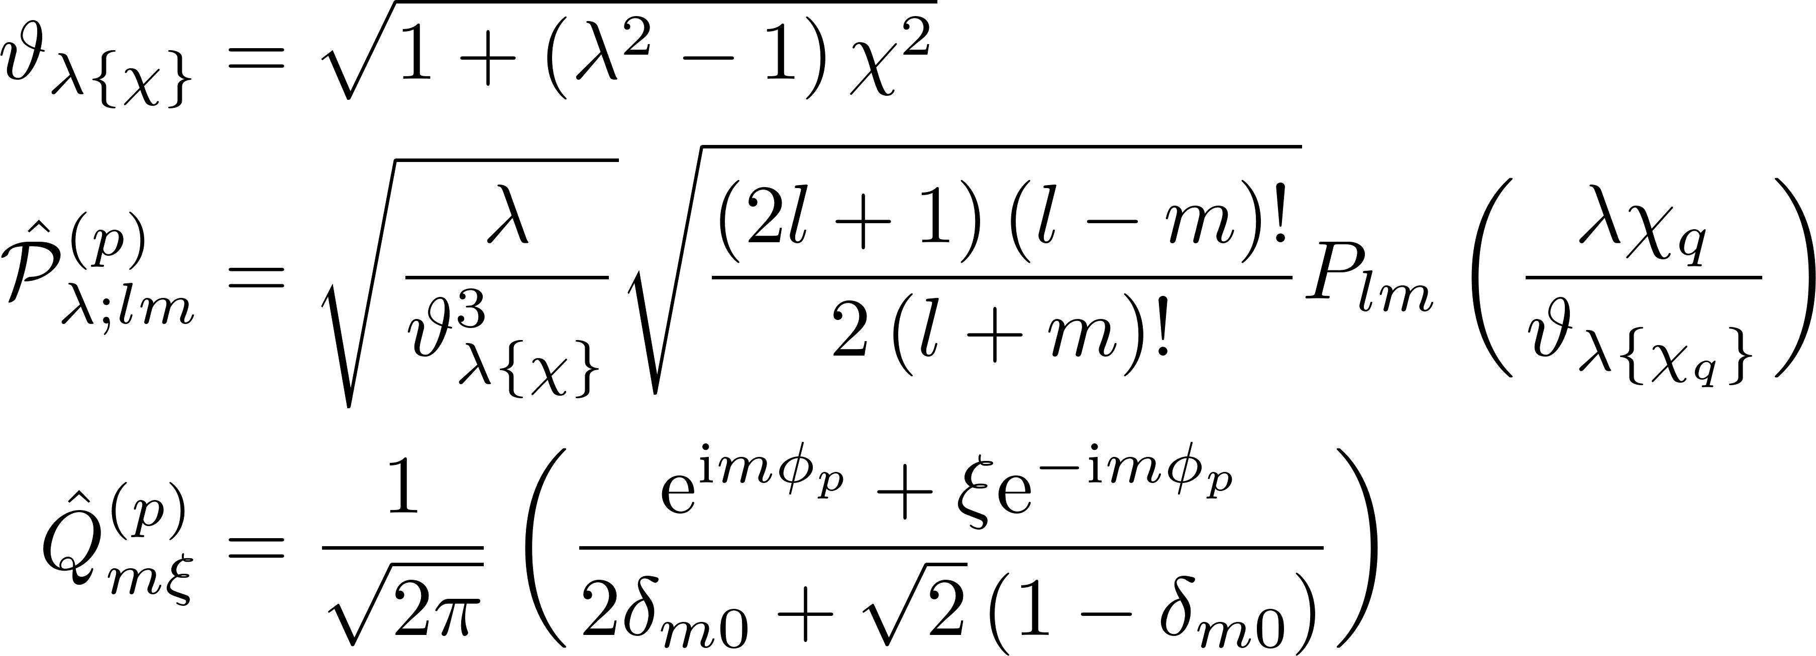
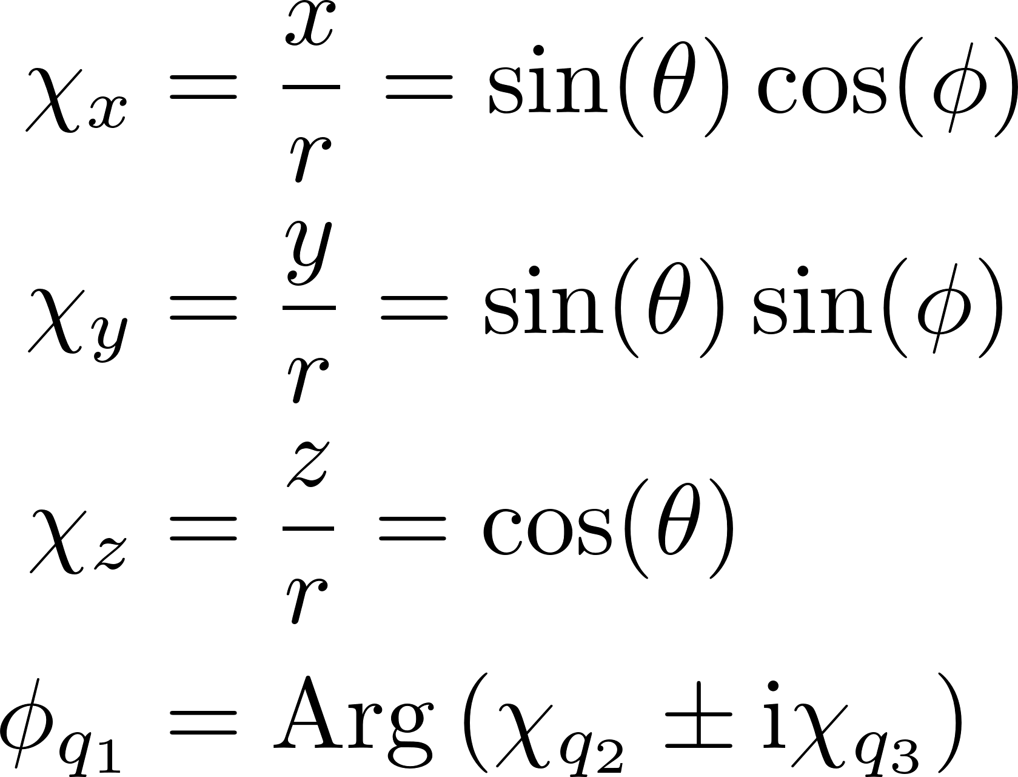
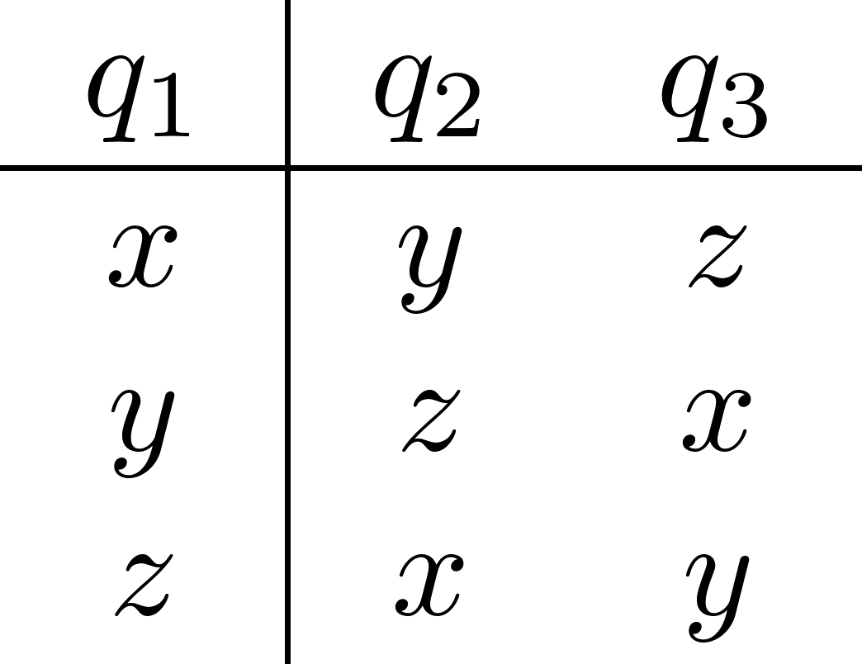
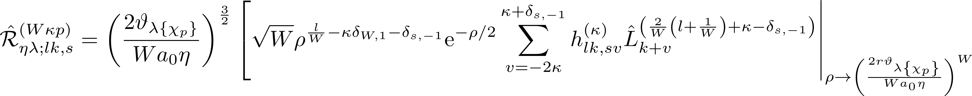
Generalized single-valley basis states

Slide 3
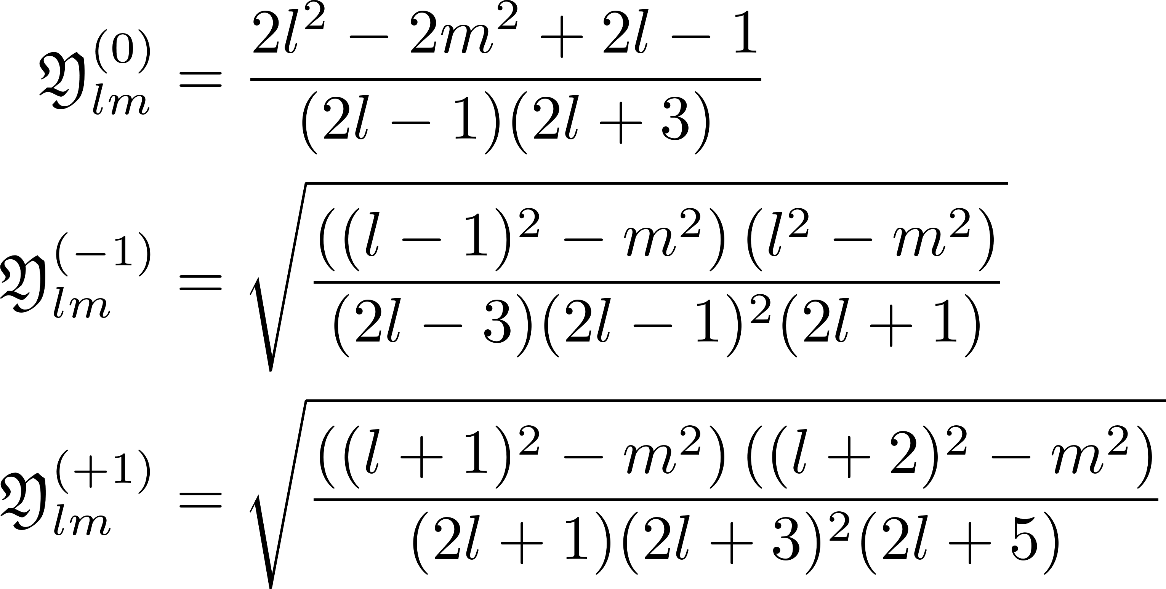
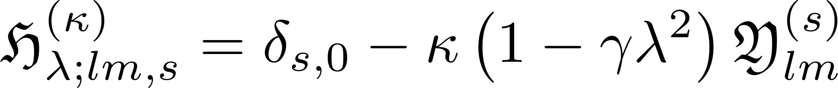
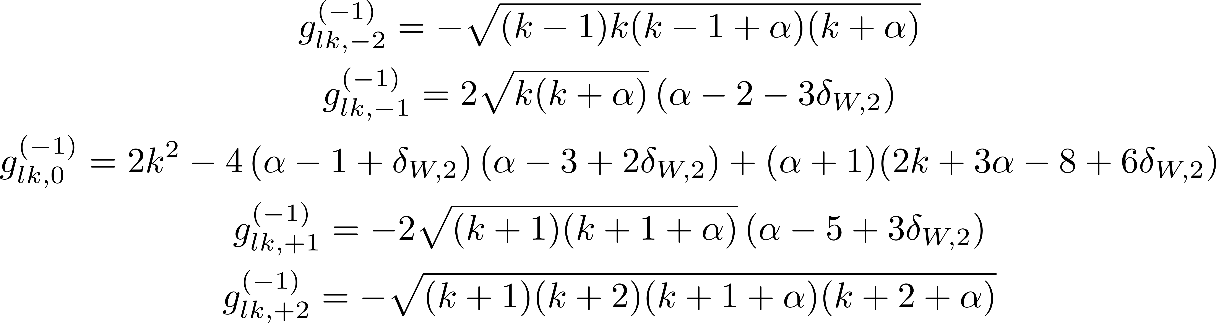
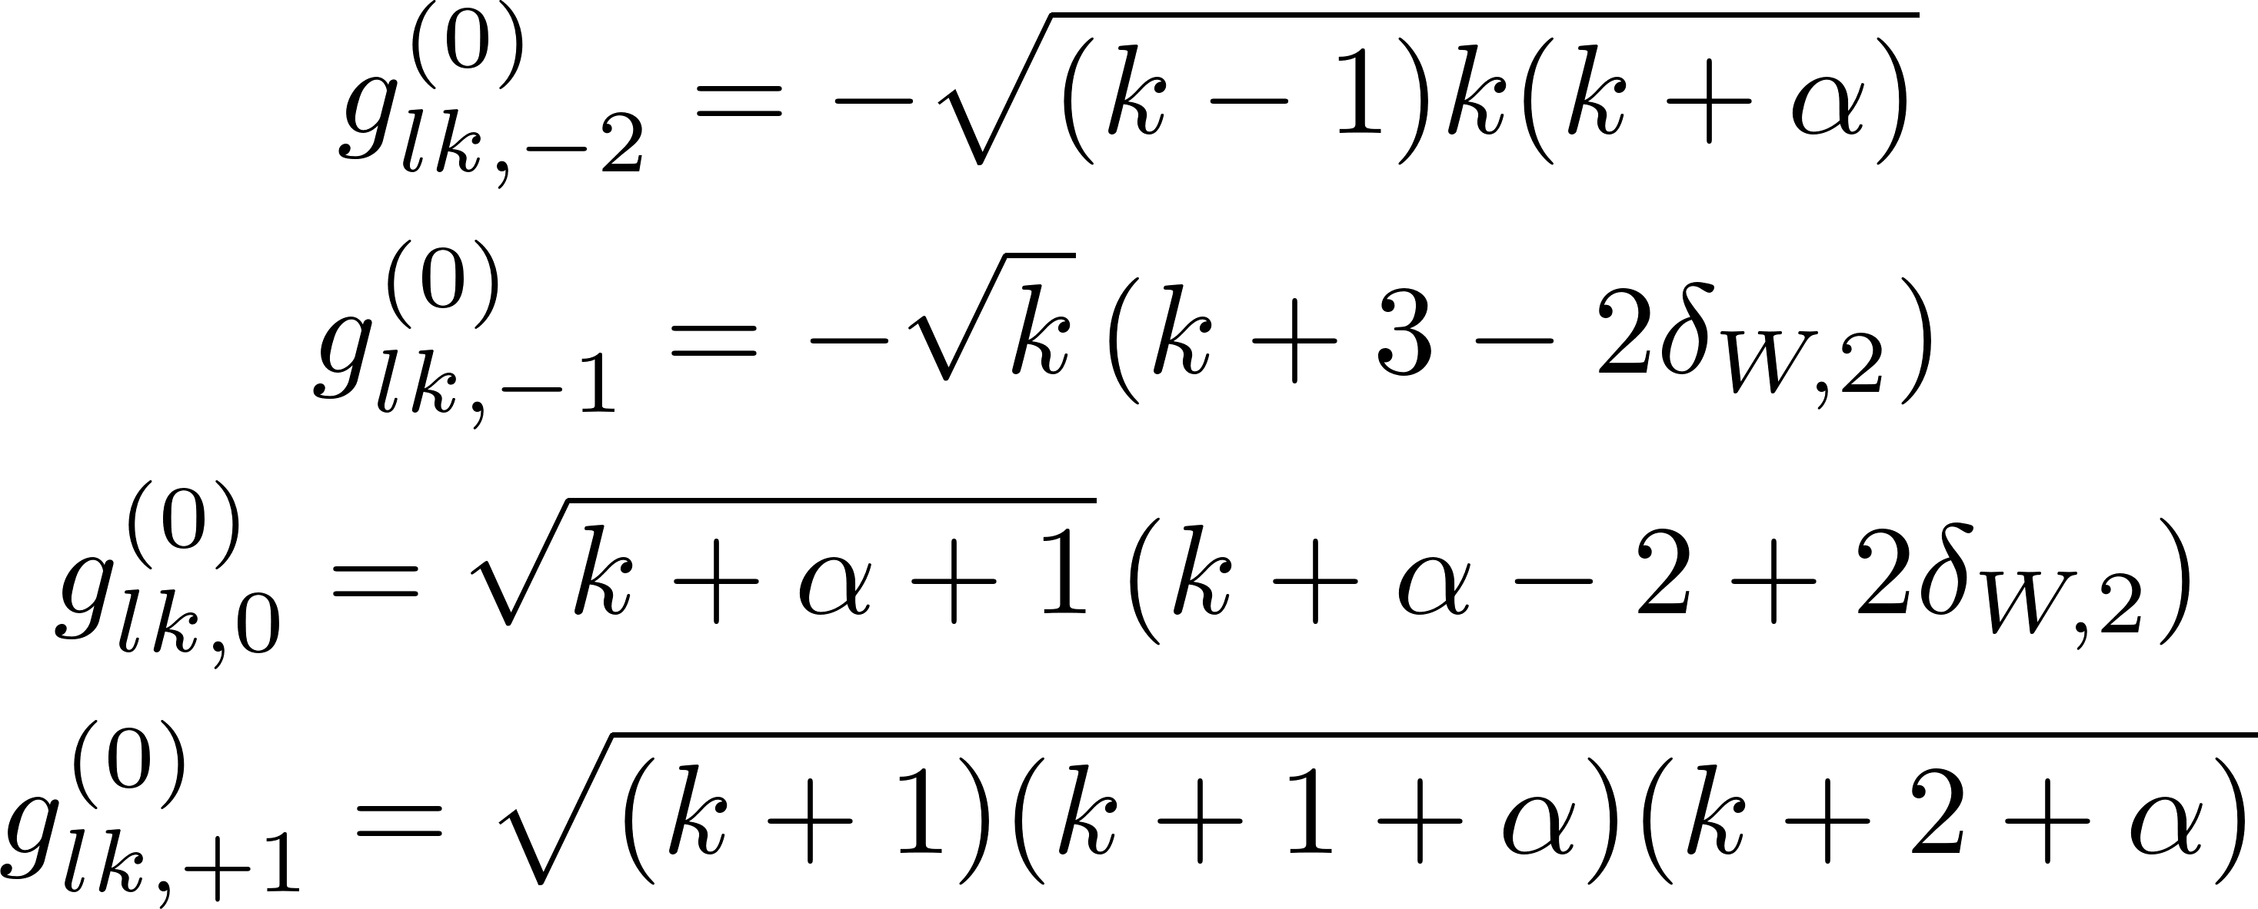
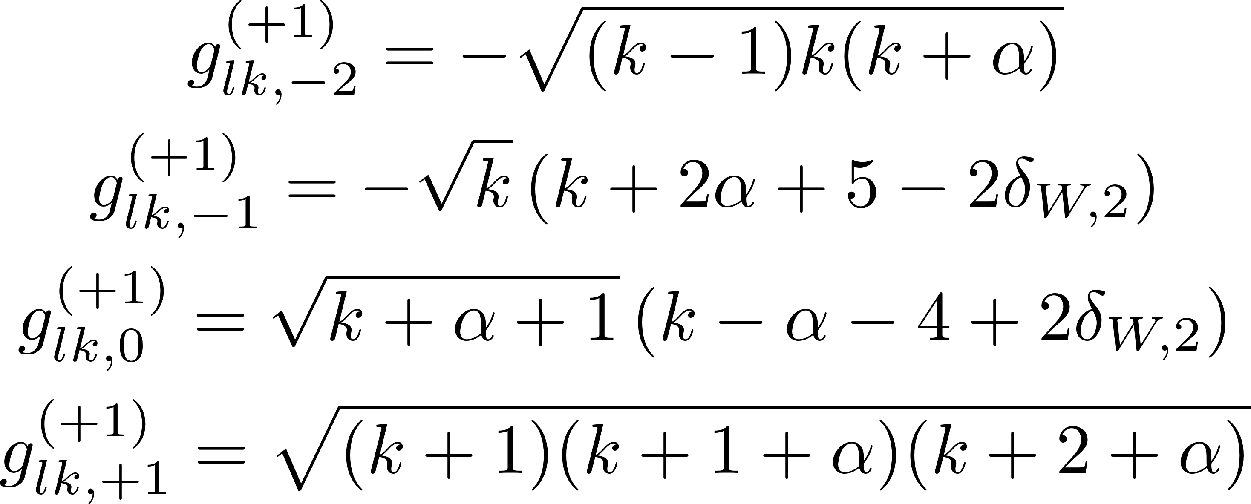
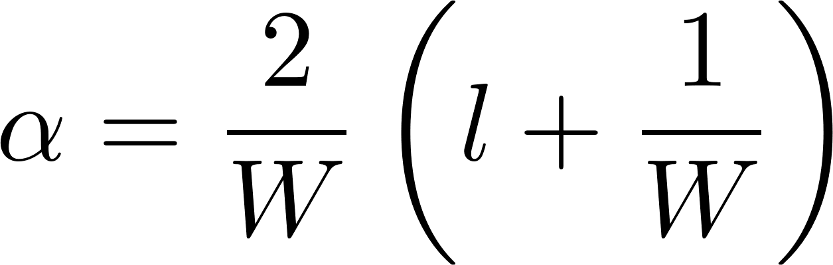
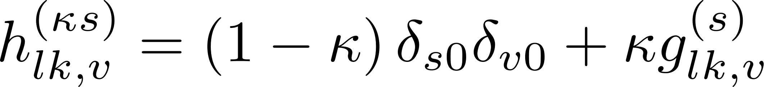
Generalized single-valley basis states

Slide 4
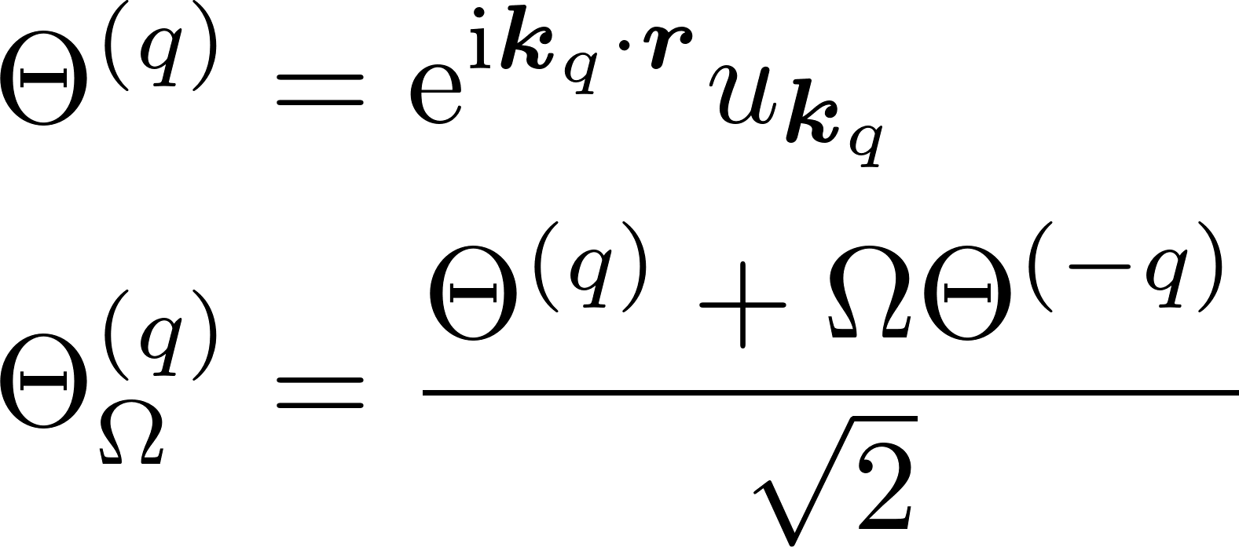
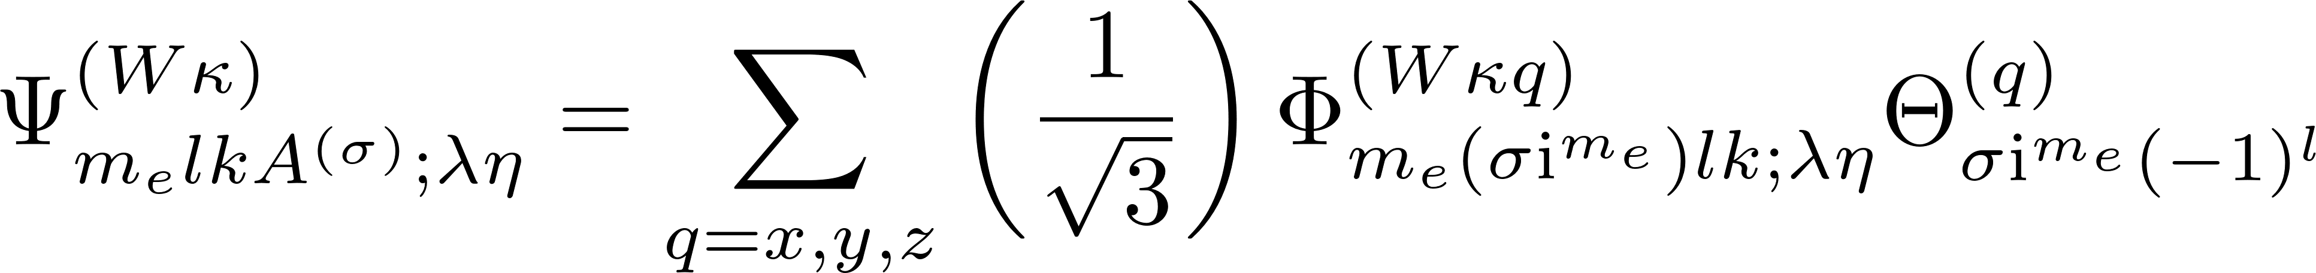
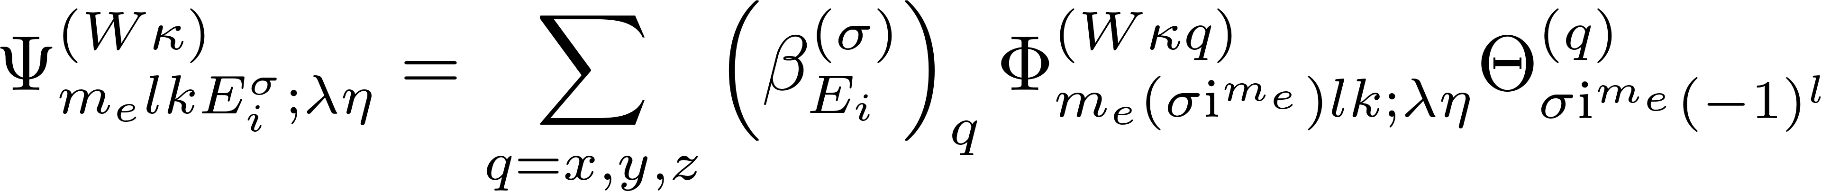
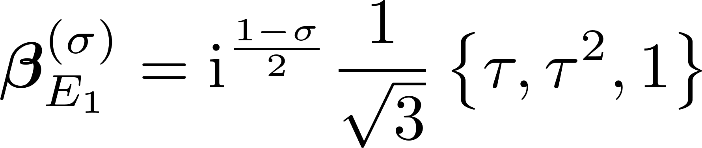
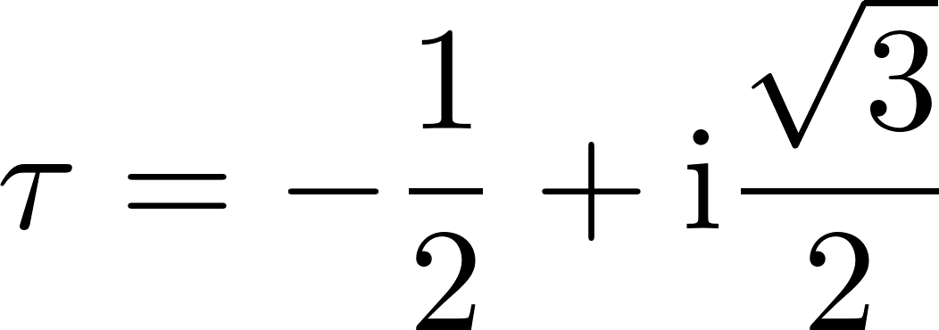
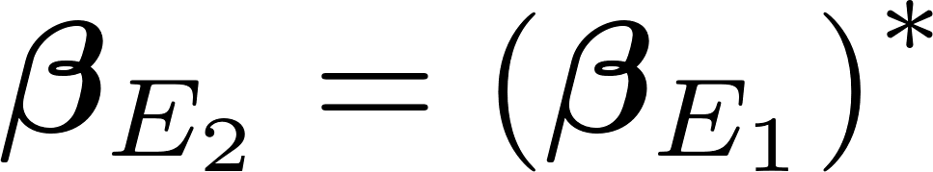
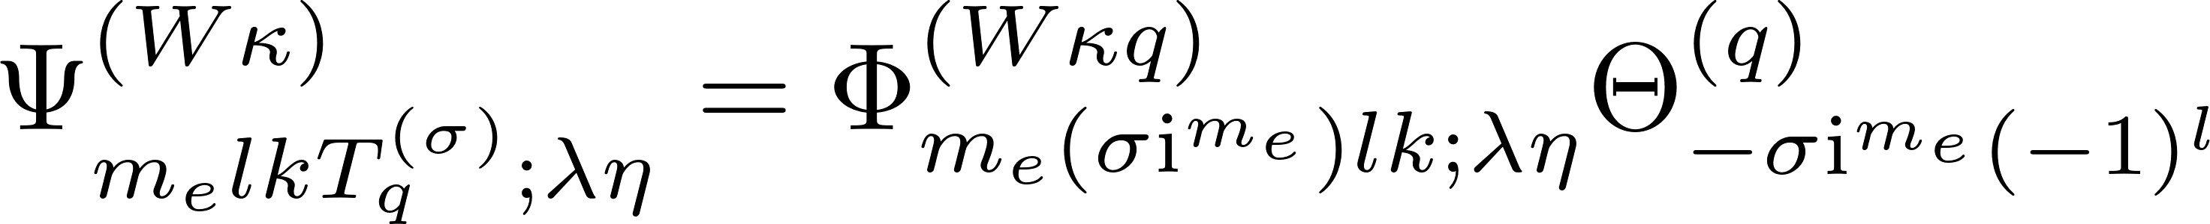
Symmetrized States, m even

Slide 5
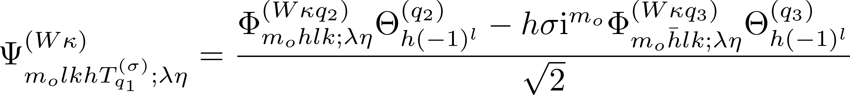
Symmetrized States, m odd

Slide 6
Integrable Potential Forms
Forms that might be used

Slide 7
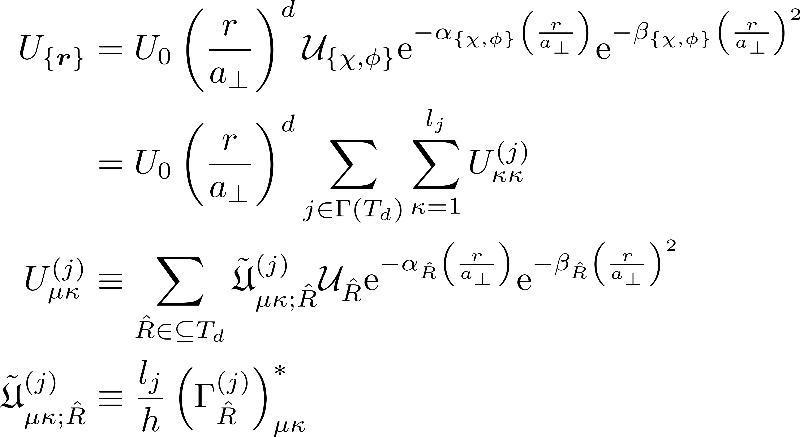
Raw potential

Slide 8
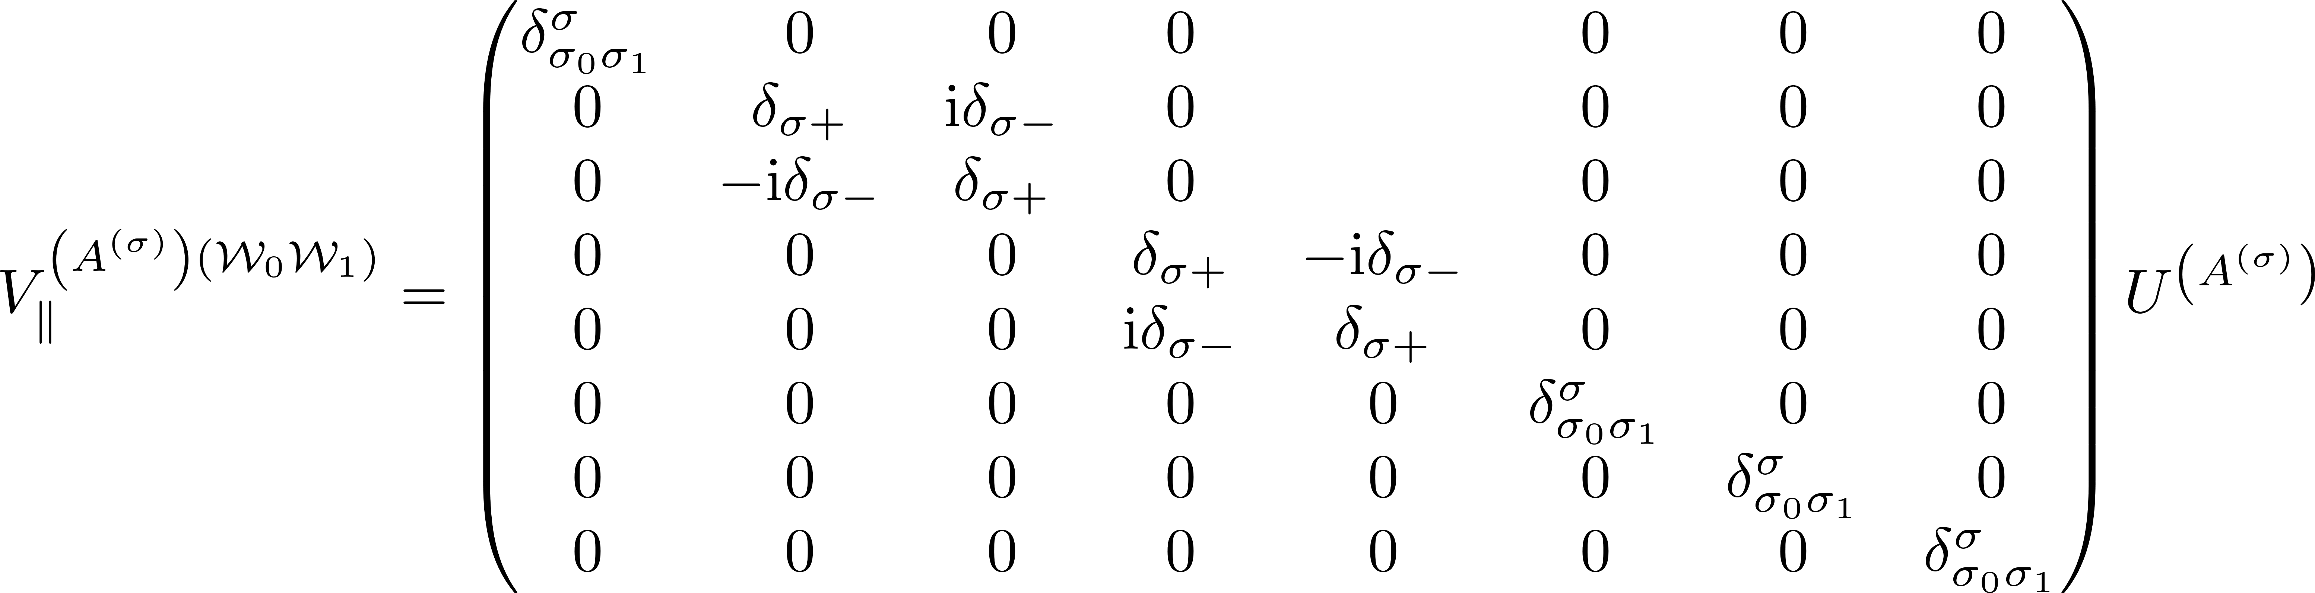
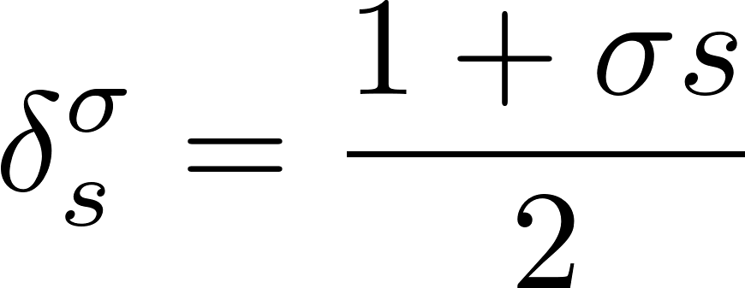
Filtered potential involving parallel valleys

Slide 9
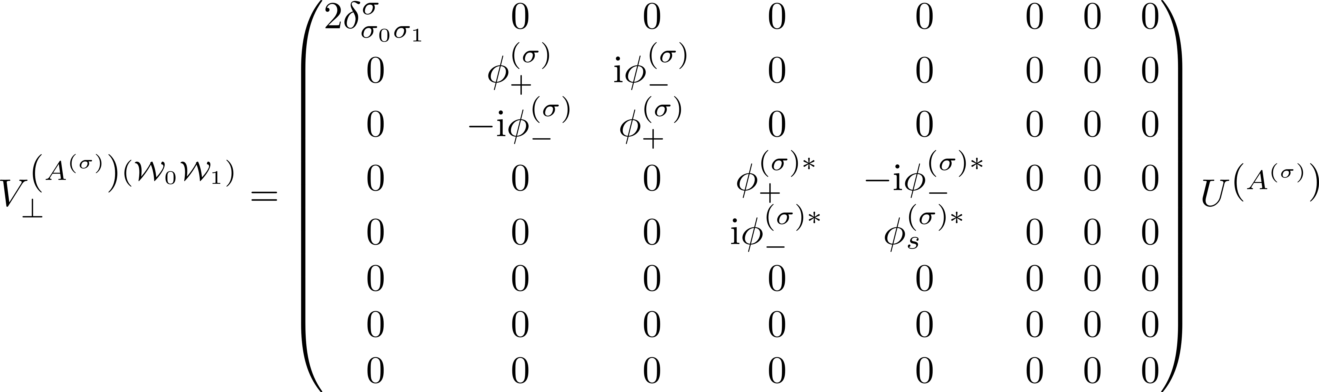
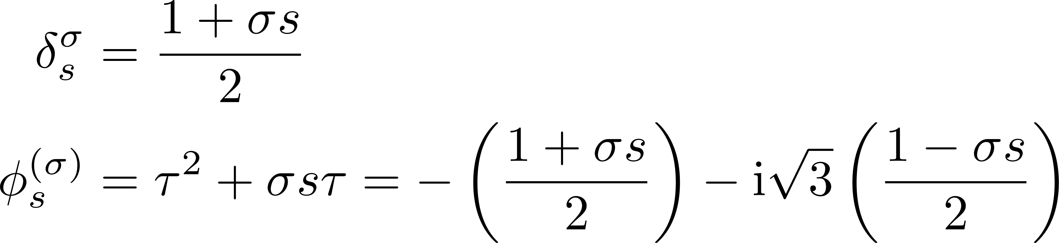
Filtered potential involving perpendicular valleys

Slide 10
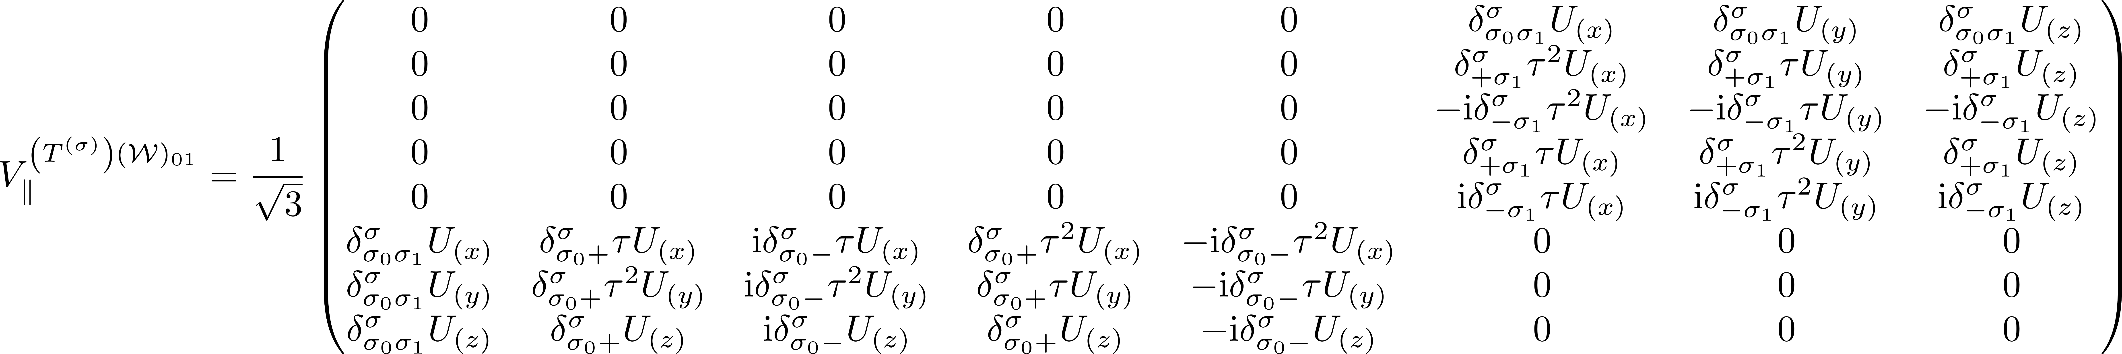
Filtered potential involving parallel valleys

Slide 11
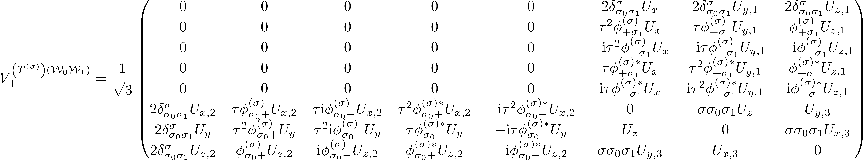

Inversion filtered potential involving perpendicular valleys

Slide 12
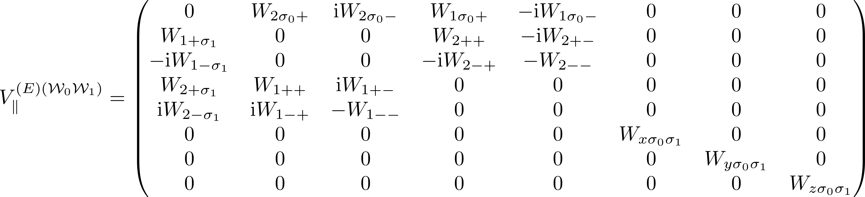
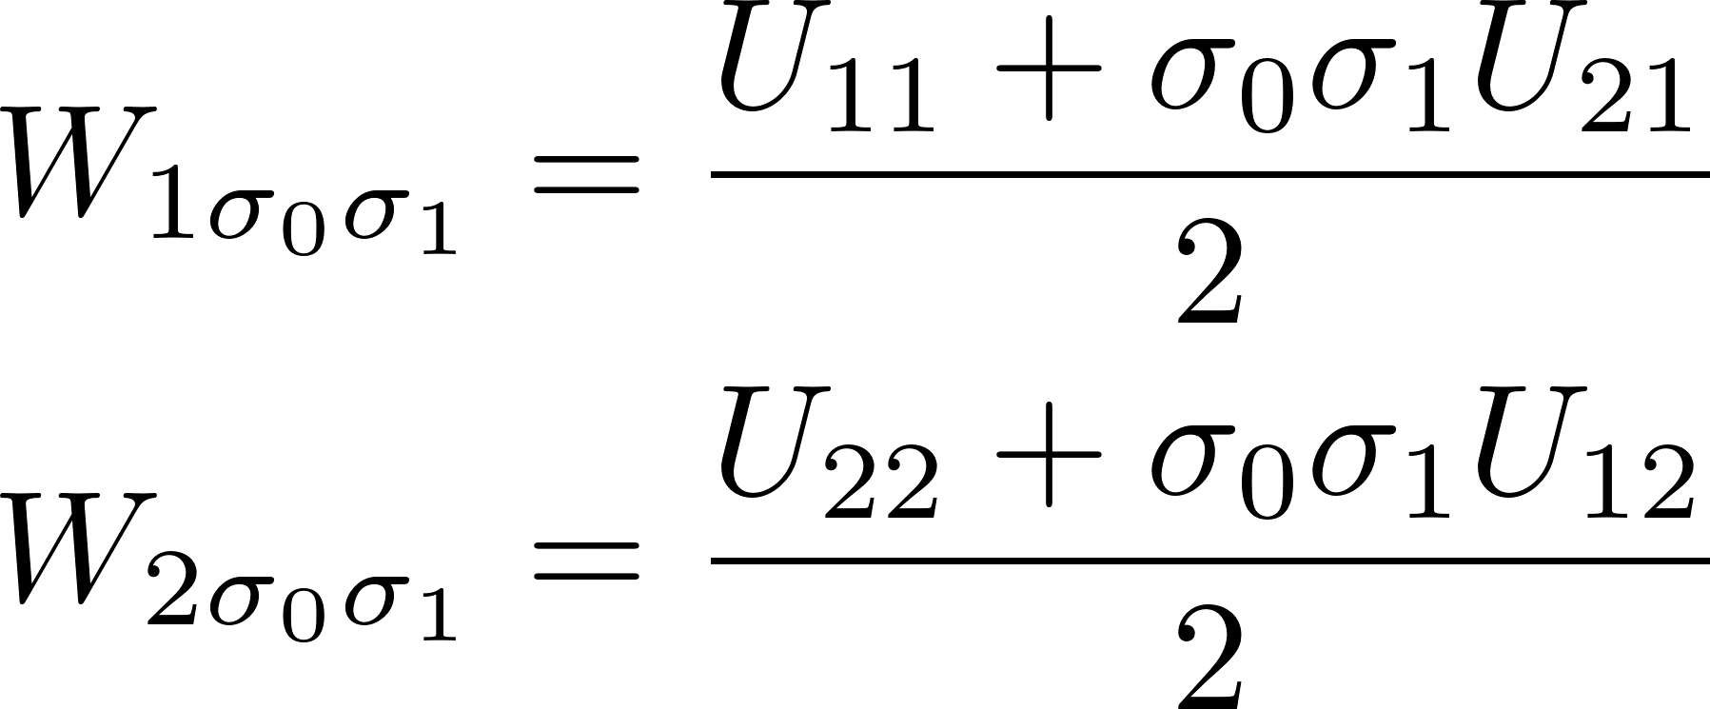
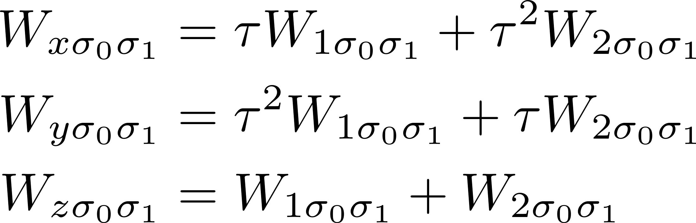
Filtered potential involving parallel valleys

Slide 13
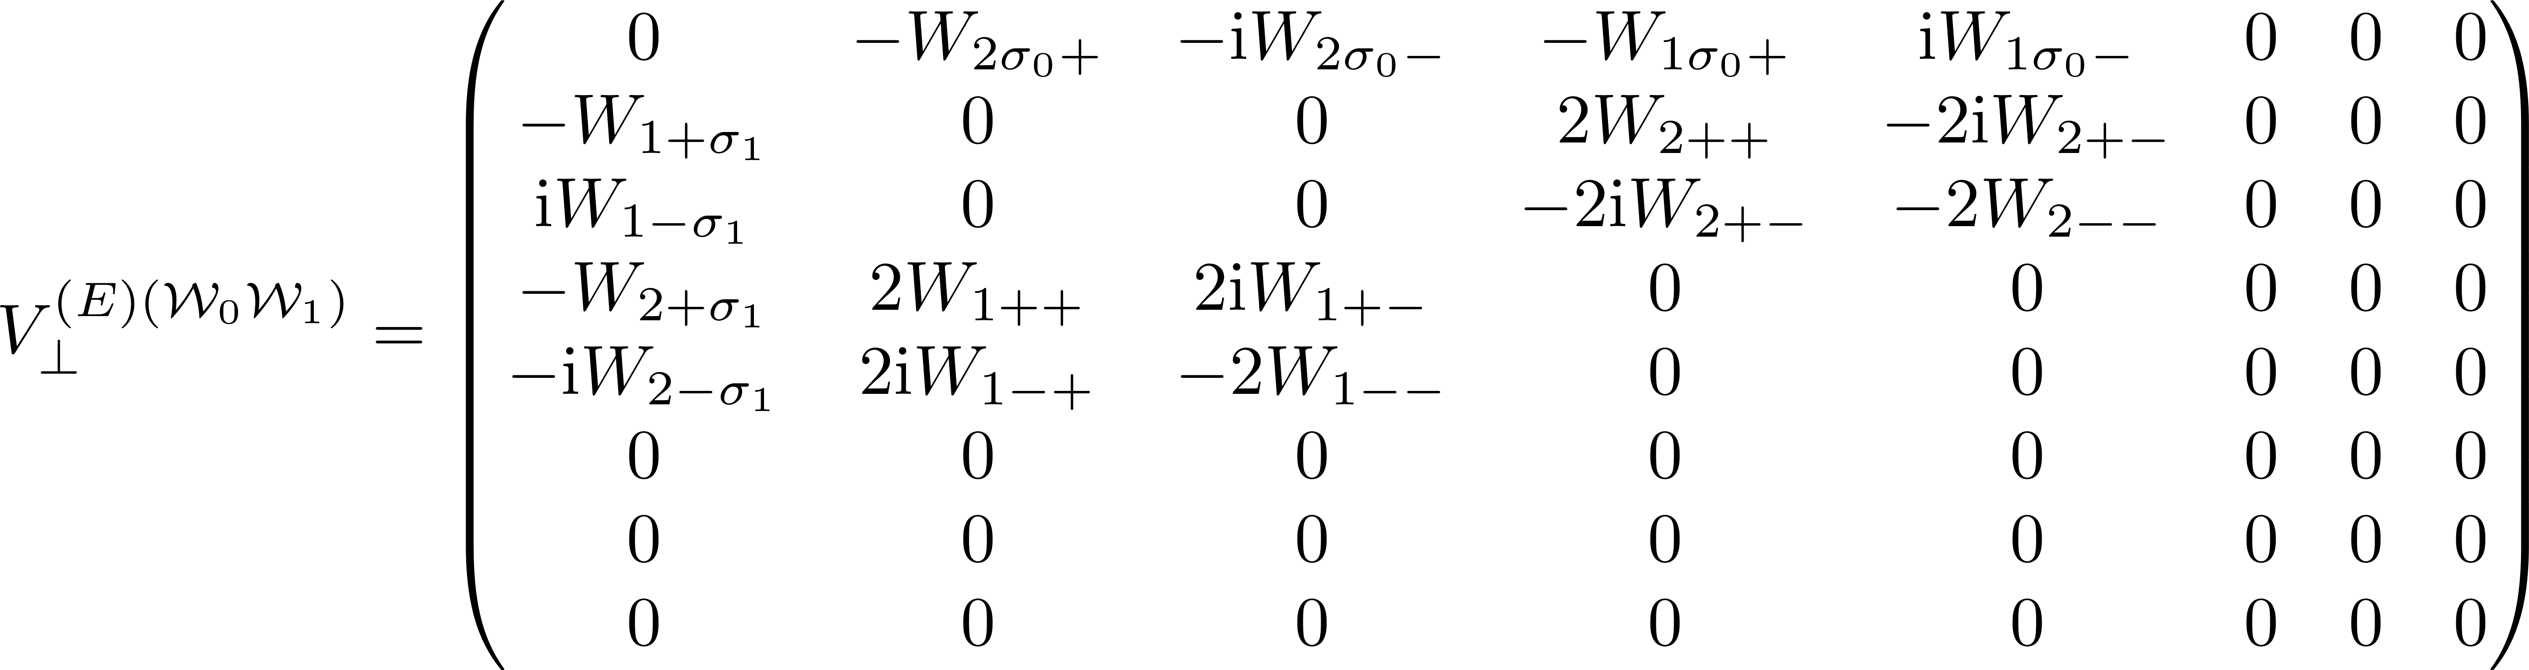
Filtered potential involving perpendicular valleys

Slide 14
GENERAL MATRIX ELEMENT FORMULA
Finding a general form for the matrix element

Slide 15
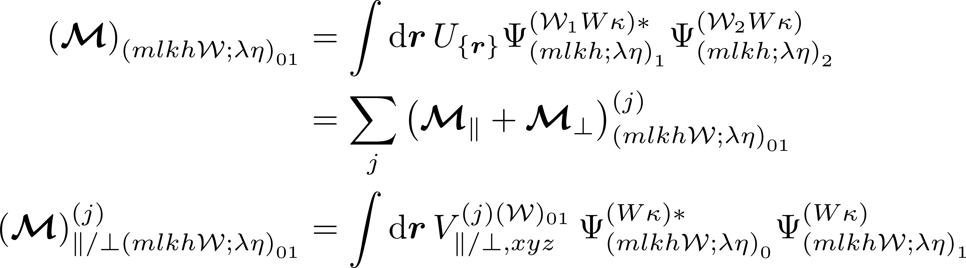
General matrix element formula

Slide 16
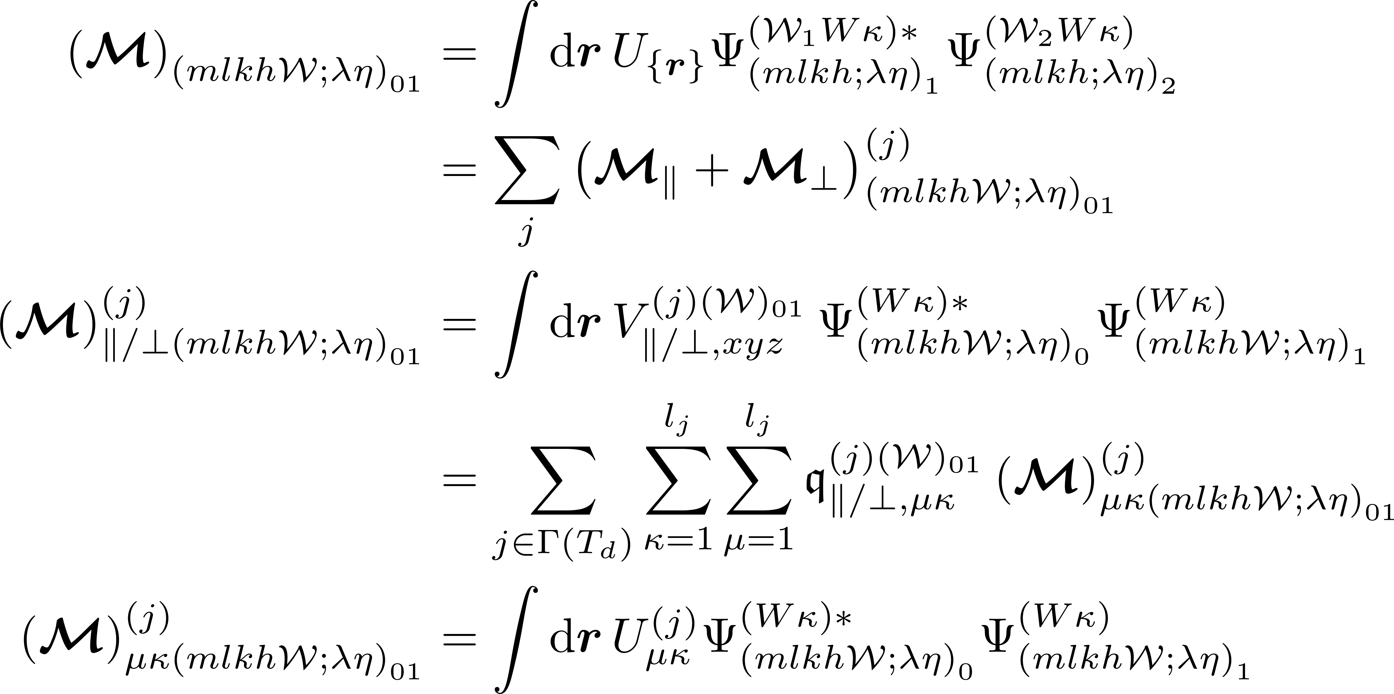
Simplifying expressions using cyclic and acyclic symmetries

Slide 17
ODD WaveFunctions
Integrals involving wavefunctions with m odd can be simplified

Slide 18
ODD, ODD

Slide 19
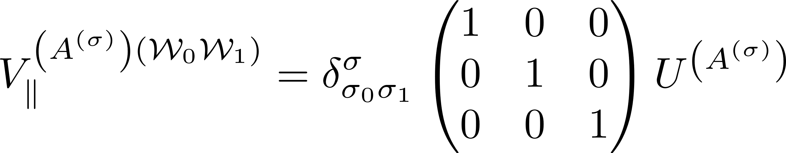
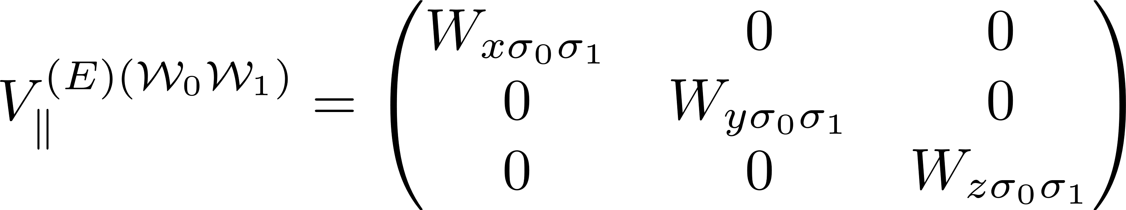
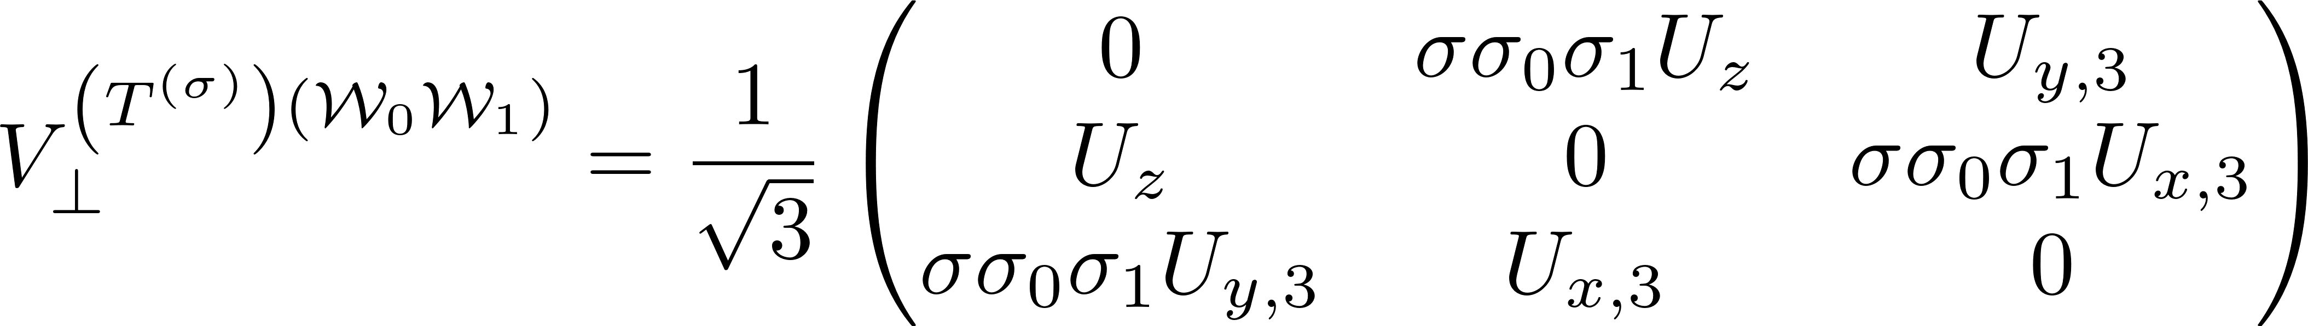
Filtered potential

Slide 20
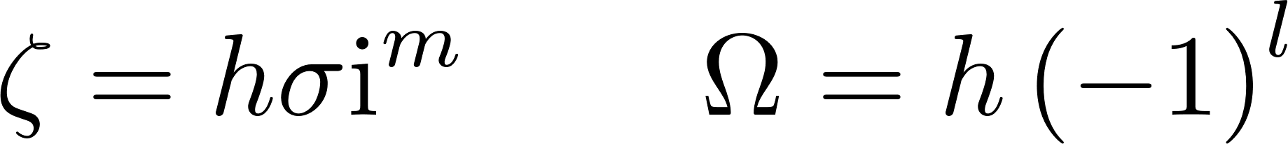
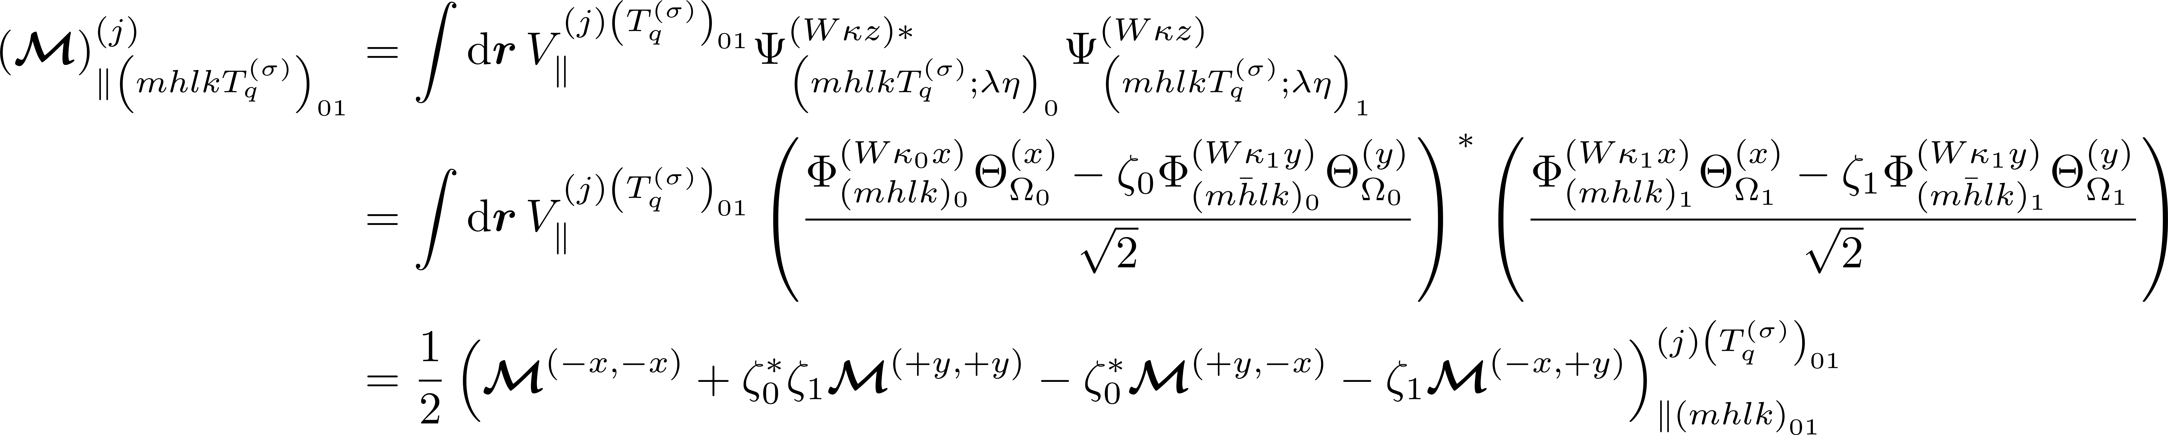
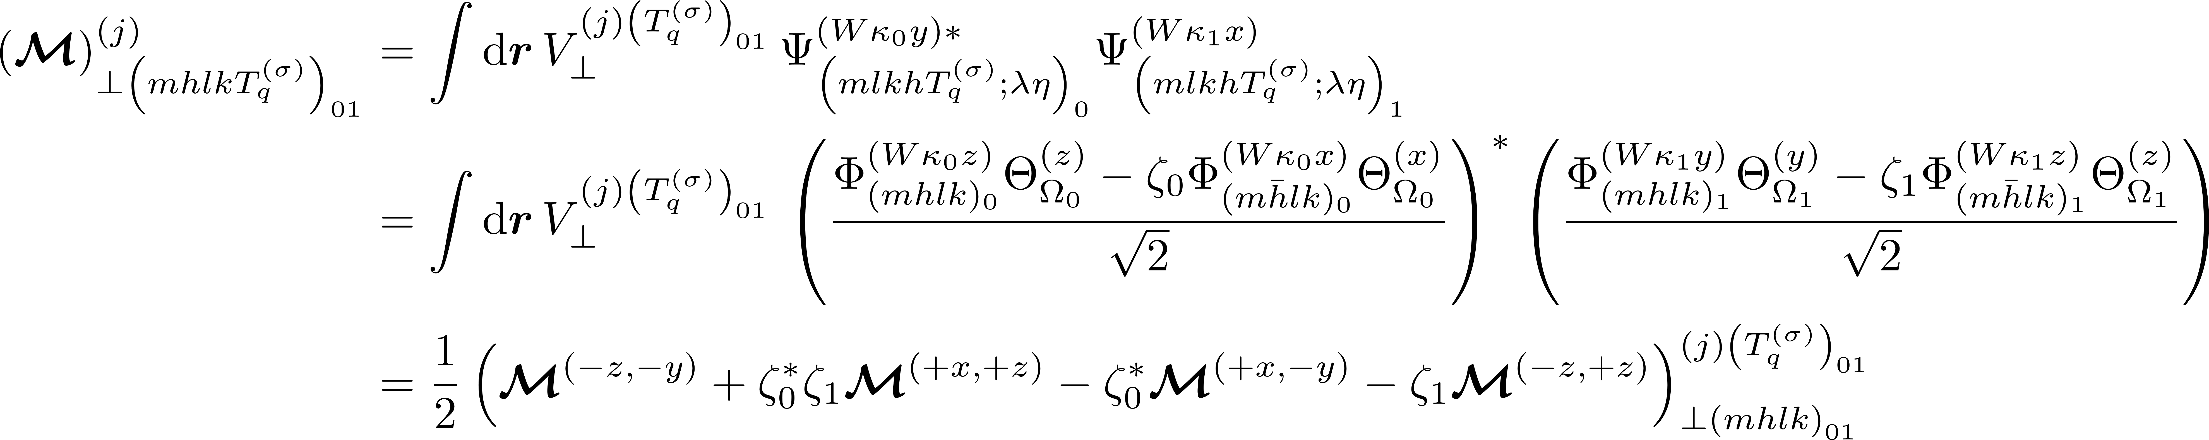
m₀ odd, m₁ odd – Expanding odd wavefunction

Slide 21
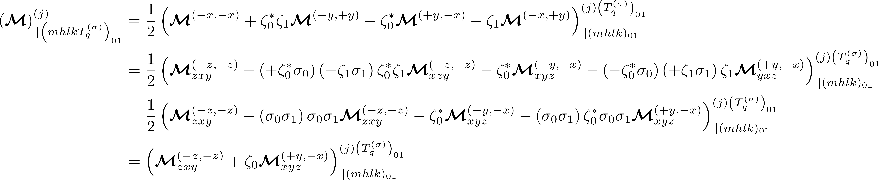
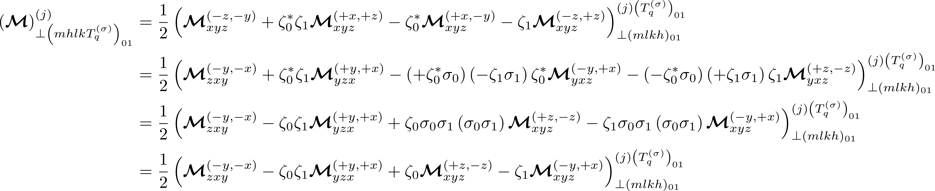
m₀ odd, m₁ odd – Simplifying using symmetry transformations

Slide 22
EVEN, ODD

Slide 23
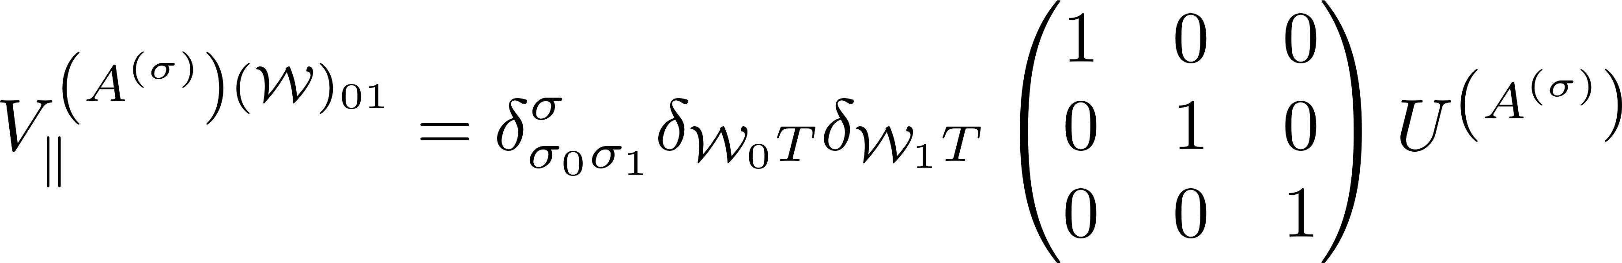
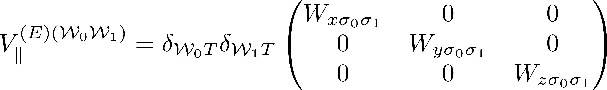
Filtered potential

Slide 24
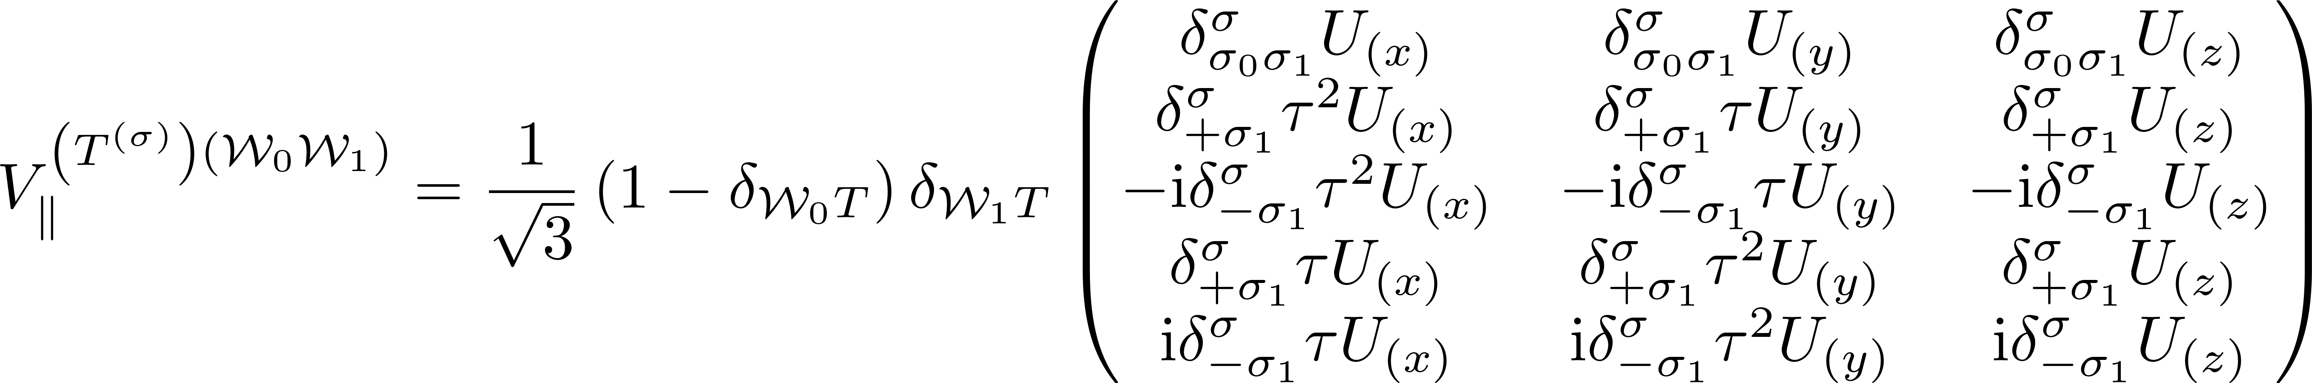
Filtered potential involving parallel valleys

Slide 25
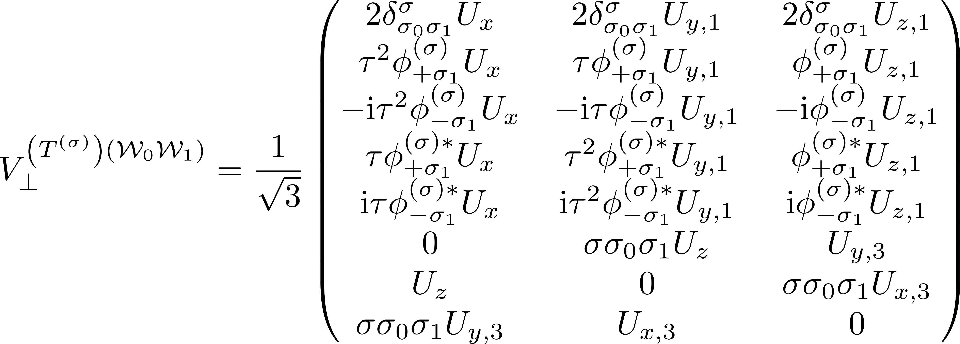
Inversion filtered potential involving perpendicular valleys

Slide 26
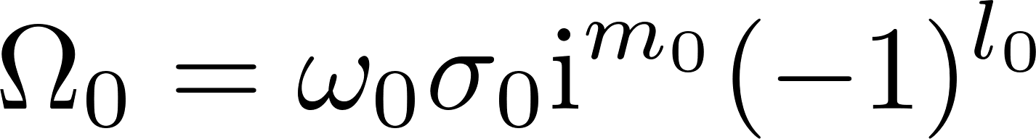
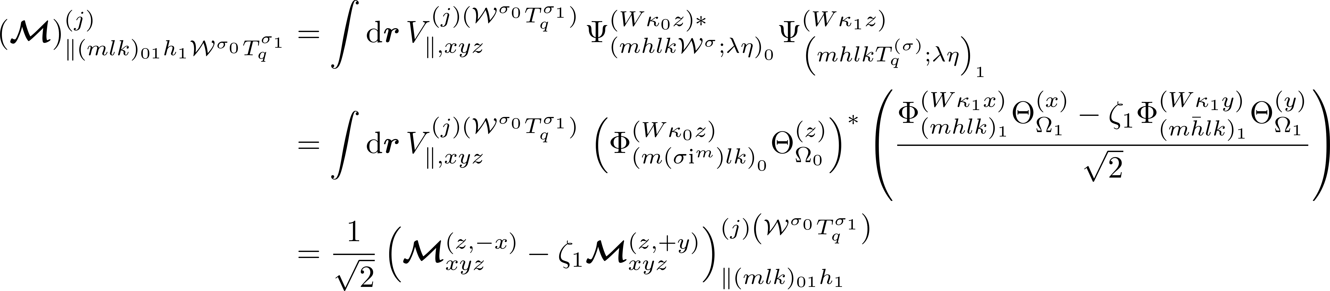
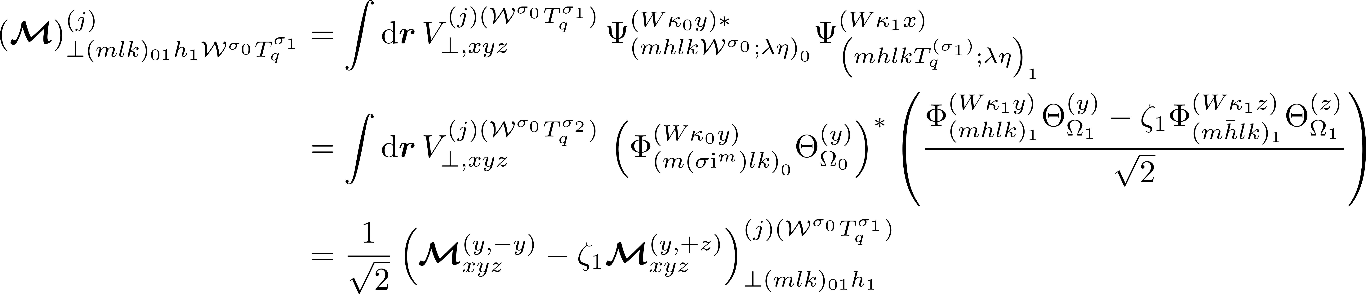
m₀ even, m₁ odd – Expanding odd wavefunction

Slide 27
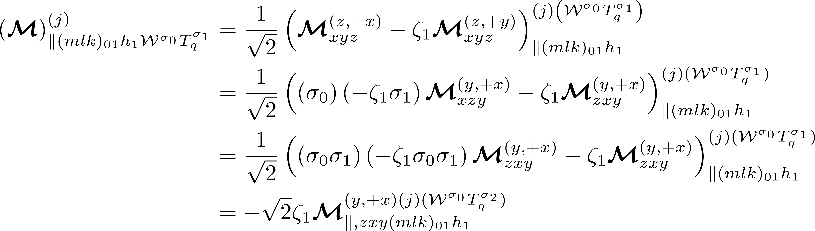
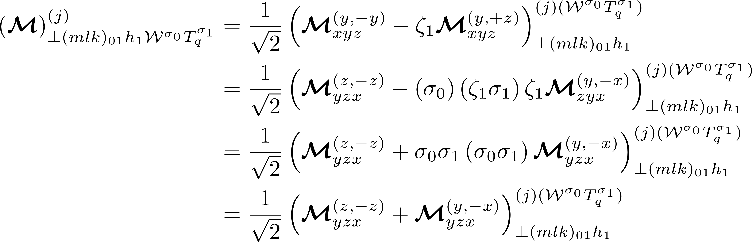
m₀ even, m₁ odd – Simplifying using symmetry transformations

Slide 28
ODD, EVEN

Slide 29



m₀ odd, m₁ even – Expanding odd wavefunction

Slide 30


m₀ odd, m₁ even – Simplifying using symmetry transformations

Slide 31
SYMMETRIZED Forms
Collecting together the matrix elements with simplified and symmetrized integrands

Slide 32
m₀ even, m₁ even – Unreduced final form

Slide 33
m₀ even, m₁ odd – Unreduced final form

Slide 34

m₀ odd, m₁ even – Unreduced final form

Slide 35
m₀ odd, m₁ odd – Unreduced final form

Slide 36
INTEGRAL REDUCTION
Reducing integral domain using symmetry operations (with a presymmetrized potential)

Slide 37




















Transformed regions and associated symmetry operation
Integrand has useful symmetry properties.
Transformations given are applied to different regions of the solid angle.
Transforming maps an integral over a different region to an integral over the blue region.

Slide 38

m₀ even, m₁ even – Final form

Slide 39

m₀ even, m₁ odd – Final form

Slide 40

m₀ odd, m₁ even – Final form

Slide 41
m₁ odd, m₂ odd – Final form

Slide 42
GENERAL MATRIX ELEMENT DeFINITION
Finding a general form for the matrix element

Slide 43
General matrix element formula

Slide 44

Raw potential

Slide 45

Filtered potential involving parallel valleys

Slide 46

Filtered potential involving perpendicular valleys

Slide 47
Filtered potential involving parallel valleys

Slide 48

Inversion filtered potential involving perpendicular valleys

Slide 49

Filtered potential involving parallel valleys

Slide 50

Filtered potential involving perpendicular valleys

Slide 51

m₀ even, m₁ even – Final form

Slide 52
m₀ even, m₁ odd – Final form

Slide 53
m₀ odd, m₁ even – Final form

Slide 54

m₀ odd, m₁ odd – Final form

Slide 55
Base Integration Formula for Matrix Elements

