Slide 1
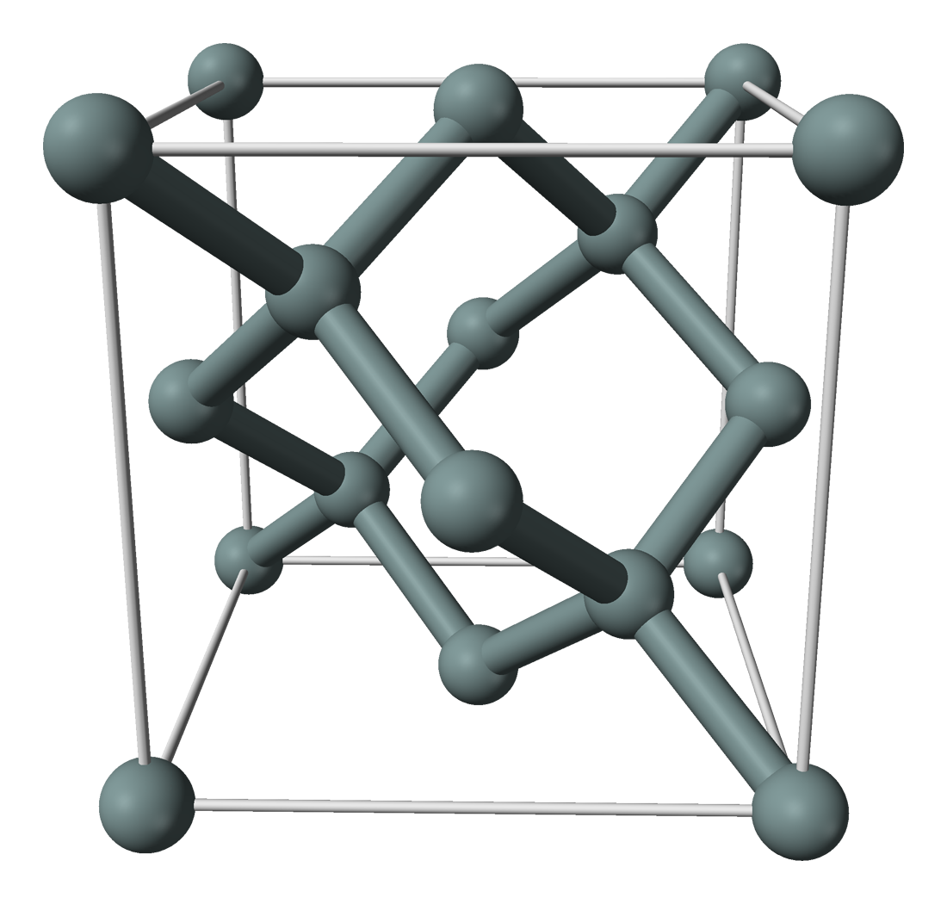
System description
Infinite silicon crystal bulk.
Silicon replaced by an isolated pnictogen (Series V/Group 15) impurity.
Specifically we consider the phosphorous substitutional donor.
System is symmetric about the impurity under operations of T_{d}.
Excess nuclear electric charge of phosphorous attracts an excess electron.
P
Crystal structure picture by Ben Mills, public domain.
https://commons.wikimedia.org/w/index.php?curid=2722584
Our rough approach
Excess electron is affected by a periodic mean field potential, and weakly bound to donor potential.
Short-range: looks like a Bloch wave.
Long-range: attenuated on a larger scale radius longer then lattice parameter.

Slide 2
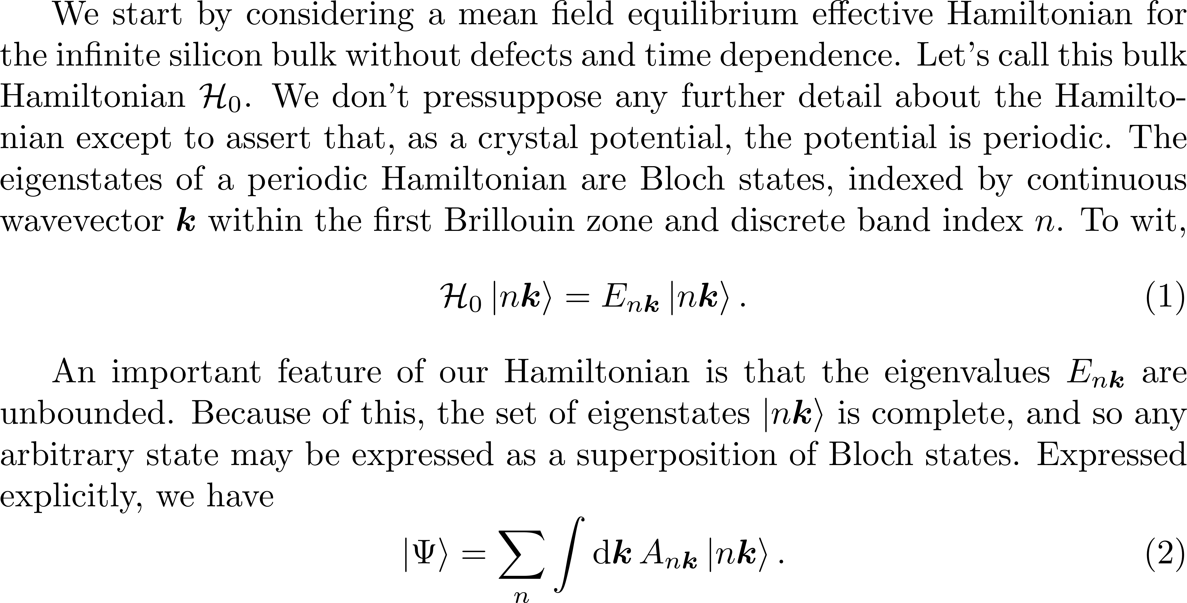
Crystal bulk Hamiltonian

Slide 3
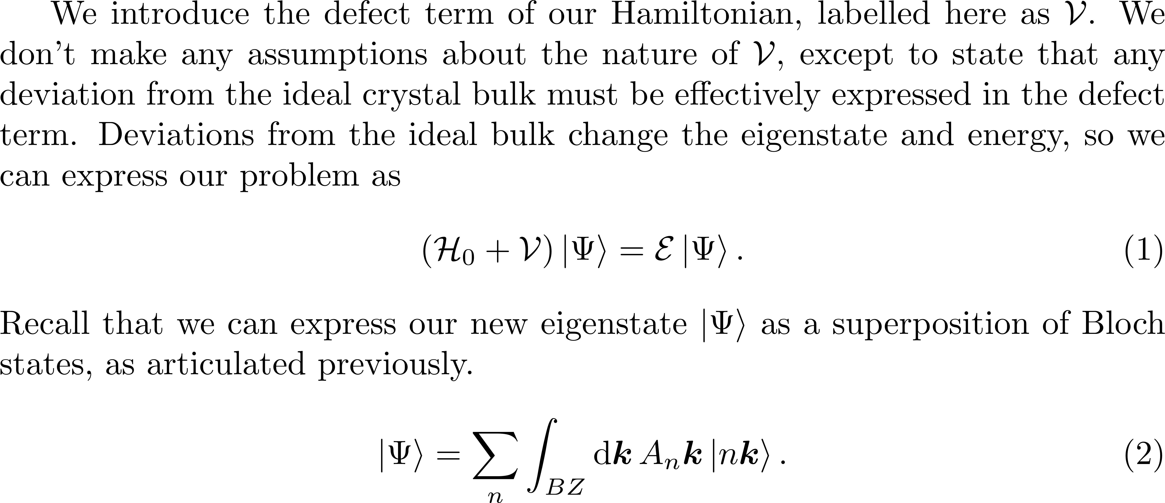
Introducing defects

Slide 4
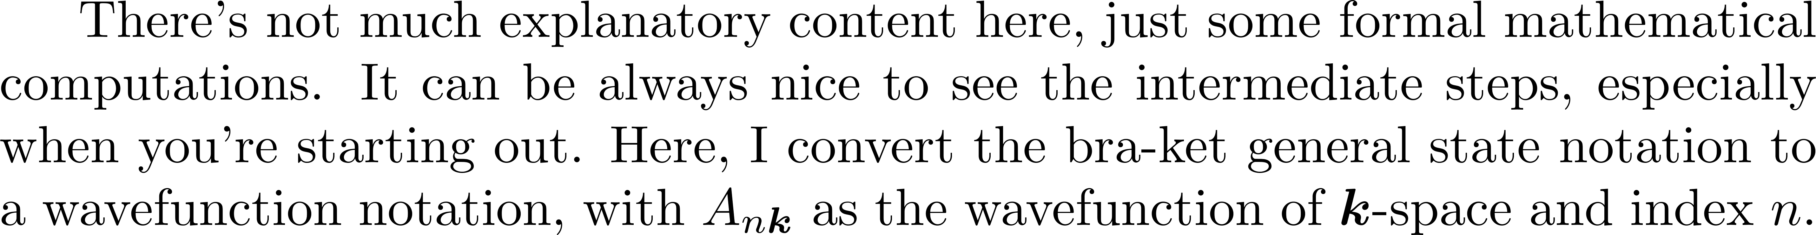
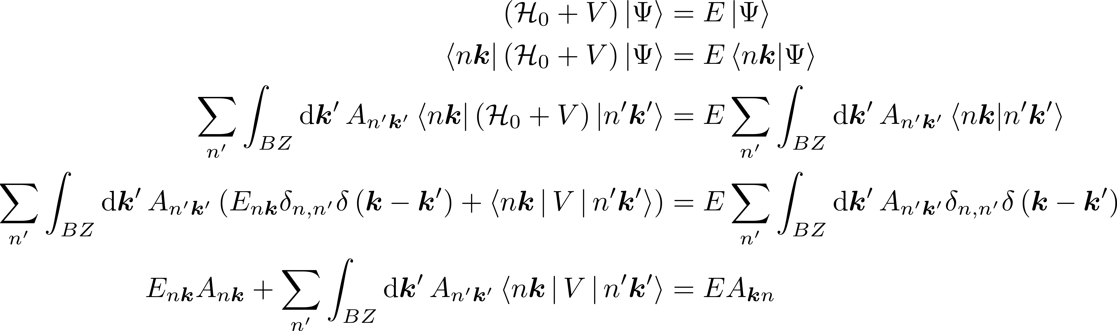
Whiteboard 1

Slide 5
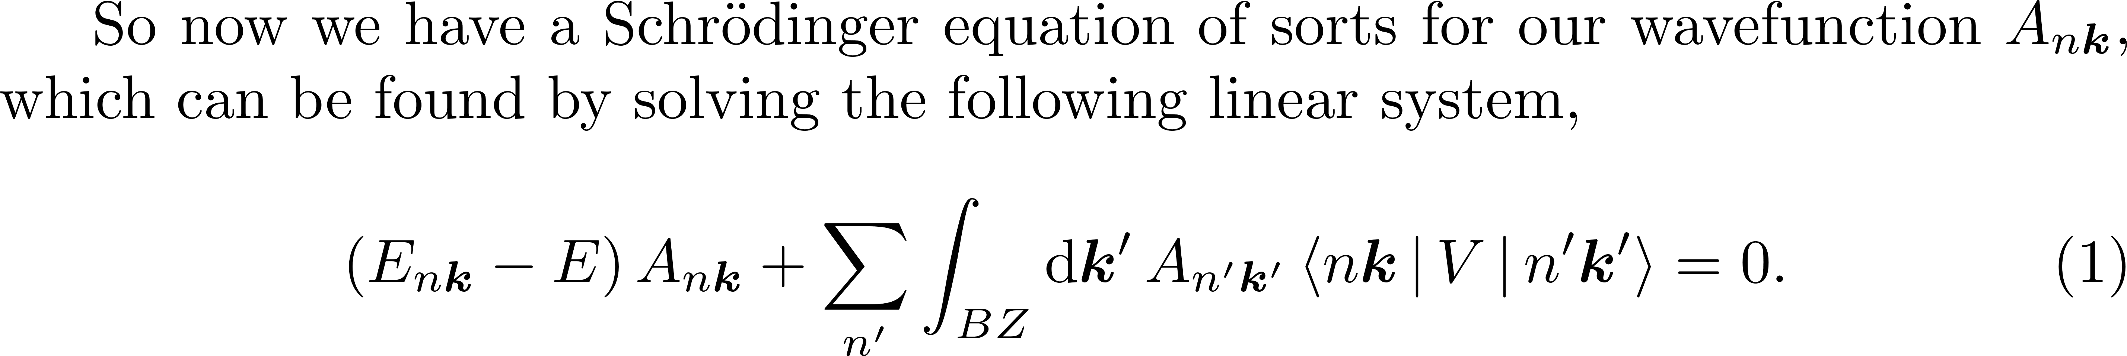
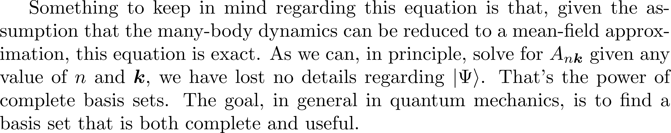
Wavefunction equation

Slide 6
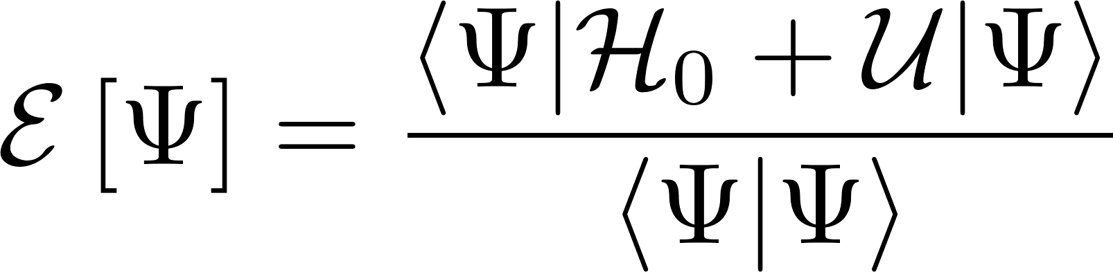
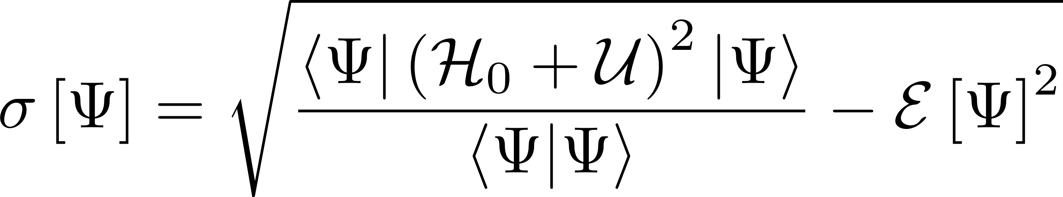
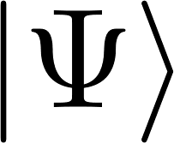

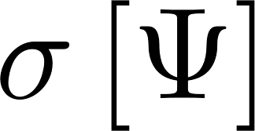

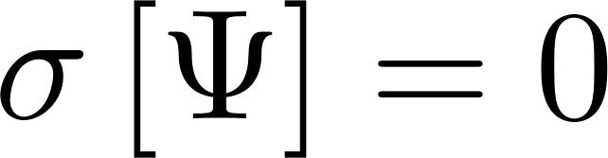
Variational method
Find an ansatz s.t. and are minimized.
Iff is exactly an eigenstate of then .
Dramatically reduces problem difficulty, but requires judicious choice of ansatz.
No clear method to refine ansatz to approach exact solution within desired numerical tolerances.

Slide 7
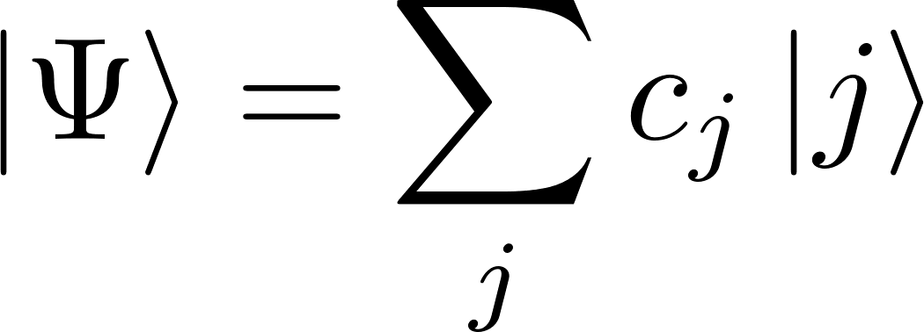
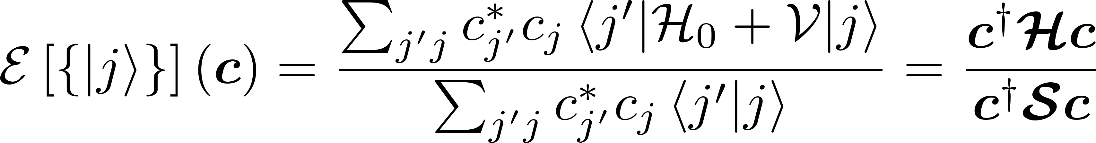
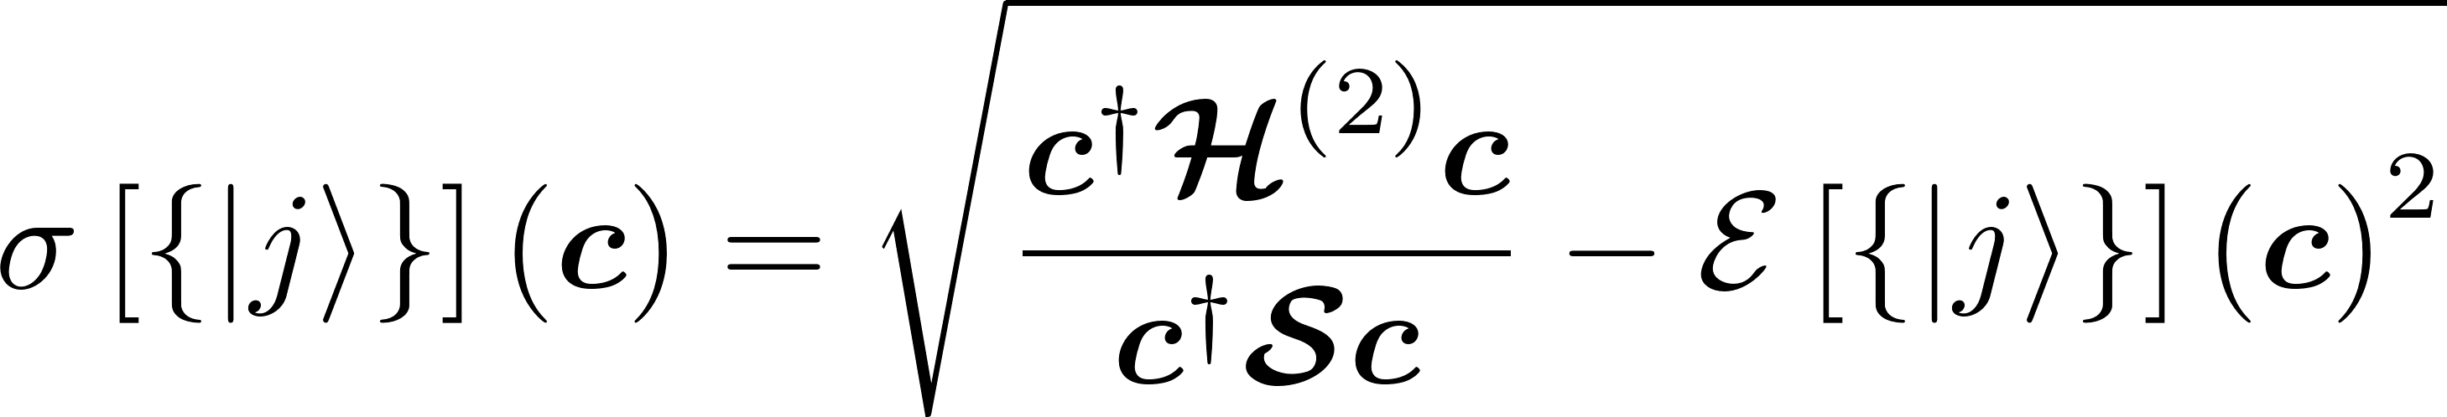
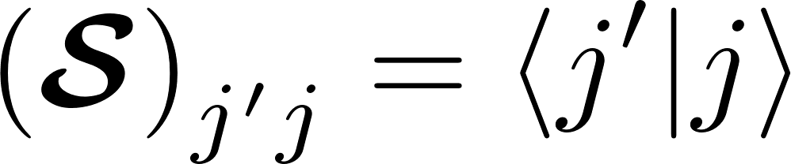
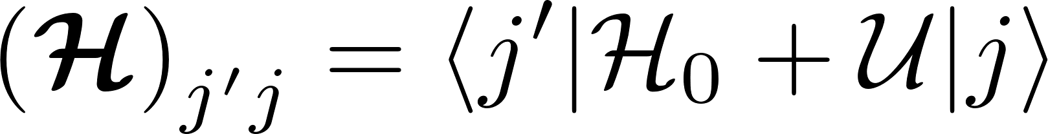
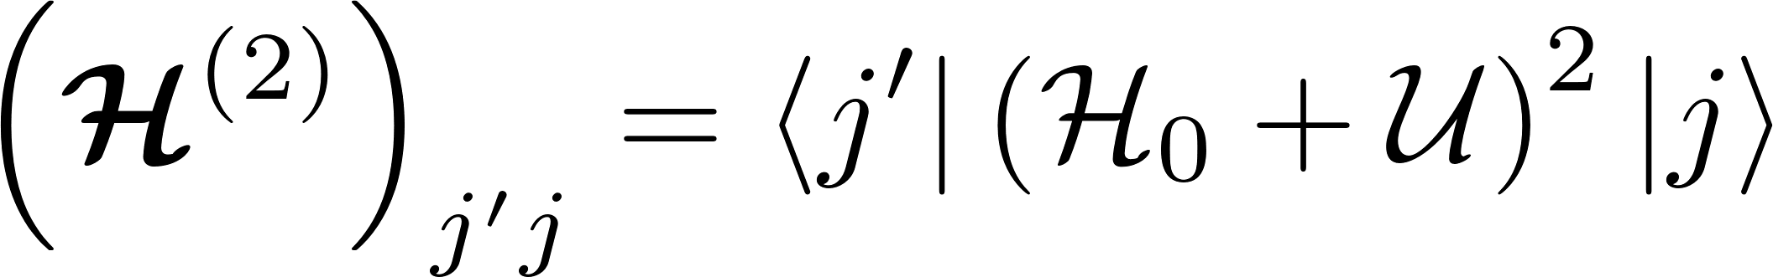
Ritz method
Express ansatz as a summation over a set of basis states.
No guarantee of orthonormality assumed.
If basis set is complete, ansatz approaches exact solution as terms are added.

Slide 8
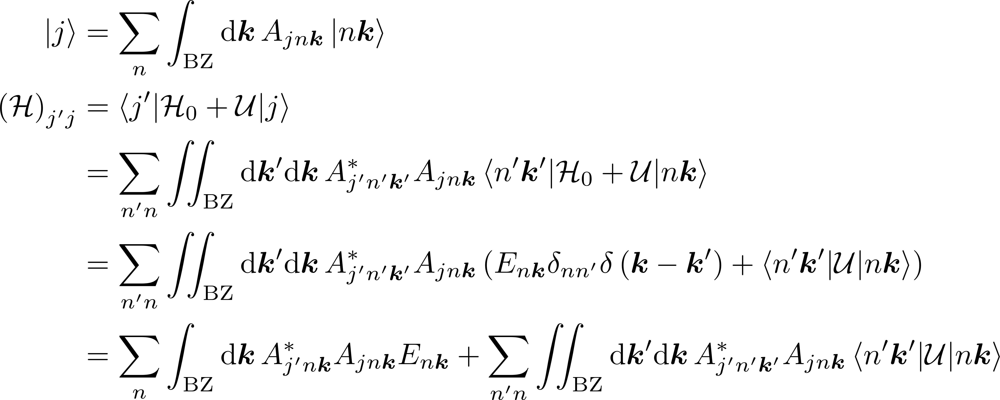
Whiteboard 2

Slide 9
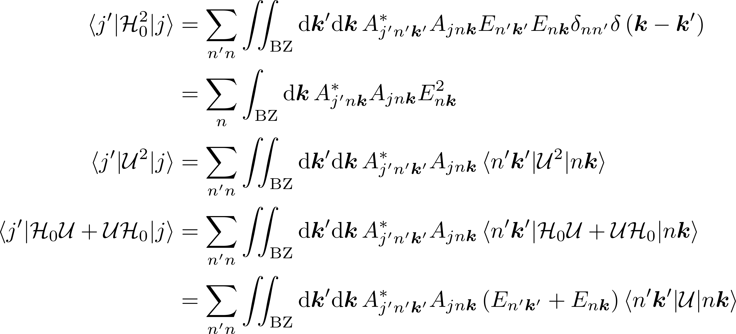
Whiteboard 3a

Slide 10
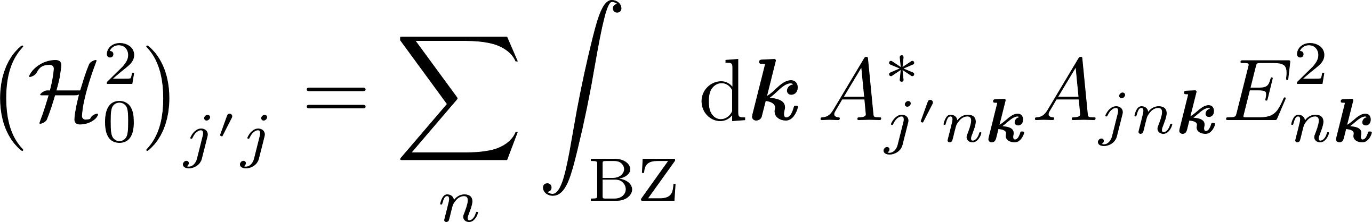
Whiteboard 3b

Slide 11
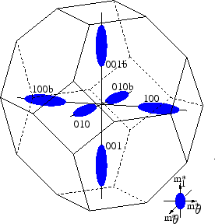
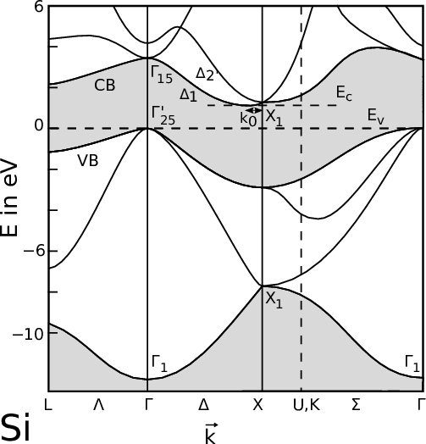
Introducing the effective mass approximations -- I
EMA-1: Assume in k-space the donor electron is localized at the six-fold degenerate minima of the silicon conduction band.
Minima picture from S. Dhar.
Dr.techn. Thesis, Vienna University of Technology, 2007.
http://www.iue.tuwien.ac.at/phd/dhar/node18.html

Slide 12
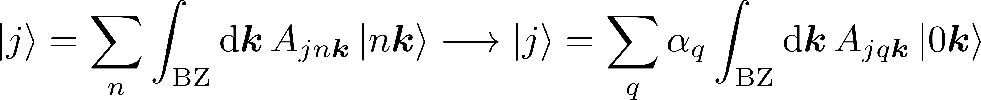
Introducing the effective mass approximations -- II
EMA-1: Assume in k-space the donor electron is localized at the six-fold degenerate minima of the silicon conduction band.

Slide 13
Whiteboard 4

Slide 14
Whiteboard 5

Slide 15
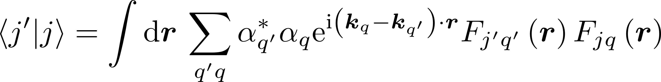
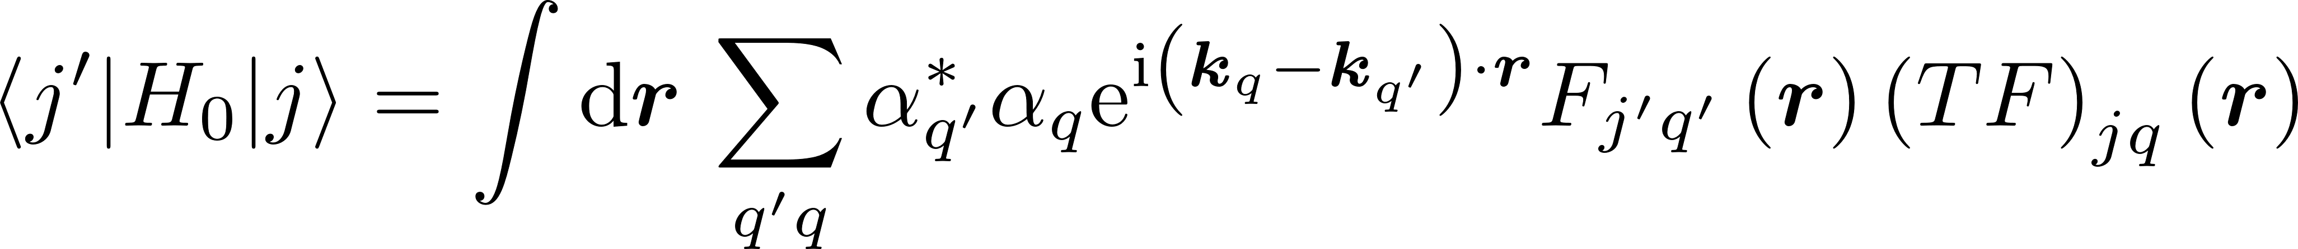
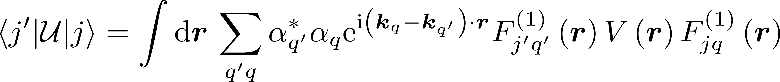
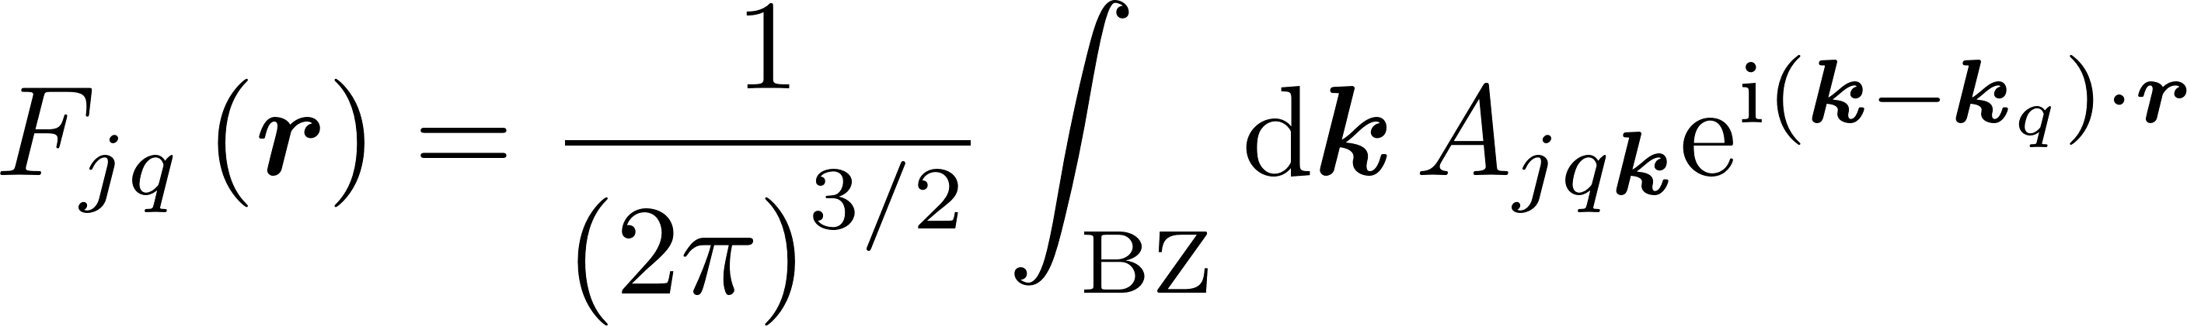
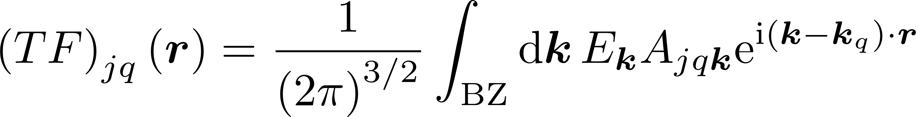
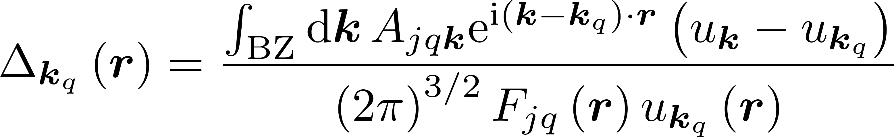
Starting to compute matrix elements

Slide 16

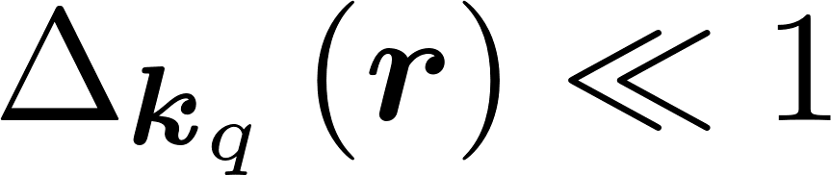
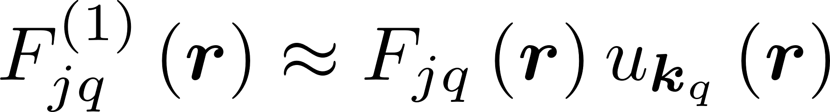
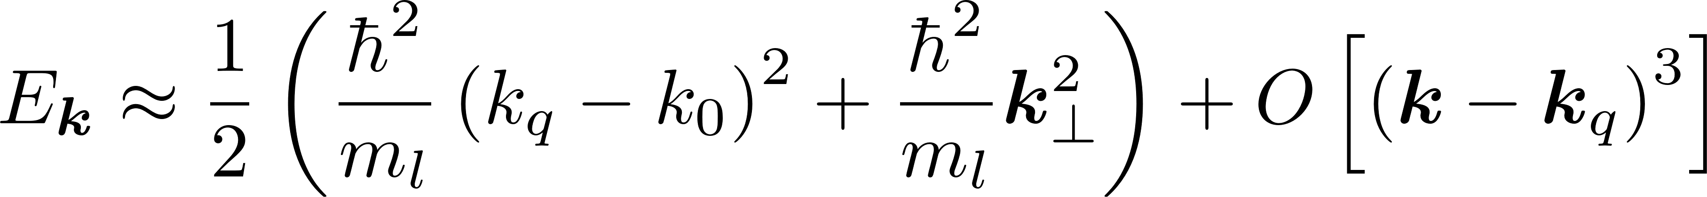
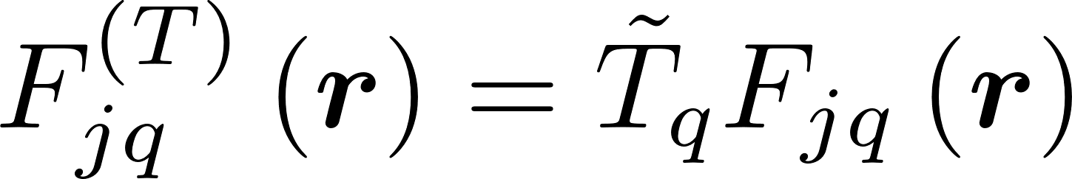
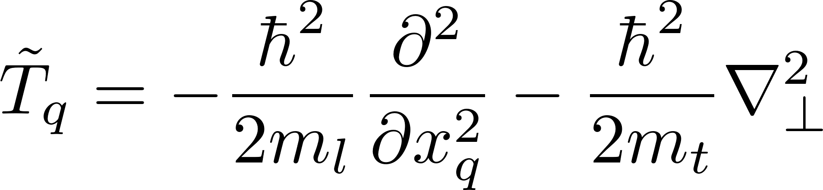
Further elaboration of effective mass approximations
EMA-2: Because of k-space localization of donor electron we assert the following two things.

