Slide 1
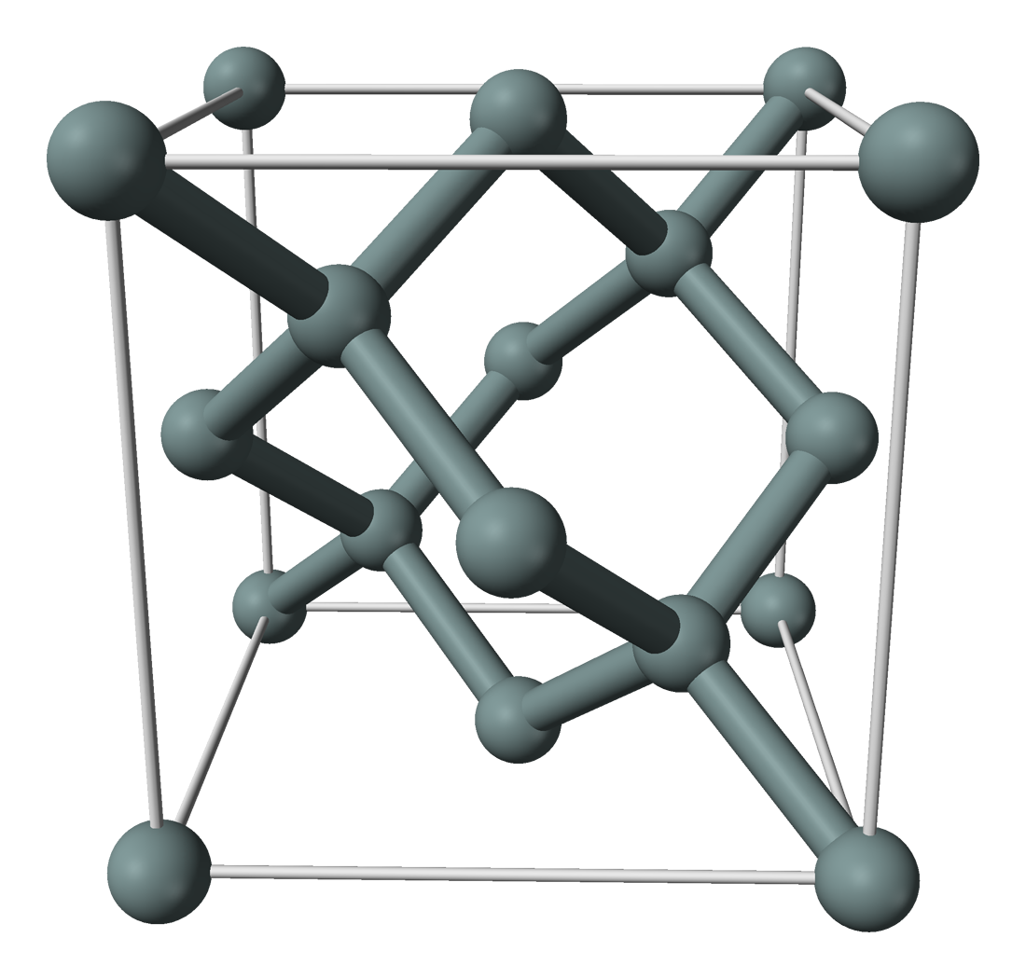
System description
Infinite silicon crystal bulk.
Silicon replaced by an isolated pnictogen (Group V/Group 15) impurity.
The pnictogen we consider most often is phosphorous.
System is symmetric about the impurity under operations of point group T_{d}.
Excess proton of pnictogen attracts an excess electron.
Excess electron affected by periodic crystal potential, weakly bound to donor potential.
Short-range: looks like a Bloch wave.
Long-range: attenuated on scale longer then lattice parameter.
P
Picture modified by L. Pendo
Original crystal structure picture by Ben Mills, public domain.
https://commons.wikimedia.org/w/index.php?curid=2722584

Slide 2
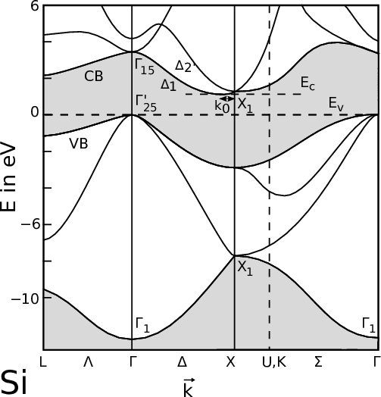
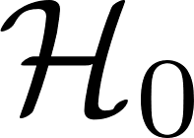
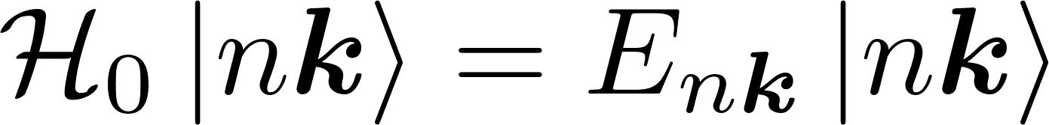
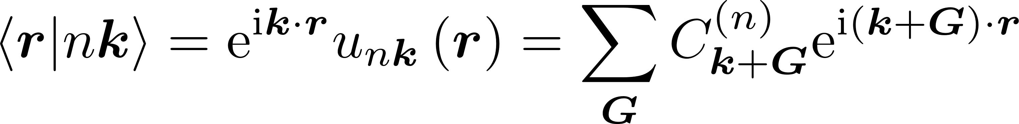
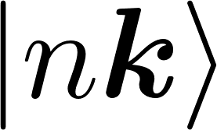
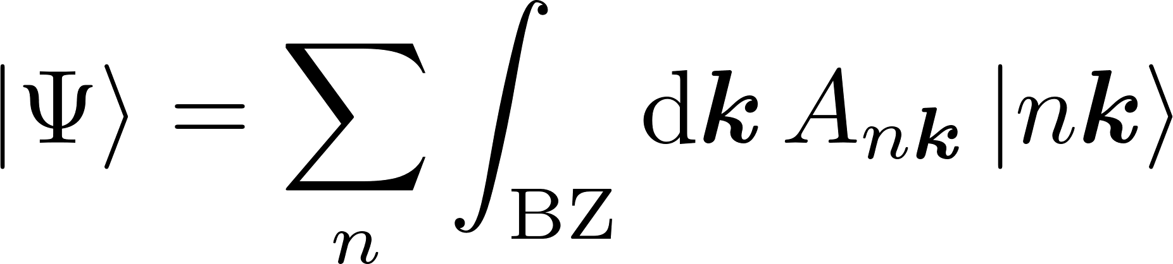
Pure crystal theory
Let the pure silicon crystal be described by the Hamiltonian .
Excess electron occupies a conduction band Bloch state.
is an unbounded Hermitian operator; set of forms complete basis.
As such, arbitrary states may be expanded in .
Band structure picture from J. Ghosh.
Dr.techn. Thesis, Vienna University of Technology, 2016.
https://www.iue.tuwien.ac.at/phd/ghosh/diss_htmse10.html

Slide 3
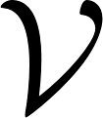
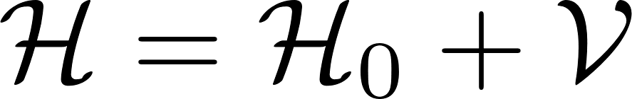
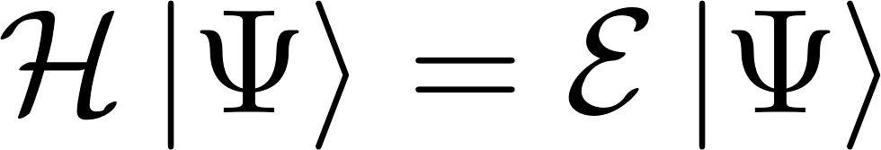
Introducing imperfections
Introduce an effective potential term to include all deviations from a perfect crystal.
Features that a candidate can include might be...
Mismatch between silicon and impurity core and valence electron wavefunctions.
Lattice deformations.
Dynamic dielectric constant, and break down of dielectric in core region.
Exchange interactions between donor excess electron and donor core and valence electrons.
External symmetry breaking fields.
The most useful form of effective potential is still an open question!

Slide 4
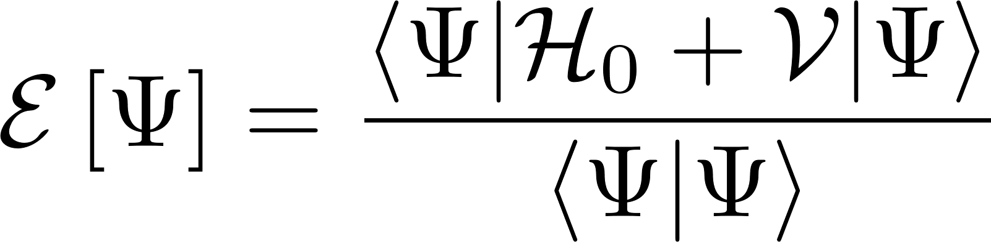
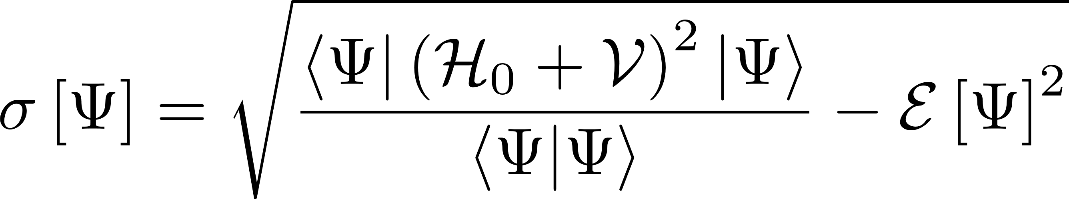
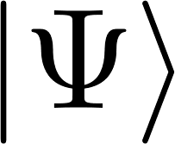
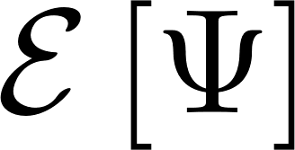
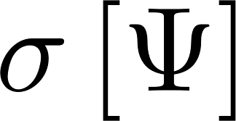
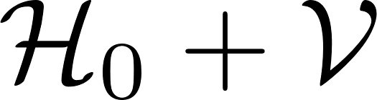
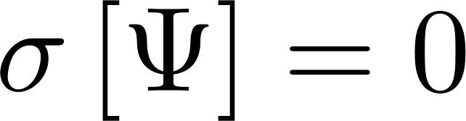
Variational method
Find an ansatz s.t. and are minimized.
Iff is exactly an eigenstate of then .
Dramatically reduces problem difficulty, but requires judicious choice of ansatz.
No clear method to refine ansatz to approach exact solution within desired numerical tolerances.

Slide 5
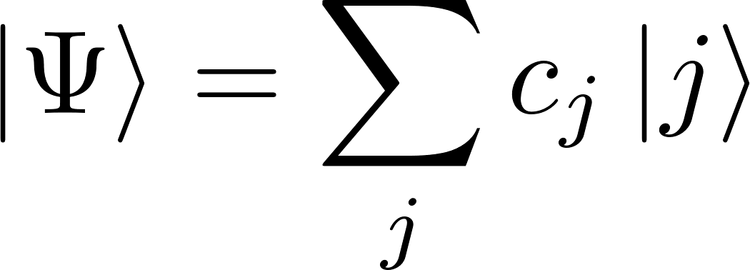
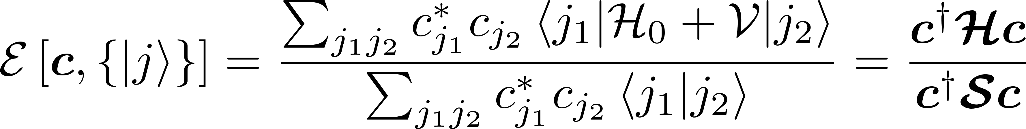
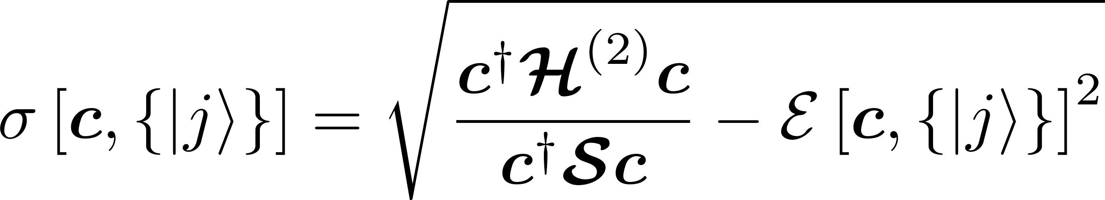
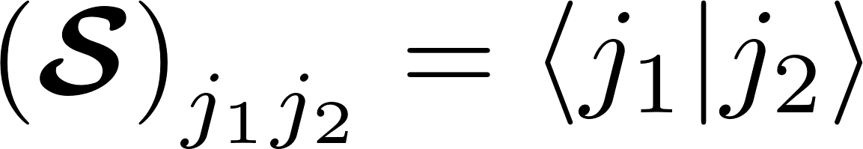
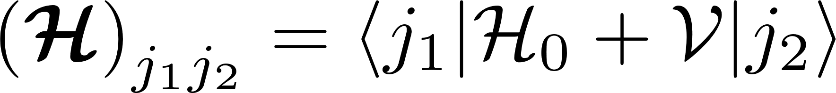
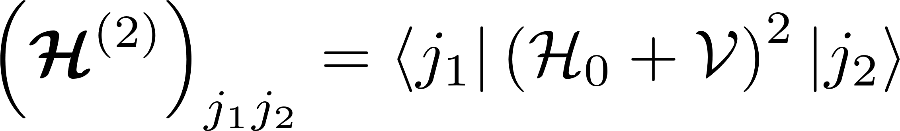

Ritz method
Express ansatz as a summation over a set of basis states.
No guarantee of orthonormality assumed.

Slide 6
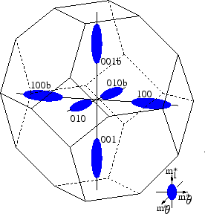
Introducing the effective mass approximations -- I
EMA-1: Assume in k-space the donor electron is localized at the six-fold degenerate minima of the silicon conduction band.
Minima picture from S. Dhar.
Dr.techn. Thesis, Vienna University of Technology, 2007.
http://www.iue.tuwien.ac.at/phd/dhar/node18.html

Slide 7
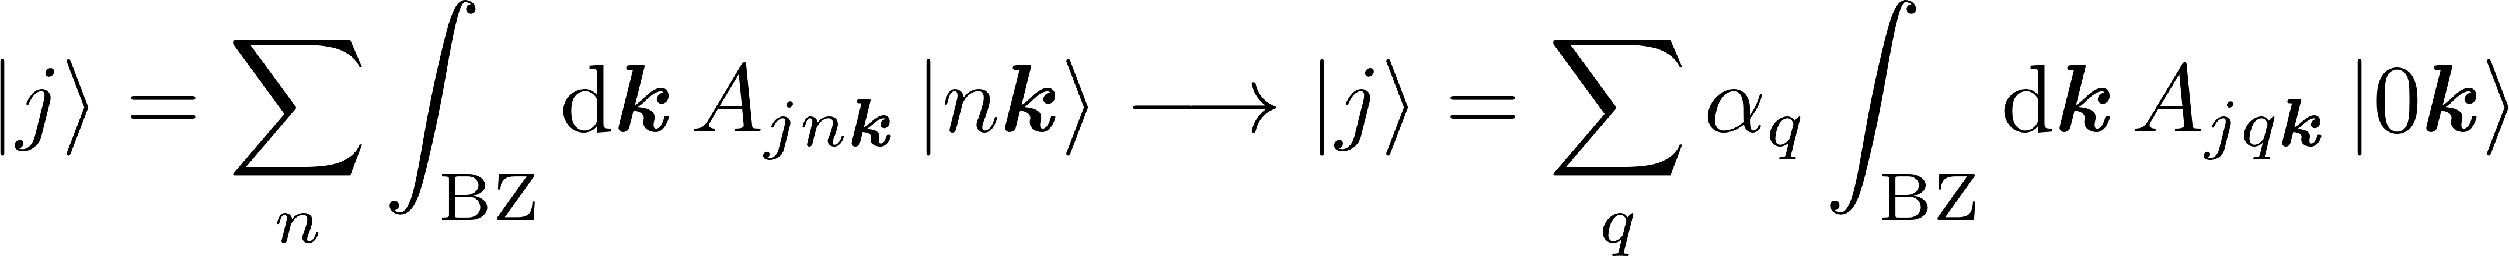
Introducing the effective mass approximations -- II
EMA-1: Assume in k-space the donor electron is localized at the six-fold degenerate minima of the silicon conduction band.

Slide 8
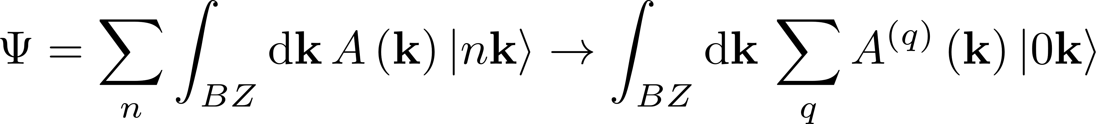
The effective mass approximation
EMA: Assume in k-space the donor electron is localized at the six-fold degenerate minima of the silicon conduction band.
[1] A.L. Saraiva, A. Baena, M.J. Calderón, B. Koiller, J. Phys: Condens. Matter 27, 154208 (2015)
[2] H.T Hui, Solid State Commun. 154, 19 (2013)
[3] A. Debernardi, A. Baldereschi, M. Fanciulli, Phys. Rev. B 74, 035202 (2006)
[4] C.J. Wellard, L.C.L. Hollenberg, Phys. Rev. B 72, 085202 (2005)
[5] K. Shindo and H. Nara, J. Phys. Soc. Jpn. 40, 1640 (1970)
[6] R.A. Faulkner, Phys. Rev. 184, 713 (1969)
Out of a multitude of effective mass models, a short list [1-6].
Why so many models?
Few agreed upon criteria for refutability (beyond agreement with energy spectrum).
Lots of freedom to generate different schemes through reasonable but ad hoc assumptions.
Is further improvement of effective mass methods possible?
In-model
Out of model
Consistency
How well does the model play by its own rules?
Verisimilitude
How well does the model resemble reality?
Completeness
Can the model answer questions posed to it?

Slide 9
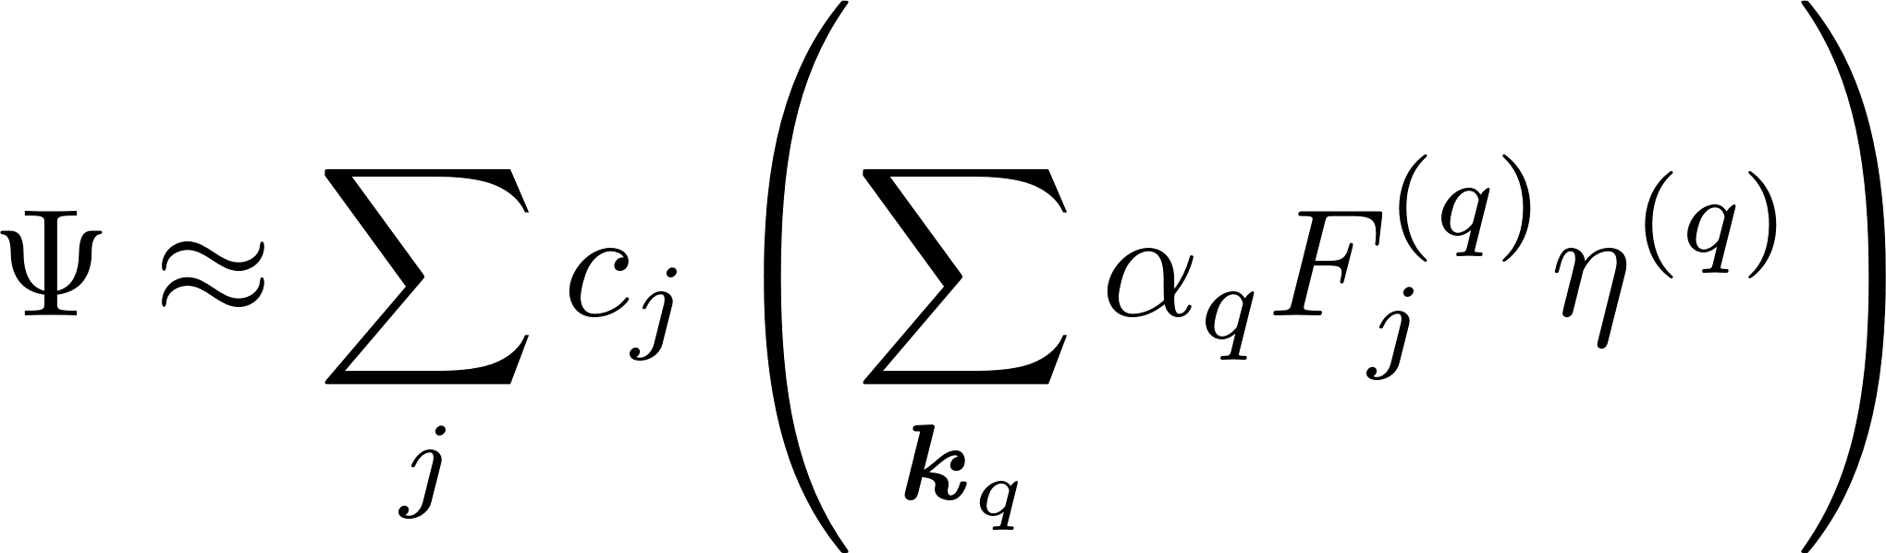
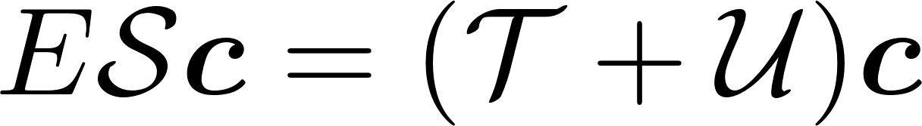
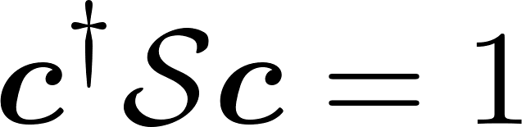
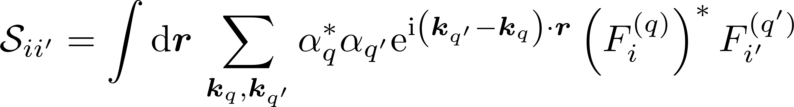
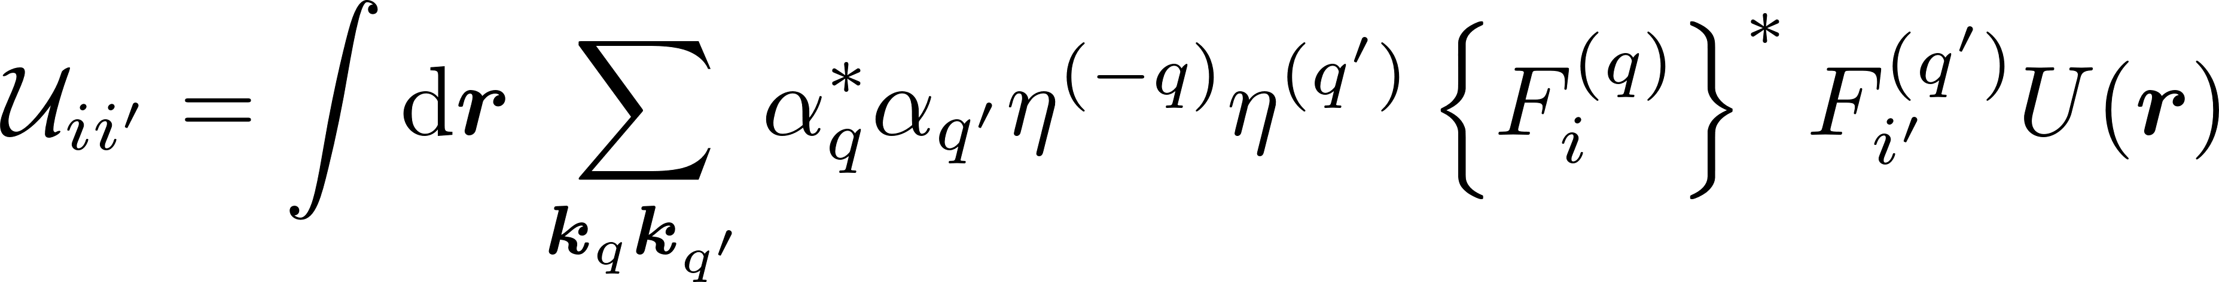
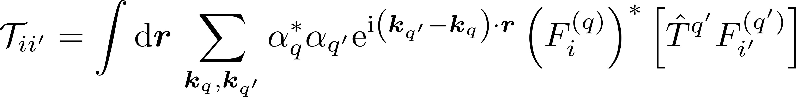
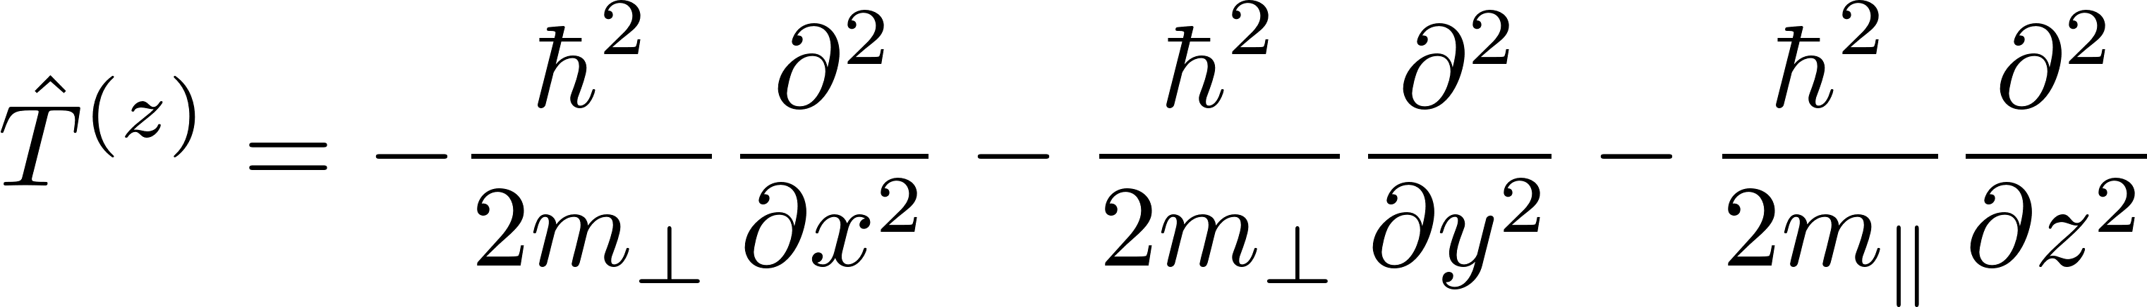
The Generalized Eigenvalue Problem
[1] K. Shindo and H. Nara, J. Phys. Soc. Jpn. 40, 1640 (1970)
[2] J. K. Gamble et al., Phys. Rev. B 91, 235318 (2015)
Shindo-Nara effective mass equation[1] cast as a generalized eigenvalue problem[2].
symmetrized anisotropic basis states
Envelopes have Slater or Gaussian radial decay.
Anisotropy introduced by scaling along valley longitudinal coordinate.
F_{j} ^{(q)} -- longitudinally scaled envelope function
η^{(q)} -- Bloch function located at the qth band-structure valley
U(r) is intended to include all deviations from the pure silicon potential.

Slide 10
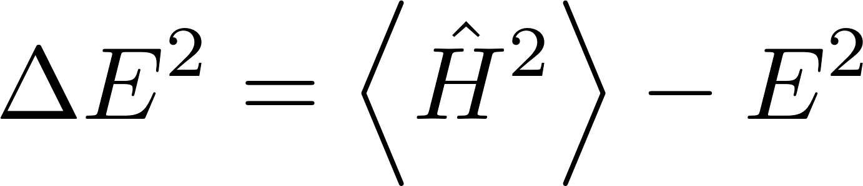
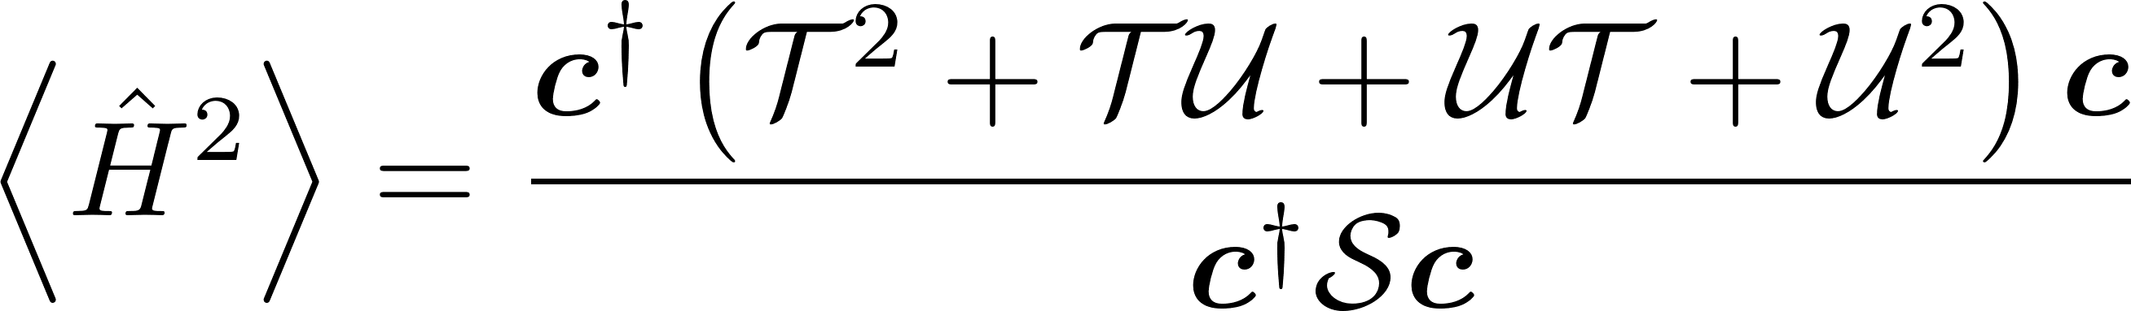
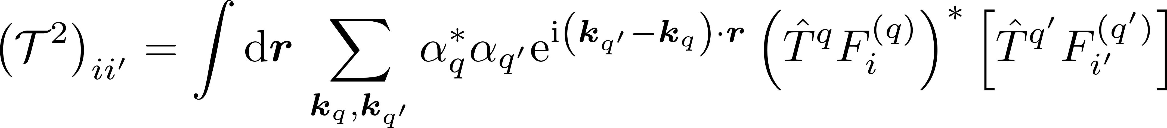
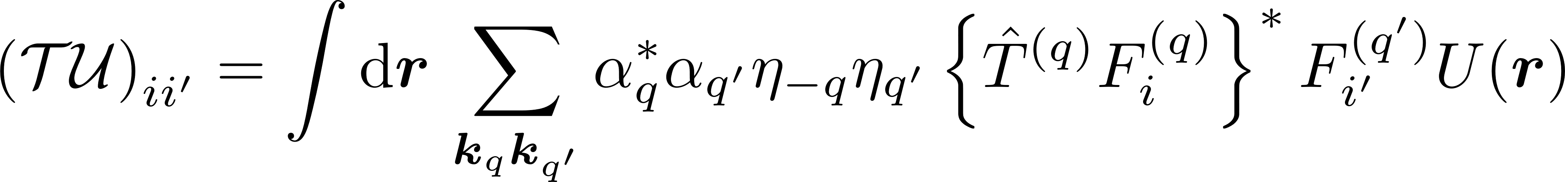
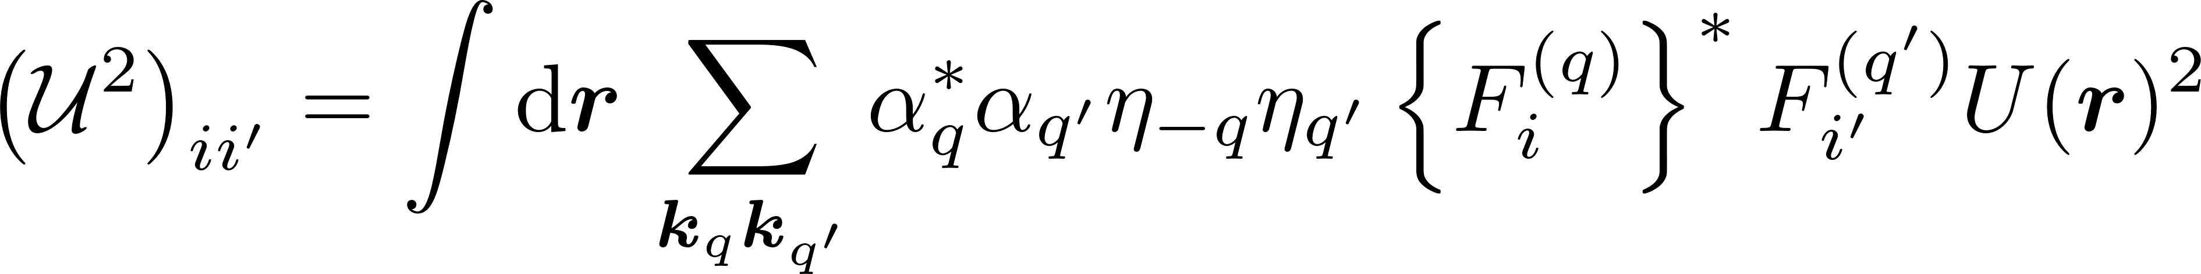
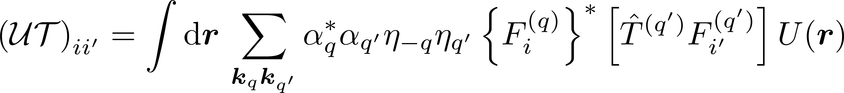
Checking the completeness with the variance
Completeness
Is the basis well-converged to an eigenstate?
Variance formulae are derived similarly as to the Shindo-Nara equation.

Slide 11
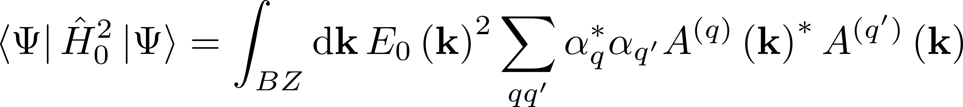
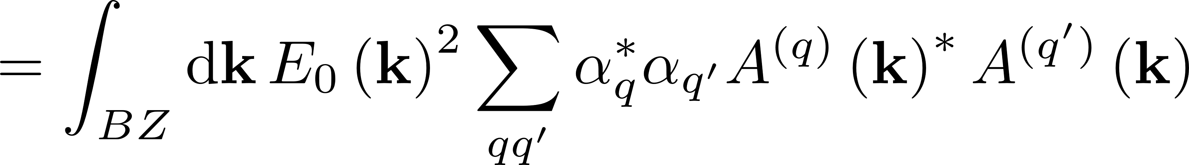
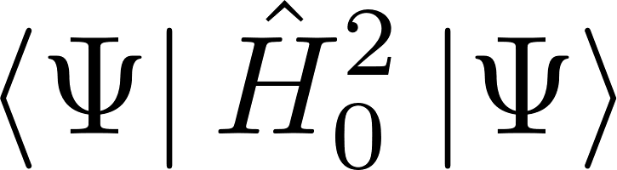
A problem with the Shindo-Nara equation?
It is a reasonable assumption for verisimilitude that the kinetic term doesn’t mix the valleys.
However, to ensure that the variance is positive definite, the previously dropped terms must be kept.

Slide 12
MoDIFIED EFFECTIVE MASS FORMULAE

Slide 13
Losing verisimilitude for a more consistent approach

