Slide 1
Hypergeometric Function
A function that needs to be calculated

Slide 2
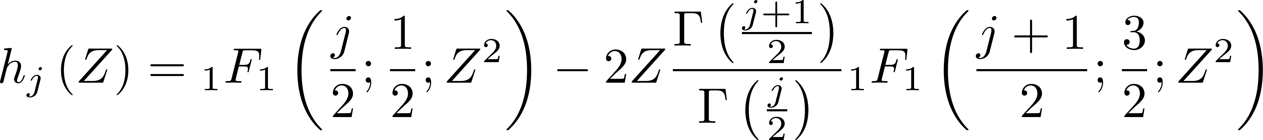
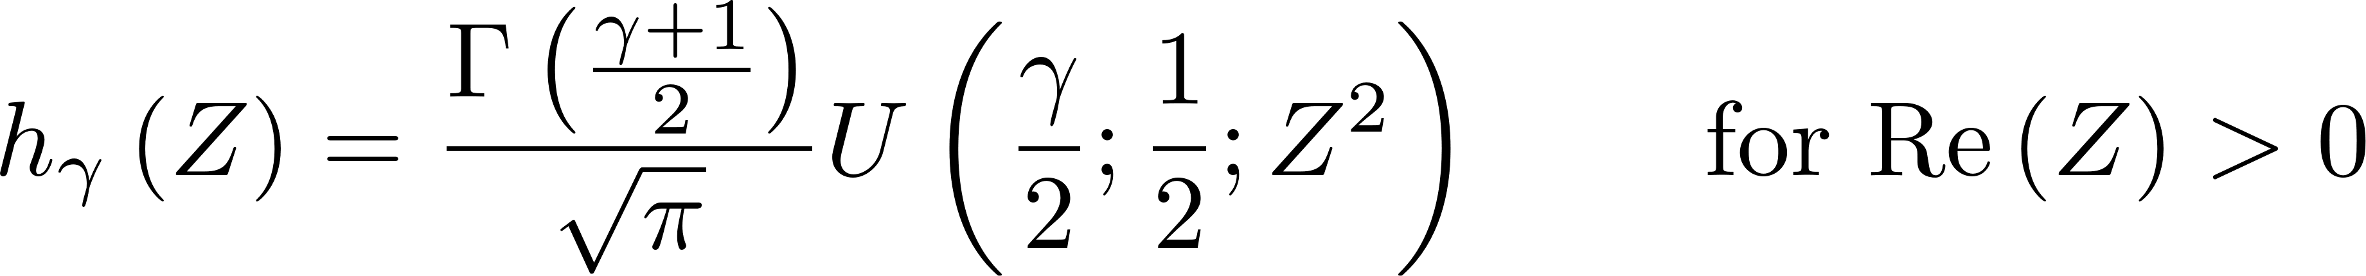
Hypergeometric function to be calculated
Notes:
The basis, as always, has been tinkered with a little bit. A given basis state breaks down into a loose set of “radial”, “longitudinal” and “azimuthal” parts.

Slide 3
1. Asymptotic Form
Notes:
Note that the different parts of the state are now normalized. Explain that the normalization integrals decouple with the introduce of the vartheta function as a normalization “constant”.

Slide 4
2. Asymptotic Form
Notes:
Note that the different parts of the state are now normalized. Explain that the normalization integrals decouple with the introduce of the vartheta function as a normalization “constant”.

Slide 5
3. Asymptotic Form
Notes:
The basis, as always, has been tinkered with a little bit. A given basis state breaks down into a loose set of “radial”, “longitudinal” and “azimuthal” parts.

Slide 6
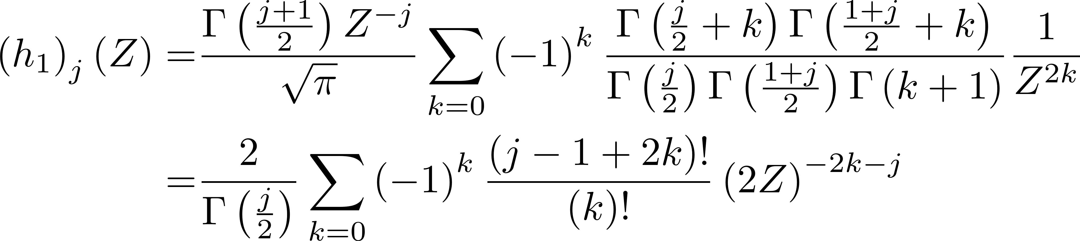
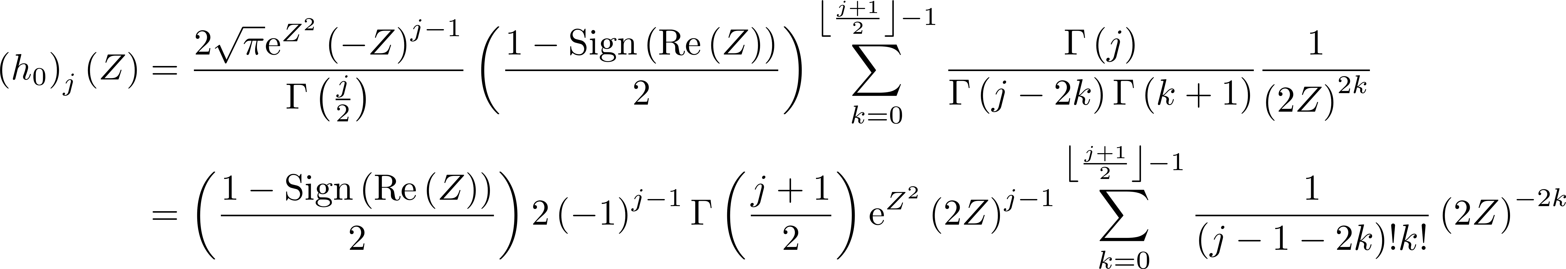
4. Asymptotic Form
Notes:
The basis, as always, has been tinkered with a little bit. A given basis state breaks down into a loose set of “radial”, “longitudinal” and “azimuthal” parts.

Slide 7
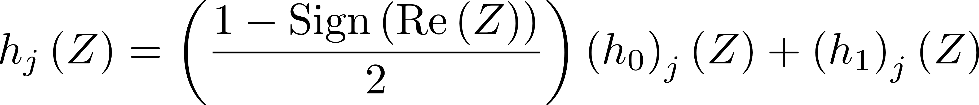
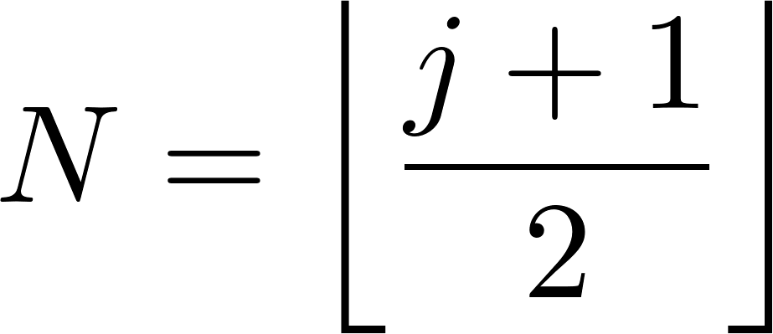
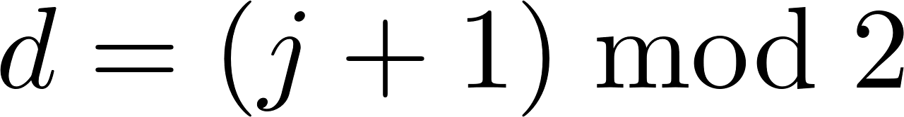
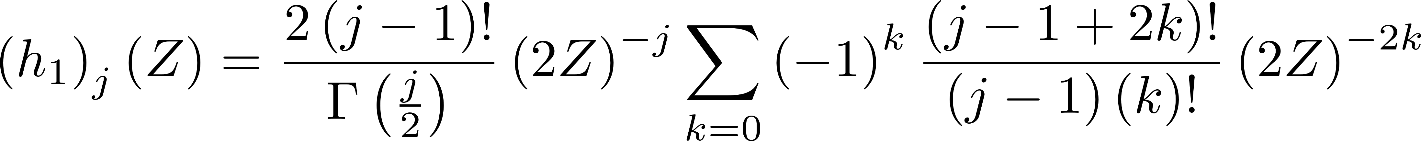
5. Asymptotic Form
Notes:
The basis, as always, has been tinkered with a little bit. A given basis state breaks down into a loose set of “radial”, “longitudinal” and “azimuthal” parts.

Slide 8
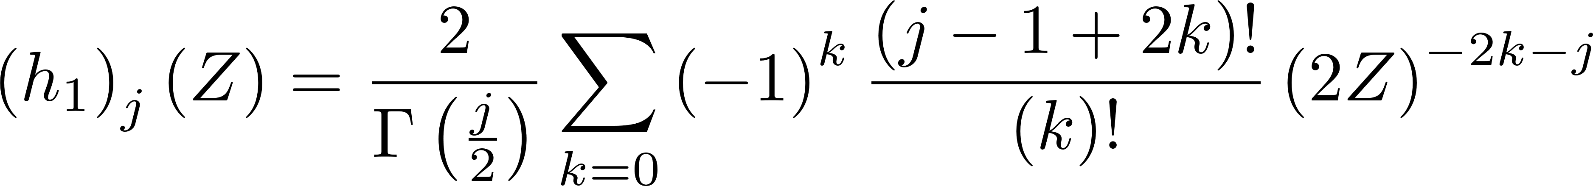
6. Asymptotic Form – Final
Notes:
The basis, as always, has been tinkered with a little bit. A given basis state breaks down into a loose set of “radial”, “longitudinal” and “azimuthal” parts.

Slide 9
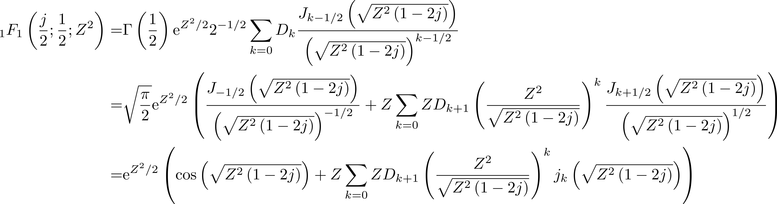
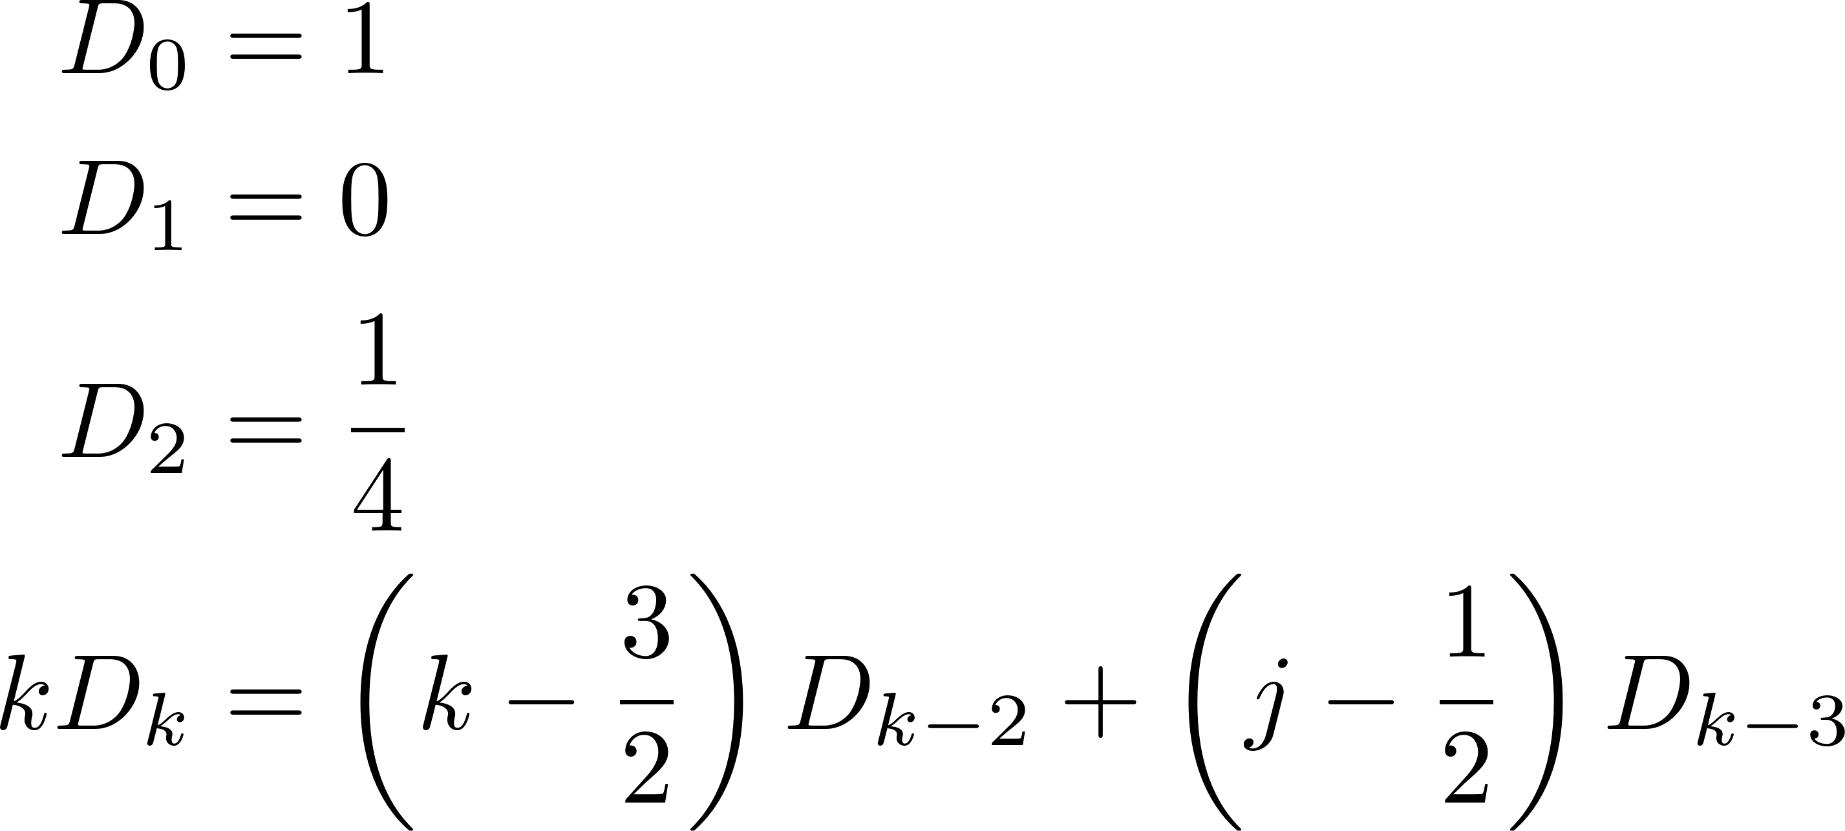
Buchholz Polynomial Form -- I
Notes:
Note that the different parts of the state are now normalized. Explain that the normalization integrals decouple with the introduce of the vartheta function as a normalization “constant”.

Slide 10
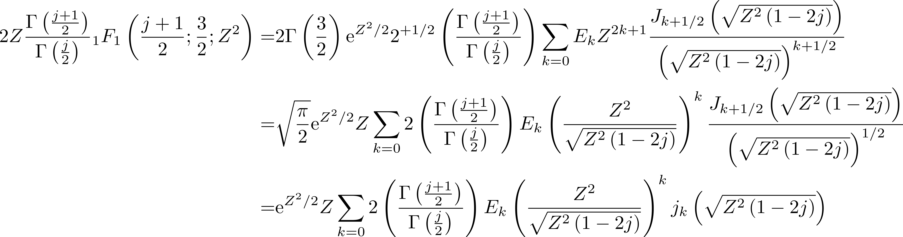
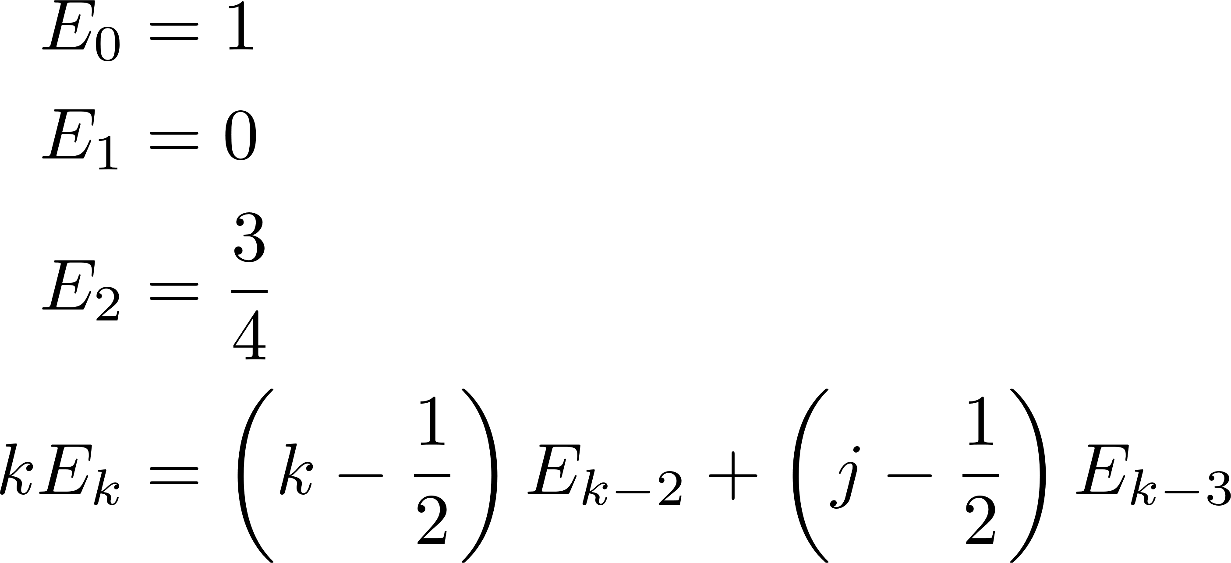
Buchholz Polynomial Form -- II
Notes:
Note that the different parts of the state are now normalized. Explain that the normalization integrals decouple with the introduce of the vartheta function as a normalization “constant”.

Slide 11
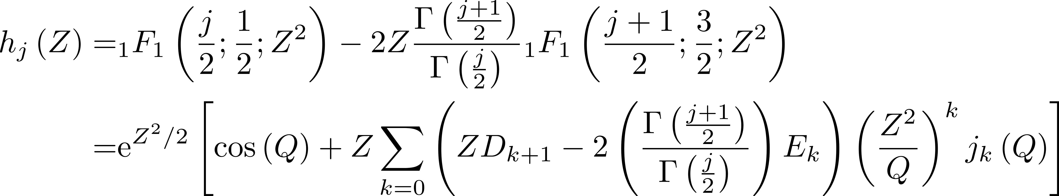
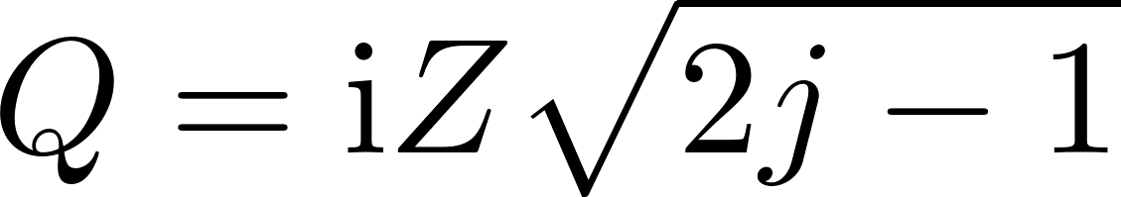
Buchholz Polynomial Form -- III
Notes:
Note that the different parts of the state are now normalized. Explain that the normalization integrals decouple with the introduce of the vartheta function as a normalization “constant”.

