Slide 1
Single-Valley BASIS
Picking a basis to describe the donor electron state of a particular valley.

Slide 2
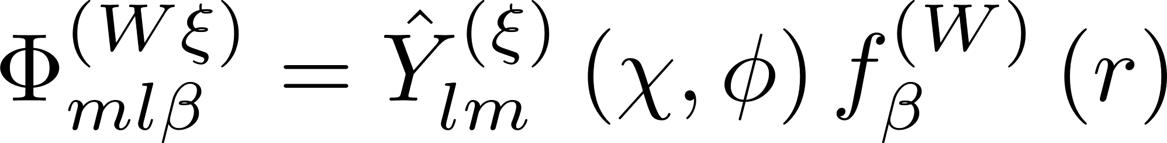
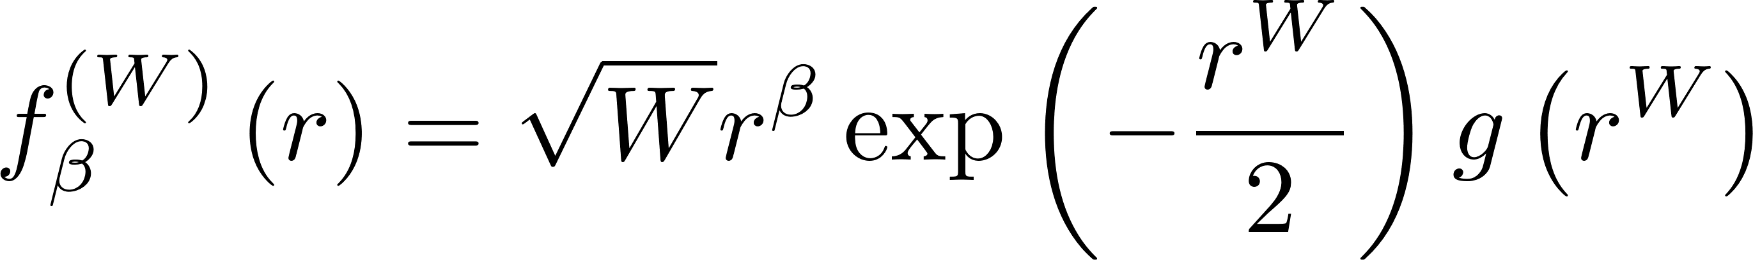
1. The unscaled basis functions defined
α is a parameter to guarantee orthonormality and integrability.

Slide 3
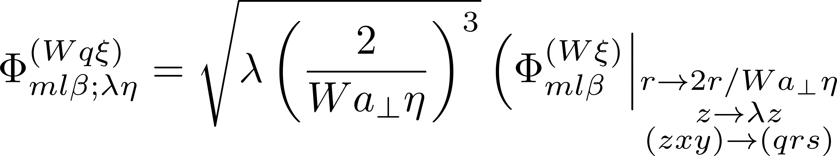
2. The scaled basis functions defined

Slide 4
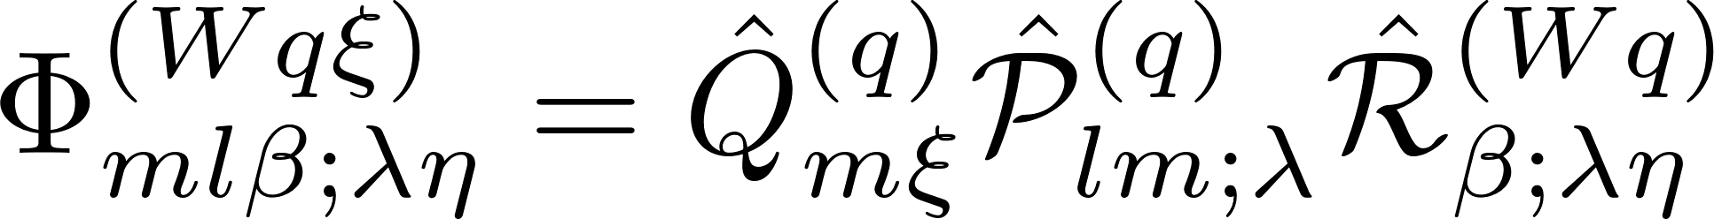
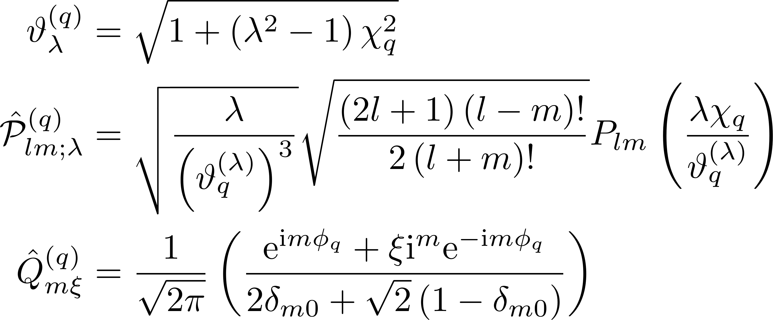
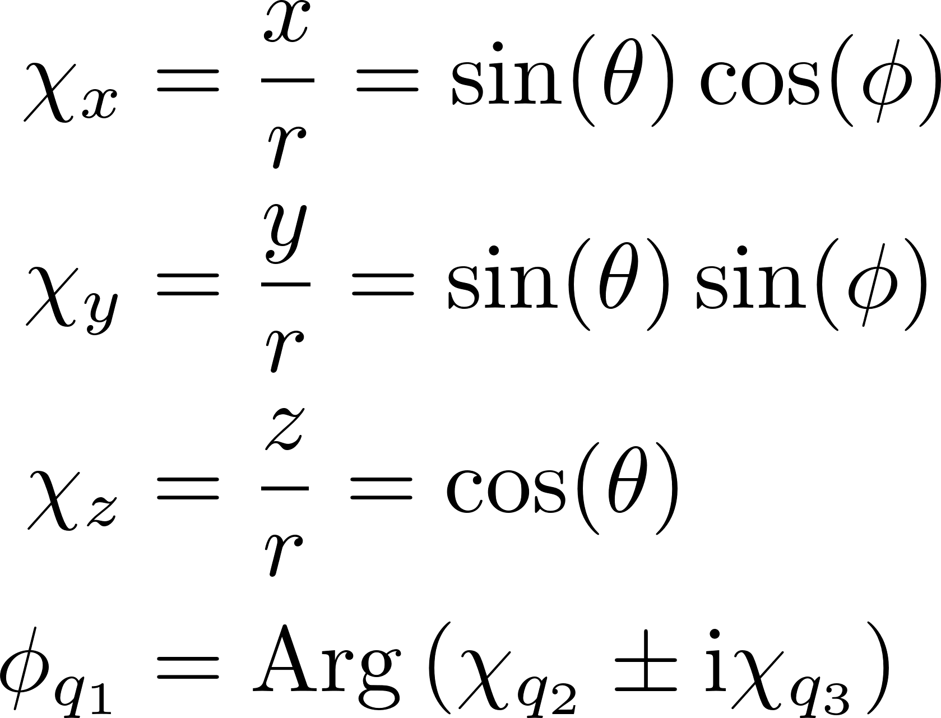
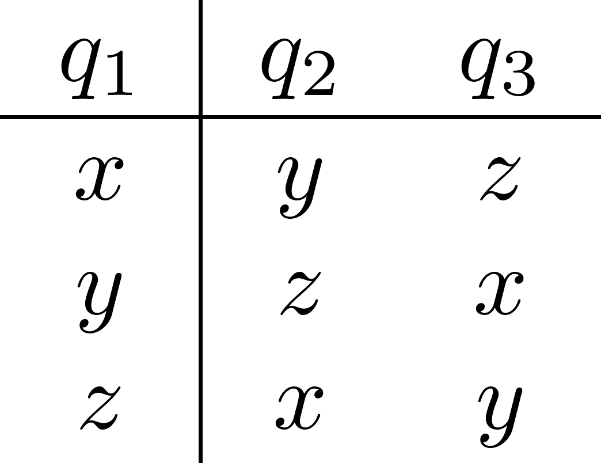
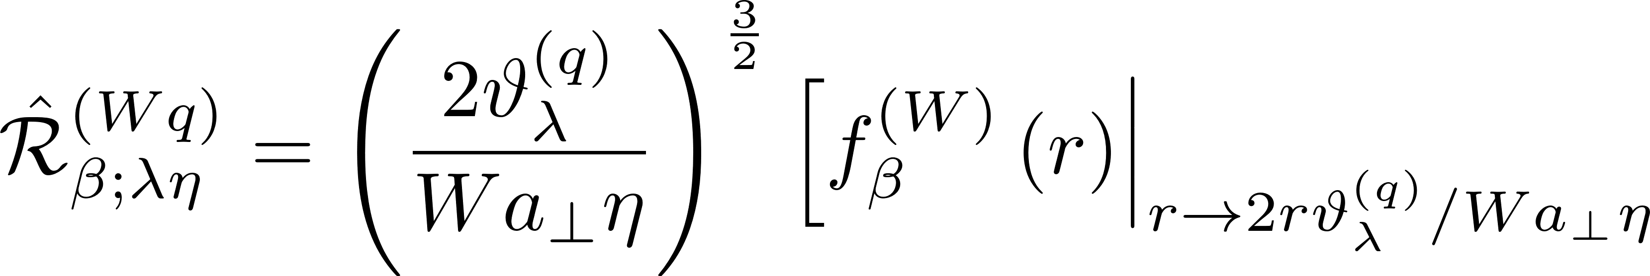
3. An equivalent basis function defined

Slide 5
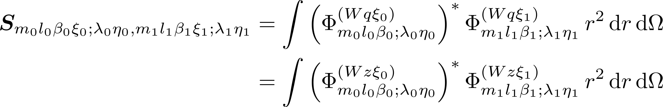
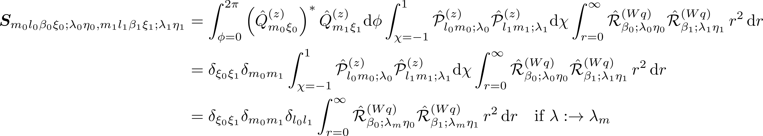
4a. Orthonormality condition

Slide 6
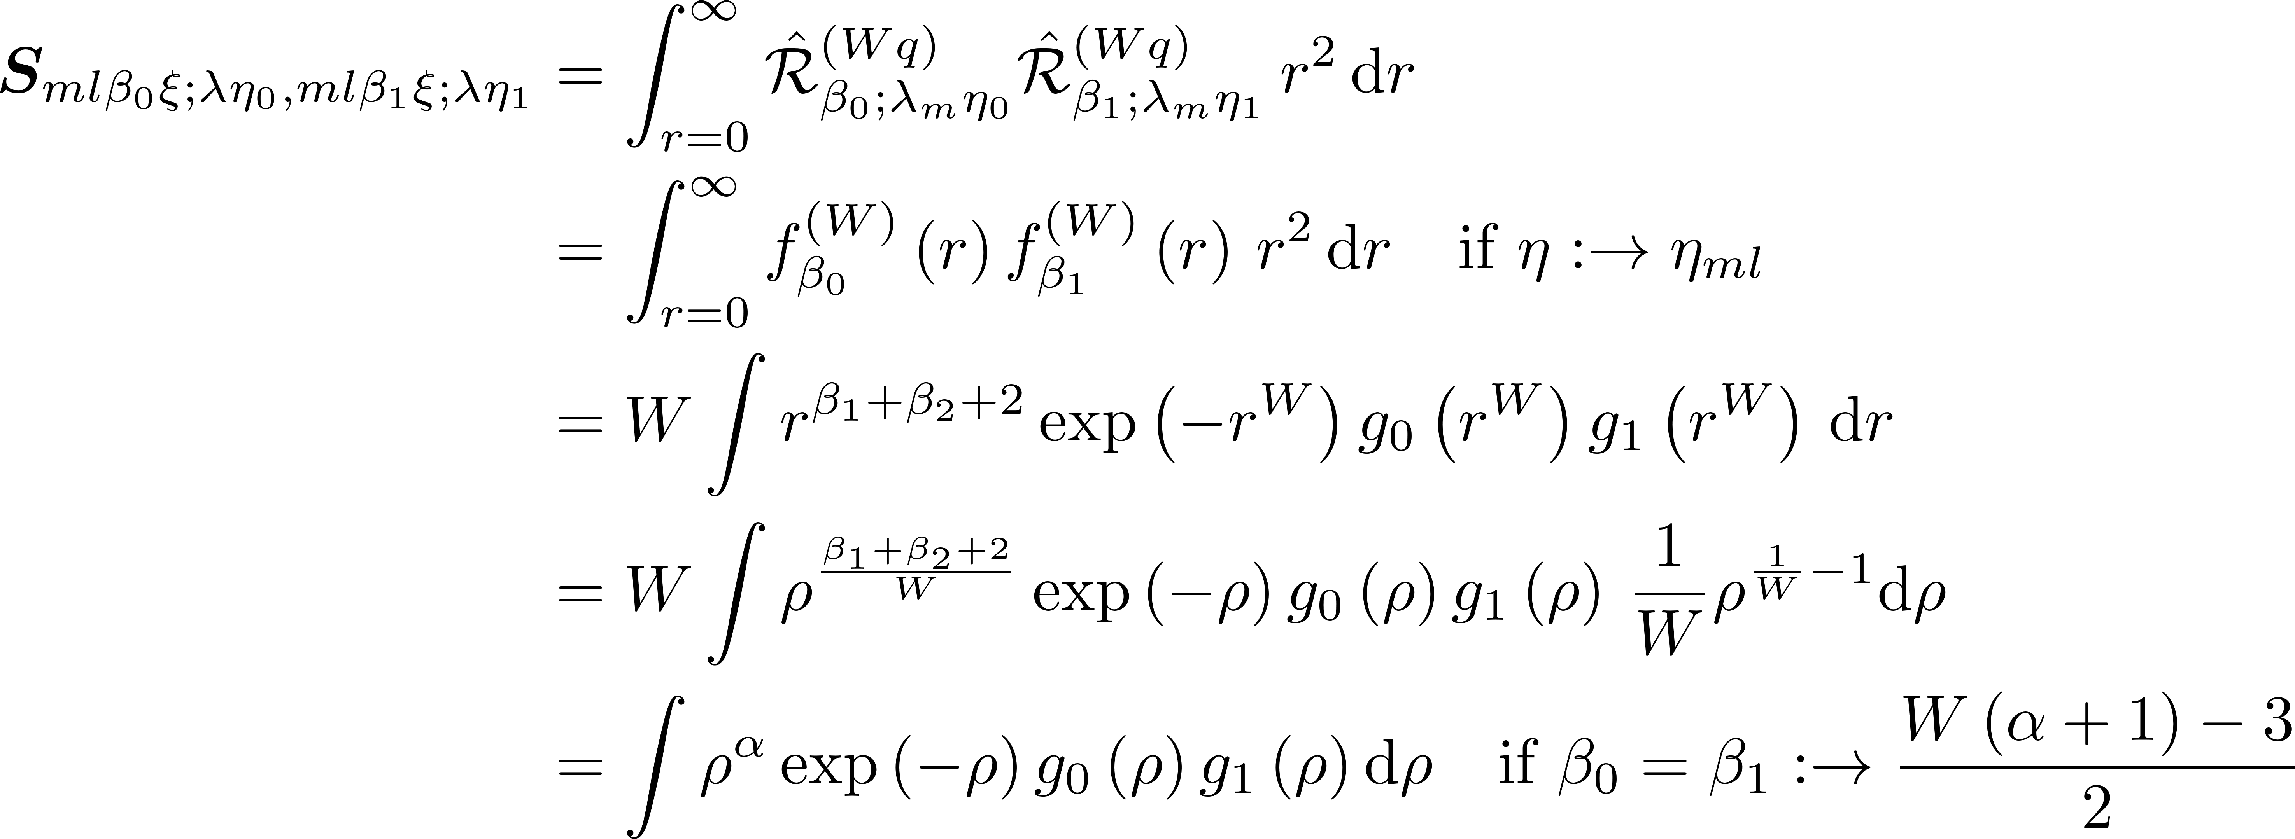
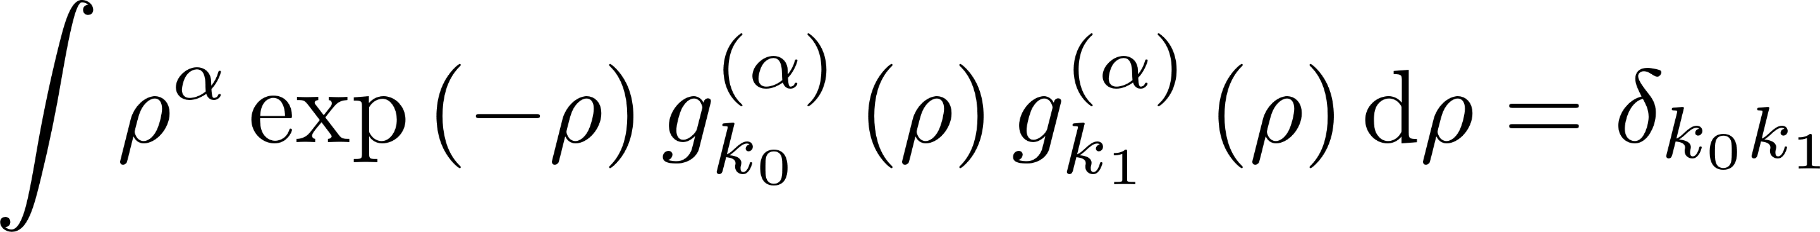
4b. Orthonormality condition

Slide 7
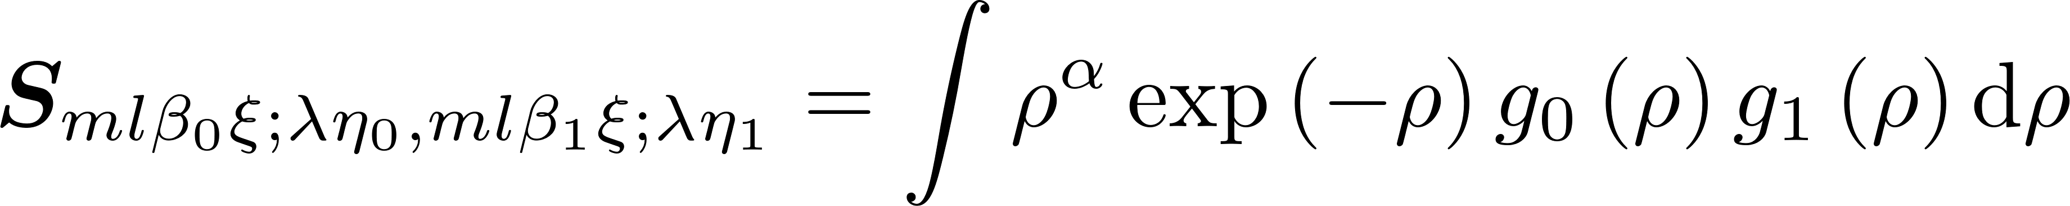
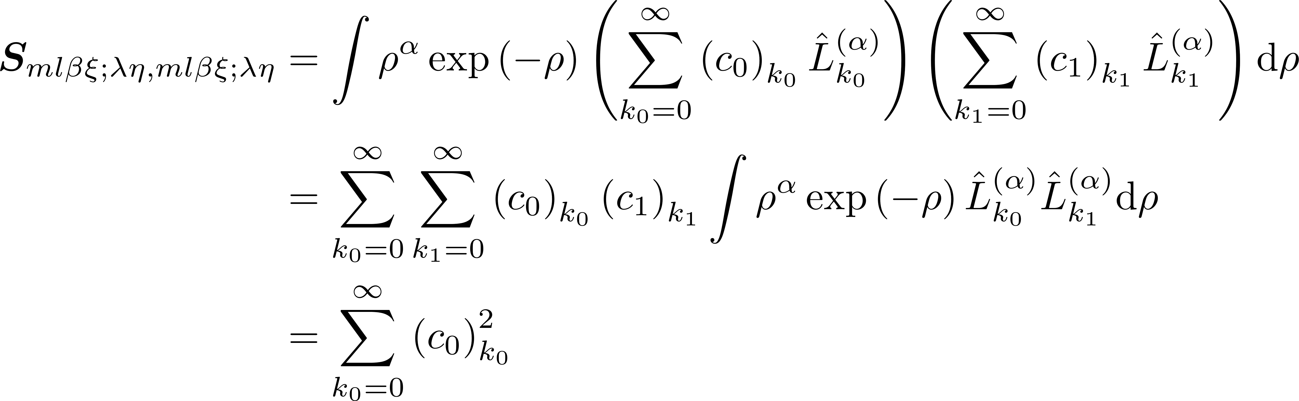
4c. Using orthogonal polynomials to express $g(ρ)$
We don’t know the exact forms of $g(ρ)$. However, we can expand $g\left(ρ\right)$ in orthogonal polynomials. The form most consistent with the hydrogenic system is the Laguerre polynomials.

Slide 8
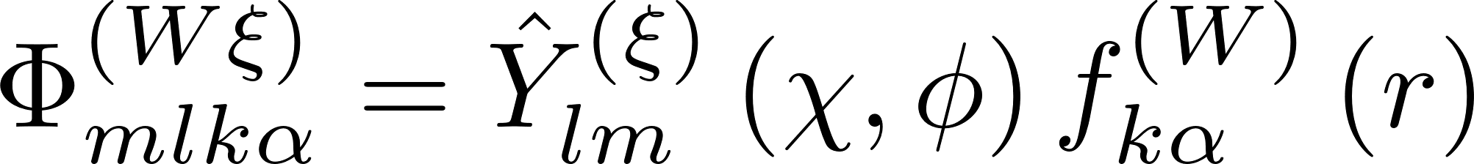
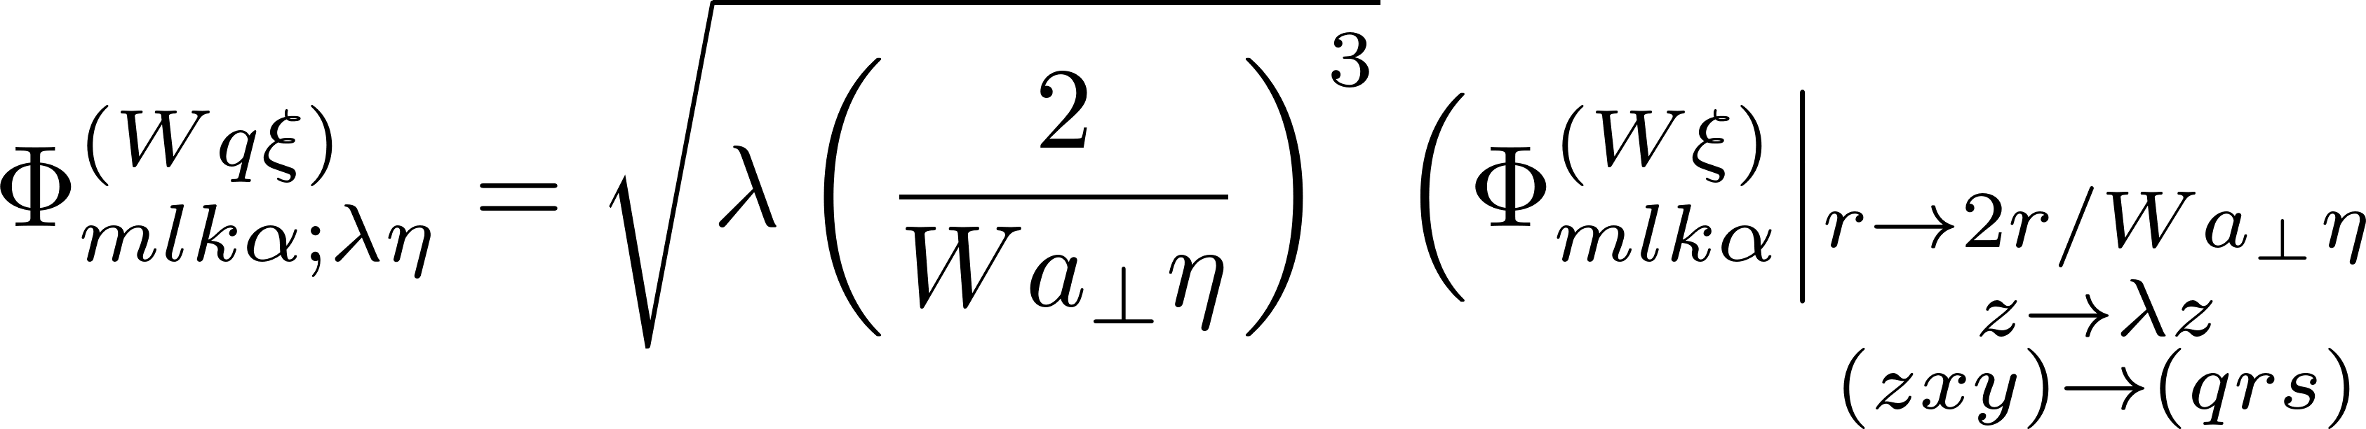
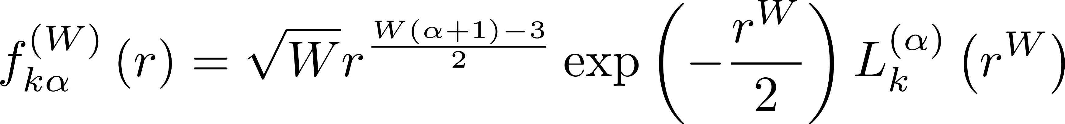
5. The final naïve basis functions defined
α is a parameter to guarantee orthonormality and integrability.

Slide 9
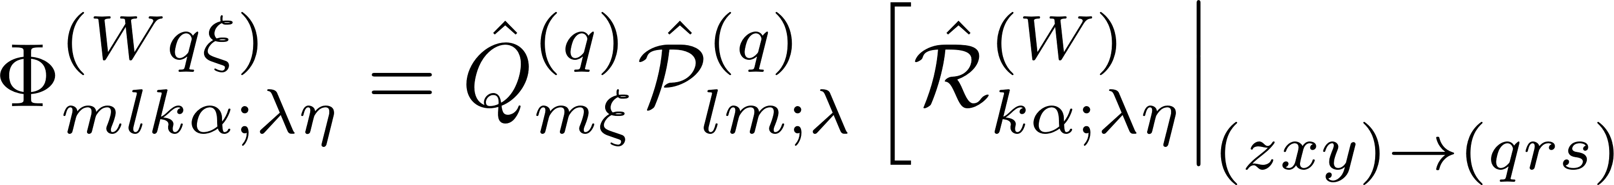
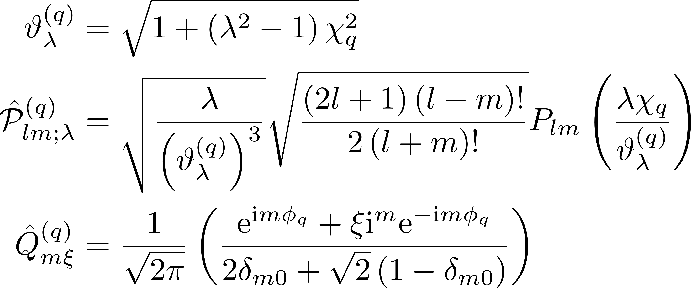
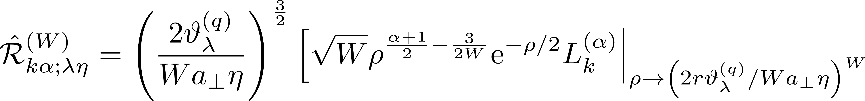
6. An equivalent basis function defined

