Slide 1
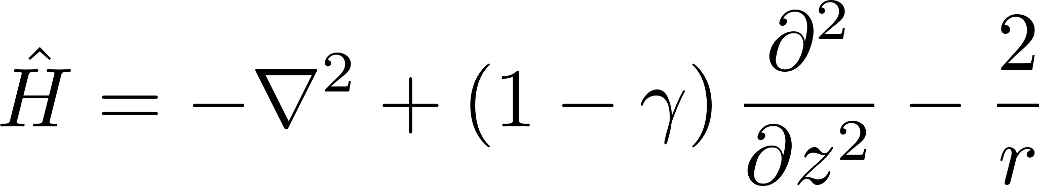
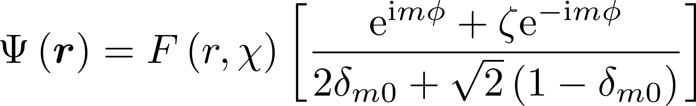
Useful differential operators acting on general functions

Slide 2
Useful differential operators acting on general functions

Slide 3
Single-Valley BASIS
Picking a basis to describe the donor electron state of a particular valley.

Slide 4
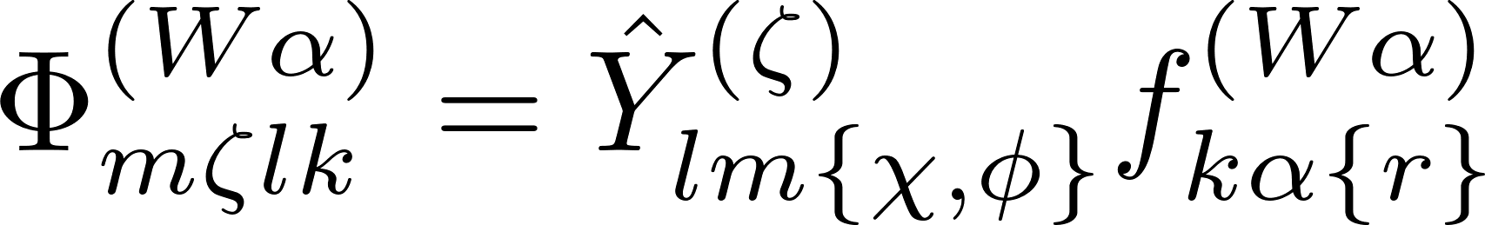
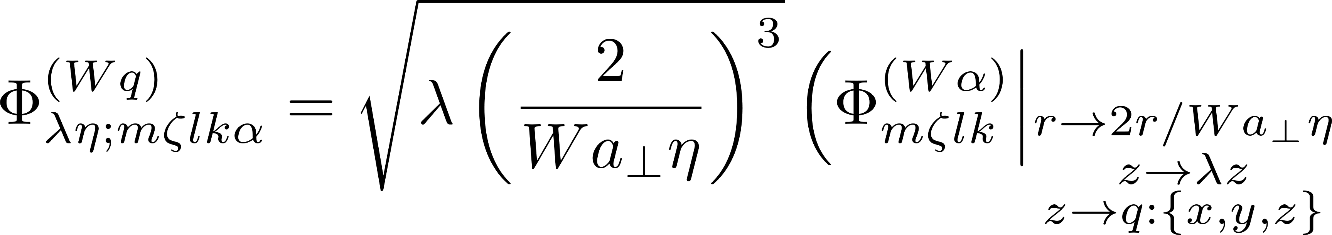
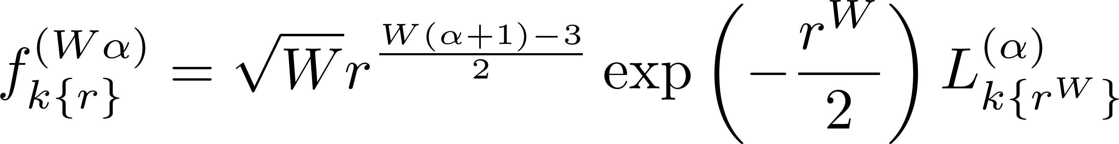
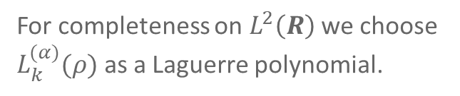
The naïve basis functions defined
α is a parameter to guarantee orthonormality and integrability.
For completeness on $L^{2}\left(R\right)$ we choose $L_{k}^{(α)}(ρ)$ as a Laguerre polynomial.

Slide 5
Kinetic OperATOR
Defining the effective kinetic matrix elements

Slide 6
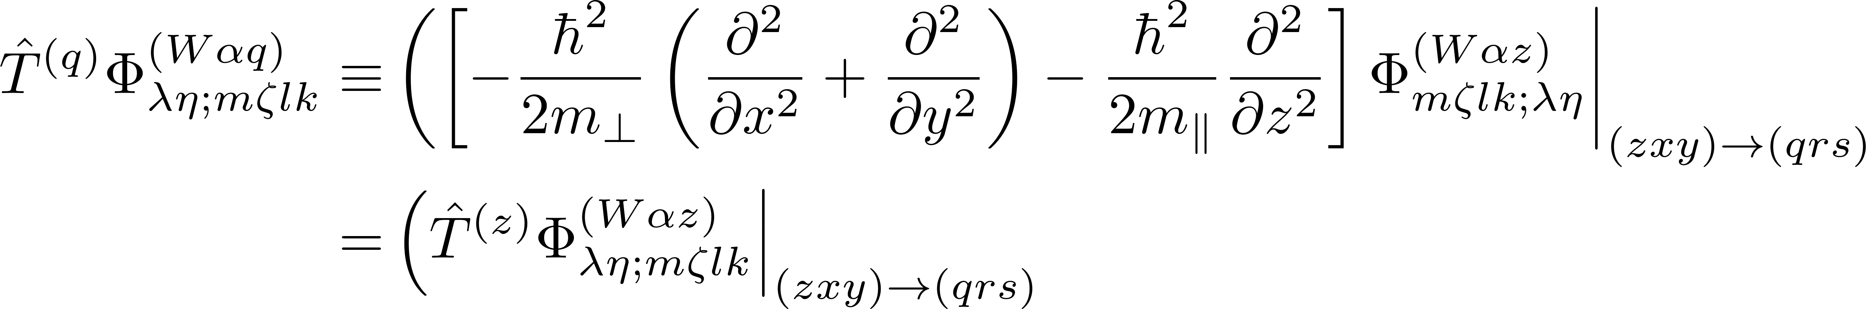
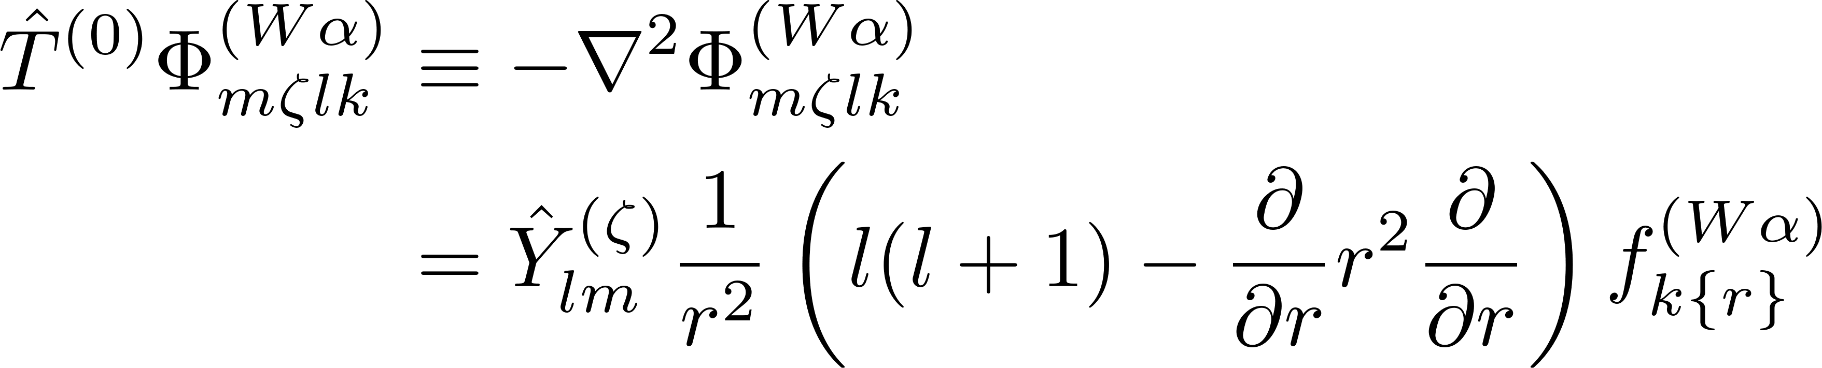
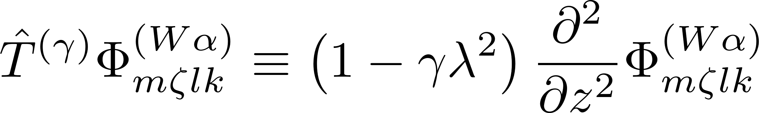
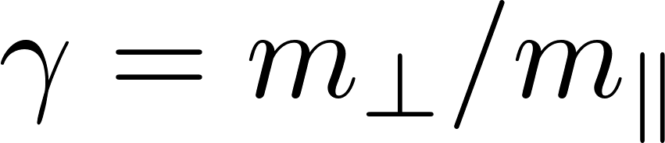
Operators used for kinetic matrix elements defined

Slide 7
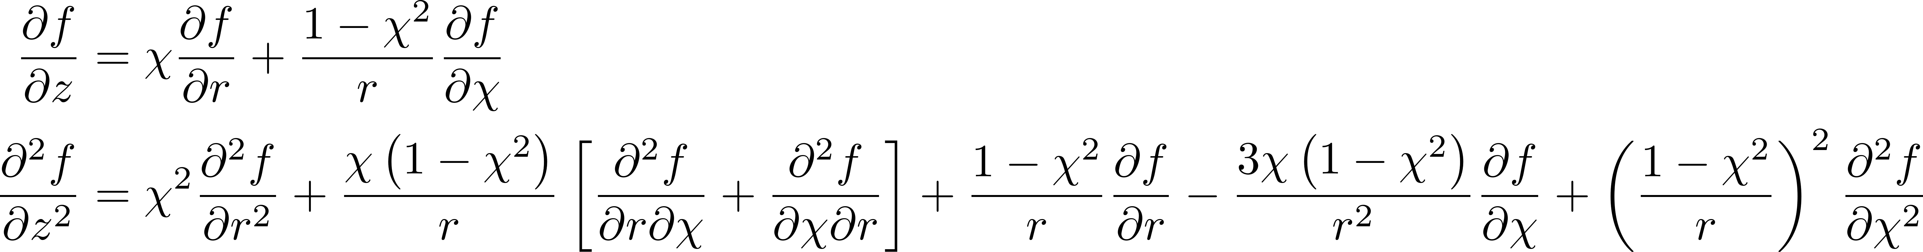
Useful differential operators acting on general functions

Slide 8
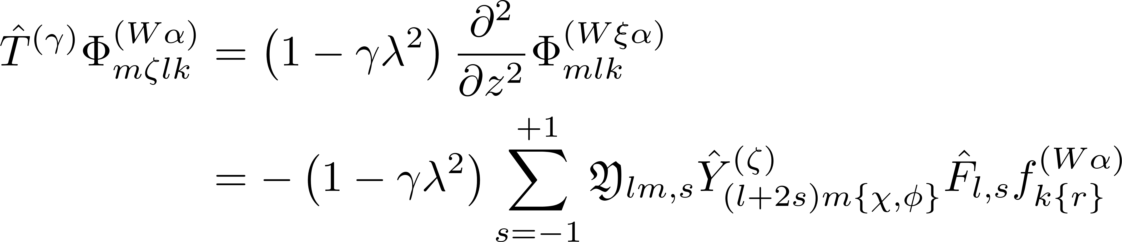
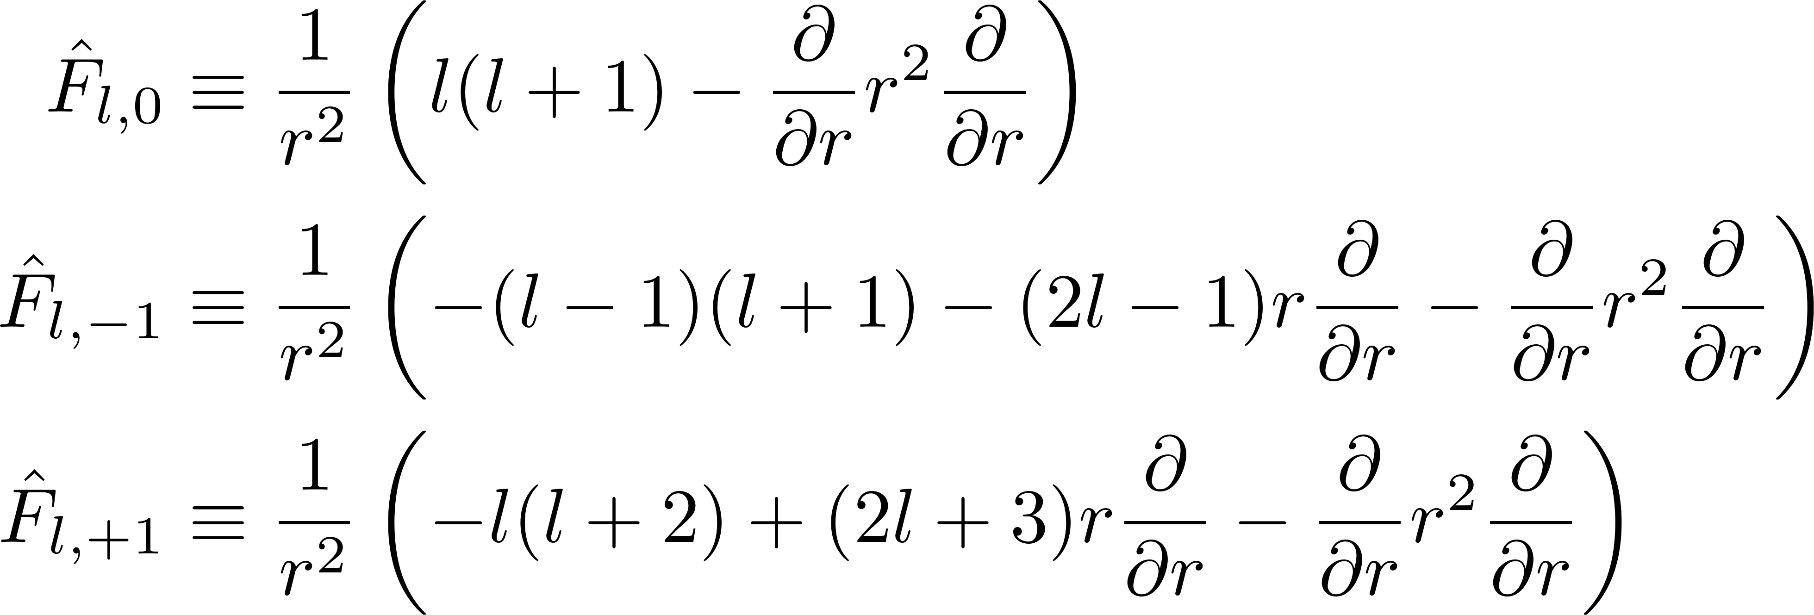
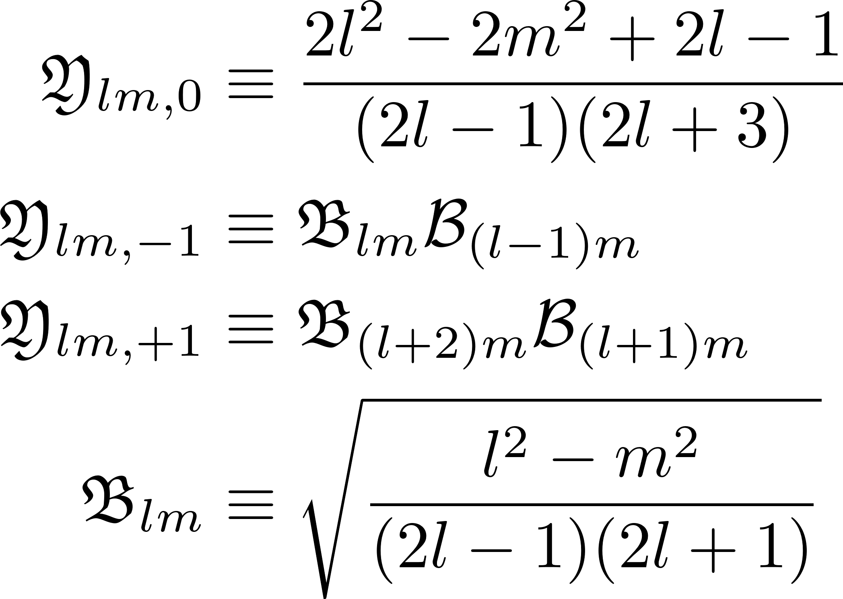
Elaborating the anisotropic kinetic operator

Slide 9
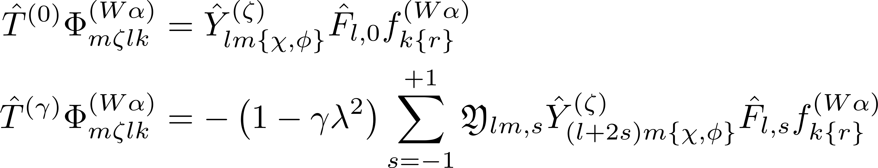
Restating effects of the iso- and anisotropic kinetic operators

Slide 10
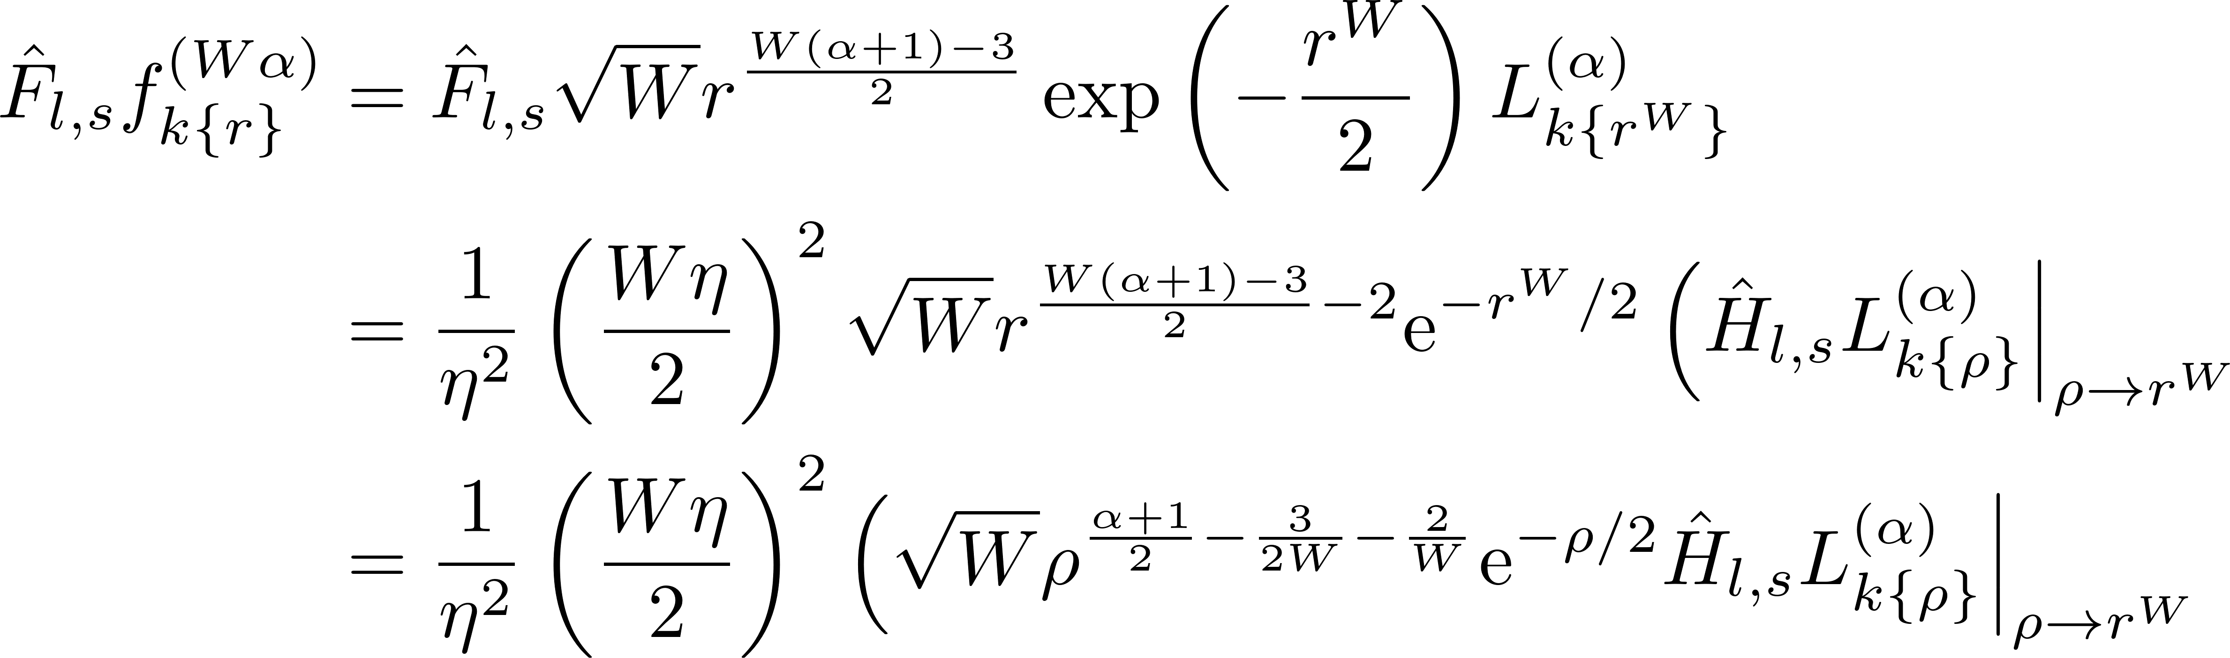
Further examination of the effect of the kinetic operators

Slide 11
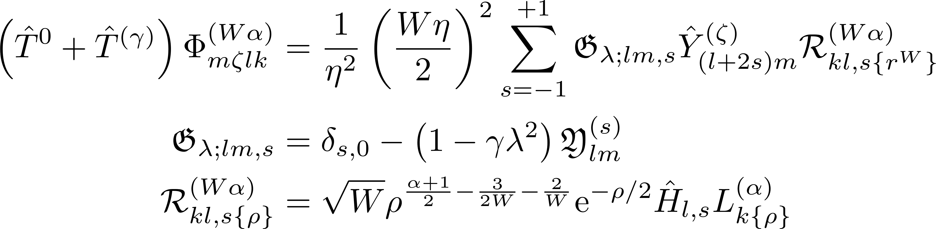
Combined effect of kinetic operators

Slide 12
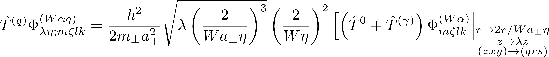
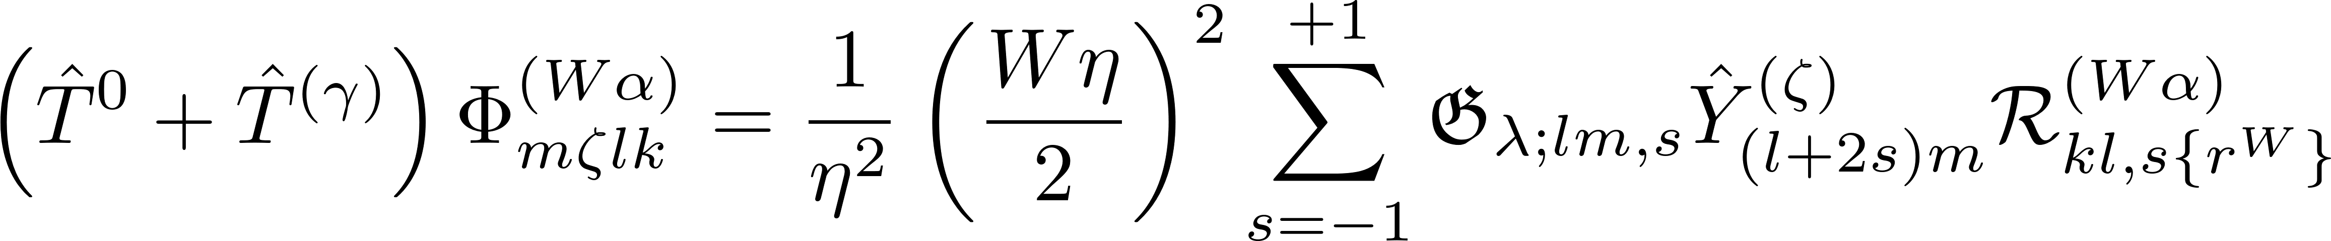
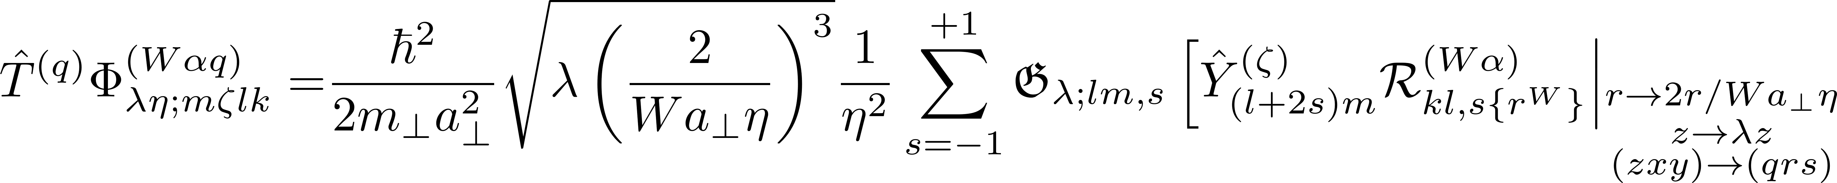
Restatement of effect of full kinetic operator

Slide 13
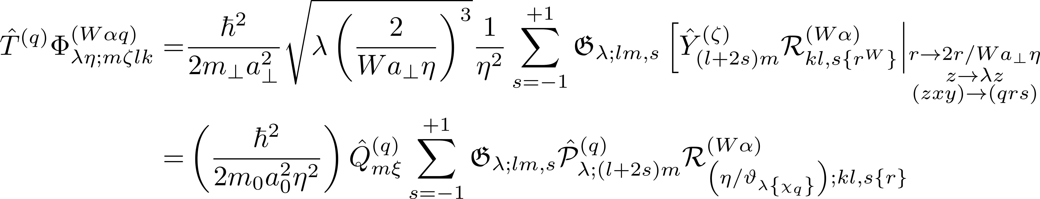
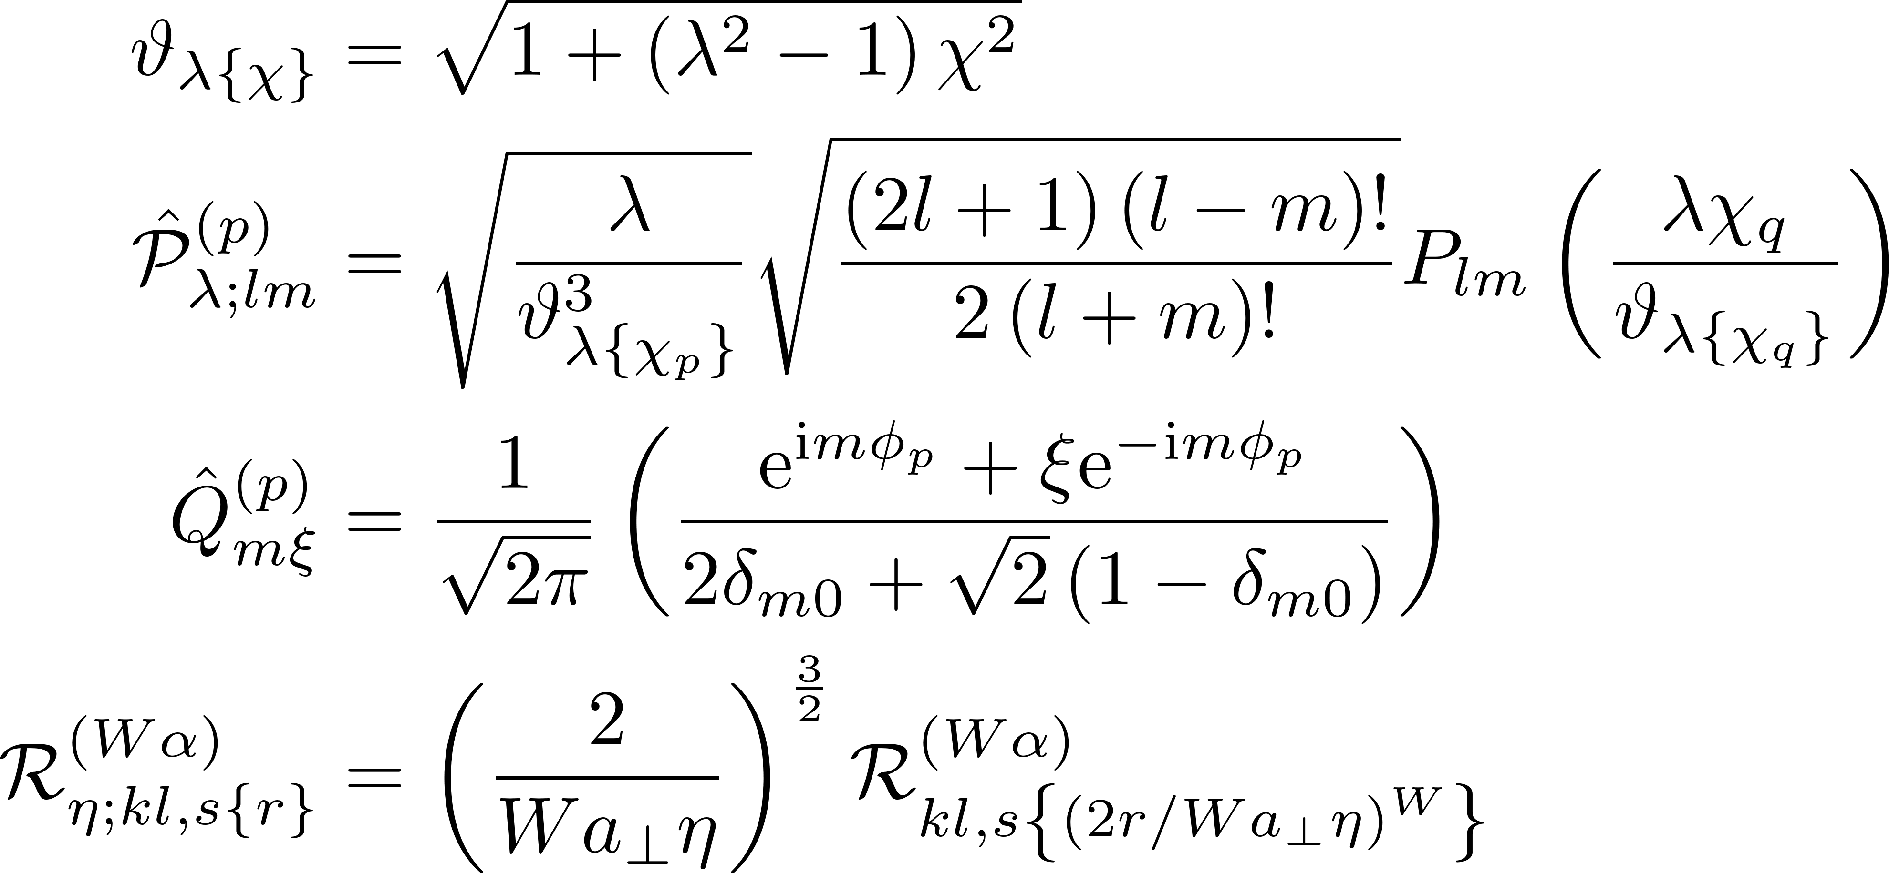
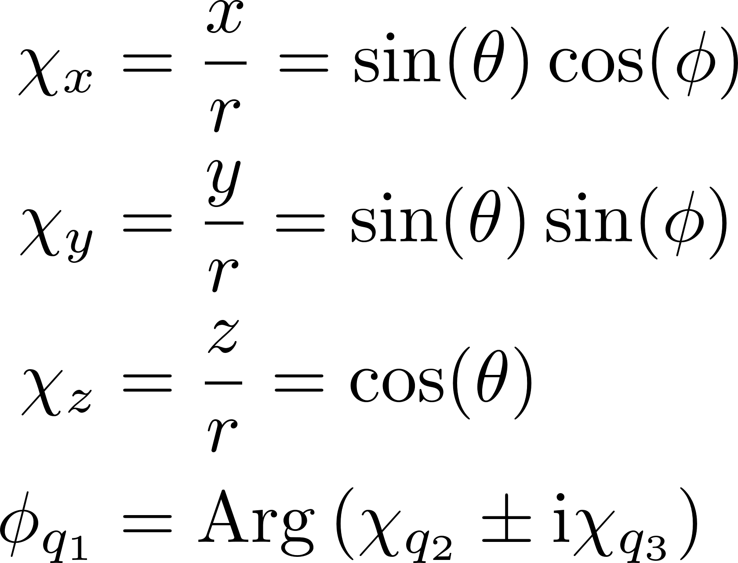
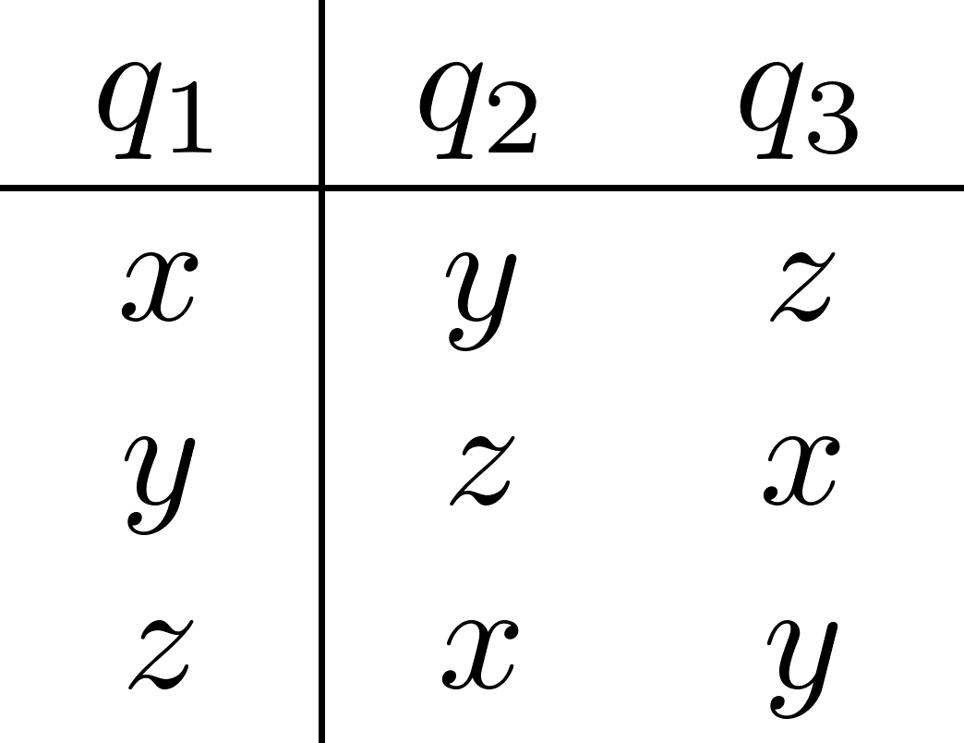
Restatement of effect of full kinetic operator

Slide 14
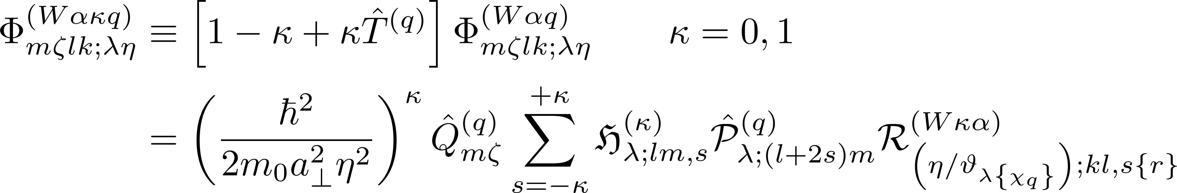
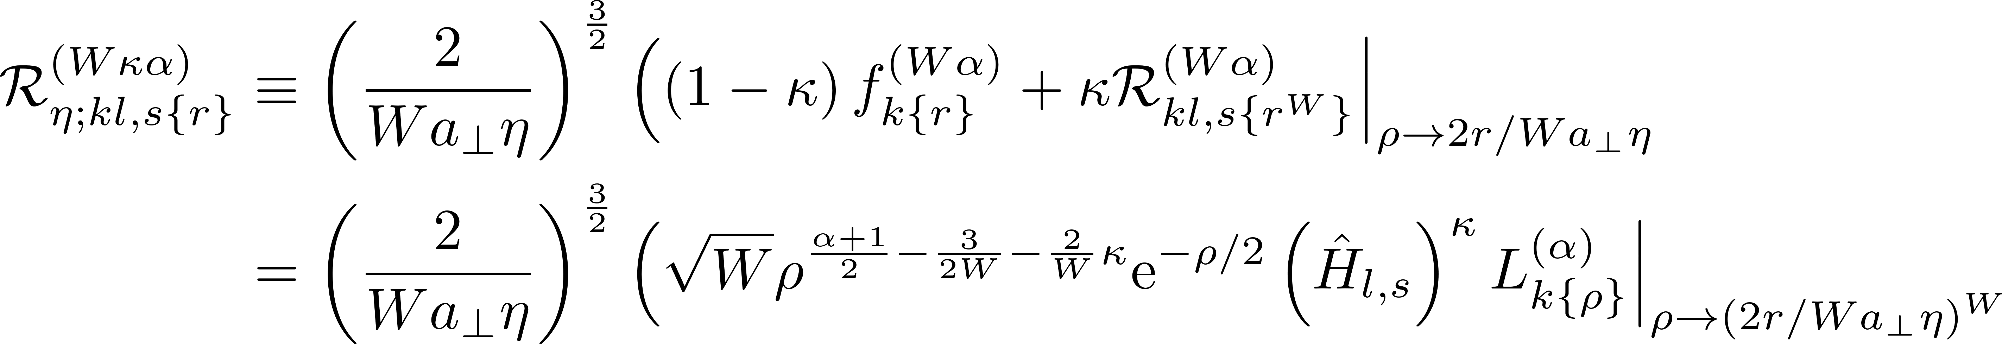
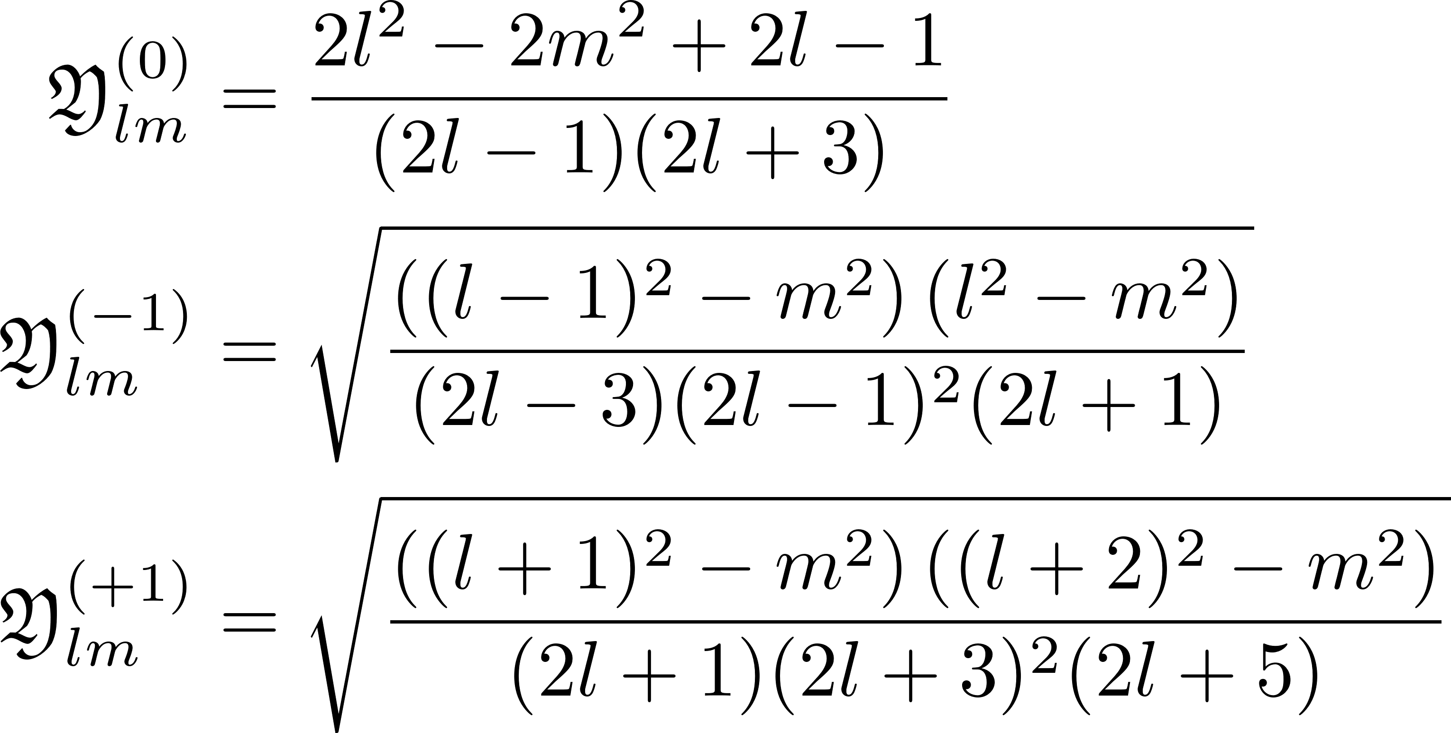
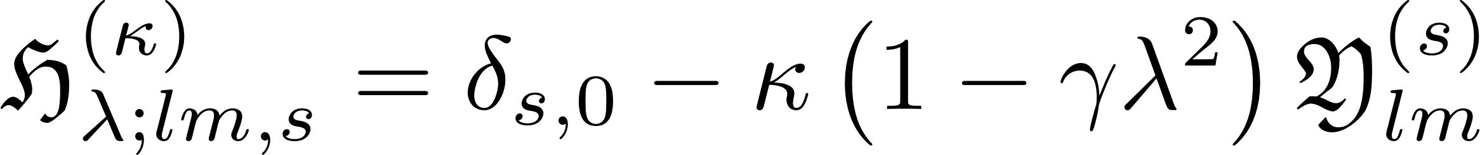
Definition of the generalized single-valley basis states

Slide 15
Operator Effects
Finding formulae for the new polynomials

Slide 16
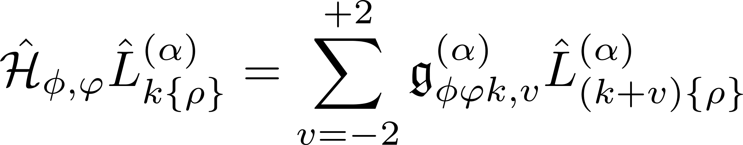
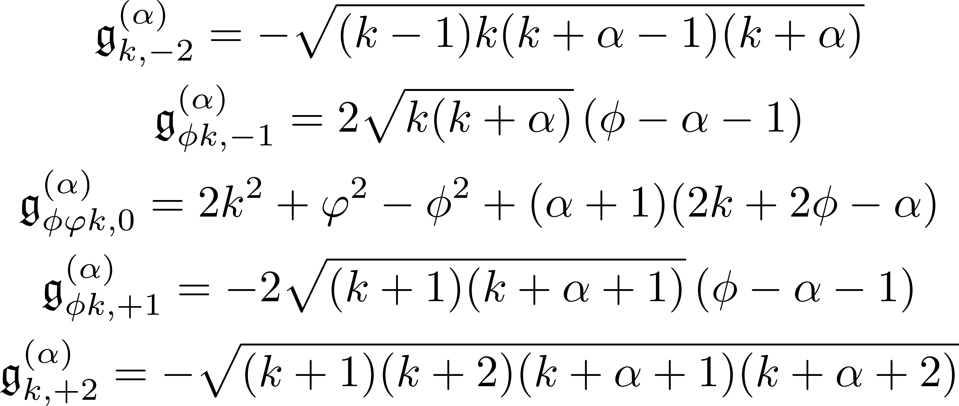
Generic kinetic operator acting on Laguerre polynomials

Slide 17
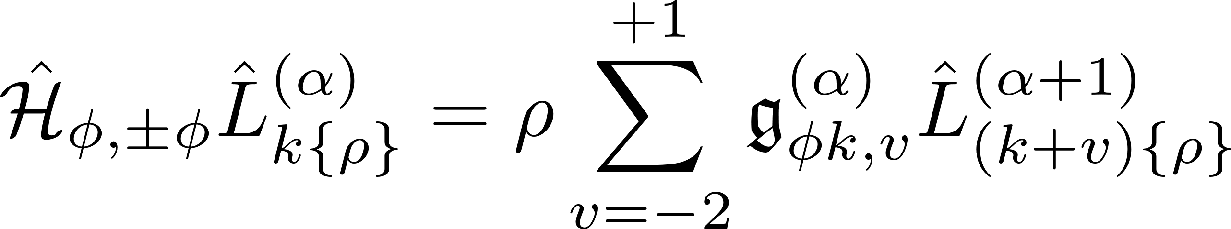
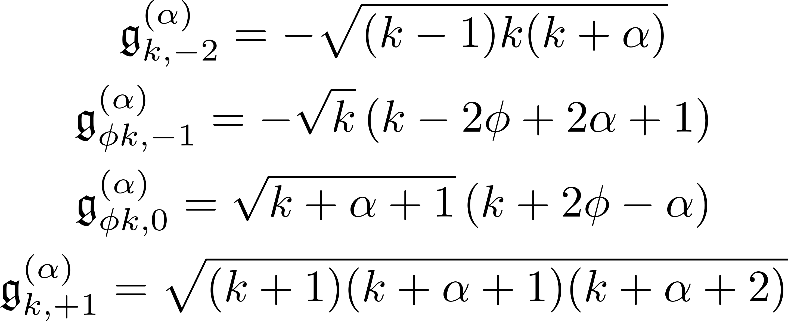
Generic kinetic operator acting on Laguerre poly. ($φ^{2}=φ^{2}$)

Slide 18
Expectation Values
Understanding integrability

Slide 19
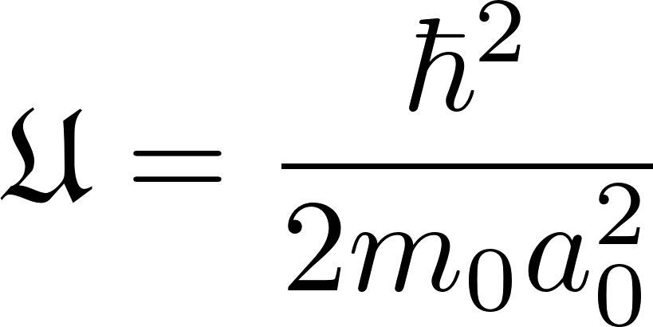
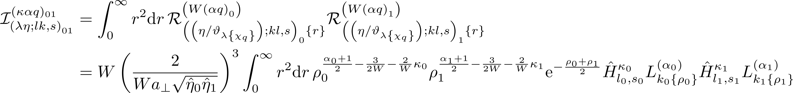
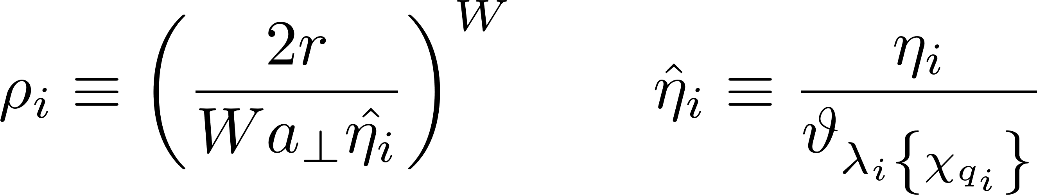
Examining the expectation values (Overlap, Kinetic, KinKin)

Slide 20
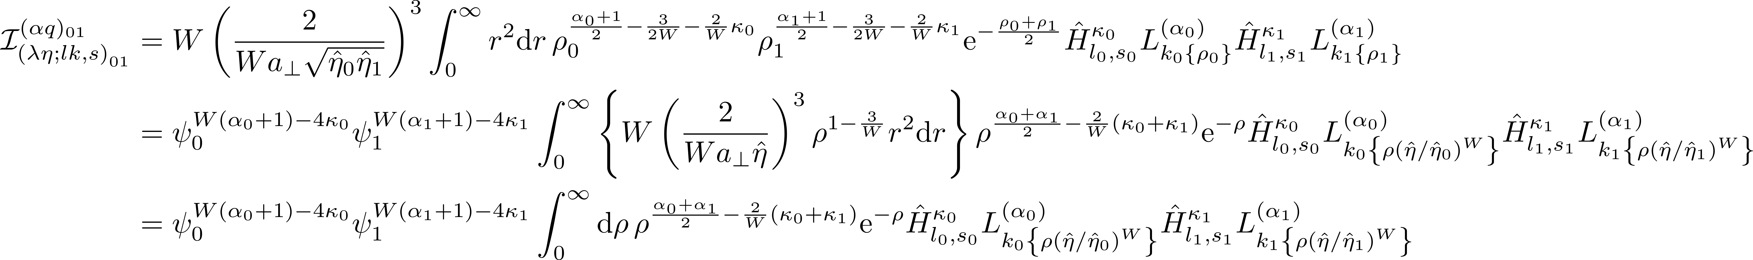
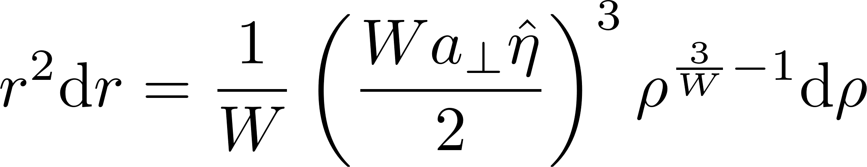
Examining the expectation values

Slide 21
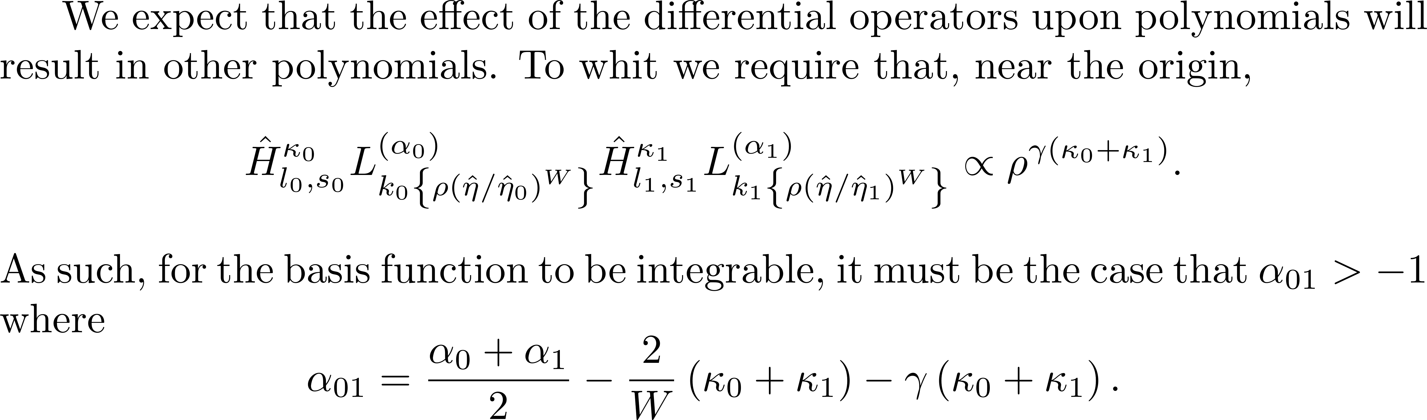
2. Integrability condition

Slide 22
Determining Alpha
Understanding integrability

Slide 23
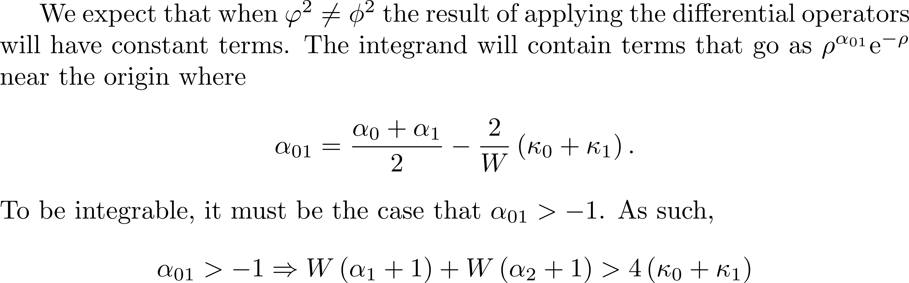
1. Exploring regimes of applicability for $φ^{2}≠φ^{2}$

Slide 24
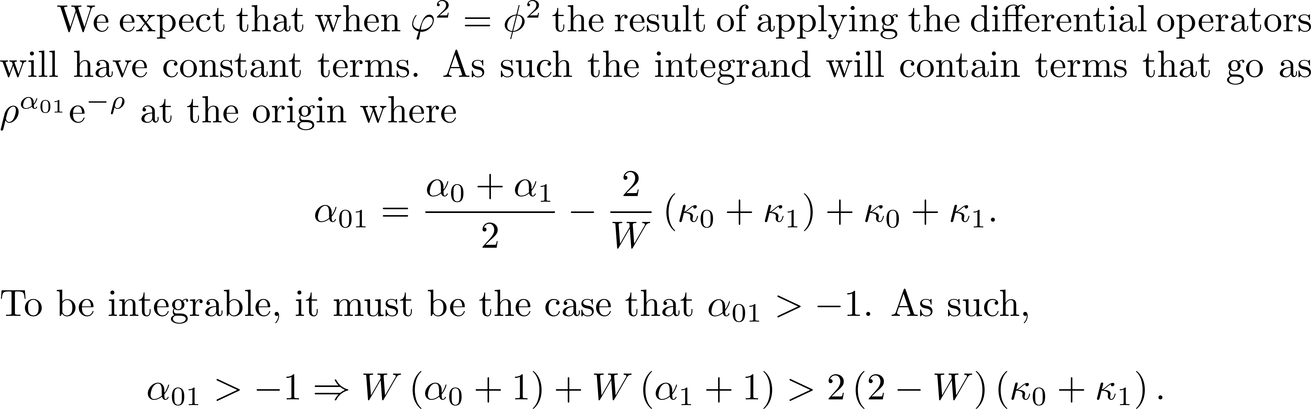
2. Exploring regimes of applicability for $φ^{2}=φ^{2}$

Slide 25
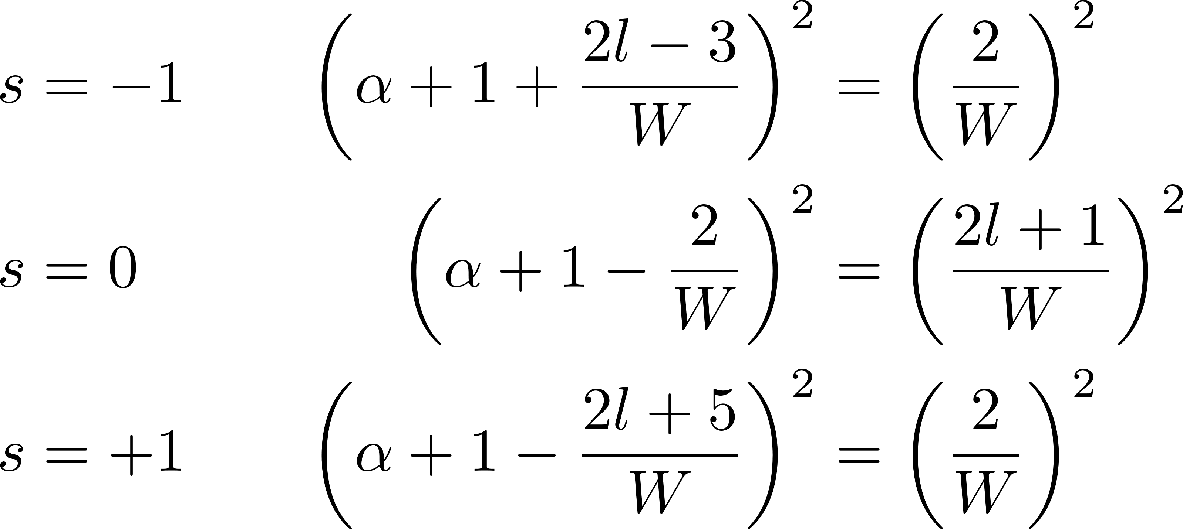
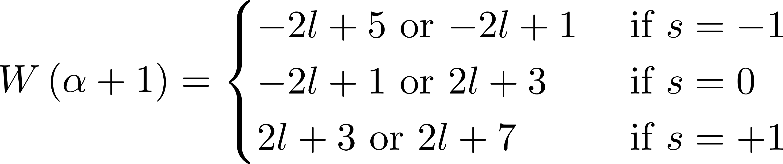
3. What criteria on α is required to achieve $φ^{2}=φ^{2}$?
* Not possible to accomplish $φ^{2}=φ^{2}$ for a given α(l) and all values of s.

Slide 26
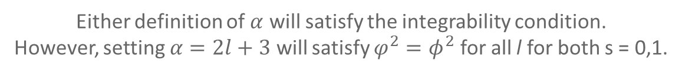
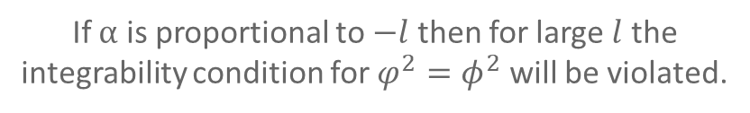
4. Exploring regimes of applicability for $φ^{2}=φ^{2}$
If $α$ is proportional to $−l$ then for large $l$ the integrability condition for $φ^{2}=φ^{2}$ will be violated.
Either definition of $α$ will satisfy the integrability condition.
However, setting $α=2l+3$ will satisfy $φ^{2}=φ^{2}$ for all l for both s = 0,1.

Slide 27
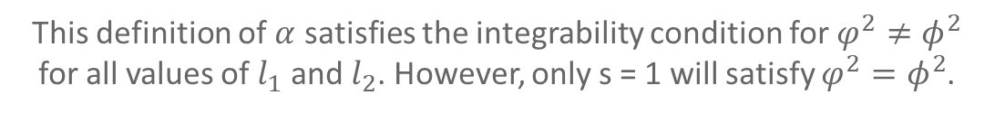
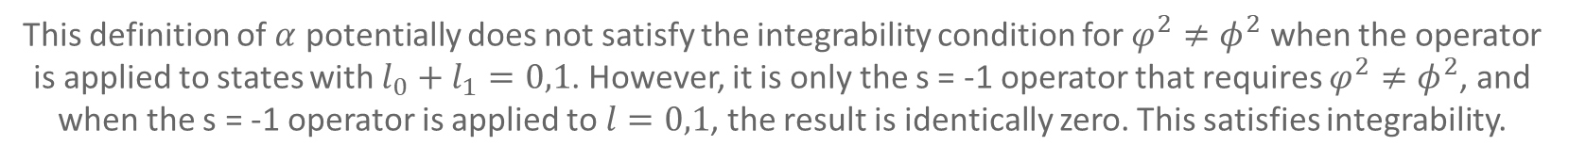
5. Exploring regimes of applicability for $φ^{2}≠φ^{2}$.
This definition of $α$ potentially does not satisfy the integrability condition for $φ^{2}≠φ^{2}$ when the operator is applied to states with $l_{0}+l_{1}=0,1$. However, it is only the s = -1 operator that requires $φ^{2}≠φ^{2}$, and when the s = -1 operator is applied to $l=0,1$, the result is identically zero. This satisfies integrability.
This definition of $α$ satisfies the integrability condition for $φ^{2}≠φ^{2}$ for all values of $l_{1}$ and $l_{2}$. However, only s = 1 will satisfy $φ^{2}=φ^{2}$.

Slide 28
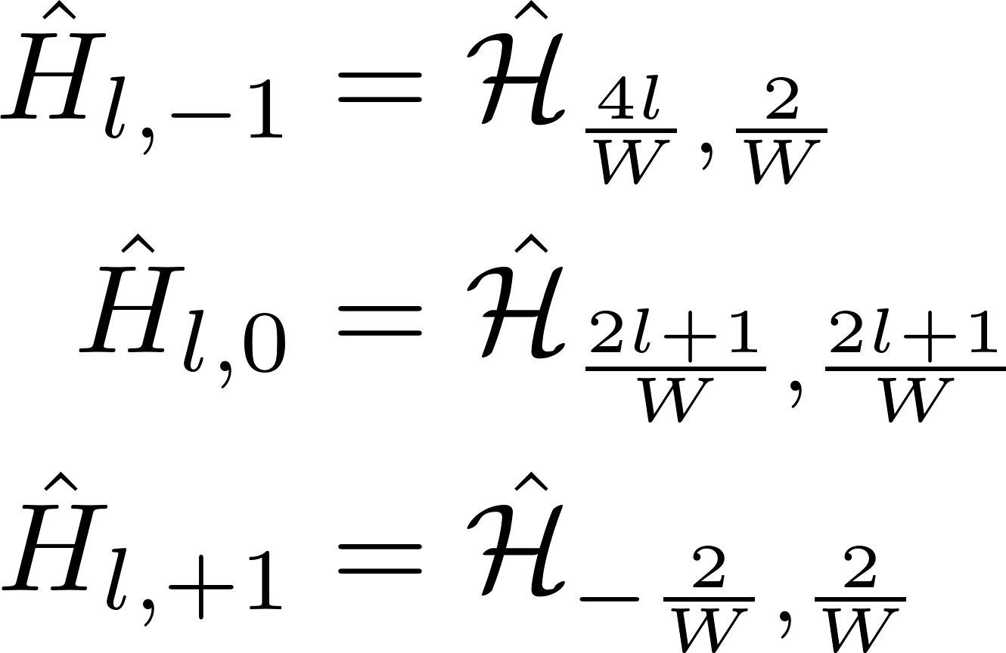
6. Making the best choice of $α$
So it makes more sense to use $W\left(α+1\right)=2l+3$. This satisfies all conditions for integrability over all state indices, and reduces the number of terms introduced by the kinetic differentiation.

Slide 29
Finishing Up
Understanding the effect of the suboperators

Slide 30
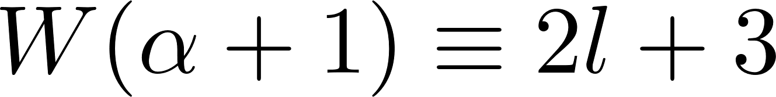
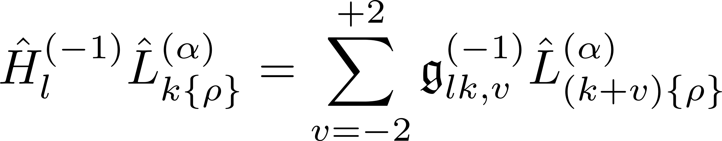
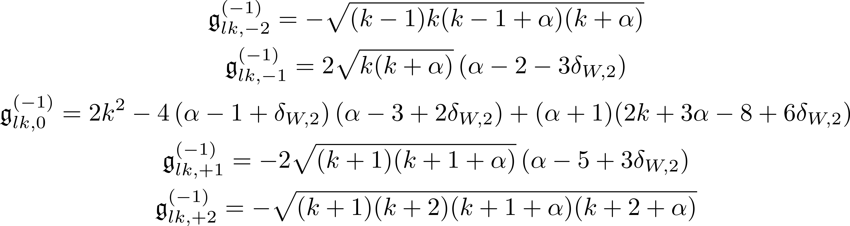
Effect of final kinetic suboperator – $s=−1$

Slide 31


Effect of final kinetic suboperator – $s=0$

Slide 32


Effect of final kinetic suboperator – $s=+1$

Slide 33
GENERALIZED BASIS STATES
The basis state, both original and with the kinetic operator applied, expressed in one formula.

Slide 34


Generalized basis states -- I

Slide 35


Generalized basis states -- II

Slide 36
APPENDIX

Slide 37

Relations involving the Laguerre polynomial -- I

Slide 38

Relations involving the Laguerre polynomial -- II

