Slide 1
BLOCH Functions
How symmetry introduces interrelationships between the coefficients of the Bloch Fourier expansion.

Slide 2
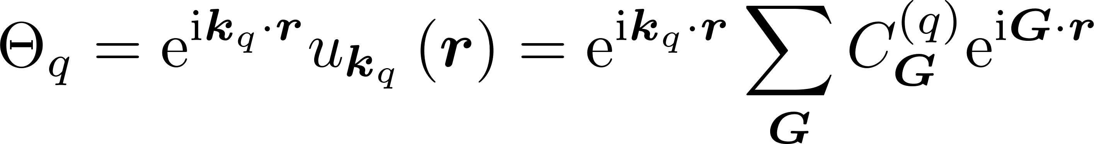
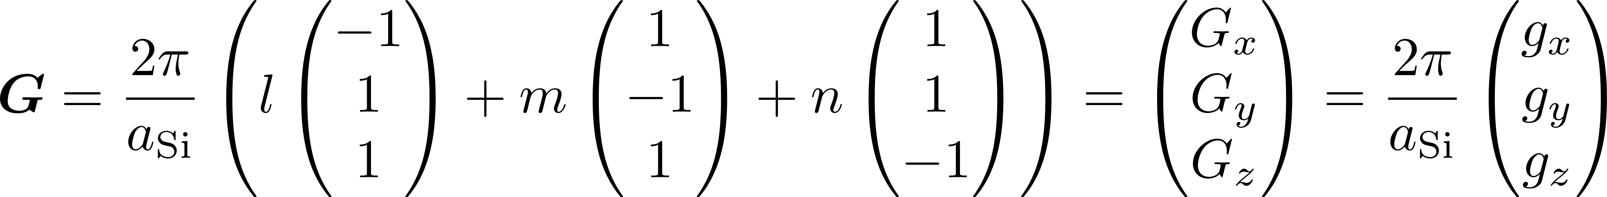
A1. Fourier series expansion of Bloch function

Slide 3
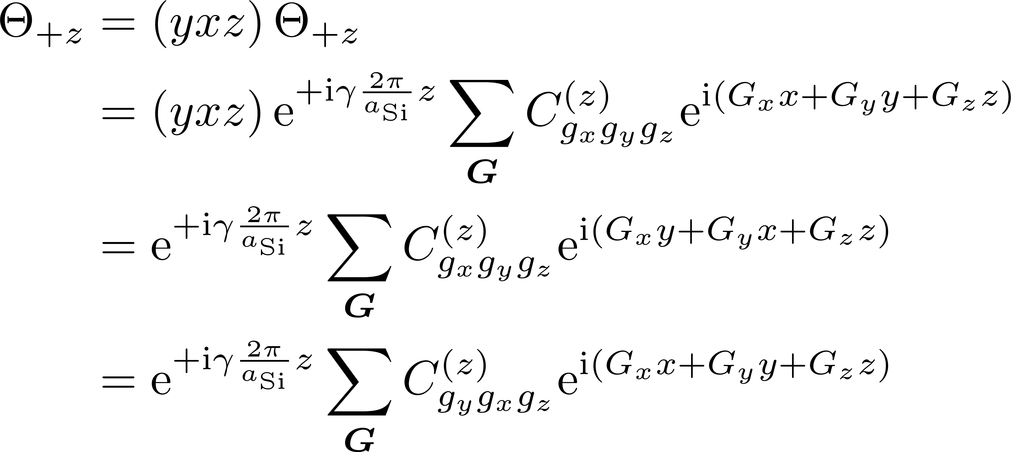
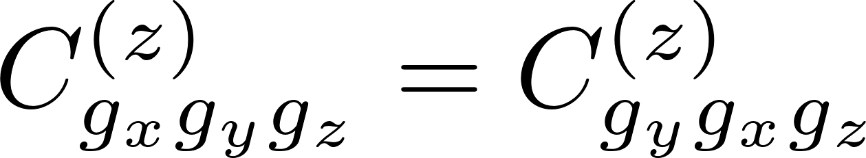
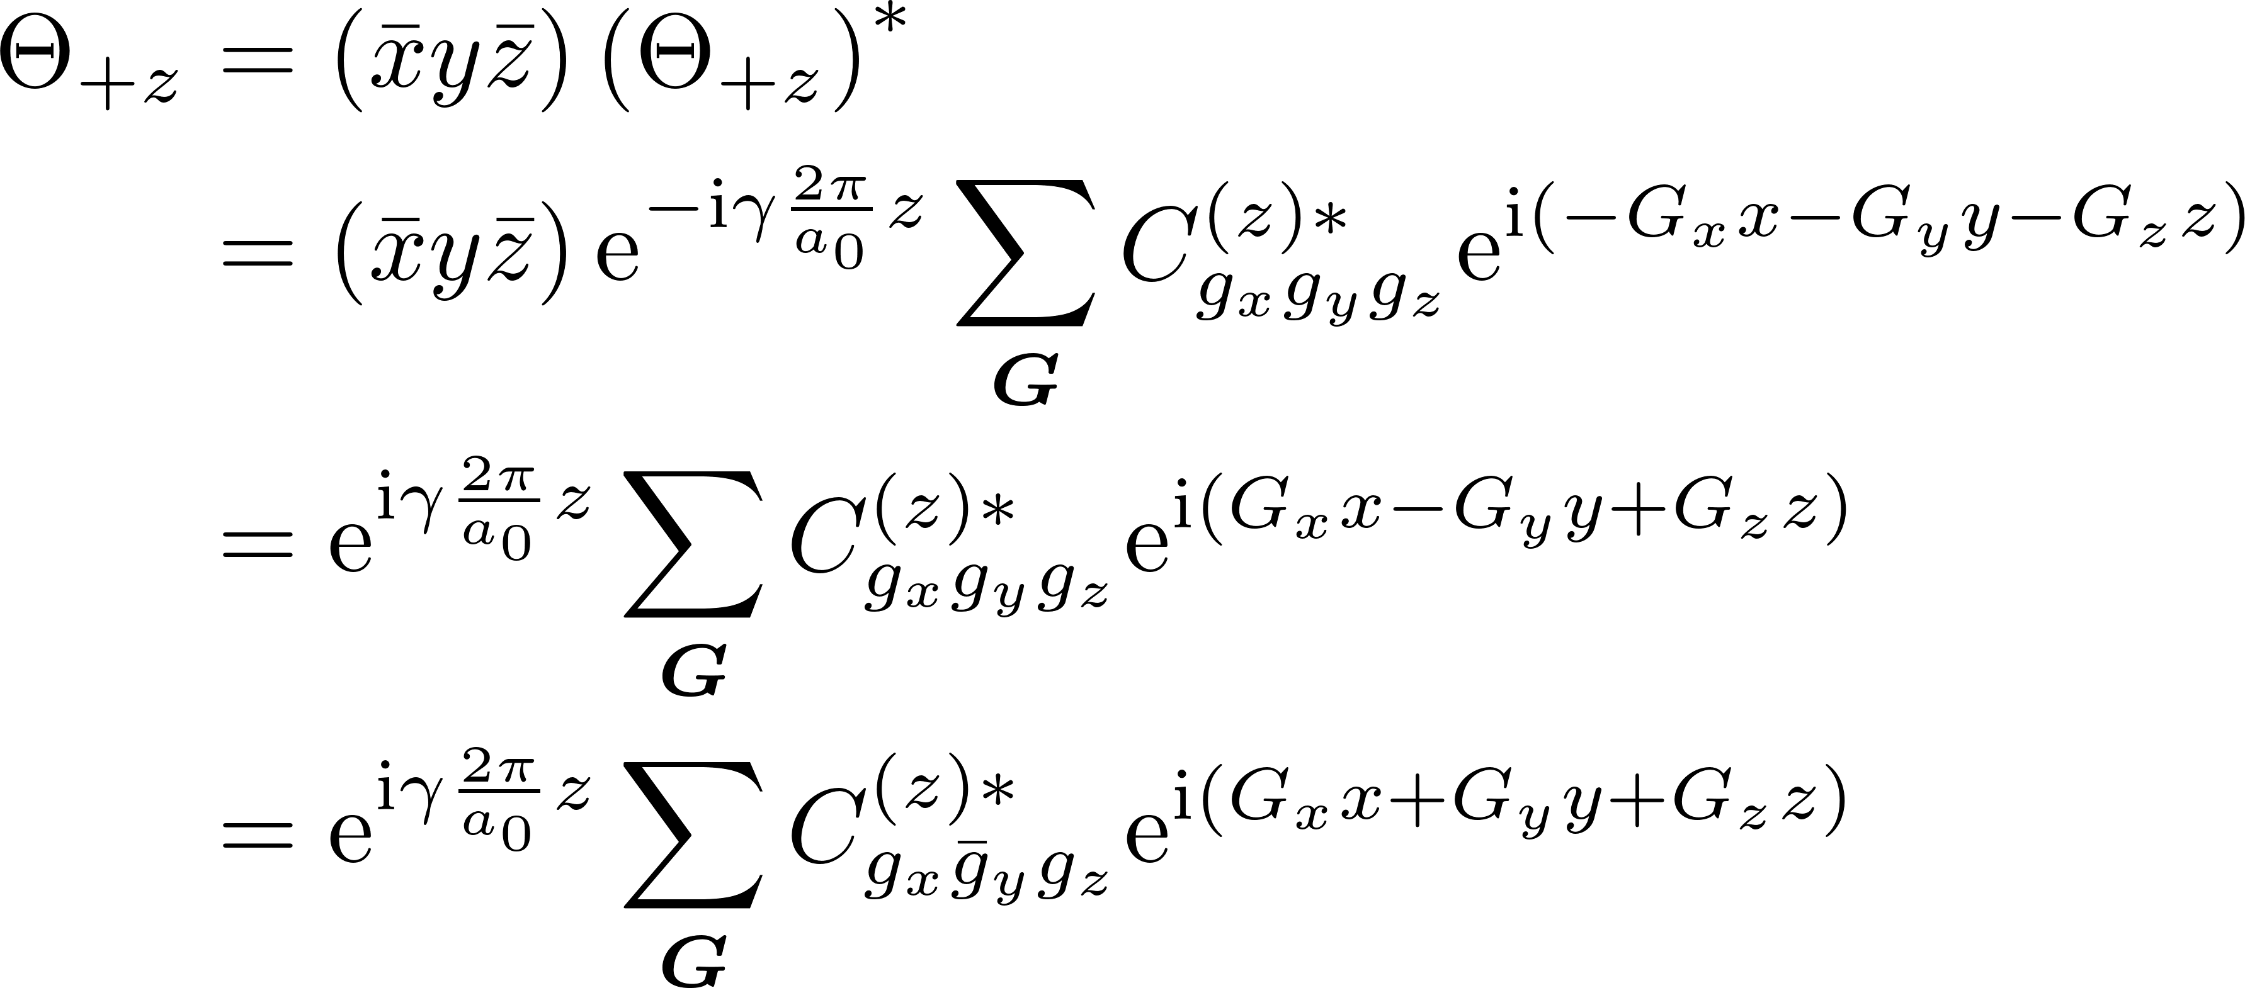
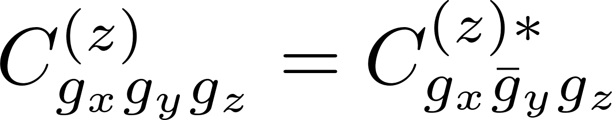
A2. Examples of invariant Bloch function transformations

Slide 4
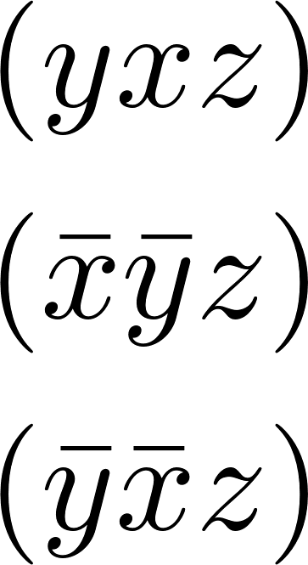
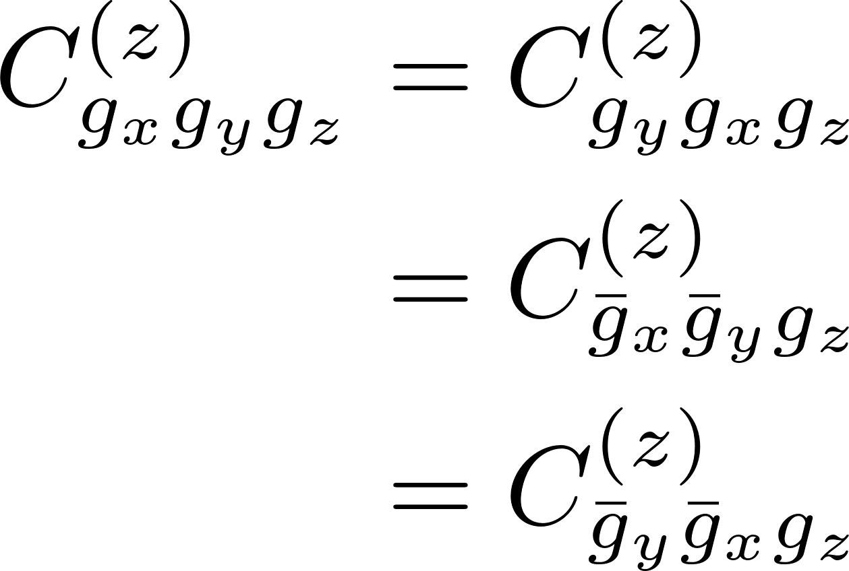
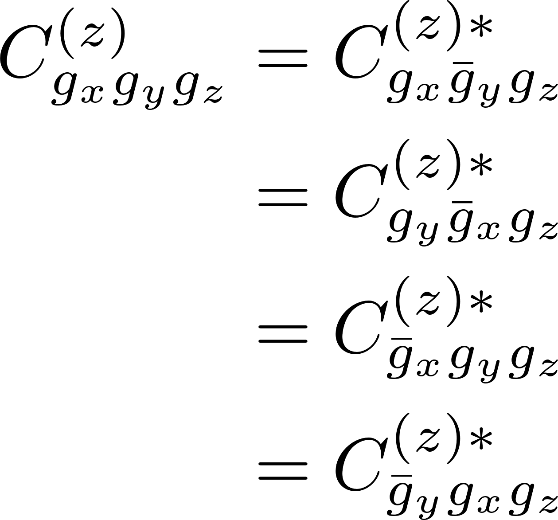
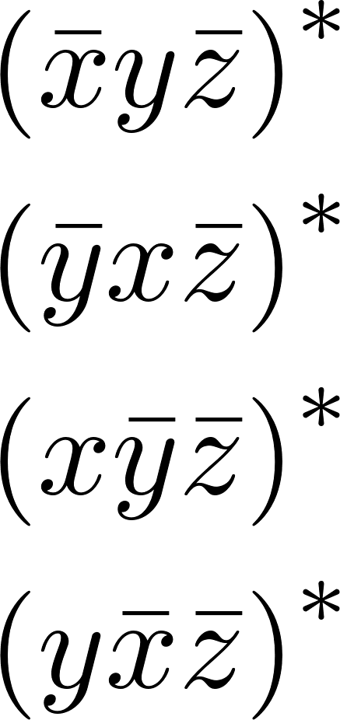
A3. Symmetries evident in the coefficients of the Bloch expansion

Slide 5
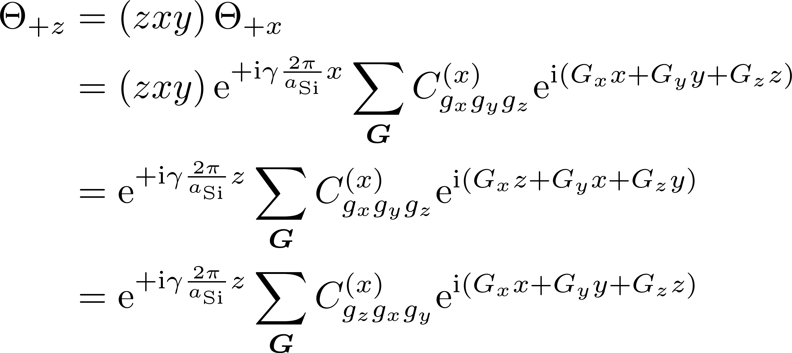
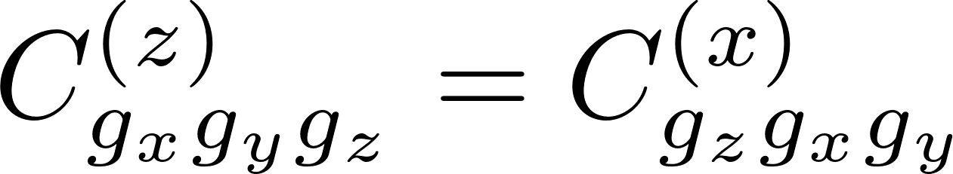
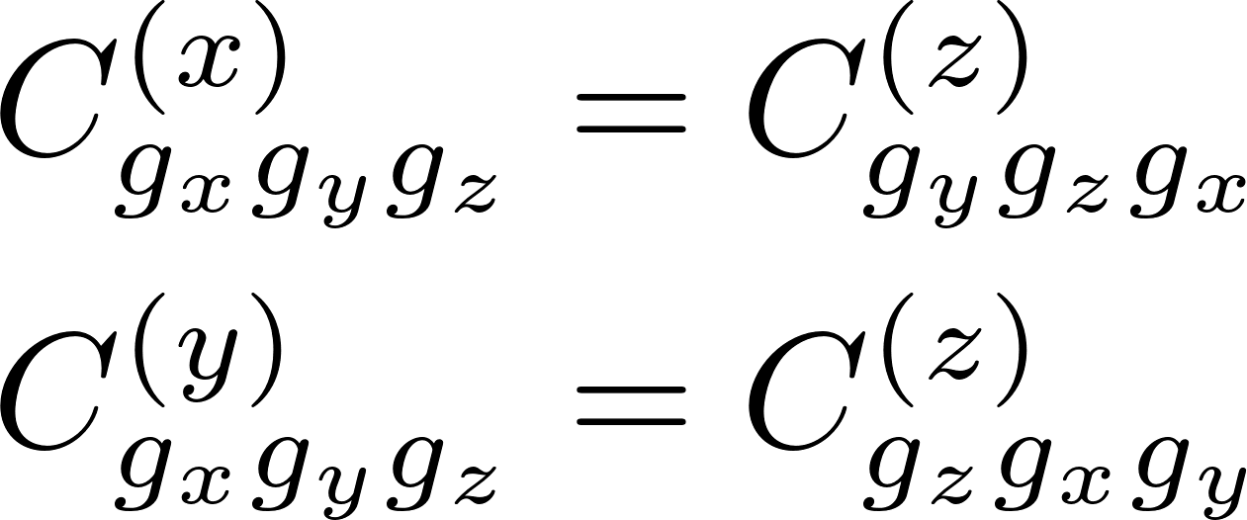
A4. Example of transformations that change Bloch function valley

Slide 6
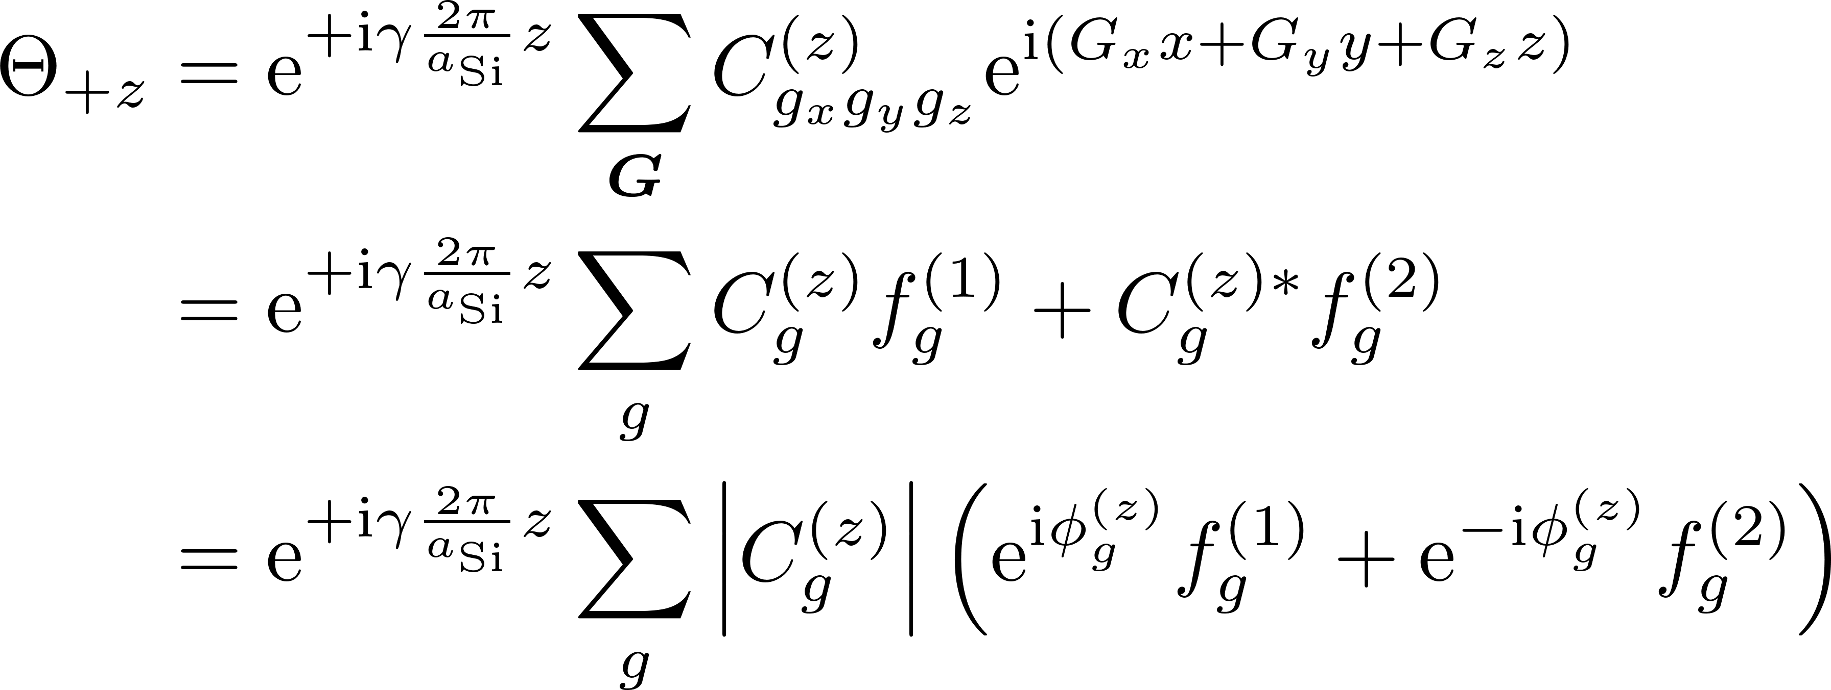
A5. Contracted summation representation of Bloch functions

Slide 7
BLOCH PRODUCTS
How symmetry introduces interrelationships between the coefficients of the Fourier expansion of products of Bloch functions

Slide 8
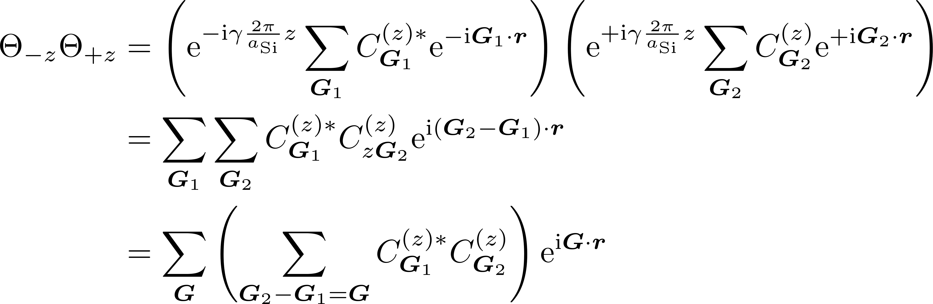
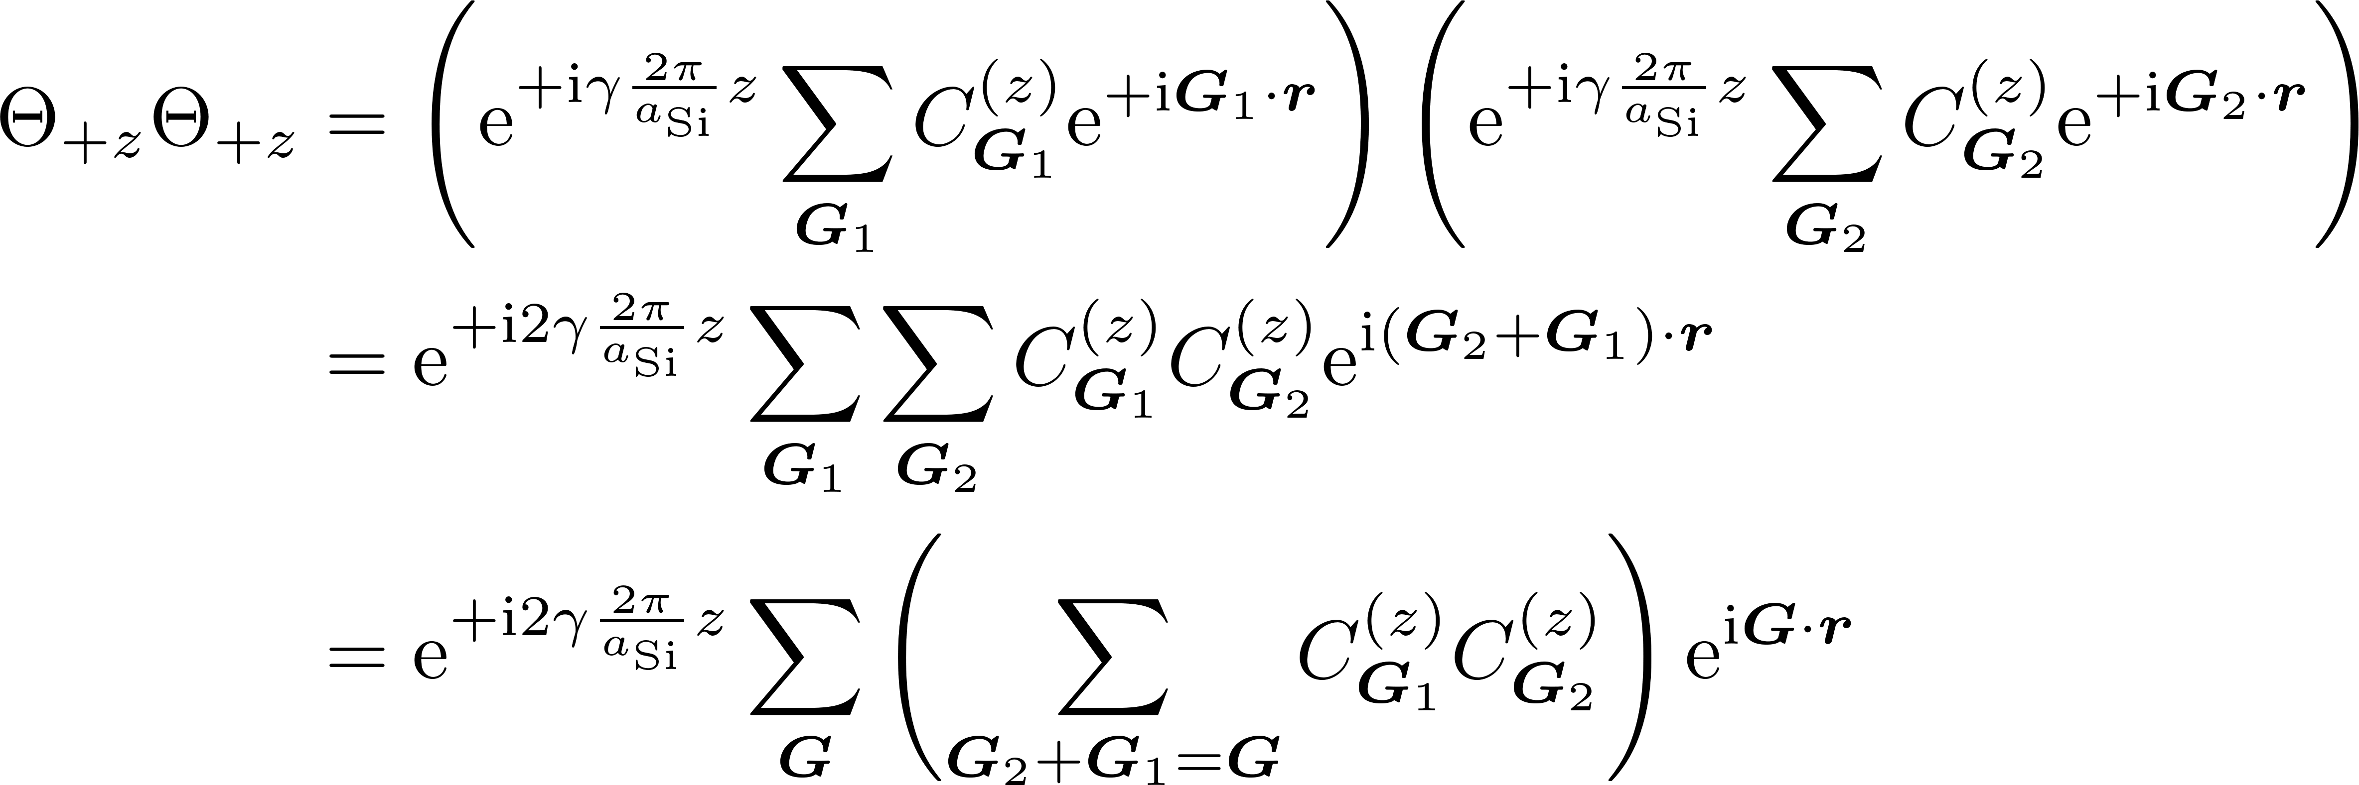
B1. Explicit formulae for parallel and antiparallel Bloch products

Slide 9
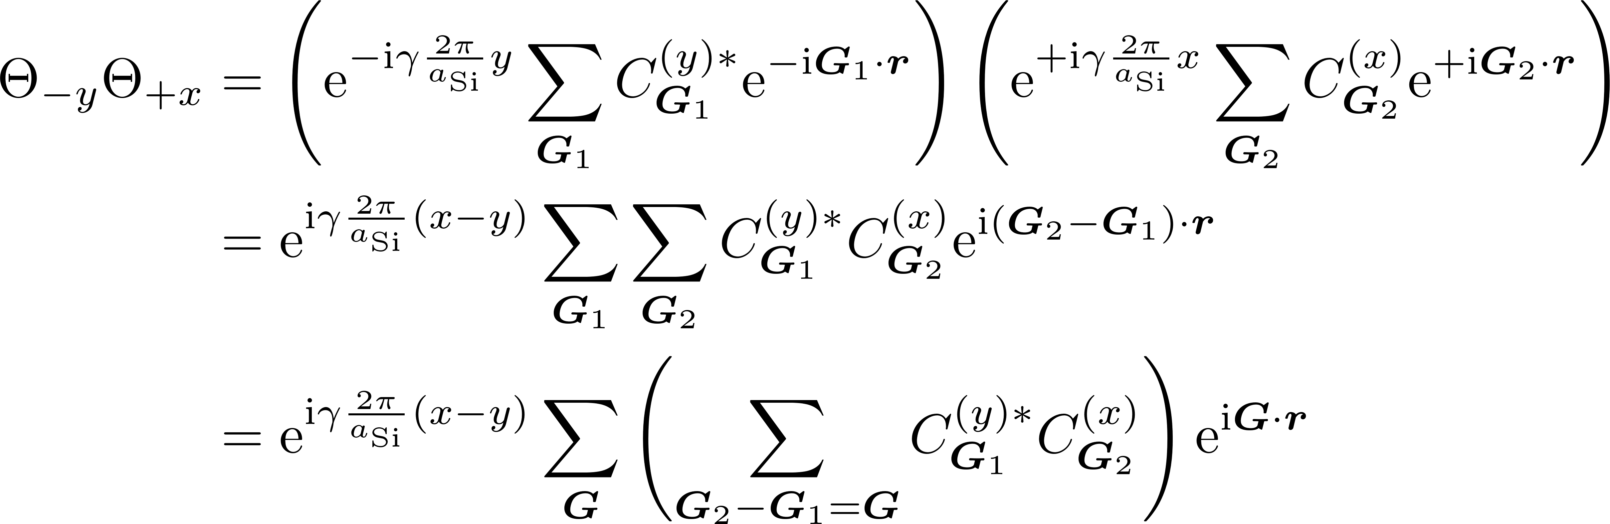
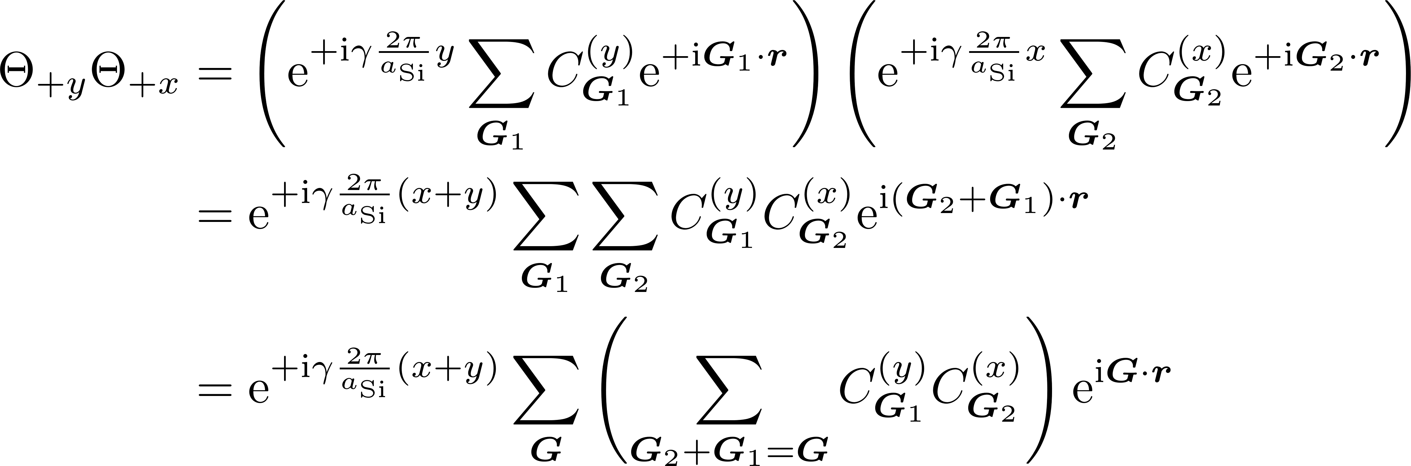
B2. Explicit formulae for perpendicular Bloch products

Slide 10
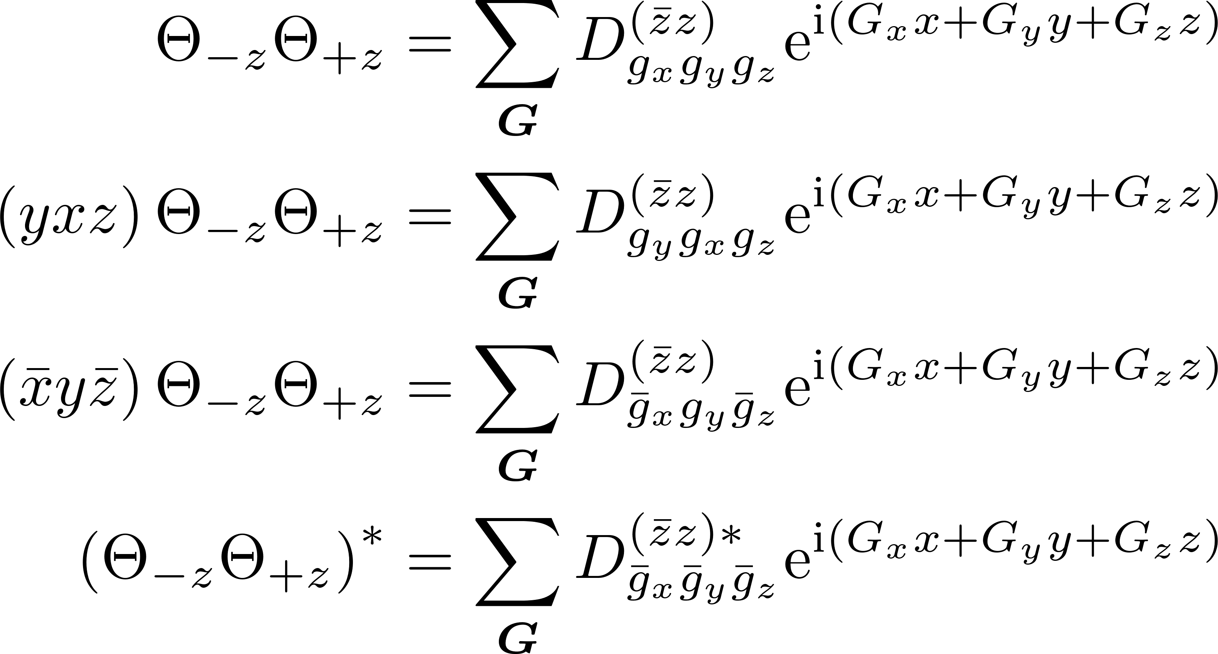
B3. Symmetries evident in the antiparallel Bloch products

Slide 11
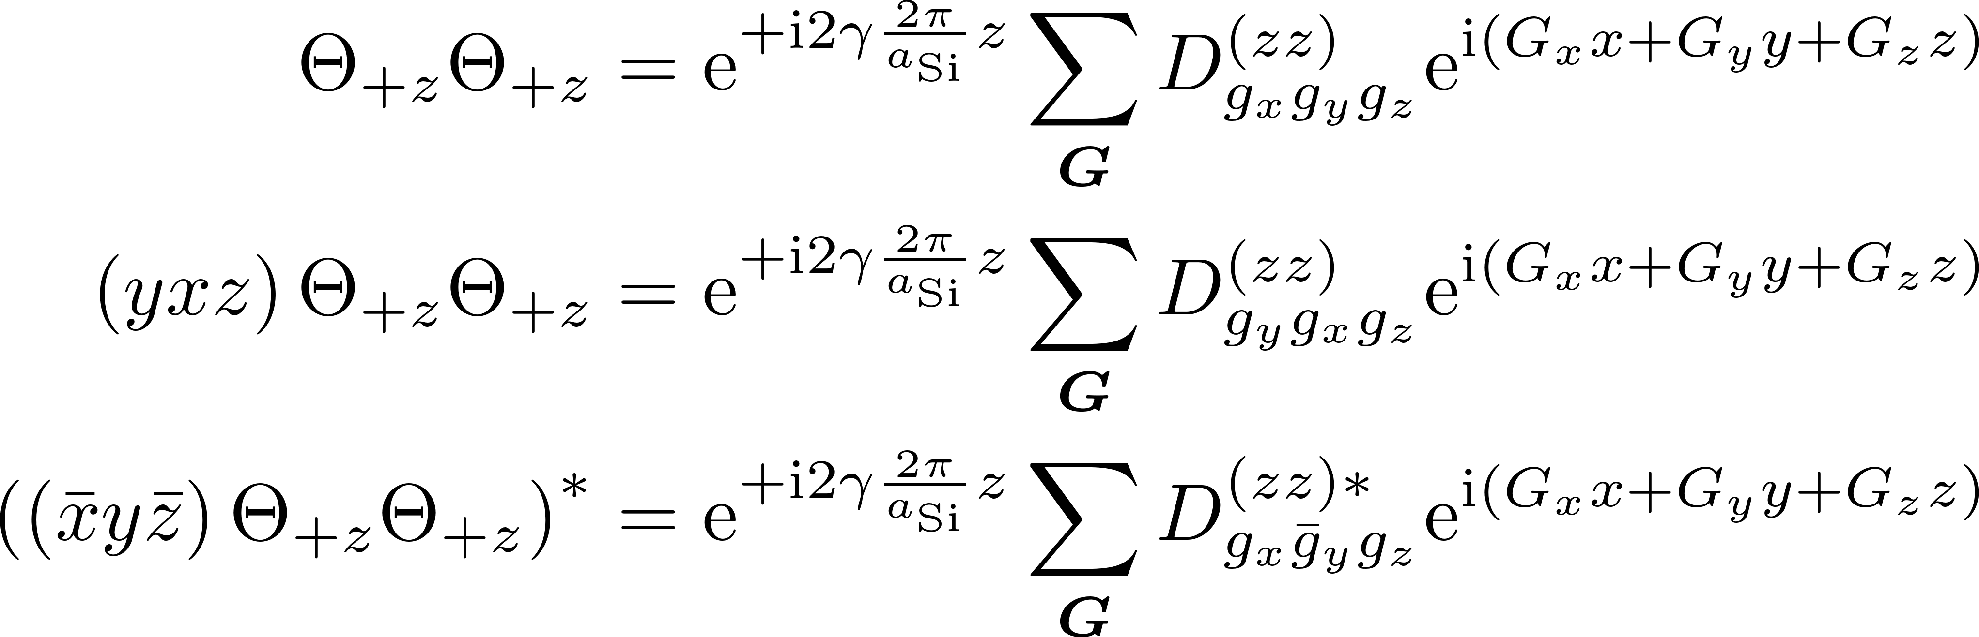
B4. Symmetries evident in the parallel Bloch products

Slide 12
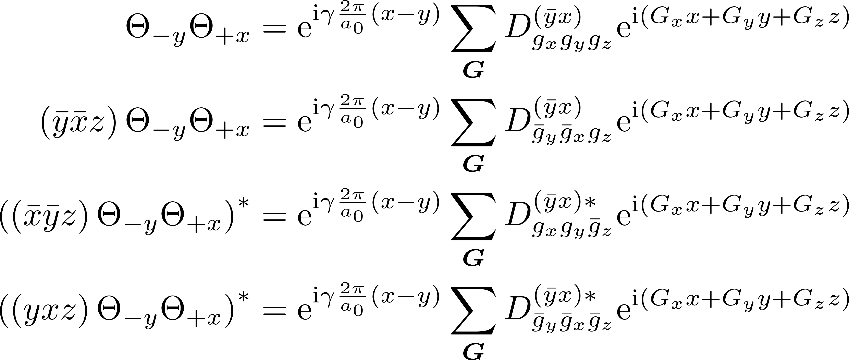
B5. Symmetries evident in the perpendicular Bloch products -- I

Slide 13
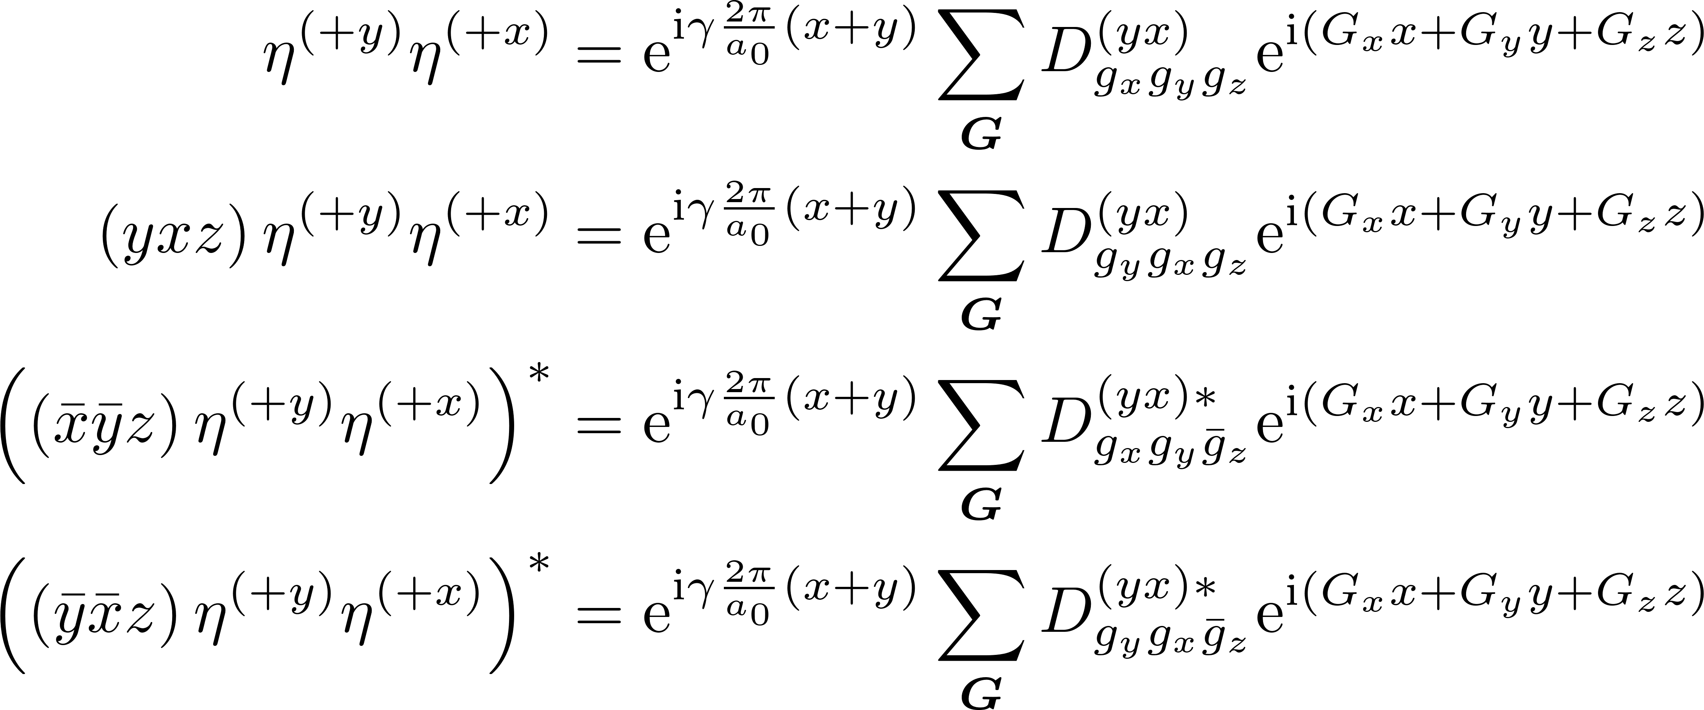
B6. Symmetries evident in the perpendicular Bloch products -- II

Slide 14
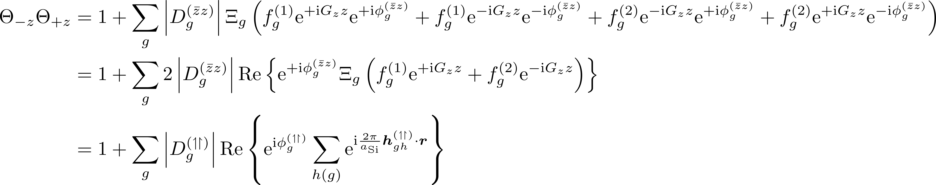
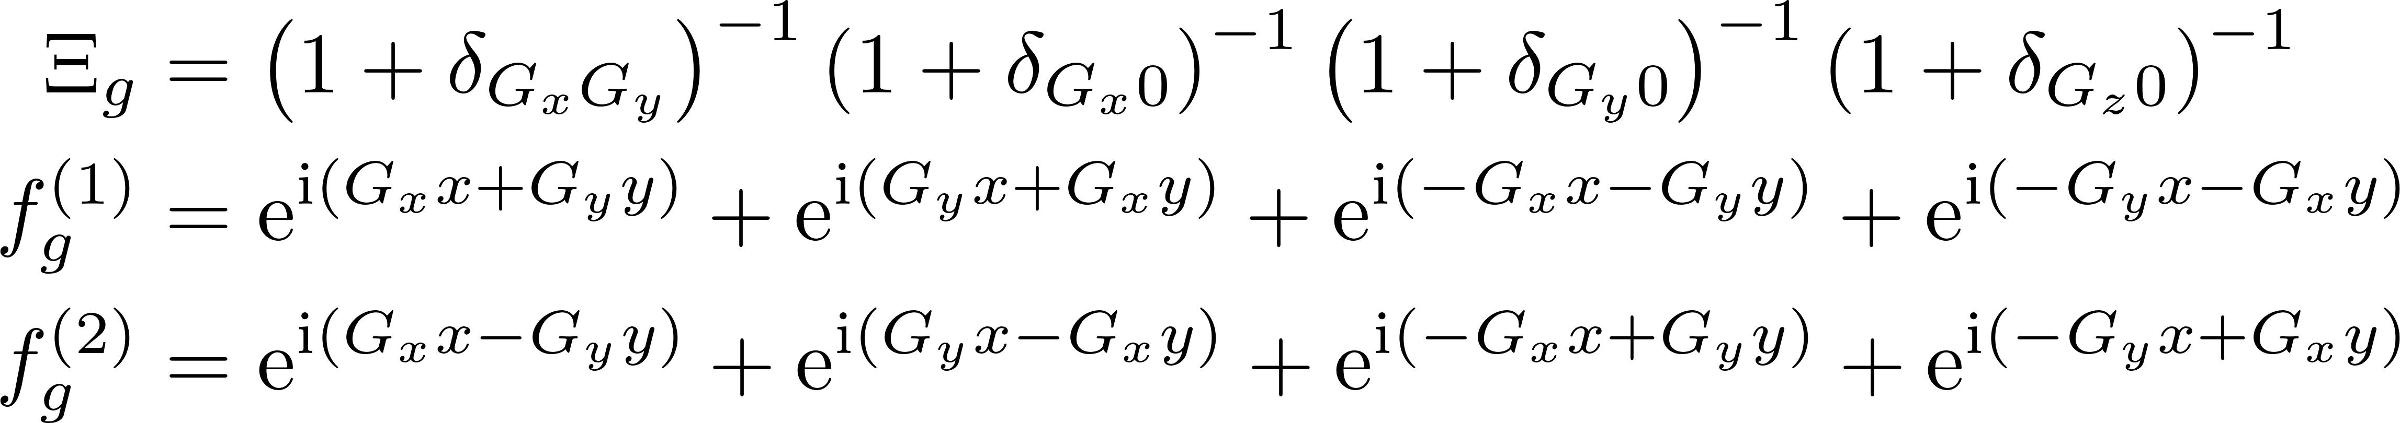
B7. Contracted summation of “parallel” Bloch products

Slide 15
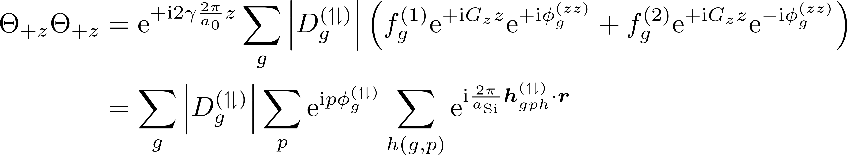
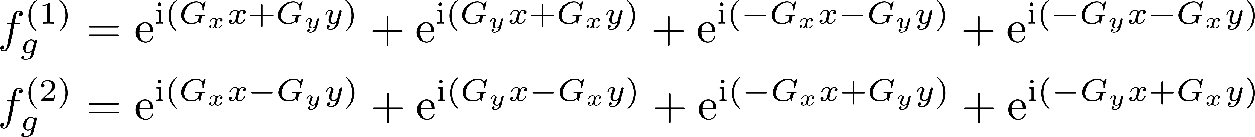
B8. Contracted summation of “antiparallel” Bloch products

Slide 16
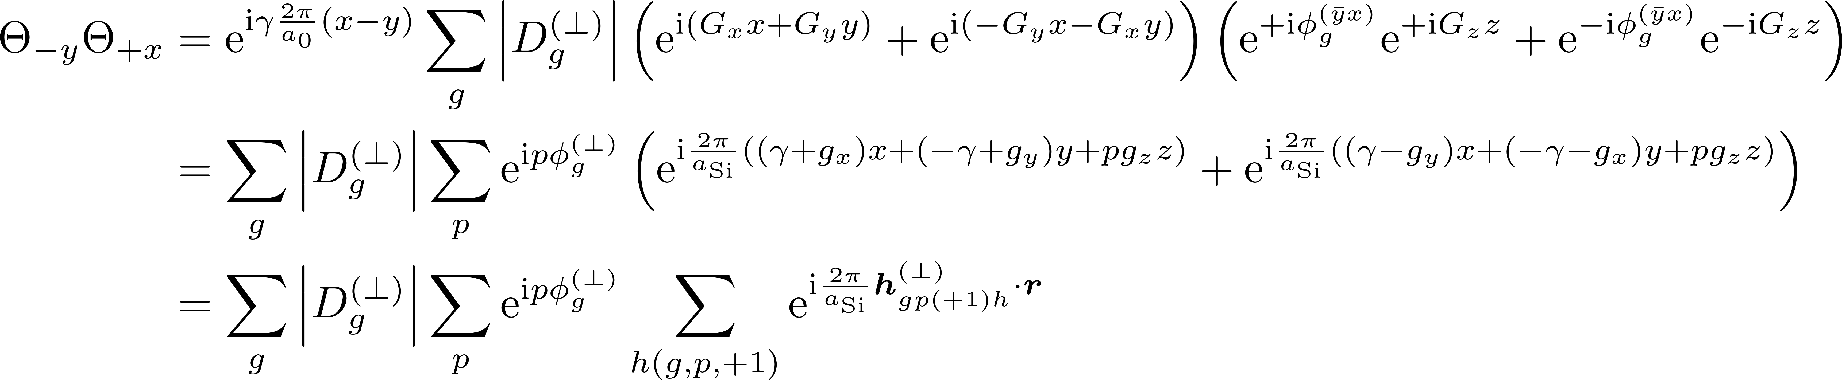
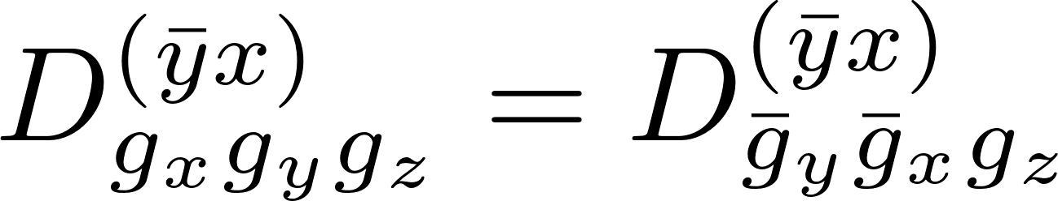
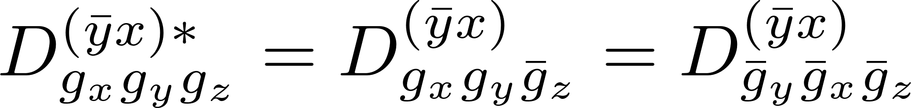
B9a. Contracted summation of “perpendicular” Bloch products

Slide 17
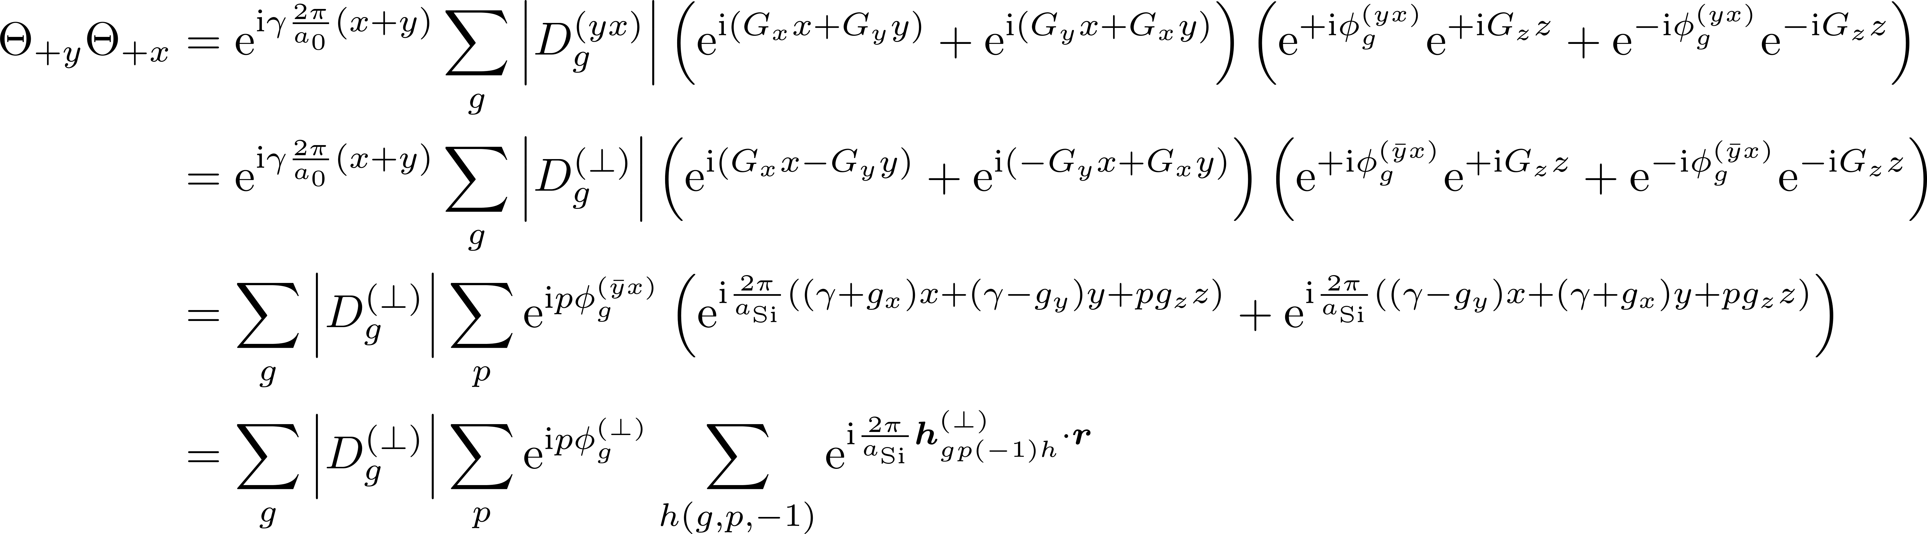
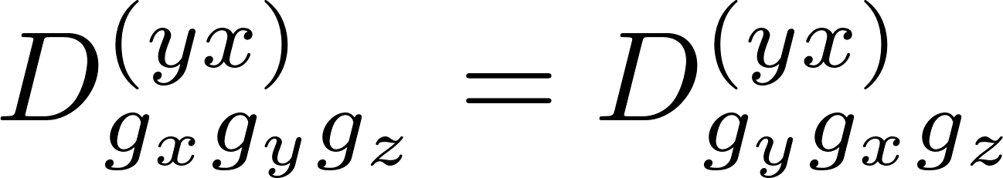
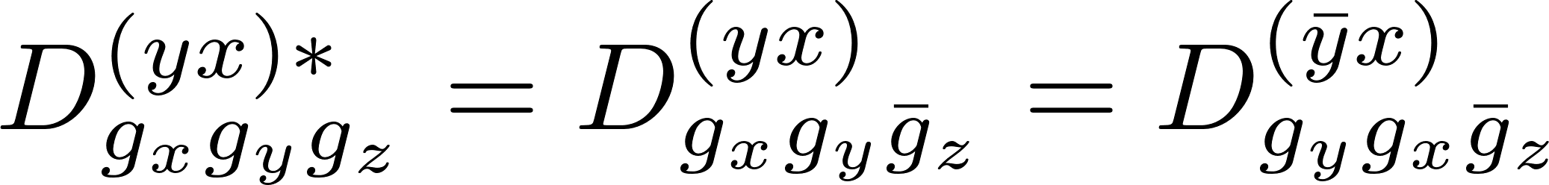
B9b. Contracted summation of “perpendicular” Bloch products

Slide 18
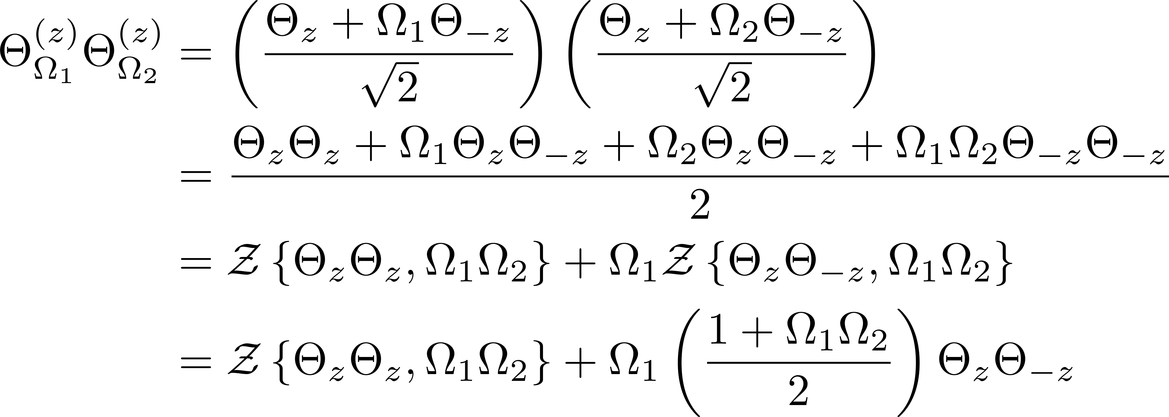
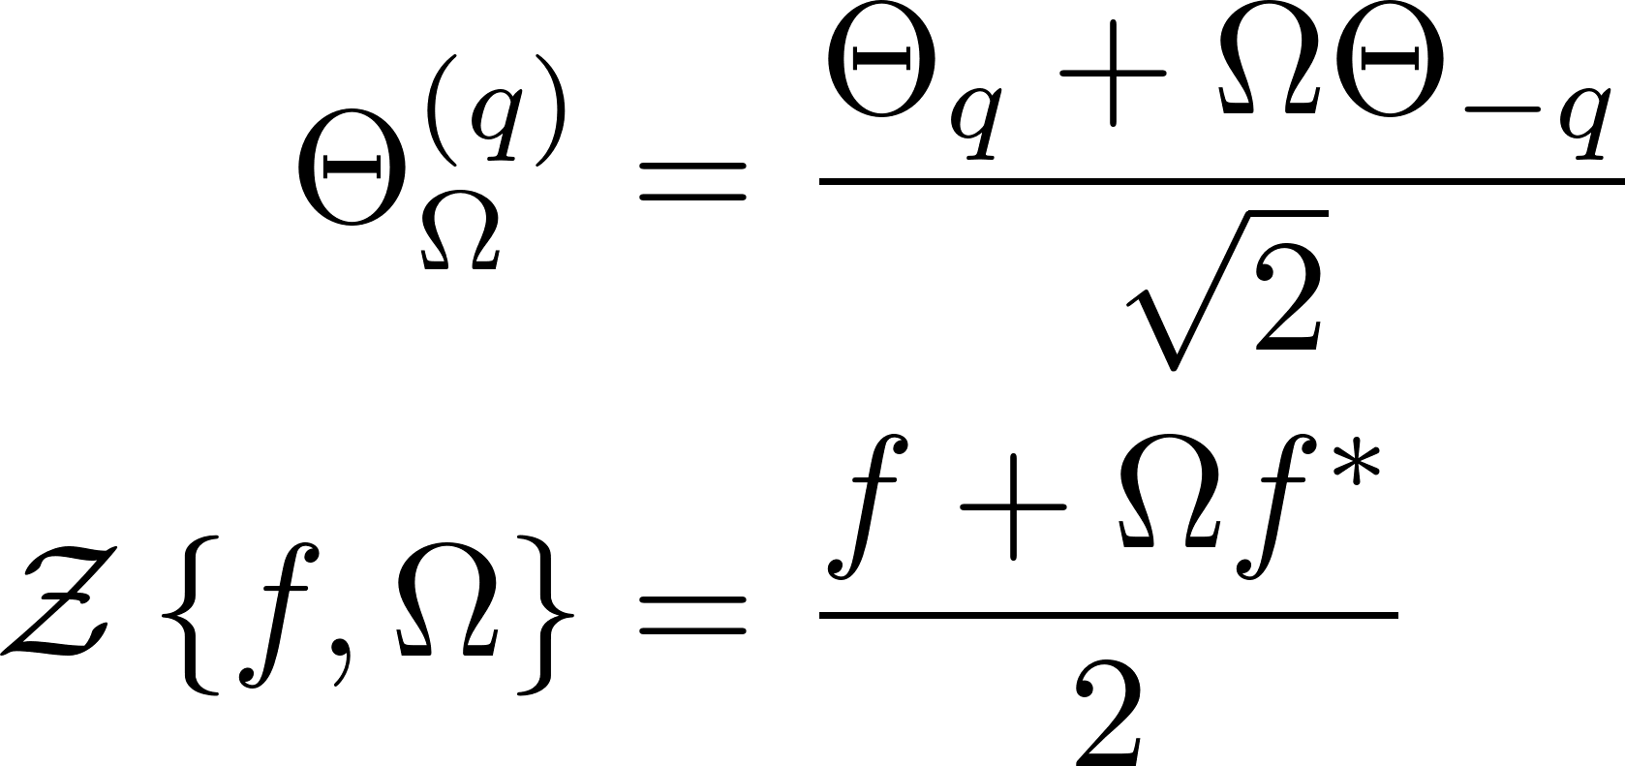
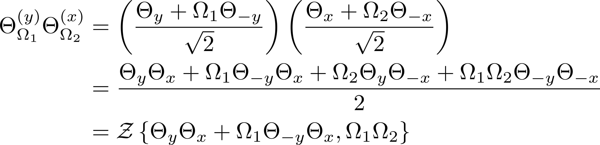
B10. Restatement of Bloch products

Slide 19
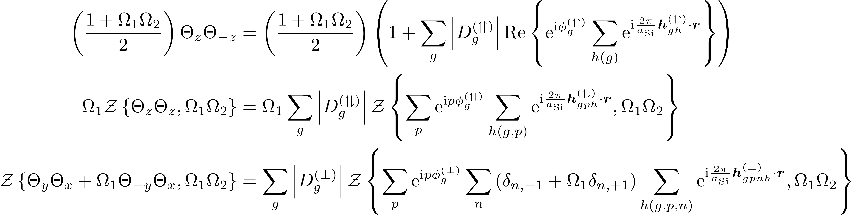
B10a. Elaboration of Bloch products

Slide 20
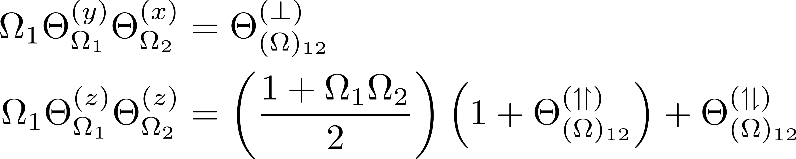
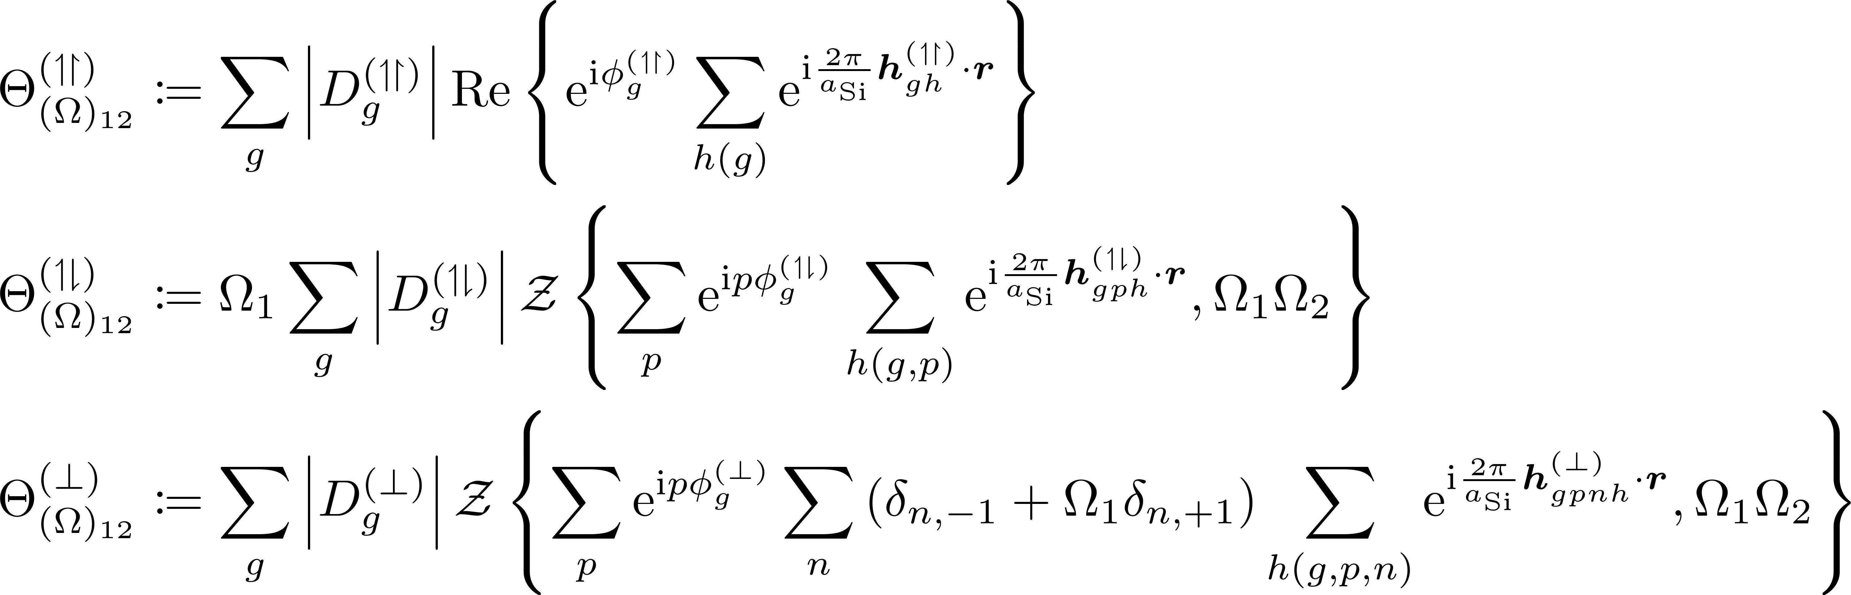
B11. Final form of Bloch product formulae

