Slide 1
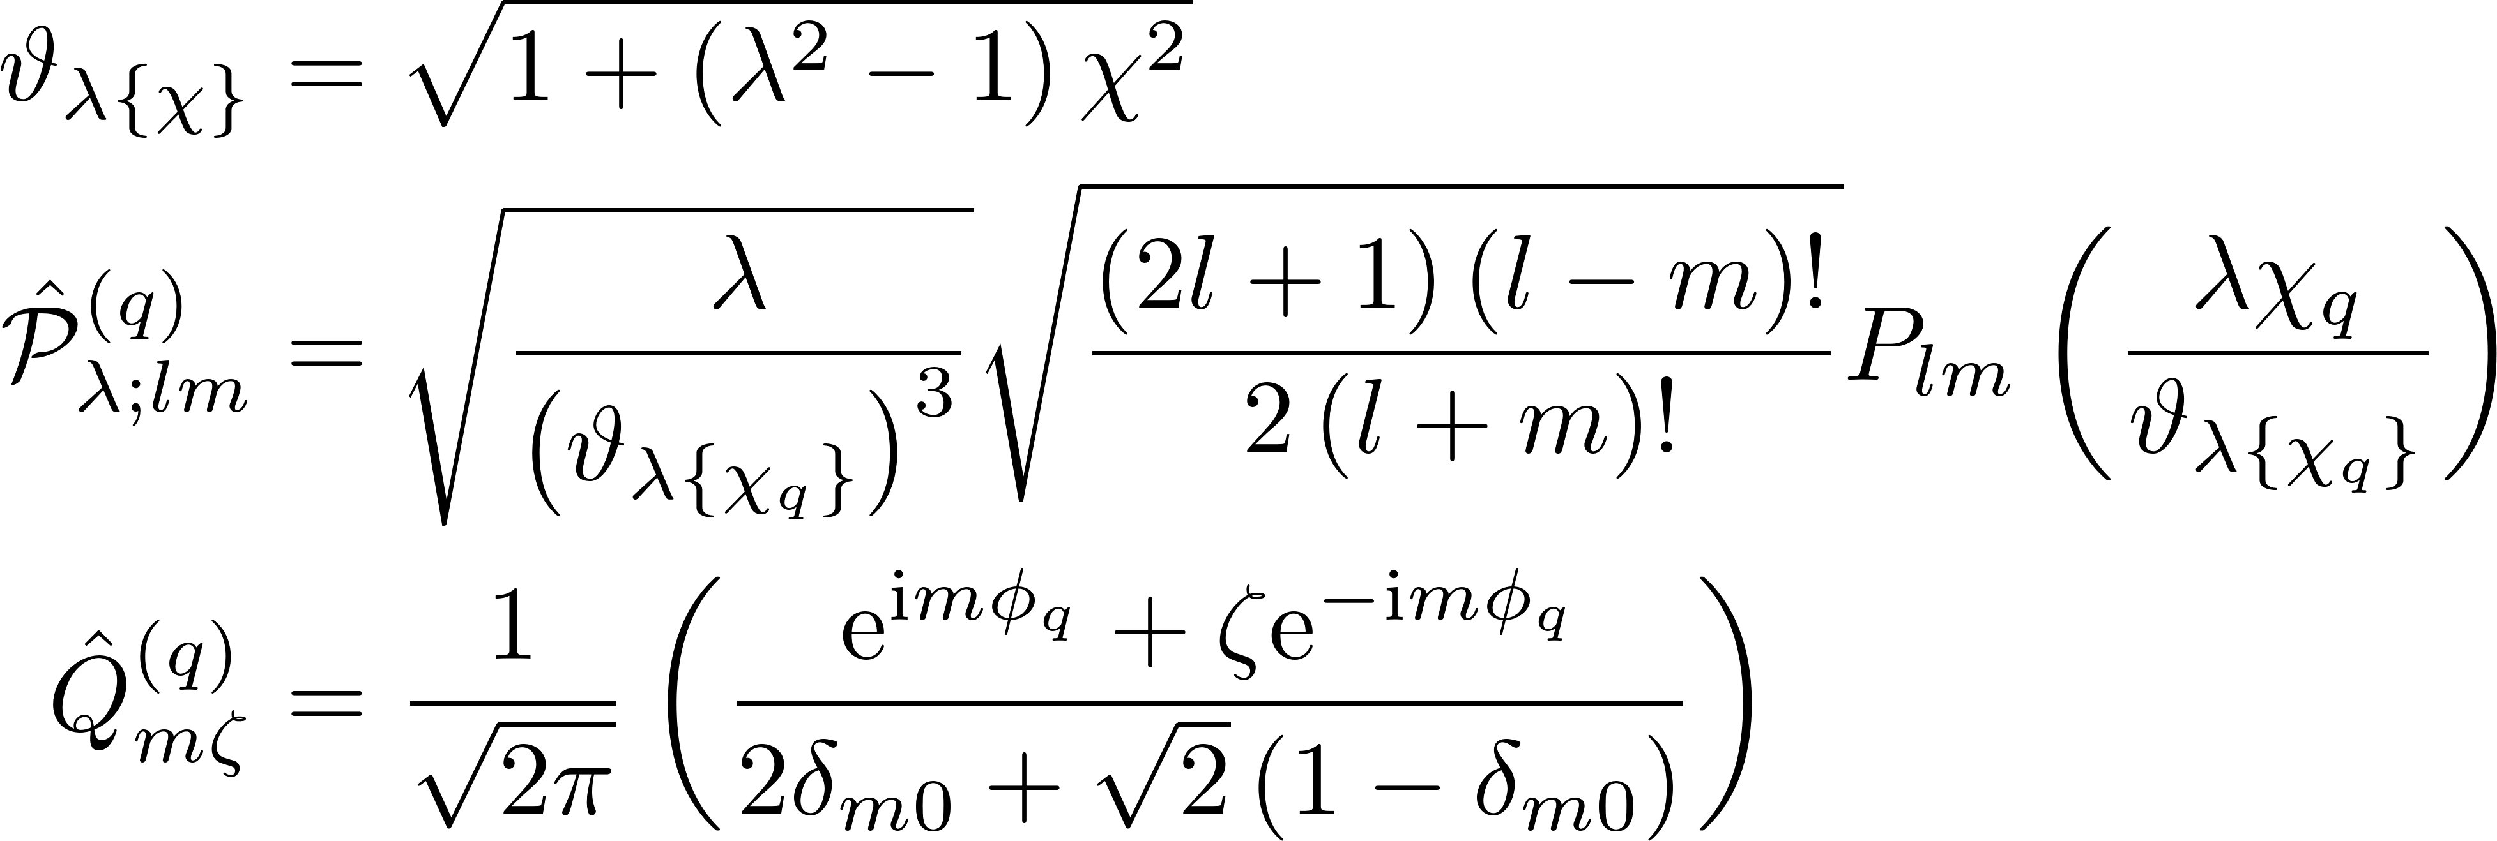
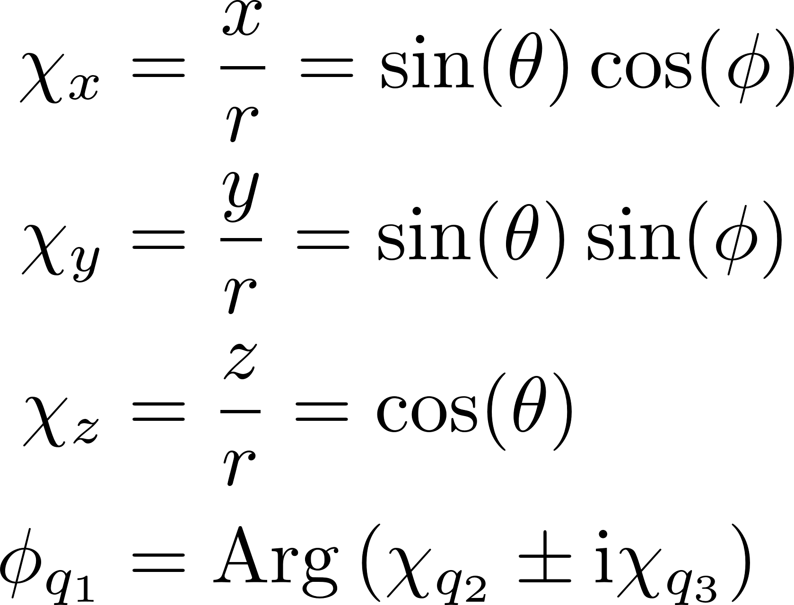
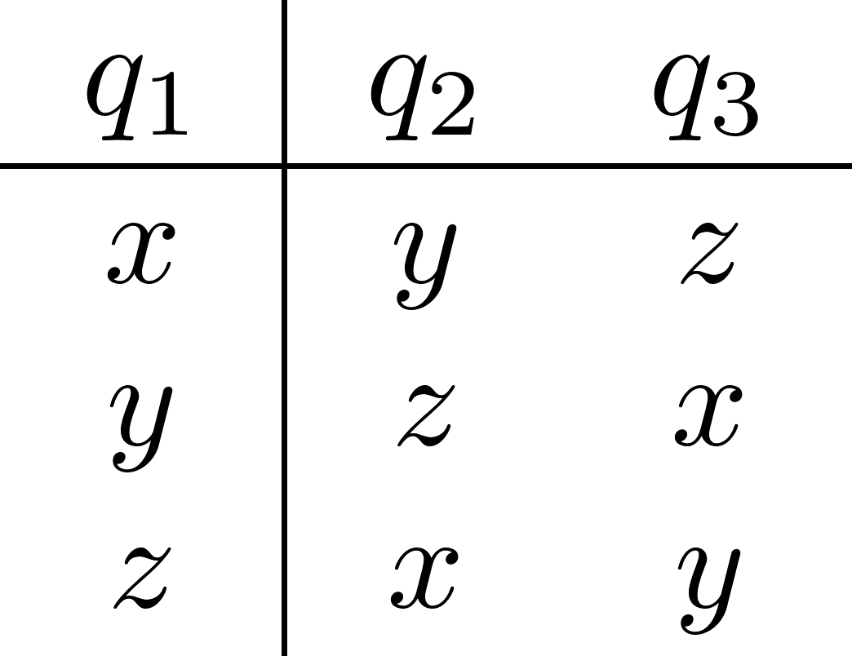
Generalized basis states -- I

Slide 2
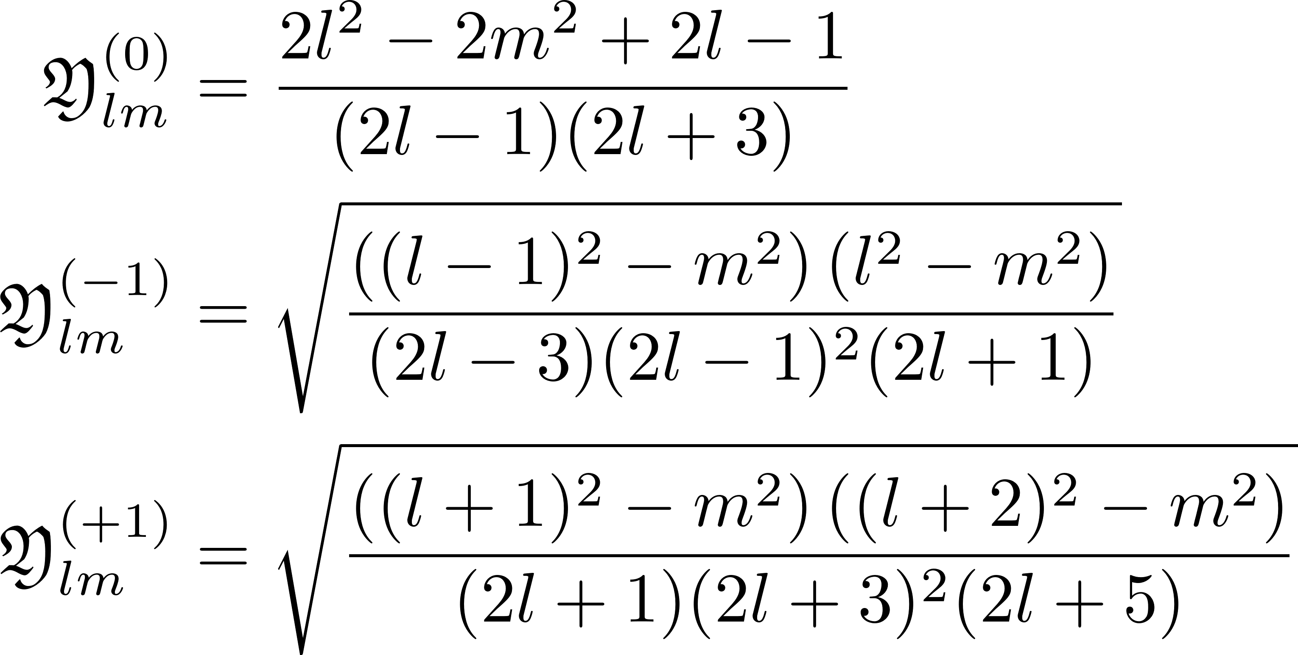


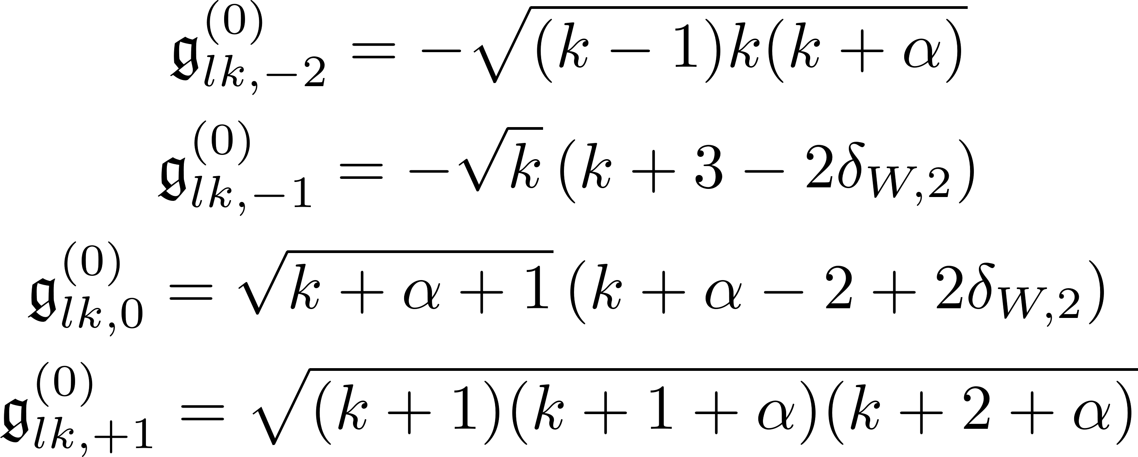
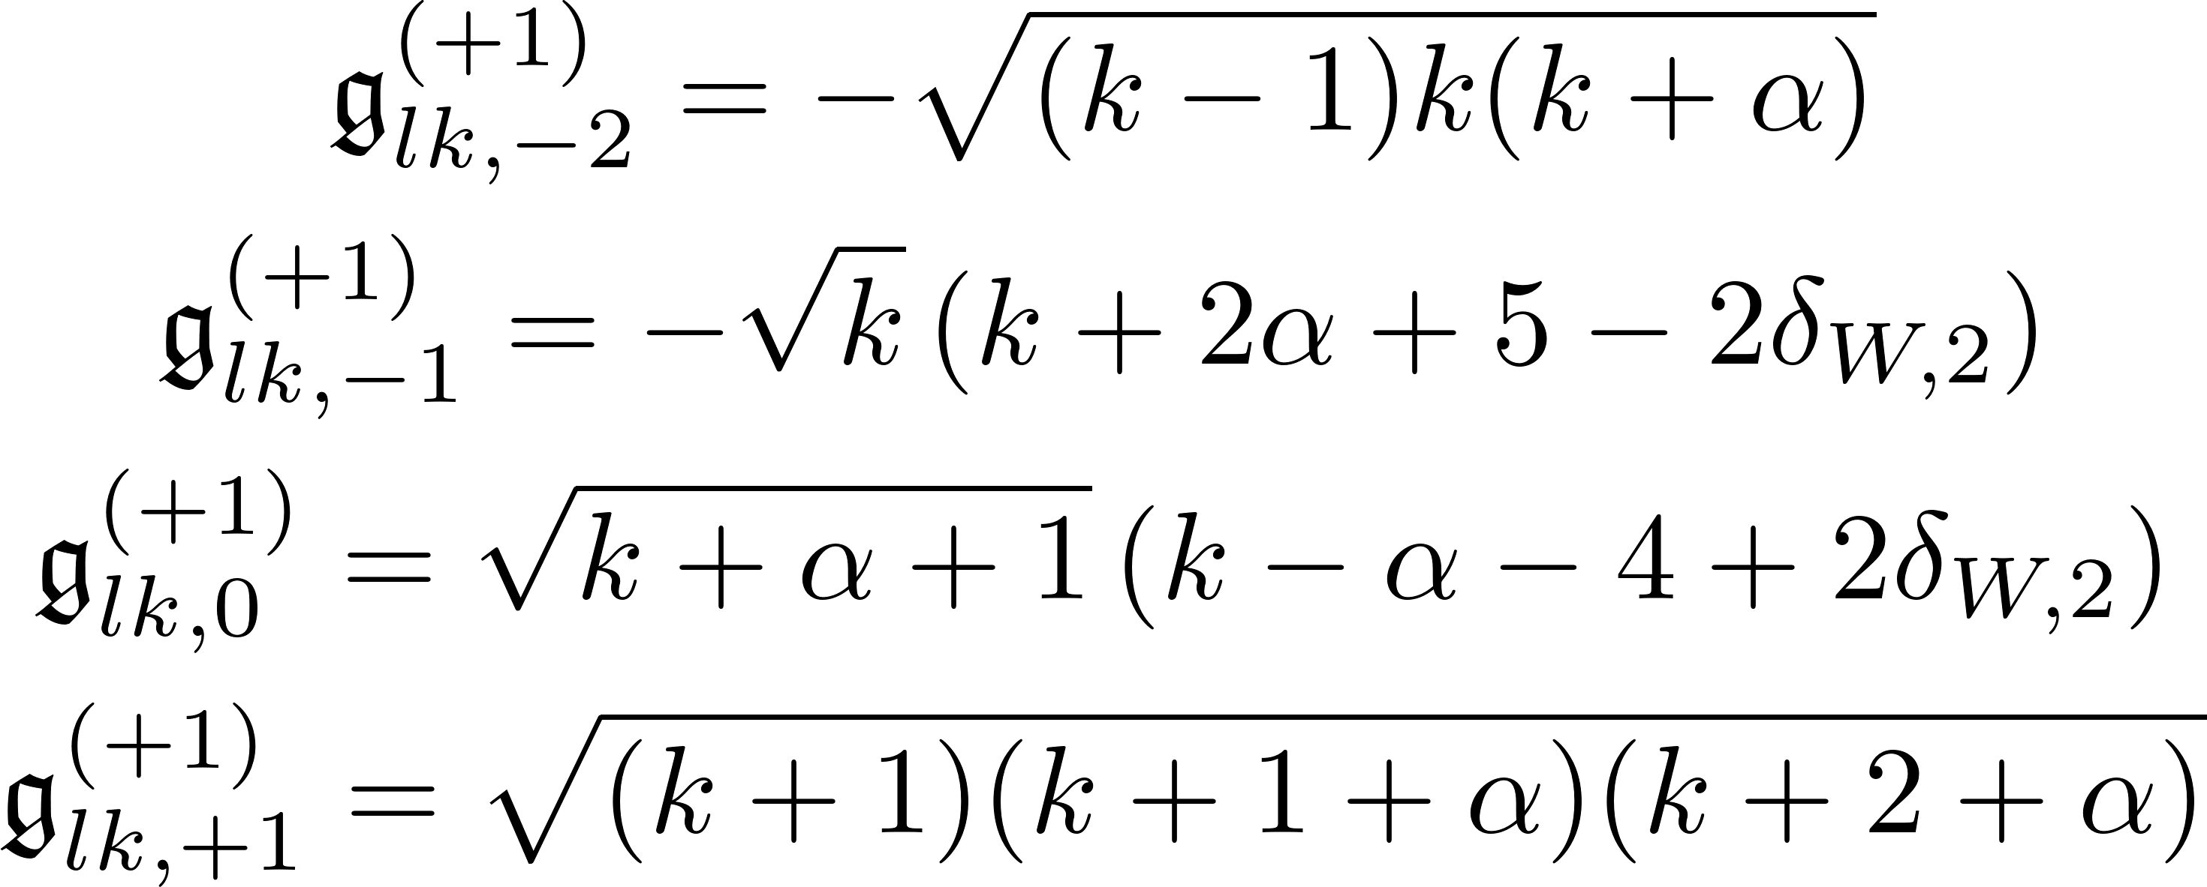

Generalized basis states -- II

Slide 3

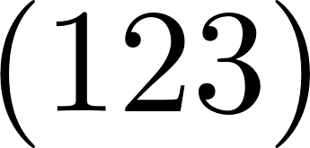
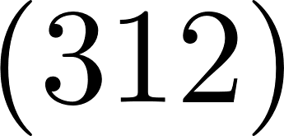
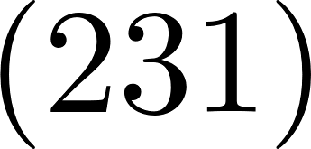
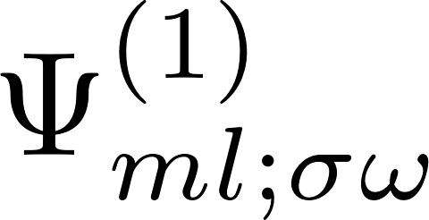
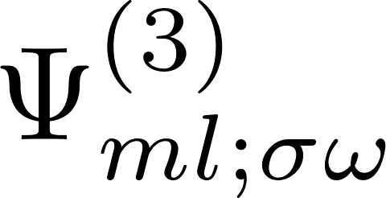
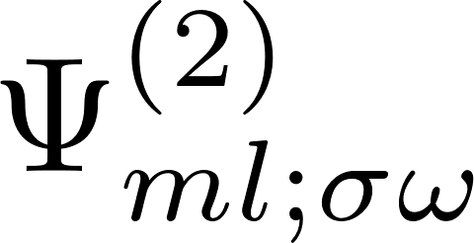
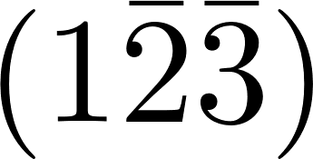
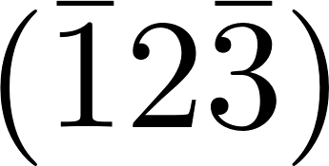
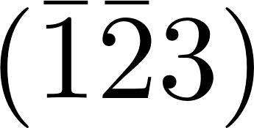

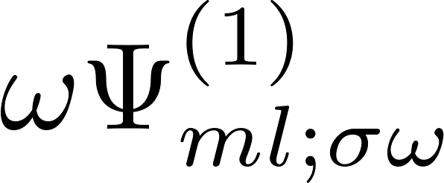
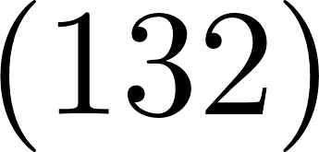
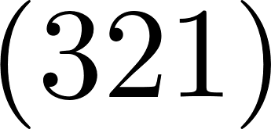
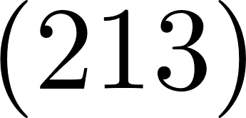
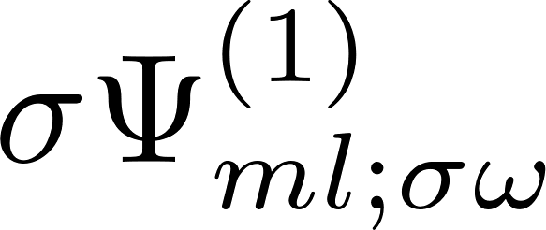
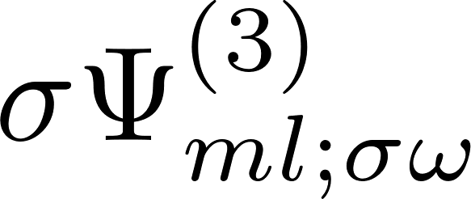
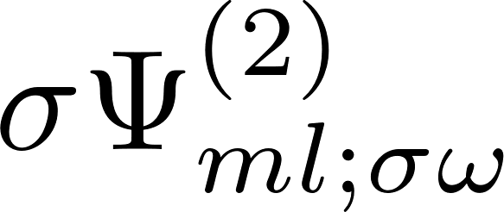
Effect of Td operations, including Bloch functions, m even
States indexed by inversion (ω) and acyclic (σ) symmetry as either even (+1) or odd (-1)
Cyclic permutations
Double inversion
Time-reversal
Acyclic permutations

Slide 4



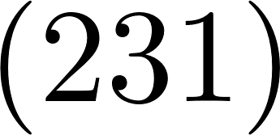



Effect of Td operations, including Bloch functions, m odd
States indexed by free parameter (h) either even (+1) or odd (-1). m odd states have odd inversion (ω = -1).
Cyclic permutations
Double inversion
Acyclic permutations
Time-reversal

Slide 5



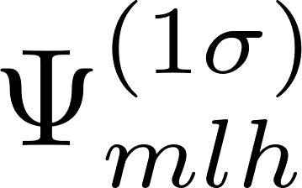
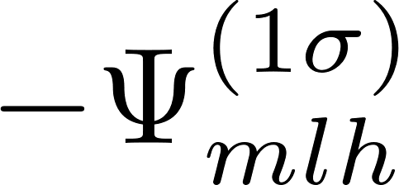

Effect of Td operations, including Bloch functions, m odd
States indexed by acyclic (σ) symmetry as either even (+1) or odd (-1). m odd states have odd inversion (ω = -1).
Cyclic permutations
Double inversion
Time-reversal
Acyclic permutations

Slide 6
MultI-Valley Basis
The basis states appropriately symmetrized

Slide 7
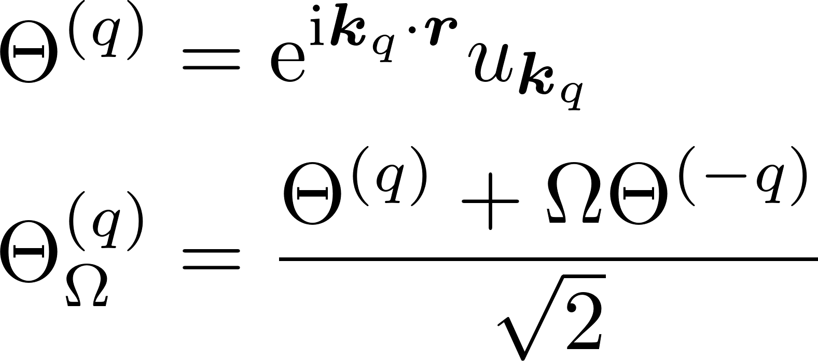



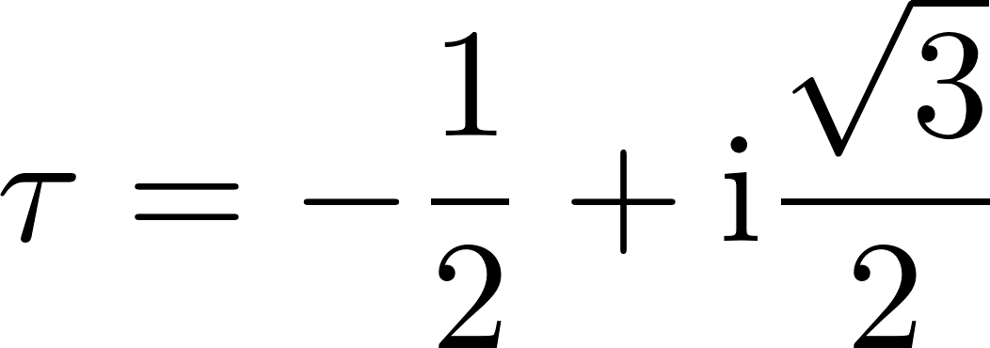


Symmetrized States, m even

Slide 8

Symmetrized States, m odd

