Slide 1
Symmetry
How the basis is impacted by symmetries of the system.

Slide 2
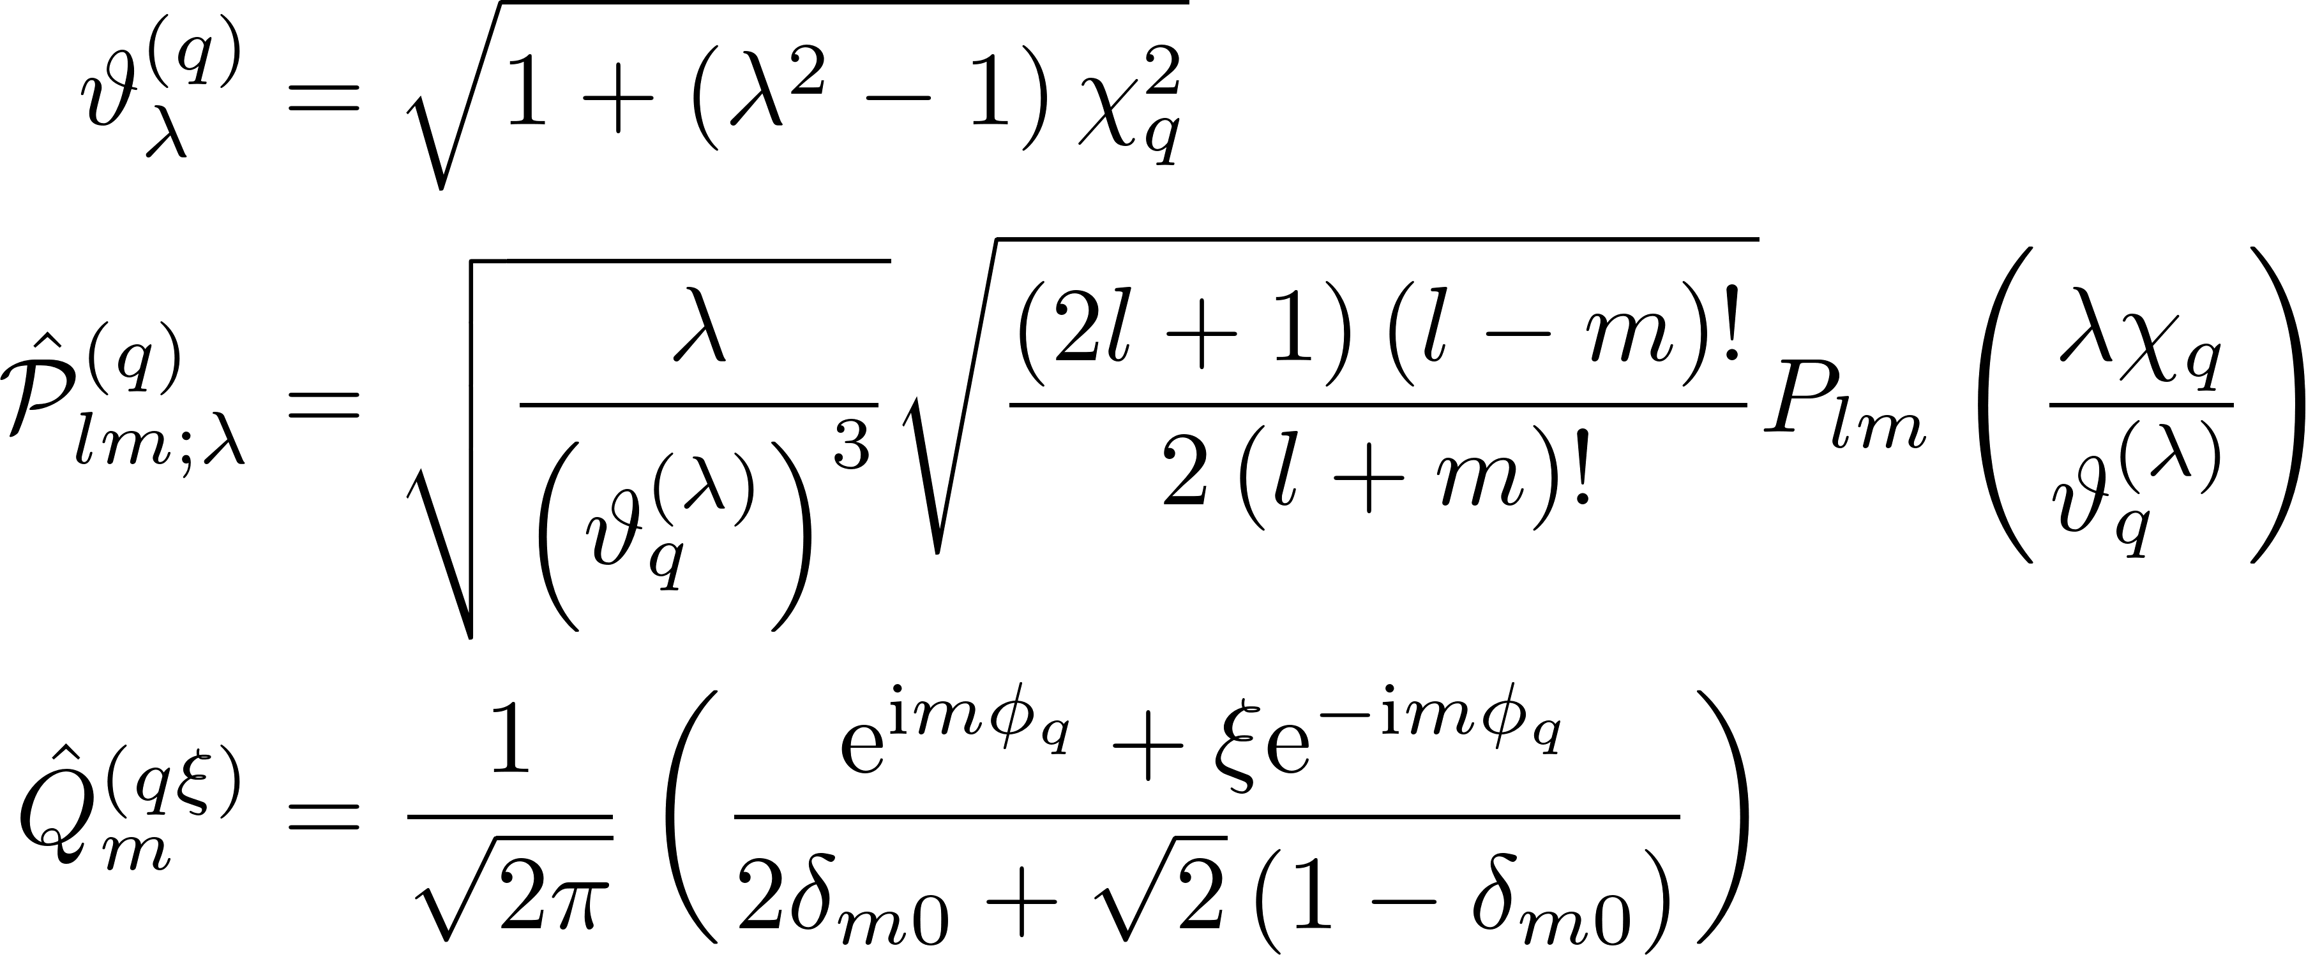
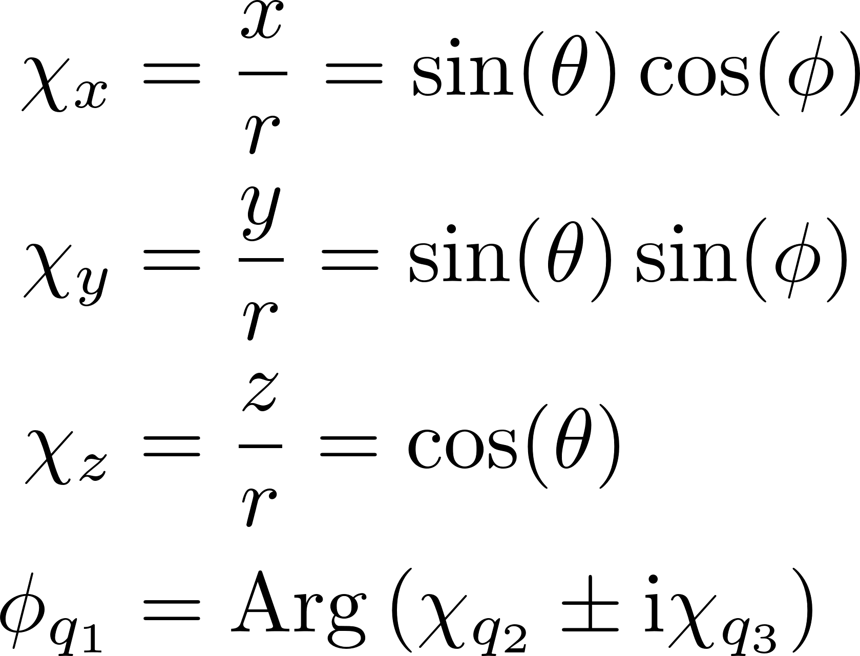
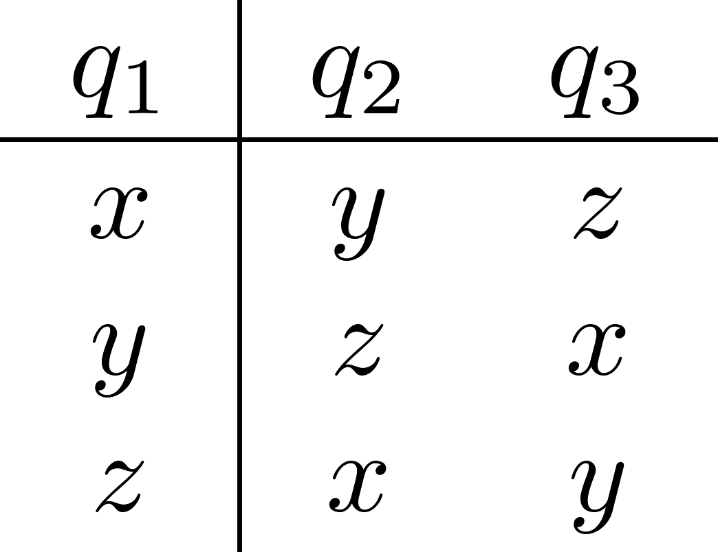
Generalized basis states -- I

Slide 3
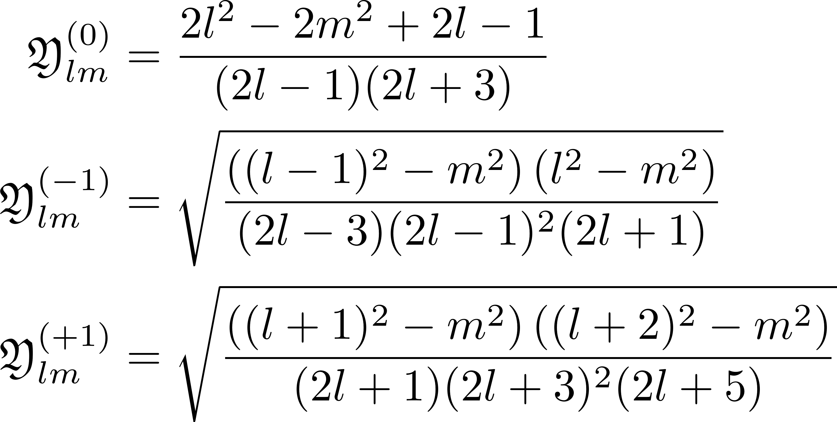


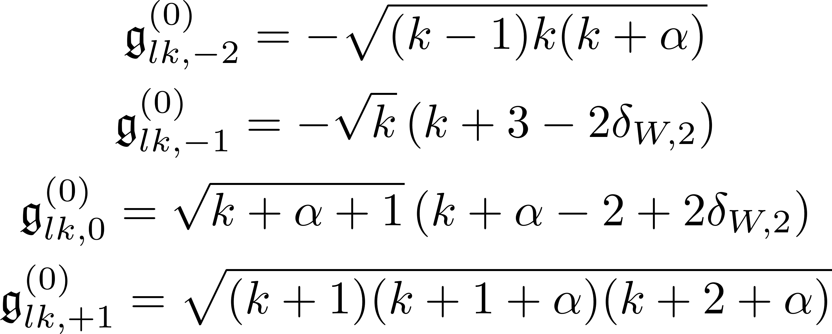
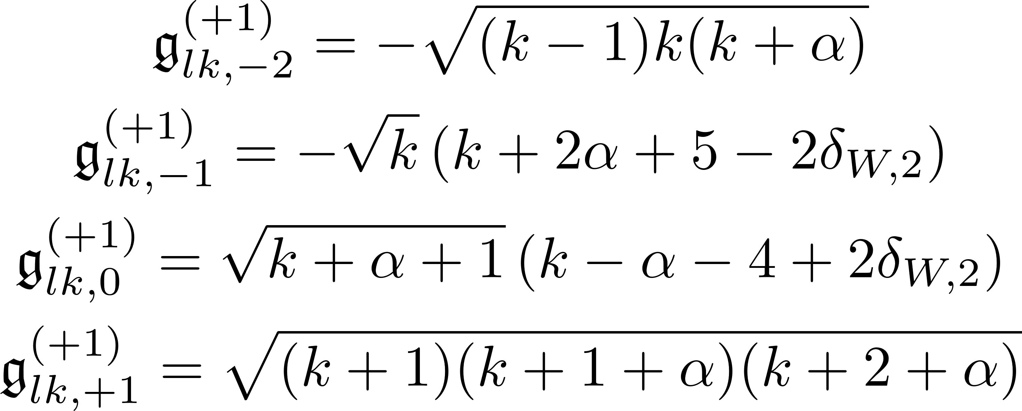

Generalized basis states -- II

Slide 4

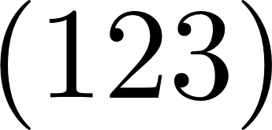
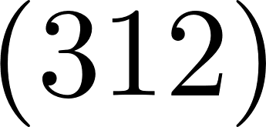
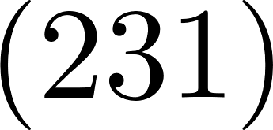
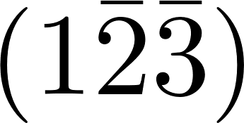
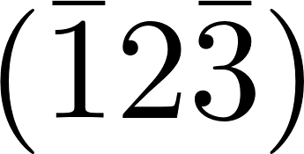
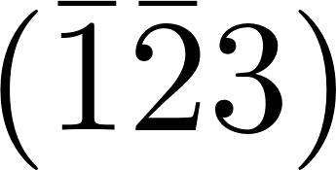

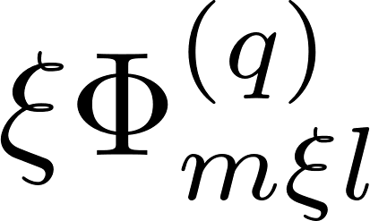
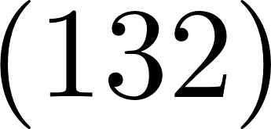
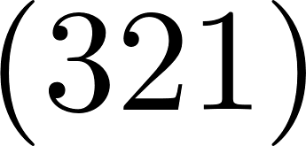
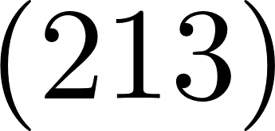
Effect of Td operations on naïve states
Cyclic permutations
Double inversion
Time-reversal
Acyclic permutations

Slide 5

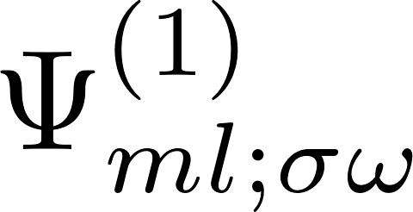
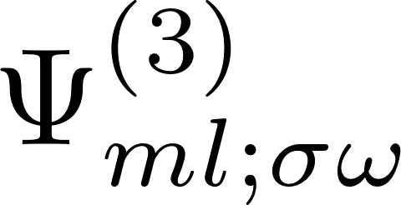
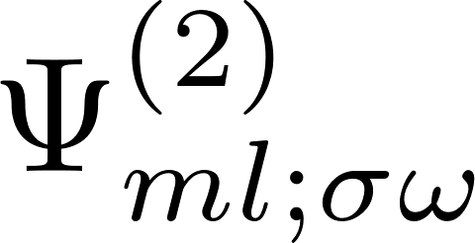

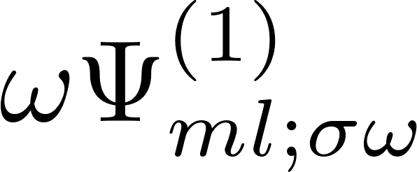
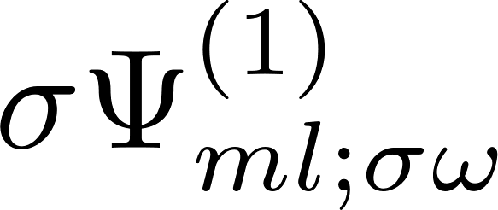
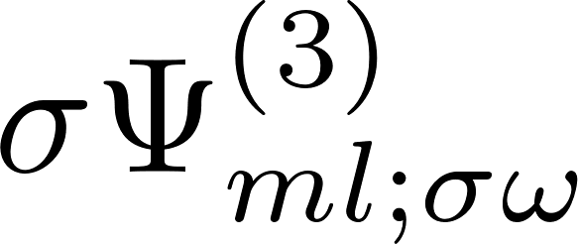
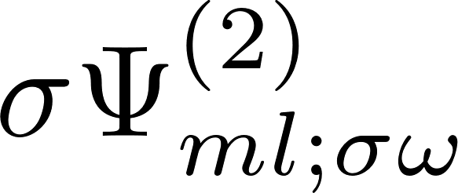
Effect of Td operations, including Bloch functions, m even
States indexed by inversion (ω) and acyclic (σ) symmetry as either even (+1) or odd (-1)
Cyclic permutations
Double inversion
Time-reversal
Acyclic permutations

Slide 6



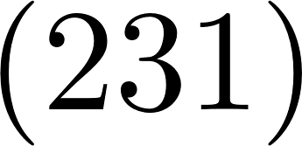



Effect of Td operations, including Bloch functions, m odd
States indexed by inversion (ω) and acyclic (σ) symmetry as either even (+1) or odd (-1)
Cyclic permutations
Double inversion
Acyclic permutations
Time-reversal

Slide 7



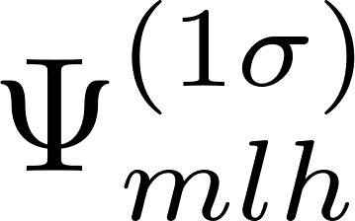
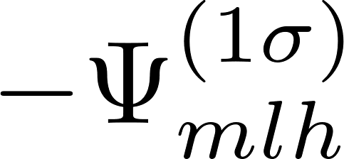

Effect of Td operations, including Bloch functions, m odd
States indexed by acyclic (σ) symmetry as either even (+1) or odd (-1). m odd states have odd inversion (ω = -1).
Cyclic permutations
Double inversion
Time-reversal
Acyclic permutations

