Slide 1
Exploring Electron Density

Slide 2
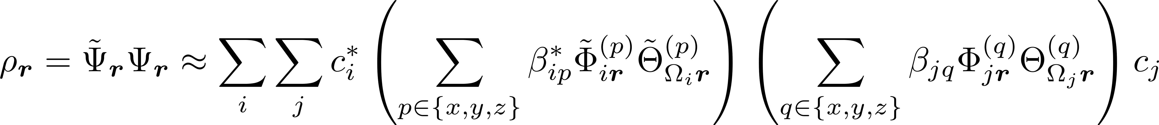
Single Electron Number Density

Slide 3
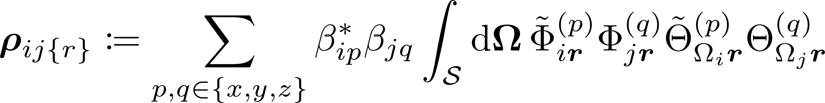
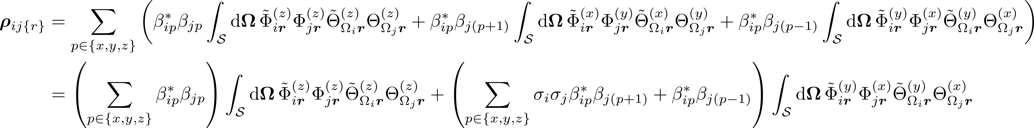
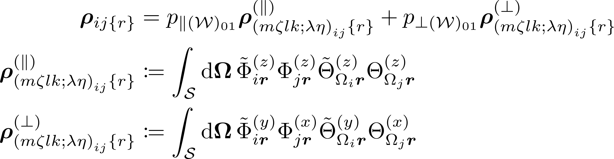
Averaged Over Solid Angle

Slide 4
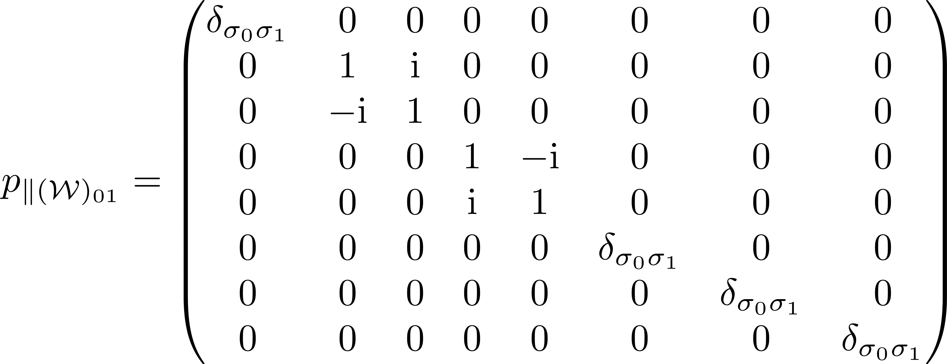
Coefficient involving parallel valleys

Slide 5
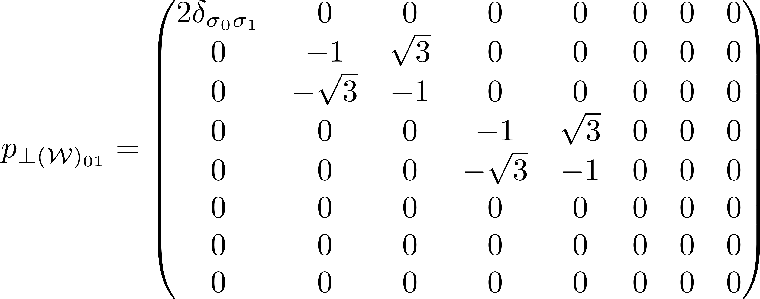
Coefficient involving perpendicular valleys

Slide 6
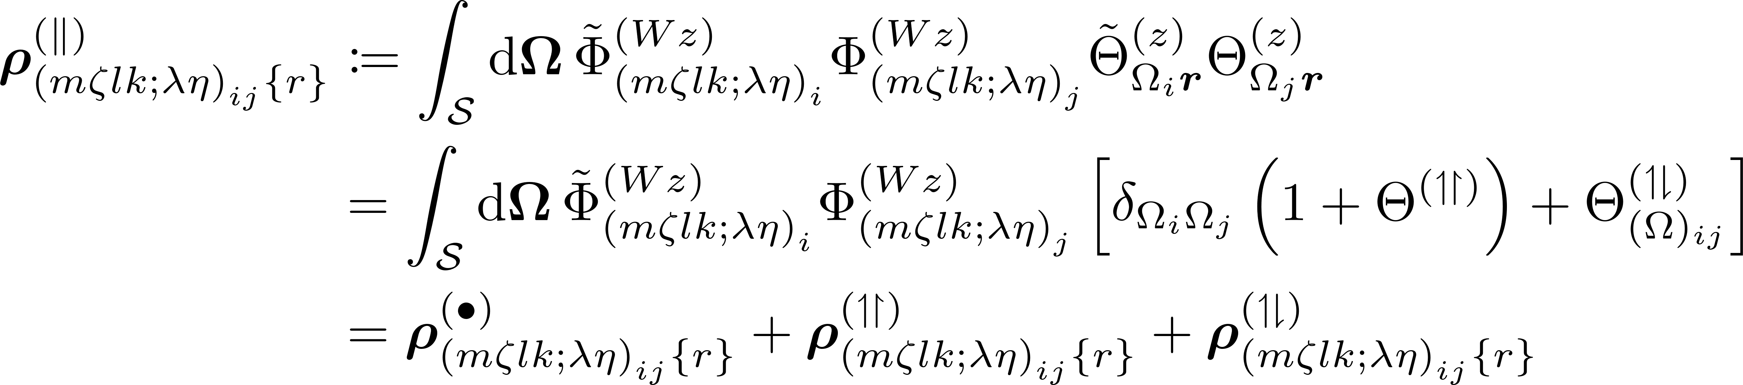
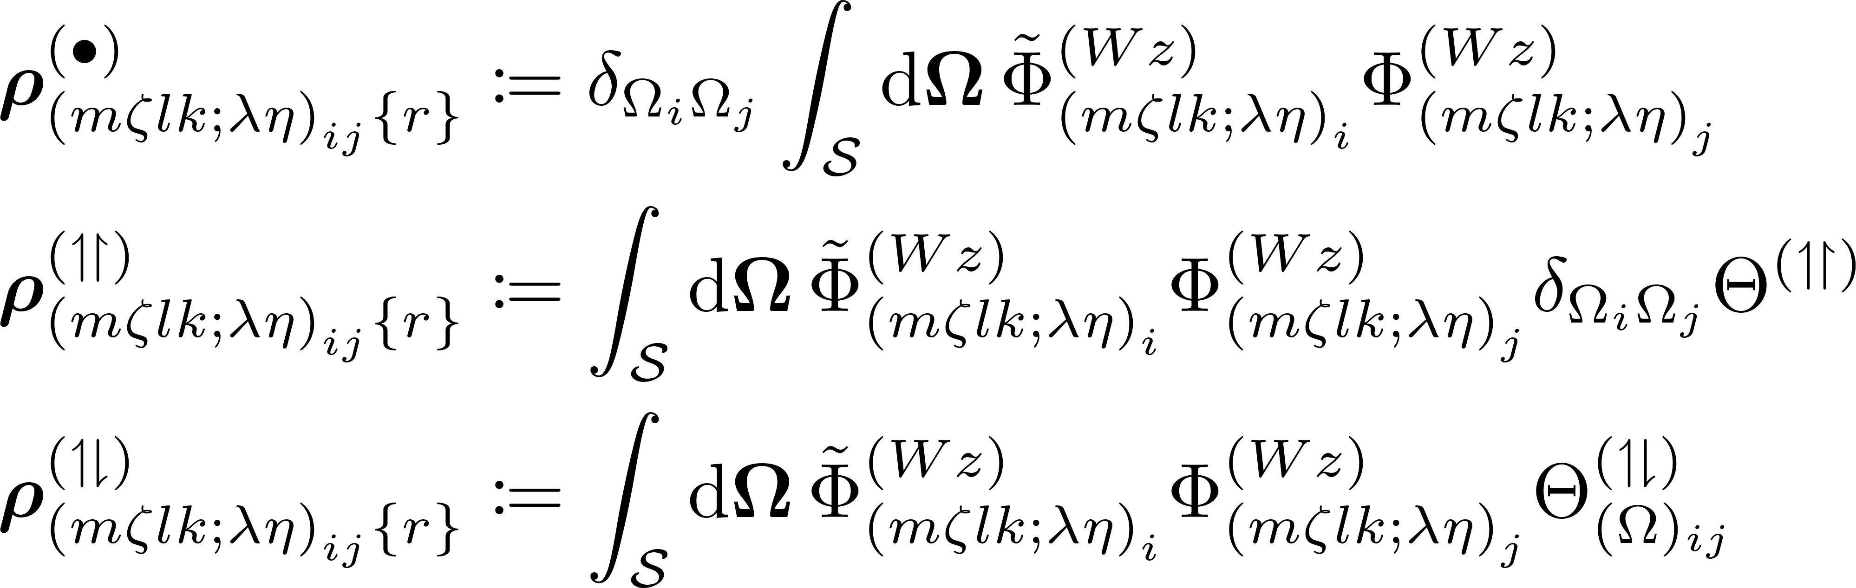
Averaged Over Solid Angle – Parallel Axes

Slide 7
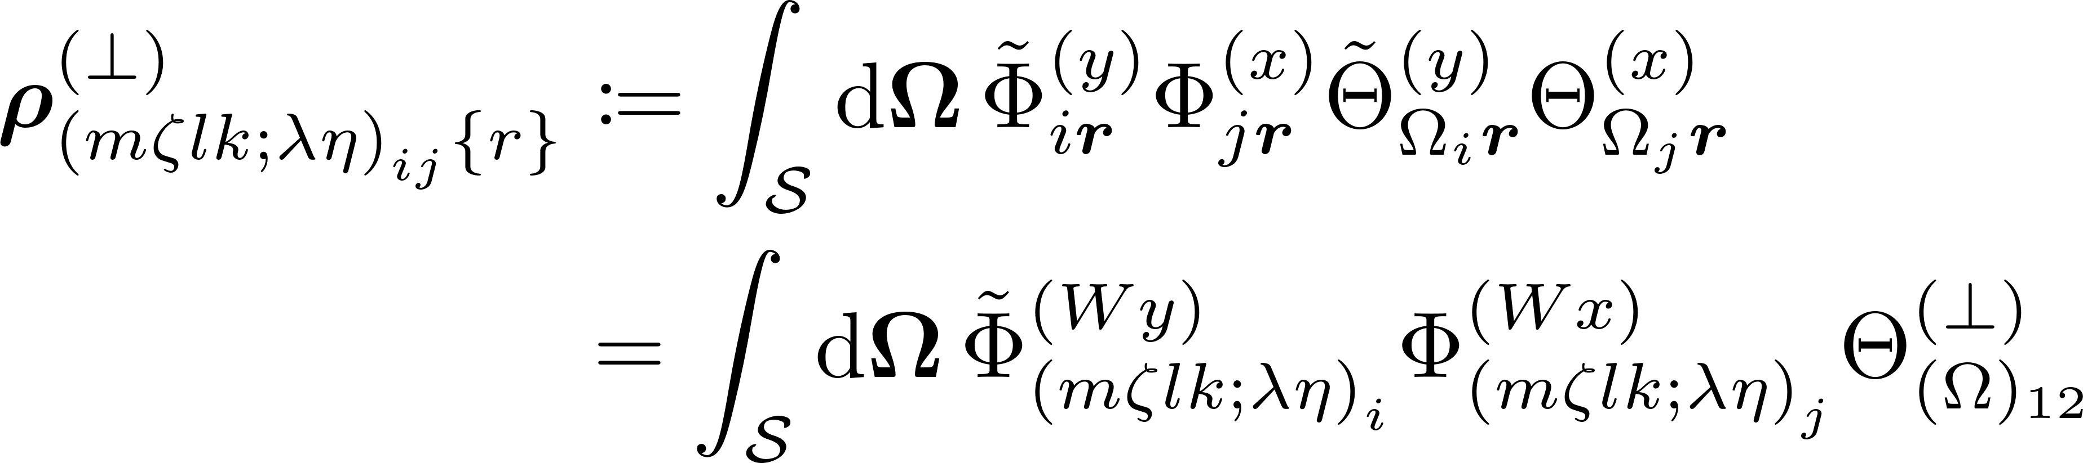
Averaged Over Solid Angle – Perpendicular Axes

Slide 8
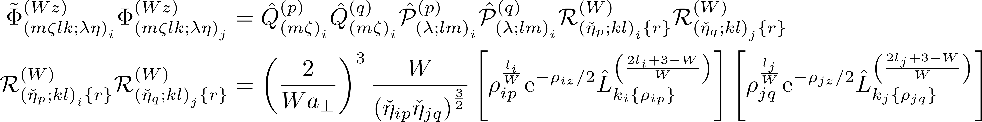
Integrand Contributions

Slide 9
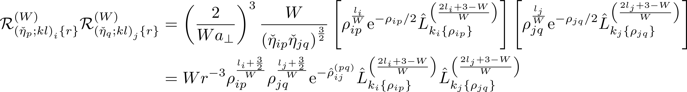
Radial Contribution – Elaboration I

Slide 10
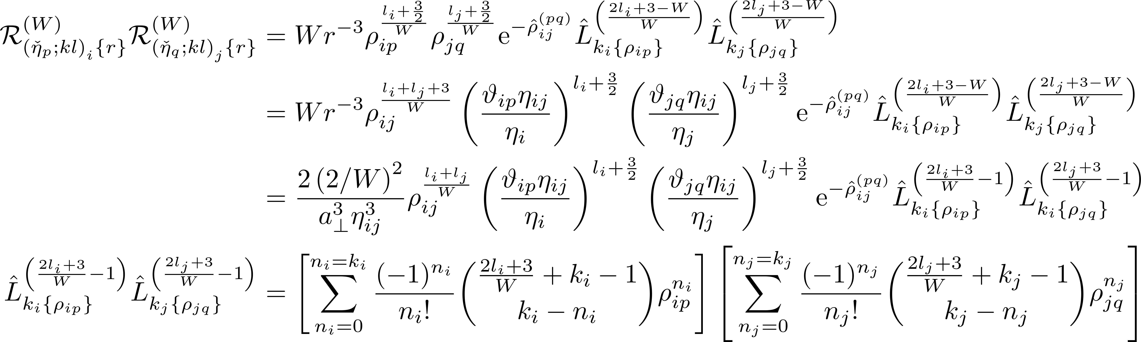
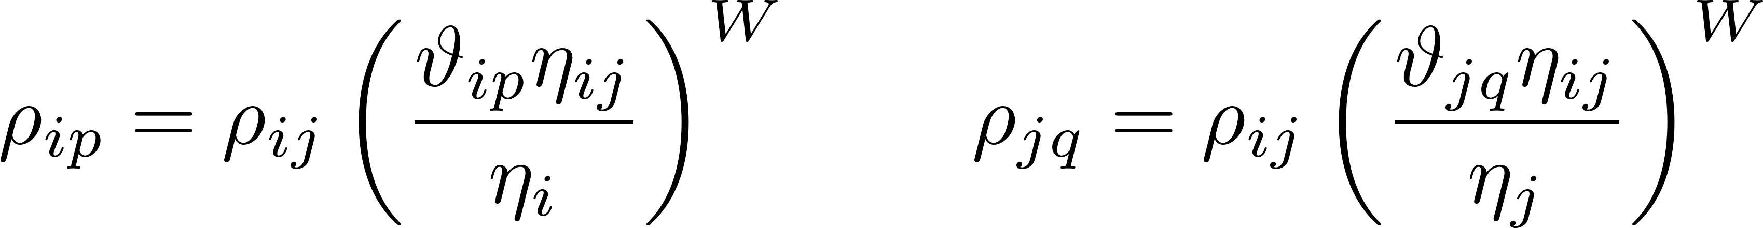
Radial Contribution – Elaboration II

Slide 11
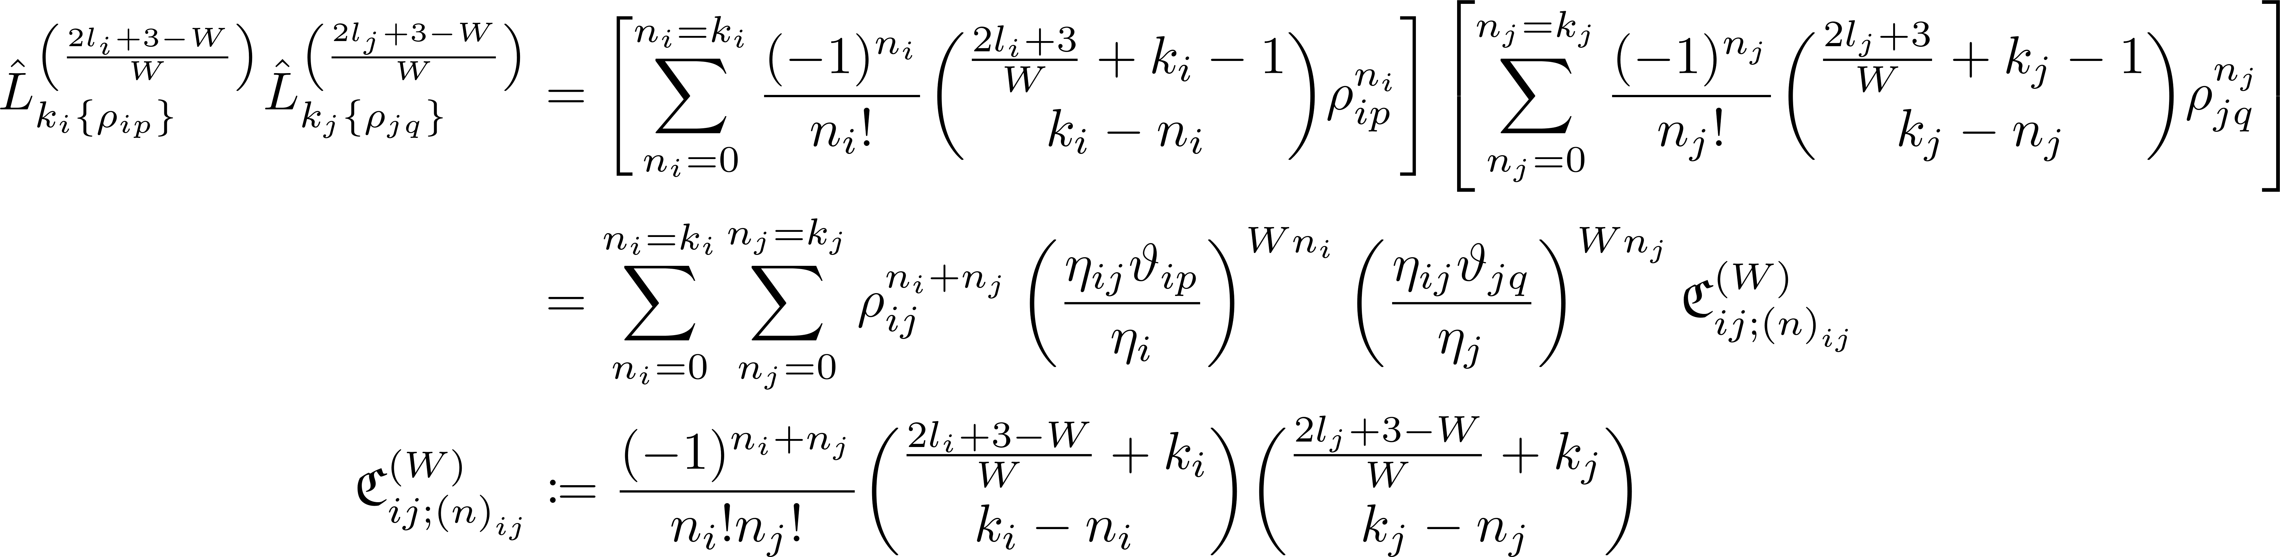
Radial Contribution – Elaboration III

Slide 12
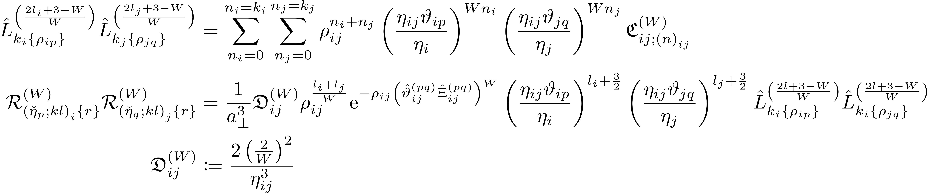
Radial Contribution – Elaboration IV

Slide 13
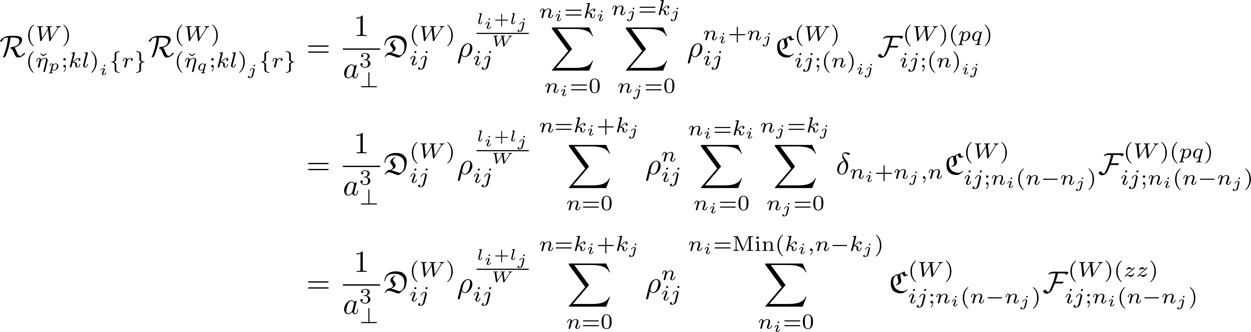
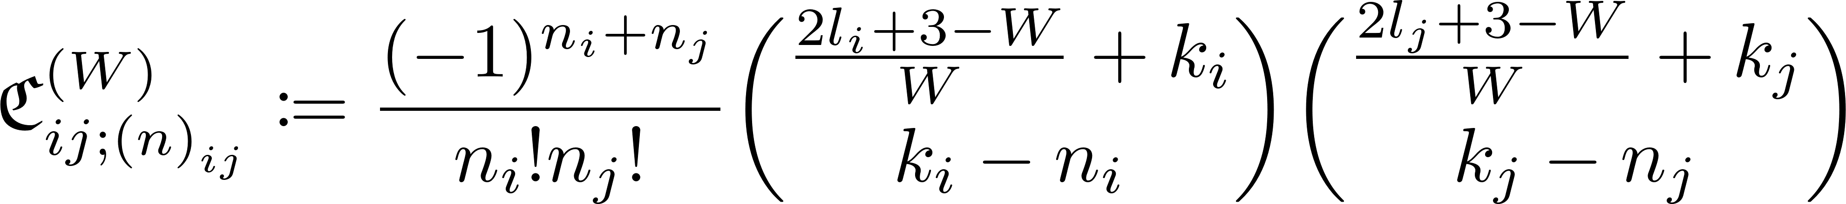
Radial Contribution – Elaboration V

Slide 14
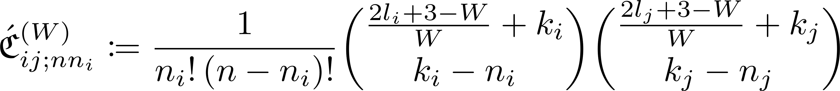
Radial Contribution – Final Statement

Slide 15
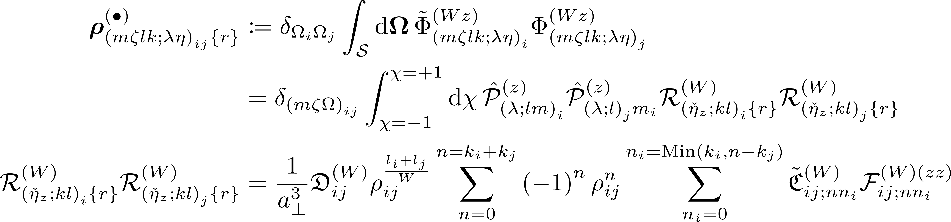
Central Term – Averaged over solid angle

Slide 16
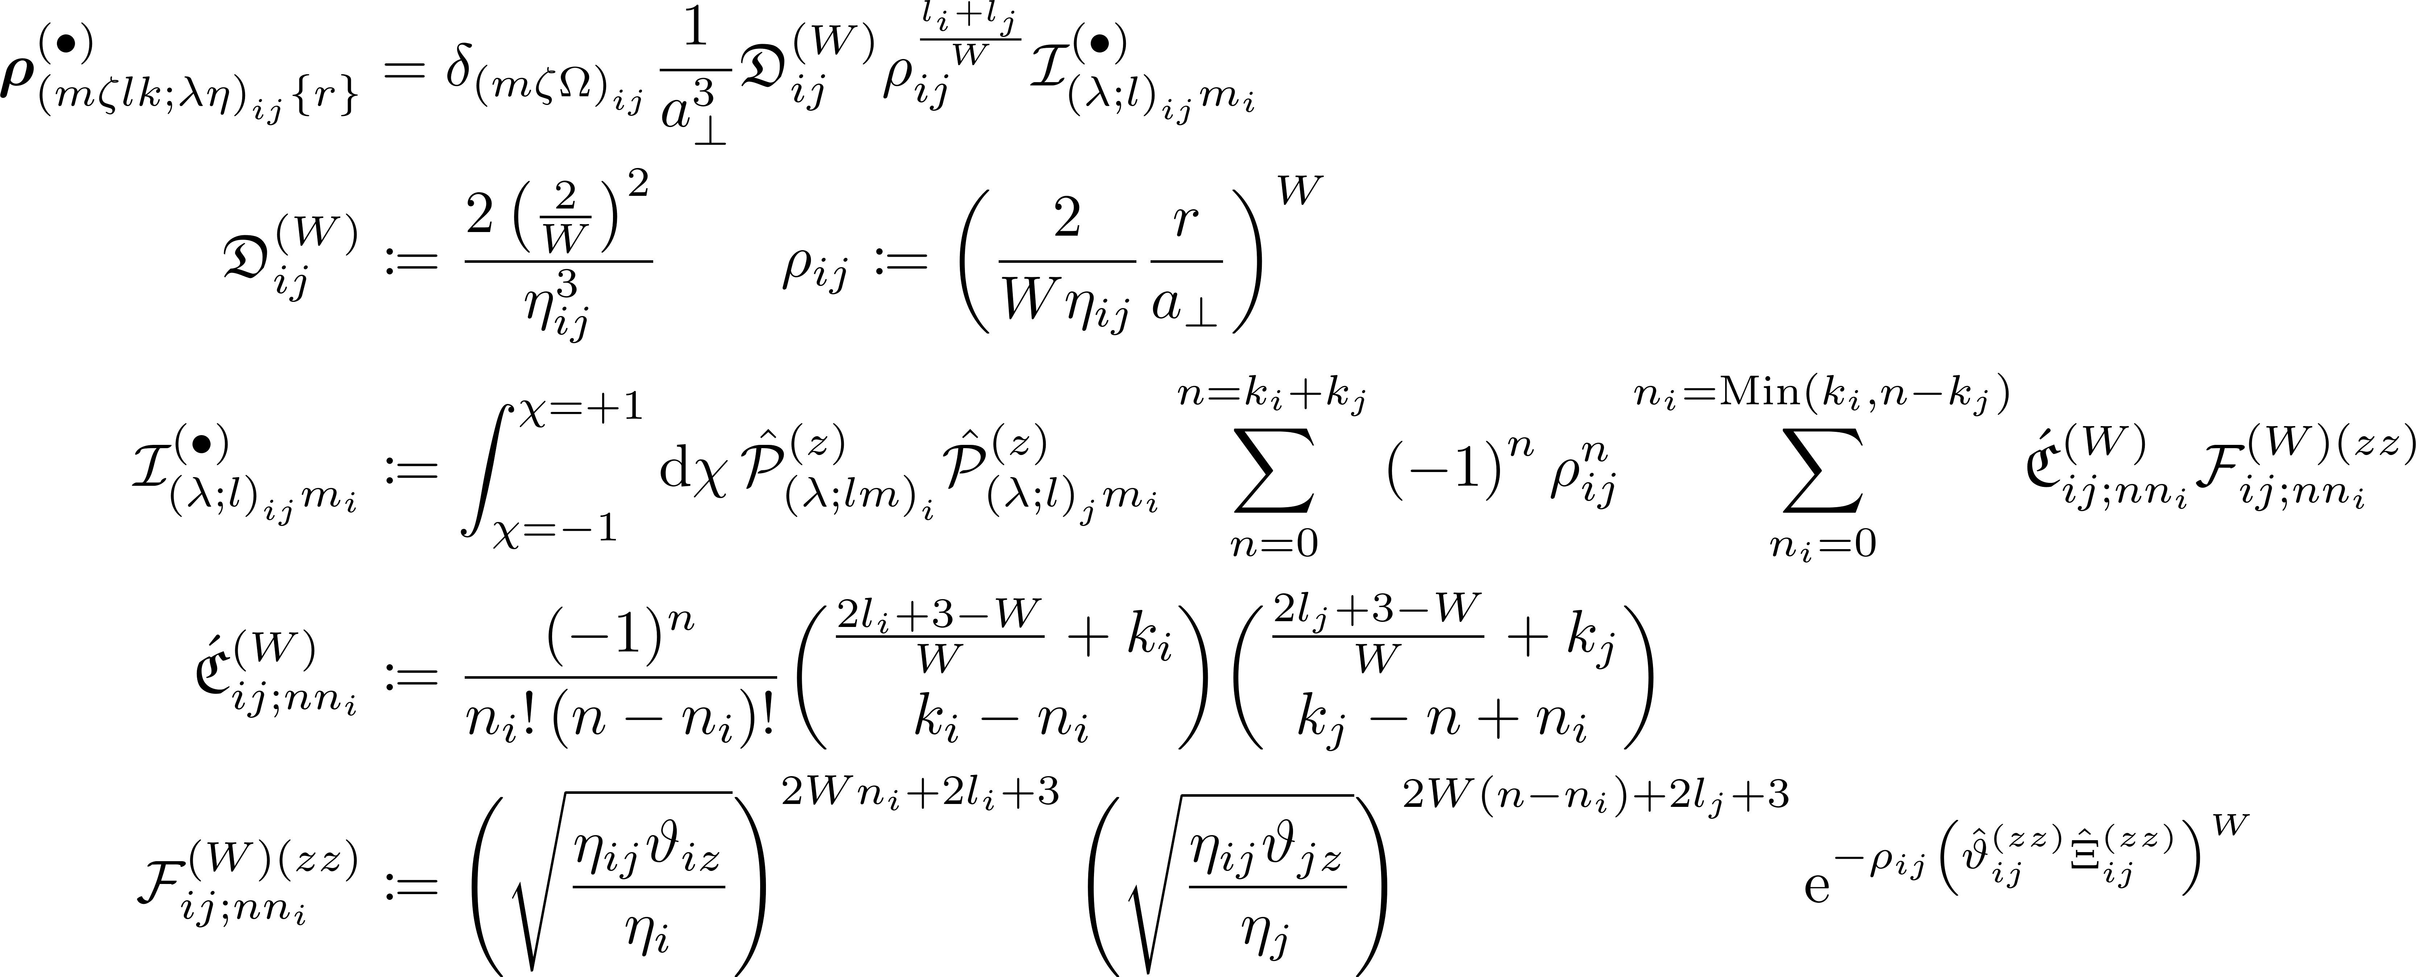
Central Term SA Avg. (General Definition)

Slide 17
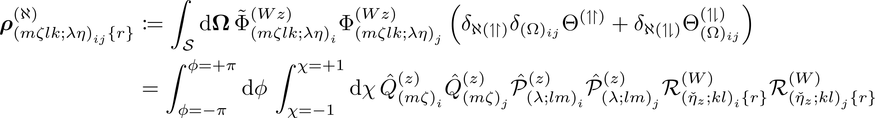
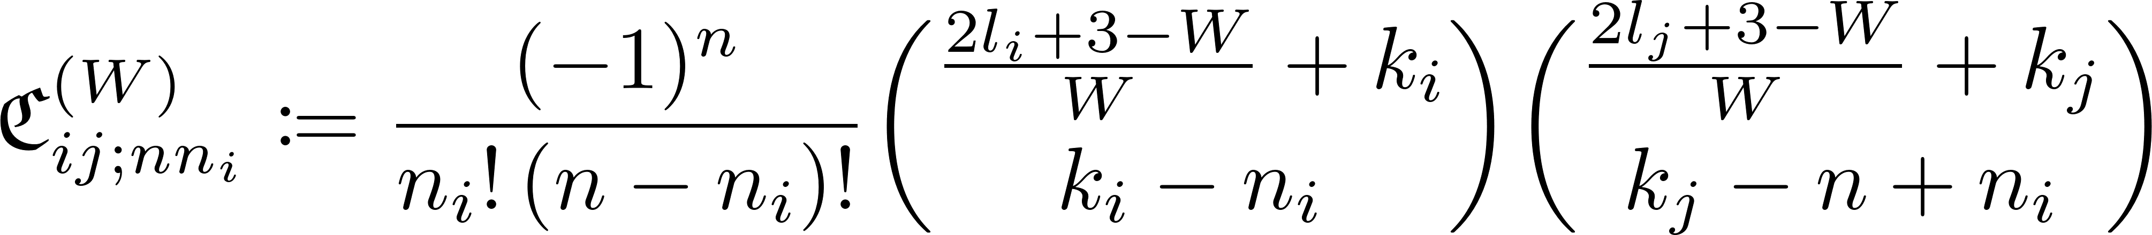
Averaged Over Solid Angle – Parallel Terms I

Slide 18
Central Terms – Elaboration V

Slide 19
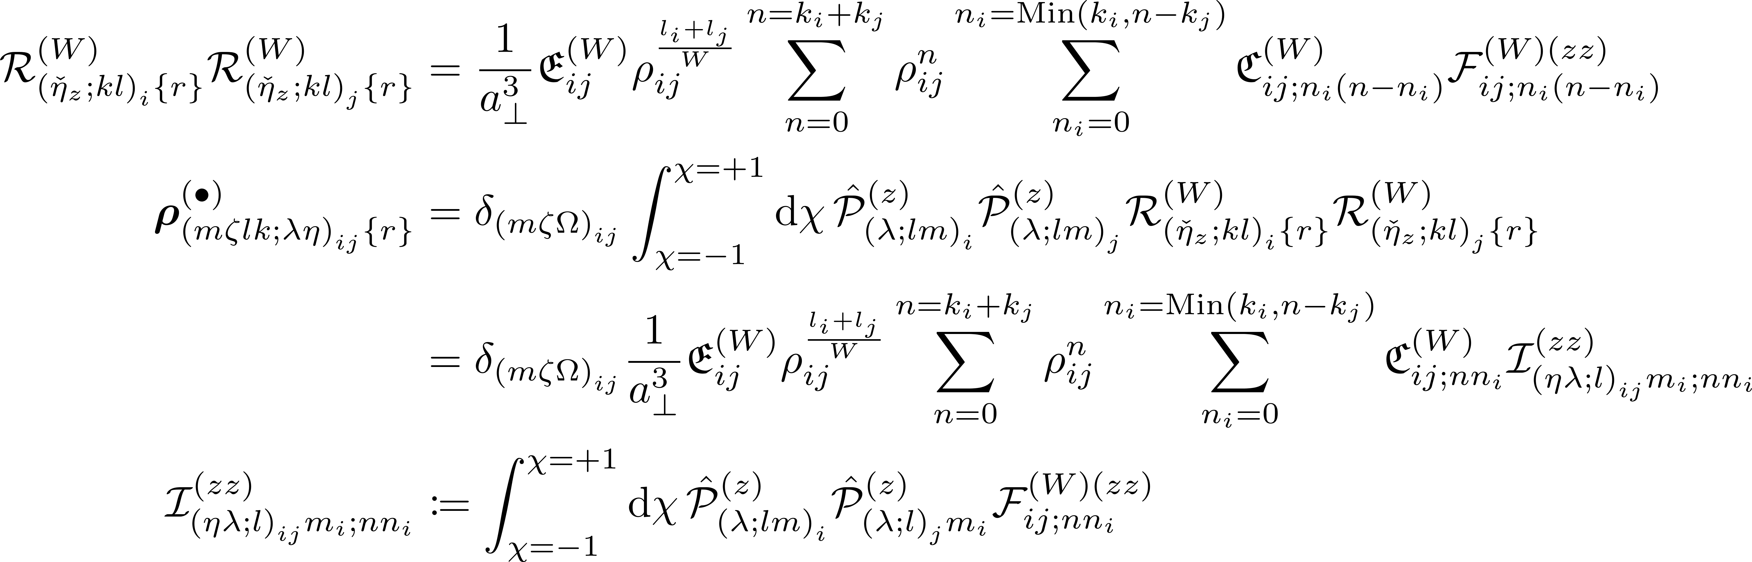
Averaged Over Solid Angle – Central Term II

Slide 20
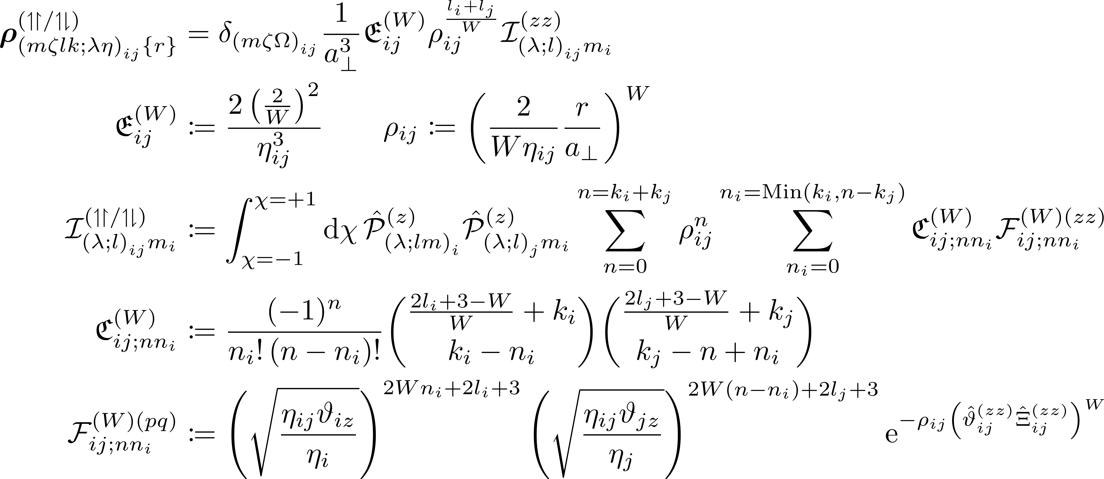
Averaged Over Solid Angle – Parallel Valley Terms (Gen. Def.)

Slide 21

Avg.’d Over Solid Angle – Perpendicular Valley Terms (Gen. Def.)

Slide 22
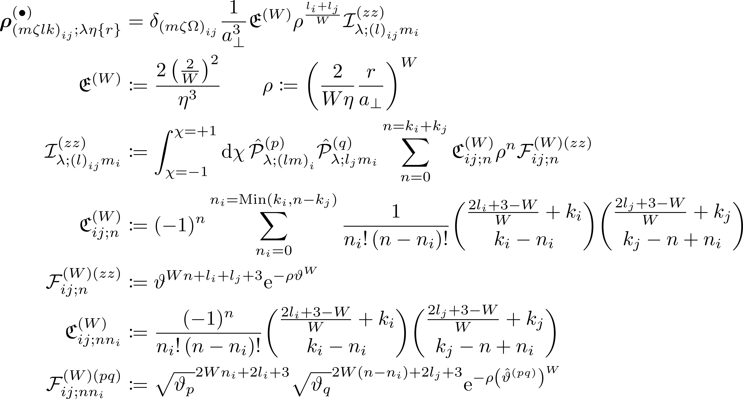
Averaged Over Solid Angle – Central Term (within subbasis)

Slide 23
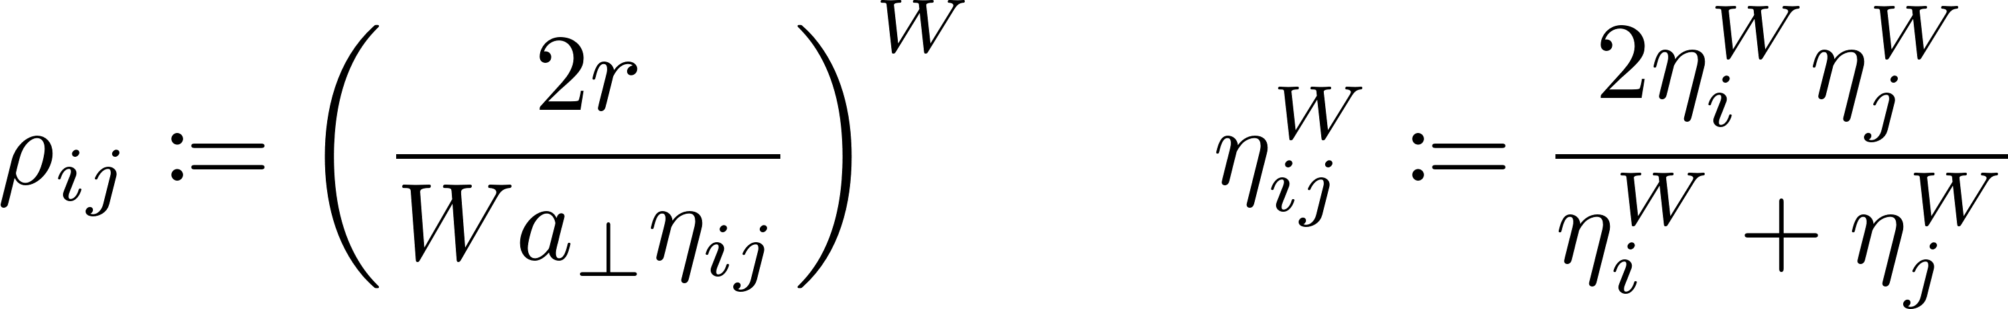
Central Integral (General)

Slide 24
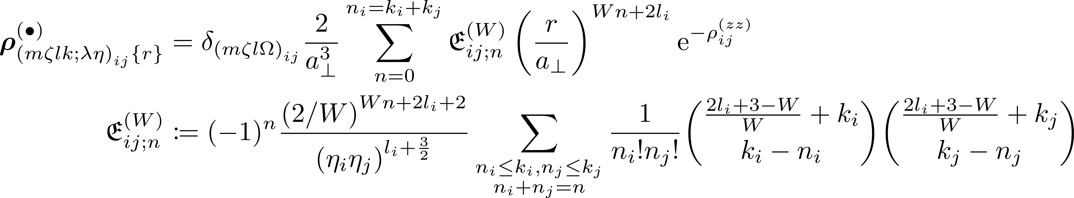
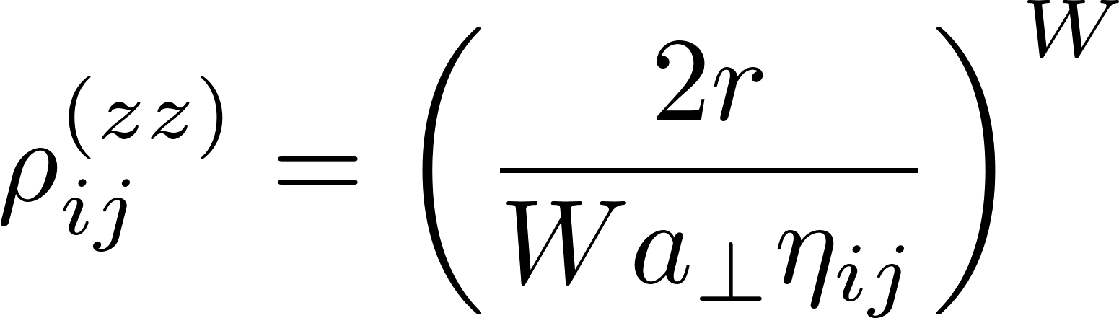
Averaged Over Solid Angle – Central Term (w/ $λ_{i},λ_{j}==1$)

Slide 25
Averaged Over Solid Angle – Central Term (w/ $λ_{i},λ_{j}==1$)

Slide 26
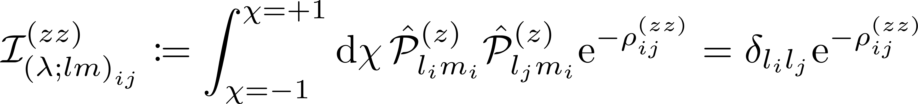
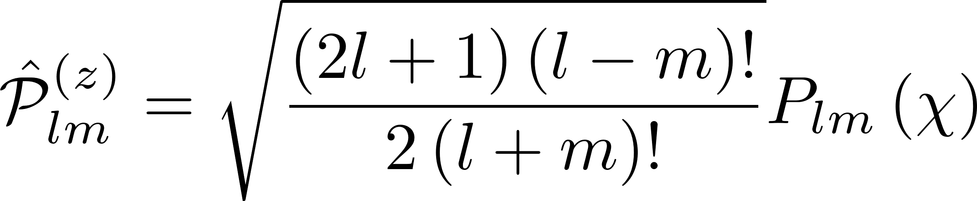
Central Integral ($λ_{i},λ_{j}==1$)

Slide 27
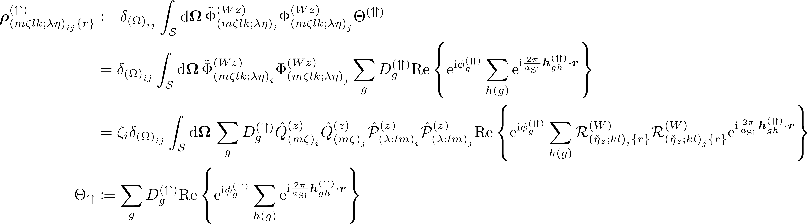
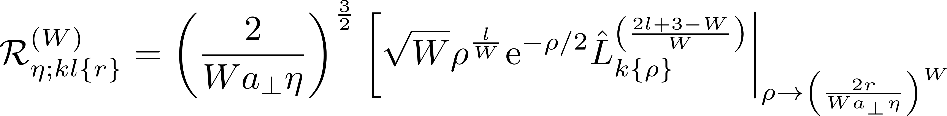
Averaged Over Solid Angle – Aligned Valleys Term I

Slide 28
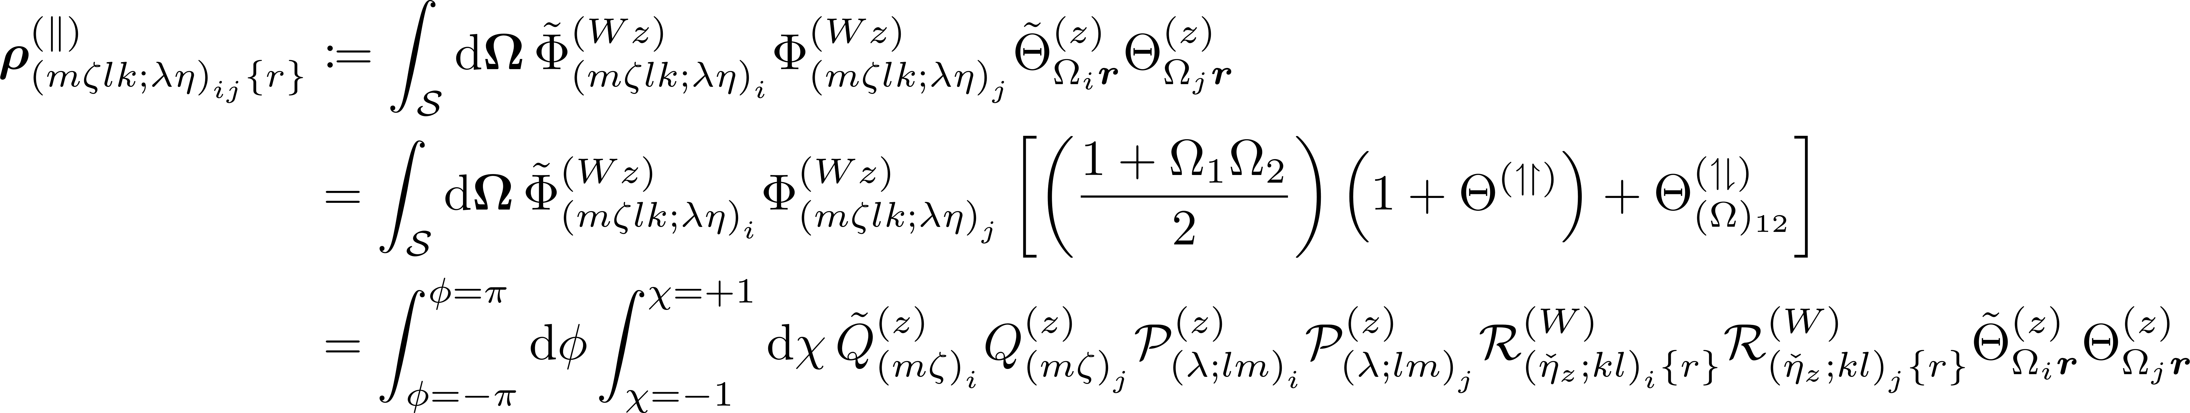
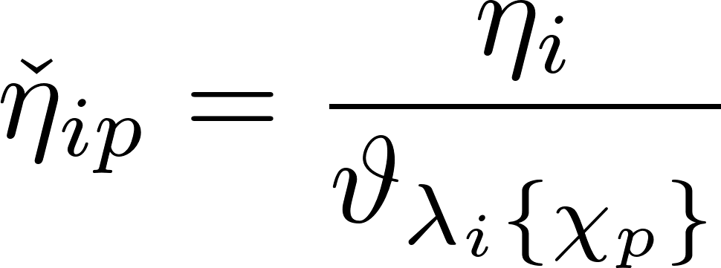
Averaged Over Solid Angle

Slide 29
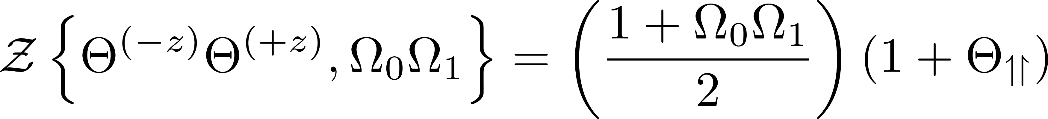
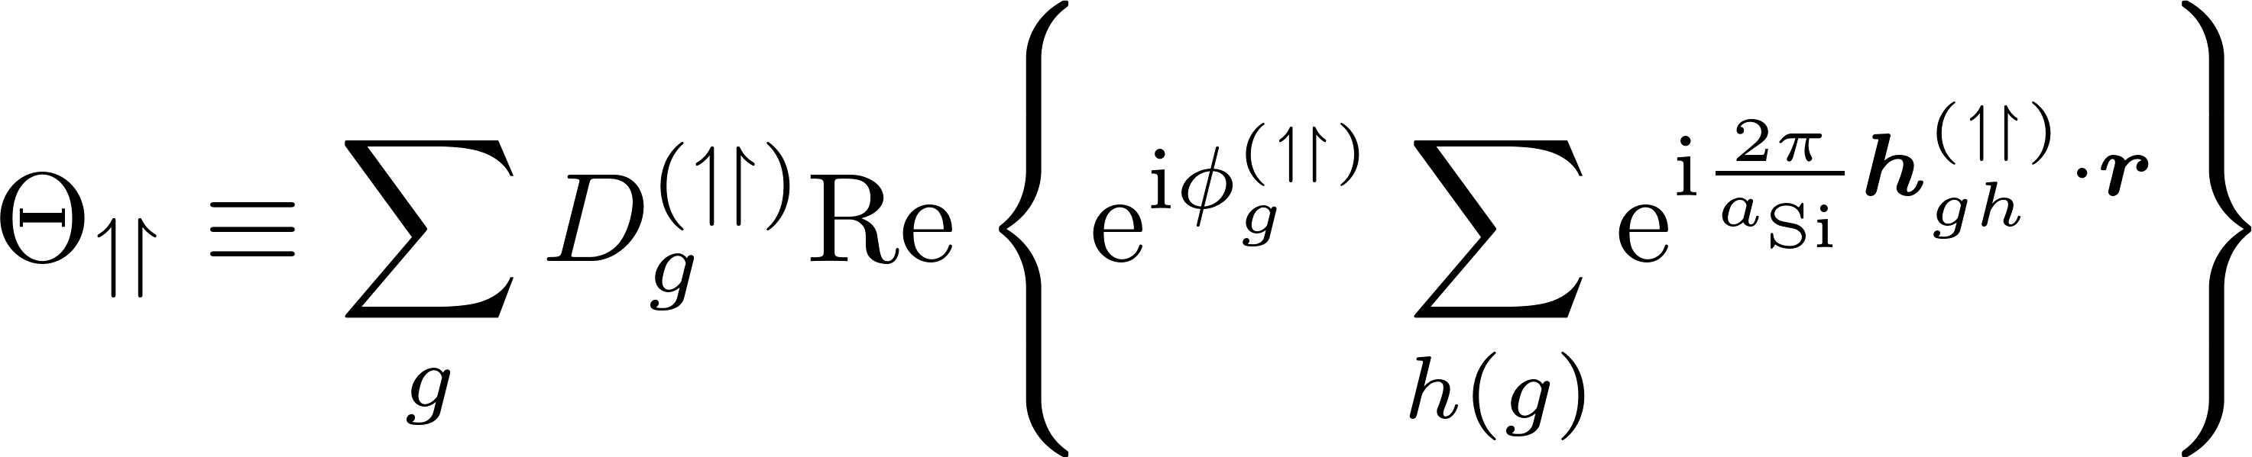
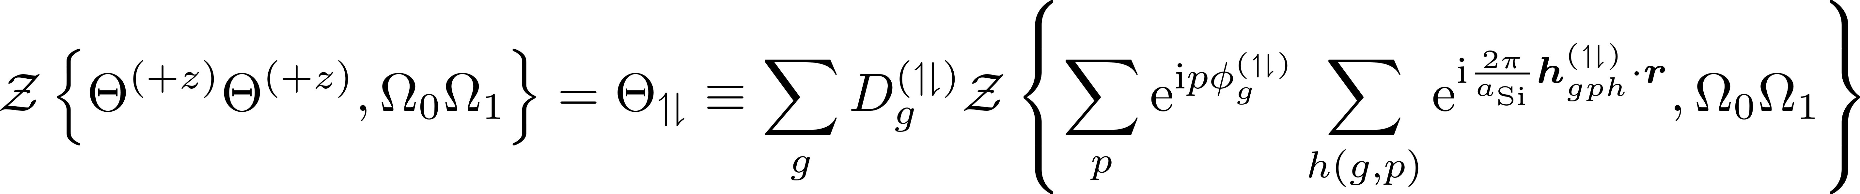
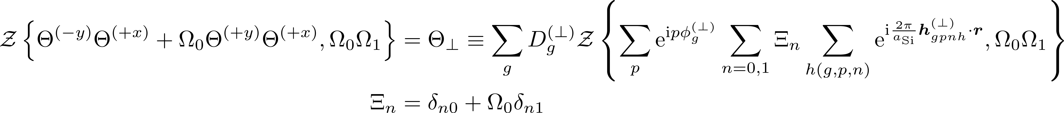
Bloch integrand

Slide 30
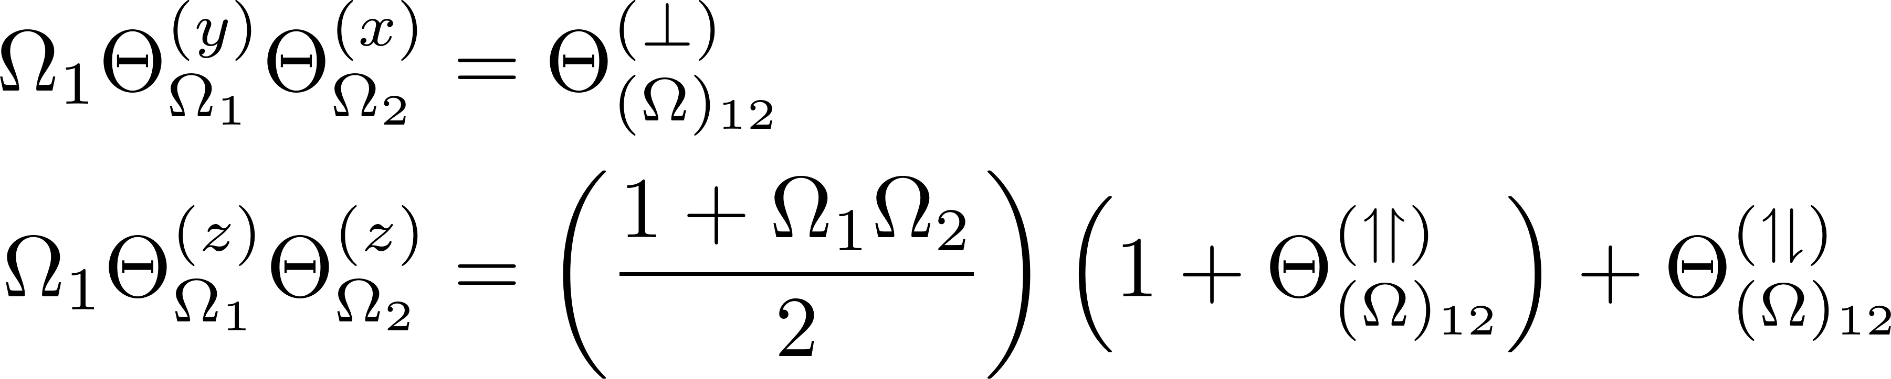
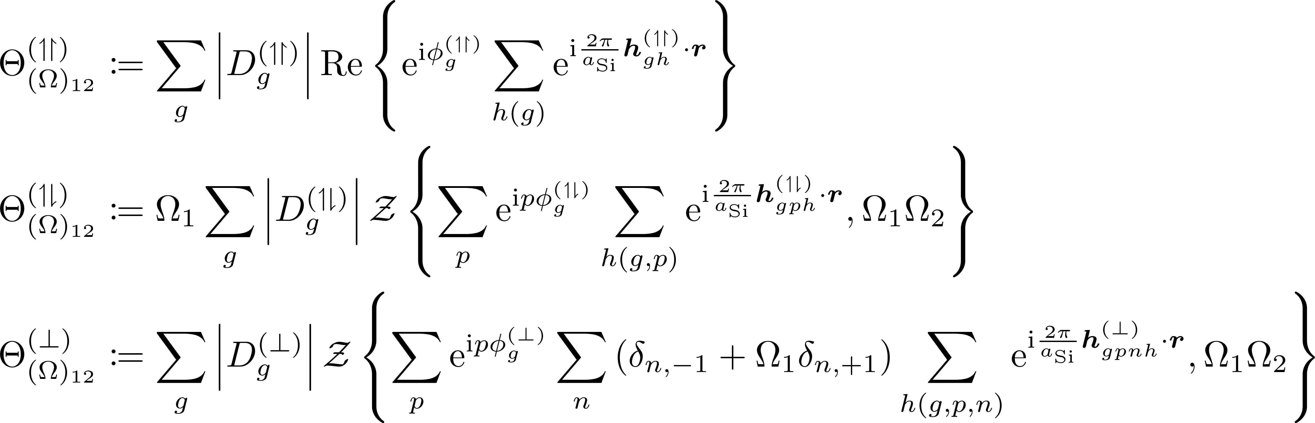
B11. Final form of Bloch product formulae

Slide 31
Basis Defined

Slide 32
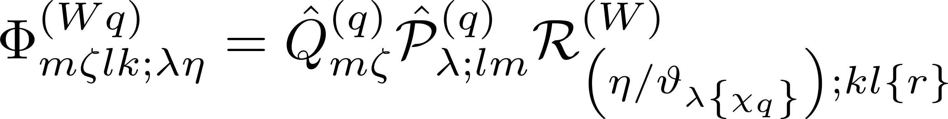
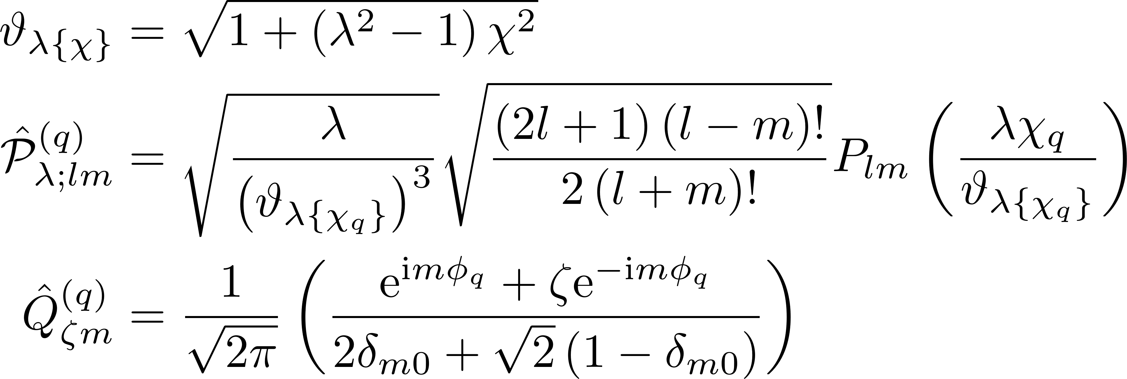
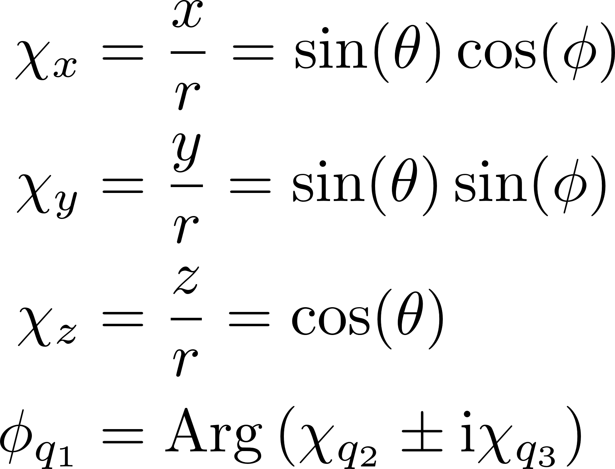
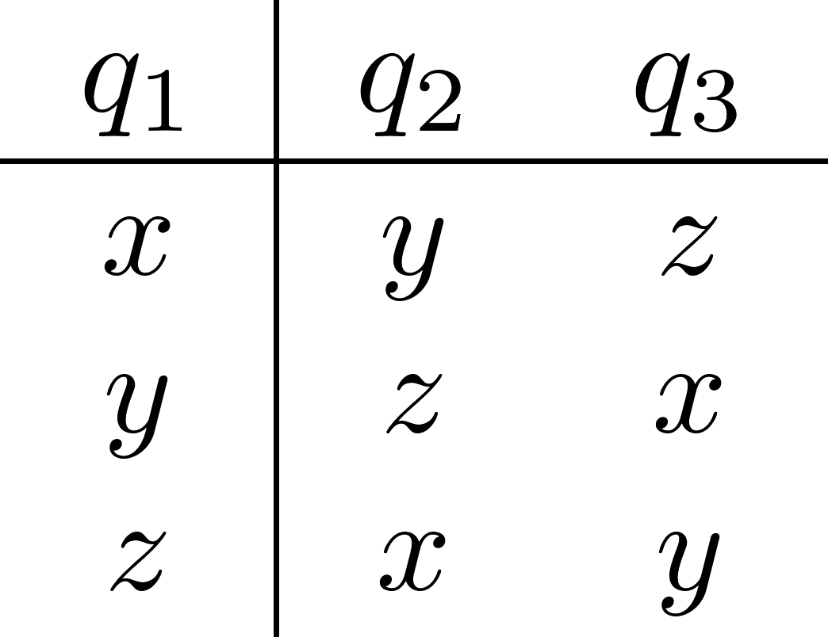
Naïve basis states -- I

Slide 33
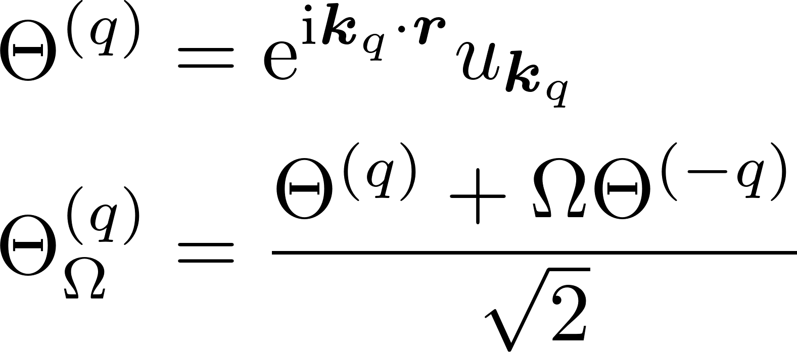
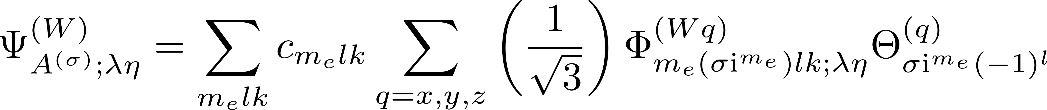
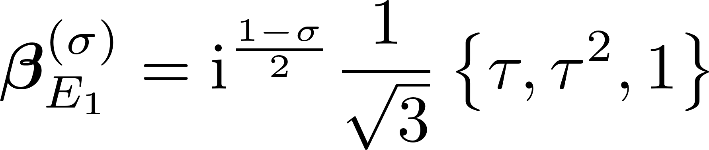
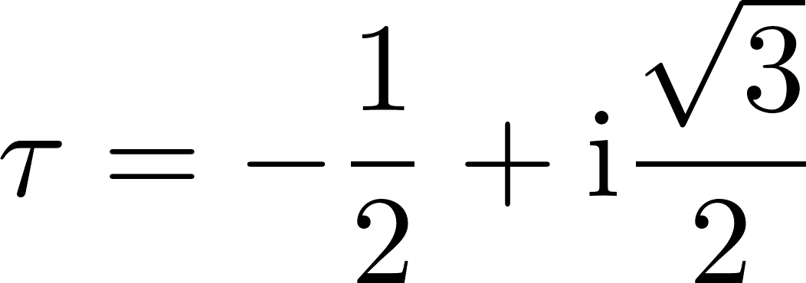
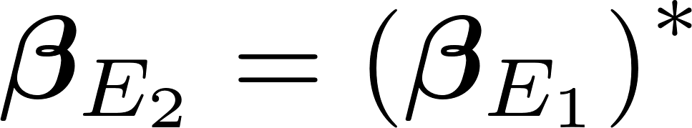
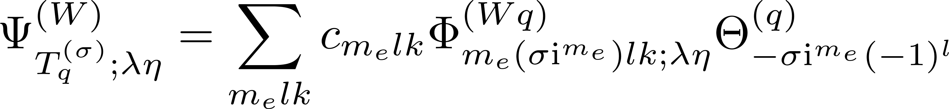
Symmetrized States, m even

Slide 34

Symmetrized States, m odd

