Slide 1
RENEWABLE ENERGY SUPPORT POLICIES: A CROSS-COUNTRY ANALYSIS
Cantay Caliskan

Slide 2
RENEWABLE ENERGY
Environmental benefits
Socioeconomic benefits
High costs – effective investment schemes

Slide 3
SUPPORT POLICIES
Countries use 20+ different support mechanisms to increase the share of RE.
Some examples:
Auditing, Codes and Standards, Feed-in Tariffs/Premiums, Obligation Schemes, Grants and Subsidies, Loans, Taxes, Tax Cuts, RD&D Funding, Strategic Planning…

Slide 4
QUESTIONS
1) How did the usage of different RE support policies evolve over time?
Which policies were preferred more in the past?
Which policies are preferred today?
2) Is there a single policy or a set of policies that lead to higher and faster RE deployment everywhere in the world?
3) How does income influence the implementation of certain policies?
4) Do particular regions in the world (such as Europe and Americas) use certain types of RE support policies?
How similar are the RE support policies of countries in particular regions?

Slide 5
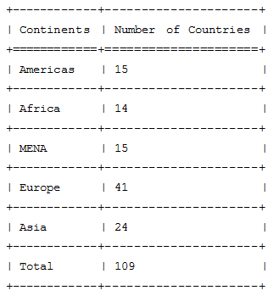
METHODOLOGY
Webscraping: IRENA/IEA Global Renewable Energy Policy Database
Binary classification for the policies of 109 countries over 1990-2014
Development variables from World Bank for control
Panel data with FE and logistic regression
Focus on non-hydroelectric renewable energy
Y_{it} =α₀+β*P _{it} +δ*D_{it} + γ*C_{i} + θ*T_{t}+ ε_{it}
Y_{it} = N_{it} / G_{it}
P_{it} = β*GDP per capita_{it} + ε_{it}

Slide 6
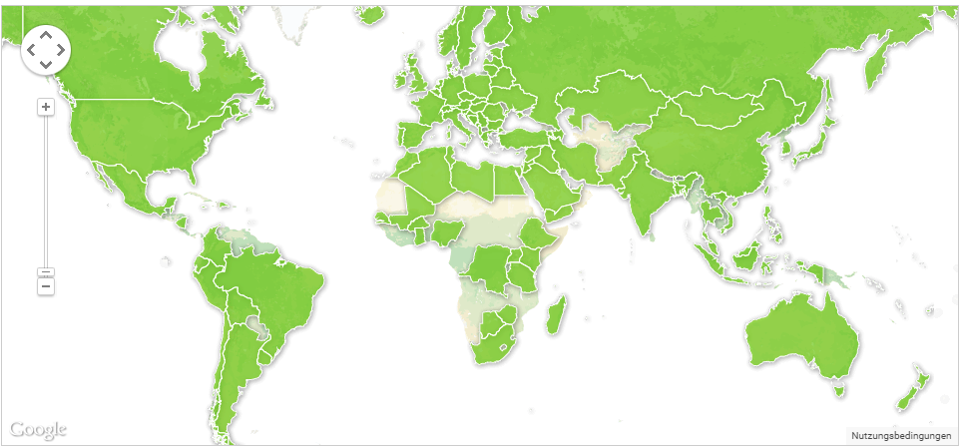
COUNTRIES IN THE DATASET

Slide 7
TECHNIQUES USED
Webscraping
Data Visualization
Multiple Linear (Panel) and Logistic Regression
Clustering

Slide 8
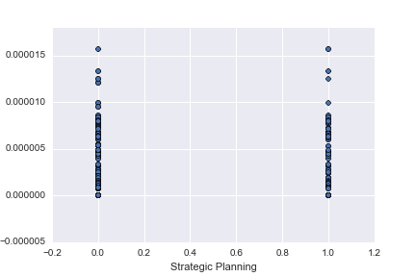
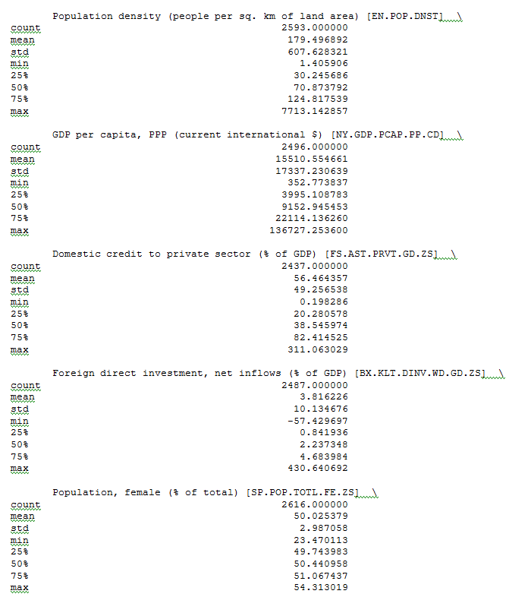
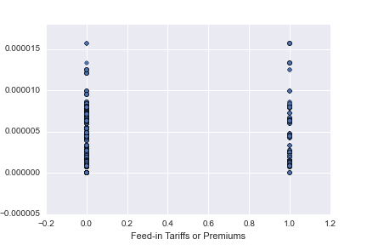
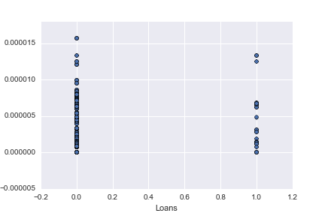
DATASET: VARIABLES

Slide 9
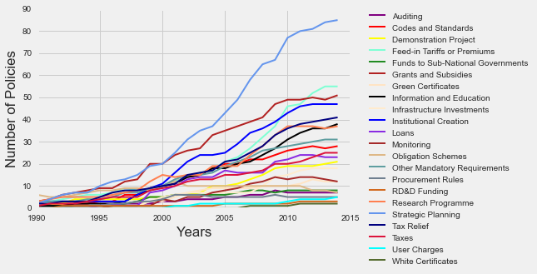
POLICIES IMPLEMENTED: 1990-2014
Policies ahead in the race:
Strategic planning 4) Institutional Creation
Grants and Subsidies 5) Tax Relief
Feed in Tariffs/Premiums 6) Research Programme

Slide 10
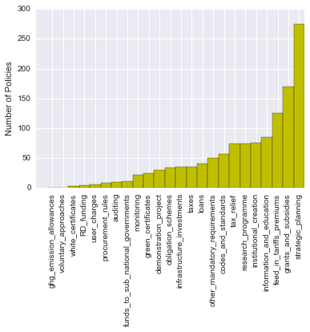
POLICIES IMPELEMENTED: 1990-2014
Number of times policies that have been put into practice over the years:
Strategic Planning
Grants and Subsidies
Feed-in Tariffs/Premiums
Information and Education
Institutional Creation
Research Programme

Slide 11
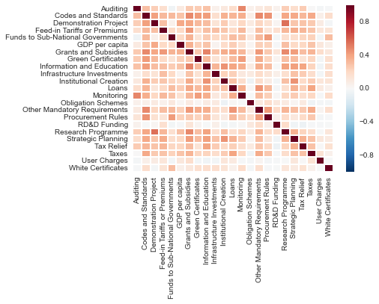
CORRELATION: SUPPORT POLICIES
Highest correlation is around 0.4. No significant evidence for multicollinearity.
Highest correlation is between “Research Programme” and “Demonstration Project”.

Slide 12
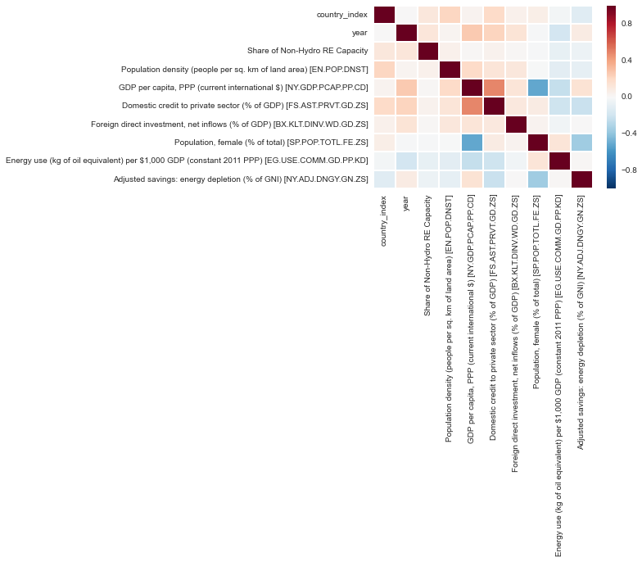
CORRELATION: CONTROL VARIABLES
- Highest correlation is between “Domestic Credit to Private Sector” and “GDP per capita”.

Slide 13
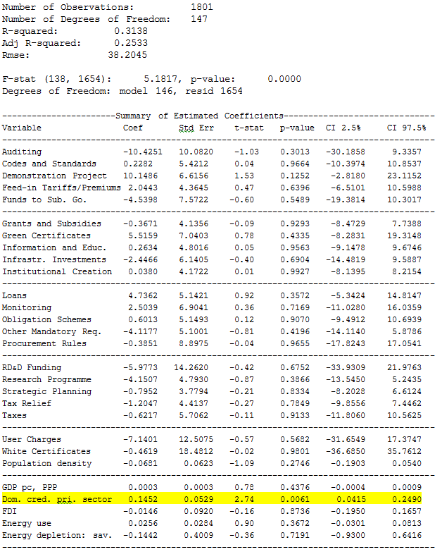



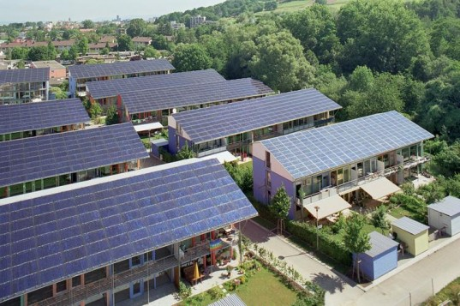
REGRESSION RESULTS: PANEL DATA
Not promising.
Except: “Domestic credit to the private sector as % of GDP”.

Slide 14
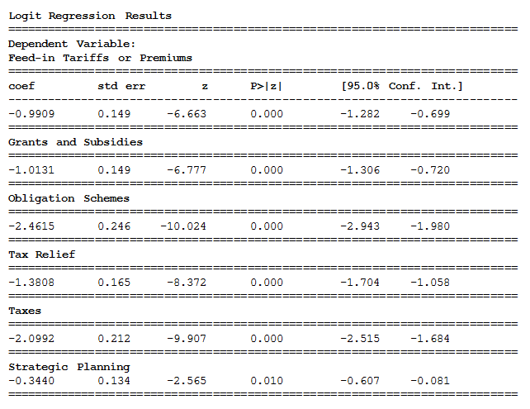
REGRESSION RESULTS: INCOME
Economic power may be affecting the implementation of RE support mechanisms.

Slide 15
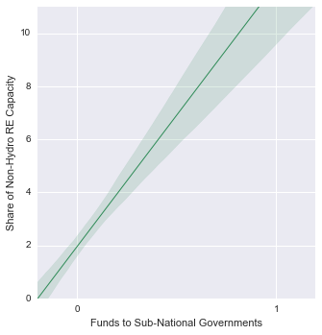
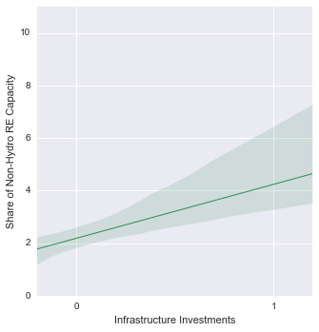
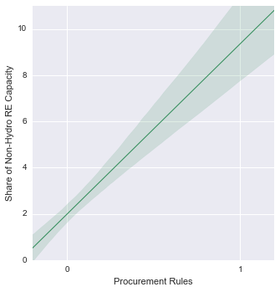
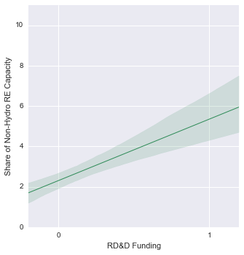
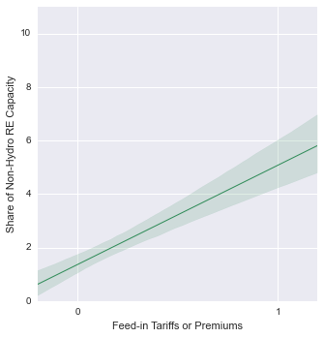
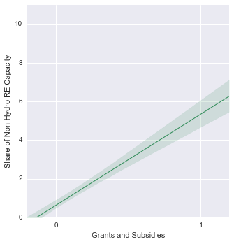
RELATIONSHIP WITH SUPPORT POLICIES

Slide 16
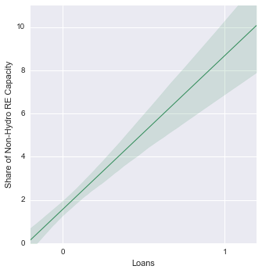
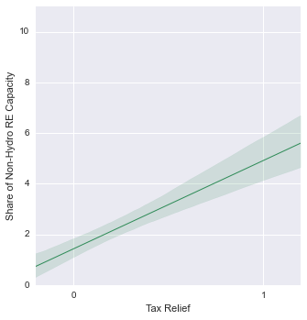
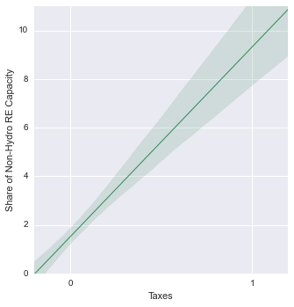
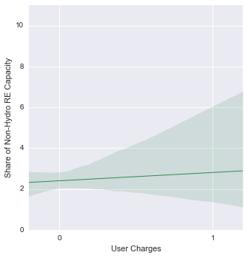
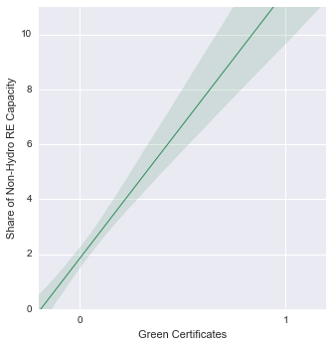
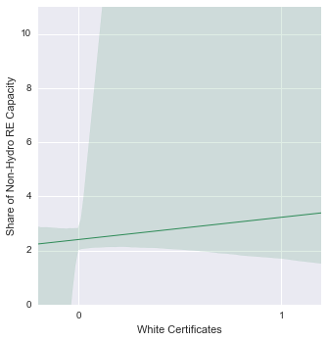
REL. WITH SUPPORT POLICIES (CONT.)

Slide 17
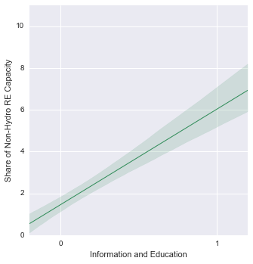
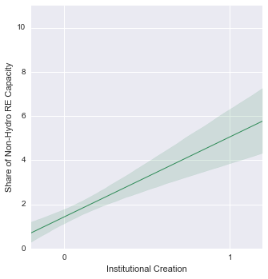
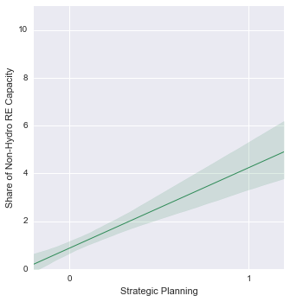
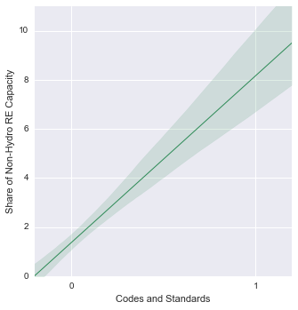
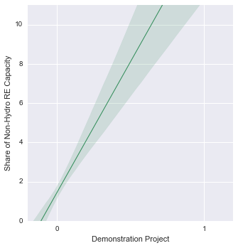
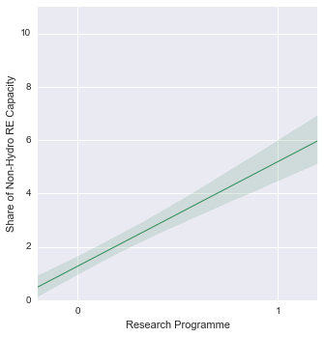
REL. WITH SUPPORT POLICIES (CONT.)

Slide 18
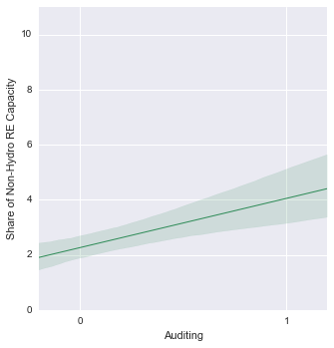
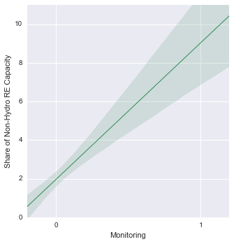
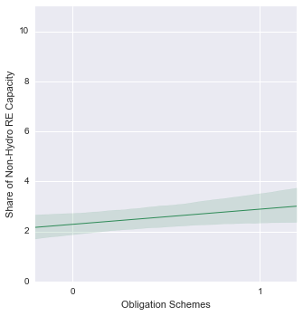
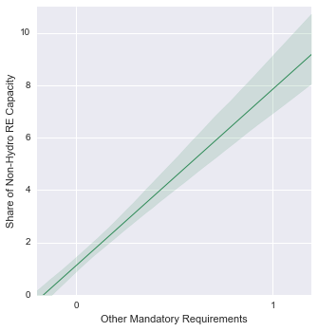
REL. WITH SUPPORT POLICIES (CONT.)

Slide 19
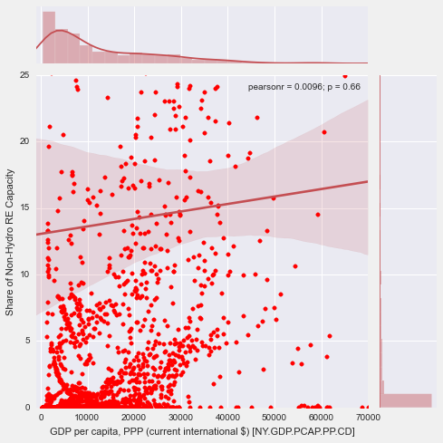
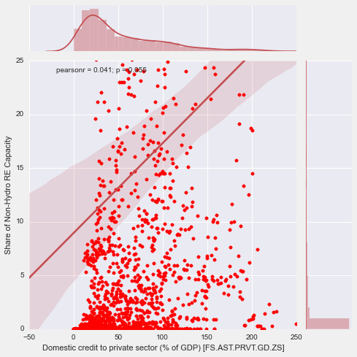
RELATIONSHIP WITH CONTROL VARIABLES

Slide 20
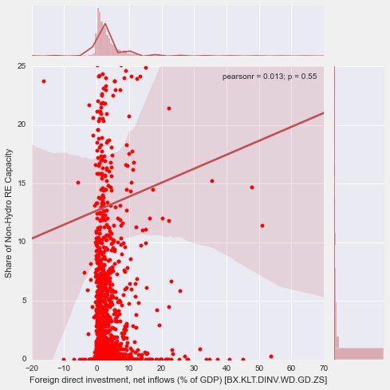
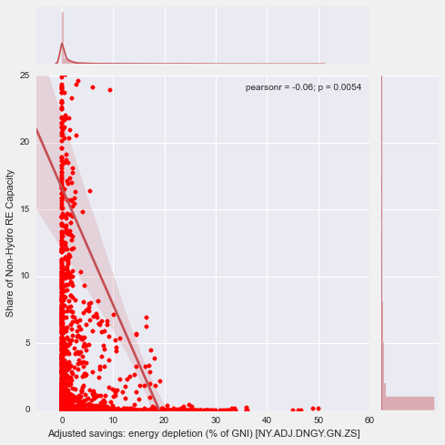
REL. WITH CONTROL VARIABLES (CONT.)

Slide 21
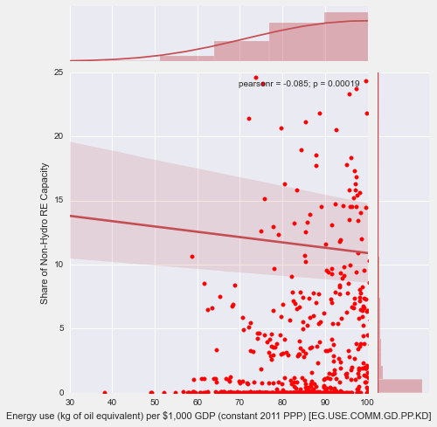
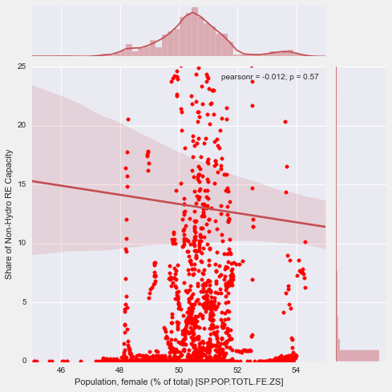
REL. WITH CONTROL VARIABLES (CONT.)

Slide 22
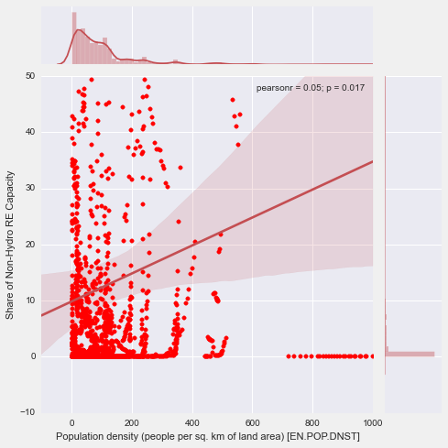
REL. WITH CONTROL VARIABLES (CONT.)

Slide 23
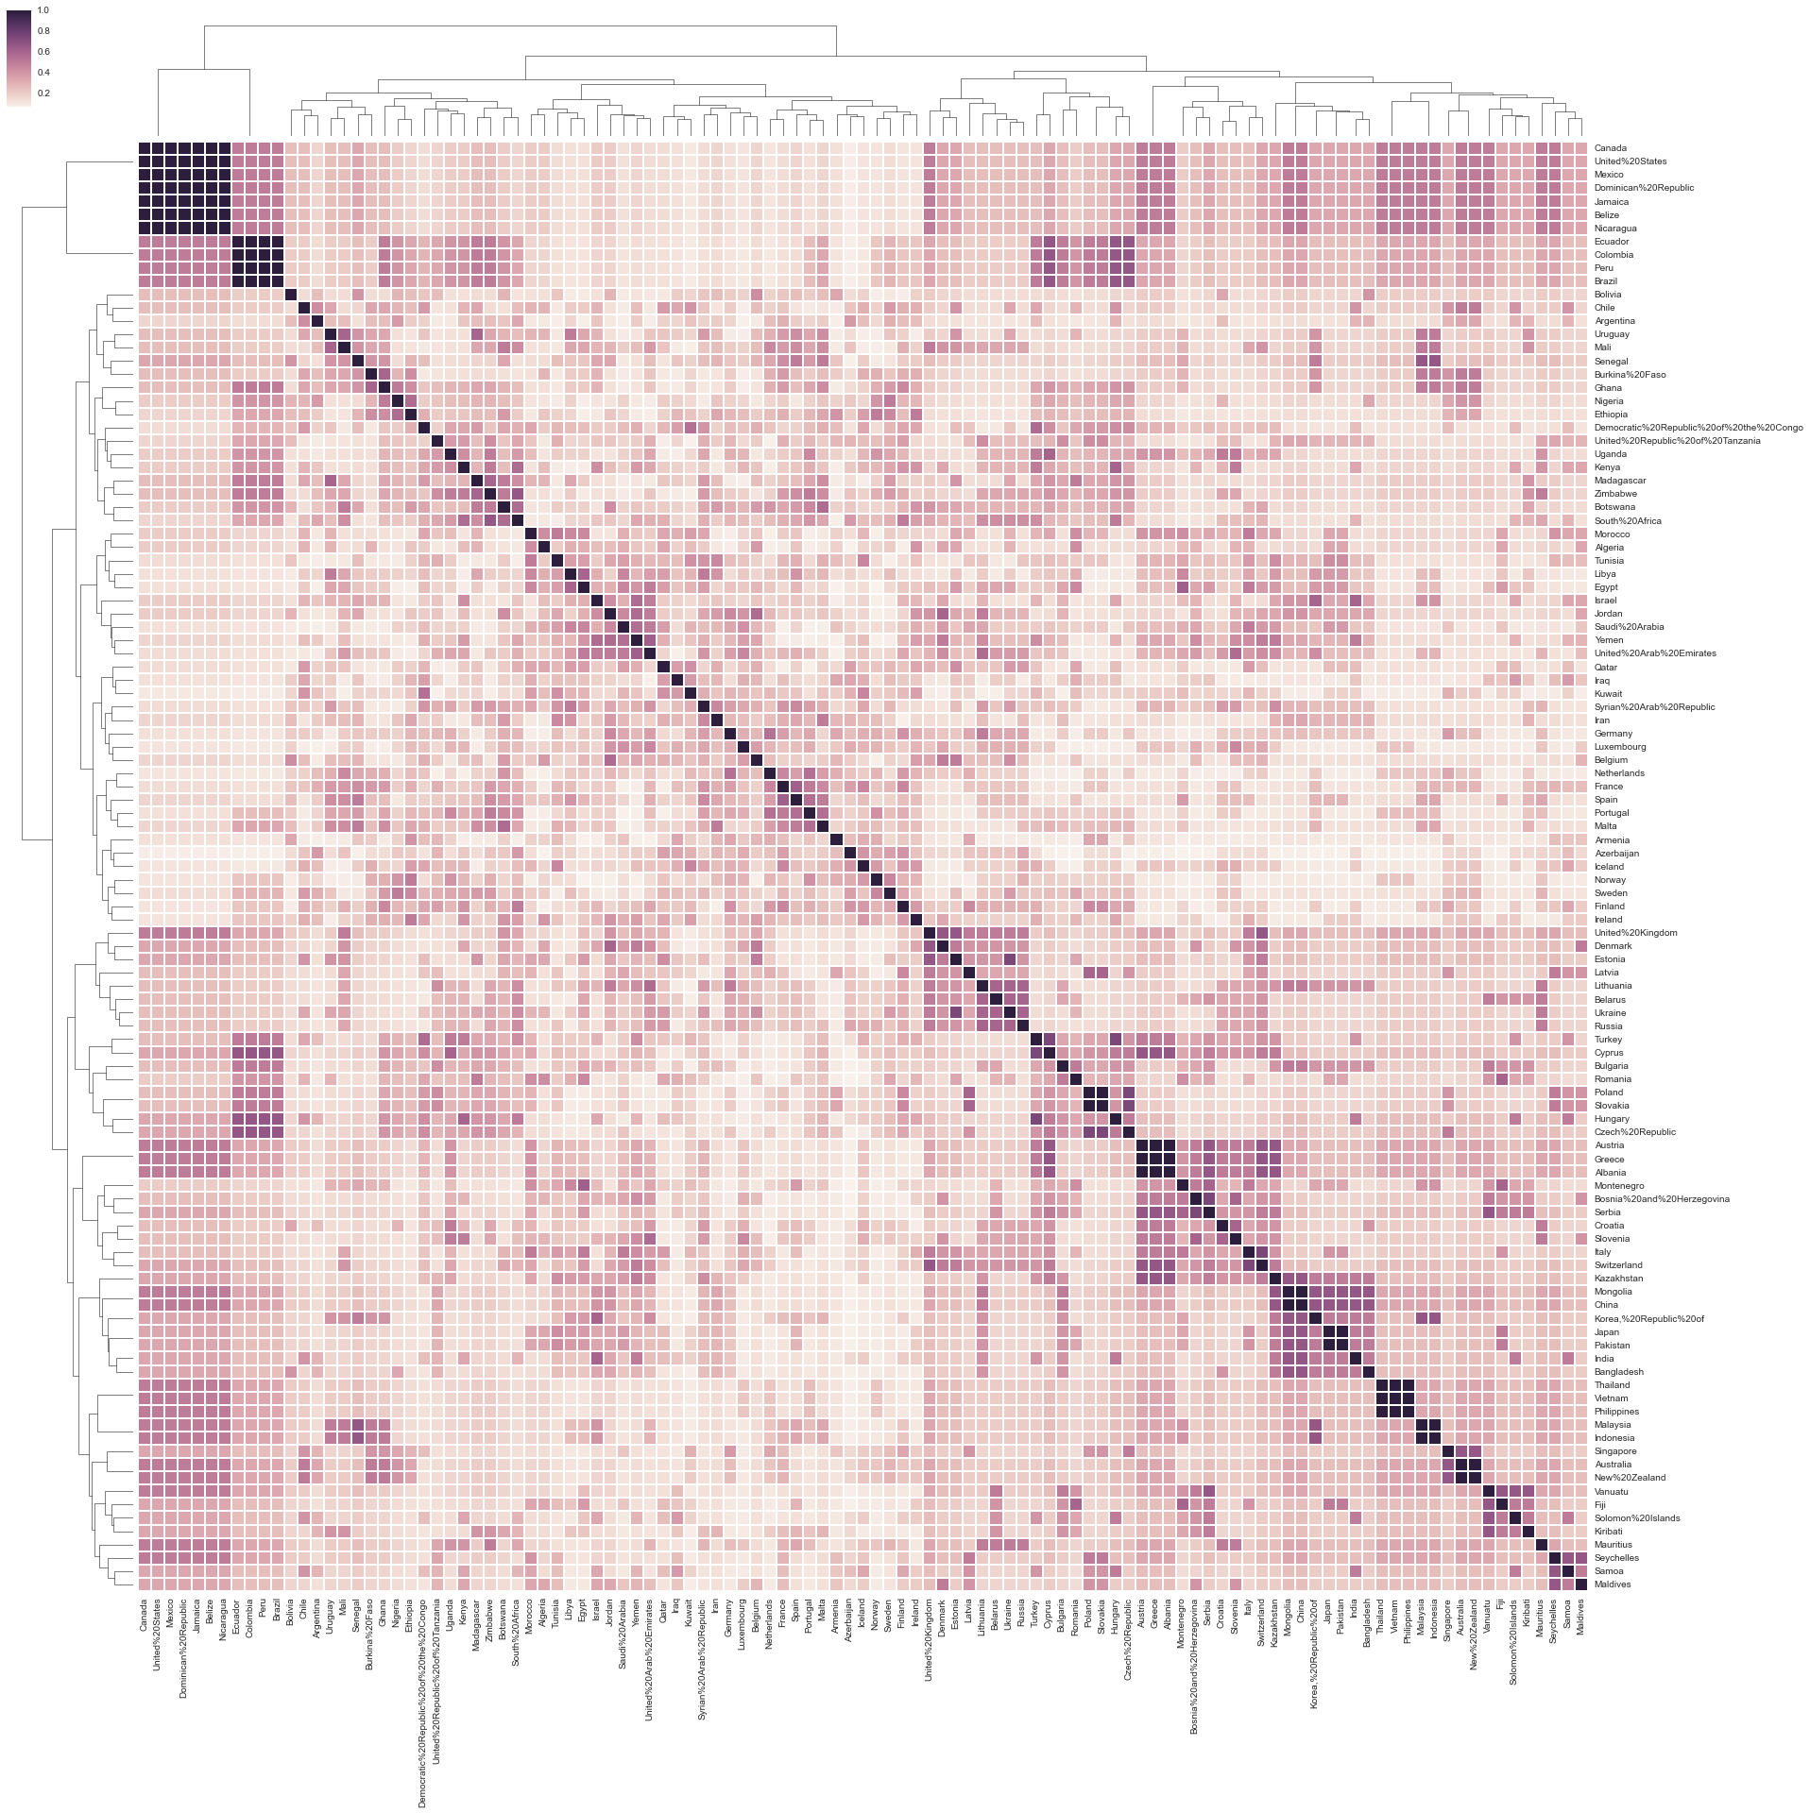
POLICY SIMILARITIES: 1990-2014
High correlations between:
Canada, US, Mexico, Dominican Republic
Madagascar, Zimbabwe, Botswana, South Africa
Uganda, Tanzania, Congo, Kenya
Chile, Argentina, Uruguay
Yemen, Qatar, UAE
Belgium, Netherlands, France, Spain, Portugal
Iceland, Norway, Sweden, Finland, Ireland
Estonia, Latvia, Lithuania, Belarus, Ukraine, Russia
Turkey, Cyprus, Bulgaria, Romania, Poland
Greece, Albania, Montenegro, Bosnia&Herzegovina, Serbia
China, Korea, Japan, Pakistan, India, Bangladesh
Thailand, Vietnam, Philippines
Singapore, Australia, New Zealand
Vanuatu, Fiji, Solomon Islands
Seychelles, Samoa, Maldives

Slide 24
LIMITATIONS
IRENA Policy Database
Statistical component of Python

Slide 25
THANK You!

