Slide 1
What is ram?
RAM (Random Access Memory) is a kind of data store that acts as a brain for the computer. In other words, if the brain in the human brain, the machine in which the engine is functioning, the RAM is the same function on the computer. It is described in detail in our article how RAM, which provides the possibility of storing information in the computer environment, and what it works for

Slide 2
Human brain in the machine, the machine is doing what the task in the computer RAM also serves as the computer. In other words, the computer is used to keep the computer memory in order to increase the fast accessibility of the data. Just like the brain of a human, every information that the computer needs must be in RAM. The RAM of a computer, ie the brain, must be based on the capacity of the computer.

Slide 3
That is, using a RAM that the computer cannot handle to load more information does not make it easier for you. This is where the motherboard and other parts support RAM. Besides, even if you have a very powerful and fast computer, if you have a slow RAM, your computer will run slowly.

Slide 4
As a result, RAM is one of the most important parts for the performance of a computer. With two types of DRAM and SRAM, the RAM needs constant energy and power to keep the data in the computer. In storage areas such as CDs and floppy disks, there is no need for power. Now, if you wish, let us find out the working principle of RAM and what it works for

Slide 5
1. What is RAM?
2. How does RAM Work?
3. What Does Ram Work?
4. Information about the subject
5. Results and Questions
6. Okur Reviews
Write a reply
7. Other Resources

Slide 6
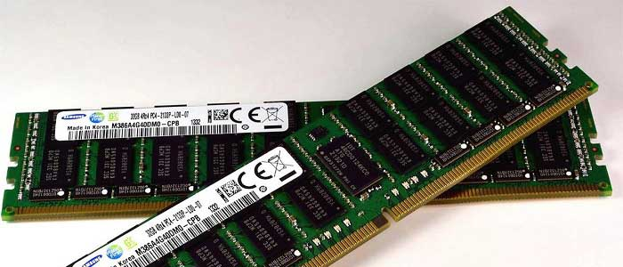
What is RAM?

Slide 7
In a word meaning, RAM is a definition created by shortening the phrase ile Random Access Memory kıs. RAM; computer, video card and many microprocessor modules. Computers often have information about the programs and processes they are currently working on.

Slide 8
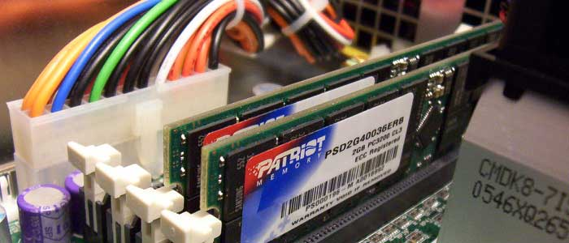
How does RAM work?

Slide 9
The RAM has chapters that contain 0 and 1. Each of these sections is called a cell. The processor sends the instruction, the address on the RAM contains the relevant information and the address is sent to the RAM controller. Coordinates the request from the processor to specific addresses. Transistors on this address open the cells to read the information in the required capacitor.

Slide 10
In order to reach two different data on a RAM chip, the same average time is used. But if the disc and so on are close to the point where the head of the read data is in the shortest time, much time is spent and the head position is constantly changing. RAM is used to temporarily store data and programs to be processed on the computer.

Slide 11
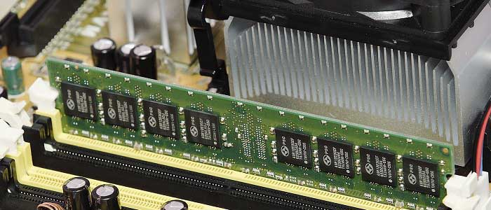
Ram What Does It Work?

Slide 12
NAME:BERİVAN
SURNAME:ASLAN
CLASS:11/B
NUMBER:292
LESSON:MESLEKİ İNGİLİZCE

