Slide 1
The Voice

Slide 2
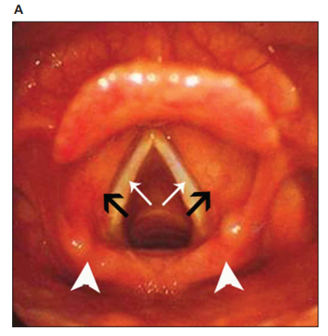
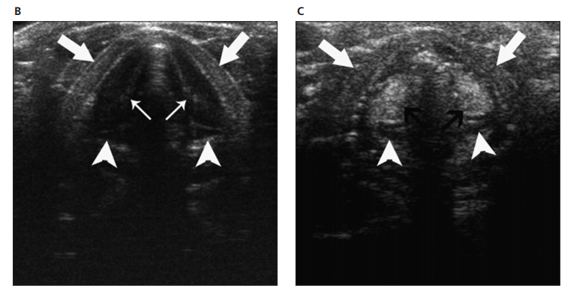
A, Laryngoscopic view of the larynx. B and C, Transverse sonograms of the true (B) and false (C) vocal cords during quiet breathing. The true and false vocal cords are abducted, and the rima glottis is wide. The true vocal cord (small white arrows) appears hypoechoic and stretches from the inner cortex of the thyroid cartilage (large white arrows) to the vocal process of the arytenoid cartilage (arrowheads). The false vocal cord (black arrows) appears hyperechoic and stretches from the upper arytenoid cartilage to the thyroid cartilage.
Qiao Hu, MS, Shang-Yong Zhu, MS, Feng Luo, MS, Yong Gao, MS, Xi-Yue Yang, MS High-Frequency Sonographic Measurements of True and False Vocal Cords American Institute of Ultrasound in Medicine • J Ultrasound Med 2010; 29:1023–1030

Slide 3
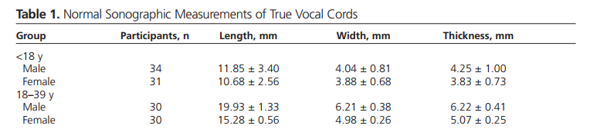
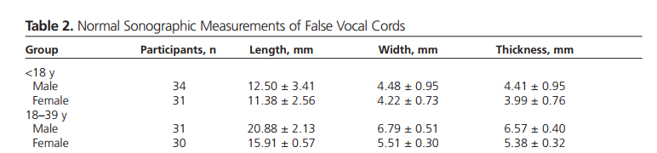
Qiao Hu, MS, Shang-Yong Zhu, MS, Feng Luo, MS, Yong Gao, MS, Xi-Yue Yang, MS High-Frequency Sonographic Measurements of True and False Vocal Cords American Institute of Ultrasound in Medicine • J Ultrasound Med 2010; 29:1023–1030

Slide 4


Slide 5
Feature - 42
'Gender', 'Age', 'vLT', 'vWT', 'vTT', 'vLF', 'vWF', 'vTF', 'wavName', 'chrMean', 'chrMedian', 'chrMin', 'chrMax', 'censMean', 'censMedian', 'censMin', 'censMax', 'melMean', 'melMedian', 'melMin', 'melMax', 'mfccMean', 'mfccMedian', 'mfccMin', 'mfccMax', 'rmsMean', 'rmsMedian', 'rmsMin', 'rmsMax', 'specCentMean', 'specCentMedian', 'specCentMin', 'specCentMax', 'tonnetzMean', 'tonnetzMedian', 'tonnetzMin', 'tonnetzMax', 'z0Mean', 'z0Median', 'z0Min', 'z0Max'

Slide 6
Feature - 30
Gender, Age, chrMean, chrMedian, chrMin, chrMax, censMean, censMedian, censMin, censMax, melMean, melMedian, mfccMean, mfccMedian, mfccMin, mfccMax, rmsMean, rmsMedian, rmsMin, rmsMax, specCentMean, specCentMedian, tonnetzMean, tonnetzMedian, tonnetzMin, tonnetzMax, z0Mean, z0Median, z0Min, z0Max

Slide 7
Başarımlar
Mean Absolute Error (MAE): 0.82
Mean Squared Error (MSE): 1.12
Root Mean Squard Error (RMSE): 1.06
R Score : 0.87

