Slide 1
Text manipulations
This text is Normal
This text is Bolded This text should be unweighted
This text is Italicized This text should be straight
This text is Underlined This text should not be underlined
This text is Struckthrough This text should be un-struck
This text is Colored This text should be black
This text is Bolded and Italicized This text should be normal
The parenthetical text is Super^{(scripted)} This text should be full size
The parenthetical text is Sub_{(scripted)} This text should be full size
This text is Normal

Slide 2
FONTS
Arial
Cambria
Comic Sans MS
Franklin Gothic Book
Georgia
Times New Roman

Slide 3
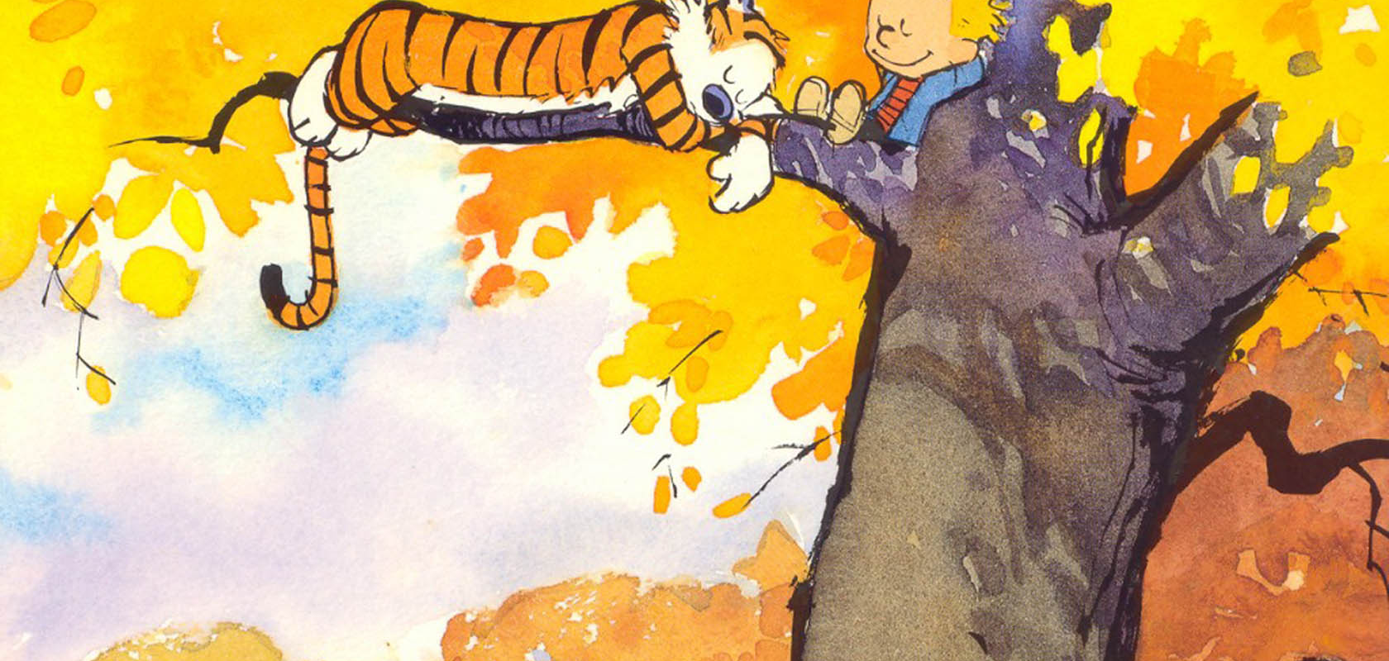
EMBEDDED Jpg

Slide 4
Embedded Gif

Slide 5
Embedded Excel bar graph

Slide 6
Embedded excel pie graph

Slide 7
Table
11 | 12 | 13 | 14 | 15
21 | 22 | 23 | 24 | 25
31 | 32 | 33 | 34 | 35
41 | 42 | 43 | 44 | 45
51 | 52 | 53 | 54 | 55

